Slide 1
Michigan’s Application for ESEA Flexibility: Overview
Based on application submitted for February 28, 2012 deadline

Slide 2
Flexibility Basics
Opportunity to submit a set of waivers regarding how the SEA implements current NCLB language
Two waiver periods
  First due – November 14, 2011
  Second due – February 2012
MDE Notification to USED
  October 12, 2011

Slide 3
Flexibility Basics
Council of Chief State School Officers
  Roadmap for Next-Generation State Accountability Systems
ESEA Flexibility
  Four Principles
  10 Waiver Package + 1

Slide 4
Flexibility Basics
Four Principles
  College and Career Ready Expectations for all Students
  State-Developed Differentiated Recognition, Accountability, and Support
  Supporting Effective Instruction and Leadership
  Reducing Duplication and Unnecessary Burden

Slide 5
Flexibility Basics
10 Waiver Package + 1
  2013-2014 Timeline for Determining Adequate Yearly Progress
  Implementation of School Improvement Requirements
  Implementation of LEA Improvement Requirements
  Rural LEAs
  Schoolwide Programs

Slide 6
Flexibility Basics
10 Waiver Package + 1
  Support of School Improvement
  Reward Schools
  Regarding Highly Qualified Teachers Improvement Plans
  Transfer Certain Funds
  Use School Improvement Grant Funds to Support Priority Schools
  Use of Twenty-First Century Community Learning Center Program Funds

Slide 7
General Requirements
  Stakeholder Input
  Goal
  Theory of Action
Evaluation
  One program, practice or strategy in MDE plan
  USED will financially support

Slide 8
Career and College ready expectations for all students
Principle 1

Slide 9
ESEA Option – Principle I
Principle 1A: Adopt career and college ready standards
  Option A: Michigan adopted the Common Core State Standards in June 2010.
  Option B: Involvement of IHE’s in the development of college and career-ready standards
    IHE involvement in SBAC
    Makes Option A more strategic for Michigan

Slide 10
Common Core State Standards
  Adopted by Michigan in June 2010
  SBAC assessments scheduled for implementation in Spring 2015
Notes:
The purpose of this slide to show that there is a transition period

Slide 11
Common Core State Standards
State-led effort to create a common core of academic standards in K-12 English/language arts and mathematics
Based on research and evidence, internationally benchmarked, aligned with college and workforce expectations
Nearly 50 states have adopted the CCSS
Notes:
Optional: Watch Video Link: http://www.youtube.com/watch?v=9IGD9oLofks&list=UUF0pa3nE3aZAfBMT8pqM5PA&index=3&feature=plcp

Slide 12
Common Core State Standards
  What are standards?
    “Standards are high points, finish lines, not complete specs for curriculum”
    “The CCSS standards were deliberately designed as a platform for the development of curricula and assessment”.
Notes:
Mathematics CCSS writer (Phil Daro, 2011)

Slide 13
Math Standards
Key Characteristics
    Mathematical Practices
    Greater focus and greater coherence
    Progressions of big ideas that span several grades
See crosswalk documents for content shifts
Notes:
www.michigan.gov/mde >hot topics>common core state standards

Slide 14
ELA Standards
Key Characteristics
    Building knowledge through content-rich informational text
    Reading, writing & speaking grounded in evidence
    Regular practice with complex text
See crosswalk documents for specific content shifts
Notes:
Key shifts from Susan Pimentel, Key Shifts in the Common Core State Standards for ELA and Literacy www.achievethecore.org
www.michigan.gov/mde >hot topics>common core state standards

Slide 15
Remember…
  Michigan Merit Curriculum is still law
  CCSS replace High School Content Expectations and Grade Level Content Expectations for mathematics and ELA only
  Course descriptions for Math and ELA have been updated with CCSS language

Slide 16
Assessment
Michigan belongs to 2 assessment consortia:
  SMARTER Balanced Assessment Consortium
    Summative assessments for K-12 general education students
  Dynamic Learning Maps
    Summative assessments for students with significant cognitive disabilities

Slide 17
Assessment
OEII/BAA memo regarding MEAP/MME
    Starting with the 2012 MEAP, “crosswalk documents will be used to assure that items that were based on the GLCE and the HSCE, but do not align to the new standards, are no longer included in Michigan’s assessment programs. Care will be taken when building these assessments to assure students who are being taught the new standards will not be penalized on their MEAP or MME.”
Notes:
http://www.michigan.gov/mde/0,4615,7-140--232021--,00.html

Slide 18
MEAP
Fall 2012 – MEAP in Math, ELA, Science and SS
Fall 2013 - MEAP in Math, ELA, Science and SS
Fall 2014 - MEAP in Math, ELA, Science and SS??
Spring 2015 – SBAC Math and ELA
  MEAP other subjects?
Fall 2015 - MEAP in Science and SS???
State Superintendent has to approve SBAC and testing schedule.

Slide 19
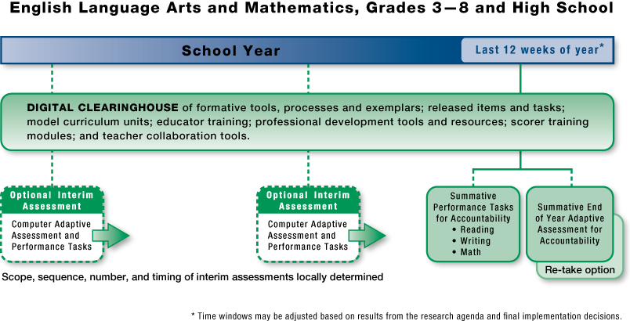
A Balanced Assessment System
Notes:
Assessment system that balances summative, interim, and formative components for ELA and mathematics:
Summative Assessment (Computer Adaptive)
Mandatory comprehensive assessment in grades 3–8 and 11 (testing window within the last 12 weeks of the instructional year) that supports accountability and measures growth
Selected response, short constructed response, extended constructed response, technology enhanced, and performance tasks
Interim Assessment (Computer Adaptive)
Optional comprehensive and content-cluster assessment
Learning progressions
Available for administration throughout the year
Selected response, short constructed response, extended constructed response, technology enhanced, and performance tasks
Formative Processes and Tools
Optional resources for improving instructional learning
Assessment literacy

Slide 20
Some Major Features
Online, rapid turnaround of results
Computer adaptive summative and interim assessments
Teacher involvement in item development, item review, and test scoring
Item types
  Multiple Choice
  Short Constructed Response
  Extended Constructed Response
  Technology Enhanced
  Performance Tasks
Notes:
What are the implications for instruction given these features?

Slide 21
Curriculum
The work we do in the classroom everyday
  Includes materials, tasks or activities, and instruction
  Guided by standards

Slide 22
Career & College Ready
MDE Definition
Career- and College- Ready (CCR) means that a high school graduate has the core foundational knowledge and skills necessary to succeed in workforce training, certification programs, and entry-level, credit-bearing academic college courses that provide preparation for careers leading to a self-sustaining wage, pathways to advancement, and competitiveness in the global economy
Notes:
Take a minute to read. Does this definition have implications for instruction?

Slide 23
Career & College Ready
New Cut Scores
  Are intended to provide a measure of career and college readiness
  Will be applied for the first time to the fall 2011 MEAP administration
  MDE Cut Score FAQ’s
Notes:
http://www.michigan.gov/documents/mde/New_Cut_Scores_FAQ_365040_7.pdf

Slide 24
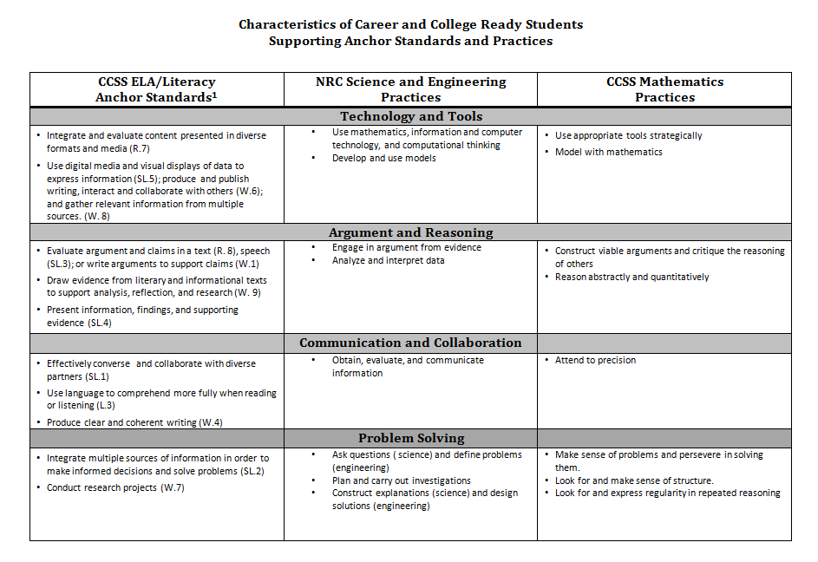

Career & College Ready Students
To be revised by Ruth Anne
Notes:
Common threads across content standards suggest that these are the characteristics of a CCR student

Slide 25
· Use technology and tools strategically in learning and communicating
· Use argument and reasoning to do research, construct arguments, and critique the reasoning of others
·Communicate and collaborate effectively with a variety of audiences
· Solve problems, construct explanations and design solutions
Career & College Ready Students
Notes:
All grade levels and content areas can own these categories based on the Math Practices, ELA Capacities, and Science Capacities.

Slide 26
Proposed Assessment Measures of CCR
(a/o Round 2 – released 9/20/11)
Reading
  “Students can read closely and critically to comprehend a range of increasingly complex literary and informational texts.”
Writing
  “Students can produce effective writing for a range of purposes and audiences.”
Speaking/Listening
  “Students can employ effective speaking and listening skills for a range of purposes and audiences.”
Research/Inquiry
  “Students can engage appropriately in collaborative and independent inquiry to investigate/research topics, pose questions, and gather and present information.”
Language Use
  “Students can skillfully use and interpret written language across a range of literacy tasks.”
Notes:
ELA Claims

Slide 27
Proposed Assessment Measures of CCR
Concepts and Procedures
  “Students can explain and apply mathematical concepts and carry out mathematical procedures with precision and fluency.”
Problem Solving
  “Students can frame and solve a range of complex problems in pure and applied mathematics.”
Communicating Reasoning
  “Students can clearly and precisely construct viable arguments to support their own reasoning and to critique the reasoning of others.”
Data Analysis and Modeling
  “Students can analyze complex, real-world scenarios and can use mathematical models to interpret and solve problems.”
(a/o Round 1 – released 8/29/11)
Notes:
Mathematics Claims

Slide 28
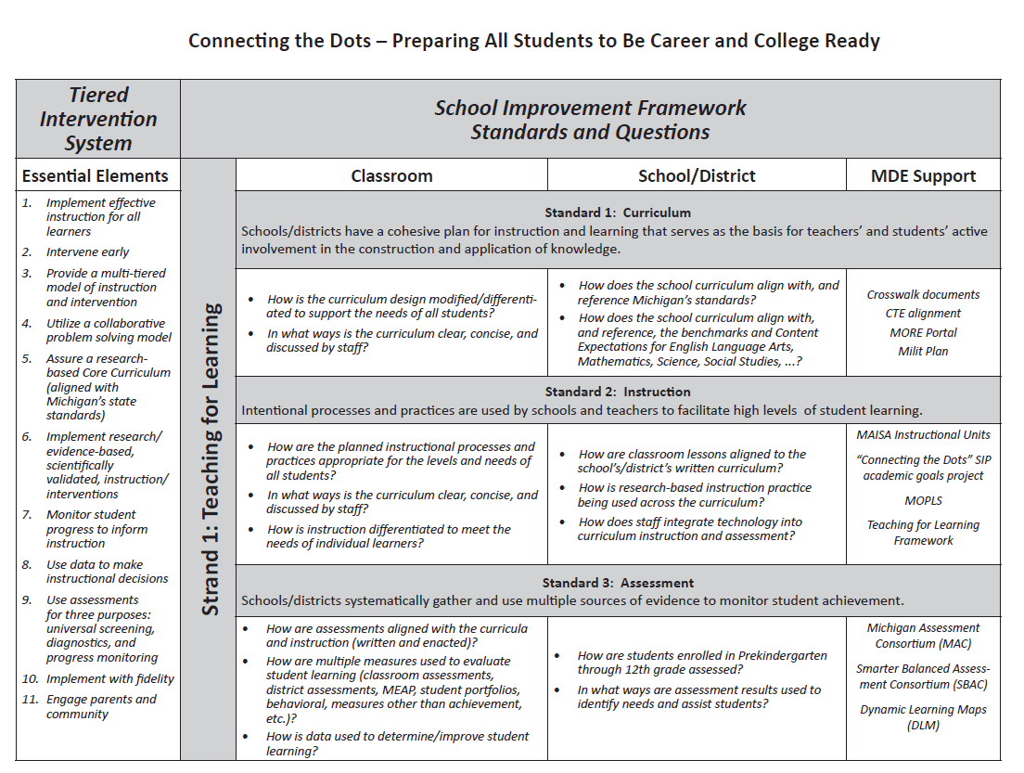

Slide 29
Regional Meetings
  Focus on high leverage strategies and activities supporting the transition to the Common Core State Standards and the new assessments.
  Intended audience is administrators, curriculum directors, school improvement facilitators, coaches and other instructional leaders

Slide 30
Regional Meetings
Dates and locations
4/10 – Saginaw
4/13 –Traverse City
4/16 –Grand Rapids
4/26 – Ypsilanti
5/15 – Marquette

Slide 31
Next Steps
Webinars with MEA and AFT
Other professional learning opportunities to be announced
Career and College Ready Portal

Slide 32
More information
Common Core State Standards and assessments
Website:
www.michigan.gov/mde >hot topics > Common core state standards
Email
CareerandCollege@michigan.gov

Slide 33
Transition to Career and College Ready Standards
Alignment crosswalk between Michigan standards and Common Core standards.
Participating in ELP standards based on Common Core.
Participating in Dynamic Learning Maps alternate assessment based on Common Core.

Slide 34
Transition to Career and College Ready Standards
Principle 1B: Transition to College and Career-Ready Standards
“Any’s”
Dual enrollment
Extra year of high school
Early/middle colleges
Increased AP/IB presence, especially in urban areas

Slide 35
Transition to Career and College Ready Standards
Principle 1B: Transition to College and Career-Ready Standards
Have identified a coherent plan to align teacher/principal preparation programs with school, teacher, and student accountability
Integrate CCR standards into the pre-service curriculum
Aligning pre-service requirements with knowledge and skills necessary for today’s successful teachers and principals
Challenge:
  Developing a teacher/administrator force prepared to teach both in the traditional classroom and in the new digital classroom

Slide 36
Transition to Career and College Ready Standards
Principle 1B: Transition to College and Career-Ready Standards
Raised cut scores to be consistent with career and college readiness
Include items on MEAP (fall 2012 and 2013) and MME Day 3 to cover Common Core standards
Potential evidence that rigorous cut scores in one subject (writing, high school) has resulted in increased student achievement

Slide 37
Differentiated Accountability
Principle 2:

Slide 38
Michigan’s Differentiated System of Accountability

Slide 39
Understanding the Components
Priority/Focus/Reward | AYP Green-Yellow-Red Scorecard
Normative—ranks schools against each other | Criterion--referenced—are schools achieving a certain PROFICIENCY level?
Focuses attention on a smaller subset of schools; targets resources | Given to all schools; acts as an “early warning” system; easy indicators
The primary mechanism for sanctions and supports | Used primarily to identify areas of intervention and differentiate supports
Fewer schools | All schools

Slide 40
Priority, focus and reward schools
Normative Approaches

Slide 41
Priority Schools
Current Thinking
  Approach
    Bottom 5% of the Top to Bottom List
  Benefits
    Aligns with current methodology
    Results in PLA = Priority

Slide 42
Focus Schools
Current Thinking
  Composite achievement gap
  All tested subjects
  Gap between bottom 30% and top 30% of students in each school
  10% of schools with largest gaps

Slide 43
Stakeholder Concerns
May disadvantage high performing schools
May result in resources going to schools with fewer needs

Slide 44
MDE Response
Both high-performing and low-performing schools are focus schools.
Laser focus on achievement gap
AYP applies to all schools
Supports will differ by need

Slide 45
Reward Schools
Current Thinking
    Top 5% of schools on top to bottom list
    Top 5% of schools on improvement metric
    Schools identified as Beating the Odds

Slide 46
Accountability Scorecard
Criterion-Referenced Approach

Slide 47
Key Elements
Proficiency targets (AMOs)
Improvement targets
Subgroup targets
Graduation/attendance rate
Educator evaluations
Compliance factors

Slide 48
Guiding Principles
Produces green-yellow-red final color for every school
Easy-to-read display
Includes all five tested subjects
Adds more differentiation than pass/fail of AYP

Slide 49

Setting Proficiency Targets
Annual Measurable Outcomes (AMOs)
Every school will get to 85% by 2022.
Targets differentiated to reflect each school’s starting point

Slide 51
Concerns
Are the targets ambitious enough?
Are they attainable enough?
Is there a disincentive to cross 85% proficient?

Slide 52
Are the AMOs ambitious enough?
New cut scores—standard for proficiency is much higher.
Almost no school in Michigan is above 85% on the new cut scores.
85% is an interim goal; 100% is still the ultimate goal.

Slide 53
Are the AMOs attainable?
These rates of improvement have largely not been demonstrated
BUT:
  Still have safe harbor, provisionally proficient and growth proficient
  Expect behavior will change with new expectations AND new supports

Slide 54
Crossing 85%
When a school crosses 85% and remains there for two consecutive years:
  “Green” status
  Opportunity to be a reward school by showing improvement

Slide 55
Safe Harbor
Balance between ambitious proficiency targets and attainable improvement goals.
Need to find a rate of improvement that has been demonstrated, but that is still rigorous

Slide 56
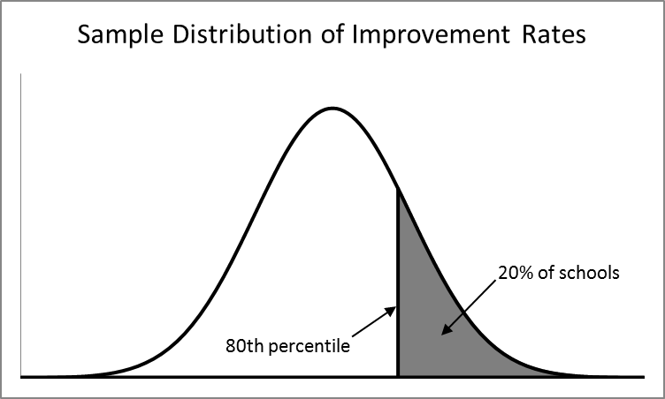

Slide 57
Subgroups
Retain original nine demographic subgroups
  Concern was voiced with dropping these, loss of focus on these groups
Add the bottom 30% subgroup
  Affirms our laser focus on closing the achievement gap

Slide 58
Subgroup Targets and Safe Harbor
Targets are the same for the whole school and all subgroups
Safe harbor:
  For all subgroups, including bottom 30%: improvement at the 80th percentile
  Making safe harbor means a subgroup has demonstrated a rigorous rate of improvement.

Slide 59
Accountability Scorecard
Green/red/yellow for each school
Clear labels for priority, focus, and reward.
Ability to click through and see more detailed information.

Slide 60
Determining the Colors
Whole school and each subgroup receive green, red or yellow for each subject.
  Red = did not meet proficiency OR improvement
  Yellow = met improvement target, not proficiency
  Green = met proficiency target

Slide 61
Participation
Must assess 95% of students overall and in each subgroup
Failure to do so in a subgroup = red for that subgroup/subject
Two “reds” in the “all student” category for participation = red overall

Slide 62
Final Overall Color
Each subgroup color in each subject awarded point value:
  Green = 2 points; Yellow = 1 point; Red = 0 points
  80% or more = Green; 50-80% = Yellow; less than 50% = Red
Red for one or more subgroups, maximum overall rating = yellow

Slide 63
Example: Green School

Slide 64
Example: Yellow School

Slide 65
Example: Red School (Points)

Slide 66
Example: Yellow School
(Red Subgroup)

Slide 67
Highlights
More differentiation; not simply pass/fail AYP.
Many schools will be yellow
Intuitive to users
Red = warning system to schools

Slide 68
Other Academic Indicators
Graduation rate and improvement
Attendance
Participation
Educator evaluations
  Reporting 100% of labels
Compliance with state law
  School Improvement Plan, school performance indicators

Slide 69
Differentiated recognition
Rewards

Slide 70
Differentiated Recognition
Recognition options (as funds allow):
  Note Reward Schools in Annual Education Reports
  Distribute a list to media & encourage coverage locally
  Recognize schools at state conferences
    MDE Sponsored conferences
    Education Organizations sponsored conferences
  Fund audio or video documentaries for 20-40 top schools post as promising practices
  Network Reward schools with demographically similar lower performing schools
  Certificates or Banners for Reward schools
  Seek corporate or philanthropic sponsors for recognition activities

Slide 71
Differentiated Supports

Slide 72
Differentiated Supports
New Redesigned Statewide System of Support:
  Must address needs of schools
  Consider building capacity at school and district level
  Must move schools rapidly from low achievement to high achievement
Challenge
  Rapid, sustained growth required
Opportunity
  Think outside the box
  What can work that we aren’t currently trying

Slide 73
Priority Schools
Align with the PLA and SIG initiatives
Schools utilize one of four reform models:
  Transition
  Transformation
  Restart
  Closure
Support selection of model based on data from a Data Workshop
Survey of Enacted Curriculum
Rubrics to determine if principal remains in place

Slide 74
Priority Schools
School Improvement Review
Content and district intervention liaison
ISD Support
Current Tools on AdvancED Website
Challenges
  Number of schools
  Trained Turnaround Specialists
  District capacity

Slide 75
Focus Schools
Supports will be provided at District level
Data-based decisions
Build around an RtI model
Strong monitoring component
Challenge
  Number of schools
  District capacity

Slide 76
Educator Evaluations
Principle 3

Slide 77
The Michigan Context
Legislative requirements
  2011-2012 and 2012-2013: locally developed systems that include growth as a “significant part” and that occur annually
  2013-2014 and beyond: statewide evaluation system

Slide 78
The Michigan Context
Statewide evaluation system
  Governor’s Council on Educator Effectiveness will make recommendations
  Legislature will write necessary legislation
  All districts will adopt that system (or equivalent)

Slide 79
ESEA Flexibility Requires:
Guidelines for a statewide evaluation system.
How MDE will ensure compliance, support districts

Slide 80
Principle 3A: Adopt Guidelines
Governor’s Council: creating recommendations for guidelines for statewide evaluation system (2013-2014 and beyond)
MDE—interim guidelines to assist districts as they implement current legislation until statewide guidelines

Slide 81
Principle 3B: Support for Implementation?
Educating field on legislative requirements (current and upcoming)
Teacher/Student Data Link and state assessment data; support for using state-provided growth measures
Educator Evaluation Best Practices Conference (February 29, 2012)

Slide 82
Supports (cont’d)
Pilot studies
  Using performance level change data in value-added modeling
  Setting standards on common assessments
  Survey data
Model observation protocol
Support for training principals and evaluators

Slide 83
Ensuring Compliance
Legislative requirement
Publish aggregate educator effectiveness labels
Accountable for submitting 100% of labels on Accountability Scorecard

Slide 84
Next Steps
Feedback

Slide 85
Next Steps
Begin negotiations with USED

