Slide 1
Preventing Occupational Exposure to Hazardous Drugs
Module 2

Slide 2
Before Beginning Module 2
Please review Module 1 of this training series before proceeding.
Module 1 includes:
An overview of the hazards of certain drugs
Personnel and procedures with greatest risk for exposure
MIOSHA regulatory requirements
Michigan Department of Labor and Economic Opportunity

Slide 3
Module 2 Training Overview
Identify routes of exposure
List the hierarchy of controls
Describe recommended procedures for controlling exposure during:
  Preparation
  Administration
  Disposal
  Decontamination and spill clean-up
Review additional consideration, resources, and references
Michigan Department of Labor and Economic Opportunity

Slide 4
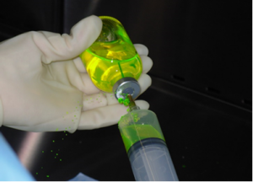
Routes of Exposure
Absorption – skin contact
Inhalation – aerosolization
Ingestion – contamination of food
or beverages
Injection – needlesticks
Michigan Department of Labor and Economic Opportunity

Slide 5
Hierarchy of Controls
Engineering Controls
Administrative and Work Practice Controls
Personal Protective Equipment
Elimination/
Substitution
- Eliminates the exposure
before it can occur
- Requires a physical
change to the workplace
Increasing Effectiveness
- Requires employer/worker
to DO something
- Requires worker
to WEAR something
Michigan Department of Labor and Economic Opportunity
Notes:
Multiple controls may be used in combination to achieve the most protection.

Slide 6

Elimination and Substitution
Professional healthcare providers prescribing
hazardous drugs (HD):
Consider possible elimination or substitution for
less hazardous drugs
Form or delivery of the drug (i.e., tablet vs. liquid)
Thorough understanding of occupational health
hazards of prescribed drugs
Michigan Department of Labor and Economic Opportunity
Notes:
Image Source: http://www.freeimages.com/photo/medical-doctor-1236694

Slide 7
Engineering Controls
Examples of controls*:
  Externally vented Biologic Safety Cabinet (BSC)
  Compounding Aseptic Containment Isolator (CACI)
  Closed system transfer device (CSTD)
Advantages:
  Isolates and Contains the hazard
  Independent of the worker
Michigan Department of Labor and Economic Opportunity
Notes:
ASHP = American Society of Health-System Pharmacists
NIOSH = National Institute of Occupational Safety and Health
ONS = Oncology Nursing Society
Engineering controls are used to remove a hazard or place a barrier between the worker and the hazard. Well-designed engineering controls can be highly effective in protecting workers and will typically be independent of worker interactions to provide this high level of protection.
Disadvantages: The initial cost of engineering controls can be higher than the cost of administrative controls or personal protective equipment, but over the longer term, operating costs are frequently lower, and in some instances, can provide a cost savings in other areas of the process.
Only one available for administration: CSTDs
The U.S. Pharmacopeial Convention (USP) is a scientific nonprofit organization that sets standards for the identity, strength, quality, and purity of medicines, food ingredients, and dietary supplements manufactured, distributed and consumed worldwide. USP’s drug standards are enforceable in the United States by the Food and Drug Administration, and these standards are used in more than 140 countries.
* U.S. Pharmacopeial Convention (USP <800>) requires the use of engineering controls when administering antineoplastic HDs
USP 800 is a chapter in the USP Compounding Compendium. General Chapter
USP 800 | USP
7

Slide 8
Engineering Controls
Control | Location | Type of Ventilation | Special Features
Containment (primary control) | Inside a compounding room | Ventilated device (i.e. biological safety cabinet, compounding aseptic isolator) | Nonsterile compounding: external vent preferred Sterile compounding: external vent required
Compounding room (secondary control) | Physically separated from other rooms | Externally vented through high-efficiency particulate air (HEPA) filter | Negative pressure
Closed system device (supplemental) | Compounding and administering | None | Not a substitute for a primary control when compounding
Michigan Department of Labor and Economic Opportunity
Notes:
U.S. Pharmacopeial Convention (USP <800>)
5.3 Compounding
140 Engineering controls are required to protect the preparation from cross-contamination
141 and microbial contamination (if preparation is intended to be sterile) during all phases of
142 the compounding process. Engineering controls for containment are divided into three
143 categories representing primary, secondary, and supplementary levels of control. A
144 containment primary engineering control (C-PEC) is a ventilated device designed to
145 minimize worker and environmental HD exposure when directly handling HDs.
146 Containment secondary engineering controls (C-SEC) is the room in which the C-PEC
147 is placed. Supplemental engineering controls [e.g., closed-system drug-transfer device
148 (CSTD)] are adjunct controls to offer additional levels of protection. Appendix B provides
149 examples for designs of HD compounding areas.
150 Sterile and nonsterile HDs must be compounded within a C-PEC located in a C-SEC.
151 The C-SEC used for sterile and nonsterile compounding must:
152 • Be externally vented through high-efficiency particulate air (HEPA) filtration
153 • Be physically separated (i.e., a different room from other preparation areas)
OSHA Tech Manual Chapter 2
A. Pharmacy or Other Preparation Areas
In large oncology centers, HDs are usually prepared in the pharmacy. However, in small hospitals, outpatient treatment areas, and physicians' offices they have been prepared by physicians or nurses without appropriate engineering controls and protective apparel. Many HDs must be reconstituted, transferred from one container to another, or manipulated before administration to patients. Even if care is taken, opportunity for absorption through inhalation or direct skin contact can occur.
Examples of manipulations that can cause splattering, spraying, and aerosolization include:
withdrawal of needles from drug vials;
drug transfer using syringes and needles or filter straws;
breaking open of ampules; and
expulsion of air from a drug-filled syringe.
Evaluation of these preparation techniques, using fluorescent dye solutions, has shown contamination of gloves and the sleeves and chest of gowns.
Horizontal airflow work benches provide an aseptic environment for the preparation of injectable drugs. However, these units provide a flow of filtered air originating at the back of the workspace and exiting toward the employee using the unit. Thus, they increase the likelihood of drug exposure to both the preparer and other personnel in the room. As a result, the use of horizontal BSC's is contra-indicated in the preparation of HD's. Smoking, drinking, applying cosmetics, and eating where these drugs are prepared, stored, or used also increase the chance of exposure
Part 520 Ventilation Controls [excerpt]
R 325.52011 Recirculation of air from exhaust systems.
Rule 11. (1) The recirculation of air containing a contaminant whose permissible exposure limit is equal to
or exceeds 1000 ppm, 15 mg/m3 , or 50 mppcf, shall be permitted if the exhaust ventilation system is equipped
with an air-cleaning device capable of reducing the contaminant concentrations to 10% or less of their permissible exposure limits in the returned air.

Slide 9
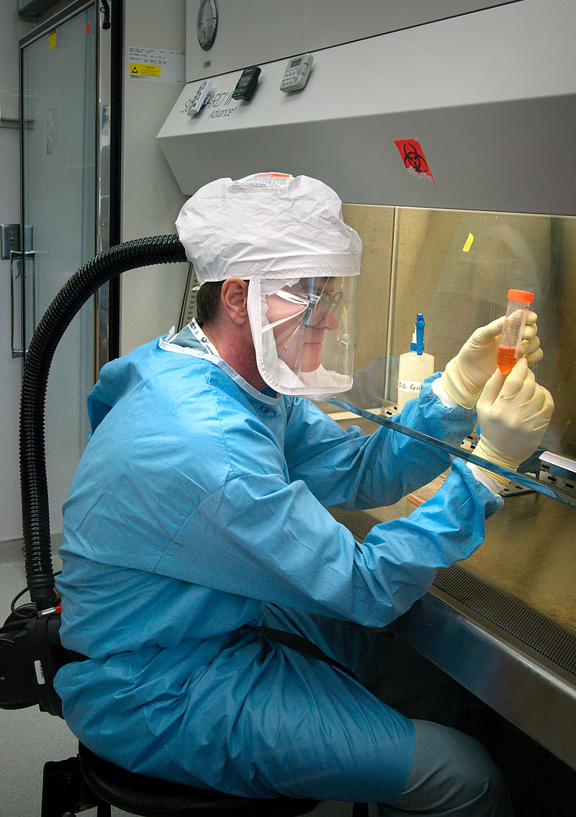
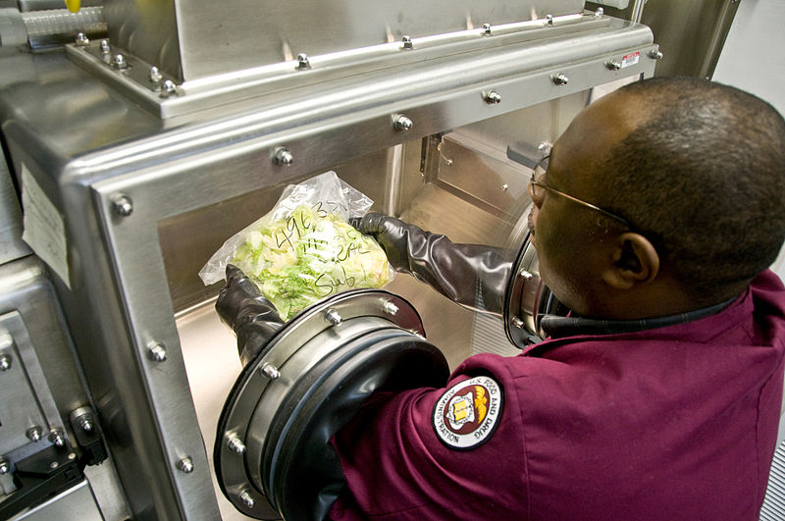
Examples of Controls
Compounding Aseptic Isolator
Biological Safety Cabinet
Michigan Department of Labor and Economic Opportunity
Notes:
Images
Free use FDA compounding aseptic isolator: https://commons.wikimedia.org/wiki/File:FDA_scientist_examines_a_lettuce_sample_in_a_sample_preparation_glove_box.jpg
Free Use CDC Biological Safety Cabinet: https://en.wikipedia.org/wiki/Biosafety_cabinet#/media/File:Influenza_virus_research.jpg

Slide 10
Administrative Controls
Examples:
Written policies and procedures
Hazardous Drug List*
Education, training and competency*
Medical surveillance
Alternative duty around pregnancy - may be discriminatory
* Required by MIOSHA Hazard Communication Standard and USP <800>
Michigan Department of Labor and Economic Opportunity
Notes:
Initial and annual competency
HD list: those drugs being used in a particular facility may vary. A list alerts the pharmacy about which drugs should be labeled as hazardous– a necessary precautions to communicate the need for safe handling precautions

Slide 11
Work Practice Controls
Examples:
Label HDs with appropriate hazard warnings
Transport HDs in sealed bags
Inspect HD containers for leaks
Wash hands after removing PPE
Avoid touching unnecessary items with contaminated gloves
Avoid wearing PPE outside drug handling areas
Avoid spiking and priming IV tubing (without a closed system)
Discard used IV equipment intact
Michigan Department of Labor and Economic Opportunity
Notes:
How should IV tubing be primed?
With a compatible non-drug solution—preferably done in pharmacy
Partial list. Many more work practices that reduce the opportunities for exposure can be identified by examining the processes of how HDs are delivered in a particular setting.

Slide 12
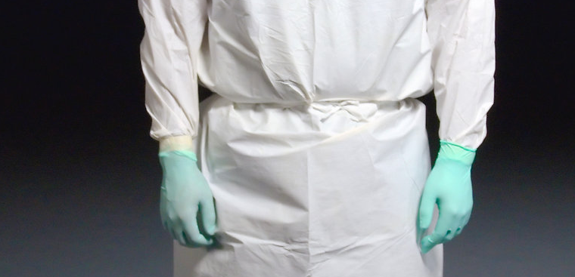
Personal Protective Equipment (PPE): Gloves
Tested with hazardous drugs
Powder-free
Latex, nitrile, neoprene*
Wear two pair
Donning
  Inner glove worn under gown cuff
  Outer glove worn over gown cuff
Doffing
  Remove gloves one at a time
  Turn gloves inside out while removing
  Keep contaminated surface from touching uncontaminated
*USP<800> requires chemo gloves to meet
ASTM standard D6978 (or its successor)
Michigan Department of Labor and Economic Opportunity
Notes:
Protect against permeation of some chemotherapy
Carmustine
Thiotepa
To prevent transfer of contamination from outer gloves to hands and other surfaces
Gloves are ALWAYS considered contaminated after chemotherapy handling (at least 5 studies since 1992)
Image in public domain: National Cancer Institute

Slide 13
Personal Protective Equipment (PPE): Gowns
Disposable
Polyethylene or
vinyl-coated
Tested with
hazardous drugs
Cuffs and back closure
Single-use
  Remove and discard gown:
    When visibly contaminated
    At the end of handling activities
    When leaving the handling area
  Do not hang up and re-use
Michigan Department of Labor and Economic Opportunity
Notes:
Protect clothing from contamination
Disposable coated gowns
Discard:
when visibly contaminated
at the end of handling activities
when leaving the handling area
To prevent the transfer of contamination from the gown to the environment and clothing

Slide 14
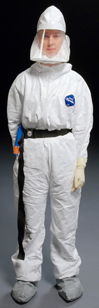
Other Personal Protective Equipment (PPE): Face/Eye/Respiratory
Eye protection
  When splashing is possible
Respirator
  For aerosols and spills
  Fitted (tight seal) respirator
  Appropriate to the hazard
    N95 rated (filtering particulate respirator)
    Powered Air Purifying Respirator (PAPR)
Michigan Department of Labor and Economic Opportunity
Notes:
Free use image: http://www.freestockphotos.biz/stockphoto/15751

Slide 15

USP <800> Requirements for PPE
Appropriate PPE MUST be worn when handling HDs during:
Receipt
Storage
Transport
Compounding (sterile and non-sterile)
Administration
Deactivation/decontamination, cleaning, and disinfecting
Michigan Department of Labor and Economic Opportunity

Slide 16
Recommended Precautions: Administration
Form/Route of Administration | Double Gloves | Protective Gown | Eye Protection | Respiratory Protection | Engineering Control
Intact tablet or capsule | No. Single glove | No | No | No | N/A
Tablet or capsule (manipulated) | Yes | Yes | Yes | Yes, if not done in control device | Yes
Oral Liquid | Yes | Yes | No | No | N/A
Topical Drug | Yes | Yes | Yes, if liquid could splash | If inhalation potential | N/A
Sub Q/M/ injection | Yes | Yes | Yes, if liquid could splash | Yes, if inhalation potential | Yes. Sharps protection
Intravenous solution | Yes | Yes | Yes, if liquid could splash | Yes, if inhalation potential | Recommend CSTD
Irrigation | Yes | Yes | Yes | Yes | N/A
Inhalation | Yes | Yes | Yes | Yes | Yes
Michigan Department of Labor and Economic Opportunity

Slide 17
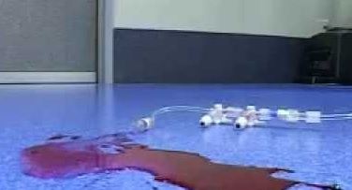
Hazardous Drug Spills
Spills happen
  Sprays
  Dropped vials and bags
  Punctured IV bags
  Broken totes from wholesalers
  Patient unit/infusion area
Spill consequences
  Personnel/patient exposure
  Environmental contamination
Michigan Department of Labor and Economic Opportunity
Notes:
Image Sources:
Top 2 images - Firouzan ‘Fred’ Massoomi, Pharm.D., FASHP. Pharmacy Operations Coordinator, Nebraska Methodist Hospital
Bottom image - https://www.youtube.com/watch?v=IXkgK7JrYds created by Epix: http://www.epixwebvideo.webs.com

Slide 18
Cleaning Contaminated Surfaces - Summary
Cleaning Step | Purpose | Agents
Deactivation | Render compound inert or inactive | As listed in the HD labeling or if no specific information available, sodium hypochlorite or other Environmental Protection Agency (EPA)- registered oxidizer
Decontamination | Remove inactivated residue | Sterile alcohol, sterile water, peroxide, or sodium hypochlorite
Cleaning | Remove organic and inorganic material | Germicidal detergent and sterile water
Disinfection | Destroy microorganisms | Sterile alcohol or other EPA-registered disinfectant appropriate for use
Resource: U.S. Pharmacopeial Convention (USP <800>), Table 5. Summary of Cleaning Steps
Michigan Department of Labor and Economic Opportunity
Notes:
USP 800 | USP

Slide 19
Recommended Contents of a Spill Kit
Sufficient supplies to absorb one liter
PPE to protect worker
  Two pair chemo-tested gloves
  Utility gloves
  Cover-all or gown and shoe covers
  Face shield
  Absorbent plastic-backed sheets or spill control “pillows”
  Disposable towels
  Two sealable, thick plastic waste bags
  Disposable scoop
  Puncture-resistant container
Michigan Department of Labor and Economic Opportunity
Notes:
ASHP recommends that contents of a spill kit include:
Sufficient supplies to absorb a spill of about 1000 mL (~IV bag)
PPE to protect the worker, including: 2 pairs of gloves, including utility gloves, coveralls or gown and shoe covers, face shield
Absorbent plastic-backed sheets or spill pads (“pillows”)
Disposable toweling
At least 2 sealable, thick plastic waste disposal bags (labeled)
One disposable scoop
One puncture-resistant container for glass fragments.
*ASHP, 2006; ONS, 2014

Slide 20
Assess the Spill
Evaluate:
Consider:
Drug spilled
Surface(s) affected
  Floor?
  Countertop?
  Furniture?
Size of spill
Presence of vapors
Glass debris
Liquid
Powder/Dust
Exposure or potential for exposure
Personal protective needed
Need for additional assistance*
Michigan Department of Labor and Economic Opportunity
20
Notes:
Assess size and scope. Call for help if needed
Bigger than what 2 spill kits can contain may require outside assistance
e.g., Spill response team

Slide 21
Spill Notification
Restricted area vs. public
Isolation of area (vapors)
Need for evacuation
Internal spill response team?
External HazMat team?
Michigan Department of Labor and Economic Opportunity
Notes:
Where is the spill? Public area?
Need to evacuate if vapors or if exposure of patients/ visitors/ staff possible.
If staff are able to contain and clean up the spill, then notification can occur after the spill is managed.

Slide 22
Step 1:
Cover (contain) the spill
Liquid:
  Absorbent pads
  Cloths/paper
  Spill control pillows
Powder:
  Dampen pads, cloths or paper
Michigan Department of Labor and Economic Opportunity
22

Slide 23
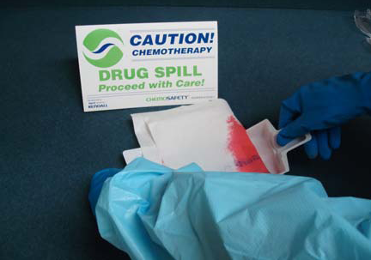
Step 2:
Don PPE
Scoop debris
Do NOT use hands!
Michigan Department of Labor and Economic Opportunity
23

Slide 24
Step 3:
Remove residue
Consider surface material
Refer to facility policy for methods to manage spills on carpet/upholstery
Michigan Department of Labor and Economic Opportunity
24
Notes:
Carpet? Other may require dedicated vacuum. May involve adding absorbent material.

Slide 25
Post-Spill Decontamination & Deactivation
Oxidizing agent
  2% sodium hypochlorite + detergent
    Effective for bleomycin, daunorubicin, etoposide, fluorouracil, mitomycin, vinblastine, vincristine
    30-second contact time
Neutralizer
  1% sodium thiosulfate
    Effective for cyclophosphamide, ifosfamide, melphalan, methotrexate
    30-second contact time
Rinse with water
Michigan Department of Labor and Economic Opportunity
Notes:
This is the decontamination procedure for BSCs and isolators. ASHP also recommends the same procedure following spill clean up.
Consider
“Sanitization” of cabinets
Caution sterile isopropyl alcohol
30 second rule--30 seconds is the contact time for bleach and thiosulfate

Slide 26
Contain Clean-up Materials
Place in Disposal Bag #1:
Absorbent pads
Papers/ cloths
Spill control pillows
Other disposables
Sharps in rigid container
Place in Disposal Bag #2:
Bag #1 with its contents
Shoe covers
Outer gloves
Face shield
Respirator (if disposable)
Michigan Department of Labor and Economic Opportunity
26

Slide 27
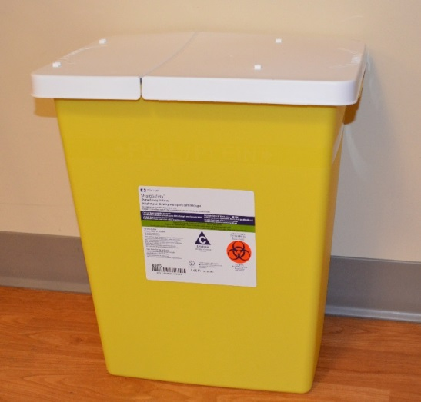
Finally…
Place in Bag #2
  Gown
  Inner gloves
Close Bag #2
Dispose of Bag #2 in designated container
Wash hands with soap and water
Michigan Department of Labor and Economic Opportunity
Notes:
Image from St. Joseph Health System (Pierre Gonyan) -Used with permission

Slide 28
Document the Spill
Recommend creating a designated spill report form:
Who, what, where, when
Participants in clean up
Steps taken to clean the spill
Follow-up
Michigan Department of Labor and Economic Opportunity

Slide 29
Managing Acute Exposure
Type of Exposure | Immediate Care | Follow Up
Skin exposure | Remove contaminated clothing/PPE. Wash affected area with soap and water. Consult DSD for drug-specific instructions. | Report to employee health professional or emergency department, based on symptoms. Complete report of employee injury/exposure. Follow policy related to workers compensation
Eye exposure | Flush eye(s) with water or isotonic eye wash for 15 minutes. Consult SDS for drug-specific instructions.
Inhalation exposure | Move to area with fresh air. Consult DSD for drug-specific instructions.
Ingestion | Do not induce vomiting. Consult SDS for drug-specific instructions.
Michigan Department of Labor and Economic Opportunity

Slide 30
MIOSHA Resources:
Standards and Compliance
Part 92 and 430 Hazard Communication
Part 431 Hazardous Work in Laboratories
Part 33 and Part 433 Personal Protective Equipment
Part 451 Respiratory Protection
Part 474 Sanitation
Part 554 Bloodborne Infectious Diseases
Recording and Reporting of Occupational Injuries and Illnesses
Michigan Department of Labor and Economic Opportunity

Slide 31
MIOSHA Resources: Consultation and Training
Preventing Exposure to Hazardous Drugs Training Module 1 – Overview
Preventing Exposure to Hazardous Drugs Training Module 2 – Staff
Fact Sheet: Preventing Exposure to Hazardous Drugs
Hazard Communication Sample Plan (pdf)
Personal Protective Equipment Guide (SP-16) (doc)
Respiratory Protection Program (SP-05) (doc)
Bloodborne Sample Exposure Control Plan (CET 5230) (doc)
Michigan Department of Labor and Economic Opportunity

Slide 32

Federal Resources
Centers for Disease Control and Prevention:
NIOSH Hazardous Drugs webpage
OSHA:
Hazardous Drugs Website
Hazardous Drugs eTool
Technical Manual Section VI: Chapter 2:
Controlling Occupational Exposure To Hazardous Drugs
Michigan Department of Labor and Economic Opportunity
Notes:
Acknowledgements.
Christopher R. Friese, PhD, RN, AOCN®, FAAN
Assistant Professor
University of Michigan School of Nursing
Thomas H. Connor, PhD
Research Biologist
Division of Applied Research and Technology
National Institute for Occupational Safety and Health

Slide 33
Questions?
Michigan Occupational Safety and Health Administration (MIOSHA)
Consultation, Education and Training (CET) Division
MIOSHA/ CET Main Line: 517-284-7720
Michigan.gov/MIOSHA

