Slide 1
Using Response to Intervention to support English Language Learners
Darren Woodruff, Ph.D
Co-Director, NCRTI
Notes:
We’d like to start by thanking the panel and our OSEP project officers for taking the time to meet with us today. We’ve had a very busy 2 years with the Center, which started in December 2007 with the Nat’l Summit on RTI, which was hosted by the Dept. of Ed’s Office of Special Education Programs, Office of Elementary and Secondary Education, Office of English Language Acquisition, and Institute of Education Sciences. Our Center collaborated with the IDEA Partnership, the National Association of Elementary School Principals and other national groups to support the Summit, with had over 700 attendees and RTI leadership teams from over 50 states and territories. Since the Summit, we’ve established communications with each of the states and territories; reached agreements around universal, targeted, and intensive TA status; established partnerships with other TA Centers, and developed over 250 tools and resources for our website.
We are proud of what we’ve accomplished to date but we also realize that there remains much to do in order to help states develop their capacity for implementing RTI in local districts and schools. We are looking to you for help and guidance on the best strategies and actions steps for moving forward.

Slide 2

Overview of the National Center on Response to Intervention (NCRTI)
Notes:
Maury is going to start off our presentation with an overview of our Center, it’s mission, primary objectives and conceptual framework . . . you can follow along in the briefing book by looking at what we call our “briefing book buddy” in the lower left hand corner.

Slide 3
Center Mission
Build the capacity of State Educational Agencies (SEAs) to assist Local Educational Agencies (LEAs) in implementing proven and promising models for RTI.
Notes:
Maury . . .

Slide 4
RTI Definition
Response to intervention integrates assessment and intervention within a multi‑level prevention system to maximize student achievement and to reduce behavior problems.
With RTI, schools identify students at risk for poor learning outcomes, monitor student progress, provide evidence‑based interventions and adjust the intensity and nature of those interventions depending on a student’s responsiveness, and identify students with learning disabilities or other disabilities.
Notes:
Maury . . .

Slide 5
Conceptual Framework
#1 –
RTI Knowledge Identification & Validation
#2 – TA Implementation & Telecommunication Supports
Proven
& Promising RTI Models
#3 – Collaboration, Networking & Web-based Dissemination of RTI Information
#4 - Evaluation
Notes:
Maury . . .

Slide 6
Center TA Model
Aligns with OSEP Conceptual Model for TA
Based on 40 years of research
Three major components
  Stages of RTI Implementation
  Capacity Building
  Levels of TA intensity
Notes:
Amy . . .

Slide 7
6 Stages of RTI Implementation
Stage 1 – Exploration and Adoption
Stage 2 – Program Installation
Stage 3 – Initial Implementation
Stage 4 – Full Operation
Stage 5 – Innovation
Stage 6 – Sustained Practice
Notes:
Most states are at an early stage of scaling-up RTI. Majority of states somewhere in the first 3 stages—none at 5 or 6.

Slide 8
Categories of Capacity Building
Five categories help guide the liaisons’ discussions with each state over time:
  Vision
  Leadership Team
  Needs Assessment
  Outreach and Training
  Evaluation

Slide 9
Levels of TA Intensity
Providing TA to all states at various levels of intensity
Three levels
  Universal
  Targeted
  Intensive

Slide 10
31 Universal TA States
WA
VT
NH
MT
ND
ME
OR
MN
ID
SD
WI
MI
NY
MA
WY
RI
IA
PA
CT
NV
NE
IN
OH
NJ
UT
IL
WV
DE
CA
CO
KS
MO
VA
MD
KY
DC
TN
NC
AZ
NM
OK
AR
SC
MS
AL
GA
TX
LA
FL
AK
HI
Notes:
31 Universal states and territories. They all have access to the Center website and they can initiate contact with our TA Liaisons on an “as need” basis.

Slide 11
21 Targeted TA States
WA
VT
NH
MT
ND
ME
OR
MN
ID
SD
WI
MI
NY
MA
WY
RI
IA
PA
CT
NV
NE
IN
OH
NJ
UT
IL
WV
DE
CA
CO
KS
MO
VA
MD
KY
DC
TN
NC
AZ
NM
OK
AR
SC
MS
AL
GA
TX
LA
FL
AK
HI
Notes:
21 Targeted states and territories.
Targeted TA goes to states, multiple states or regions. Exps: Info about evidence-based tools and practices, scaling up strategies in LEAs, recommended speakers, addressing immediate needs with the goal of moving to intensive status.

Slide 12
8 Intensive TA States
WA
VT
NH
MT
ND
ME
OR
MN
ID
SD
WI
MI
NY
MA
WY
RI
IA
PA
CT
NV
NE
IN
OH
NJ
UT
IL
WV
DE
CA
CO
KS
MO
VA
MD
KY
DC
TN
NC
AZ
NM
OK
AR
SC
MS
AL
GA
TX
LA
FL
AK
HI
Notes:
8 Intensive TA States that we are helping to plan, implement, and evaluate their statewide RTI initiatives through developing and providing PD, developing model demo sites and establishing state guidance for LEA adoption of RTI practices with fidelity.
Hawaii
Kansas
Maine
Missouri
New Mexico
Oklahoma
Pennsylvania
South Carolina

Slide 13
Knowledge Development:
Technical Review Committees
Role of the TRC:
  To identify and disseminate information about tools and interventions that are grounded in a rigorous scientific evidence base
Three TRCs:
  (1) Screening; (2) Progress Monitoring; (3) Tiered Instruction
Model:
  National Center on Student Progress Monitoring
  http://www.studentprogress.org/chart/chart.asp

Slide 14
TRC Status: Screening
Recruited TRC members
Developed protocol
Issued call for tools in reading in September
Received 15 submissions (15 tools across 6 vendors)
Completed final review in March
Published review results in March 2009
Plan to issue a call for math and reading tools in spring 2009
Notes:
Amy . . .

Slide 15
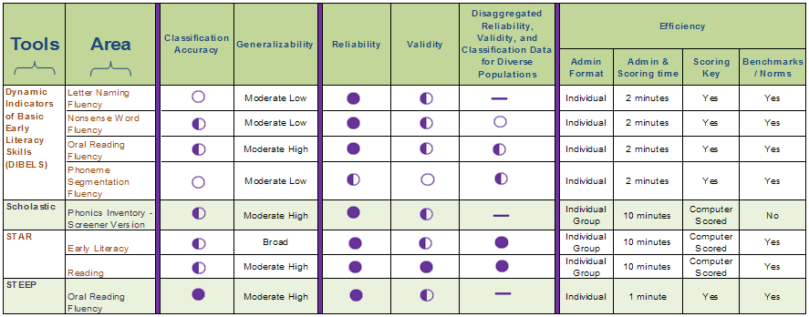
Screening Reading Tools Chart
http://www.rti4success.org/index.php?option=com_content&task=view&id=1091&Itemid=139
Notes:
Amy . . .

Slide 16
TRC Status: Progress Monitoring
Recruited TRC members
Developed protocol
Issued call for tools in September
Received 48 submissions (48 tools across 12 vendors)
First and second level reviews recently completed
In the process of compiling the materials to be published
Results to be published in May 2009
Plan to issue an additional call in fall 2009
Notes:
Amy . . .

Slide 17
TRC Status: Instruction
Recruited 9 “TRC consultants”, conducted meeting December 18th
Developed protocol
Currently recruiting TRC members
Plan to issue call for interventions in summer 2009
Results to be published by end of 2009
Notes:
Amy . . .

Slide 18
Work Groups
Disproportionality Work Group (5 members)
English Language Learners (ELL) Work Group (6 members)
Secondary RTI Work Group ( 10 members)
SEA Implementation and Evaluation Work Group (11 members)
SLD Identification Work Group (being formed in Year 3)
Notes:
DW: The purpose of our 5 workgroups is to address “RTI-related” topics for which many states have indicated a need for focused support.
For each of the workgroups, we are preparing a variety of products—such as papers, webinars, podcasts and training modules for state and local professional development.
The disprop workgroup focuses on addressing the over-representation of students of color in special education. Related to RTI, this includes awareness building regarding the use of RTI to address disprop, the role of early intervening services , and the importance of cultural and linguistic competency in frameworks for RTI
The ELL workgroup focuses on the inclusion of supports for English Language Learners and culturally and linguistically appropriate interventions. We are synthesizing the existing research on ELL supports, identifying gaps in the current knowledge base, and seeking to highlight model practices.
The secondary workgroup is working with the National High School Center and the Center on Instruction to identify model programs for secondary RTI and to synthesize existing research from middle and high schools.
And the State Implementation and Evaluation workgroup is developing a training module on RTI evaluation in partnership with Lehigh University. Areas of focus include integrating general and special ed in RTI, cross-agency coordination, and statewide evaluation of RTI.
The workgroup on the identification of specific learning disabilities will be formed during year 3. This workgroup will focus on how to define SLD, including attention to contextual factors that can lead to identification, risk determination, early intervention, and disability identification for non-responders.
Notes: Disprop currently has 5 members with a broad level of experience in addressing disproportionality and related issues (don’t go thru them):
Kathy Chapman, from the Mid South RRC,
Elizabeth Kozleski, from NCCREST and the Arizona State University,
Alfredo Artiles, also from NCCREST and ASU,
Janette Klingner, from NCCREST and the University of Colorado at Boulder,
and Gwen Cartledge, from the Ohio State University working with Bradley Scott from the Equity Center on this—ALSO SEE EIS TRAINING BRIEF in our Appendix).
The English Language Learners work group includes:
Carlos Rodriguez, from AIR and the Ohio High School Transformation Initiative
Julie Esparza Brown, from Portland State University
Richard Figueroa, from the University of California at Davis
Janette Klingner, from NCCREST and the Univ of Colorado at Boulder
Alba Ortiz, from the Univ of Texas at Austin, and
Elizabeth Pena, from the University of Texas at Austin

Slide 19

What do schools that successfully meet the needs of English Language Learners look like?

Slide 20
A Culturally & Linguistically Appropriate RTI Model
Special
Education
Intensive assistance
as part of
general education
support system,
ongoing monitoring
Ongoing
problem-solving by
a collaborative team
with relevant
expertise
Culturally
and linguistically
appropriate instruction in
GE, with progress
monitoring
Notes:
In this revised RTI model – we emphasize the addition of culturally responsive practices at each level – Additionally, we include observing in classrooms at each level specifically looking for all the contexts and variables that may be contributing to a student’s inability to “respond” to intervention -

Slide 21
An RTI Framework for Culturally and Linguistically Diverse Students
1st Tier
The foundation of Tier 1 should be culturally and linguistically responsive, appropriate, quality instruction with on-going progress monitoring and authentic assessments.
Tier 1 includes these essential components:
  a supportive, motivating learning environment;
  culturally responsive, research-based, appropriate core instruction (validated with similar students, in similar contexts);
  knowledgeable, skilled, caring, culturally responsive teachers; and
  differentiation to meet students’ needs.

Slide 22

2nd Tier
When students have not made adequate progress when taught using appropriate methods at the 1st tier, intervention is warranted.
Tier 2 is a level of intensive support that supplements the core curriculum and is based on student needs as identified through progress monitoring and other means.
Interventions are instructionally, culturally, and linguistically responsive and appropriate.
Notes:
When culturally and linguistically diverse students have not made adequate progress when taught using appropriate, culturally responsive methods implemented with fidelity, a second tier of intervention is warranted.
Tier 2
This tier is characterized as providing a level of intensive support that supplements the core curriculum and is based on student needs as identified by ongoing progress monitoring.
For now, we do not know a great deal about what this intensive support should look like for culturally and linguistically diverse students, or the extent to which it should differ from the second tier of support provided to all students identified as at risk.

Slide 23

3rd
Tier
This tier is generally considered to be special education, though students might receive this level of support without an IEP.
Instruction at this level is:
  tailored to the individual needs of the student,
  even more intensive,
  of longer duration.
Students with disabilities must also be provided with access to the general education curriculum and be instructed in the least restrictive environment.

Slide 24

Problem-solving Team
The make-up of the team should be diverse and include members with expertise in culturally responsive instruction, and, if appropriate, English language acquisition and bilingual education.
Notes:
The make-up of the team should be diverse and include multiple members with expertise in culturally responsive pedagogy.
A bilingual or English as a second language (ESL) specialist should also be involved when the student is an English language learner (Harry & Klingner, in press).
There should be a team member who can offer guidance with culturally sensitive on-going assessment.
Teams should have a wide range of meaningful intervention strategies available to them.
Using a problem-solving approach, they should determine how to alter the support a student has been receiving and develop specific instructional objectives based on student performance data
An important role for the team should be observing the student in her classroom as well as in other settings.

Slide 25
Challenges When Using RTI with English Language Learners
Most teachers lack the training, expertise, and experience to teach reading and other subjects to English language learners.
Most “evidence-based” practices have not been sufficiently validated with English language learners.

Slide 26
Challenges to RTI and ELLs . . .
Most English language learners do not receive optimal instruction. There is:
  too much focus on expecting students to fit the curriculum, rather the other way around, and
  too much focus on phonological awareness and letter naming at the expense of other skills, e.g. comprehension and vocabulary development.
Recommendations for assessing and teaching English language learners do not adequately account for what we know about learning to read in one’s first and in a second language.

Slide 27
Challenges to RTI and ELLs . . .
Most school-level teams charged with making special education eligibility decisions for culturally and linguistically diverse students lack training and experience in distinguishing a language difference from a learning disability.

Slide 28
If a child does not make adequate progress with research-based instruction that is presumed “to work,” the assumption is made that the child must have a deficit of some kind.
  How do we ensure that the child has in fact received culturally and linguistically responsive, appropriate, quality instruction?
  As with earlier identification criteria, this model must be based on students having received an adequate “opportunity to learn.”
Notes:
Yet, like previous eligibility criteria, this model presumes that if a child does not make adequate progress, he or she must have an internal deficit of some kind.
How do we assure that the child has in fact received culturally responsive, appropriate, quality instruction?
As with earlier identification criteria, this model must be based on students having received an adequate “opportunity to learn.”

Slide 29

Challenges to RTI and ELLs . . .
It is not feasible to provide Tier 2 instruction to all ELL (and other “at risk” students) not meeting benchmarks in the core curriculum.

Slide 30
English language development should be part of Tier 1 for all ELLs.
Tier 2 interventions:
  Supplement the core curriculum
  Are based on students’ needs as assessed by progress monitoring and other data
  Are the domain of general education

Slide 31
Review the quality of instruction (P-S Team):
  Has the instructional program been validated with students like those in the class?
  Is instruction at an appropriate level for students’ language and learning needs?
  Is the program well-implemented?
  Are teachers sufficiently differentiating instruction to meet diverse student needs?
  Is the environment conducive to learning?
This will require observing in classrooms and supporting instruction.
Develop and capitalize on local expertise.

Slide 32
Shift from figuring out what is wrong with a student to looking more broadly at the instructional context and at how to provide support for all students who need help, regardless of label.
Make sure someone on the team has expertise in ELLs and how to distinguish between language acquisition and learning disabilities.

Slide 33

What Do We Mean by “Evidence-based”?
The RTI model is based on the principle that instructional practices or interventions at each level should be based on scientific research evidence about “what works.”
However, it is essential to find out what works with whom, by whom, for what purposes, and in what contexts—
One size does not fit all.

Slide 34

With Whom?
When deciding if a practice is appropriate for implementation as part of an RTI model, it should have been validated with students like those with whom it will be applied.
The National Reading Panel report “did not address issues relevant to second language learning” (2000, p. 3).
Notes:
Not meeting this criterion is a fundamental limitation of almost all instructional research in education.
Researchers typically provide inadequate information about participants in their reports, making it hard to determine if a practice should be considered appropriate.
For this reason, we are cautious in interpreting research findings when applied to culturally and linguistically diverse students.

Slide 35

With Whom?
Research reports should include information about:
  language proficiency
  Ethnicity
  life and educational experiences (e.g., socio-economic, previous schooling)
Data should be disaggregated to show how interventions might differentially affect students from diverse backgrounds.
Notes:
Research reports should include information about:
the language proficiency, ethnicity, life experiences (e.g., socio-economic, specific family background, immigration status),
and other characteristics of participants (Bos & Fletcher, 1997; Keogh, Gallimore, & Weisner, 1997).
Data should be disaggregated to show how interventions respectively might differentially affect students from diverse backgrounds.

Slide 36

By Whom?
It is essential to observe in classrooms.
  Is the instruction appropriate for students’ language and learning needs?
  What is the relationship between a teacher and students?
  How does the teacher promote interest and motivation?
We draw different conclusions when several students are struggling rather than just a few ...
Notes:
As the field considers how RTI models should be implemented, not enough attention has focused on the role of classroom teachers.
By looking in classrooms, we can tell a great deal about teachers’ instruction, the activity, and the ways teachers and students interact.
What do we notice about the nature of the relationship between a teacher and students?
How are students supported?
How does the teacher promote interest and motivation?
With so much variability in teachers’ knowledge, skills, and dispositions, it is unrealistic to assume that all teachers will be able to implement interventions in such a way that we can have confidence they are providing students with an adequate opportunity to learn.

Slide 37
By Whom?
Is the teacher…
  skilled in effective intervention and assessment procedures for English language learners?
  knowledgeable about the centrality and importance of culture in learning?
  knowledgeable about second language acquisition, bilingual education, and English as second language (ESL) teaching methods?
Does the teacher…
  have the attributes of culturally responsive teachers?
    build positive, supportive relationships with students?
    work well with students’ families and the community?
    help most culturally diverse students succeed to high levels?
  collaborate well with other professionals?

Slide 38

For What Purposes?
What is the goal of instruction?
  Some widely touted instructional approaches help improve word identification skills, but not necessarily reading comprehension.
  According to the Reading First Impact Study: Interim Report, “Reading First did not have statistically significant impacts on student reading comprehension test scores in grades 1-3.”
  Some differences in the early grades “wash out” by third grade.

Slide 39
In What Contexts?
Variations in program implementation and effectiveness across schools and classrooms are common (see the First Grade Studies for a classic example, Bond & Dykstra, 1967).
  When students struggle, is it the program, the teachers’ implementation, or the school context?
  What is it about the system that facilitates or impedes learning?
  Schools are dependent on larger societal influences that should not be ignored.

Slide 40
In What Contexts?
RTI requires strong leadership from the principal (and others) and must be a comprehensive, school-wide approach that:
  coordinates curriculum and assessment considerations,
  addresses teachers’ professional development needs,
  attends to school climate issues,
  and enhances leaders’ capacities to orchestrate and respond to multiple (often contradictory) reforms (Adelman & Taylor).

Slide 41
State certification requirements should focus more on teaching English language learners.
Teacher education programs should prepare all pre-service teachers to work with English language learners.
Professional development opportunities are essential and should focus on teaching English language learners.

Slide 42
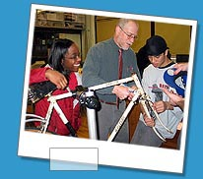
It is not enough to implement isolated evidence-based interventions.
Instructional methods do not work or fail as decontextualized practices, but only in relation to the socio-cultural contexts in which they are implemented.
Notes:
These three courses of action provide a framework for moving closer to leveling the educational playing field for African American, Hispanic, and other culturally and linguistically diverse students.
We believe they can also be used as a backdrop for helping us think about culturally responsive literacy instruction.
It is not enough to implement isolated evidence-based interventions.
Central to our approach is the belief that instructional methods do not work or fail as decontextualized generic practices, but only in relation to the socio-cultural contexts in which they are implemented.
These perspectives form the foundation for how we are thinking about culturally responsive RTI models.

Slide 43
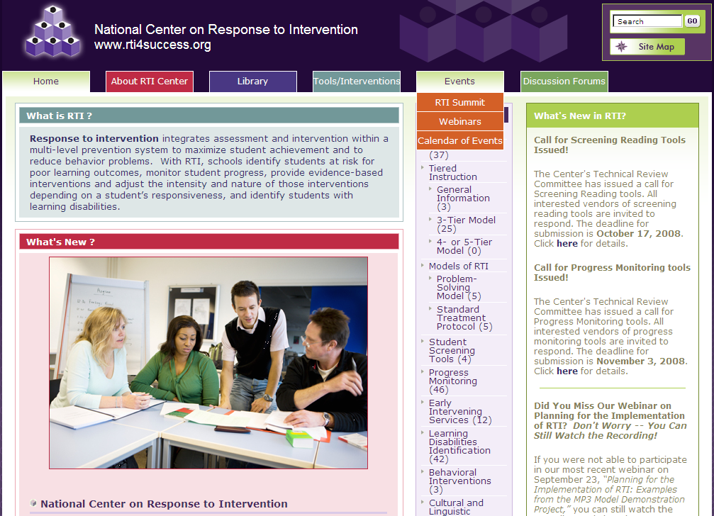
ELL Resources www.rti4success.org
Notes:
Amy . . .

Slide 44
English Language Learners and
RTI
Janette Klingner
University of
Colorado at
Boulder

Slide 45
Recommendations from the IES Practice Guide for English Learners

Slide 46
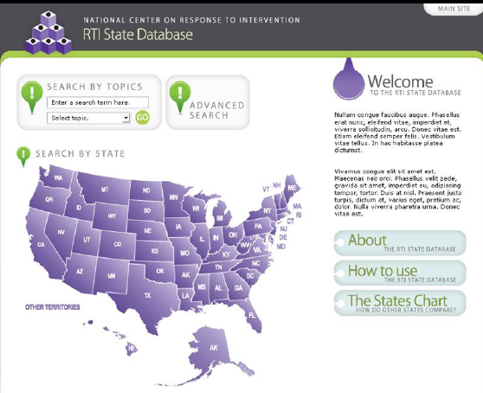
NCRTI State Database
COMING SOON!
Database to contain RTI information and resources from states, such as:
Policies
Guidance documents
Briefs
Handbooks
Presentations
Tools
Checklists
Sec. II
p. 6
Notes:
Amy . . .

Slide 47

Notes:
Welcome to the World-Class Instructional Design and Assessment (WIDA) Consortium site.
WIDA is a consortium of states dedicated to the design and implementation of high standards and equitable educational opportunities for English language learners.
To this end, the WIDA Consortium has developed English language proficiency standards and an English language proficiency test aligned with those standards (ACCESS for ELLs®). In addition, WIDA has developed Spanish language arts standards and is planning a system of parallel academic assessments for beginning English language learners (ONPAR™). Research and professional development activities importantly complement the WIDA standards and assessment products.
Originally established through a federal grant, the WIDA Consortium consists of nineteen partner states: Alabama, Delaware, the District of Columbia, Georgia, Illinois, Kentucky, Maine, Mississippi, New Hampshire, New Jersey, North Carolina, North Dakota, Oklahoma, Pennsylvania, Rhode Island, South Dakota, Vermont, Virginia, and Wisconsin.
In the 2008-09 school year, WIDA expects to serve about 725,000 English language learners in kindergarten through grade 12.

Slide 48
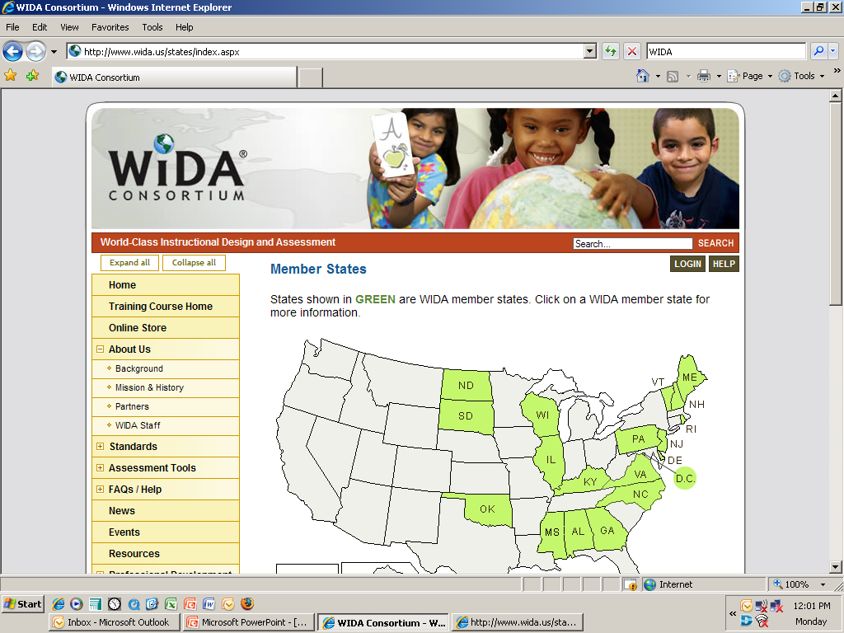

Slide 49
Questions or comments?
Learn more at www.rti4success.org!
Notes:
DW . . .
Thank you--This concludes our formal presentation.
Are we having lunch before the Q&A?
We will now open the floor to any questions or comments that you may have.

