Slide 1


M-STEP
ONLINE

Slide 2
Pre-Identification
DAS pre-identified students using the Fall 2014 MSDS General Collection (student count day) to M-STEP grades 3-8 and high school
DAS did not continue to pull from MSDS – one time pull only
Schools needed to un-assign students from M-STEP and assign to MI-Access Functional Independence (FI), Supported Independence (SI) or Participation (P)

Slide 3
Pre-Identification And Online Sessions
Schools must continue to pre-ID new students in the Secure Site through the end of testing.
Schools testing online need to put students into online sessions by proctor (First pull from BAA Secure site to eDIRECT on 3/27/15, begin using eDIRECT 4/3/15)
If the proctor is not available in the dropdown, will need to put under another proctors name
Select Online Sessions from the Pre-ID Functions menu

Slide 4
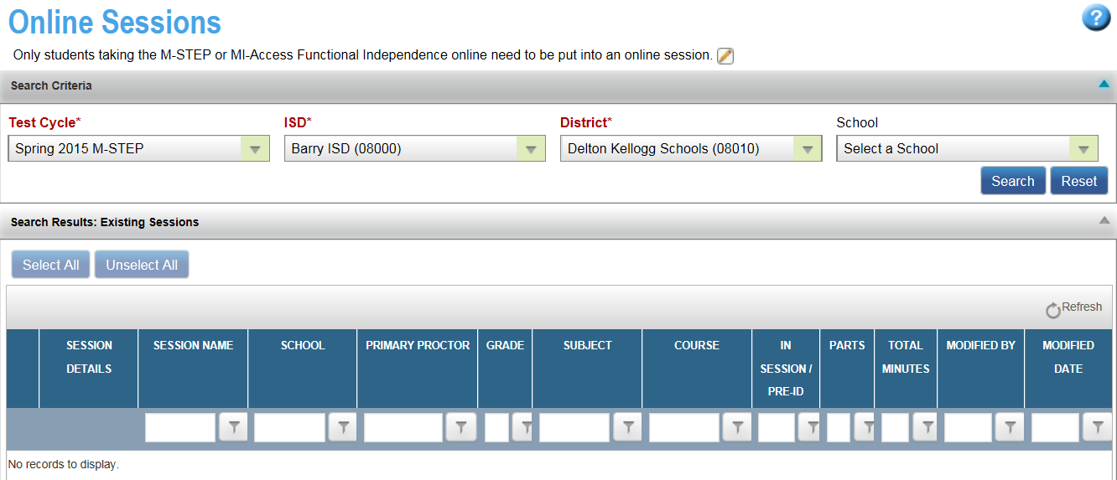
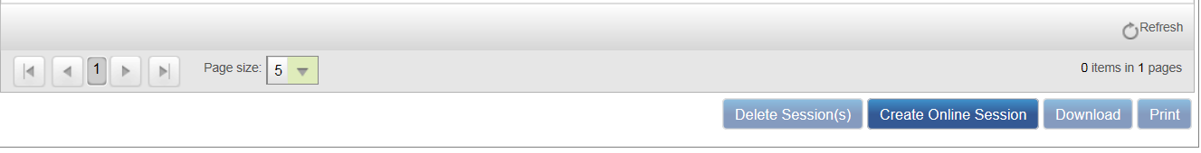

Slide 5
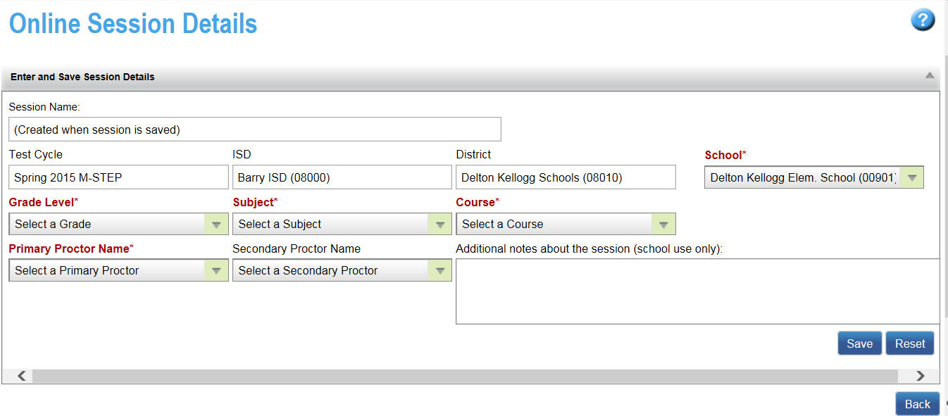

Slide 6
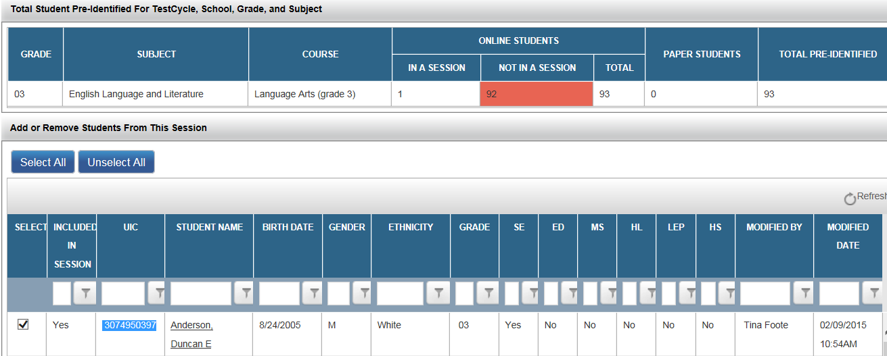
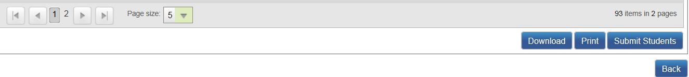

Slide 7
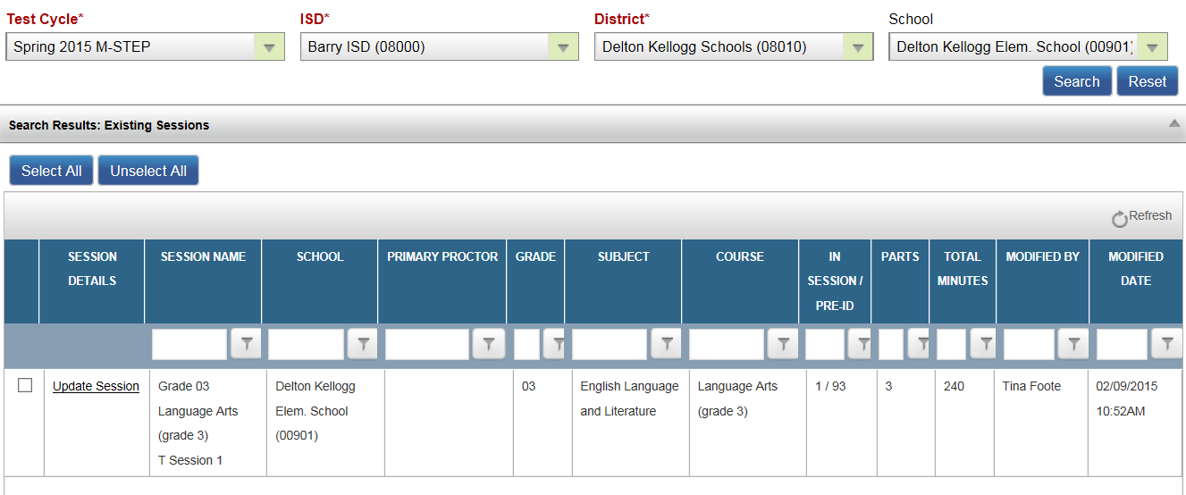

Slide 8
Online Sessions
Students pre-identified and added to an online session will be loaded into eDIRECT after 5:00 pm on March 27
After March 27, schools will continue to pre-ID students on the Secure Site but will need to be placed into sessions in eDIRECT
Access to eDIRECT will begin April 3, 2015.
New students must always first be loaded to the BAA Secure Site but after March 27, students will be added to new or existing sessions in e-DIRECT.
They are pulled daily from BAA to e-DIRECT

Slide 9
Material Orders
If all students testing online, the school does not need to place an order for materials
If testing online, DAS will create an order for any needed materials such as graph paper, test directions, etc.
Schools testing online can order paper/pencil materials for students that need paper/pencil tests
Initial Material Order deadline was February 18
Students need to have the online flag removed from the content areas for each student that will be testing with paper/pencil
The AMO will open around 3/31/15

Slide 10
Some Materials for ADDITIONAL ORDERS Must Be Downloaded and Printed
From a link to be established at: www.michigan.gov/mstep
Online Directions
TA Directions
Graph Paper (grades 6 and above)
Online Classroom Activities

Slide 11
Accountability Implications
It is the intent of the MDE not to use the results of the 2015 M-STEP assessment to make high-stakes accountability determinations.
  Participation will be calculated
  Data will be provided to schools and districts for informational purposes
  No Priority, Focus, or Reward labels for schools

Slide 12
Online Testing Technology Components
Component | What is it?
eDIRECT | A secure website used to assign accommodations, manage student test sessions and create tickets and monitor online testing status
INSIGHT | Software that needs to be installed on the testing devices for secure online testing
Testing Site Manager (TSM) | Software that needs to be installed on a computer in the school or district for secure caching of test content and student responses
Note: There is public access to part of eDIRECT. Many resources/documents can be downloaded from: https://mi.drcedirect.com/

Slide 13
Online Testing Technology Components
Component | Primary Responsibility | Other users
eDIRECT | District Coordinator Building Coordinator | Technology Coordinator (only software and documentation)
INSIGHT | Technology Coordinator | Building Coordinator Test Administrator
Testing Site Manager (TSM) | Technology Coordinator

Slide 14
Access to eDIRECT
All users requiring eDIRECT access (Technology Coordinators, District Coordinators, and Building Coordinators) must be listed under the appropriate role in the Secure Site (www.michigan.gov/securesitetraining).
User information was pulled from the secure site and loaded into eDIRECT 2/20/15 and will occur daily.
Please note that this is the only method for adding users to the eDIRECT system. Users will not be added manually over the phone.

Slide 15
Access to eDIRECT- continued
Technology Coordinators will need access to eDIRECT to download testing software.
Building Coordinators will need eDIRECT access to manage test sessions, monitor testing progress, assign accommodations, and print test tickets.
District Coordinators will need access in order to monitor testing progress as well as serve as backup support for Building Coordinators.
Test Administrators will not need eDIRECT access.
All users have access to the documents section of eDIRECT as it does not require a login. Documents can be accessed at http://mi.drcedirect.com

Slide 16
Roles & Responsibilities in Online Testing
Technology Coordinator
    Attend training sessions
    Read system documentation
    Install the testing software
    Determine system capacity
    Monitor the TSM
    Review testing schedules
    Provide device preparation guidance
    Maintain assessment security
    Provide tech support during testing to schools and teachers

Slide 17
Roles & Responsibilities in Online Testing
    District Coordinator
    Provide training to Building Test Coordinators
    Coordinate with Technology Coordinator
    Order materials if necessary
    Provide assistance to Building Test Coordinators
    Ensure test tickets and scratch paper are destroyed by the Building Coordinator
    Monitor return of materials
    Maintain assessment security
    File Incident Reports if necessary
    Contact Call Center as necessary

Slide 18
Roles & Responsibilities in Online Testing
Building Coordinator
    Provide training to online Assessment Administrators
    Coordinate with Technology Coordinator and District Coordinator
    Create testing schedules
    Print, organize, and disseminate Test Tickets
    Distribute Test Materials (Directions, Graph Paper, Classroom Activities)
    Work with Technology Coordinator to provide device preparation assistance
    Destroy used Test Tickets and all used scratch paper
    Maintain assessment security

Slide 19
New Experiences…
ELA Listening (Embedded or CD/Script (requires headphones for Online)
Classroom Activities- (ELA and Math)
Performance Tasks- (ELA and Math)
Stacked Spanish version (Math only)
Test Tickets (ELA and Math)

Slide 20
Test Tickets
Online Test Tickets By Grade Level, Test Component, and Content Area
 | ELA | Math | Science |  | Social Studies
 | All Grades | All Grades | Grades 4 & 7 | Grade 11 | Grades 5 & 8 | Grade 11
Fixed Form | 1 | 1 | 2* | 1 | 2* | 1
Classroom Activity | N/A | N/A | N/A |  | N/A
Performance Task | 2 | 1
* Science (grades 4 & 7) and Social Studies (grades 5 & 8) are administered in 2 parts.

Slide 21
M-STEP ELA Components
Online Test session- Fixed form
    Approximately 90 minutes – grades 3-8
    Approximately 120 minutes – grade 11
One session (part) – one test ticket – secure material
Must Administer in one day!
  Less than 20 minutes - student can resume without login
  Greater than 20 minutes – requires student to login before resuming
  Login expires at the end of the day – test session is closed – no longer available

Slide 22
M-STEP ELA Components
Classroom Activity - not online
  30 minute teacher led – script provided
  Must be administered before the Performance Task
  Within 3 days of Performance Task
  May be recorded – May NOT be pre-recorded
Performance Task – administered online (Part 1 before Part 2)
  2 parts, approximately 60 minutes each
  2 test tickets, one for each part – secure material
  May be administered on the same day, or on two separate days

Slide 23
Classroom Activity and Associated Performance Task
Required for students in grades 3-8
Not required for students in grade 11
  Due to concerns about amount of time required to test in grade 11
  No accountability penalty in terms of participation or scoring for high schools that choose not to administer the Classroom Activity and associated Performance Task in Spring 2015
  College entrance test and Work skills assessments are required by law
Classroom Activity: (Must be administered before the Performance Task)
  provides a framework for the Performance Task
  Can’t have one without the other!

Slide 24
Tests and Parts – Classroom Activity
Classroom Activity -ELA and Mathematics: (Can be administered the same day)
This is a 30 minute scripted lesson.
It is non-secure and should be returned to the Building Coordinator immediately after testing and shredded.
Should be administered by a teacher.
Can be recorded but not pre-recorded. May use tools/devices to present the material. For example smart boards, white board, computers, projectors etc. The CA is a background/context building activity. No supplemental material is allowed

Slide 25
Tests and Parts – Classroom Activity
Students may take notes but the notes cannot be used during the PT. They must be collected at the end of the CA, and returned with test materials to the Building Coordinator for shredding at the end of the assessment.
Paper and Pencil examples of the Classroom Activity can be found at www.Michigan.gov/mstep . Select 3-8 or 11.

Slide 26
Tests and Parts – More about CAs
The CA is a scripted lesson that introduces students to the context of a performance task.
The CA may introduce a setting or situation, clarify unfamiliar concepts and introduce key terms or vocabulary.
Teachers should read through and prepare the CA in advance and be familiar with the activity before presenting to the class.
Teachers may pause at any time and ask students if they have questions.
Recommended resources are listed (examples, chart paper, scratch paper, whiteboard, chalkboard etc.)
Children may share ideas in groups (follow the script) and then share their discussion with the full group.

Slide 27
M-STEP Mathematics
Assessed at every grade level 3-8, and 11
Measures concepts and procedures, problem solving, modeling and data analysis, and communicating reasoning
Smarter Balanced content, plus Michigan developed field test items
Includes multiple choice (selected response), technology enhanced (TE) items, short answer and constructed response (CR) items
A parallel “stacked Spanish” version is available.

Slide 28
Calculators
Online calculators are embedded and will be grouped and available only when permitted, students will not be able to return to non-calculator permitted items.
Online Calculator Resource (cut and paste the link into the Google Chrome browser): https://wbte.drcedirect.com/MI/portals/mi/ using the Google Chrome browser.
Protractors or rulers are not required or needed
Scratch Paper is allowed
Students taking paper/pencil may do graphing problems in their test booklets, graph paper is not provided but can be downloaded.

Slide 29
Calculators- continued
Types of embedded online calculators
Grades 3,4, and 5 – Calculators are NOT available
Grade 6- Basic
Grade 7 and 8- Scientific
Grade 11 - Graphing

Slide 30
M-STEP Mathematics Components
Online Test session- Fixed Form
    Approximately 90 minutes – grades 3-5
    Approximately 120 minutes – grades 6-8, and 11
One session – one test ticket – Test Tickets are secure material. The session is divided into 2 parts (non-calculator and calculator). When the student starts the embedded calculator problems they cannot return to the non-calculator problems.
Administer in one day but may have breaks.

Slide 31
M-STEP Mathematics Components
May schedule breaks – pause feature
  Less than 20 minutes - allows student to resume without login
  Greater than 20 minutes – requires student to login before resuming
  Login expires at the end of the day – test session is closed – no longer available for login
  Scratch paper is allowed and Graph Paper will be supplied with materials for students in grades 6 and above

Slide 32
M-STEP Mathematics Components
Classroom Activity - not online
  30 minute teacher led – script provided
  Must be administered before the Performance Task (PT)
  As close to the PT as possible – may be on the same day
  May be recorded – May NOT be pre-recorded

Slide 33
M-STEP Mathematics Components
Performance Task – administered online
  1 part – 1 test ticket – secure material
    Approximately 60 minutes – grades 3-8
    Approximately 90 minutes – grade 11*
  Administer in one day
*Classroom Activity and Performance Task not required for students in Grade 11

Slide 34
Online Testing Schedules
Some students will need extra time
      Identify a location where students can complete their test without pressure or disturbances
      Test can be easily paused/exited so that the student may resume testing on another device
      Think about bells and things like announcements

Slide 35
Online Testing Schedules-continued
Some testing devices will have issues
    Make extra devices available at the testing location (think 10%)
    If a device hangs, crashes, or loses power, the student can log in and resume testing on another device (same TSM)
    Know your device reliability and plan accordingly

Slide 36
Item Types
Technology Enabled: Student may use technology as a resource (for example using recordings as source material).
Technology Enhanced: Student may use technology as a tool (for example graphing or marking passages within a document).

Slide 37
Online Tools Training (OTT)
Sample Item Sets (OTT)
Students can practice with OTT as often as desired
Vital part of the online testing preparation process
Provides students with ample practice opportunities and will ensure they are familiar with the test content, item types, system tools and navigation on test day
Use INSIGHT

Slide 38

Online Tools Training (OTT)
USE THE OTT TO PRACTICE REVIEW AND END!

Slide 39
Accommodations Before Tickets!
Online accommodations must be turned on before the test ticket is generated. These accommodations are referred to as “embedded” They include:
Audio Video Sign-Language,
Color Chooser,
Contrasting Text,
Masking,

Slide 40
Identify Supports and Accommodations in e-DIRECT
The “stacked” Spanish) must also be selected before tickets are printed. If these accommodations are not selected before the test ticket is printed the support or accommodation will not work properly for the student.
The Supports and Accommodations Tracking Spreadsheet is an optional document that can be used to organize a list of students who require supports and accommodations. The document can be found at: www.michigan.gov/mstep

Slide 41
Supports and Accommodations Information (www.Michigan.gov/mstep)
Michigan Supports and Accommodations Manual for M-STEP, MI-Access, and WIDA
M-STEP, MI-Access, and WIDA Student Supports and Accommodations Table
M-STEP Math and English language arts (ELA) Read-Aloud Guidelines

Slide 42
Supports and Accommodations Information (www.michigan.gov/mstep)
M-STEP, MI-Access, and WIDA Scribing Protocol
Recommended Qualifications and Guidelines for Use of Translators and Language Interpreters for the M-STEP and MI-Access Assessments
M-STEP and MI-Access Word-to-Word Bilingual Dictionary Guidance

Slide 43
Supports and Accommodations
Mode Options for Individual Students
If your school is testing online:
Some supports for students require that they take a paper-pencil version of the assessment. These requests for a paper-pencil version of the assessment can be made through the Secure Site.
If your school is taking the paper-pencil version:
Some supports may also require a student take the online version of the test. Identifying individual students to take the online version of the assessment can be done through the Secure Site.

Slide 44
TAMS/ Checklists/Directions
The Test Administration Manual will be available on-line. It is divided into chapters/modules and some video clips for users to select as needed
Checklists are role specific (Technology Coordinator, District Coordinator, Building Coordinator, Test Administrator)
Directions: Test Administration Directions will be sent as a material so that TAs can assist students in logging on and beginning the test. The Directions are universal and can be used for all tests.

Slide 45
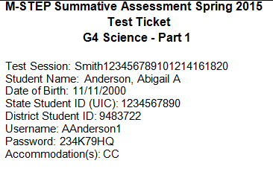
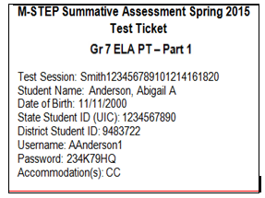
Getting Started: SAMPLE Test Tickets

Slide 46
Technology Preparations
Install the TSM and coordinate schedules with the Technology Coordinator to make sure the TSMs will support the testing schedule
  Work with your Technology Coordinator to make sure INSIGHT is installed on all testing devices

Slide 47
Technology Preparations- continued
Plan to make sure that...
  displays are functioning correctly
  mice/pointing devices are working
  keyboards are working
  wireless keyboards are properly paired
  headphones are working
  sound level is set properly
  batteries are fully charged or plugged in
  software updates don’t occur before or during testing
  there are extra devices available at each testing location

Slide 48
Technology Preparations- continued
iPad setup
  Mobile Device Management (MDM) is required to deploy INSIGHT on iPads
  The following must be disabled before testing: Check Spelling, Predictive Text, Auto‑Correction, and Auto‑Capitalization
  Guided Access must be turned on
  Keyboards are required for ELA and Math assessments
Chromebooks
  Must have Google Apps for Education set up and your devices enrolled in Chrome device management
  Do not use touch-enabled Chromebooks or Windows Tablets

Slide 49
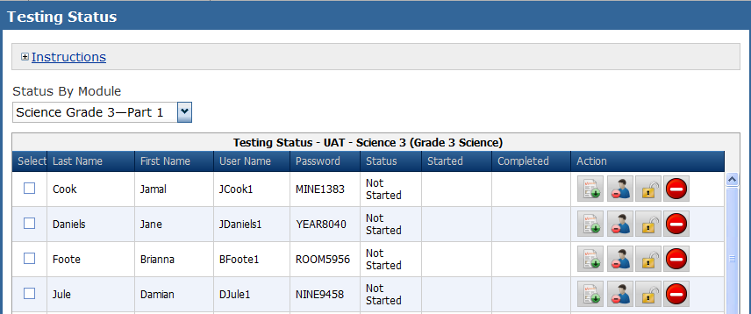
Monitoring Test Status
Individual student status for each part

Slide 50
Incident Reports
Incident Reports can be obtained by logging on to the BAA Secure Site. They are found under General Announcements.

Slide 51
Checking for Unsent Responses on the TSM

Slide 52
Checking for Unsent Responses on the TSM

Slide 53

Questions: baa@Michigan.gov

