Slide 1
Product Labels – Defending the Use of Processed Foods
Michigan Department of Education
School Nutrition Programs
Annual Conference – June 2015
Notes:
Welcome to the session on Product Labels – Defending the Use of Processed Foods

Slide 2
Overview
Child Nutrition (CN) Label
Child Nutrition(CN) Label with Watermark
Product Formulation Statement (PFS)
Nutrition Facts Label
Manufacturer Specification or Fact Sheets
Notes:
In this presentation, different types of product documentation will be discussed. Guidance will be provided about how product literature can be used to make purchasing decisions.
We will also review what is acceptable product documentation during an Administrative Review.

Slide 3
Child Nutrition (CN) Labels
Notes:
Let’s begin talking about Child Nutrition or CN Labels and how we use them in menu planning in the child nutrition programs. They help us to verify the crediting of menu items.

Slide 4
Child Nutrition (CN) Labels
Gold standard for verifying the crediting of menu items:
  Provides SFAs a warranty against audit claims when product is used according to the manufacturer’s instructions
  Provides an assurance that foods provide the stated contribution toward Child Nutrition meal pattern requirements
  Ensure foods are produced under an approved Quality Control (QC) plan
Program is managed by the Agricultural Marketing Service (AMS) in collaboration with:
  Food and Nutrition Service (FNS)
  National Marine Fisheries Service (NMFS)
  Food Safety Inspection Service (FSIS)
Notes:
Schools and other program operators are not required to offer processed products with CN Labels. However, it is important to recognize that CN Labeled products provide an assurance that foods provide the stated contributions toward CN meal pattern requirements.
CN Labels are the “gold standard” for verifying the crediting of menu items. They provide SFAs a warranty against audit claims when the food product is used according to the manufacturer’s instructions;
provide an assurance that foods provide the stated contribution toward child nutrition meal pattern requirements;
and ensure foods are produced under an approved Quality Control (QC) plan.
The Child Nutrition Labeling program is managed by the Agricultural Marketing Service in collaboration with several partners.

Slide 5
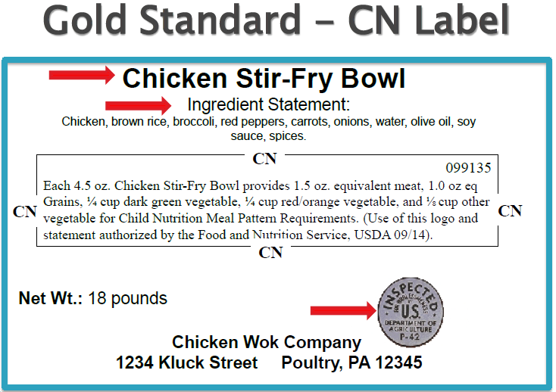
Notes:
Here is an example of a CN Label. A CN Label contains the following information:
The CN logo, which is a distinct border
Name of product
Ingredients
Boxed area that indicates meal contribution, CN number (in the upper right hand corner), and month and year of FNS approval date CN statement was authorized.
USDA inspection stamp
Signature/address line
Net weight
The newer labels show crediting of m/ma, vegetable subgroups, grains, and fruit.

Slide 6



Process to Document a CN Label
Remove the CN Label from the product carton
Photograph of the CN Label
  Label must be attached to the product carton
Photocopy of the CN Label
  Label is laser printed on product carton
  Label cannot be easily removed
CN Labels that are photographed or photocopied must be visible and legible
Notes:
This slide shows the different ways to document a CN Label from a product.
If you are not saving the label from the product carton, photographed or photocopied images must be legible.

Slide 7

CN Label with a Watermark
New FNS guidance allows the watermarked CN Label as acceptable documentation
Watermarks are used when the CN logo and contribution statement are on product information other than the actual product carton
Manufacturers may provide schools with a watermarked CN Label during the bidding process
Notes:
Per USDA memo SP 27-2015 – Administrative Review Process Regarding the Child Nutrition (CN) Label, Watermarked CN Label and Manufacturer’s Product Formulation Statement (issued March 11, 2015):
CN Labels with a watermark can be accepted as product documentation under certain circumstances, as shown in this slide:
- Watermarks are used when the CN logo and contribution statement are on product information other than the actual product carton.
- Manufacturers may provide schools with a watermarked CN Label during the bidding process.

Slide 8
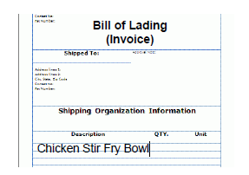
CN Label with a Watermark
Watermarked CN Label (hardcopy OR electronic copy)
  With product name and CN number
  Attached to the Bill of Lading (invoice)
    Product name documented on Bill of Lading
Notes:
The Bill of Lading (invoice) must be attached to the watermarked CN Label and kept on file.
USDA memo SP 11-2015 (v.2) : CN Labels Copied with a Watermark Acceptable Documentation (issued March 1, 2015) – clarifies that a CN Label copied with a marking referred to as a watermark is acceptable documentation for an Administrative Review.

Slide 9
Sample CN Label with a Watermark
Notes:
Here is an example of a CN Label with a watermark.
Manufacturers may provide schools with a CN label watermark during the bidding process. Schools should be aware that product information on the CN Label with a watermark can be changed. Therefore, schools are encouraged to verify that the CN Label with a watermark came from a product that was purchased by the school and accurately reflects that product.

Slide 10
Verifying Acceptable Documentation of CN Labels During an Administrative Review
USDA memo SP 27-2015: Administrative Review Process Regarding the Child Nutrition (CN) Label, Watermarked CN Label and Manufacturer’s Product Formulation Statement
USDA memo SP 11-2015 (v2): CN Labels Copied with a Watermark – Acceptable Documentation
USDA memo TA-07: Guidance for Accepting Processed Product Documentation for Meal Pattern Requirements
Notes:
On this slide are the most current USDA memos regarding CN Labels and PFS.
During an Administrative Review, if the SFA has a valid CN Label or watermarked CN Label, then the SFA will not need to have a PFS for documenting crediting information.
The next slide provides a flowchart for verifying acceptable documentation during an AR.

Slide 11
Verifying Acceptable Documentation of CN Labels
During an Administrative Review
Notes:
This flowchart shows when a Product Formulation Statement is needed. A PFS is only required when an unacceptable CN Label is not provided.

Slide 12
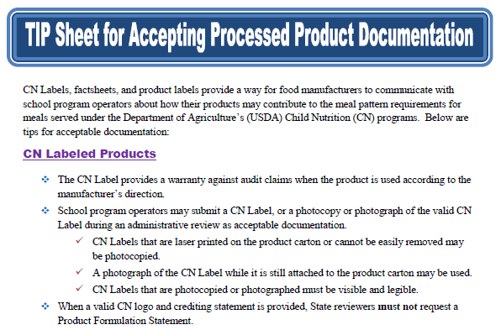
Tip Sheet for Accepting Processed Product Documentation
http://www.fns.usda.gov/sites/default/files/cn/cnl_tipsheet-processedproduct.pdf
Notes:
There is also a Tip Sheet for Accepting Processed Product Documentation, located on the website indicated on the slide. It provides tips for acceptable documentation for CN Labels (regular and watermarked) and Product Formulation Statements.

Slide 13
CN Label Verification System
Assist State reviewers to verify status of CN Label and contribution statement
Estimated completion date is Fall 2015
Notes:
The Food and Nutrition Services office is working with AMS to establish a CN Label verification system. This will be a big help to all in determining crediting information of processed foods when the product has a CN Label.

Slide 14
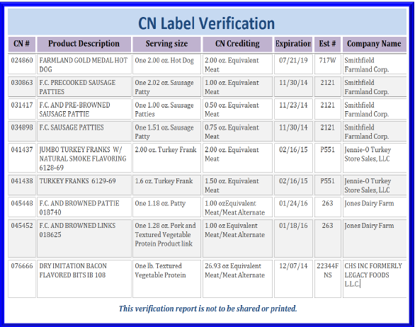
CN Label Verification System
Notes:
Here is an example of the information that will be contained in the CN Label Verification System.

Slide 15
Product Formulation Statement (PFS)
Notes:
When a processed product is purchased without a CN label, a program operator should request a signed PFS on manufacturer's letterhead that demonstrates how the processed product contributes to the meal pattern requirements.

Slide 16
Product Formulation Statement (PFS)
When a valid CN Label or watermarked CN Label with Bill of Lading is provided, PFS must not be requested during an Administrative Review
Only request a PFS when purchasing a processed product without a CN Label
Notes:
If an SFA provides a valid CN Label or watermarked CN Label with Bill of Lading (invoice), then they do not have to provide a Product Formulation Statement.

Slide 17
Product Formulation Statement (PFS)
Must be on signed company letterhead that demonstrates how the processed product contributes to the meal pattern
Creditable ingredients listed in PFS must match a description in the Food Buying Guide for School Meal Programs
Product’s contribution to the meal pattern requirements is not greater than the serving size of the product
Should assure that the creditable components are in the finished product
Notes:
Product Formulation Statements must contain the information listed here. USDA has provided templates for m/ma, vegetables and fruits, and grains.
Manufacturers can use different formats for the PFS, as long as they contain the required information.
PFS may be modified for various types of products available, for example – cheese pizza could have crediting information about the red/orange vegetable subgroup in addition to the m/ma and grain components.

Slide 18
Product Formulation Statement – Meat/MA
Notes:
Product Formulation Statement templates for documenting meat/meat alternates (m/ma), grains, and fruit vegetable components are available on the CN Labeling website. This slide shows the PFS template for m/ma.

Slide 19
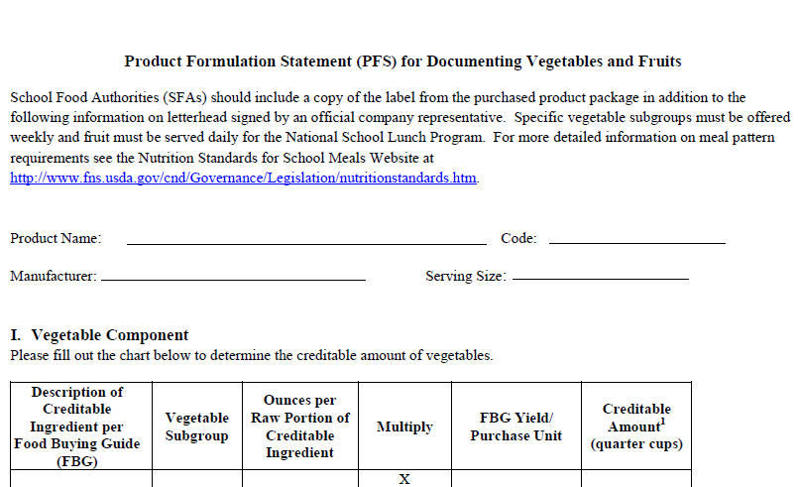
Product Formulation Statement – Vegetables & Fruits
Notes:
This slide shows the PFS template for documenting vegetables and fruits.

Slide 20
Product Formulation Statement - Grains
Grains can be credited by two different methods:
  Crediting standards based on Revised Exhibit A weights per oz equivalent
  Crediting standards based on grams of creditable grains
Notes:
Grains can be credited by two different methods - Crediting standards based on Revised Exhibit A weights per oz equivalent or crediting standards based on grams of creditable grains.
SFAs have the option to choose the crediting method that best fits the specific needs of the menu planner.

Slide 21
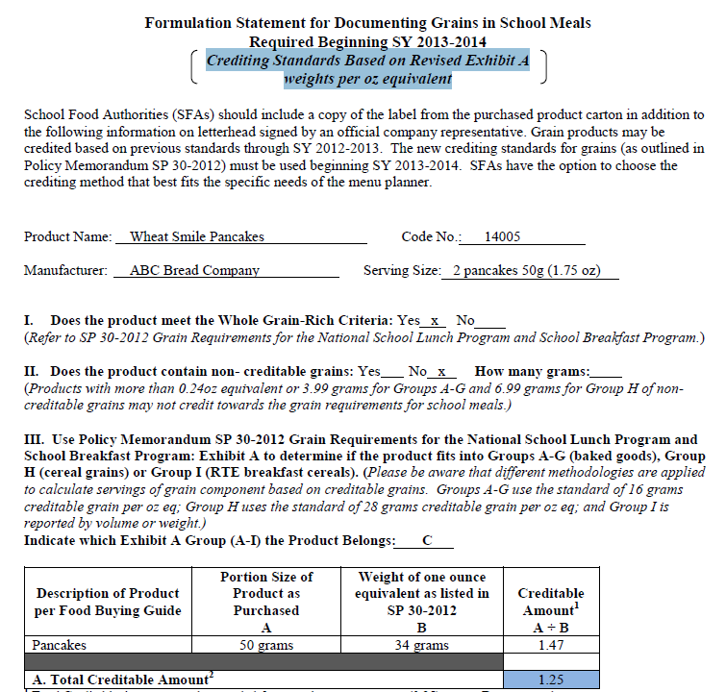
Product Formulation Statement - Grains
Crediting Standards Based on Revised Exhibit A weights per oz equivalent
Notes:
Here is a PFS template for grain that shows crediting standards based on Revised Exhibit A weights per oz equivalent.
In this example, the total contribution of product (per portion) is 1.25 oz equivalent grains.

Slide 22
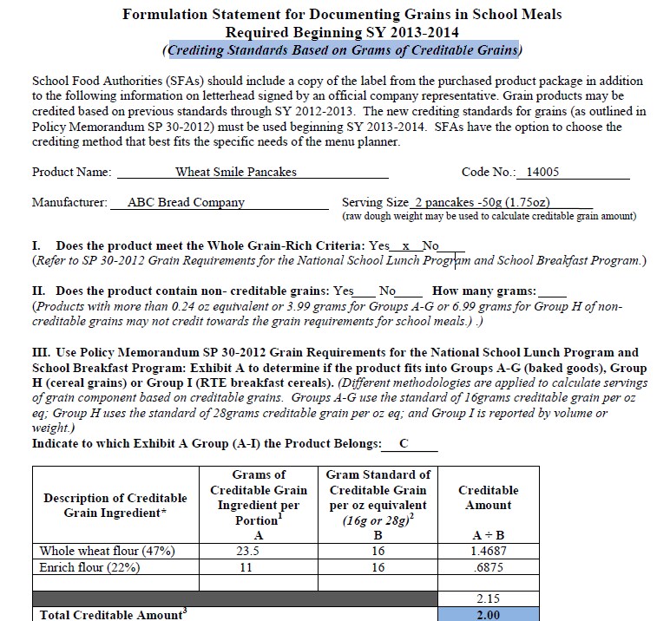
Product Formulation Statement - Grains
Crediting Standards Based on Grams of Creditable Grains
Notes:
Here is a PFS template for grain that shows crediting standards based on grams of creditable grains.
In this example, the total contribution of product (per portion) is 2.0 oz eq grains.

Slide 23
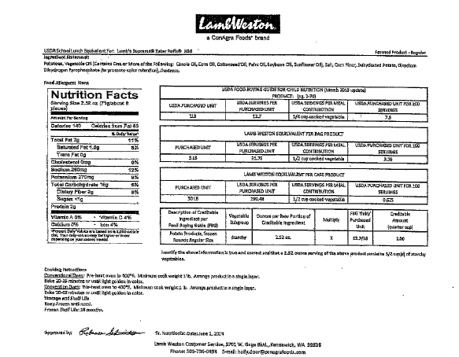
Sample PFS - Vegetable
Notes:
Here is a sample of a PFS for a vegetable. Even though the USDA PFS template was not used, this PFS is acceptable because it is signed, on company letterhead, shows how the ingredients match the information in the Food Buying Guide, and shows the calculations to demonstrate how the product contributes to the meal pattern.

Slide 24
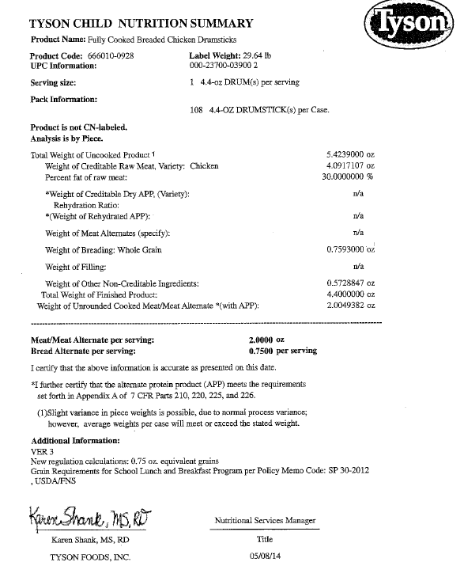
Sample PFS – Breaded Meat Item
Notes:
Here is a sample of a PFS for a breaded poultry item. Even though the USDA PFS template was not used, this PFS is acceptable because it is signed and certified, on company letterhead, shows how the ingredients match the information in the Food Buying Guide, and shows the calculations to demonstrate how the product contributes to the meal pattern.

Slide 25
Nutrition Facts Label
Notes:
Let’s talk about what information is contained on a Nutrition Facts label. Oftentimes, a menu planner needs specific nutrient information that is found on the Nutrition Facts Label.

Slide 26
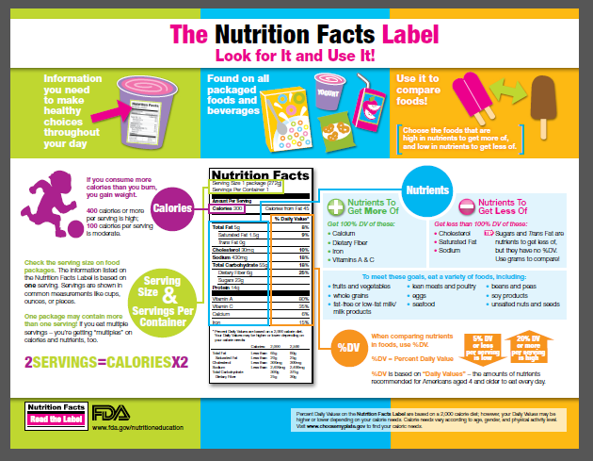
Nutrition Facts Label
http://www.fda.gov/Food/IngredientsPackagingLabeling/LabelingNutrition/ucm20026097.htm
Notes:
The Nutrition Facts Label is an easy tool for making quick, informed food choices that contribute to a healthy diet. Let’s focus on what we look for when we are choosing foods to put on our school menus:
Calories
Sodium
Saturated fat
Trans fat
It is important to look at the serving size. How many servings are in the food package? Do you plan to eat one or two servings?
Calories: Calories provide a measure of how much energy you get from a serving of this food.
The number of servings you consume determines the number of calories you actually eat.
Look at the top of the nutrient section in this sample label. It shows some key nutrients that impact your health and are separated into two main groups:
nutrients to limit (fats, cholesterol and sodium). Eating too much of these nutrients may increase your risk of certain chronic diseases, like heart disease, some cancers, of high blood pressure.
AND
2) nutrients that most people don’t get enough of (dietary fiber, vitamin A & C, calcium and iron) Eating enough of these nutrients can improve your health and help reduce the risk of some diseases and conditions.

Slide 27
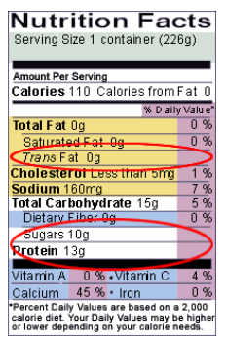
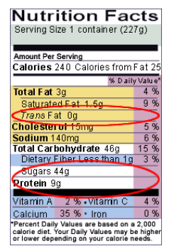
Comparison Example – Yogurt
Plain yogurt
Fruit yogurt
Notes:
Here are examples of two kinds of yogurt – plain and with fruit. Each serving size is one container.
Which has more calories? (fruit yogurt)
Which has more saturated fat? (fruit yogurt)
Which has more sugars? (fruit yogurt)
Which yogurt are you more likely to menu – especially when making a breakfast parfait? (plain yogurt)

Slide 28
Product Specification Sheets
Notes:
Next, we will talk about product specification sheets, also known as product fact sheets. These sheets don’t take the place of a CN Label or a Product Formulation Statement, but still provide a lot of valuable information to the menu planner.

Slide 29
Sample Product Specification Sheet ≠ PFS
Lots of good information.
Signature, but no source of calculations.
Notes:
This product specification or fact sheet contains a lot a great information for the food service manager. This example would NOT qualify for a PFS because the document needs to demonstrate how the 2.0 oz credit was determined.

Slide 30
Sample Product Specification Sheet ≠ PFS
No signature or calculations of how crediting was done.
Appears to have valid CN number, but not actual copy of CN Label or CN Label with Watermark.
Notes:
In order for this meatball sheet to be considered a PFS, this document needs to be signed on company letterhead , as well as demonstrate how the 2.0 oz eq credit for m/ma was determined.
This is a valid CN Labeled product, so an actual CN Label or CN Label with a Watermark may be used in lieu of a PFS.
As a point of reference, when the CN ID number: 076055 is entered into the search feature of the CN Labeling site, this product is listed on the site. The next slide shows this.

Slide 31
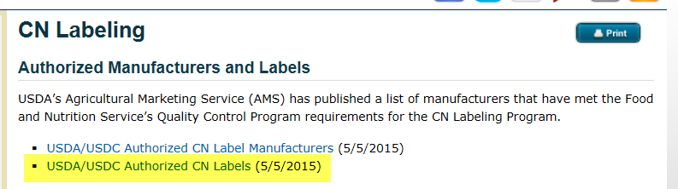
CN Labeled Meatballs
http://www.fns.usda.gov/cnlabeling/authorized-manufacturers-and-labels
Notes:
When the number 076055 is searched for on the USDA Authorized CN Labels website, it shows these meatballs have a CN Label and the expiration date for the label is 11/10/2019.

Slide 32
Summary
The only way to ensure a processed food product provides the stated contributions toward Child Nutrition meal pattern requirements is to provide proper documentation:
Child Nutrition (CN) Label
Child Nutrition (CN) Label with Watermark
Product Formulation Statement (PFS)
Notes:
In summary, the only way to ensure a processed food product provides the stated contributions toward child nutrition meal pattern requirements is to provide proper documentation in the form of:
an actual CN Label;
a CN Label with a Watermark; or
a Product Formulation Statement.

Slide 33

Questions?
Phone: 517-373-3347
or
E-mail: MDE-SchoolNutrition @michigan.gov
Notes:
Please contact MDE if you have any questions.
Thank you for attending this presentation.

