Slide 1

Statewide Professional Development Initiative
Office of field service - our mission
accelerate student achievement through school improvement by working as partners to maximize the allowable use of supplementary resources.

Slide 2

Your partners in this learning experience are…
Dr. Shereen Tabrizi
Manager of the Special Population Unit (OFS)
Oralia Cooper
ELL Consultant
Dr. Jennifer Fontenot
Author, Educator & Literacy Consultant
Nadra Shami
Coach – SIOP & BEW
Dennis Terdy
SIOP Trainer
Center for Applied Linguistics
Great Lake East
American Institutes for Research
ISDs

Slide 3
Statewide Professional Development Initiative Includes
1. Sheltered Instruction Observation Protocol (SIOP)
2. Blueprint for Exceptional Writing
(BEW)
Purpose – To accelerate student achievement

Slide 4
ELL Statewide Writing MEAP Results
2008-2009
2008 Writing Grade 5: ELL 35% Non-ELL 64% FLEP 67%
2008 Writing Grade 8: ELL 52% Non-ELL 75% FLEP 79%
2008 Writing Grade 3: ELL 43% Non-ELL 62% FLEP 71%
2009 Writing Grade 11: ELL 9% Non-ELL 44% FLEP 36%

Slide 5
ELL Statewide MEAP Results
Results for 2009
Reading Grade 5: ELL 62% Non-ELL 86% FLEP 92%
Math Grade 5: ELL 68% Non-ELL 80% FLEP 93%
Reading Grade 8: ELL 62% Non-ELL 84% FLEP 93%
Math Grade 8: ELL 50% Non-ELL 71% FLEP 86%
Reading Grade 3: ELL 82% Non-ELL 90% FLEP 98%
Math Grade 3: ELL 92% Non-ELL 95% FLEP 99%

Slide 6

Creating a Community of Learners

Slide 7
Creating a Community of Learners
Administrative Role
Support at local & ISD Levels
Common time for collaboration & growth
Follow-up Learning Opportunities
Reflection
Systematic Job Embedded Professional Development
Coaching Model
Include SIOP & BEW in school improvement process
New Strategies
Assessment for learning
Walk through as a team for reflection & sustainability
Continuous examination of data on improvement
Parent Partners

Slide 8

SIOP® Model TOT Workshop Participant Outcomes
Receive an in-depth introduction to the SIOP® Model, the research behind SIOP, and its content.
Engage in practice with the eight (8) components and thirty (30) features of the SIOP® model.
Discuss sources of language objectives, issues in second language acquisition, and implementation strategies for sheltered instruction.
Co-facilitate or assist in delivering a four-day SIOP® model professional development workshop series using CAL PowerPoint slides and supporting materials to Michigan educators as part of the Michigan Department of Education initiative.

Slide 9

SIOP Model: The Research
The Effects of Sheltered Instruction on the Achievement of LEP Students
  A seven year research study (1996-2003), funded by the US ED, Quasi-experimental design
Academic Literacy Through Sheltered Instruction for Secondary ELLs: The SIOP Model
  A two year research study (2004-2006), funded by the Carnegie Corporation of New York & the Rockefeller Foundation, Quasi-experimental
The Impact of the SIOP Model on Middle School Science and Language Learning
  A Multi-phase study began in 2005, funded by the US Dept. of Education, Small cluster-randomized trial with randomization at the school level

Slide 10
SIOP Participant Expectations
Full attendance of SIOP Train the Trainer sessions
Provide at least four regional SIOP workshops to Michigan educators as part of the Michigan Department of Education SIOP initiative
Represent oneself as an ELL educator who has been trained by the Center for Applied Linguistics, subcontractor of GLECC
Refrain from providing SIOP professional development commercially, for any compensation, or in any other manner not explicitly authorized in writing.

Slide 11
SIOP Participant Expectations
Receive CAL SIOP Materials
Duplicate and distribute SIOP materials as permitted by the CAL and the SIOP Manual
Maintain the integrity of SIOP materials
Utilize CAL SIOP professional development core slides only during SIOP professional development workshops conducted on behalf of MDE

Slide 12
Sheltered Instructional Observational Protocol
&
Blueprint for Exceptional Writing
SIOP
BEW
Success for ELLs
Notes:
History & Development of BEW

Slide 13
So, what is Blueprint for Exceptional Writing?
BEW is a set of research-based, clear differential teaching strategies that can help ELL students, think, plan, organize and then write proficient selections.
BEW compliments any writing curriculum or teaching strategies that you’re currently using.
BEW provides a Master Plan that scaffolds the teaching of writing for ELLs in grades K-12 covering every genre.
Notes:
Pearson’s Role in BEW

Slide 14

We have SIOP. Why do we need BEW?
It’s the piece that finishes the puzzle for teaching ELLs
narrative and informational writing.
Notes:
Suggests a combination of 6 Traits & BEW

Slide 15

The Master Plan
BEW
Phase I
Authentic Vocabulary
Phase II
Prewriting
Phase III
Writing
Phase IV
Authentic Editing
Phase V
Publishing

Slide 16
Research Investigation One – 2006 Eastern Michigan University Approved 2006
The improvement for General Ed students taught using BEW was more than double the improvement achieved by the Process Writing (PW) strategies: 11.48 points vs. 5.67.
The improvement for Special Needs/ELL students using BEW strategies was more than 12 times the change achieved by the PW strategies: 12.38 points vs. 0.76.
These results were tested statistically and were found to be highly significant in both cases. Student scores were a assessed with the WIAT .
Notes:
Remember to discuss the graphic organizers as the building blocks.

Slide 17
Research Investigation Two – 2008 Lincoln Consolidated Schools Summer School Data
It is important to note that the majority of students in the summer program were at-risk students.
The BEW strategies proved highly effective in improving test scores for all grade clusters in the short-duration summer school program. The improvement was 66% for grades 1-2, 116% for grades 3-5 and 80% for grades 6-8.
The results were statistically tested and found to be highly significant in all cases. Scored with the state standardized MEAP rubric with a teacher-created prompt.

Slide 18
Research Investigation Three – 2009 International Reading Association Grant Data
The group of students taught using the BEW Blueprint Graphic Organizer improved by a factor of 286% whereas the students taught using the Standard Approach improved by a factor of only 16%.
All results were tested statistically and found to be highly significant. Student samples were scored with the state scoring rubric with a teacher-created writing prompt.
These results were achieved using only one of the many BEW strategies.

Slide 19
Research Investigation Four – 2010 Dearborn Public School’s Summer School Data
Students in all three test clusters showed a substantial gain after applying the BEW strategies: 25.7% for grades K-2, 23.4% for ELLs in grades K-2 and 29.1% for grades 3-5.
These results were tested statistically and found to be highly significant in all cases. Students were scored with a district-designed 6 Traits Rubric including a BEW Organizational component.
The results were achieved in a short 5-week summer program where the majority of students were special needs/at-risk/ELLs.
Notes:
Rubric was a district-designed 6 Traits with BEW under organization.

Slide 20
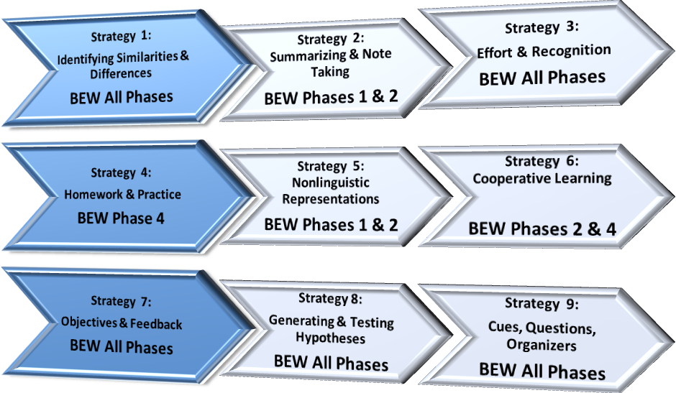
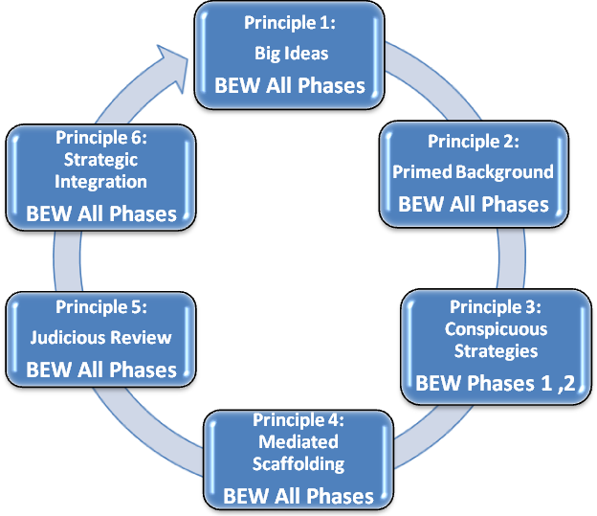
Aligned with Best Practices for sure!
Robert Marzano
Kame'enui & Carnine

Slide 21


Is BEW Aligned with the GLCE’s & Common Core Standards?
Michigan GLCE's
Common Core Standards
Notes:
Shift to Common Core we’re not loosing anything with this training.

Slide 22
BEW Workshop Goals & Outcomes
Day One Narrative Genres (April)
Content Goal #1
Workshop participants will be able to identify, analyze and apply the features of the 5-Phase Process Writing Framework of Blueprint for Exceptional Writing to classroom instructional practices for ELL students within narrative genres.
Workshop Outcome #1
Workshop participants will be able to write a BEW 5-Phase lesson plan for narrative genres.
Content Goal #2
Workshop participants will be able to analyze and apply strategies for combining SIOP and BEW instructional practices.
Workshop Outcome #2
Workshop participants will be able to write mini-lessons for narrative genres.
Content Goal #3
Workshop participants will be able to differentiate between the characteristics and text structures of different narrative genres.
Workshop Outcome #3
Workshop participants will be able read an discuss the text structures and genre organization for all narrative genres.
Content Goal #4
Workshop participants will be to adapt a student-friendly narrative assessment rubric.
Workshop Outcome #4
Workshop participants will be able to write and then assess student writing selections using a student-friendly narrative rubric.

Slide 23
BEW Workshop Goals & Outcomes
Day Two Informational Genres (May)
Content Goal #1
Workshop participants will be able to identify, analyze and apply the features of the 5-Phase Process Writing Framework of Blueprint for Exceptional Writing to classroom instructional practices for ELL students within informational genres.
Workshop Outcome #1
Workshop participants will be able to write a BEW 5-Phase lesson plan for informational genres.
Content Goal #2
Workshop participants will be able to analyze how an informational concept can be connected to students’ experiences.
Workshop Outcome #2
Workshop participants will be able to write and discuss ways to build on students’ prior experiences within the informational genres. .
Content Goal #3
Workshop participants will be able to differentiate and analyze the differences between narrative and informational text structures.
Workshop Outcome #3
Workshop participants will be able discuss and write six different informational text structures within given genres.
Content Goal #4
Workshop participants will be to adapt a student-friendly informational assessment rubric.
Workshop Outcome #4
Workshop participants will be able to write and then assess student writing selections using a student-friendly narrative rubric

Slide 24

Requirements for BEW/SIOP Workshop Attendance
PARTICIPANTS PAY NO WORKSHOP FEE, EXCEPT FOR THE COST OF MEALS (APPROX. $100)
PARTICIPANTS MUST ATTEND ALL 3 DAYS (SIOP PLUS WRITING) DURING EACH OF APRIL AND MAY TRAINING SESSIONS
PARTICIPANTS MUST APPLY THEIR NEW SKILLS WITH STUDENTS AND SHARE THEIR EXPERIENCES WITH COLLEAGUES
PARTICIPANTS MUST COMMIT TO ATTENDING SUBSEQUENT WEBINARS AND FOLLOW UP WORKSHOPS AND SHARE NEW INFORMATION WITH COLLEAGUES
IMPLEMENT SIOP AND BLUEPRINT FOR EXCEPTIONAL WRITING WITH FIDELITY.

Slide 25
Specific Trainer Requirements
Trainers will insure teaching of BEW with fidelity
Trainers will use formative and summative assessment tools to drive instruction
Trainers will be able to duplicate all Bew instructional power point presentations for instructional purposes
AN Evaluation will be completed BY TRAINERS

Slide 26
Training Dates For Cohort 3
April 6-7 SIOP; April 8 Blueprint for Exceptional Writing (BEW)
May 18-19 SIOP; May 20 BEW
Follow up regional workshop dates are: June 20-23, August 8-11, and August 15-18. Location TBD
Follow up local workshop dates are flexible and based on TOT availability.

Slide 27
Question/Answer

