Slide 1
How Smart Inverters Will Serve the Future Distribution Grid
Michigan Public Service Commission Presentation
April 19, 2017
Katie Hsia-Kiung
Business Development Manager, Enphase Energy

Slide 2
Background: Why do we need smart inverters?
Current distribution grids = one-way power flow
Future distribution grids = bi-directional power flows
With greater penetration of renewable energy (i.e. solar and wind), a greater portion of the energy sources on the grid will be intermittent power sources
To prepare for this future, the grid must become smarter to handle the increasing amount of distributed energy resources like solar

Slide 3
What is a smart/advanced inverter?
An inverter that can continue to operate during disturbances to the electrical grid and help manage those disturbances/smooth out variabilities
Not necessary unless there is a high penetration of intermittent energy resources (like solar and wind) on the grid, but necessary to be prepared
Smart capabilities make the inverter an active participant in the grid, rather than a passive participant
Smart inverter = provider of energy services to the grid
Traditional inverter = provider of energy to the grid

Slide 4
Smart Inverters vs. Traditional Inverters
Traditional Inverters
Ride through
Traditional inverters meet “must trip before” requirements
Reactive Power Functions
Traditional inverters not allowed to participate in voltage regulation
Active Power Functions
Historically, these functions were not defined
Advanced Anti-Islanding
Historically, testing protocols only defined anti-island functionality through voltage and frequency limits
Communications
Traditional inverters cannot be updated remotely
Smart Inverters
Ride through
Smart inverters meet “must stay online until” requirements
Reactive Power Functions
Smart inverters are able to participate in voltage regulation of distribution system
Active Power Functions
Smart inverters can provide active power for frequency/voltage regulation and have passive functions like ramp rate control
Advanced Anti-Islanding
Use of tone injection or phase impedance change detection
Communications
Smart inverters can be updated and controlled remotely

Slide 5
Smart Inverter Capability #1: Ride-Through
Allows inverters to keep operating through voltage and frequency events rather than dropping off and making grid less stable
Voltage Ride-Through
Keeps distributed energy resources (DERs) from going offline during a short-duration voltage event
Problem: Significant loss of generation from DERs can delay voltage recovery or cause further grid instability
Solution: Smart inverters can adopt variable ride-through curves that extend the voltage and time limits under which inverter must ride-through

Slide 6
Smart Inverter Capability #1: Ride-Through
Frequency Ride-Through
Keeps inverters operating through low frequency excursions
Problem: Traditional limits cause inverters to trip offline when outside a fairly small window around nominal frequency
Can increase bulk system instability when frequency is low
Large amount of generation can be tripped at the same time if similar frequency trip settings are used across a wide area
Solution: Smart inverters can be set to ride-through off-nominal frequency excursions, which will keep them operating for as long as possible before tripping due to frequency excursion

Slide 7
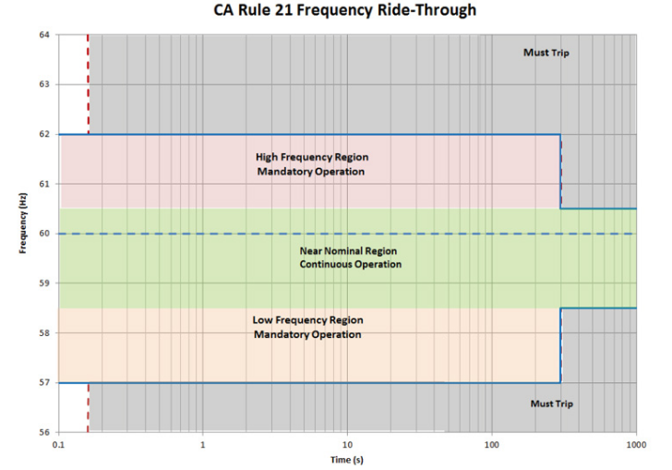
Smart Inverter Capability #1: Ride-Through

Slide 8
Smart Inverter Capability #2: Reactive power
When real power is fed back into the grid from an inverter, the voltage at the point of connection can rise
Higher voltage

Slide 9
Smart Inverter Capability #2: Reactive power functions
Problem: High penetration of systems feeding power into a circuit can cause voltage in area to rise and potentially exceed power quality thresholds or trip the distributed generation resources off line
Solution: Reactive power is needed to regulate voltage on distribution feeders. Smart inverters can help absorb or supply reactive power to reduce or increase voltage.
There are 2 options to control reactive power output from the smart inverter:
Fixed power factor – VARs are provided whether needed or not
Volt-Var control – VARs are injected or absorbed based on voltage observed

Slide 10
Smart Inverter Capability #3: Active power functions
Frequency/Watt (freq droop) - needed to stabilize bulk system during load to generation imbalances
Ramp rate control - helps keep the grid stable following a severe fault condition when all the DER comes back online all at once
Must be coordinated with utility frequency regulation schemes
Must be coordinated with utility voltage regulation schemes
Volt/Watt – reduces active power during severe overvoltage conditions
An emergency brake where reactive power does not work
A linear reduction instead of distinct and coordinated tripping

Slide 11
Smart Inverter Capability #4: Advanced anti-islanding
Anti-islanding is a feature of a grid-tied inverter that senses when there is a power outage and shuts itself off to stop feeding power back to the grid
Historically, inverters assumed a power outage when the voltage or frequency went outside certain limits
But, with active and reactive power control and new ride through requirements, smart inverters need a more advanced way of detecting a power outage that is unrelated to voltage and frequency trips
New active anti-islanding methods remain effective with ride through and active & reactive power control
Decreases likelihood of unintentional islanding

Slide 12
Smart Inverter Capability #5: Communications and remote updates
Advanced inverters include communication capabilities, allowing functions to be enabled or disabled or settings to be changed remotely
Case Study: Hawaii
Hawaii has highest penetration of PV of any state (almost 22%)
Enphase collaborated with Hawaiian Electric to remotely update 800,000 smart microinverters over two-day period (however, could have been implemented in under 8 hours)
Implemented new frequency and voltage ride-through settings, improving the stability of grid and helping HECO ride through solar-influenced disruptions on the edges of its power network.
Hawaiian Electric estimated savings at $47 million, including avoided truck rolls and personnel time to update systems manually as other systems require

Slide 13
Regulatory Update – Where are we now?
Hawaii Rule 14H has mandated advanced inverters for more than a year, California Rule 21 will mandate advanced inverters for IOUs Sept 2017
IEEE 1547 (2017) is the interconnection standard, undergoing full revision
Will go to ballot in spring of 2017
Close of balloting period is unclear – may be as late as winter 2017
IEEE 1547.1 (2017) is the testing protocol for IEEE 1547 and a full revision will begin soon
IEEE 1547.1 defines how you test your inverter for compliance with the standards laid out in IEEE 1547
Publication likely 6 months after IEEE 1547 – early/mid 2018

Slide 14
How to plan for Smart Inverters
Watch California, Hawaii, and other states with high penetration to learn from their experiences
Adopt IEEE 1547 and IEEE 1547.1 following publication of IEEE 1547.1
Not all functions need to be enabled, but having capabilities latent in the fielded fleet is critical for the future. If you are intending to implement these capabilities, make sure utility is staffed to do dynamic management of the distribution network
Modify interconnection agreements now to do the following:
Allow utilities, or their agents, to share customer data for operational purposes (while preserving customer privacy)
Allow utilities, or their agents, to make changes to settings of customer-owned smart inverters
Signal intent to develop communications capabilities for utilities and DER customers

