Slide 1
Distributed Generation Program
Jesse Harlow, Julie Baldwin & Chuck Putnam
Distributed Generation Program Workgroup
MPSC Staff Contacts

Slide 2
Current Net Metering Program Status: Business As Usual
2016 PA 342 Section 173(1) states that the Commission shall establish a Distributed Generation (DG) Program
It is Staff’s intent that the program will be a continuation of the net metering program until the completion of 2018 rate cases (mid-2019) approving a new DG tariff
We anticipate an order with more details in May or June of 2017

Slide 3
Net Metering Grandfathering
2016 PA 342 Section 183 (1) A customer participating in a net metering program approved by the Commission before the Commission establishes a tariff pursuant to section 6a(14) PA 3 may elect to continue to receive service under the terms and conditions of that program for up to 10 years from the date of enrollment.

Slide 4
Distributed Generation Program Overview
2016 PA 342, Part 5 DG Program Key Elements
Applies to rate-regulated utilities and alternative electric suppliers
Open to all customer classes
Eligible generators: methane digester or renewable energy system; size limited to the customer’s annual usage
1% Program Size Limit (carries forward from the net metering program)
0.5% for customers with generators 20 kW or less
0.25% for customers with generators 150 kW or less
0.25% for customers with methane digesters 550 kW or less
Notes:
4

Slide 5
DG Program Overview (continued)
20 kW and less Projects
Qualify for true net metering
>20 kW and 150 kW and less Projects
Qualify for modified net metering
Renewable energy credits (RECs) are owned by the customer
Application Fee cannot exceed $50
The customer pays all interconnection costs; except utility testing and inspection costs

Slide 6
Three Primary Workgroup Tasks
Investigate grid-balancing functions of smart inverters per PA 342 Section 173 (6)(b)
Develop and implement the Distributed Generation Program based on PA 342 Part 5
Determine necessary changes to net metering and interconnection rules
Commence a study to design a tariff per PA 341 Section 6(a)(14) within 1 year of April 20, 2017
This may result in a distributed generation program with a tariff mechanism different from net metering
Notes:
Batteries

Slide 7
Smart Inverters (IEEE 1547a)
IEEE is currently studying updates with work this work wrapping up in 2018
Some potential topics for us are:
Intentional Islanding
Voltage and Frequency Ride Through and Regulation
VAR Support
Demand Response Communication
Batteries
Timeline to be determined

Slide 8
DG Study
Commission will conduct “…a study on an appropriate tariff reflecting equitable cost of service for utility revenue requirements…”
To narrow the scope, Staff suggests limiting the study to customers with solar and customers with solar plus batteries
The study and development of an appropriate tariff must be completed by April 20, 2018
Rate cases filed after June 1, 2018 must include the tariff resulting from the study
The tariff should also include new aspects of the DG Program.
Notes:
2016 PA 342 Section 177 (5) refers to a charge for net metering and distributed generation customers established pursuant to section 6a of 1939 PA 3

Slide 9
DG Study & Tariff Process
Conduct a Cost of Service Study for solar DG customers and solar plus battery customers
Investigate tariff mechanisms:
Inflow/outflow
Net metering w/adjustor
Buy all/sell all
Others?
Select one (or more) tariff mechanism and develop a generic rate design to recover the cost of service

Slide 10
DG Study & Tariff – Staff Report
MPSC Staff will prepare a report on the study and tariff
tentative issue date is January or February 2018
There will be an opportunity to comment on the report
Final report will be issued in March or April 2018
During the rate case process, parties can file their own study and tariff filing for the Commission to consider

Slide 11
Cost of Service Study Presentation

Slide 12
Study Data Needs Discussion

Slide 13
Proposed Timeline
March 22: Initial DG Workgroup Meeting
March 22 – June 30: Plan study parameters and obtain data
April 19: Second DG Workgroup Meeting
May 10: Third DG Workgroup Meeting
June 28: Fourth DG Workgroup Meeting
June – July: Conduct Cost of Service Study
August 15 : Present results of COS Study

Slide 14
Proposed Timeline
August – September: Develop tariff September 25: Present tariff concepts
September – December: Staff drafts COS study report and tariff recommendation
January/February: Draft report issued to DG Workgroup for comments
Final report issued in March/April 2018
After June 1, 2018: All rate cases will include a DG Program tariff
New tariff could become effective as early as April 2019 (or earlier if a rate case is settled)

Slide 15
Next Meeting
Wednesday, April 19, 2017
1pm - 4pm
Rob Ozar will discuss his inflow/outflow research
IEEE 1547a discussion
Distributed Generation Program Website:
http://www.michigan.gov/mpsc/0,4639,7-159-16400_79103-406256--,00.html

Slide 16
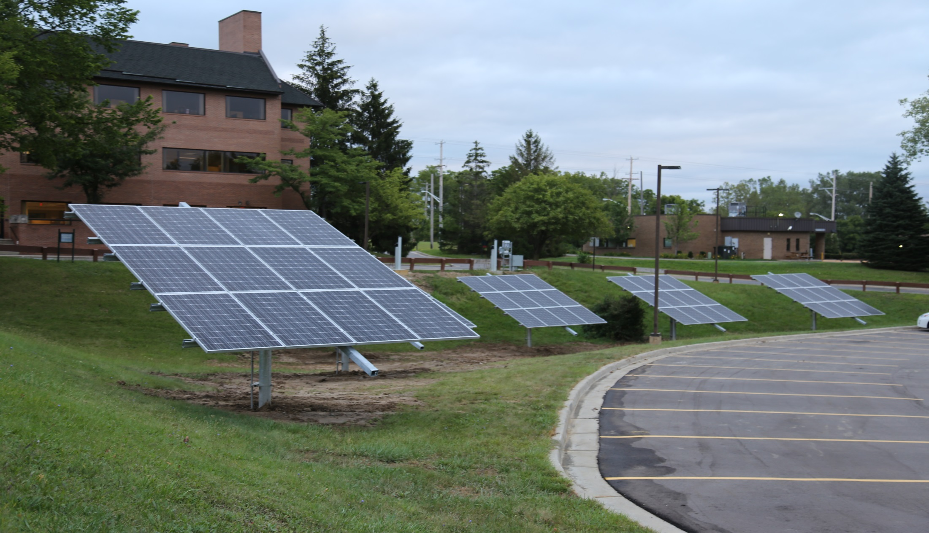
Michigan Public Service Commission Distributed Generation Program Workgroup Staff Contacts
Julie Baldwin
baldwinj2@michigan.gov
517.284.8318
Chuck Putnam
putnamc@michigan.gov
517.284.8291
Jesse Harlow
harlowj@michigan.gov
517.284.8320

