Slide 1
21st Century Infrastructure Commission Asset Management Pilot
Find the report and executive summary at
www.miinfrastructurecommission.com

Slide 2
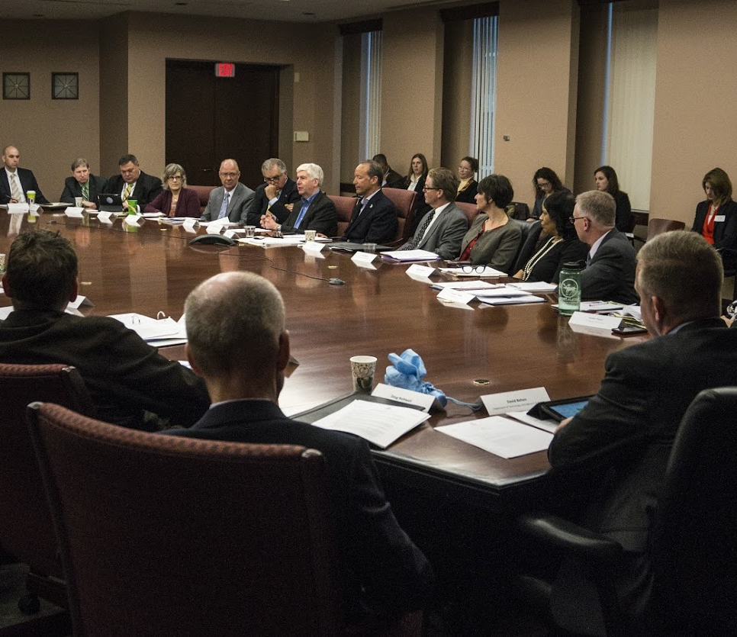
21st Century Infrastructure Commission Background
Began in March 2016
Comprised of 27 appointed members:
Infrastructure experts
Government representatives
Academic scholars
Business representatives
Provided a long-term, comprehensive set of infrastructure recommendations by November 30, 2016
Healthy systems ensure a better quality of life, spur economic activity and job growth
For the next 30-50 years across all sectors

Slide 3
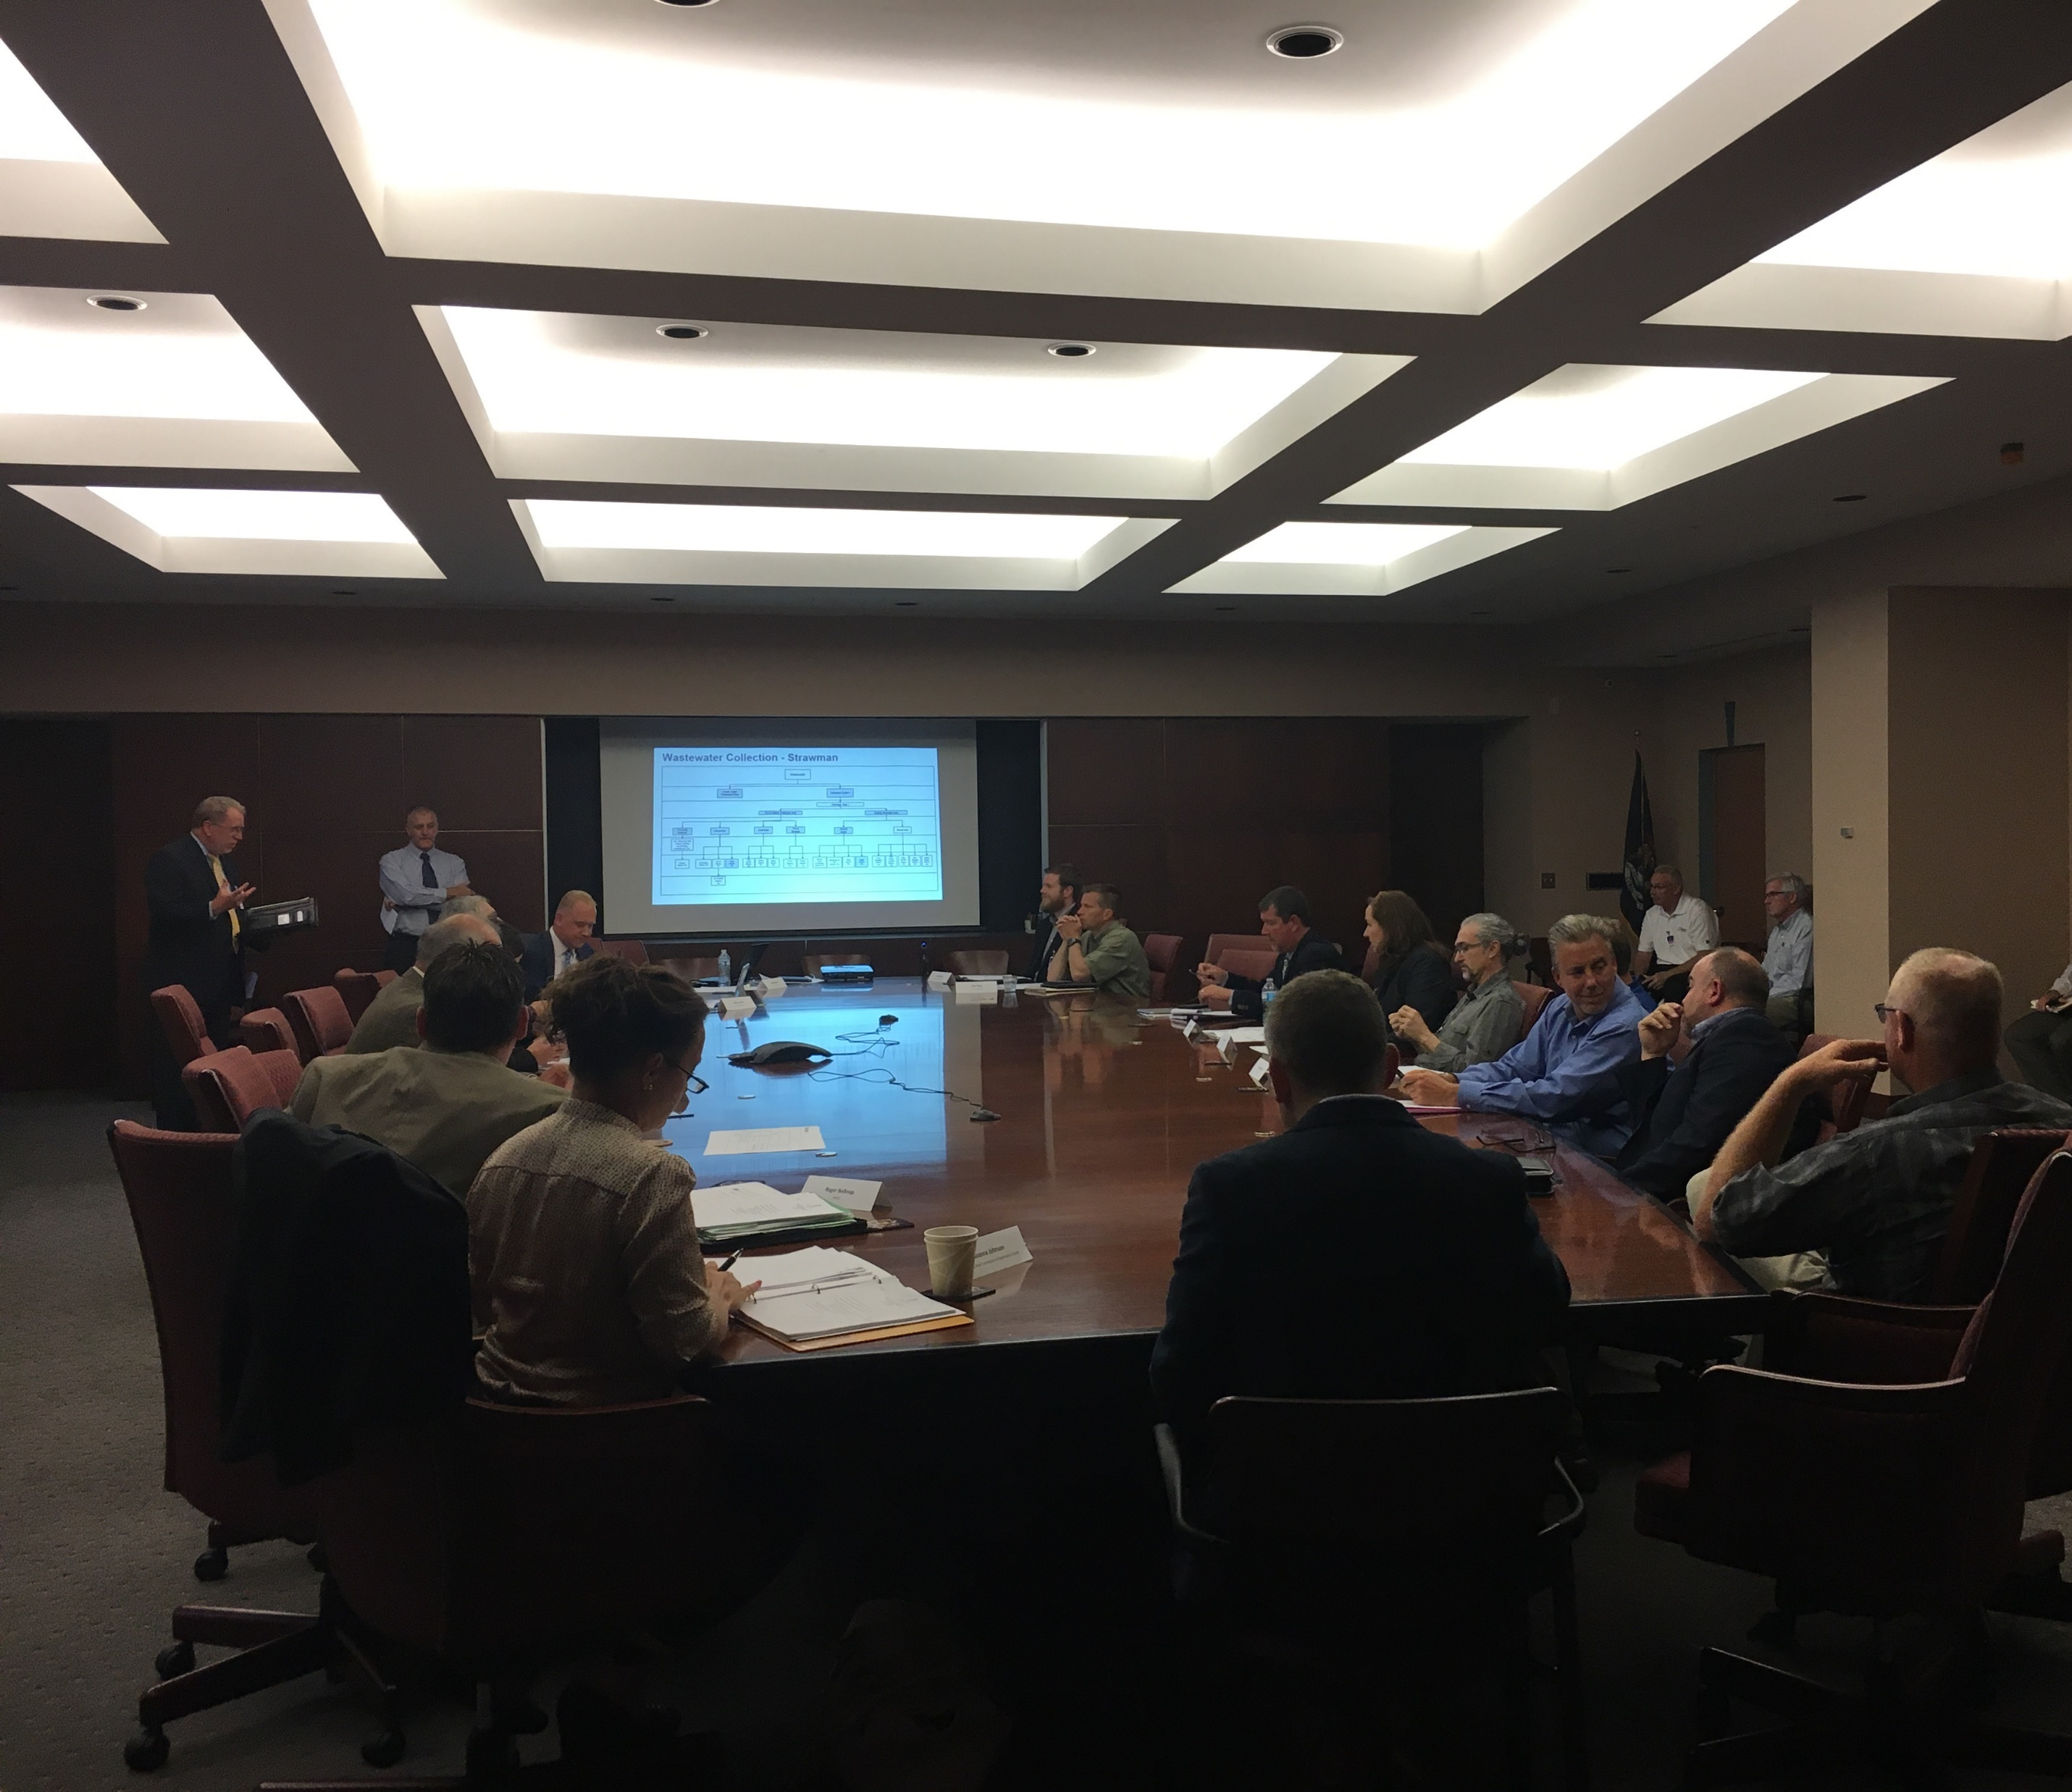
Regional Asset Management Pilot
Announced April 2017
Comprised of three core groups with over 120 members:
Advisory Board
Stakeholder Team
Subject Matter Experts
Asset classes included:
Drinking Water
Storm Water
Wastewater
Transportation (Culverts)
Private Utilities
Provided a long-term, comprehensive set of recommendations to the Governor by end of April 2018

Slide 4
Notes:
Video can be found at https://www.youtube.com/watch?v=YjKm43rl0YA

Slide 5
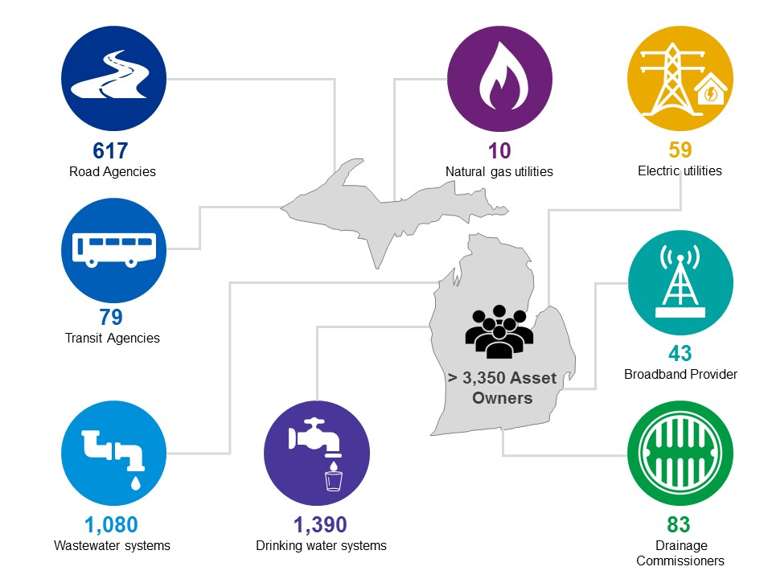

Slide 6
Pilot Vision
Pilot Mission
A culture of asset management across all infrastructure assets.
A statewide assessment of our transportation, water, wastewater and stormwater infrastructure.
A long-term integrated asset management strategy that results in coordination and increased cost efficiencies for utilities and local agencies of all sizes.
The data and information needed to determine funding levels, and the incentives needed, for strategic infrastructure investments.
Build a culture of asset management across the state.
Develop consistency across asset owners in asset standards and management practices.
Create mechanisms for coordinated planning and communication across asset owners and types statewide.
Develop a system that will support our understanding of assets and enable us to make informed decisions at a local, regional and state level.

Slide 7
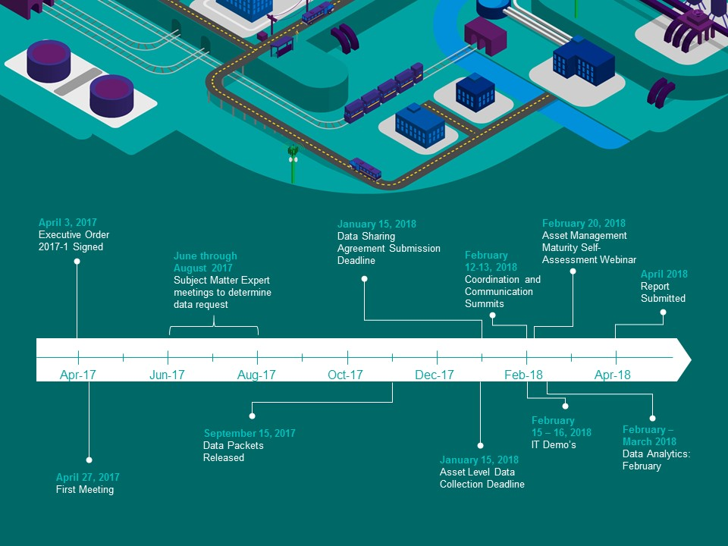

Slide 8
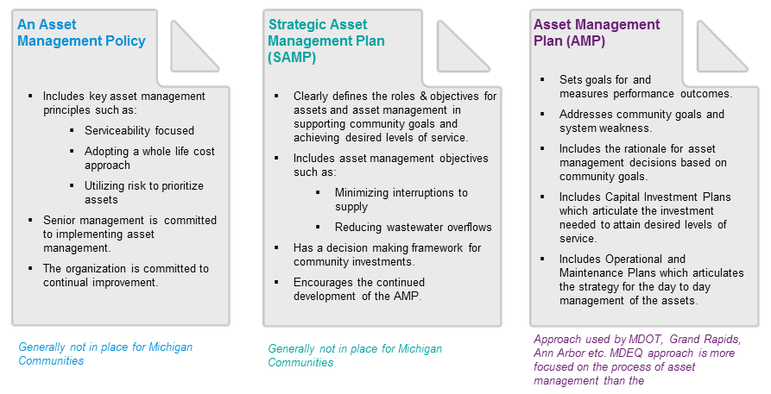
What is Asset Management?

Slide 9
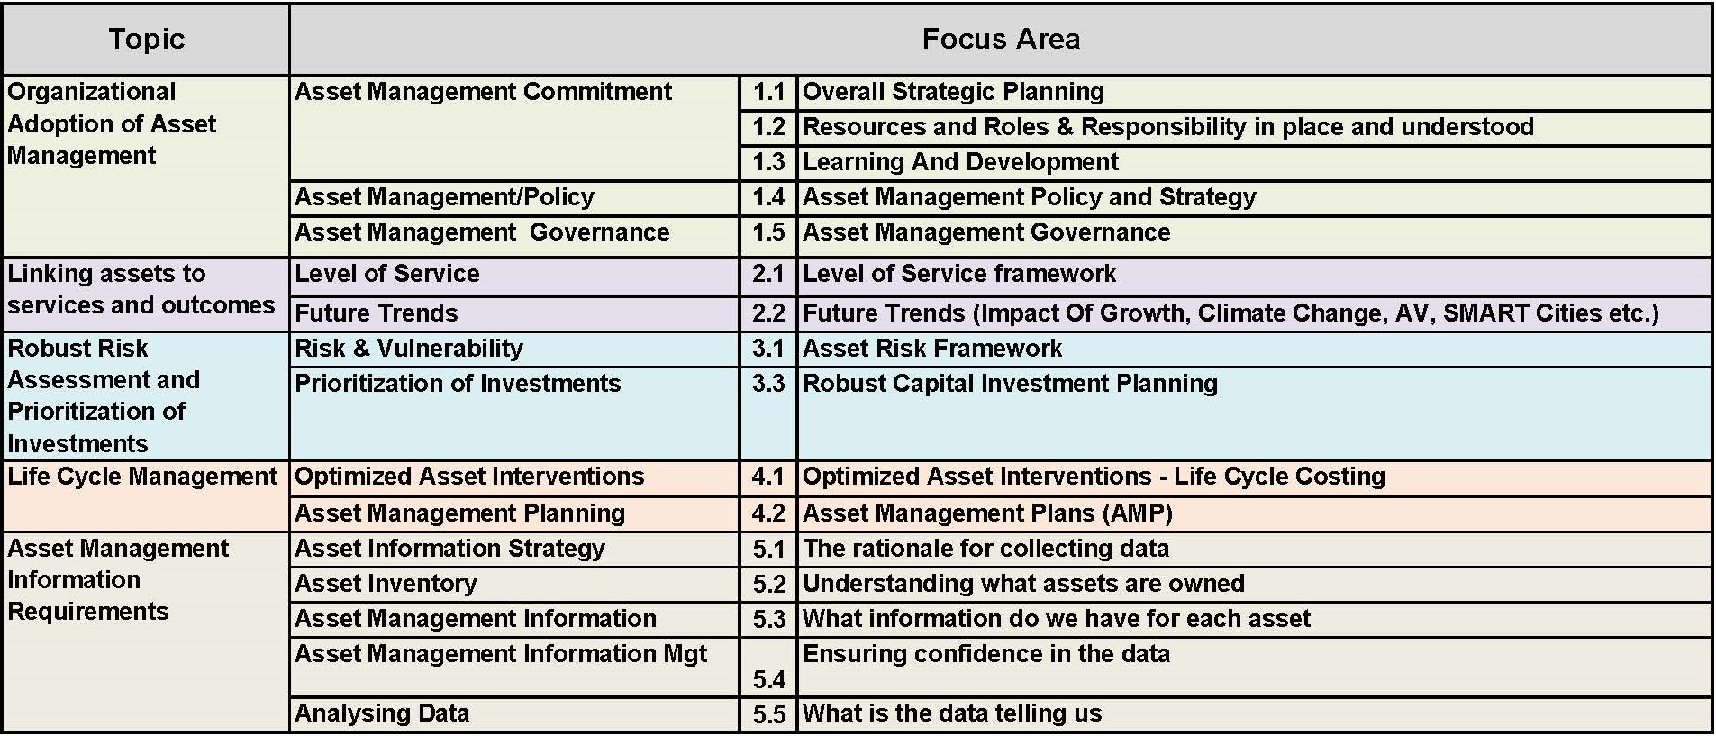
Asset Management Maturity Assessment

Slide 10
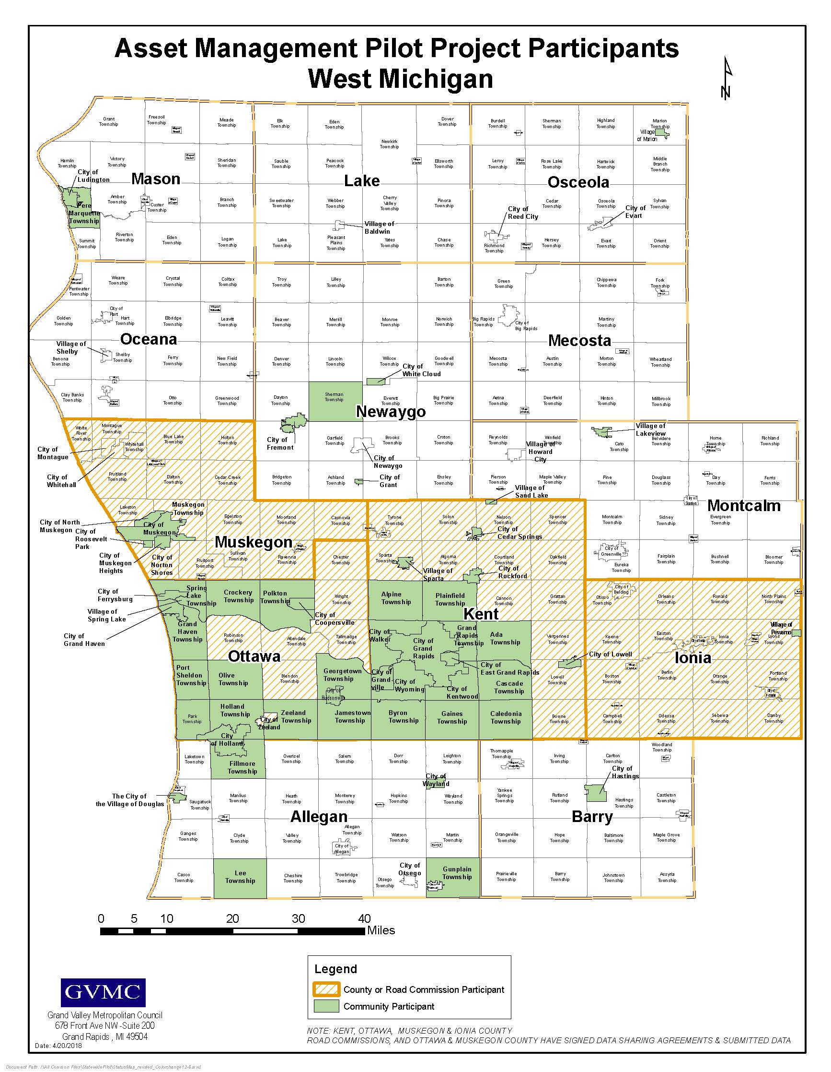
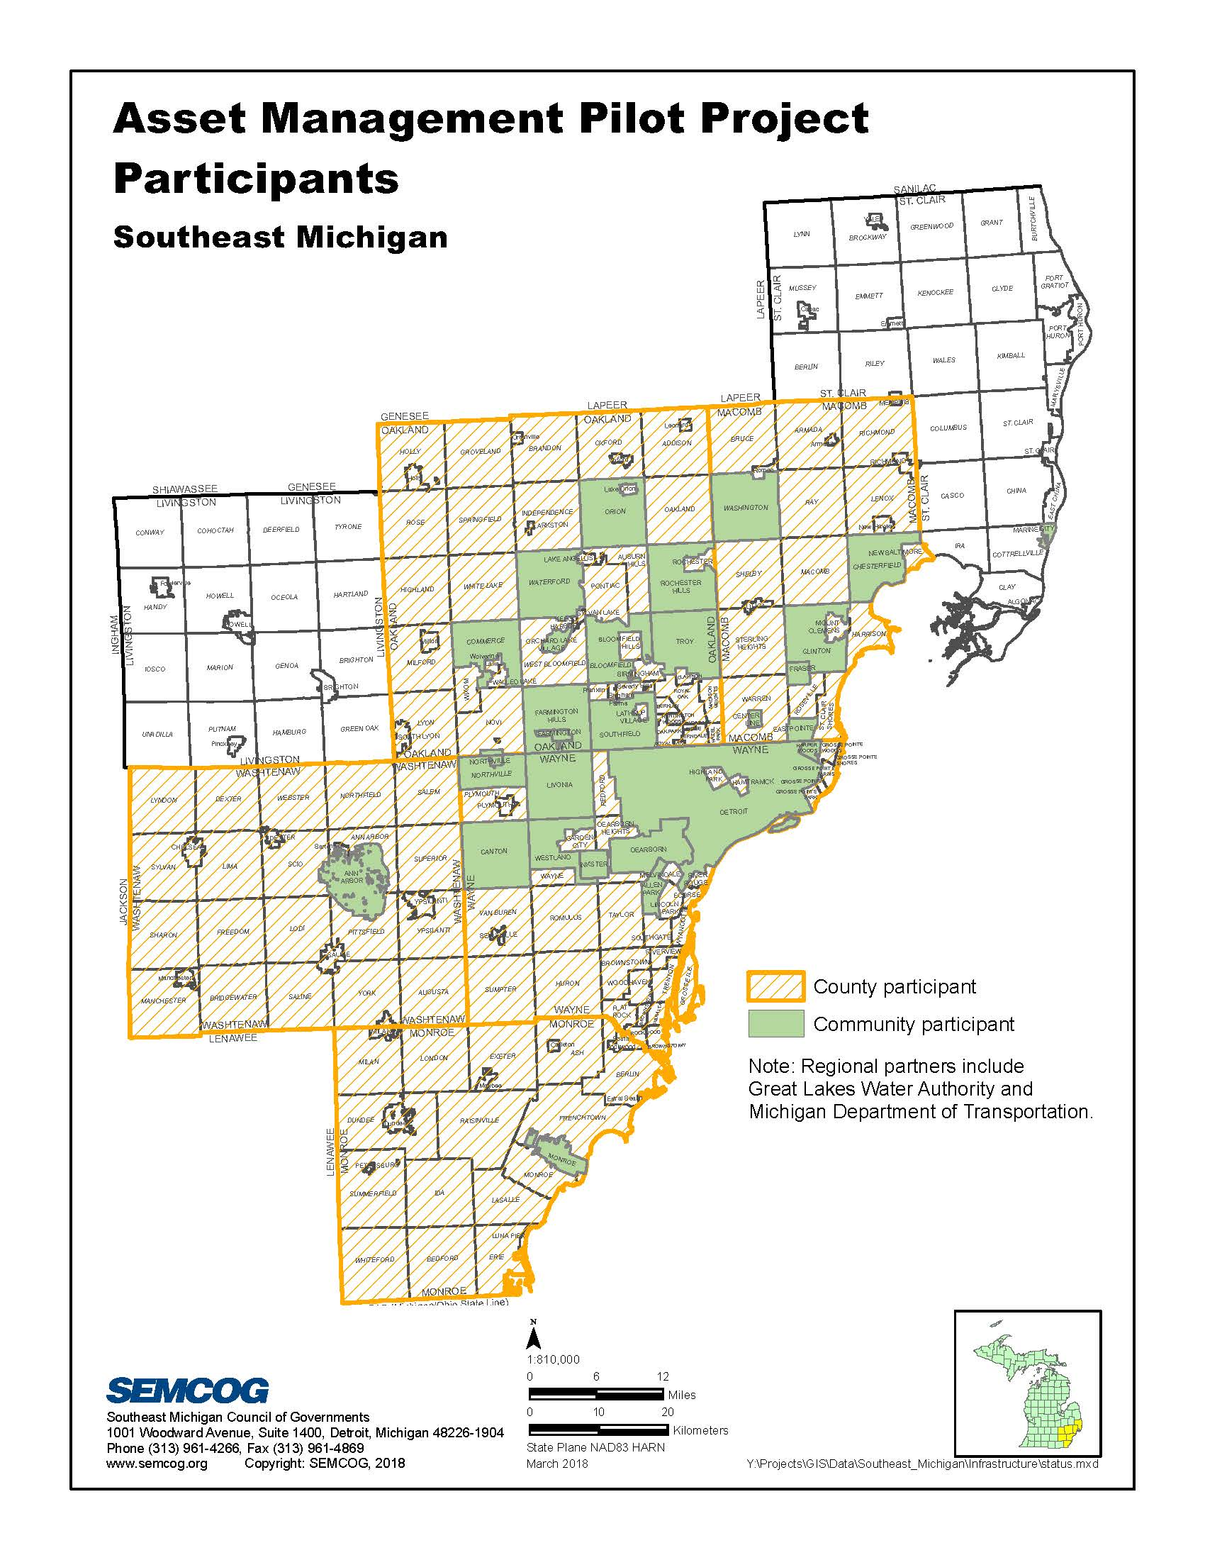
Pilot Participation

Slide 11
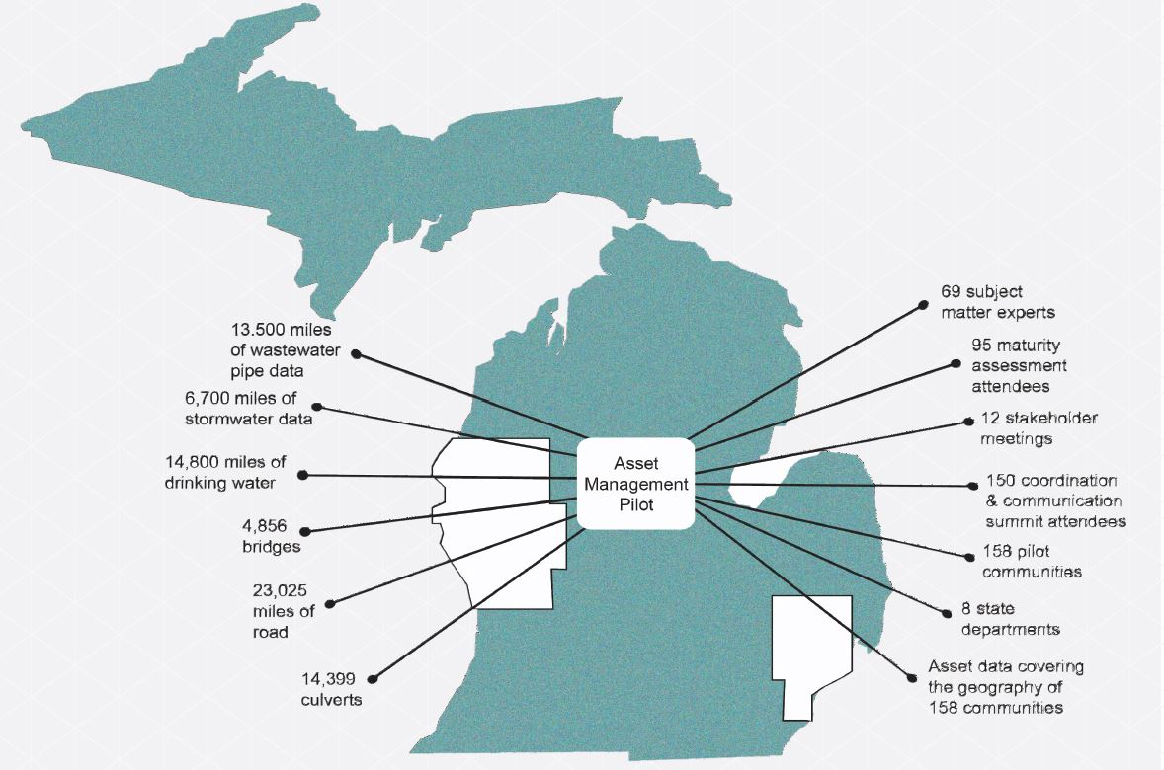

Slide 12
Data Collected
 | Drinking Water | Wastewater | Stormwater | Roads | Bridges | Culverts
Segments/Number | 540,121 | 335,273 | 324,289 | - | 4,856 | 14,338
Miles | 15,104 | 13,505 | 6,673 | 23,025** | - | -
* Data from communities that did not sign a data sharing agreement was removed from this dataset prior to the analytics phase of the Pilot.
** Miles of road with condition ratings. 22,462 miles supplied by TAMC plus 563 miles collected direct from communities during the Pilot.

Slide 13
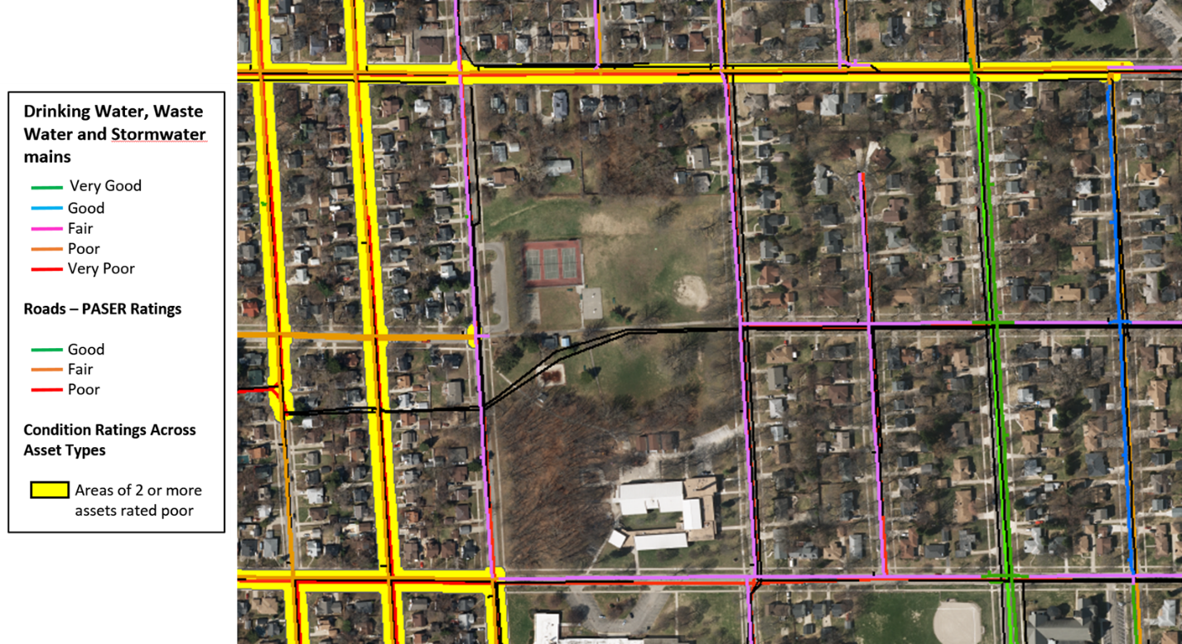
Data Analysis
Condition Grade | Percent of Effective Useful Life Remaining
Very Good | > 85%
Good | 60 – 85%
Fair | 30 – 60%
Poor | 10 – 30%
Very Poor | < 10%
Utilizing condition grade and/or estimated percent of effective useful life remaining to determine opportunities of coordinated investment.

Slide 14
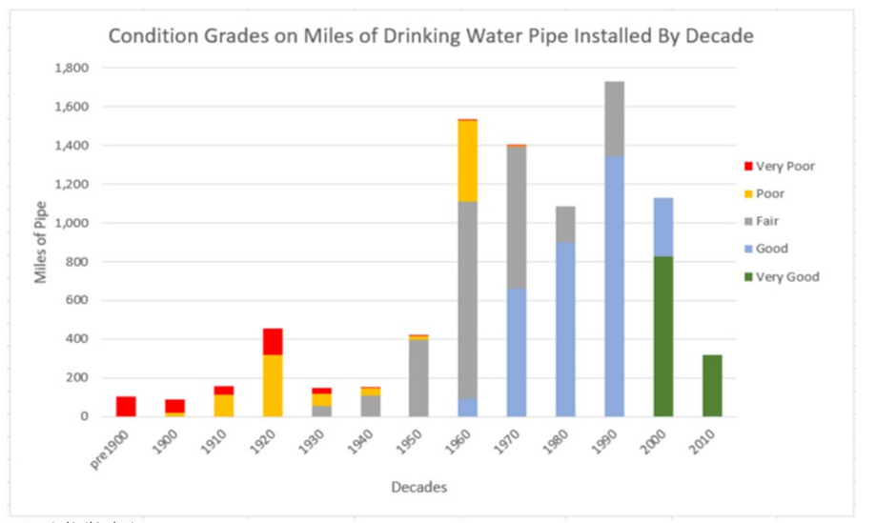
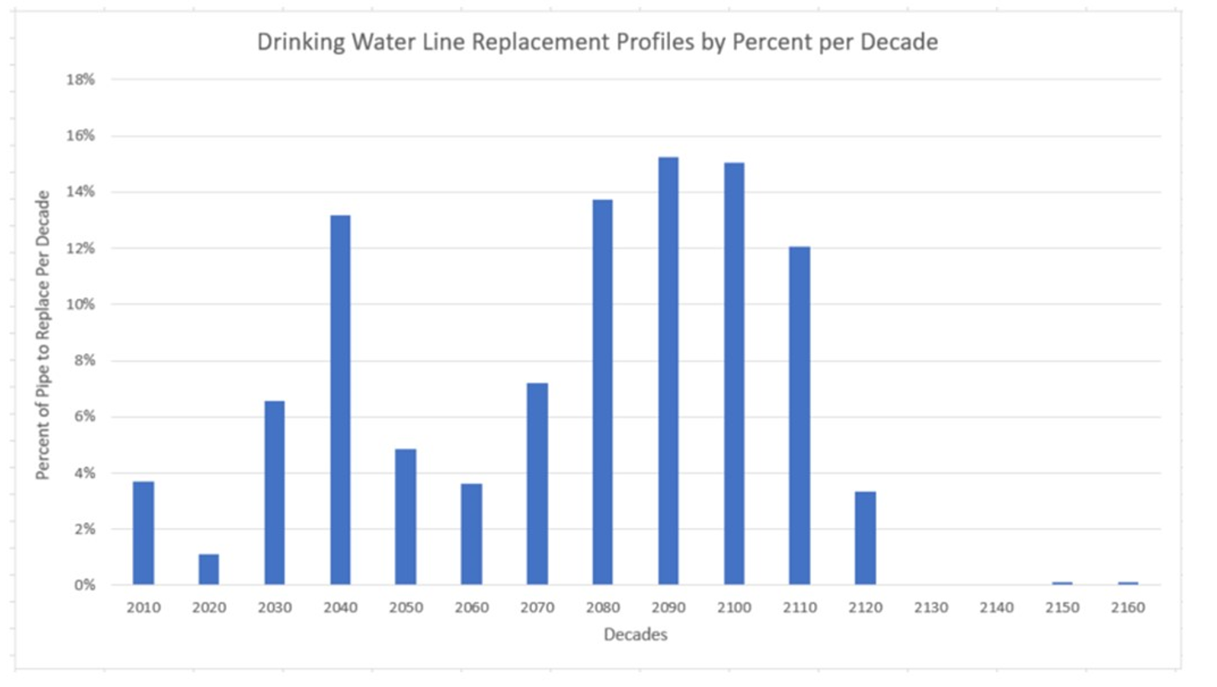
Data Analysis
The sample size of the data collected as part of the Pilot was not considered sufficient to depict an actual representation of condition grades across the Pilot areas and beyond. The results shown are therefore illustrative only and show the type of analysis that can be carried out.

Slide 15
Pilot Recommendations
The Value Proposition (Section 4.4)
Ensure that all participants in the statewide asset management database at the local, regional, and state level receive a benefit for participating, make it a ‘win-win’.
Clearly articulate to public and private asset owners submitting data to the system the value-add of participation including a better understanding of asset performance and cost in the state of Michigan as well as an increased ability to make better informed decisions that align with community priorities.
Provide actionable infrastructure data on public assets to local, regional, and state level officials so that they can make more informed asset management and investment decisions.
When possible, provide updated aggregate data and information directly back to the communities who submitted their information for increased access and usability of their data.
Promote the value-proposition that participation in a statewide asset management program will inspire public confidence and will help residents understand the decisions being made with regard to investment in infrastructure, through increased transparency.

Slide 16
Pilot Recommendations (cont.)
Building a Statewide Asset Management Culture (Section 4.5)
Asset management is about more than data, it is about technical experts having the tools and information to make strategic, financial and tactical decisions about assets. Data is the starting point and foundation for making better strategic decisions as a state.
The Michigan Infrastructure Council will need to build on the results of the Pilot to provide resources and education on asset management. It will be important for the Council to create a venue to share asset management best practices, accomplishments and innovations.
Asset management education is important at all levels of government, from public officials to technical staff. Michigan is a leader in transportation asset management and must continue to build upon this legacy by increasing awareness of asset management best practices across all asset types.

Slide 17
Pilot Recommendations (cont.)
Facilitating the Data Collection Process (Section 4.6)
Data collected in the statewide asset management database should build on the work of the Pilot and will need to be of aggregated value at the local, regional, and state level.
There is a wide variety of community systems from sophisticated GIS asset systems to less technical paper/ knowledge based approaches. The statewide asset management system, like the Pilot, must work to involve all communities who wish to participate regardless of their current technical capabilities or systems.
The Pilot focused on determining baseline standardized data requirements necessary to encourage asset management at the local and regional level while also collecting the data necessary for high level analysis of asset condition. Further discussions should take place to determine what data should be collected, and data collection frequency.
Many agencies have already recognized the value of data about the condition of existing infrastructure. To maximize return on investment it is critical to recognize that infrastructure exists to enable local, regional, or state goals for quality of life such as safety, public health, and economic activity. While condition is a good snapshot of today, in order to improve strategic investment, it is critical to collect, measure, and ensure decision makers see data that tracks progress toward strategic goals.
The focus of data collection should be on better understanding performance outcomes as opposed to only focusing on asset condition.
Subject Matter Experts should continue to be engaged at all levels of government to prioritize future data collection, build out data governance structures and data standards.

Slide 18
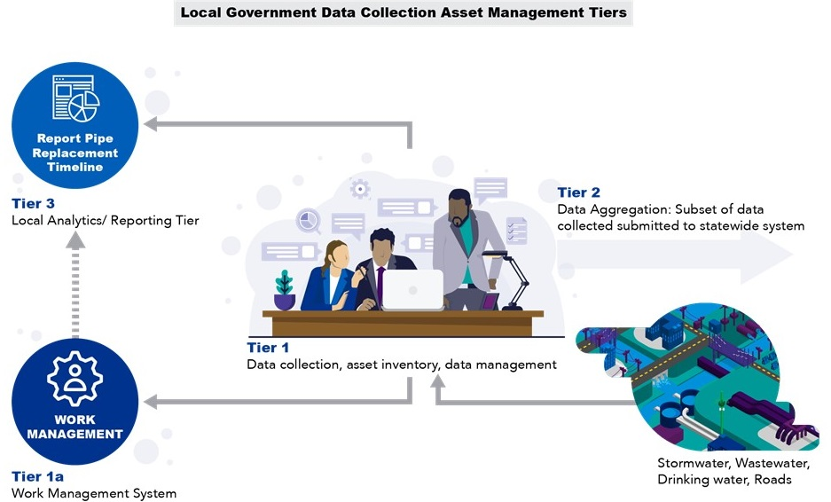

Slide 19
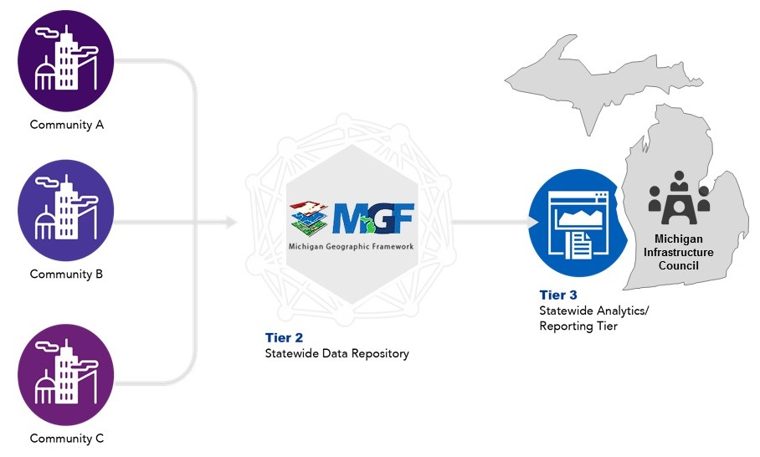

Slide 20
Pilot Recommendations (cont.)
Creating a Statewide Integrated System (Section 4.7)
The statewide asset management database should provide local communities the ability to collect, store, and make data driven decisions utilizing a geospatial format which is the industry standard. This will allow the Michigan Infrastructure Council and local asset owners to analyze data across asset types and jurisdictions. This will also lead to increased transparency for all residents in the state of Michigan.
It is critical for the statewide database to provide the ability to enable coordinated, long term investment planning at the local, regional, and state level.
In order for the statewide database to encourage a statewide asset management culture, training will need to be provided for users to fully take advantage of the system.
To protect highly sensitive critical infrastructure data, all data submitted to the statewide database should be housed within the Michigan Geographic Framework.
The Michigan Infrastructure Council must identify and remove barriers for communities of all sizes to participate in the system.

Slide 21
Pilot Recommendations (cont.)
Enabling Coordination within the Public Right of Way (Section 4.8)
Coordination and communication meetings should be held at the regional and local level between public and private asset owners to facilitate better project coordination. This will lead to financial savings for public and private asset owners and will provide residents of Michigan improved levels of service.
The creation of a geodatabase of project information in conjunction with the statewide asset management database will enable integrated coordination to take place at the state, regional, and local level within the shared space of the public right of way.
There is an opportunity to review current permitting practices for modernization opportunities, investigate a more standardized permitting process, and to facilitate long-term strategies to better coordinate short-term planning.

Slide 22
Recommendation Implementation
Michigan Infrastructure Council
(Treasury)
MPSC
(LARA)
TAMC
(MDOT)
WAMC
(DEQ)

Slide 23
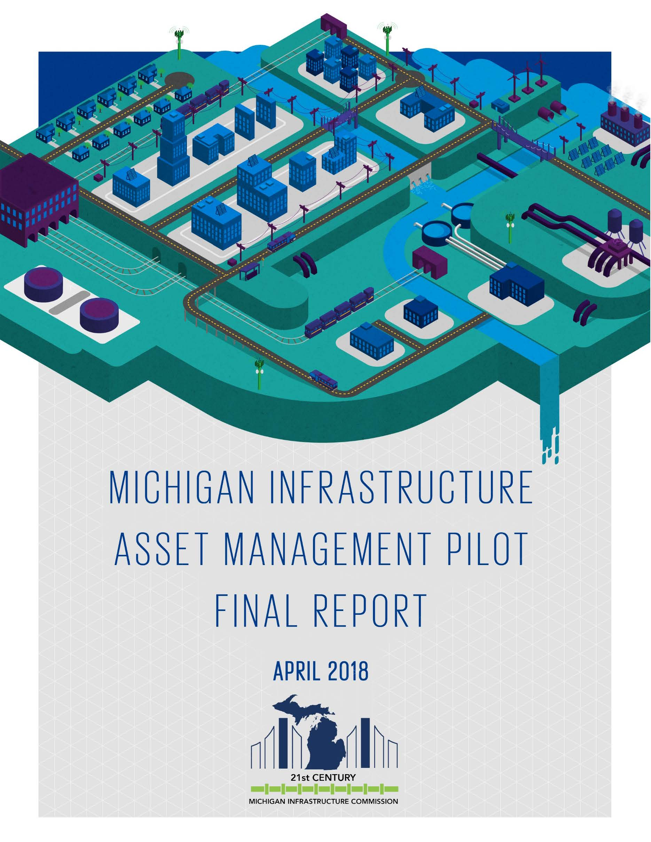
Questions?
Find the report and executive summary at
www.miinfrastructurecommission.com

