Slide 1
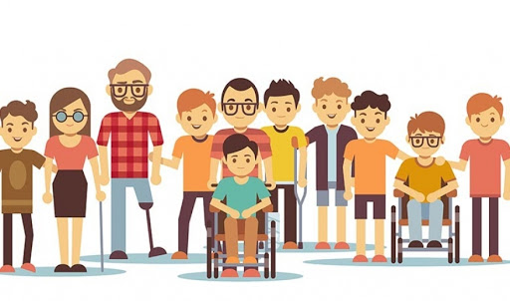
Disability Awareness

Slide 2
Overview
Different disability experiences
What is disability awareness?
Hidden vs. visible disabilities
What should I do when…?
Your words matter
Future considerations

Slide 3
Types of Disability Experiences
No one person is going to have the same exact experience as someone else. We can, however, often find similarities. Listed below are general impacts of disabilities, that will be further addressed in the presentation:
Mobility
Deaf/Hard of Hearing
Low Vision/Blindness
Communication
Neurodiverse
Chronic Health

Slide 4
What is Disability Awareness?
Disability awareness is the practice of knowing, acknowledging, and accepting individuals' experiences as they relate to disability. Knowing, being aware, and moving beyond your own level of comfort is key to a greater understanding as well.

Slide 5
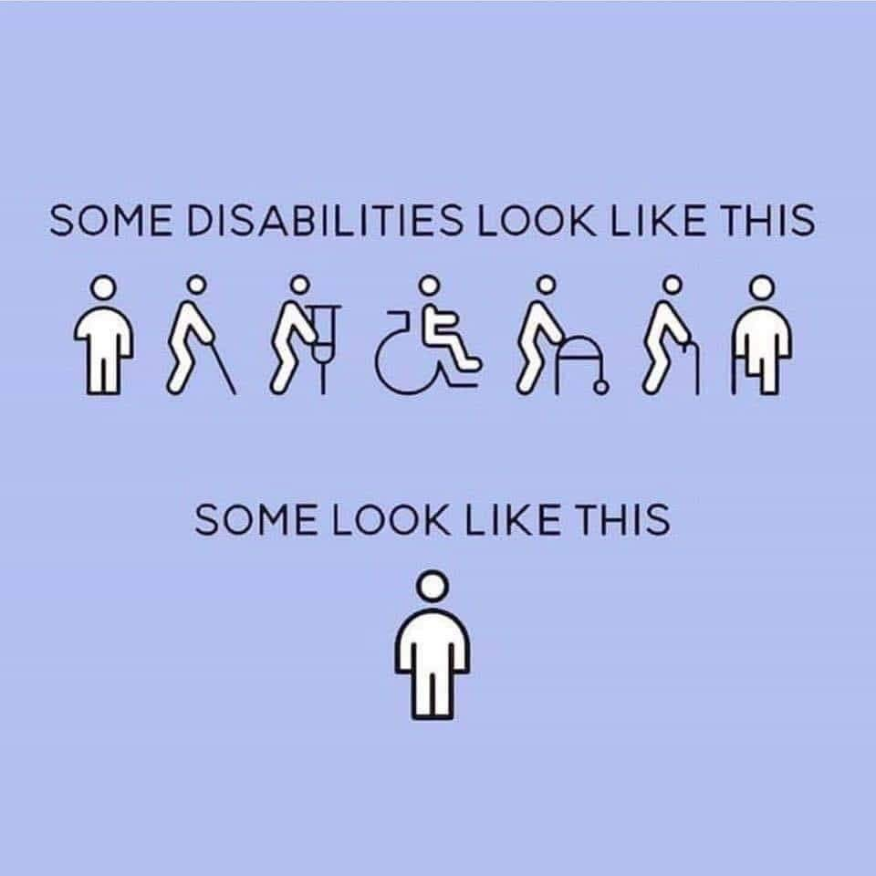
Hidden vs. Visible Disabilities
It is important to be aware of your own biases; this can be especially important when thinking of hidden and visible disabilities. Some individuals may have a disability that cannot be seen – try and check your assumptions at the door.

Slide 6
What Should I do When…?
Here are a few tips for interacting with individuals, no matter their disability:
Address the individual directly with whom you are speaking. If someone with a disability has another person with them, it is not OK to respond to the other person instead of the person with the disability.
People with disabilities are capable of making their own decisions, give them the opportunity to do so.
People with disabilities will ask for help if needed.
Be sure to ask the individual how you can be most helpful; individuals are experts with their own needs.
No matter the situation, if you are unsure if someone needs assistance, ask.
Treat the individual like an adult if they are in fact an adult.
If you have made a mistake while interacting, acknowledge the mistake, apologize and move on.

Slide 7
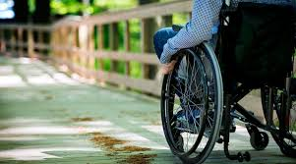
What Should I Do When…?
When interacting with an individual with a mobility disability:
Speak to the individual directly and when referring to the individual do not treat them as though they are equipment. Example: “There is only room for one wheelchair in this space.”
Treat the mobility device as an extension of that person – do not grab a walker or wheelchair or other mobility device without permission.
Do not reach across a wheelchair user to speak with another person or use their device for your own use. For example, setting a drink cup on the tray of the wheelchair.
When speaking with an individual in a seated position, do your best to kneel or sit beside them when speaking.

Slide 8
What Should I Do When…?
When interacting with an individual who is hard of hearing or deaf:
Speak clearly and do your best to look directly at the person.
Do not shout.
Be aware of background noise and the lighting around you.
If an individual is deaf and you need to communicate, try writing on a piece of paper if the communication is quick such as offering directions.
Rather than repeating yourself exactly, try rephrasing what you have said.
Do not say “never mind, it is not important.”
Do not assume that all individuals who are hard of hearing or who are deaf use American Sign Language.

Slide 9
What Should I Do When…?
When interacting with someone with a vision disability:
Immediately identify yourself, including your role (when appropriate,) before you attempt any physical contact.
Offer your arm to an individual rather than grabbing their arm, hand, etc.
If an individual has a guide dog, walk on the opposite side of the dog.
If providing directions, be specific. It is most helpful to say “Move forward until you get to the wall and then turn right.” Rather than “Go straight and turn right.”

Slide 10
What Should I Do When… Vision Cont.
If opening a door for someone, announce what way the door is opening. For example, the door opens out and to the right.
If you are leaving the area be sure to announce you are leaving.
Do not touch the individual’s cane or guide dog.
Do not move items without announcing that they might be in the way and allow the individual the opportunity to move the items themselves.
Do not assume all individuals who have a vision impairment read braille.

Slide 11
What Should I Do When…?
When interacting with someone experiencing a communication disability:
Give the individual your full attention.
Be aware of background noise as this may interfere with your interaction.
If you do not understand ask the individual to repeat what they said.
Do not just smile and nod if you still are not understanding. It is OK to say “I am still not understanding you, is there another way you can say it?”
Do not finish the persons sentences.
To clarify what you have heard, try rephrasing what you have heard to the individual.
If someone is nonverbal, it may be best to ask “yes” and “no” questions. Continue to check in with the individual to ensure they understand.

Slide 12
What Should I Do When…?
When interacting with an individual who is neurodiverse:
Be clear and direct. Some individuals who are neurodiverse may take phrases literally such as “It is so quiet in here, I hear crickets.”
Be aware that individuals who are neurodiverse may not understand certain cues in conversation. Example: Some individuals find it difficult to understand body language and facial expressions, consider the most direct approach.
If it seems as though the individual is not understanding what you are saying, ask what is the best way to communicate? For example, writing it down.
If someone’s memory is impacted you may have to repeat yourself more than once.
Do not use “baby talk.”

Slide 13
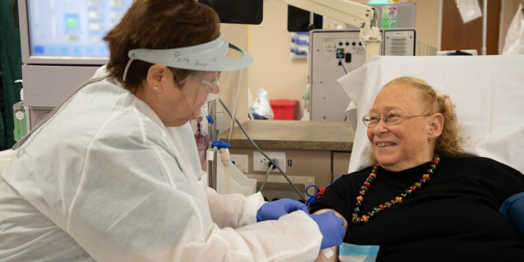
What Should I Do When…?
When interacting with someone who has a chronic health condition:
Understand that the individual may be experiencing fatigue and will need to limit their movements and/or sit down.
The individual may be experiencing pain/fatigue and not wish to communicate fully.
Understand that certain environmental factors may trigger pain, nausea, behavioral changes, etc.

Slide 14
Your Words Matter
It is important to speak with an individual with a disability as though they are in fact an individual. And, although all individuals have a preference as to how they are addressed and/or referred to, here are a few basics to keep in mind:
Do Say: Person with a Disability
Do Not Say: Handicapped or Crippled
Do Say: Individual experiences cerebral palsy
Do Not Say: individuals suffers from cerebral palsy
Do Say: Wheelchair user or individual in a wheelchair
Do Not Say: Wheelchair bound or confined to a wheelchair

Slide 15
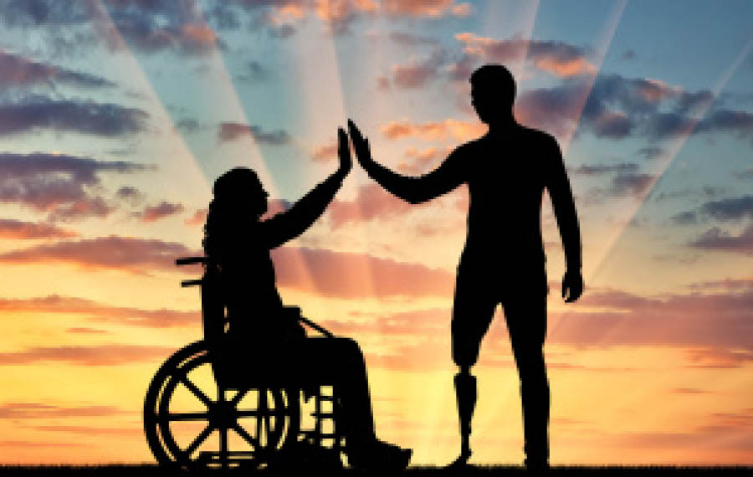
Things to Consider
As previously mentioned, individuals with disabilities are individuals – people just like anyone else. Here are a few words and phrases for you to consider:
“You are such an inspiration!”
“You are so brave.”
Because an individual’s experience may be different than yours, it does not make them an inspiration or brave. Ask yourself this question the next time you see someone with a disability performing a task: Would I be considered brave or inspirational if I were doing that same thing?

Slide 16
Consider This
Have you found yourself saying…”I have heard that if you cannot see, you have extraordinary hearing.”
An individual’s ability to hear or not hear is not linked to their ability to see or not see. It is simply a matter of using all available senses to be more familiar with their surroundings.

Slide 17
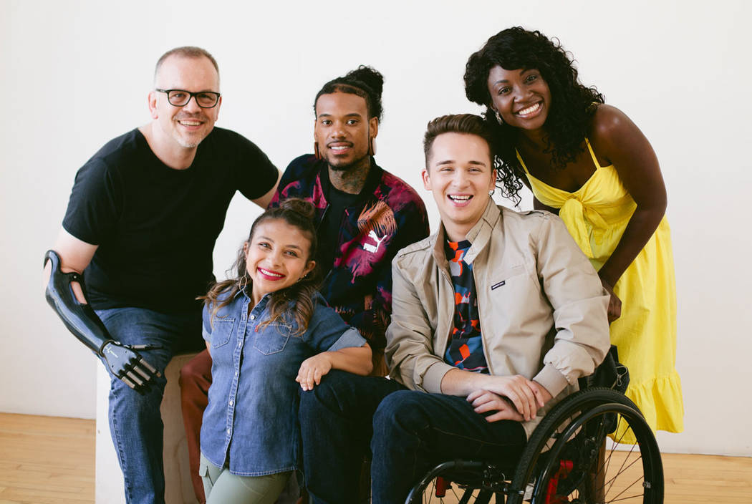
Recap
This presentation has addressed several topics and concerns when talking about disability awareness. Here are a few key points to take with you.
Not all disabilities are visible.
Each person has their own experience.
If you do not know how or if to help someone, ask.
Your words matter so please choose them carefully.

Slide 18
Thank You!
Thank you for your time and attention during this presentation. For any questions you may have, please contact Disability Network Capital Area at 517-999-2760 or members of the CATA Local Advisory Council (LAC)

