Slide 1
Facility Worker
User Role

Slide 2
What is a Facility Worker?
The Facility Worker User Role was created to handle the Hospital Exempted Discharges (3877-HED) that your residents admitted on from the Hospital. The 25 Day queue will track the HED admission dates, identifying them on their 25th day, so that you can send them in to your local OBRA Coordinator’s Office on time.
This role does not require a license, however if you are a licensed Social Worker, you will want to have both the 3877 User Role and the Facility Worker User Role.

Slide 3
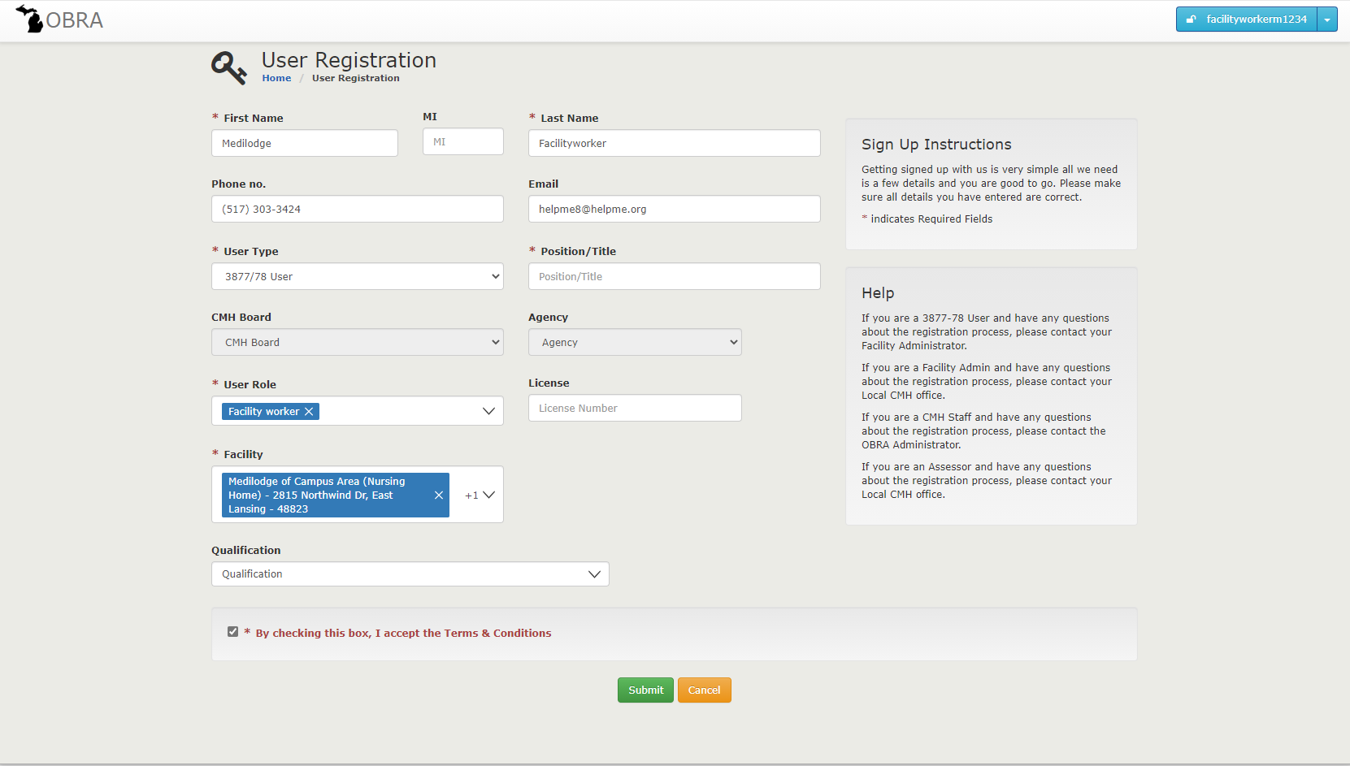
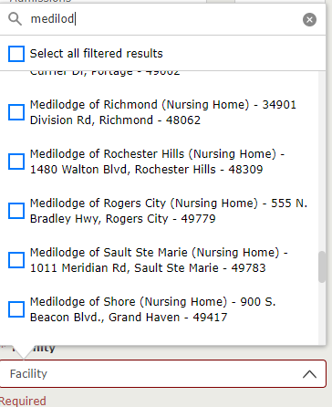
Your demographic info will auto populate
The areas/boxes with a red * are required.
See filled out examples for what you are looking for.
Select your user role, facility and then check the box and hit submit.
Select this user type
Select your position/title
Select this user role
By clicking on the down arrow in the Facility Box, you will open the search function.
You can start the name of your facility and it will go to the closest match

Slide 4
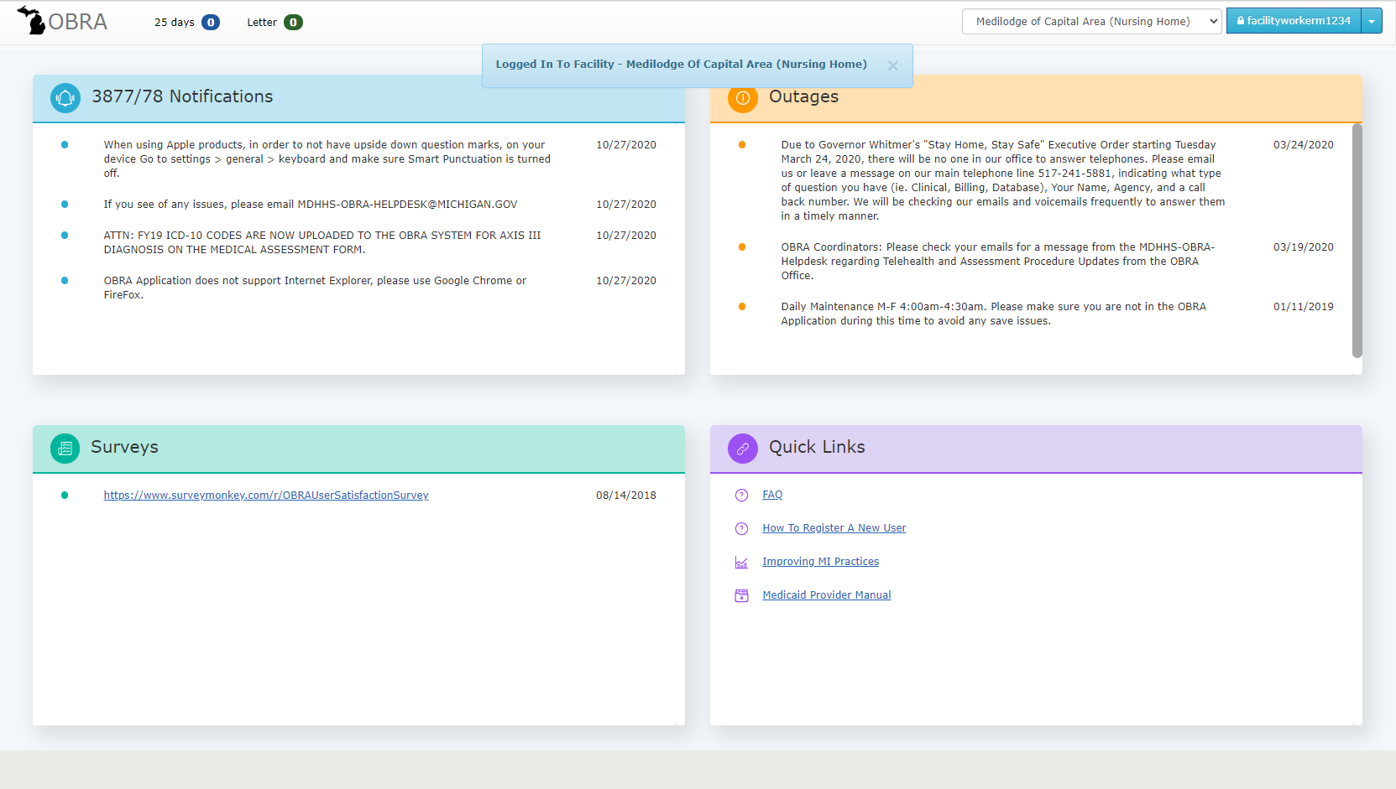
If you are the licensed social worker for your facility, you will need a dual role as the Facility Worker so you can utilize the 25-day queue.
25 Day Queue: When a resident admitted under an HED, this queue will populate when they are at their 25th day following admission. If they are still there and their 3877 had any questions 1-6 answered yes, then its time to send the referral to the
OBRA Coordinator.
Letter Queue: If after the OBRA Coordinator triages the referral and they do not need a full Level II Evaluation, a letter will be available to upload/print for your facility records on this resident.
Your Splash Page

Slide 5
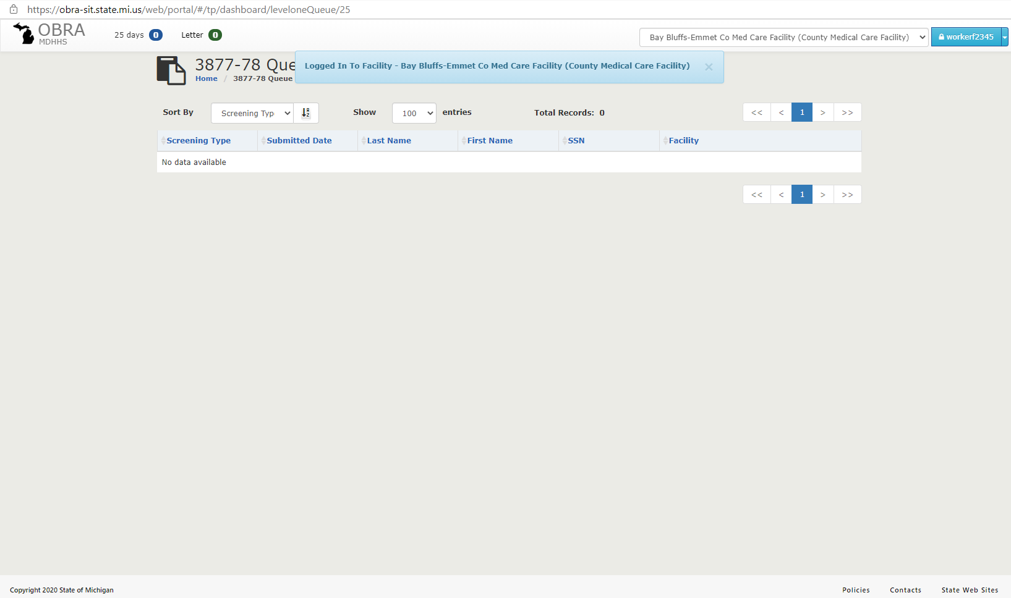
This is what the queues look like when you open them

Slide 6
Home Page
I’ve logged in, went through the MFA and clicked on the OBRA button at the top left of the screen and landed on the Home Page…next I just need to click on the 3877-78 button if I want to do a search.

Slide 7
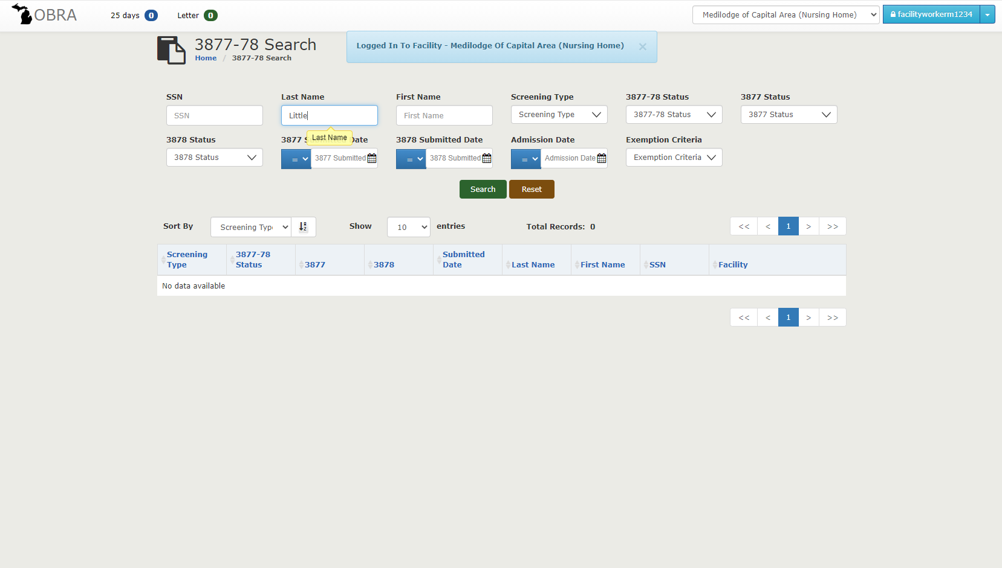
What do I need to do….
Let’s do a search… fill in the SS# or type in the name of the person, then click on the “Search” button

Slide 8
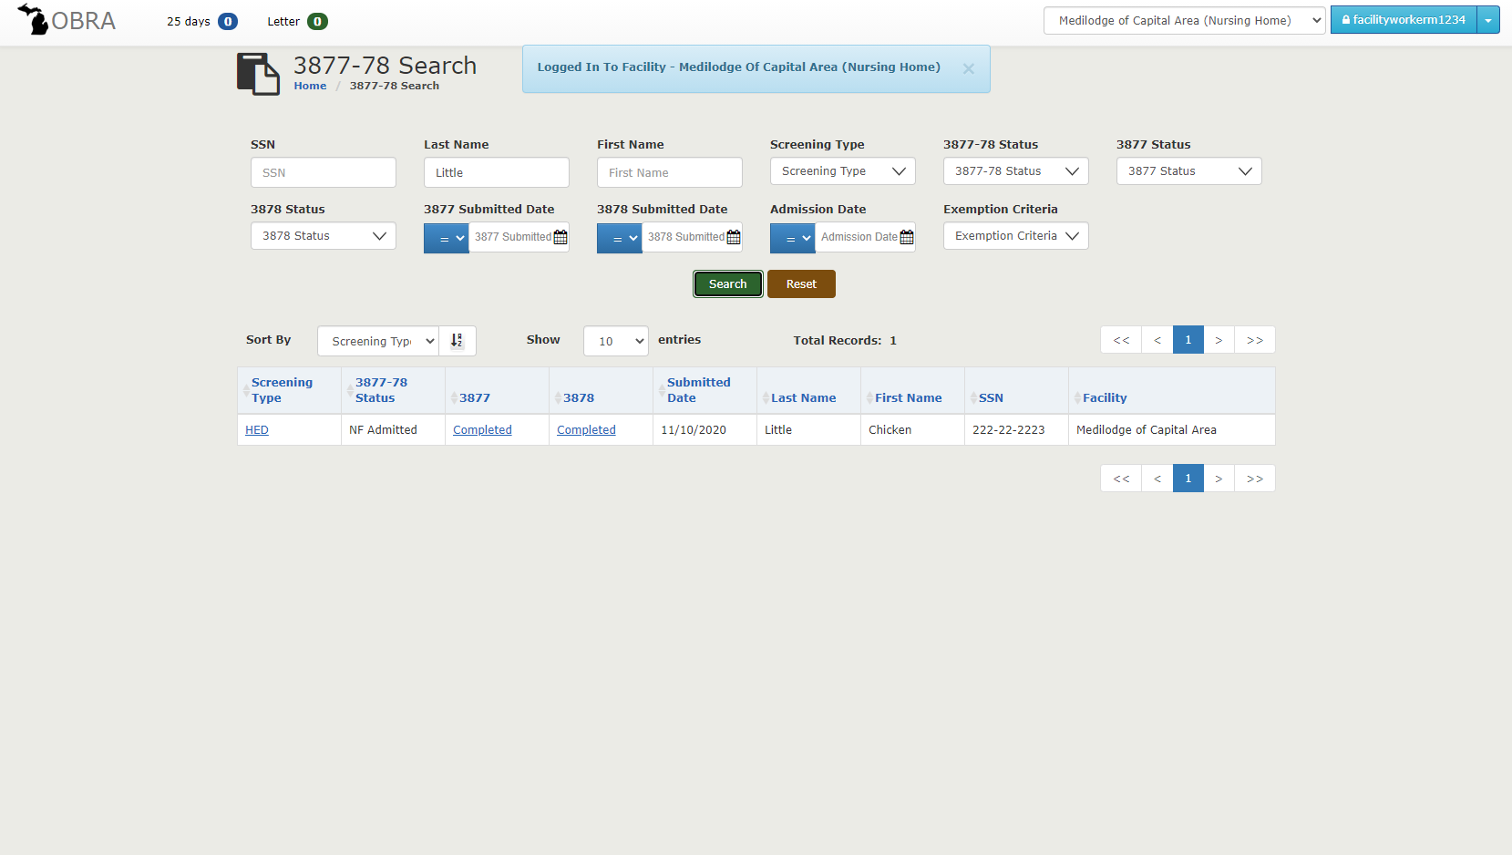
I am going to click on the HED

Slide 9
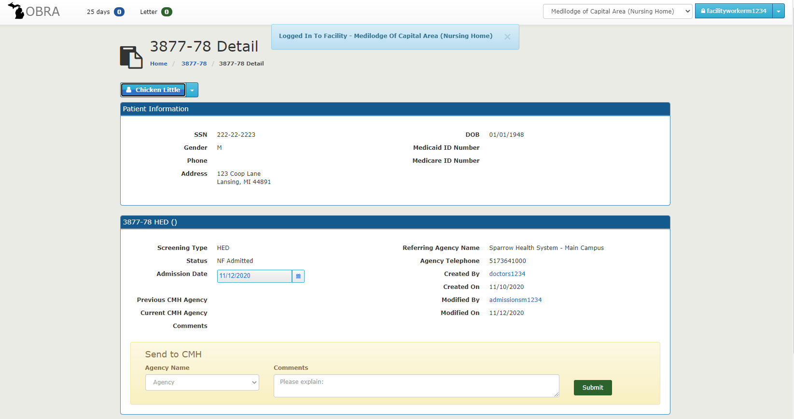
In the “Send to CMH” area select your CMH and then write any comments you might have about the resident. Then just click on the Submit button.
If you click on the separate forms, a copy of the completed form will open for you. Clicking on the View All will open both documents.

Slide 10
When you fill in the Agency Name and Comments then click on Submit
Once submitted it will assign as the Current CMH Agency

Slide 11
Thank you!

