Slide 1

Michigan Department of Health and Human Services
Bureau of Community action and economic opportunity
January 24, 2019

Slide 2

Michigan Department of Health and Human Services
Mission and Vision
Mission
The Michigan Department of Health and Human Services provides opportunities, services, and programs that promote a healthy, safe, and stable environment for residents to be self-sufficient.
Vision
Develop and encourage measurable health, safety and self-sufficiency outcomes that reduce and prevent risks, promote equity, foster healthy habits, and transform the health and human services system to improve the lives of Michigan families.

Slide 3
BCAEO
Funding Source: U.S. Department of Energy (DOE) and LIHEAP
Weatherization Assistance Program for PY18/FY19
Annual Allocation: $16.9 Million DOE
$ 9 Million LIHEAP
$27.9 Million
Production Goals: 2,508 dwellings

Slide 4
The Weatherization Assistance Program
The U.S. Department of Energy (DOE) Weatherization Assistance Program reduces energy costs for low-income households by increasing the energy efficiency of their homes, while ensuring their health and safety.
The program supports 8,500 jobs and provides weatherization services to approximately 35,000 homes every year using DOE funds.
Through weatherization improvements and upgrades, these households save an average of $283 or more every year according to a national evaluation of the program.
Since the program began in 1976, WAP has helped improve the lives of than 7 million families through weatherization services.

Slide 5
Barrier #1- High Regulation
  The DOE WAP is a highly regulated, federal program
    Many federal rules to follow
    State rules must be followed to assure compliance
  Which -
    Keeps clients safe
    Ensures the highest energy savings that can be achieved in each dwelling touched
    Allows for a custom analysis and plan for each dwelling – The NEAT Audit uses both nationally vetted scientific formulas to identify appropriate measures to be installed and state specific data of heating/cooling days unique to each location
    Provides a highly certified workforce in building science to achieve results

Slide 6
Barrier #1 – High Regulation – Federal
Federal Statutes (Legislation)
Regulations (Rules) (CFR)
Grant Guidance (WPNs)
1
2
3
Notes:
There are three main categories of policy documents that affect WAP’s operation:
Federal statutes (Legislation) – This is the law.
It takes an act of Congress to change a statute. As a result, changes to basic statutory requirements are limited and proceed slowly.
Regulations – Regulations are also called Rules. These are the means by which an agency (in this case, mainly the US Department of Energy (DOE)) implements the intent of the law. DOE regulations must be in compliance with the Statute. Changes to regulations are easier than Statute changes, but it still typically takes several years from the beginning of the process to publishing a Final Rule.
Grant guidance – This is direction from the DOE Program Office. Guidance provides practical information on how the regulations can be interpreted within the program. Written guidance is issued as documents called Weatherization Program Notices (WPN). Grant Guidance policies can be easily updated by the WAP Program Office compared to Regulations and Statute changes. These policies are intended to aid in implementation of the WAP.
Grant Guidance is issued each year:
Typically, DOE issues 6-8 guidance documents each year.
DOE guidance must be in compliance with the Statute and the regulations.
All regulation changes and current WPNs are available on http://energy.gov/eere/wipo/weatherization-assistance-program.

Slide 7
Barrier #1 – High Regulation – Statute
(b) It is, therefore, the purpose of this part [42 USCS §§ 6861 et seq.] to develop and implement a weatherization assistance program to increase the energy efficiency of dwellings owned or occupied by low-income persons, reduce their total residential energy expenditures, and improve their health and safety, especially low-income persons who are particularly vulnerable such as the elderly, the handicapped, and children.

Slide 8
Barrier #1 – High Regulation – CFR
10 CFR Part 440, Final Rule (February 1, 2002)
    Offers interpretation and insight on 30 different topics relating to WAP, including:
    Purpose and scope.
    Definitions.
    Allocation formula.
    Minimum requirements.
    Oversight and training.
    Reports.
    Appendix A provides standards for weatherization materials.
Notes:
10 CFR 440, Final Rule (February 1, 2002 was the last full publication of WAP regulations):
Offers interpretation and insight on 30 different topics relating to WAP (Sections of Interpretation), including:
Purpose and scope.
Definitions.
Allocation formula.
Minimum requirements.
Oversight and training.
Reports.
Appendix A provides standards for weatherization materials.
WAP staff looks to the CFR when deciding whether something is allowable. The regulations are supposed to ensure that we all read the law the same way.
The regulations are written as broadly as possible, within the requirements of the Statute, so WAP staff isn’t boxed into a corner. Sometimes the regulations feel stifling, but they also protect the program, ensuring that it stays true to its mission.

Slide 9
Barrier #1 – High Regulation – WPN
WPNs and WAP Memos
  These provide specific guidance on the WAP from DOE
  Topics are specific, extensive processes and policies to follow
  Offer complex instructions to State on how to manage the program
Notes:
10 CFR 440, Final Rule (February 1, 2002 was the last full publication of WAP regulations):
Offers interpretation and insight on 30 different topics relating to WAP (Sections of Interpretation), including:
Purpose and scope.
Definitions.
Allocation formula.
Minimum requirements.
Oversight and training.
Reports.
Appendix A provides standards for weatherization materials.
WAP staff looks to the CFR when deciding whether something is allowable. The regulations are supposed to ensure that we all read the law the same way.
The regulations are written as broadly as possible, within the requirements of the Statute, so WAP staff isn’t boxed into a corner. Sometimes the regulations feel stifling, but they also protect the program, ensuring that it stays true to its mission.

Slide 10
Barrier #1 – High Regulation – Required State Guidance
Michigan Weatherization Field Guide
Health & Safety Plan
Michigan DOE State Plan
Community Services Policy Manual (CSPM)
1
2
3
4
Notes:
There are three main categories of policy documents that affect WAP’s operation:
Federal statutes (Legislation) – This is the law.
It takes an act of Congress to change a statute. As a result, changes to basic statutory requirements are limited and proceed slowly.
Regulations – Regulations are also called Rules. These are the means by which an agency (in this case, mainly the US Department of Energy (DOE)) implements the intent of the law. DOE regulations must be in compliance with the Statute. Changes to regulations are easier than Statute changes, but it still typically takes several years from the beginning of the process to publishing a Final Rule.
Grant guidance – This is direction from the DOE Program Office. Guidance provides practical information on how the regulations can be interpreted within the program. Written guidance is issued as documents called Weatherization Program Notices (WPN). Grant Guidance policies can be easily updated by the WAP Program Office compared to Regulations and Statute changes. These policies are intended to aid in implementation of the WAP.
Grant Guidance is issued each year:
Typically, DOE issues 6-8 guidance documents each year.
DOE guidance must be in compliance with the Statute and the regulations.
All regulation changes and current WPNs are available on http://energy.gov/eere/wipo/weatherization-assistance-program.

Slide 11
Barrier #1- High Regulation
The Weatherization Assistance Program [WAP] is an energy efficiency program
  Measures installed are based upon expected energy savings associated with the measures – must meet a house specific savings to investment ratio of one or greater
    The measures must generate more dollars in energy savings during their expected lifetime than they cost to install
    OR the measures must ensure the Health & Safety of the client and remain within budget
Measures must be completed in alignment with the SWS and the Michigan Weatherization Field Guide

Slide 12
Barrier #1 – High Regulation – NEAT Audit
The Weatherization Assistance Program [WAP] is an energy efficiency program
  To qualify, each home must receive a comprehensive energy audit
  Energy auditors in Michigan use the NEAT (National Energy Audit Tool)
  Energy auditors take a “whole home” approach to identify structural and systemic barriers to energy efficiency
  Not every home will receive the same measures

Slide 13
Barrier #2 – Deferrals
  Deferrals are a reality for all energy efficiency programs
    Consider the housing stock in Michigan; age, type, and material composition
    Funding is limited for the program and getting a home to a safe condition can at times be costly; flexible funding sources are being reduced or eliminated
    Many items we encounter make bringing the home to a safe condition is too expensive to cost justify the work
    Deferral rates are different all over Michigan. Some are as high a 1 out of 4 dwellings can be weatherized. (75% deferral rates)
      Increases costs of administration in reviewing applications
      Increases costs for non-energy efficient measures

Slide 14
Barrier #2 – Deferrals
  Realistic Expectations
  An approved application does not guarantee Wx services will be provided
    A certain percentage of homes will be deferred
      Roof leaks
      Structural issues
      Mold & moisture problems
      Difficult or uncooperative clients
      Accessibility issues – clutter, insect infestation, safety of staff & contractors, illegal activity, etc.
      Home for sale
      Work needed is beyond scope of Weatherization
      Cuts of available funding

Slide 15
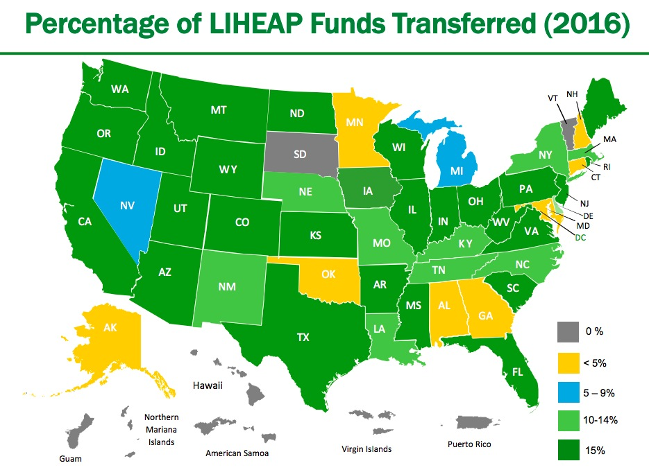
Barrier #3 – Funding does not meet need
Map courtesy of “Weatherization and LIHEAP: Fact, Fuzzy, or Fiction?”. February 2018. Erica Burrin, DOE, Holly Ravesloot HHS
Michigan’s 2018 LIHEAP Budget was approximately $165.3 million

Slide 16
Barrier #3 – Funding does not meet need
Low-Income Home Energy Assistance Program (LIHEAP) WAP
  Annual funding is lower than other State’s allocations, totaling 5% of LIHEAP funding. Max is 15% to 20%.
Michigan Public Services Commission: In previous years, annual utility funds in the form of a Weatherization Assistance Program Grant from the MPSC was administered by BCAEO. These funds were allocated to the Weatherization Operators in the State of Michigan. This funding applied the same rules, regulations, and high quality work of the DOE WAP. Approximately $10 M annually was received.
Without the planned allocation aligned with other WAP funds, it is more difficult for agencies to predict and spend leveraged utility funds in alignment with their other WAP expenditures.

Slide 17
Wap
What the WAP is NOT
  A block grant
  A window and door replacement program
  A remodel or reconstruction program
  An automatic furnace replacement program
  An unskilled labor program

Slide 18
Wap
What the WAP IS
  A low-income energy efficiency program with a focus on health & safety
  Formula grant with federal and state regulations which must be followed
  Supporter of local economies
  Leading development resource for energy efficient measures in low income housing
  Highly technical demanding program
  A program that uses building science and a comprehensive, diagnostic energy audit to address indoor air quality, health and safety, baseload and seasonal load efficiency measures

Slide 19
Summary
Many barriers in this program exist for serving every client who could use energy efficiency support
Focus is on the benefit of the client in terms of energy efficiency with an emphasis on health and safety
  Our program must work for clients in order to be successful
  The process to leverage additional funds must be realistic and work for WAP program staff who are working with heavy regulations

Slide 20


Weatherization Assistance Program
Questions?

