Slide 1
ProjectWise Training
Aero’s Payment System

Slide 2
What is this & why?
An electronic way to pay invoices
We call it e-invoicing
A way to reduce paper & postage costs
Decrease processing time

Slide 3
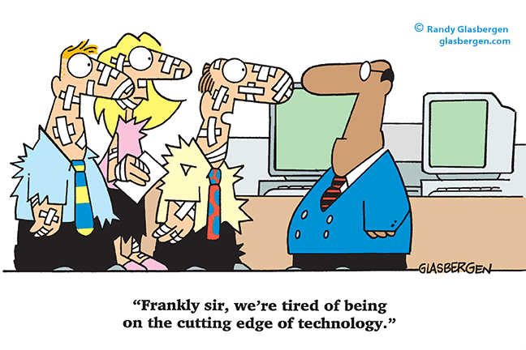
Who is involved?
Consultants & Contractors who want to get paid for the airport work
Airports who have projects with State and Federal money
MDOT Aero & ProjectWise staff
We all are in on this together

Slide 4
When is paperless happening?
NOW!! It has already started
Aero is currently paying invoices electronically
Money issued in FY 2017 is required to be processed in ProjectWise.

Slide 5
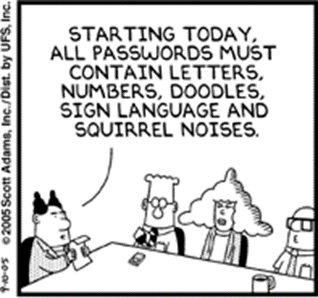
How do we start?
New User Registration Form
Anyone who approves or processes payments may have access
MDOT ProjectWise staff gets this form. They assign username and password.
You’ll get an email with the info & how to download ProjectWise.
Ask MDOT ProjectWise if you have questions.
MDOT-ProjectWiseConsultant@Michigan.gov

Slide 6
What’s next?
Once you have ProjectWise and have logged in, you’re ready to process payments.
Follows existing paper system
Consultant submits invoice into correct ProjectWise folder
Airport receives email from consultant
Airport opens ProjectWise, reviews & approves invoice (clicks “Next”)
MDOT receives email from sponsor
MDOT opens ProjectWise, reviews & approves invoice (clicks “Next”)
Consultant and/or Contractor gets paid ☺

Slide 7
Payment process
Paper – old process
E-Invoice/ProjectWise
Consultant sends invoice to airport – 2-5 days
Airport receives invoice
Airport reviews and mails invoice to MDOT – AERO
MDOT-AERO receives invoice (5-7 days via mail)
MDOT –AERO reviews invoices and approves – 30 minutes
MDOT-AERO gives to Finance to key into our MAIN system, approves and mails or send EFT – 3-10 days
Consultant submits invoice in ProjectWise – 10 minutes
Airport receives e-mail with link to invoice
Airport opens ProjectWise, review and approves invoice – 10 minutes
MDOT-AERO receives email and approves invoice – 10 minutes
Email goes to Finance to key into our MAIN system, approves and mails or sends EFT 3-10 days
3-5 weeks 2-3 weeks

Slide 8
What does this really look like? Let’s start with the consultant adding an invoice

Slide 9
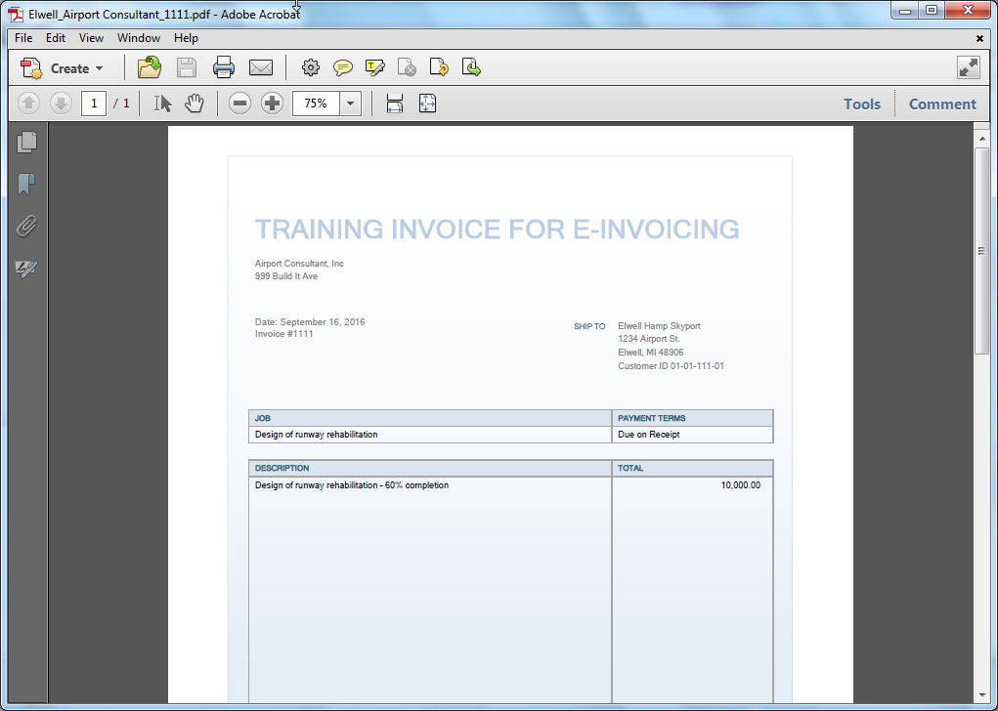
Save invoice as…
Notes:
Assign proper naming convention

Slide 10
Consultant Adding Invoices
Notes:
File is saved locally
Consultant Login

Slide 12
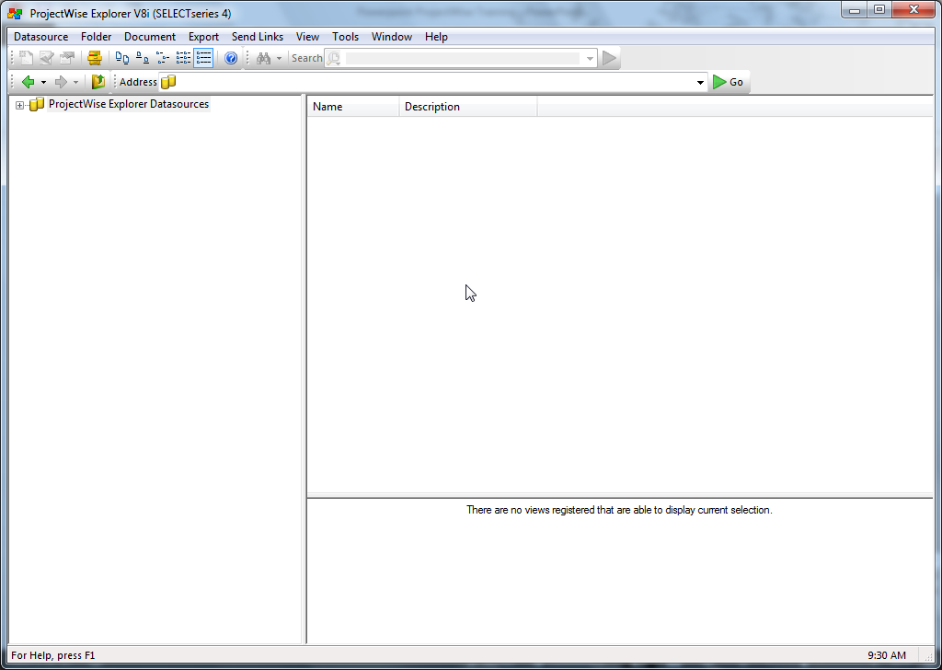
Consultant Adding Invoices
Expand
Consultant
Notes:
Open Folder

Slide 13
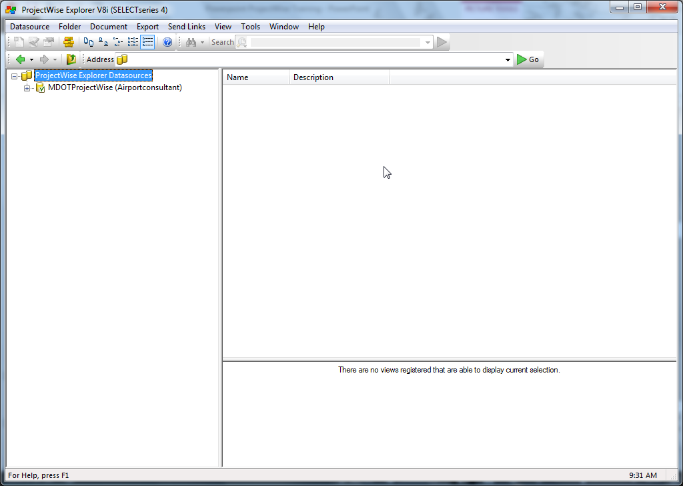
Consultant Adding Invoices
Expand
Consultant
Notes:
Open Subfolder

Slide 14
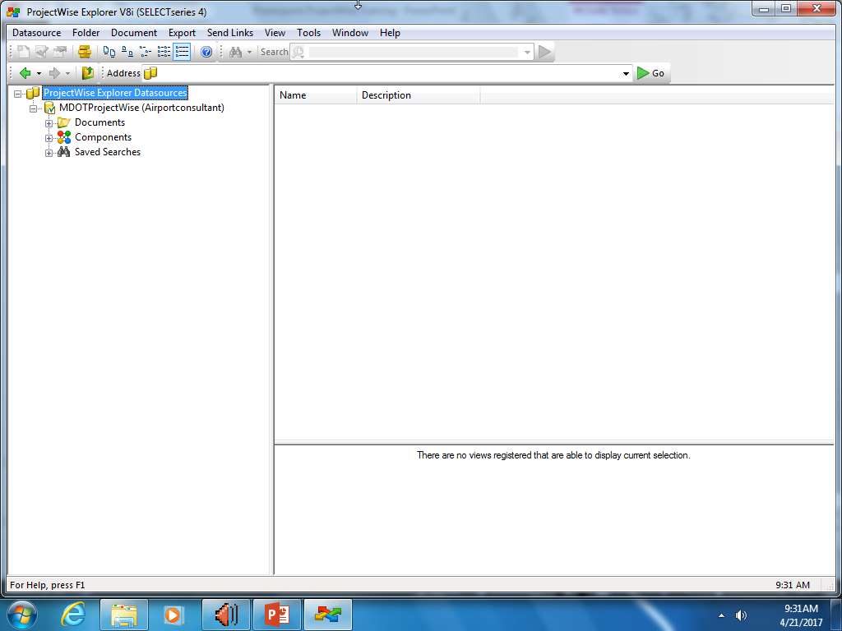
Expand
Consultant
Notes:
Open Documents

Slide 15
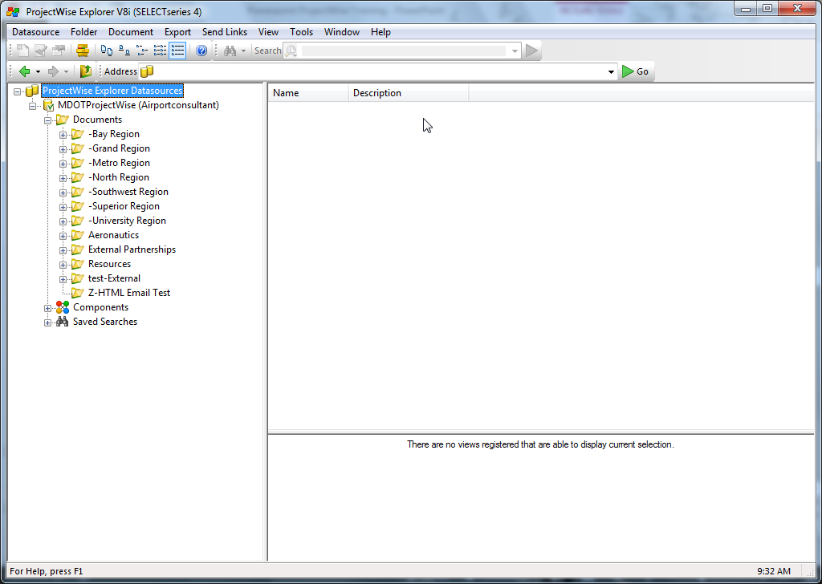
Expand
Consultant
Notes:
Open Aeronautics

Slide 16
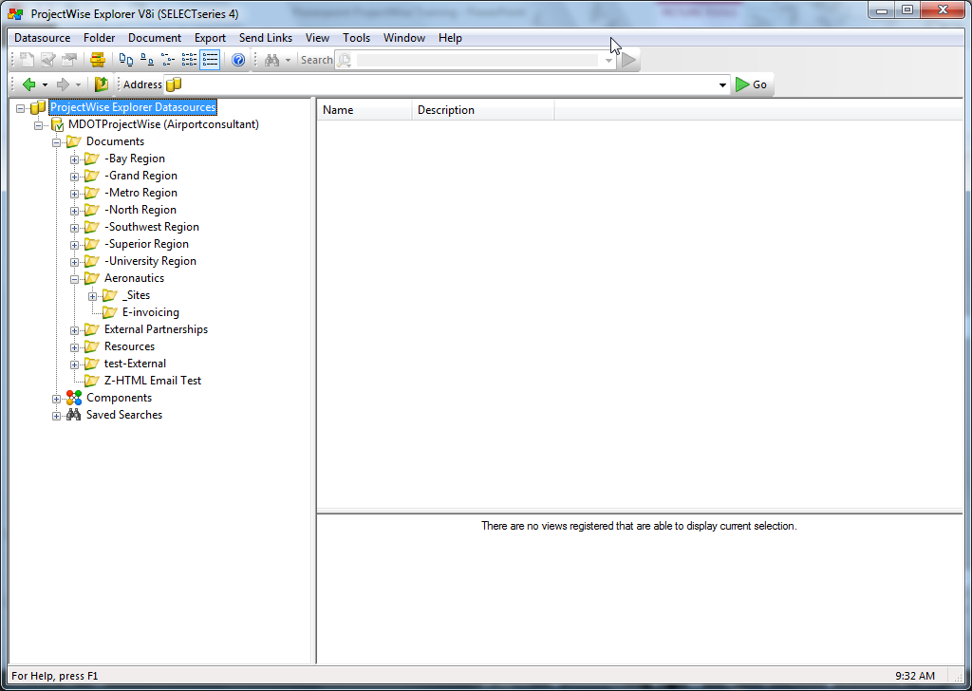
Expand
Consultant
Notes:
Open Sites

Slide 17
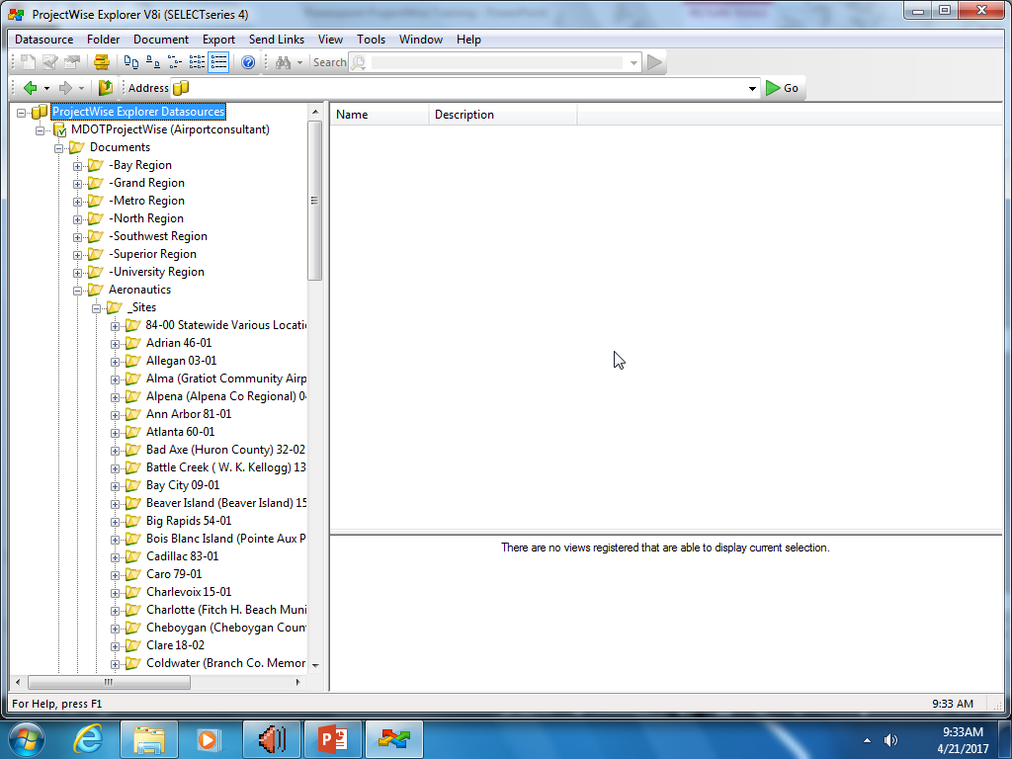
Scroll to your airport from the list
Consultant
Notes:
Scroll to your airport

Slide 18
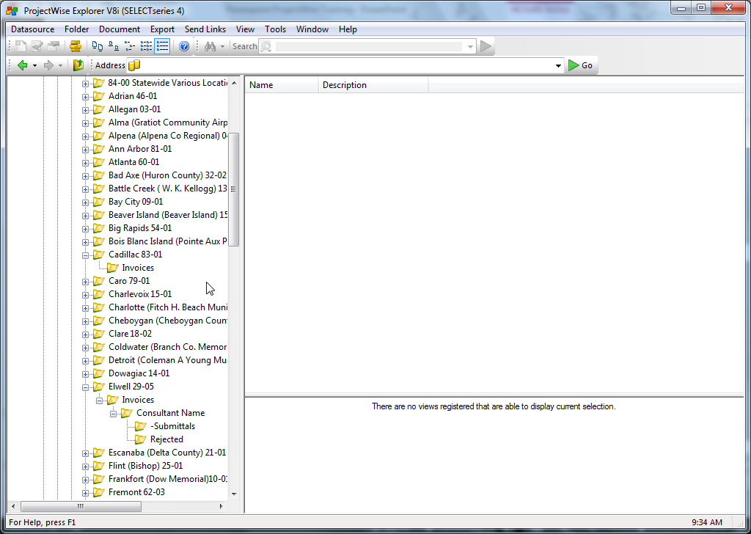
No Access
Access
Consultant
Notes:
Open Invoices, Consultant Name. Note: can see other sites but cannot access the subfolders unless you work with that airport.

Slide 19
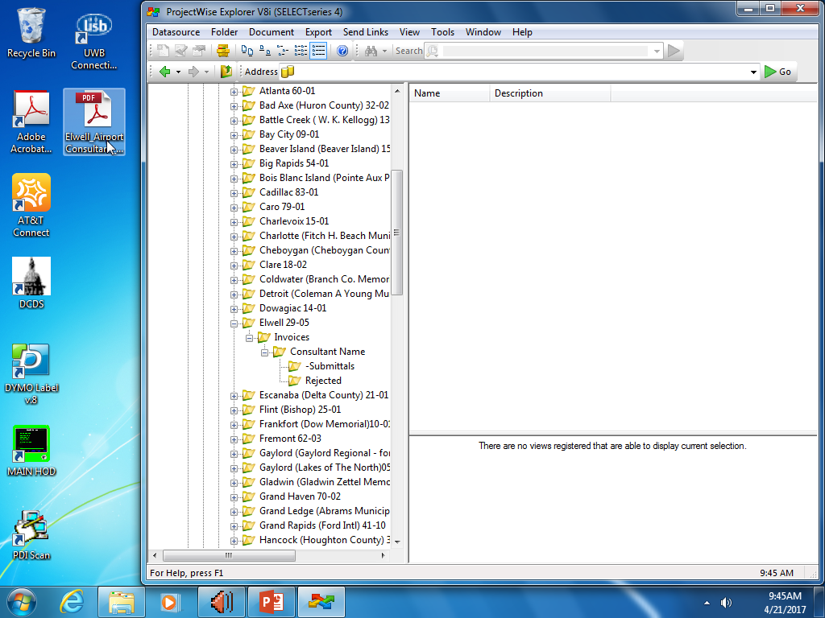
Drag & drop,
select ‘No Wizard’
Consultant
Notes:
Drag and Drop Invoice. Keep a copy for your records.

Slide 20
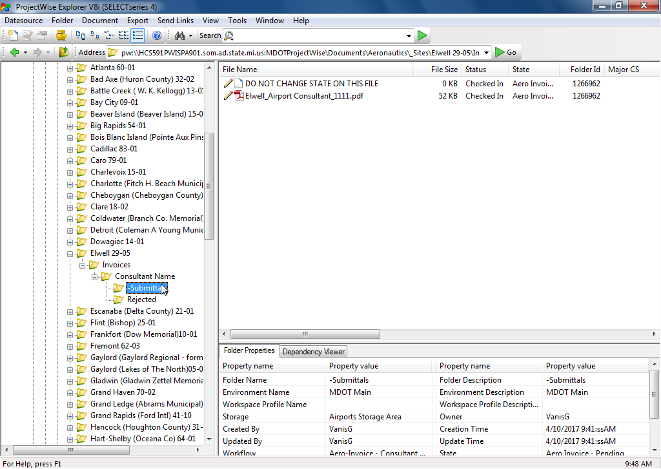
Invoice is visible when
“-Submittals” is selected
Consultant

Slide 21
This file shows up automatically and sets the workflow of the folder.
DO NOT delete this file or change state.
Consultant
Notes:
You can see the file has been added. Keep “DO NOT CHANGE..” file. It needs to be there.

Slide 22
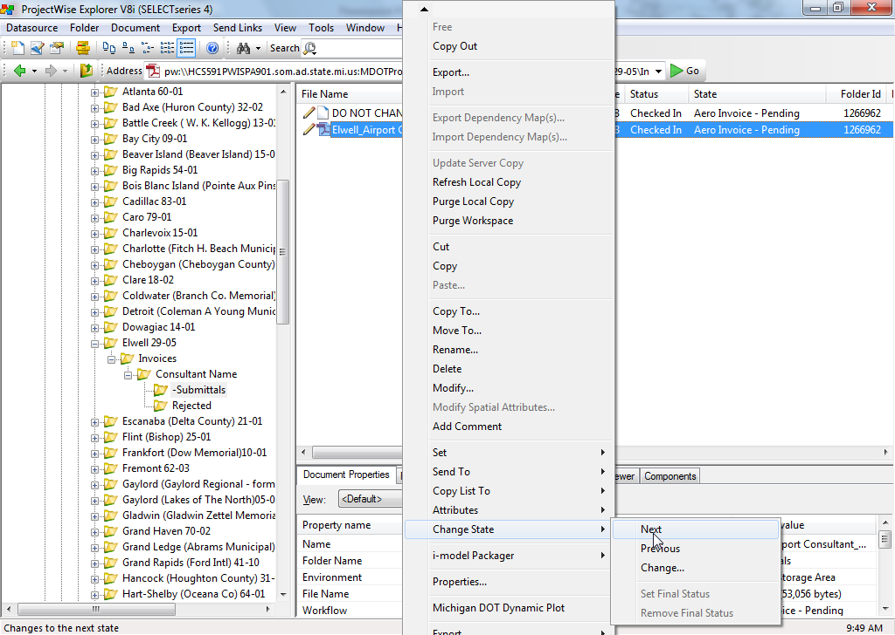
Right click
Consultant
Notes:
Not done yet…Highlight invoice, Right click, Scroll down to Change state – Click Next.

Slide 23
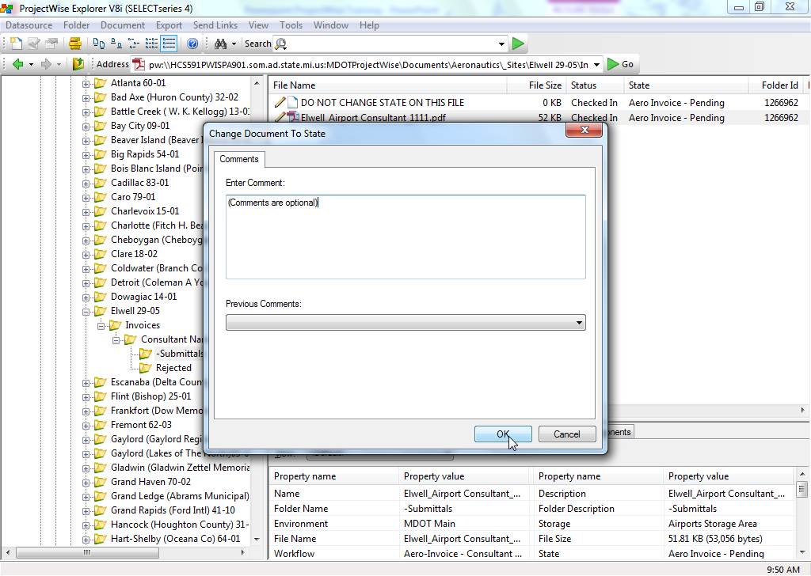
Consultant
Notes:
Can add comments that will stay with the file

Slide 24
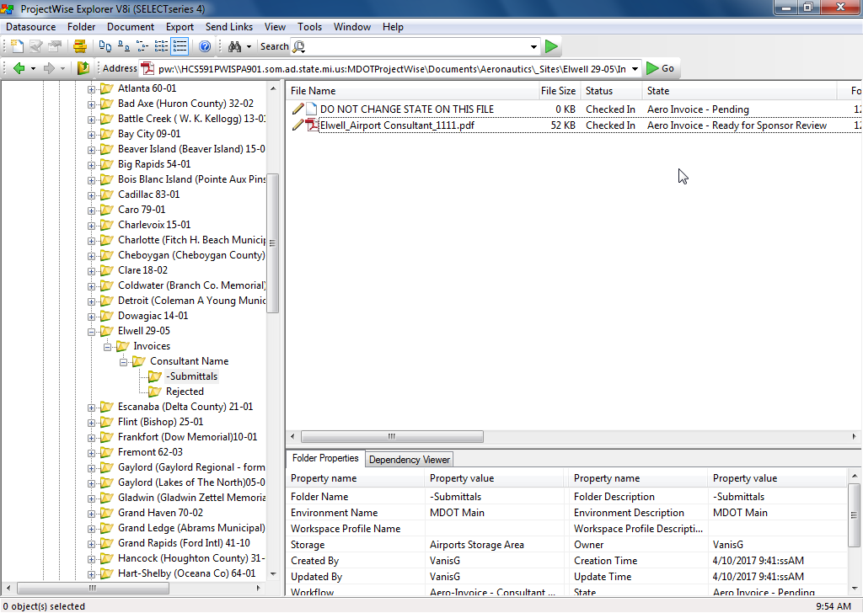
Notice state change from “Pending” to “Ready for Sponsor Review”
Consultant
Notes:
Done. State has changed.

Slide 25
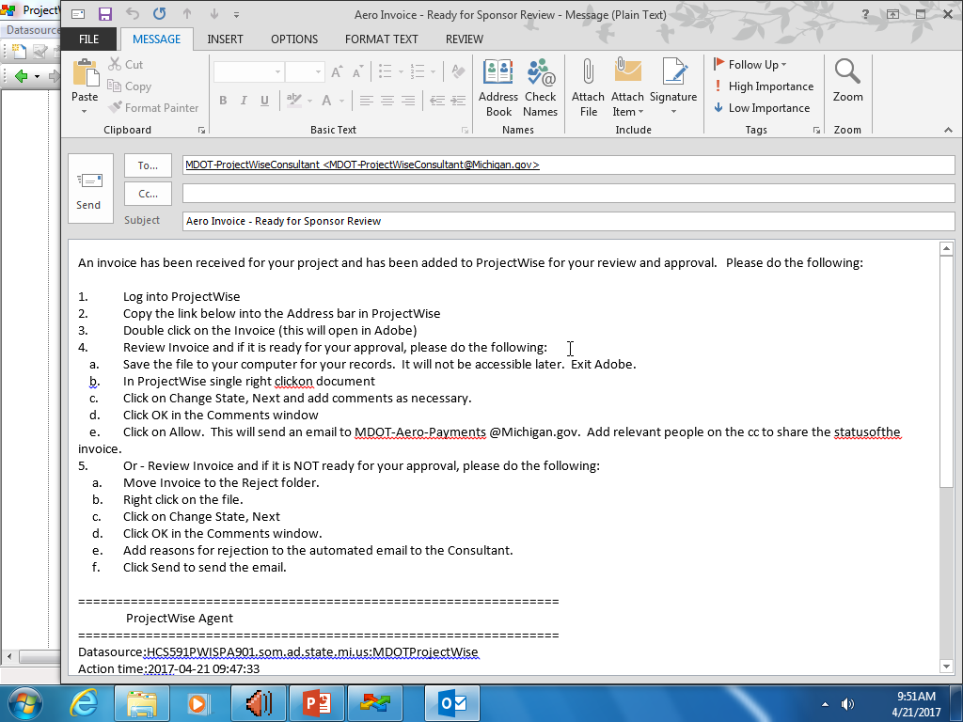
Your email may open automatically.
Do not delete default email address.
Consultant
Notes:
Email should automatically pop up; otherwise send email manually.

Slide 26
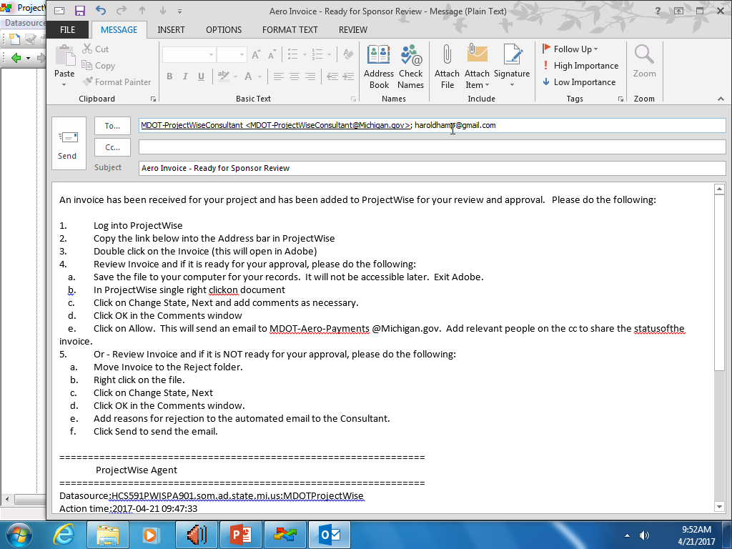
Send email
Add sponsor’s email address
Consultant
Notes:
Add airport manager email address. Hit SEND!

Slide 27
Consultant is done!

Slide 28
Consultants - let’s review
1: Name your file
2: Open ProjectWise
3: Drop invoice into appropriate Airport folder
4: Right click, change state to “Next”
5: Send Email

Slide 29
Next up is the airport…

Slide 30
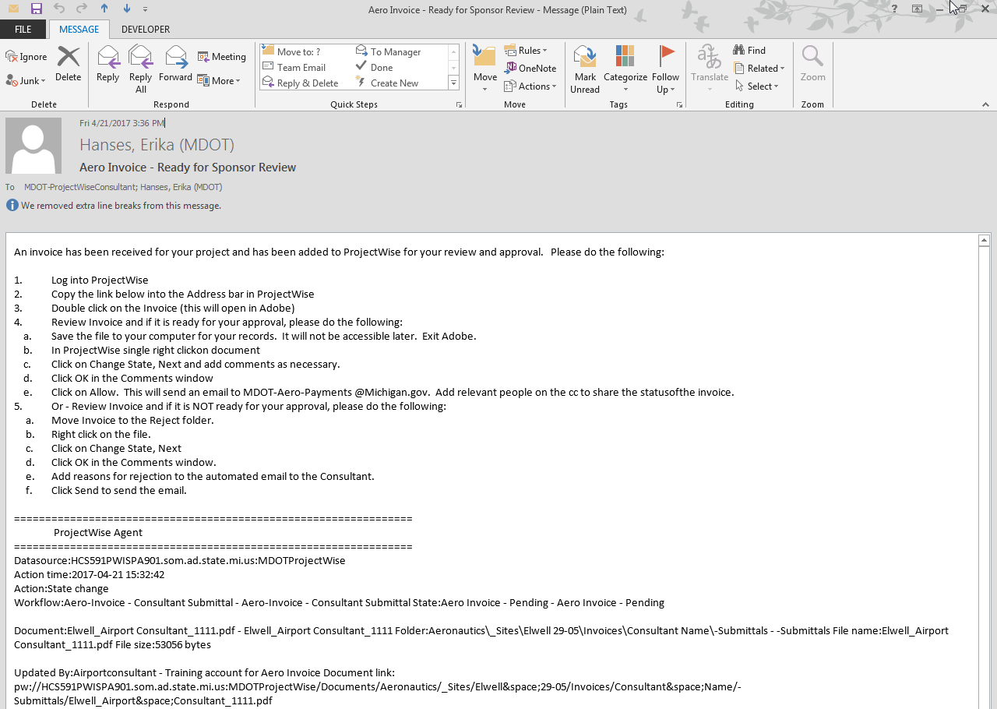
Email from Consultant
Steps to Approve Invoice are in the email
If hyperlink doesn’t work, find invoice here
Airport

Slide 31
Consultant Adding Invoices
Airport
Notes:
Locate and open ProjectWise
Consultant Login

Slide 32
AirportManager
Airport

Slide 33
Consultant Adding Invoices
Expand
Airport
Notes:
Open Folder

Slide 34
Consultant Adding Invoices
Expand
Airport
Notes:
Open Subfolder

Slide 35
Expand
Airport
Notes:
Open Documents

Slide 36
Expand
Airport
Notes:
Open Aeronautics

Slide 37
Expand
Airport
Notes:
Open Sites

Slide 38
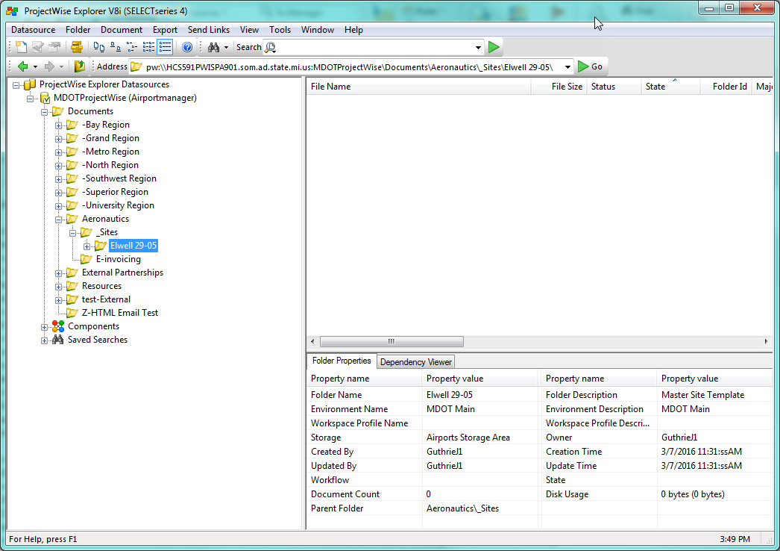
Only airports you have access to will show up
Airport

Slide 39
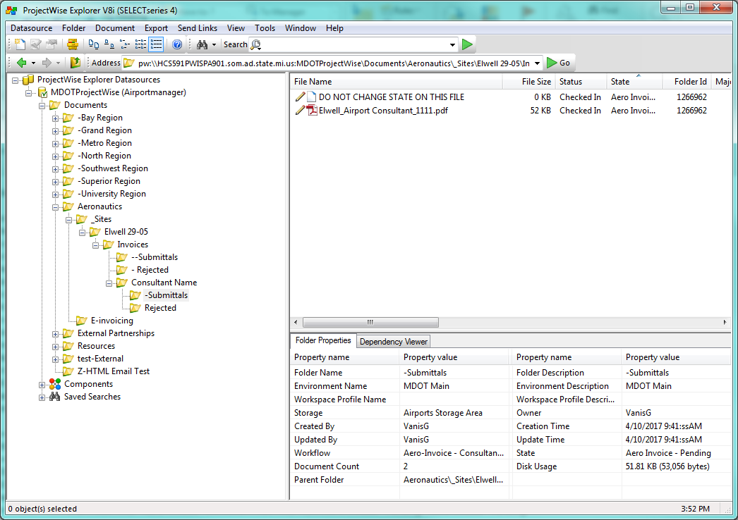
Double-click to open and review invoice.
Expand each folder
Airport

Slide 40
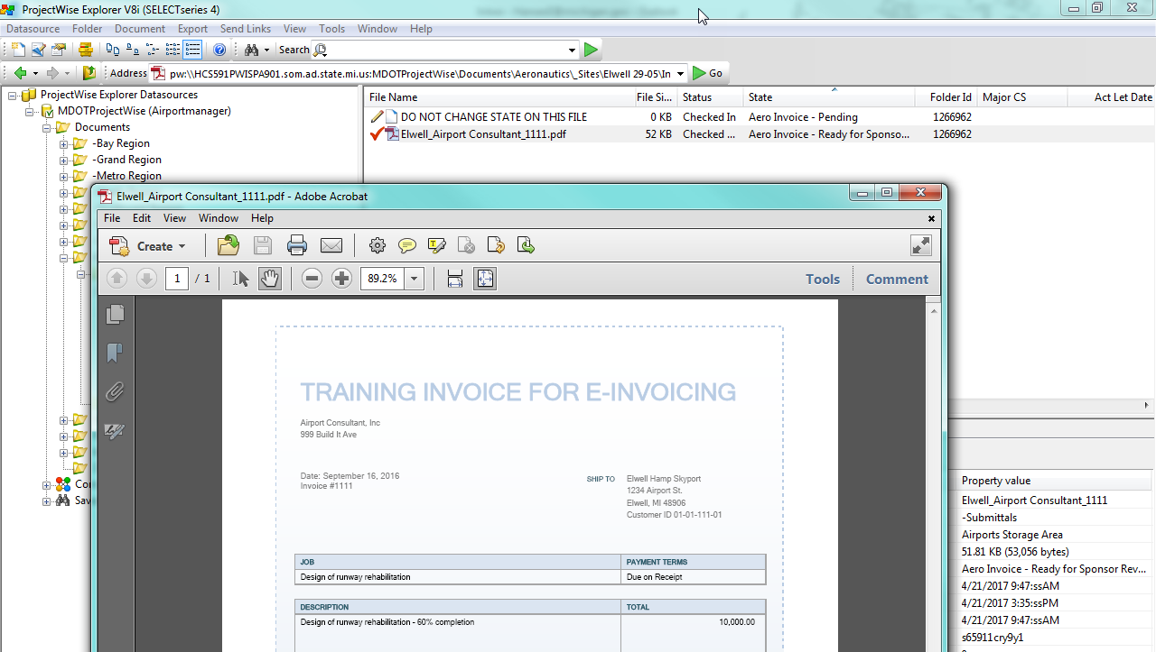
PDF opens Document is checked out
Airport

Slide 41
Review the invoice per your usual process and save for your records.
Follow the next steps in ProjectWise to document your approval.
Airport

Slide 42
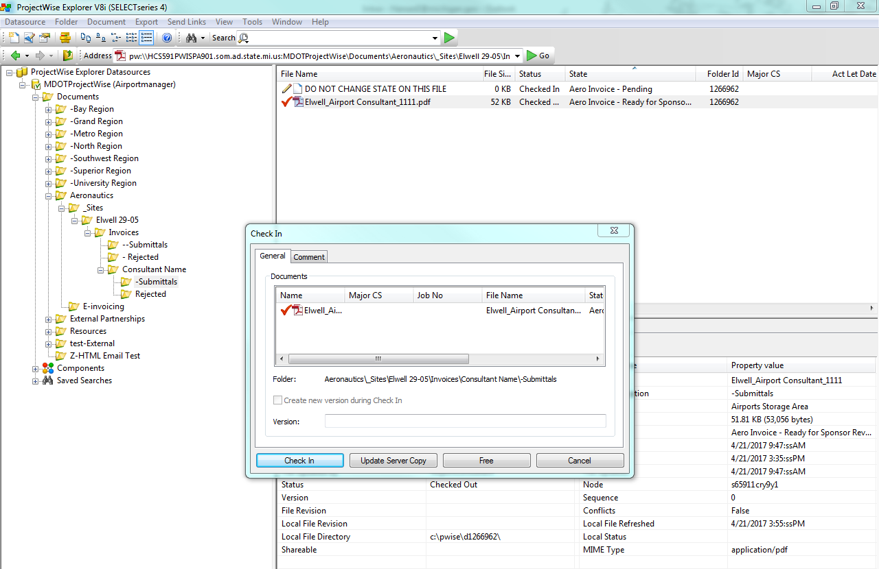
NOTE: Close the PDF, then click “Check In”
Airport

Slide 43
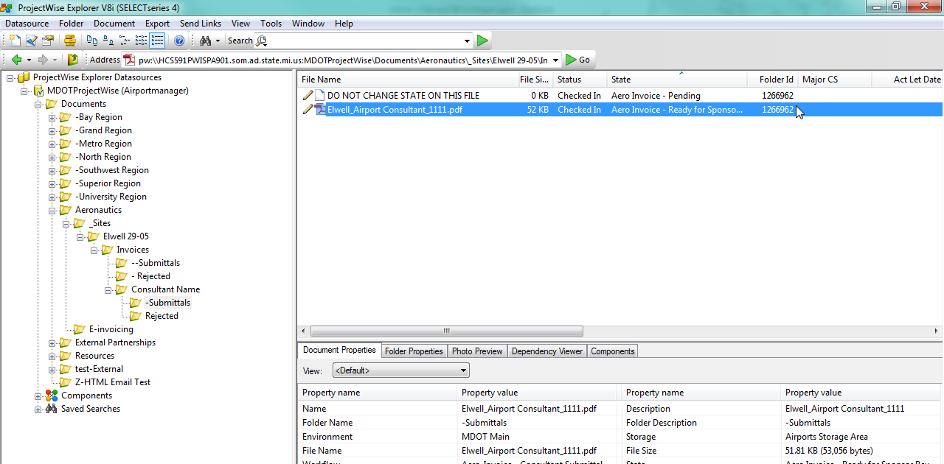
Red check mark changes to a pencil
Airport

Slide 44
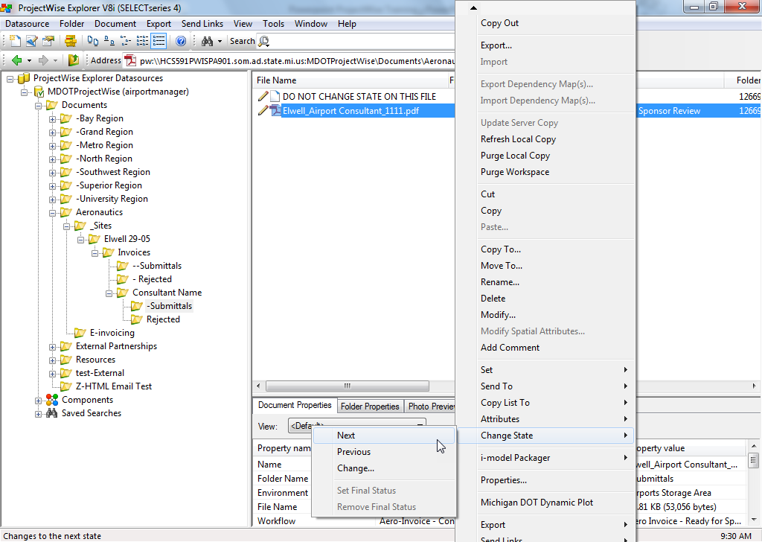
Right
Click
Airport

Slide 45
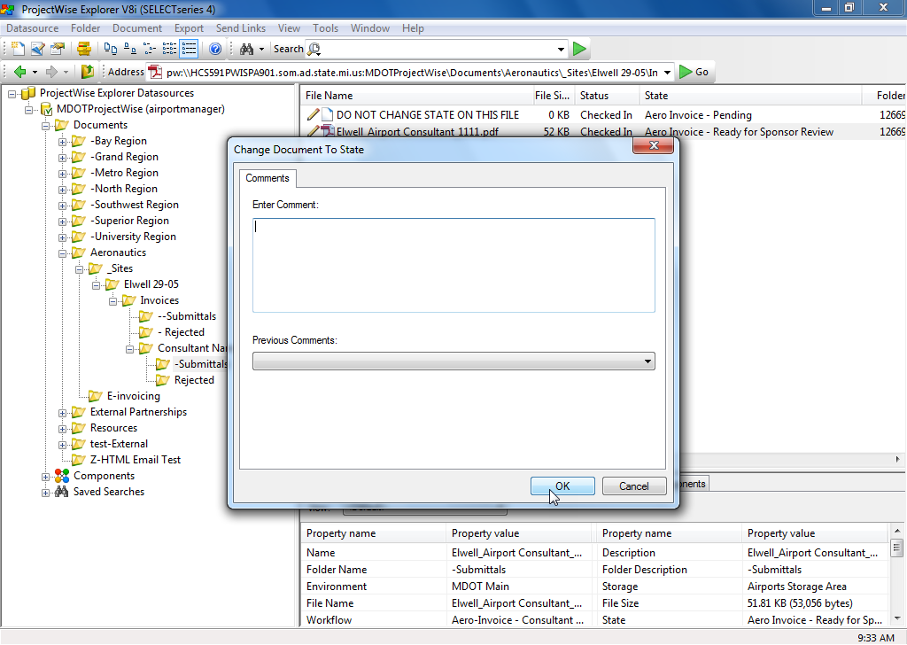
Airport

Slide 46
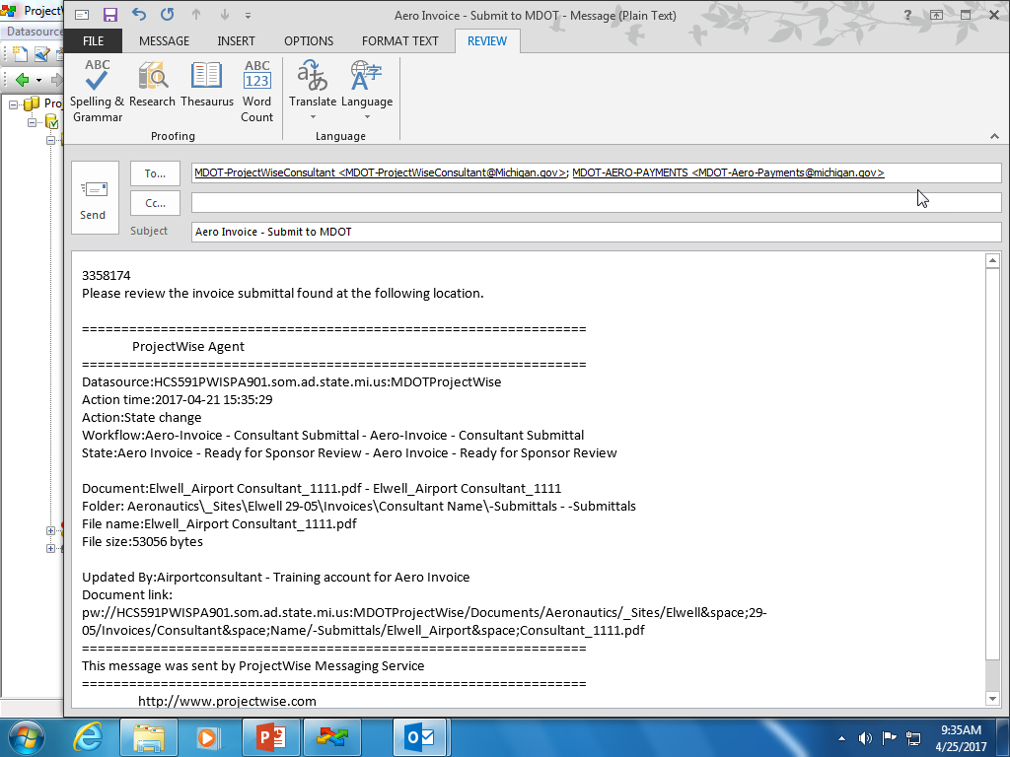
Airport

Slide 47
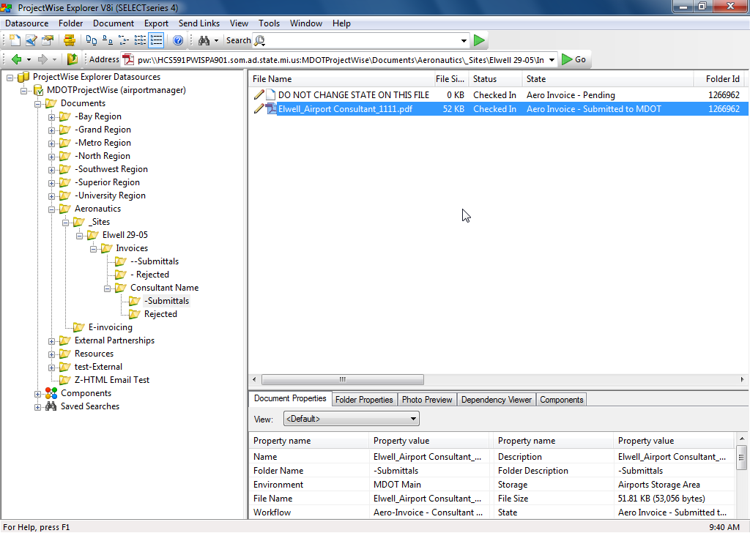
Check in
Notice state change from “Ready for Sponsor Review” to “Submitted to MDOT”
Airport

Slide 48
Airport is done!

Slide 49
Airports - let’s review
1: Receive an email & open ProjectWise
2: Find and open invoice, review it, save it for your files
3: Check file back in
4: Right click to change state to
“Next”
5: Send Email

Slide 50
What happens next?
MDOT receives the email
MDOT goes through the same process you just did. We review it and right click to next.
Remember to keep a copy for your records. An invoice will no longer be visible to the airport or consultant. Contact your AERO Project Manager to check payment status, if you have questions.

Slide 51
Helpful things
Common 3 icons you’ll see
Naming convention examples
FAQ resource

Slide 52
Icons to look for
Red Check – You have it checked out. Must check it back in.
Right click, Check In
Lock – Someone else has it locked. Check audit trail and contact them.
Pencil- you can edit the document. This is the state we want.

Slide 53
Naming conventions
City_Consultant_Invoice Number
Essex_MeadHunt_235792.pdf
City_Contractor_Invoice Number
Essex_RiethRiley_235792.pdf
Common Abbreviations
Mead & Hunt = MeadHunt
Commonwealth Associates = Commonwealth
QoE Consulting, PLC = QoE
RS&H = RSH
C & S Engineers, Inc = CS
Wade-Trim = WadeTrim
Prein & Newhof Inc = PreinNewhof
Baker and Associates = Baker
DJMcQuestion and Sons = DJMcQuestion
Highlight Markings = Highlight

Slide 54
Troubleshooting
If it’s tech – contact MDOT-ProjectWiseConsultant@Michigan.gov
Firewalls
Email doesn’t work
Username and/or Password problems
Data folder- Empty folders/No folders
If it’s processes – Contact MDOT AERO (Your Project Manager, Erika, or Jenn)
Payment not made
It’s locked and you don’t know how to free it
Don’t know next step
www.Michigan.gov/aero
http://www.michigan.gov/aero/0,4533,7-145-61401_61434_61435_76144---,00.html

Slide 55
Questions?
Presentation and handouts are available on MDOT’s website.

Slide 56
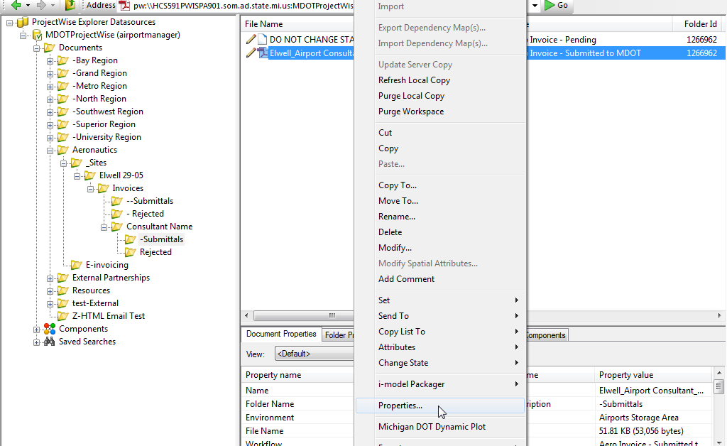
How to find the audit trail
Right Click on file

Slide 57
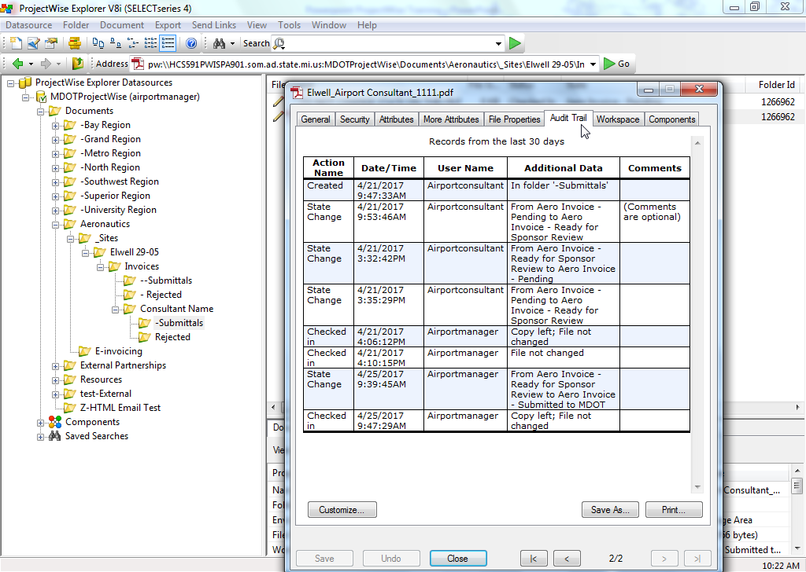
Comments stay with file
Audit Trail

Slide 58
Audit Trail

Slide 59
Audit Trail

