Slide 1


Michigan Network to Innovate for Community Health Equity (MNICHE)
Rapid Response Initiative
Evaluation Report Summary
Prepared by

Slide 2


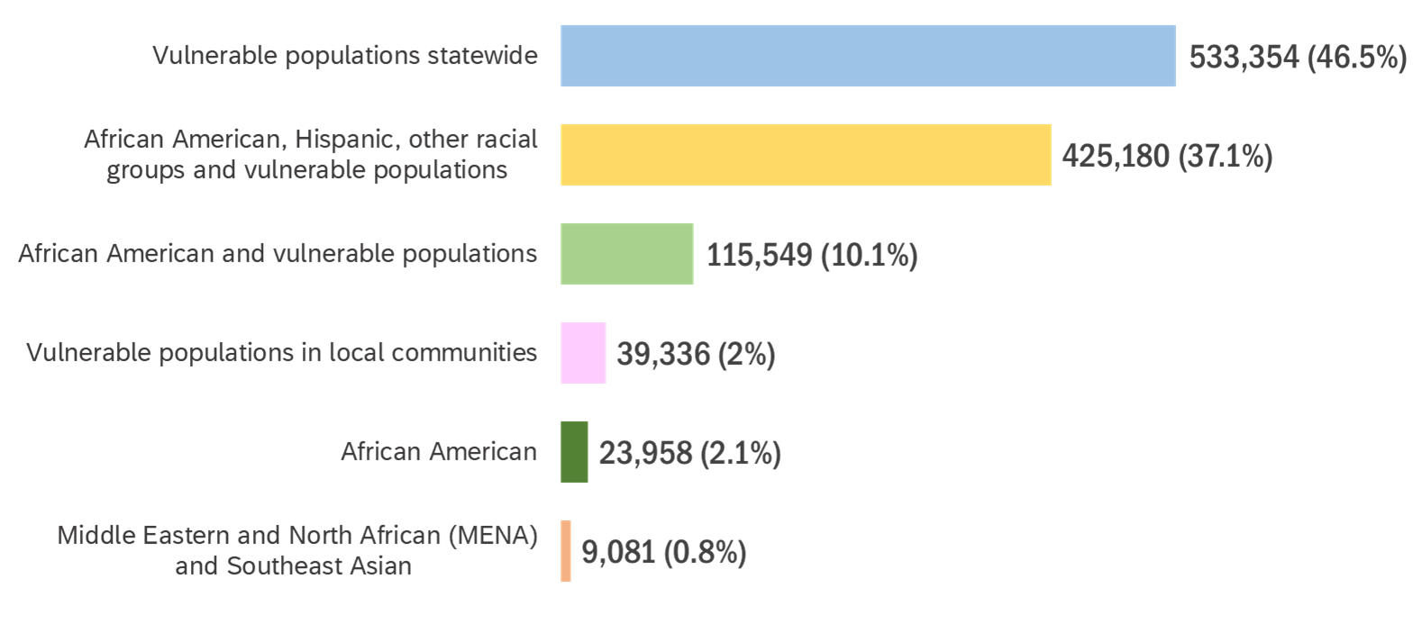



























The Rapid Response Initiative - An efficient and effective use of public funds
$17.2 million to community organizations / 1,146,458 Michiganders served
Notes:
What is the distinction between the first 4 groups. As titled, they seem duplicative. All 4 use the word “vulnerable”. [Answer: It’s based on a combination of 1) how each organization listed their target population priorities (all organizations have done this), and 2) reported demographics (only some have done this).]
Is vulnerable pops in local communities and subset of vulnerable pops statewide (bar 1 & 4) [Answer: No - There is no overlap or duplication, the classification depends on the region of operation for each organizations; some local, some statewide],
Afr Amers is listed in bar 2, 3, 5 – is that duplicative? [There is no duplication across any categories the total N is still 1,146,458]

Slide 3
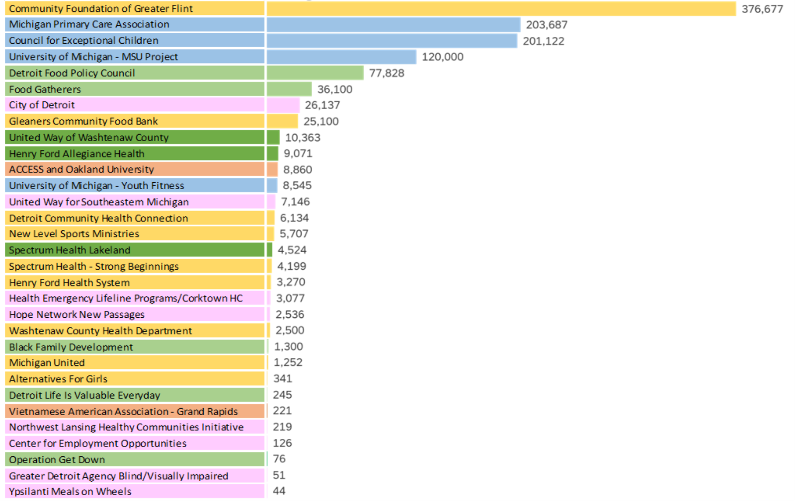
Programs and number of people served
Notes:
You always need a unit of measure – I added “number of” in the heading. Is that correct? [Answer: Correct, thank you!]
If MSU did not serve people, I would remove them from this table. [Done!} I also think that where we list MSU, we should say MSU/UM [Answer: Not sure, I am using the name listed in “RRI - Final Subrecipient Program Report Data”]

Slide 4


RRI provided critically needed funds
76% of the community project leaders of RRI-awarded programs believed their organization could not have found another funding source to support their work.
One program which provides much needed supports to blind and visually impaired clients was forced to close for months because of the pandemic. RRI was the only funding source to support this work.

Slide 5

Programs served targeted populations
98% - 100% of individuals served were from the communities and populations identified by the Task Force.
A program with 49 subrecipient organizations reported leadership demographics of subrecipient awardees as:
91% African American
9% Hispanic
51% Women

Slide 6





Provided crucially needed assistance to the vulnerable, underserved and the marginalized
A snapshot of populations served
Populations with little or no access to preventive or primary care services, for example, 84% of participants had not received a flu vaccine in recent memory, 24% had never received it.
Families with young children facing eviction, foreclosure, food insecurity and utility shut-off.
High risk older adults who had never used any video conferencing tool and did not want to leave their homes during the pandemic.
Medically homebound adults, isolated, living alone and in poverty, 95% of whom were assessed at high nutritional risk.
Young women and their children (newborn to 5 years) experiencing homelessness.
Pregnant and interconception women, and their children (under 18 months) in abusive relationships with a clinical diagnosis of depression and living in extreme poverty; 67% of them having multiple chronic conditions, and 75% of them assessed to be in crisis by CHWs.
People returning home after incarceration.
Notes:
96% of women and 93% of children served had a medical home by the end of the initiative.
94% of children served had the last age-appropriate well-child visit.
A statewide program to promote youth physical activity and wellness in disadvantaged school districts reached children in all 83 counties (100% coverage).

Slide 7
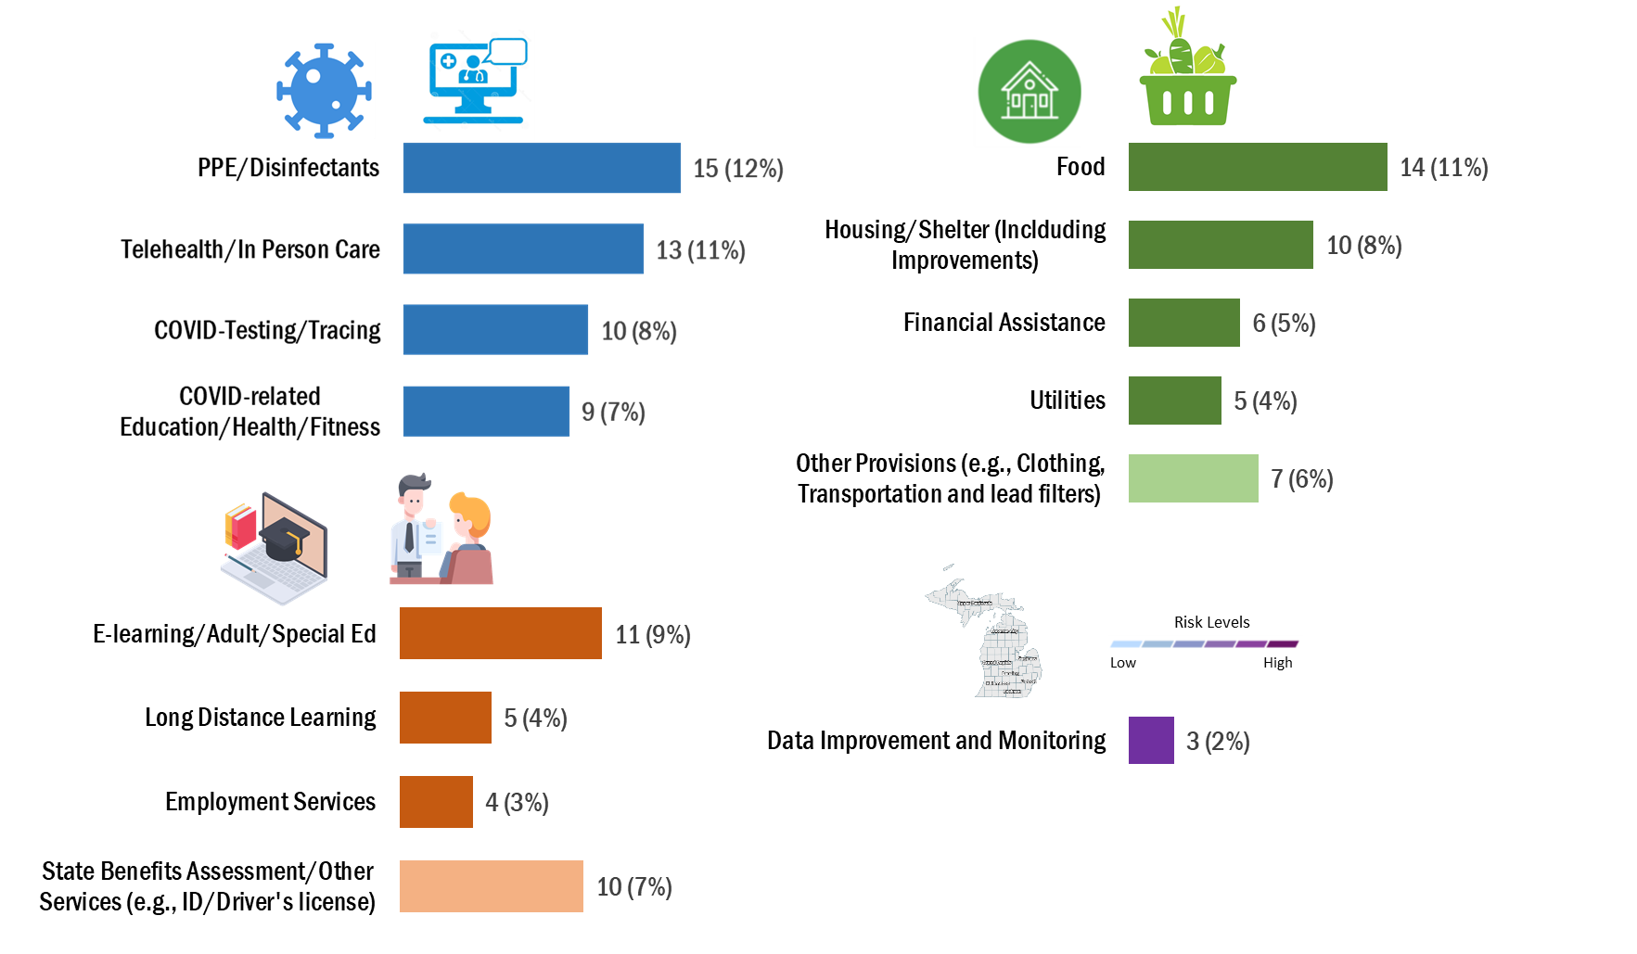
Strategies and Frequency used across programs (122 total strategies)
Healthcare services
Non-medical resources
Education and livelihoods
Data improvement
Notes:
These are about the https://www.mistartmap.info/ dashboard and 2 epidemiologic surveillance projects one conducted by MSU and the other by UoM

Slide 8
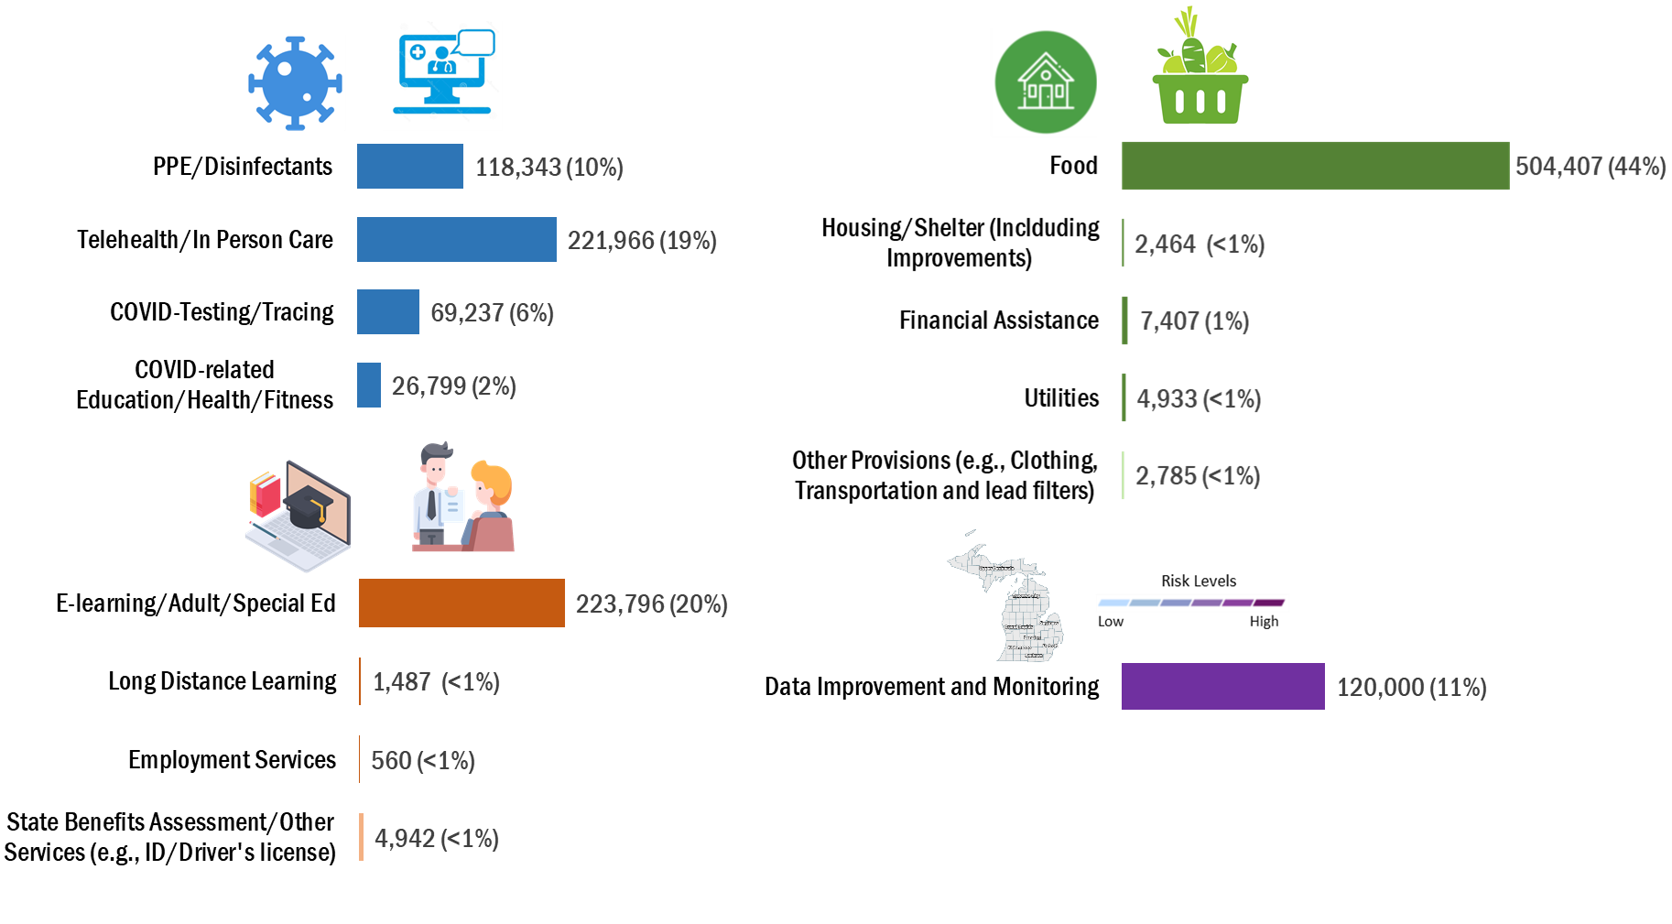
People served: Service recipients by strategy
Healthcare services
Non-medical resources
Education and livelihoods
Data improvement

Slide 9
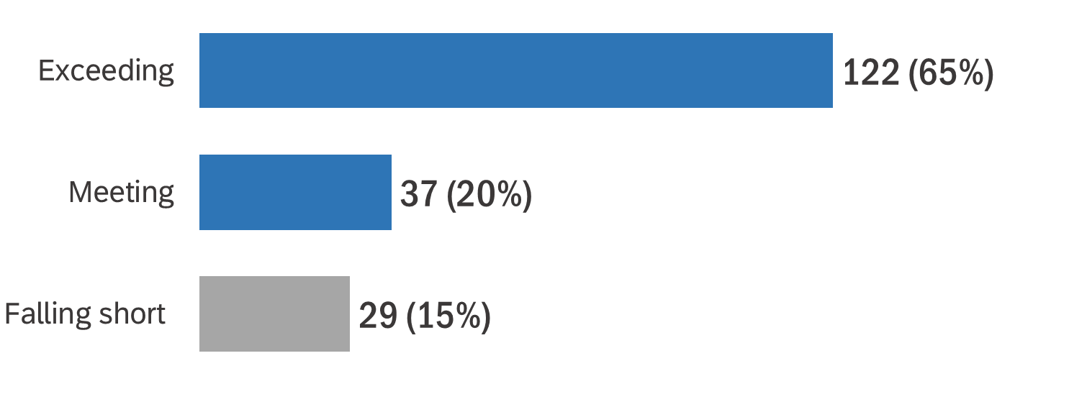


Exceeded expectations
Funded Programs were asked to compare expected and actual project outcomes
85% of the reported outcome indicators* met or exceeded expectations
Examples:
Food, water, and personal care items were expected to go to 144,200 people, but the actual number of participants served was 356,076.
Financial assistance to address critical housing, utilities and food needs was expected to go to 60 households, but the actual number of supported households was 722.
*Across all programs there were 188 explicit outcome indicators that were measured and evaluated.

Slide 10

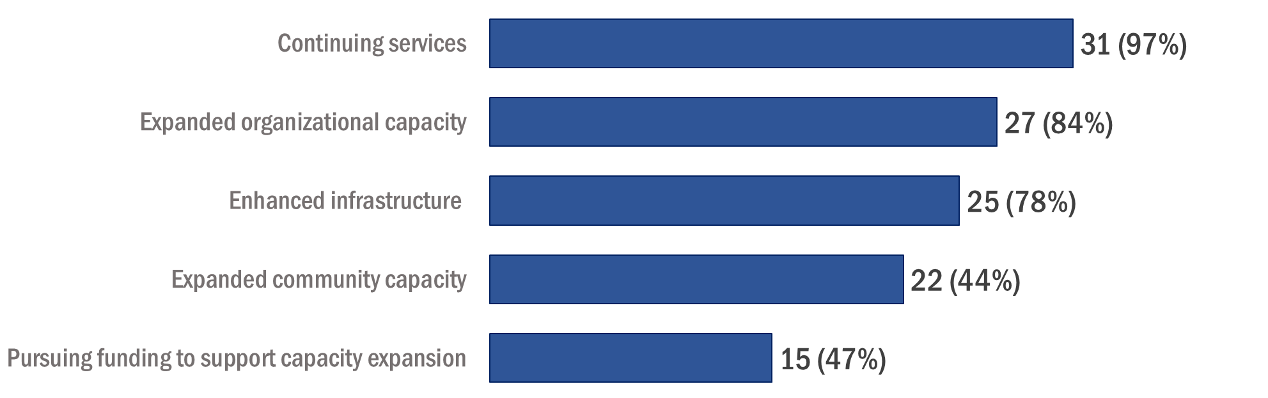
Organizational and community benefits of RRI participation
84% organizations report expanded capacity to provided services

Slide 11




Lessons learned
Community Partnerships: Bring the right partners, especially those already active with the target population, to the table from the initial stages of strategy formation and proposal development.
Consistent program implementation: Make sure that everyone in your organization clearly understands the full scope of project to effectively execute strategies in the face of frequent changes, delays, or unexpected events.
Optimize implementation effectiveness: Use tools such as United Way's ALICE to deploy resources strategically, while avoiding duplication, to optimize the impact on the target population.
Support the people doing the work: Intervention success requires staff who are agile, flexible, resourceful and caring. Organizations need to provide the people doing the work with the adequate training, support and resources.
Community outreach and engagement: People are often most comfortable working directly with individuals they trust. Engage with, empathy, integrity and respect, and be cognizant of historically justifiable reasons to distrust institutions and systems.

Slide 12














A great foundation for future work
The Rapid Response Initiative Empowered individuals, Equipped organizations and Engaged communities
“Built confidence, collective agency, sense of power to change.”
“There was an increase in satisfaction and renewed commitment to the work through the successes of the RRI”

Slide 13
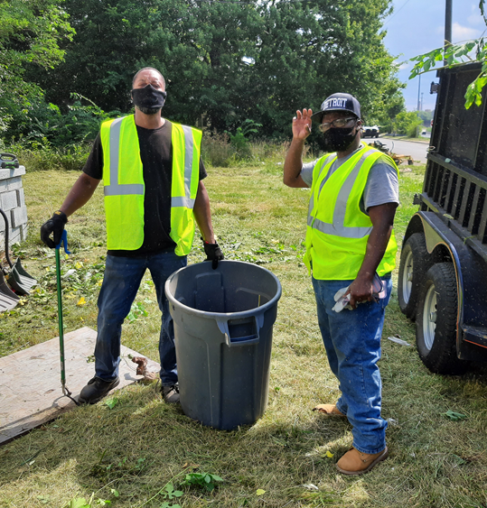
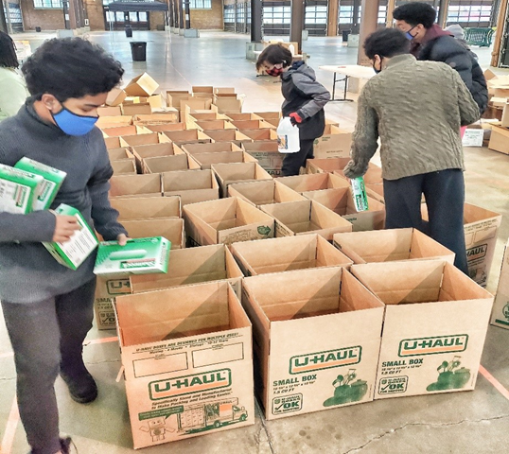

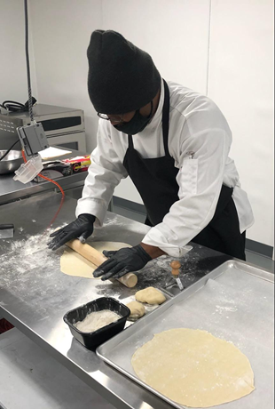
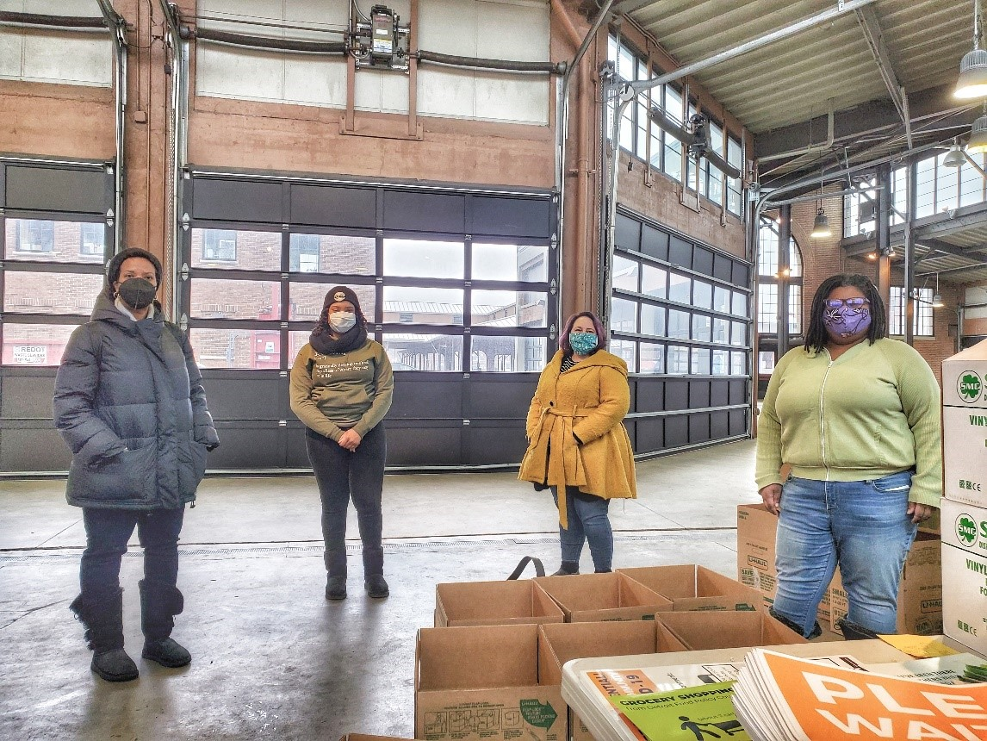
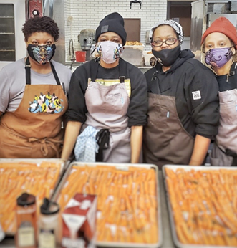
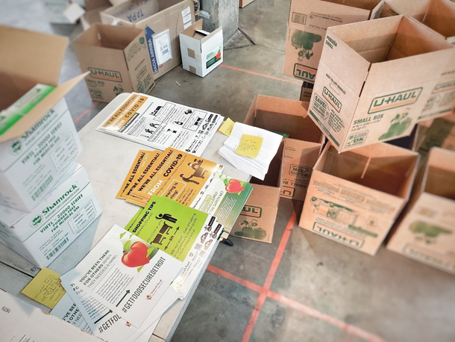
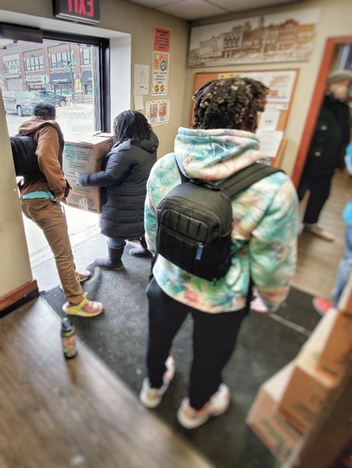
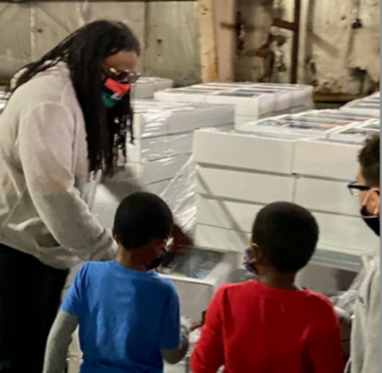
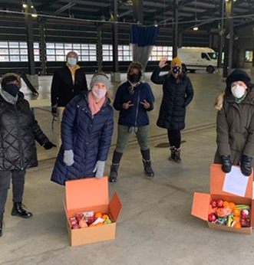
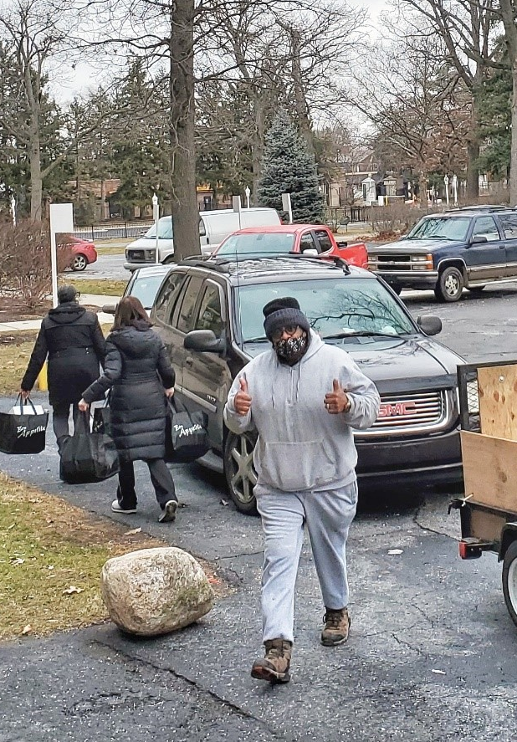
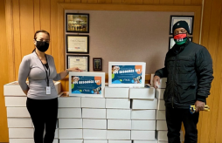
RRI In Action

