Slide 1
Innovation in Concrete
Steve Waalkes, P.E.
Director of Engineering – W. Mich.
Michigan Concrete Association

Slide 2
High Level Overview of Concrete Innovation
Competition & communication are the keys to innovation
Always lessons to learn – have to keep trying, implementing new ideas
Solving problems & making improvements before they become problems

Slide 3
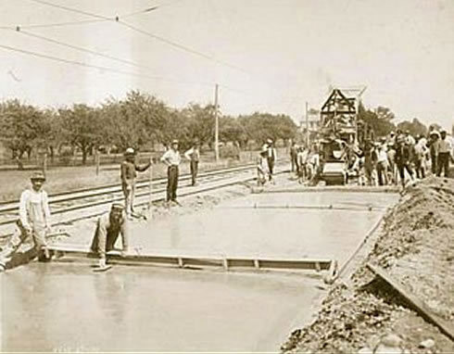
Long History of Innovation in Michigan
1909 – U.S. first full mile of concrete highway, on Woodward Ave., 6 Mile Rd. to 7 Mile Rd.
1911 – U.S. first painted centerline
1912 – U.S. first highway materials testing lab
1918 – U.S. first 4-way red/yellow/green signal
1929 – U.S. first paved runways at Ford Airport in Dearborn
1955 – World’s first freeway-to-freeway interchange
1960 – U.S. first state to complete border-to-border interstate (I-94, Detroit to New Buffalo)

Slide 4
Recent History of Concrete Innovation in Michigan
Mid-1990’s
1997
2004
Movement towards Performance Related Specifications
Midwest Concrete Consortium started (precursor to NC²) – state DOT’s and industry collaboration
Increase in state gas tax funding; included are requirements for pavement warranties and LCCA
P1Mod spec first developed by MDOT concrete engineers
Re-tooling of the P1Mod spec; requires 3 aggregates, well-graded, optimized blend

Slide 5
Recent History of Concrete Innovation in Michigan (cont.)
2005
2006
2010
2015
P1Mod upgraded: stockpile management, process control
MCA funded study indicates ASR, air entrainment, and other issues are to blame for some early durability problems
I-96 and Ambassador Gateway projects utilize stabilized subgrades
Supplementary cementitious materials required at min. of 25%
Optimized mixtures for use in bridge elements
FHWA, CP Tech Center, and MDOT start NC² PEM implementation

Slide 6
Recent History of Concrete Innovation in Michigan (cont.)
2015
2018
2020
2021
MDOT specs allow ASTM C595 Type IL cement
MDOT demonstrates 30- and 50-year designs, utilizing stabilized subgrades (among other improvements)
WisDOT adopts optimized/well-graded concrete mixtures
New MDOT spec book, P1M now called 3500HP
MCA & MDOT discussing innovative concepts including:
Stabilized subgrades; Thickened edge for truck lane; Recycling concrete into 3-inch minus material, into subgrade

Slide 7
FHWA Emphasis on Pavement Foundation(s)
“…ME designs do not consider the effects of any deterioration or spatial variability in the foundation layers. Over time, the conditions of the foundation layers can degrade and deform under the influence of repeated heavy loads, leading to non-uniform support conditions and localized failures. Thus, the principal role of a robust pavement foundation is ensuring the foundation layers retain their integrity throughout the pavement life.”

Slide 8
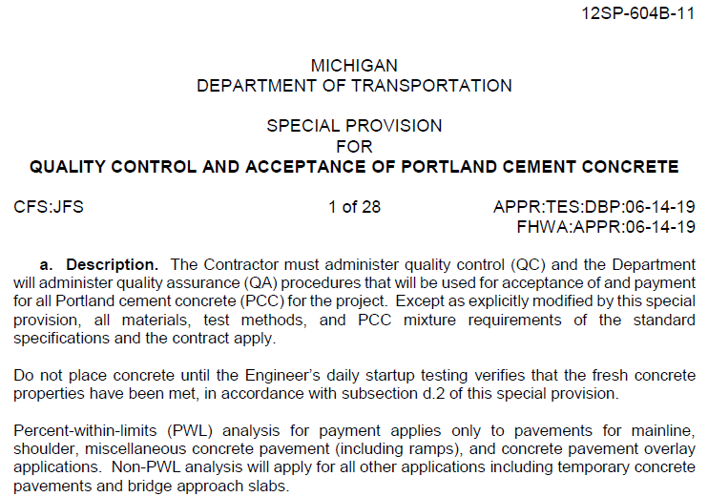
MDOT Specifications:
12SP-604B-11 (Quality Control and Acceptance of Portland Cement Concrete):
Required for all trunkline
12SP-604B
Moving to new spec. book
3.09 Optimized Aggregate Gradation
MDOT MQAP Manual

Slide 9
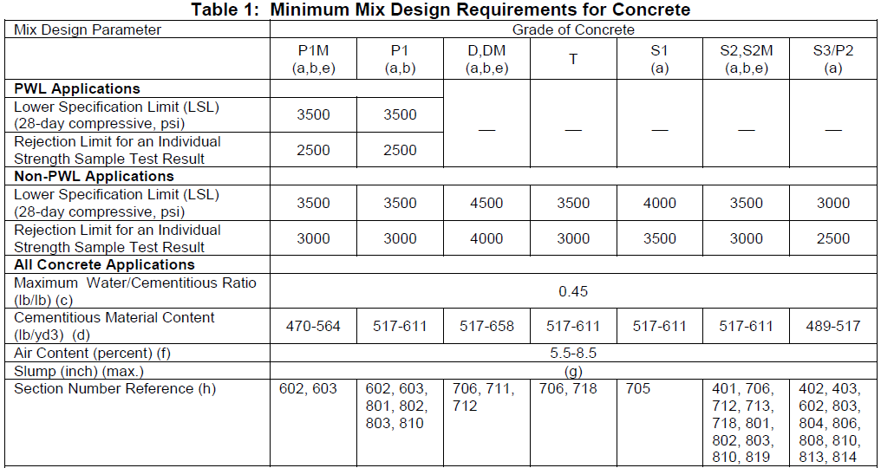
Maximum Cement Content and W/C:
Maximum Cement Content:
Pavements: 564 lbs.(6 sack)
Bridge Decks: 611 lbs. (6.5 sack)
Maximum W/C Ratio:
0.45
Benefits:
Reduced paste content
Reduced costs associated with cement
Difficulties:
Dependent on Water Reducing Admixtures
Local Cement testing

Slide 10
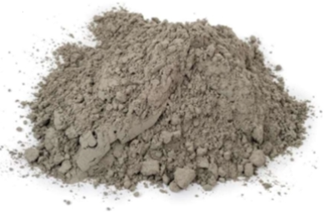
Supplementary Cementitious Materials:
Replacement rates:
25%-40% replacement of Portland cement
Replacement amount is determined by the Contractor
40% total replacement
Improvements:
Permeability
Resistance to Freeze-thaw damage
Consistency
Difficulties:
Initial pushback/learning curve
Can cause air issues
Slower initial strength gains

Slide 11
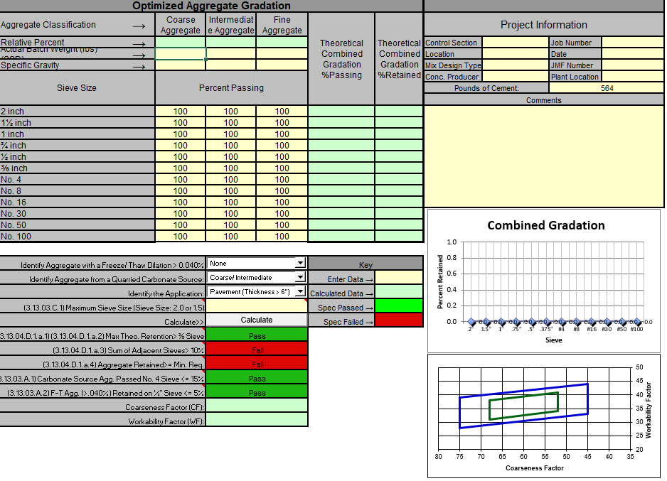
Optimized Aggregates:
Improvements:
Slump/Consistency
Permeability
Additional aggregates gradation used
Difficulties:
Agency and Contractor understanding
MDOT Optimized Aggregate Spreadsheet
Ready Mix with limited bins
Preblended aggregates
2 aggregate gradation blends

Slide 12
PEM (Performance Engineered Mixtures)
Pooled Fund Study
19 state DOT’s
4 national industry associations
Implement newer technologies to deliver enhanced concrete durability & maximize pavement performance

Slide 13
PEM (Performance Engineered Mixtures)
V-Kelly Ball (V-Kelly)
Box Test
Maturity Method
Formation Factor
Surface Resistivity
Bulk Resistivity
Sequential Air Metric Apparatus/Super Air Meter (SAM)

Slide 14
PEM Testing
V-Kelly Ball (V-Kelly):
Has been used in the lab
Have not required its use on Projects
QC Test

Slide 15
PEM Testing
Box Test:
Has been used in the lab
Have not required its use on Projects
Perhaps require its use for trial batches in the future
QC Test

Slide 16
PEM Testing
Maturity Method:
MDOT Special Provision
Contractor’s option
Open to traffic only
Training is key:
Fingerprints correct
Doesn’t measure strength development – it predicts it

Slide 17
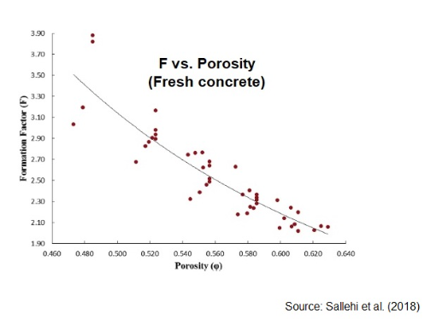
PEM Testing
Formation Factor:
MDOT has not used the formation factor
Mainly focused on resistivity testing

Slide 18
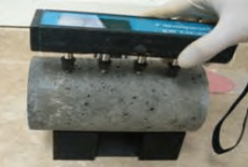
PEM Testing
Surface Resistivity:
Testing was performed on 2 long-life (30 and 50 year) pavement projects
Was being conducted on all freeze-thaw samples
40+ sets of coarse aggregate samples were tested
All testing and mix ingredients were provided to Jason Weiss at Oregon State University
MDOT’s experience:
Fairly high level of variability
Must hold Probes perpendicular to the surface
Ensure the Probes’ reservoirs are full
Keep Probes away from voids and aggregate located on the surface
Currently, MDOT has transitioned to Bulk Resistivity

Slide 19
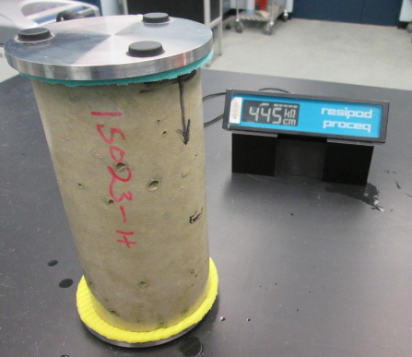
PEM Testing
Bulk Resistivity:
Used on multiple research & pilot projects
MDOT’s experience:
Simpler test than surface resistivity
Consistent results
Ensure the sponges remain wet
Keep away from metal
Correlates with surface resistivity
Correlated well with RCP in recent research project

Slide 20
PEM Testing
Bulk Resistivity:
Currently MDOT is collecting data
Performed on all freeze-thaw samples
Perhaps require its use for trial batches in the future?

Slide 21
PEM Testing
Super Air Meter (SAM):
MDOT owns 19 SAMs
Introduced to Region personnel
Pilot field Testing/Shadow SP:
12CF601
Requires testing for information only:
Mainline Pavement
Structures
Barrier
One test per sublot
Typically 5 tests per day for mainline paving

Slide 22
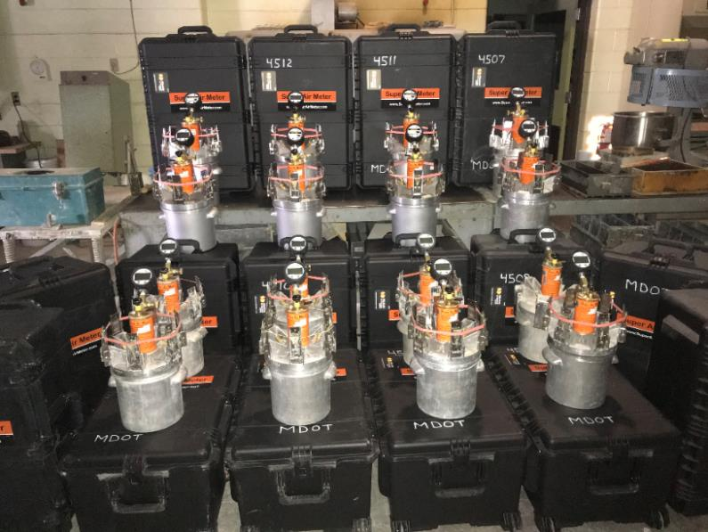
PEM Testing
Super Air Meter (SAM):
Michigan Concrete Association’s SAM Certification Class:
2 train-the-trainer classes completed
3 certification classes completed
In-field, on-site training in 2020

Slide 23
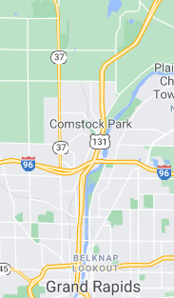
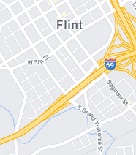
PEM Testing
Super Air Meter (SAM):
Shadow SP: 12CF601
Placed in multiple projects:
Previous:
I-75, Monroe
US-131, Grand Rapids (Rockford)
I-69, Flint
Information provided to Federal Highway and CP Tech Center

Slide 24
PEM Testing
Super Air Meter (SAM):
Shadow SP: 12CF601
Project Complete in 2020:
I-496, Lansing
66 complete samples
2021 Research Project:
University of Michigan
Hardened air analysis of 75 samples
Future projects?
Lansing

Slide 25
PEM Testing
Super Air Meter (SAM):
MDOT’s Experience:
Introduce the SAM gauge
Inspectors experience
Time to run the test
Do not store wet gauges in cases
Do not leave the gauges in the air-conditioned cab prior to testing
Always have spare batteries
Have a backup gauge
Use the Shotgun
Follow the gauge’s directions

Slide 26
PEM Testing
Super Air Meter (SAM):
Future Use:
QC?
Mix Design Verification?
Quality Assurance Daily Test?
Random number Testing?
PWL?

Slide 27
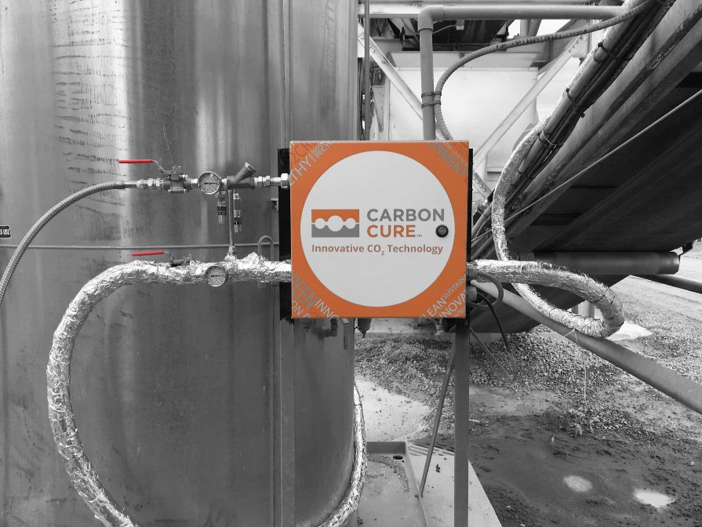
Summary
Michigan has a history of innovation
More innovation in the works
Not all innovations prove themselves to be worth it
Concrete open and suited to innovation
We have the tools to properly assess Performance Related Specifications and new materials to be added to concrete

Slide 28
Special Thanks To:
Ethan Bahmer, MDOT CFS Bahmert1@Michigan.gov (517) 230-0190

