Slide 1

MIOSHA Part 35 Confined Space in Construction - Awareness
(OSHA 1926.1201 SubPart AA)
Presented by
MIOSHA Consultation Education and Training
517-284-7720
Notes:
3/2/16 – KO added slide 18 related to 3 ways to enter a PRCS.
Rev. 11/16/16 KO (rev S.Notes on slides 5 and 11), Rev. JKT 11/13/2015, 11/03/15 added KO speaker notes (slides 1-10) & slide numbers to Master.
Speakers Notes:
Welcome to today’s webinar on MIOSHA’s Part 35 Confined Space in Construction Standard.
We are currently in broadcast mode so all lines have been muted since this webinar is being recorded.
If you have any questions, please submit them using the chat feature and we will address them at the end of the webinar.
If you are calling in using a phone, please hit * 6 to mute your line.
Your presenters for today’s webinar include myself (Kristin Osterkamp) and my colleague (Jenelle Thelen).
We are Senior Industrial Hygienists in MIOSHA’s Consultation, Education and Training Division.

Slide 2
Agenda
Provide overview of the existing and new standards
Describe roles of controlling owner/employer and individuals
Review training requirements
Provide resources and additional information
Review compliance policies
Question and Answer
Notes:
For today’s agenda, we intend to provide you with:
An overview of the existing and new standards
Describe the roles of the controlling owner/employer and individuals
Review training requirements
Provide resources and additional information
Review compliance policies
And at the end provide and opportunity for Question and Answer

Slide 3
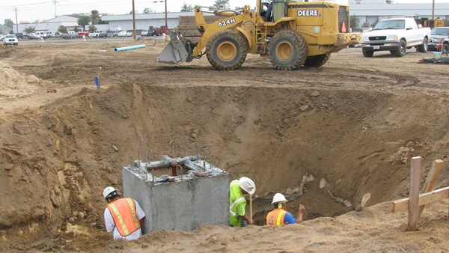
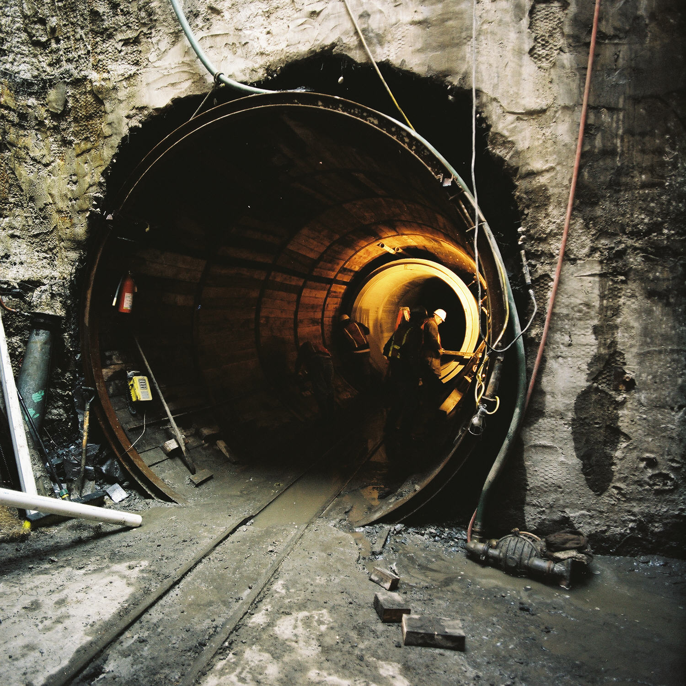
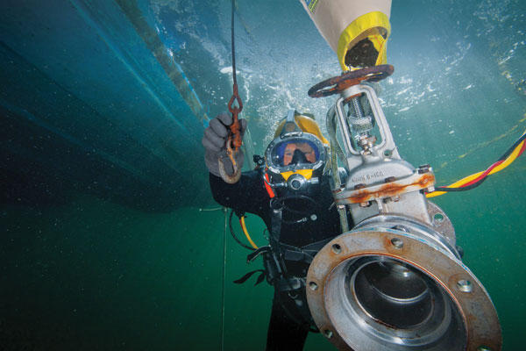
Part 35 Scope and Application
To protect employees engaged in construction activities at a worksite with 1 or more confined space
Does not apply to the following:
  Excavation, Trenching and Shoring (Part 9)
  Tunnels, Shafts, Caissons and Cofferdams (Parts 14 & 665)
  Diving Operations (Part 504)
When Part 35 and another MIOSHA standard applies to confined spaces
(except those listed above), employer must comply with both.
  Examples: Part 1 – General Rules and Part 7 – Welding and Cutting
Notes:
The scope and application section of Part 35, indicates that this Standard applies to employees engaged in construction activities at a worksite, with one or more confined spaces.
The Standard does not apply to:
Excavations, Trenching and Shoring operations
Tunnels, Shafts, Caissons and Cofferdams or
Diving Operations
As these work activities are addressed under their respective vertical standards noted on this slide.
When Part 35 and another MIOSHA standard applies to confined spaces (with the exception of those listed above), the employer must comply with both Standards.
For example: Part 1 – General Rules and Part 7 – Welding and Cutting

Slide 4

What is a confined space?
Is large enough and so configured that an employee can bodily enter it;
Has limited or restricted means for entry and exit; and,
Is not designed for continuous employee occupancy
Must have all three to be a confined space!
Notes:
So “What is a confined space?”
To be considered a “confined space” a space must be:
Large enough and so configured that an employee can bodily enter it;
Have limited or restricted means for entry and exit; and,
Not be designed for continuous employee occupancy
The space must meet all three of these conditions to be considered a confined space!
Before beginning work at a worksite, each employer must ensure that a competent person identifies all confined spaces in which one or more of the employees it directs may work, and identifies each space that is a permit space.
What constitutes a “permit space” will be discussed in great detail later in this presentation.

Slide 5
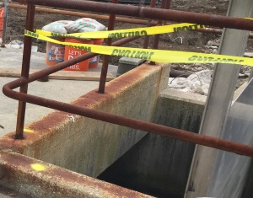
Examples of a Confined space
Bins, boilers, pits
Manholes
Tanks
Incinerators
Scrubbers
Concrete pier columns
Sewers
Transformer vaults
HVAC ducts, Air receivers
Storm drain, water mains
Drilled shafts
Enclosed beams
Vessels, digesters
Lift stations
Cesspools
Silos
Sludge gates
Air preheaters
Step up transformers
Turbines
Chillers
Bag houses
Mixers/reactors
Notes:
The spaces noted on this slide are examples of confined spaces.
If you have these types of confined spaces in your workplace, you must review them to ensure compliance with this Standard.
Not part of script - Image from Partnership with Walsh Construction at Ann Arbor Waste Water Treatment Facility.

Slide 6

What is a permit required confined space?
A confined space containing one or more of the following:
  Hazardous atmosphere or potential to contain a hazardous atmosphere;
  Material that has the potential for engulfing an entrant;
  An internal configuration such that an entrant could be trapped or asphyxiated by inwardly converging walls or by a floor which slopes downward and tapers to a smaller cross section; or
  Any other recognized serious safety or health hazard
Notes:
So “What is a Permit Required Confined Space?”
A Permit Required Confined Space is a confined space (as defined on the previous slide) which contains one or more of the following:
A hazardous atmosphere or potential to contain a hazardous atmosphere;
A material that has the potential for engulfing an entrant;
An internal configuration such that an entrant could be trapped or asphyxiated by inwardly converging walls or by a floor which slopes downward and tapers to a smaller cross section; or
Any other recognized serious safety or health hazard
If the workplace contains one or more permit spaces, the employer who identifies, or who receives notice of, a permit space has additional obligations under the Standard.

Slide 7

Revised Construction Safety Rules
Part 1 General Rules
Part 7 Welding and Cutting
Revised to reference Part 35 Confined Space in Construction
Notes:
Part 1 General Rules and Part 7 Welding and Cutting, were revised to reference Part 35 Confined Space in Construction.

Slide 8
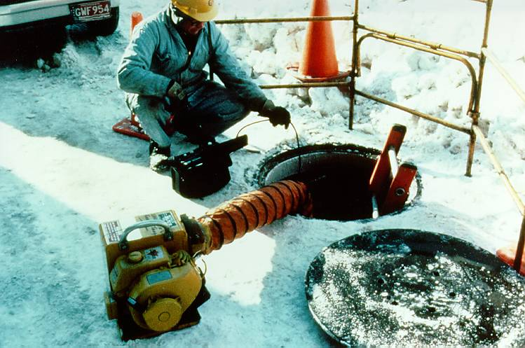
MIOSHA G.I. Part 90/490 & OSHA 1910.146
General Industry – Permit-required Confined Space Rules are similar to the new Construction Safety Part 35
Notes:
Some of you may already be familiar with MIOSHA’s General Industry Permit-required Confined Spaces Standard (Parts 90 & 490).
The new Part 35. Confined Space in Construction Standard is very similar to the General Industry Standard.
Determining which Standard applies, will depend on the work activity being performed.

Slide 9

Is the Work Construction or Maintenance?
Construction work would include:
  construction, alteration, and/or substantial repair (upgrades and improvements)
  painting and decorating.
The General Industry Standard would apply to “maintenance activities“
  Activities related to making or keeping a structure, fixture or foundation in proper condition, in a routine, scheduled, or anticipated fashion.
Maintenance involves "keeping equipment working in its existing state, i.e., preventing its failure or decline.“
Notes:
For example, construction work would include: construction, alteration, and/or substantial repair (upgrades and improvements), including painting and decorating.
The General Industry Standard would apply to “maintenance activities“; which would include activities related to making or keeping a structure, fixture or foundation in proper condition, in a routine, scheduled, or anticipated fashion.
Maintenance involves "keeping equipment working in its existing state, i.e., preventing its failure or decline.“

Slide 10
Overview of Differences:
G.I. vs Construction Confined Space Rules
GI Standard, Plus:
A competent person must conduct worksite evaluation
Employers using “alternate procedures” for permit space entry must prevent physical hazard exposures through elimination or isolation (e.g. Lockout/Tag Out).
Permits may be suspended instead of cancelled, provided the space is returned to permit conditions prior to re-entry
Notes:
Part 35 is very much like the General Industry Standard plus:
A competent person must conduct a worksite evaluation
Employers using “alternate procedures” for permit space entry must prevent physical hazard exposures, through elimination or isolation (e.g. Lockout/Tag Out)
Permits may be suspended instead of cancelled, provided the space is returned to permit conditions prior to re-entry

Slide 11

Overview of Differences (continued)
Continuous monitoring of atmospheric and engulfment hazards
Employers relying on local emergency services for rescue must arrange for responders to notify in advance if responders will be unavailable
Specific information exchange
requirements for multi-employer
work sites
Image from: sewerhistory.org
Notes:
Additionally, Part 35 requires:
Continuous monitoring of atmospheric and engulfment hazards
Employers relying on local emergency services for rescue, must arrange for responders to notify in advance if they will be unavailable
And the Standard states specific information exchange requirements for multi-employer work sites
Image source: http://www.sewerhistory.org/grfx/components/mhcus/images/us_mi_mhc02.jpg
Manhole cover, Lansing, Michigan. Made by the East Jordan Iron Works. Photo date 2006.
Source: Jon Schladweiler, Historian, Arizona Water Association.

Slide 12
Confined Space in Construction:
Who’s Who
Host Employer
Controlling Contractor
Entry Employer
Entry Supervisor
Competent Person
Attendant
Authorized Entrant
Emergency Rescue Personnel
All have a specific jobs responsibilities outlined
in the Confined Space in Construction Standard
Notes:
It is important to know “who’s who” as defined by the standard.
Each of the following have clearly defined roles which we will be describing in more detail in this program:
Host Employer
Controlling Contractor
Entry Employer
Entry Supervisor
Competent Person
Attendant
Authorized Entrant
Emergency Rescue Personnel

Slide 13
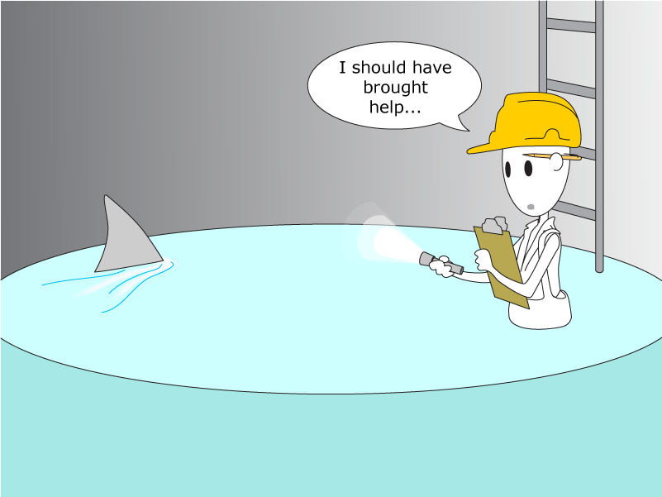
1926.1203(a) general requirements: Before Work Begins
Each employer must ensure that a competent person identifies and evaluates all confined and permit-required spaces.
Reprinted with permission: Waterhelp.org Project
Notes:
Each employer must ensure that a competent person identifies and evaluates all confined and permit-required spaces.
This does not necessarily mean that there must be more than one competent person who identifies and evaluates the spaces but rather each employer must ensure that this is done by a competent person.

Slide 14
1926.1202/1203 Competent Person
Definition: one who is capable of identifying existing and predictable hazards in the surroundings or working conditions which are:
  unsanitary,
  hazardous, or
  dangerous to employees
  Has the authorization to promptly correct/eliminate hazards.
Identifies all confined spaces in which employees it directs may work
Identifies each space that is a permit space. Evaluating all hazards. May included testing.
Reevaluate and reclassify a space, if necessary
Notes:
A “competent person” is defined as: one who is capable of identifying existing and predictable hazards in the surroundings or working conditions which are unsanitary, hazardous, or dangerous to employees, and who has the authorization to take prompt corrective measures to eliminate them.
The competent person also:
identifies all confined spaces in which one or more of the employees it directs may work;
each space that is a permit space, through consideration and evaluation of the elements of that space.
This may include testing as necessary
They are responsible to reevaluate and reclassify a space, if necessary, as:
A permit required confined space
Non-permit confined space

Slide 15

1926.1203 general requirements: Before Work Begins (continued)
If the workplace contains one or more permit spaces, the employer must:
Inform exposed employees of the:
  Existence;
  Location; and,
  Danger posed by each permit space
  Sign may be used
Inform employees’ authorized representatives and the controlling contractor:
  Timely manner
  Manner other than posting
  Existence, location of, and danger posed by each permit space.
Notes:
If the workplace contains one or more permit spaces, the employer must:
(1) Inform exposed employees by posting signs or other effective method of the existence and location of, and the danger posed by, each permit space; and
(2) Inform, in a timely manner and in a manner other than posting, its employees’ authorized representatives and the controlling contractor of the existence and location of, and the danger posed by, each permit space.
Note : A sign reading “DANGER – PERMITREQUIRED CONFINED SPACE, DO NOT ENTER” or other similar language would satisfy the requirement for a sign.
These may be obtained from the MIOSHA CET Library.

Slide 16
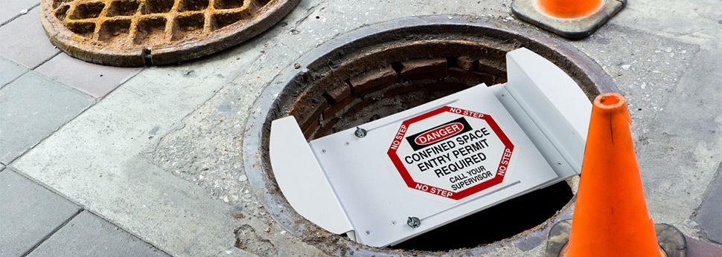
1926.1203 general requirements - Prevent Entry or else…
Each employer must effectively prevent their unauthorized employees from entering the permit space.
Image Source: Brady Corporation
Notes:
Speaker notes:
Each employer must effectively prevent their unauthorized employees from entering the permit space. This could include a combination of signage, barriers and employee training. This is performance-based and the means used must be effective.
The barriers used must not prevent egress out of the space by authorized entrants.
Brady Corp Conditions for use of image:
You may download or copy the Contents and other downloadable materials displayed on the Sites for your personal business use only. You may not reproduce (except as noted above), publish, transmit, distribute, display, modify, create derivative works from, sell or exploit in any way any of the Contents or the Sites.

Slide 17
1926.1203 general requirements – Written Program
Each entry employer must have a written permit space program implemented at the construction site.
The written program must be made available prior to and during entry operations for inspection by employees and their authorized representatives
  Accident Prevention Program and,
  1926.1204 Permit Required Confined Space (PRCS) Program
Notes:
Speakers notes:
Each entry employer must have a written permit space program implemented at the construction site that must be made available prior to and during entry.
This would include the Accident Prevention Program (Part 1) and the Permit Required Confined Space Program (Part 35).

Slide 18
18
Notes:
Once you have identified a permit-required confined space, there are three ways that a space can be entered.
Option 1, would be to enter the space as a “full permit required confined space”. This would be the case if the hazards inside the space can not be eliminated and/or controlled with ventilation.
Option 2, would be to enter under “alternate procedures”. This option can be used when the only hazard is an atmospheric one that can be controlled using ventilation.
Option 3, would be to eliminate or isolate all hazards prior to entry and then “reclassify” the space as a non-permit space.
It is very important to know under which option, employees will be entering the space in order to determine which rules contained in Part 35 apply.

Slide 19
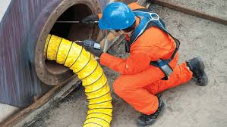
1926.1203 general requirements:
Alternate Entry and Reclassification
Construction Part 35 CSC permits alternate entry:
  (e)(1) – Alternate Entry
  (g) - Reclassification
G.I. Part 490 PRCS permits alternate entry:
(c)(5) – Alternate Entry
  (c)(7) - Reclassification
Image source: ehstoday.com
Notes:
Speakers notes:
Both Part 35 for construction and Part 490 for General Industry include provision to perform work under alternate entry or to reclassify the space from Permit-required to non-permit required confined space.
CSC = Confined Space in Construction
Summary:
Alternate Entry – Elimination and/or control of all hazards including “controlling” atmospheric hazards below MACs
Reclassification – Elimination of all hazards without and before entry.

Slide 20
1926.1203 general requirements:
Alternate Entry Procedures - Overview
Eliminate or isolate physical hazards
Eliminate unsafe conditions when opening the space cover and guard opening
Provide forced air ventilation
Monitor and inspect (pre-entry):
  Oxygen
  Flammable gasses/vapors
  Potential toxic air contaminants
Make data available to employees or employee representatives
Eliminate hazardous atmosphere
Provide continuous air monitoring during entry
(some exceptions)
Provide continuous forced air ventilation (during entry)
Ensure a safe method of entering and exiting the space.
Maintain inspection, entry and monitoring records
Reevaluate space as
needed to protect
employees
Notes:
Speakers notes:
Alternate entry is permitted if the only hazard in the space is atmospheric and it can be controlled through forced air ventilation. The employer must also demonstrate that employees can safely evacuate the space if the ventilation stops working.
There are several conditions and procedures that must be followed to make a permit-required confined space eligible for alternate entry procedures.
Here is an overview (read each bullet)

Slide 21
What are Physical hazards?
Physical hazard means an existing or potential hazard that can cause death or serious physical damage
Energy:
  Mechanical
  Electrical
  Hydraulic
  Pneumatic
Radiation
Noise
Temperature extremes
Explosives (see definition)
Engulfment
Other hazards introduced
Inwardly converging surfaces
Falls
Examples
Physical hazard also includes chemicals that can cause death or serious physical damage through skin or eye contact (rather than through inhalation).
Notes:
Speaker’s notes:
As was mentioned on the previous slide, alternate entry is permitted if the physical hazards have been eliminated or isolated.
What are these physical hazards? (read each bullet)

Slide 22

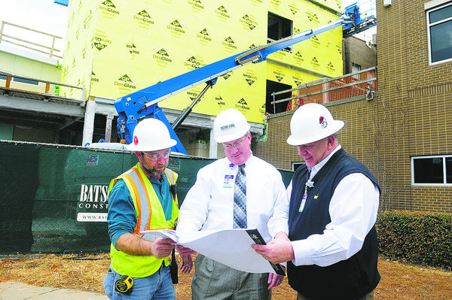
1926.1203 general requirements:
Reclassification (e)(2)(g) - Overview
Determined by a competent person
Space contains no actual or potential hazardous atmosphere
Elimination of hazard without entering
Documentation of reclassification criteria
Employee exit and return to permit
space classification if hazards arise
HAZARDS
Notes:
Speaker’s notes:
It may also be possible to reclassify the permit-required confined space to a confined space by eliminating ALL hazards in the space prior to entry.
The following conditions must be in place (read bullets)

Slide 23
Confined Space and PRCS Hazard and Procedures Information Exchange
Host Employer
Space:
-Location
-Hazards
-Precautions
Pre entry
Post entry debrief
Controlling Contractor
Pre entry:
Pre/post entry:
- Permit program
-Hazards present
or created
Pre/post entry:
-Permit program
-Hazards present
or created
Space:
-Location
-Hazards
-Precautions
Controlling Contractor
Sub Contractor
Coordinate during entry
Sub Contractor
Notes:
(h)(1) Before entry operations begin, the host employer must provide the following information, if it has it, to the controlling contractor:
(i) The location of each known permit space;
(ii) The hazards or potential hazards in each space or the reason it is a permit space; and
(iii) Any precautions that the host employer or any previous controlling contractor or entry employer implemented for the protection of employees in the permit space.
(h)(2) Before entry operations begin, the controlling contractor must:
(i) Obtain the host employer’s information about the permit space hazards and previous entry operations; and
(ii) Provide the following information to each entity entering a permit space and any other entity at the worksite whose activities could foreseeably result in a hazard in the permit space:
(A) The information received from the host employer;
(B) Any additional information the controlling contractor has about the subjects listed in paragraph (h)(1); and
(C) The precautions that the host employer, controlling contractor, or other entry employers implemented for the protection of employees in the permit spaces.
(3) Before entry operations begin, each entry employer must:
(i) Obtain all of the controlling contractor’s information regarding permit space hazards and entry operations; AND
(ii) Inform the controlling contractor of the permit space program that the entry employer will follow, including any hazards likely to be confronted or created in each permit space.
(4) The controlling contractor and entry employer(s) must coordinate entry operations when:
(i) More than one entity performs permit space entry at the same time; OR
(ii) Permit space entry is performed at the same time that any activities that could foreseeably result in a hazard in the permit space are performed.
(5) After entry operations:
(i) Controlling contractor: debrief each entity that entered a permit space regarding the permit space program followed and any hazards confronted or created in the permit space(s) during entry operations;
(ii) Entry employer: inform the controlling contractor in a timely manner of the permit space program followed and of any hazards confronted or created in the permit space(s) during entry operations; and
(iii) Controlling contractor must apprise the host employer of the information exchanged with the entry entities.
(iv) If there is no controlling contractor present at the worksite, the requirements must be fulfilled by the host employer or other employer.

Slide 24
1926.1204 Permit Required Confined Space Program - Overview
Each Entry Employer Must:
Prevent unauthorized entry
I.D. and evaluate hazards
Develop and implement safe entry: means, procedures and practices
Provide and ensure proper use of equipment
Evaluate permit space conditions for air contaminants
Provide attendant(s) outside space
Manage multiple spaces in an emergency
Assign duties to employees involved in permit space entry
Develop and implement procedures:
  Rescue and emergency services
  Prep, use and cancel entry permits
  Coordinate entry with multiple employers
  Conclude/close entry operations
Review entries and program; revise when needed
Annual review using cancelled permits
Notes:
Speaker’s Notes:
This slide provides an overview of the Permit Required Confined Space Program (read each bullet)
The following slides will highlight some specific provisions of the PRCS Program.

Slide 25
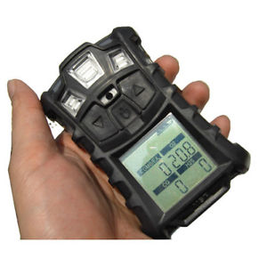
1926.1204 Permit Required Confined Space Program (e):
Evaluation
Evaluate permit space conditions when entry operations are conducted:
  Before entry - test conditions in the permit space before changing the space’s natural ventilation,
  Exceptions: If isolation of the space is infeasible because the space is large or is part of a continuous system (such as a sewer), the employer must:
    Perform pre-entry testing; and,
    Continuously monitor entry conditions in the areas where authorized entrants are working
    Provide an early-warning system that continuously monitors for non-isolated engulfment hazards.
Notes:
Speaker’s notes:
The first step is to properly evaluate the permit space that will be entered…..
(e) Evaluate permit space conditions when entry operations are conducted:
(1) Test conditions in the permit space to determine if acceptable entry conditions exist before changes to the space’s natural ventilation are made, and before entry is authorized to begin, except that, if an employer demonstrates that isolation of the space is infeasible because the space is large or is part of a continuous system (such as a sewer), the employer must:
(i) Perform pre-entry testing to the extent feasible before entry is authorized; and,
(ii) If entry is authorized, continuously monitor entry conditions in the areas where authorized entrants are working, except that employers may use periodic monitoring in accordance with paragraph §1926.1204(e)(2) for monitoring an atmospheric hazard if they can demonstrate that equipment for continuously monitoring that hazard is not commercially available;
(iii) Provide an early-warning system that continuously monitors for non-isolated engulfment hazards. The system must alert authorized entrants and attendants in sufficient time for the authorized entrants to safely exit the space.
(2) Continuously monitor atmospheric hazards unless the employer can demonstrate that the equipment for continuously monitoring a hazard is not commercially available or that periodic monitoring is of sufficient frequency to ensure that the atmospheric hazard is being controlled at safe levels. If continuous monitoring is not used, periodic monitoring is required with sufficient frequency to ensure that acceptable entry conditions are being maintained during the course of entry operations;

Slide 26
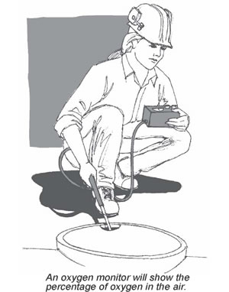
1926.1204 Permit Required Confined Space Program (e):
Evaluation (continued)
  Continuously monitor atmospheric hazards unless:
    Equipment is not commercially available OR
    Periodic monitoring is sufficient to ensure the hazard at are safe levels.
    If continuous monitoring is not used, periodic monitoring is required with sufficient
    frequency to ensure acceptable entry conditions are maintained during the entry operations
Notes:
Speaker’s notes:
Continuously monitor atmospheric hazards unless:
Equipment is not commercially available OR
Periodic monitoring is sufficient to ensure the hazard at are safe levels.
If continuous monitoring is not used, periodic monitoring is required with sufficient
frequency to ensure acceptable entry conditions are maintained during the entry operations

Slide 27

1926.1204 Permit Required Confined Space Program (e):
Evaluation (continued)
  Testing for atmospheric hazards:
    Oxygen (Range = 19.5 to 23.5%)
    Combustible gases and vapors
    Measured by Lower Explosive Limit (LEL)
    Toxic gases and vapors:
    Permissible Exposure Limit (PEL)
    Test in that order!
O₂
LEL
CO
H₂S
Notes:
Speaker’s notes:
(3) When testing for atmospheric hazards, test first for oxygen, then for combustible gases and vapors, and then for toxic gases and vapors;
Many flammable gas sensors are oxygen dependent and will not provide reliable readings in an oxygen deficient atmosphere. Therefore, oxygen content must always be determined before taking combustible gas readings. Flammable gases and vapors are tested second because the risk of fire or explosion is typically more life-threatening than exposure to toxic air contaminants. Monitoring for toxicity is usually conducted last. This monitoring process is greatly simplified by using a multi-gas monitor containing sensors for oxygen, LEL, and the relevant toxic gases.
Always follow the manufacturer’s instructions for operation of instruments.

Slide 28
1926.1204 Permit Required Confined Space Program (f)-(h)
Attendant:
Provide at least one attendant outside the permit space for the duration of entry operations
  May be assigned to more than one space
  May be stationed at any location (outside)as long as duties can be performed
If multiple spaces assigned to 1 attendant, document how emergencies will be managed without detracting from responsibilities for other spaces
Designate each person who has a role in entry operations:
  Identify their duties
  Provide training
Notes:
Speaker’s notes:
Attendants must be present during entry of a PRCS.
(f) Provide at least one attendant outside the permit space for the duration of entry operations;
(1) May be assigned to more than one permit space able to manage [for example, if there are 2 vaults side-by-side with entry points next to each other, one attendant may be able to sufficiently manage the entry]
(2) Attendants may be stationed at any location outside the permit space as long as the duties can be effectively performed for each assigned permit space
(g) If multiple spaces are to be assigned to a single attendant, include in the permit program the means and procedures to enable the attendant to respond to an emergency affecting one or more of those permit spaces without distraction from the attendant’s responsibilities;
(h) Designate each person who is to have an active role in entry operations, identify the duties of each such employee, and provide required training to each employee

Slide 29
1926.1204 Permit Required Confined Space Program (i)-(l)
develop and implement procedures:
Summoning rescue and emergency services
Preventing unauthorized personnel from attempting a rescue;
Preparing, issuing, using, and cancelling of entry permits
Coordinating entry operations when employees of more than one employer are working simultaneously in a permit space or where their activities may result in a hazard within the confined space
Concluding the entry after entry operations have been completed
Notes:
Speaker’s notes:
Entry employers are required to ….
Develop and implement procedures for the following:
(i) Summoning rescue and emergency services and for preventing unauthorized personnel from attempting a rescue;
(j) Preparing, issuing, using, and cancelling of entry permits
(k) Coordinating entry operations when employees of more than one employer are working simultaneously in a permit space or elsewhere on the worksite where their activities could foreseeably result in a hazard within the confined space
(l) Concluding the entry after entry operations have been completed;

Slide 30
1926.1205 Permitting Process
Before entry each entry employer must:
  Prepare an entry permit.
  Have entry supervisor sign the entry permit to authorize entry.
  Make completed permit available to all entrants or their representatives
    Posting at the entry portal or
    Other equally effective means
The duration of the permit may not exceed the time required to complete the task/job identified on the permit.
Notes:
Speaker’s notes:
The following outlines the permitting process.
[1926.1205 Permitting Process]
(a) Before entry, each entry employer must prepare an entry permit.
(b) Before entry begins, the entry supervisor identified on the permit must sign the entry permit to authorize entry.
(c) The completed permit must be made available at the time of entry to all authorized entrants or their authorized representatives, by posting it at the entry portal or by any other equally effective means, so that the entrants can confirm that pre-entry preparations have been completed.
(d) The duration of the permit may not exceed the time required to complete the assigned task or job identified on the permit.

Slide 31

1926.1206 Entry Permit
The entry permit must identify:
The permit space to be entered;
The purpose of the entry;
The date and the authorized duration of the entry permit;
The name/ID of authorized entrants within the permit space;
Means of detecting an increase in atmospheric hazard levels if ventilation system stops working;
Name of each person serving as an attendant;
Notes:
Speaker’s notes:
The entry permit that documents compliance with this section and authorizes entry to a permit space must identify:
(a) The permit space to be entered;
(b) The purpose of the entry;
(c) The date and the authorized duration of the entry permit;
(d) The authorized entrants within the permit space, by name or by other means to enable the attendant to determine quickly and accurately, for the duration of the permit, which authorized entrants are inside the permit space;
(e) Means of detecting an increase in atmospheric hazard levels in the event the ventilation system stops working;
(f) Each person, by name, currently serving as an attendant;
Note to paragraph §1926.1206(d). This requirement may be met by inserting a reference on the entry permit as to the means used, such as a roster or tracking system, to keep track of the authorized entrants within the permit space.

Slide 32

1926.1206 Entry Permit
The entry permit must identify (continued):
Name of the “on duty” entry supervisor and signature or initials of each entry supervisor who authorizes entry;
Hazards of the permit space to be entered;
Measures used before entry to
  Isolate the permit space
  Eliminate or control hazards;
Acceptable entry conditions;
Results of tests and monitoring performed including:
  Names or initials of the testers
  Note when tests were performed;
Notes:
Speaker’s notes:
Additionally, the entry permit must identify…
(g) The individual, by name, currently serving as entry supervisor, and the signature or initials of each entry supervisor who authorizes entry;
(h) The hazards of the permit space to be entered;
(i) The measures used to isolate the permit space and to eliminate or control permit space hazards before entry;
Note to paragraph §1926.1206(i). Those measures can include, but are not limited to, the lockout or tagging of equipment and procedures for purging, inerting, ventilating, and flushing permit spaces.

Slide 33

1926.1206 Entry Permit
The entry permit must identify (continued):
Rescue and emergency services that can be summoned and the means (such as the equipment to use and the numbers to call);
Communication procedures used by authorized entrants and attendants;
Equipment to be provided (e.g. PPE, testing equipment, communications equipment, alarm systems, and rescue equipment);
Other information necessary to ensure employee safety; and
Additional permits (e.g. hot work) that have been issued to authorize work in the permit space.
Notes:
Speaker’s notes:
The entry permit must also identify…
(l) The rescue and emergency services that can be summoned and the means (such as the equipment to use and the numbers to call) for summoning those services;
(m) The communication procedures used by authorized entrants and attendants;
(n) Equipment (e.g. PPE, testing equipment, communications equipment, alarm systems, and rescue equipment) to be provided for compliance;
(o) Any other information necessary to ensure employee safety; and
(p) Any additional permits (e.g. hot work) that have been issued to authorize work in the permit space.

Slide 34
1926.1207 Training
The employer must provide training:
At no cost to the employee
Ensures employee possesses understanding, knowledge, and skills to safely perform assigned duties
Results in an understanding of the hazards and the methods used to:
  Isolate,
  Control
  Protect employees
Instructs unauthorized employees in the dangers of attempting rescue.
Notes:
Speaker’s Notes:
(a) The employer must provide training to each employee whose work
is regulated by this standard
At no cost to the employee
Ensure employee possesses understanding, knowledge, and skills necessary for the safe performance of the assigned duties
Must result in an understanding of the hazards in the permit space and the methods used to:
Isolate,
Control or
Protect employees from these hazards
Instruct unauthorized employees in the dangers of attempting rescue.

Slide 35
1926.1207 Training
The employer must provide training (continued):
  In understandable language and vocabulary;
  Before the employee is assigned duties;
  Before a change in assigned duties;
  Whenever there is a change that presents a new hazard
  Whenever there is any evidence of a deviation from the permit space entry procedures or,
  Whenever there are inadequacies in the employee’s knowledge or use of the procedures
Notes:
Speaker’s Notes:
Training must be provided to each affected employee:
(b) Training required by this section must be provided to each affected employee:
(1) In both a language and vocabulary that the employee can understand;
(2) Before the employee is first assigned duties under this standard;
(3) Before there is a change in assigned duties;
(4) Whenever there is a change in permit space entry operations that presents a hazard about which an employee has not previously been trained; and
(5) Whenever there is any evidence of a deviation from the permit space entry procedures or there are inadequacies in the employee’s knowledge or use of these procedures

Slide 36
1926.1207 Training
The employer must provide training (continued):
Establishes employee proficiency in the duties
Introduce new or revised procedures, as necessary.
The employer must maintain training records including:
  Each employee’s name,
  Name of the trainers, and
  Dates of training.
Notes:
Speaker’s notes:
The training must also:
Establish employee proficiency in the duties
Introduce new or revised procedures, as necessary.
The employer must maintain training records including:
Each employee’s name,
Name of the trainers, and
Dates of training.
The documentation must be available for inspection by employees and their authorized representatives, for the period of time the employee is employed by that employer.

Slide 37
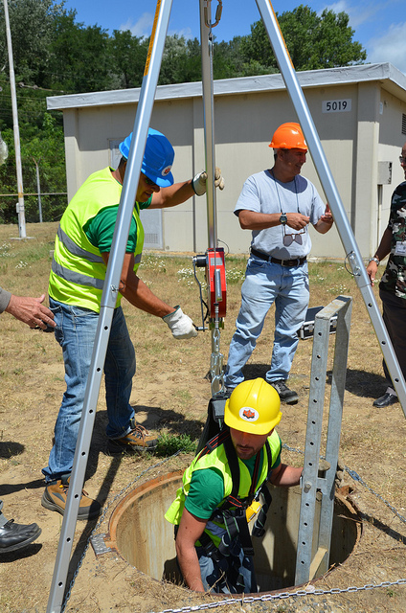
Duties and Responsibilities
Authorized Entrant
Attendant
Entry Supervisor
Notes:
Image from free source: https://farm7.staticflickr.com/6130/5953438115_01bfb2fbd9_z.jpg
Speaker’s notes:
There are specific duties and responsibilities for the
-Authorized Entrant
-Attendant
-Entry Supervisor

Slide 38
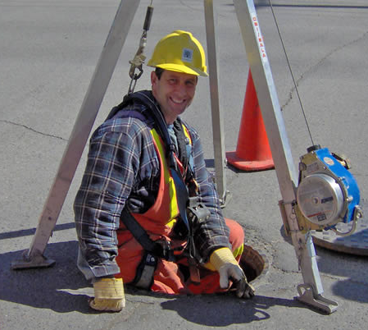
1926.1208 Duties: Authorized Entrant
The entry employer must ensure that all
authorized entrants:
Familiar and understand the hazards
including exposure information
Properly use required equipment
Communicate with the attendant and
alert the attendant whenever:
  There is any warning sign or symptom of exposure or
  The entrant detects a prohibited condition
Notes:
Speaker’s notes:
The entry employer must ensure that all authorized entrants:
(a) Are familiar with and understand the hazards that may be faced during entry, including information on the mode, signs or symptoms, and consequences of the exposure;
(b) Properly use equipment as required by paragraph §1926.1204(d) of this standard;
(c) Communicate with the attendant as necessary to enable the attendant to assess entrant status and to enable the attendant to alert entrants of the need to evacuate the space as required by paragraph §1926.1209(f) of this standard;
(d) Alert the attendant whenever:
(1) There is any warning sign or symptom of exposure to a dangerous situation; or
(2) The entrant detects a prohibited condition; and
(e) Exit from the permit space as quickly as possible whenever:
(1) An order to evacuate is given by the attendant or the entry supervisor;
(2) There is any warning sign or symptom of exposure to a dangerous situation;
(3) The entrant detects a prohibited condition; or
(4) An evacuation alarm is activated.

Slide 39

1926.1208 Duties: Authorized Entrant (continued)
The entry employer must ensure that all authorized entrants (continued):
Exit from the permit space as quickly as possible whenever:
  An order to evacuate is given by the attendant or the entry supervisor;
  There is any warning sign or symptom of exposure to a dangerous situation;
  The entrant detects a prohibited condition; or
  An evacuation alarm is activated.
Notes:
Speaker’s notes:
The entry employer must ensure that all authorized entrants:
(a) Are familiar with and understand the hazards that may be faced during entry, including information on the mode, signs or symptoms, and consequences of the exposure;
(b) Properly use equipment as required by paragraph §1926.1204(d) of this standard;
(c) Communicate with the attendant as necessary to enable the attendant to assess entrant status and to enable the attendant to alert entrants of the need to evacuate the space as required by paragraph §1926.1209(f) of this standard;
(d) Alert the attendant whenever:
(1) There is any warning sign or symptom of exposure to a dangerous situation; or
(2) The entrant detects a prohibited condition; and
(e) Exit from the permit space as quickly as possible whenever:
(1) An order to evacuate is given by the attendant or the entry supervisor;
(2) There is any warning sign or symptom of exposure to a dangerous situation;
(3) The entrant detects a prohibited condition; or
(4) An evacuation alarm is activated.

Slide 40
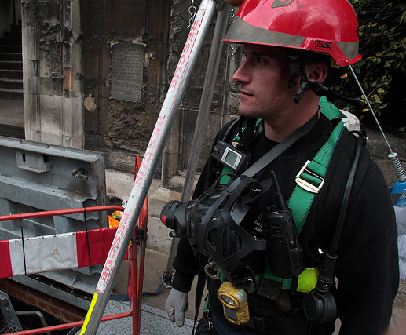
1926.1209 Duties of Attendants
Notes:
Speaker’s Notes:
Next, we will review the duties of attendants.
Image from free source: http://farm4.staticflickr.com/3145/2967781018_0567f7318a_z.jpg

Slide 41
1926.1209 Duties of Attendants
The entry employer must ensure that each attendant:
Familiar and understand the hazards:
  Exposure modes, signs, symptoms
  Behavioral effects of hazard exposure in entrants
Maintains an accurate count and identity of authorized entrants in the permit space
Remains outside the permit space during entry operations until relieved by another attendant;
Communicates with entrants as necessary:
  Assess entrant status
  Alert entrants to evacuate when necessary
Assesses activities and conditions inside and outside the space to determine if it is safe for entrants to remain in the space
Notes:
Speaker’s Notes:
The entry employer must ensure that each attendant:
(a) Is familiar with and understands the hazards that may be faced during entry, including information on the mode, signs or symptoms, and consequences of the exposure;
(b) Is aware of possible behavioral effects of hazard exposure in authorized entrants;
(c) Continuously maintains an accurate count of authorized entrants in the permit space and ensures that the means used to identify authorized entrants under paragraph 1926.1206(d) of this standard accurately identifies who is in the permit space;
(d) Remains outside the permit space during entry operations until relieved by another attendant;
Note to paragraph §1926.1209(d). Once an attendant has been relieved by another attendant, the relieved attendant may enter a permit space to attempt a rescue when the employer’s permit space program allows attendant entry for rescue and the attendant has been trained and equipped for rescue operations as required by paragraph §1926.1211(a).
(e) Communicates with authorized entrants as necessary to assess entrant status and to alert entrants of the need to evacuate the space under paragraph §1926.1208(e);
(f) Assesses activities and conditions inside and outside the space to determine if it is safe for entrants to remain in the space and….

Slide 42

1926.1209 Duties of Attendants
The entry employer must ensure that each attendant (continued):
Orders entrants to evacuate immediately if any of the following occur:
  There is a prohibited condition
  The entrant exhibits behavioral effects of hazard exposure
  There is a situation outside the space that could endanger the authorized entrants
  If the attendant cannot effectively and safely perform all assigned duties
Summons rescue and other emergency services if entrants need assistance to escape from permit space
Notes:
Image source: www.scotia-radio.co.uk/sectors/construction/
Speaker’s notes:
(f)…..orders the authorized entrants to evacuate the permit space immediately under any of the following conditions:
If there is a prohibited condition;
1926.1202 DEFINITIONS
Prohibited condition means any condition in a permit space that is not allowed by the permit during the period when entry is authorized. A hazardous atmosphere is a prohibited condition unless the employer can demonstrate that personal protective equipment (PPE) will provide effective protection for each employee in the permit space and provides the appropriate PPE to each employee.
The attendant will also order an evacuation…
(2) If the behavioral effects of hazard exposure are apparent in an authorized entrant;
(3) If there is a situation outside the space that could endanger the authorized entrants; or
(4) If the attendant cannot effectively and safely perform all the duties required under §1926.1209 of this standard;
The attendant
(g) Summons rescue and other emergency services as soon as the attendant determines that authorized entrants may need assistance to escape from permit space hazards;

Slide 43
1926.1209 Duties of Attendants
The entry employer must ensure that each attendant (continued):
During entry, takes the following actions when unauthorized persons approach or enter a permit space:
  Warn the unauthorized persons to stay away from the permit space;
  Advise the unauthorized persons to exit immediately if they have entered; and
  Inform the authorized entrants and the entry supervisor if unauthorized persons have entered
Performs non-entry rescues as specified by the employer’s rescue procedure
Performs no duties that might interfere with the attendant’s primary duties:
  Assess conditions during entry
  Protect the authorized entrants.
Notes:
Image source: www.scotia-radio.co.uk/sectors/construction/
Speaker’s notes:
Additionally the attendant…
(h) Takes the following actions when unauthorized persons approach or enter a permit space while entry is underway:
(1) Warns the unauthorized persons that they must stay away from the permit space;
(2) Advises the unauthorized persons that they must exit immediately if they have entered the permit space; and
(3) Informs the authorized entrants and the entry supervisor if unauthorized persons have entered the permit space;
(i) Performs non-entry rescues as specified by the employer’s rescue procedure; and
(j) Performs no duties that might interfere with the attendant’s primary duty to assess
and protect the authorized entrants.

Slide 44
1926.1210 Duties of Entry Supervisors
The entry employer must ensure that each entry supervisor:
Familiar and understand the hazards including exposure information
Verifies by reviewing the entry permit:
  Any tests specified by the permit have been conducted
  Procedures and equipment are in place before endorsing and allowing entry to begin
Terminates the entry and cancels or suspends the permit
Notes:
Speaker’s notes:
The entry supervisor…
(a) Is familiar with and understands the hazards that may be faced during entry, including information on the mode, signs or symptoms, and consequences of the exposure;
(b) Verifies, by checking that the appropriate entries have been made on the permit, that all tests specified by the permit have been conducted and that all procedures and equipment specified by the permit are in place before endorsing the permit and allowing entry to begin;
(c) Terminates the entry and cancels or suspends the permit as required by paragraph 1926.1205(e) of this standard;

Slide 45

1926.1210 Duties of Entry Supervisors
The entry employer must ensure that each entry supervisor (continued):
Verifies that rescue services:
  Are available
  Can be summoned (system used is operable)
  Will notify the employer if services become unavailable
Removes unauthorized individuals who enter or who attempt to enter the permit space during entry operations
Whenever responsibility for a permit space entry operation is transferred:
  Determines that entry operations remain consistent with terms of the entry permit
  Acceptable entry conditions are maintained.
Notes:
Speaker’s notes:
The entry supervisor also….
(d) Verifies that rescue services are available and that the means for summoning them are operable, and that the employer will be notified as soon as the services become unavailable;
(e) Removes unauthorized individuals who enter or who attempt to enter the permit space during entry operations; and
(f) Determines, whenever responsibility for a permit space entry operation is transferred, and at intervals dictated by the hazards and operations performed within the space, that entry operations remain consistent with terms of the entry permit and that acceptable entry conditions are maintained.

Slide 46

1926.1211 Rescue and Emergency Services - Evaluate
An employer who designates rescue and emergency services must evaluate:
Rescuer’s ability to respond in a timely manner, considering the hazard(s) identified;
Rescue service’s ability (proficiency) with rescue-related tasks and equipment, used to rescue entrants from the each type of permit space identified
Notes:
Speaker’s notes:
(a) An employer who designates rescue and emergency services must:
(1) Evaluate a prospective rescuer’s ability to respond to a rescue summons in a timely manner, considering the hazard(s) identified;
(2) Evaluate a prospective rescue service’s ability, in terms of proficiency with rescue-related tasks and equipment, to function appropriately while rescuing entrants from the particular permit space or types of permit spaces identified;
Note: to paragraph §1926.1211(a)(1). What will be considered timely will vary according to the specific hazards involved in each entry. For example, §1926.103—Respiratory Protection [Standard] requires that employers provide a standby person or persons capable of immediate action to rescue employee(s) wearing respiratory protection while in work areas defined as IDLH atmospheres.
Preamble states that 4 minute response in IDLH atmosphere. If primary hazard is injury (broken bones, abrasions), response time of 10-15 minutes may be considered timely.

Slide 47
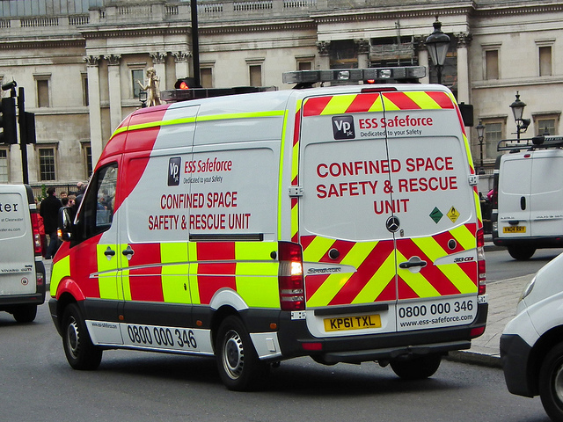
1926.1211 Rescue and Emergency Services - Selection
  Select a rescue team or service from those evaluated that:
    Has the capability to reach the victim(s) within a time frame that is appropriate for the permit space hazard(s) identified
    Is equipped for, and proficient in, performing the needed rescue services
    Agrees to notify the employer
    immediately if rescue service
    becomes unavailable
Notes:
Image from UK (free source) https://c2.staticflickr.com/8/7047/7042498645_95e0667ba4_z.jpg
Speaker’s notes:
(3) Select a rescue team or service from those evaluated that:
(i) Has the capability to reach the victim(s) within a time frame that is appropriate for the permit space hazard(s) identified;
(ii) Is equipped for, and proficient in, performing the needed rescue services;
(iii) Agrees to notify the employer immediately in the event that the rescue service becomes unavailable;

Slide 48
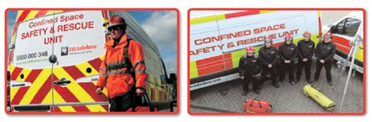
1926.1211 Rescue and Emergency Services – Information and Access
  Inform each rescue team or service of the hazards
  Provide the rescue team or service with access to all permit spaces:
    From which rescue may be necessary
    To develop appropriate rescue plans
    To practice rescue operations.
Notes:
Image from UK (free source)
Speaker’s notes:
The entry employer must:
(4) Inform each rescue team or service of the hazards they may confront when called on to perform rescue at the site; and
(5) Provide the rescue team or service selected with access to all permit spaces from which rescue may be necessary so that the rescue team or service can develop appropriate rescue plans and practice rescue operations.

Slide 49
1926.1211 Rescue and Emergency Services – Provided by Employee(s)
Employees designated to provide permit space rescue:
Training and PPE provided at no cost
Training in use of PPE needed to conduct rescues safely
Training to perform assigned rescue duties and proficiency as authorized entrants
At least one member of the rescue team or service holding a current certification in basic first aid and CPR is available
Practice (simulate) making permit space rescues before attempting an actual rescue at least once every 12 months.
Notes:
Speaker’s notes:
(b) An employer whose employees have been designated to provide permit space rescue and/or
emergency services must take the following measures and provide all equipment and training at no cost to those
employees:
(1) Provide each affected employee with the personal protective equipment (PPE) needed to conduct
permit space rescues safely and train each affected employee so the employee is proficient in the use of that PPE;
(2) Train each affected employee to perform assigned rescue duties. The employer must ensure that
such employees successfully complete the training required and establish proficiency as authorized entrants, as
provided by §§ 1926.1207 and 1926.1208;
(3) Train each affected employee in basic first aid and cardiopulmonary resuscitation (CPR). The
employer must ensure that at least one member of the rescue team or service holding a current certification in
basic first aid and CPR is available; and
(4) Ensure that affected employees practice making permit space rescues before attempting an actual
rescue, and at least once every 12 months, by means of simulated rescue operations in which they remove
dummies, manikins, or actual persons from the actual permit spaces or from representative permit spaces, except
practice rescue is not required where the affected employees properly performed a rescue operation during the last
12 months in the same permit space the authorized entrant will enter, or in a similar permit space. Representative
permit spaces must, with respect to opening size, configuration, and accessibility, simulate the types of permit
spaces from which rescue is to be performed.

Slide 50
1926.1211 Rescue and Emergency Services –
Non-entry or Entry
Non-entry rescue is required unless the retrieval equipment would increase the overall risk of entry or would not contribute to rescuing the entrant.
Whenever non-entry rescue is selected, the entry employer must:
  Ensure that retrieval systems or methods are used
  Confirm, prior to entry, that emergency assistance would be available in the event that non-entry rescue fails.
If entry rescue is selected, the employer must designate an entry rescue service
SDS or written information must be made available to the medical facility treating the exposed entrant
Notes:
Speaker’s notes:
Non-entry rescue is required unless the retrieval equipment would increase the overall risk of entry or would not contribute to rescuing the entrant.
Whenever non-entry rescue is selected, the entry employer must:
Ensure that retrieval systems or methods are used
Confirm, prior to entry, that emergency assistance would be available in the event that non-entry rescue fails.
If entry rescue is selected, the employer must designate an entry rescue service
SDS or written information must be made available to the medical facility treating the exposed entrant
Excerpt from Standard for reference only:
(c) Non-entry rescue is required unless the retrieval equipment would increase the overall risk of entry or would not contribute to the rescue of the entrant.
The employer must designate an entry rescue service whenever non-entry rescue is not selected.
Whenever non-entry rescue is selected, the entry employer must ensure that:
Retrieval systems or methods are used whenever an authorized entrant enters a permit space
Confirm, prior to entry, that emergency assistance would be available in the event that non-entry rescue fails.
(c) is continued on next slide……
(d) SDS or written information must be made available to the medical facility treating the exposed entrant where SDS is available and kept on site.

Slide 51
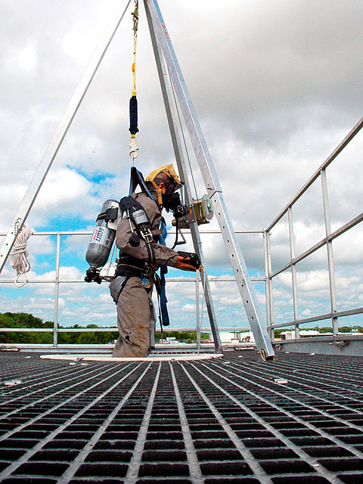
1926.1211 Rescue and Emergency Services
Retrieval systems requirements:
Chest or full body harness
Goal:
Quick, safe removal
and rescue in an emergency
Do not use:
Unsuitable retrieval equipment (e,g, entanglement or configuration of space
or other issues)
Retrieval line - Attached center of back near shoulder and above head or other…and other end of line attached to:
Mechanical device or fixed point outside the space (>5 ft deep)
Notes:
Image Source (free use): http://farm4.staticflickr.com/3214/3040581077_e2b0568721_z.jpg?zz=1
Speaker’s notes:
(c) continued… Retrieval systems must meet the following requirements:
(1) Entrants must use a chest or full body harness, with a retrieval line attached at the center of the entrant’s back near shoulder level, above the entrant’s head, or at another point which the employer can establish presents a profile small enough for the successful removal of the entrant.
(2) The other end of the retrieval line must be attached to a mechanical device or fixed point outside the permit space in a way for rescue to begin ASAP. A mechanical device must be available to retrieve personnel from vertical type permit spaces more than 5 feet deep.
(3) Unsuitable retrieval equipment must not be used, (e.g. retrieval lines that may become easily entangled with those used by other entrants, or lines that will not work due to the internal configuration of the permit space).
Wristlets or anklets may be used in lieu of the chest or full body harness if the employer can demonstrate that the use of a chest or full body harness is infeasible or creates a greater hazard and that the use of wristlets or anklets is the safest and most effective alternative.

Slide 52

1926.1212 Employee Participation
Employers must:
Consult with affected employees and their authorized representatives on the development and implementation of all aspects of the permit space program.
Make available to each affected employee and his/her authorized representatives all information required to be developed by this standard.
Notes:
Image source (free): http://2012books.lardbucket.org/books/management-principles-v1.1/section_17/4b8e92895582523a8d24a69a0082581e.jpg
Speaker’s notes:
(a) Employers must consult with affected employees and their authorized representatives on the development and implementation of all aspects of the permit space program required by §1926.1203 of this standard.
(b) Employers must make available to each affected employee and his/her authorized representatives all information required to be developed by this standard.

Slide 53
Additional Information
MIOSHA Confined Space in Construction webpage
OSHA Small Entity Compliance guide
OSHA Fact Sheets and FAQs
Standard Interpretations
General Industry Standard – Permit-required Confined Space
Notes:
Speaker’s notes:
Additional information is available on the MIOSHA and OSHA websites.
To access the MIOSHA webpage, go to www.michigan.gov/miosha then select the A-Z Index on the left side of the page. Choose “C” for “confined space”.
The MIOSHA Confined Space in Construction webpage provides links to Federal OSHA resources including the Small Entity Compliance Guide, Fact Sheets, FAQs and Standard Interpretations.
You may also refer to the General Industry Permit-Required Confined Space guidelines and interpretations.

Slide 54
Questions?
Michigan Occupational Safety & Health Administration
Michigan Department of Licensing and Regulatory Affairs
www.michigan.gov/miosha
Consultation Education & Training Division
(517) 284-7720
Construction Safety and Health Division
(517) 284- 7680
Notes:
Speaker’s notes:
This concludes the training. If you have questions, please contact the MIOSHA Consultation Education and Training Division at (517) 284-7720 or Construction Safety and Health Division (517) 284-7680.
Thank you.

