Slide 1

HOPE Recuperative Center
A Hospital “Discharge to Home” Option for Those Who Are Homeless.

Slide 2
What is Recuperative Care?
Recuperative care is acute and post acute medical care for homeless persons who are too ill or frail to recover from a physical illness or injury on the streets but are not ill enough to be in a hospital.
National Healthcare for the Homeless Council

Slide 3
HISTORY OF RECUPERATIVE CARE
Recuperative Care aka Medical Respite began in 1985 in Boston
Popularity of this model soared in CA in late 1990s due to legislative response to shelter “dumping”
HOPE is the first using this model in MI; currently about 90 centers in the US and Canada
Model is easy to replicate with strong community partnerships and is cost effective
More information on this model including policies, protocols, etc. can be found at www.nhchc.org

Slide 4
HOPE’s Recuperative Care Pilot
HOPE Recuperative Care Center is an initiative of the Oakland County Homeless Healthcare Collaboration—Hospital Discharge Planning Committee
Ten bed pilot opened Oct 1, 2015
Located at 175 Branch in Pontiac
Participating hospitals for pilot: St. Joseph Mercy Oakland, McLaren Oakland, Henry Ford West Bloomfield
Provides a safe and dignified space for homeless people being discharged from the hospital to recover from acute illness/injury or stabilize from an exacerbation of a chronic condition

Slide 5
What Recuperative Care Offers
Successful resolution of acute conditions and stabilization of chronic conditions
Linkages to additional services
Development of plans focused on positive, long term changes
Recuperation from not only physical illness but also the emotional distress and isolation that accompany homelessness

Slide 6













Community Partners

Slide 7
Recuperative Care Admission Criteria
Patient must be literally homeless
Patient is referred by a participating hospital or medical rehab working with a participating hospital
Medically and behaviorally stable
Patient must agree to the admission as well as agree to be clean and sober during the stay at HOPE Recuperative Center
Patient agrees to meet daily with the nurse, take medication and go to follow up appointments
Notes:
Referral from participating hospital is only for the pilot. We expect that this service will be Medicaid billable and are working towards that goal.

Slide 8
Recuperative Center Admission Criteria
Patient must be alert and oriented.
Patient must be able to handle all activities of daily living.
Patients must be able to walk to the dinner table and the bathroom.
Patients must be able to shower.
Patients requiring wound care or dressing changes must be followed by a home health care nurse so that adequate supplies will be available.

Slide 9
Recuperative Care Admission Criteria
Patients must have a 30 day supply of all medications.
Patients with a primary diagnosis of a psychiatric illness will not be admitted to the recuperative center. The Recuperative center specifically addresses the needs of medical/surgical patients.
Patients with IV access lines will not be admitted to the recuperative center.
Patients with active infectious diseases such as VRE,
C Diff and MRSA will not be admitted

Slide 10
Pilot Goals
Improve patient outcomes
Promote the patient’s human right to health and dignity
Decrease hospital readmissions
Connect patients with medical, mental health supports
Connect patient with permanent housing

Slide 11
When Homeless Individuals are Discharged from the Hospital
We provide…
A bed for bed rest
Patient education and an environment to keep wounds clean
Nurses to oversee medication compliance and education
Nutritious meals & snacks
A support system of professionals to help with treatment plan
Education on how to use insurance benefits, including transportation benefit for follow up care
Linkage to permanent housing
Pre-tenancy coaching and other preparation for independent living

Slide 12
Role of HOPE’s Service Navigator
Linkage to:
  Access of vital documents (Birth Certificate, Social Security Card, ID)
  Community resource referrals (housing, mental health service, supportive services)
  Help guests learn about insurance benefits (e.g. transportation)
  Individual needs assessments of each guest, development of case care plan

Slide 13
PILOT FUNDING
Foundations
Hospital grants
MSHDA and Oakland ESG
ESP
Medicaid reimbursable in other states

Slide 14
HOPE Recuperative Statistics
Pilot Census to Date—41
Patient issues
-amputations
-cancer
-brain shunt
-post surgery
-uncontrolled hypertension
-open heart surgery
-hit by car/car accident
-compound fractures requiring follow up surgery
-complications from diabetes, epilepsy and lupus
Notes:
Some reasons why recuperative care or medical respite is a good idea.

Slide 15
HOPE Recuperative Statistics
Of the 41 patients:
  29 have been positively discharged to stable housing
  One guest with cancer died
  3 guests were discharge to psychiatric hospitals
  One guest was discharged to court ordered program for substance use rehab
  Current census is 9
  Average length of stay 44 days

Slide 16
Community Mental Health Connection
36 were connected with community mental health services
2 were receiving private mental health services
1 was ineligible for CMH services
2 refused mental health screenings

Slide 17
HOPE Recuperative and Healthy Michigan Medicaid Plans
All discharged and current guests have health insurance
Nurses and staff coach guests on proper use of prescribed medication, managing the guest’s particular medical condition, importance of keeping follow up appointments.
Guests are coached on how to secure transportation to appointments and what to do if the ride does not come
Guests learn about and are connected with pharmacies that deliver to their home

Slide 18
HOPE Recuperative and Healthy Michigan Medicaid Insurance Plans
HOPE also advocates for better accountability for those providing transportation to medical appointments
HOPE is working to improve medical transportation flexibility including those with multiple appointments in a day or during the week

Slide 19
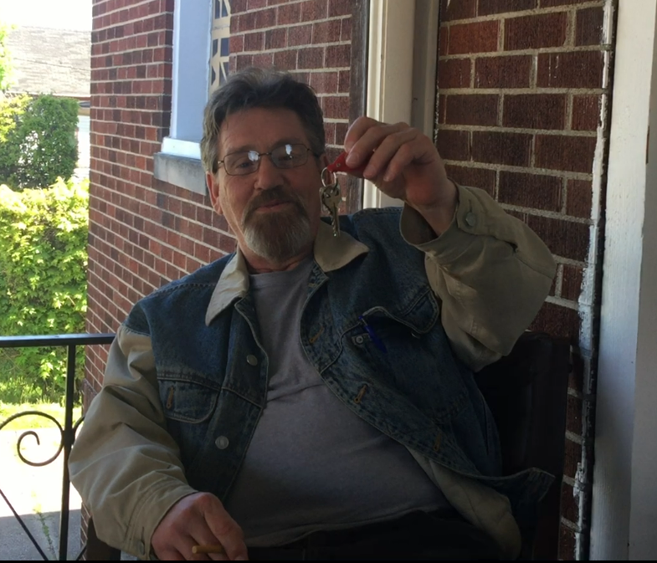

Recuperative Care Makes a Difference!
Case Studies

Slide 20
Inspiration for HOPE Recuperative
Age 47
Hx of substance use
Frostbite injury to toes of right foot
Progressive amputations
6+ hospital stays between 12/10 and 6/11
Cost hospital $1 million+
Jim died in Dec 2012

Slide 21

Eric’s Story
Age 50
Hx of substance use
Frostbite injury to toes of right foot
Amputation of two toes
One hospital stay
Discharged to home of his own
Living independently for more than 6 months
Embraced sobriety and is receiving IDDT level services for mental health and substance use dual dx
Attends AA/NA multiple times per week
Eric’s hospital cost was approximately $30,000

Slide 22
How Much Does Homelessness Cost the Healthcare System?
People struggling with homelessness are often frequent users of emergency departments. On average, they visit the emergency room five times per year. The highest users of emergency departments visit weekly. Each visit costs $3,700; that's $18,500 spent per year for the average person and $44,400 spent per year for the highest users of emergency departments.
People struggling with homelessness spend, on average, 3 nights per visit in the hospital which can cost over $9,000.
Not only does homelessness cause health problems, "homeless people have higher rates of chronic health problems than the general population. This takes the form of higher rates of illnesses such as high blood pressure, heart disease, diabetes, lung disease, and HIV disease" (Dr. Margot Kushel, Associate Professor of Medicine in Residence, UCSK/ SF General Hospital).
80% of emergency room visits made by people struggling with homelessness is for an illness that could have been treated with preventative care.
National Healthcare for the Homeless Council

Slide 23
HOPE RECUPERATIVE OUTCOME STUDY
HOPE Recuperative study being conducted by OUWB School of Medicine assistant professor Dr. Jason Wasserman
Although this is a well studied model, this is the first study post ACA
Study is grant funded by BCBSM Foundation and Metro Health Foundation

