Slide 1

Transition to Success™
A Standard of Care to Treat Poverty
Homeless Summit
9/21/2016
Kalamazoo, MI
Marcella Wilson, Ph.D.
President & Founder
Transition To Success® LLC
1
© 2016 Transition To Success®

Slide 2

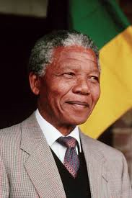
“Poverty is not an accident. Like slavery and apartheid – it was man made and can be removed by the actions of human beings.”
- Nelson Mandela
2

Slide 3

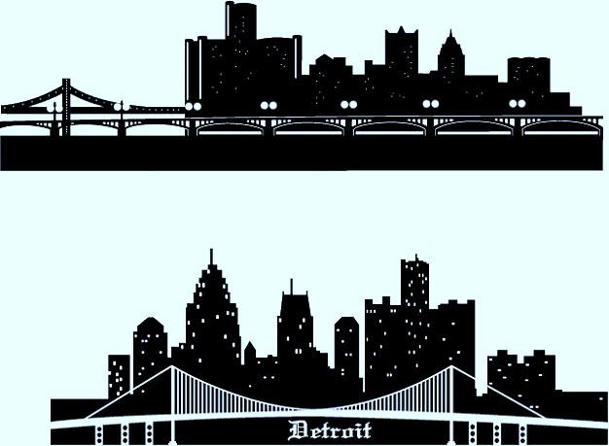
Detroit
59%
According to the Annie E. Casey Foundation, 59% of children in Detroit are living in poverty – the highest of any urban setting in America. (Annie E. Casey Foundation, 2012, www.aecf.org)
3x
Women are dying from pregnancy-related causes at a rate 3 X greater than for the nation, higher than Libya, Uruguay, or Vietnam. (Kaiser Health News, July 2014)
47%
Detroit- One of the highest illiteracy rates in the country with over 47% of Metro Detroiters classified as functionally illiterate. (Detroit Literacy.org)
3
Notes:
Poverty: When a person or group of people lack human needs because they cannot afford them. Human needs include clean water, nutrition, health care, education, clothing and shelter (Center for Disease Control, 2015).
The number of poor Detroit kids increased 34% since 2006 (Detroit News, 2/19/15, Study: Detroit worst big city for childhood poverty)
Reports of child abuse and neglect increased by 77% in Detroit from 2008-2012, confirmed neglect or abuse increased 40% (Detroit News, 2/19/15, Study: Detroit worst big city for childhood poverty)
There are approximately 54,000 children 0-5 in Detroit
An estimated 44,000 need childcare for only 19,322 Head Start slots
0-3 4,064 slots for 21,000 babies
A service gap of 69% (IFF Education Needs Assessment, July 2014, Kresge Foundation)
Health
Infant mortality in Detroit is 15 deaths for every 1,000 births… more than double the national average- the highest in the nation (Detroit Early Childhood Ed. Needs Assessmt., 2013, Kresge Foundation).
Detroit where over 40% of mothers did not receive prenatal care (Data Driven Detroit)
Detroit- where our seniors ages 50-59 are dying at a rate 122% higher than their counterparts in MI (DAAA Dying By Their Time)
Detroit - Women are dying from pregnancy-related causes at a rate 3 X greater than for the nation. (Kaiser Health News, July 2014)
Preterm delivery is the number 1 killer of babies to Detroit , the highest infant mortality rate in the U.S. (Detroit News, July 2014).
Detroit’s infant mortality rate is the worst among big U.S. cities at 13.5 per 1,000 births, and worse than some Third-World countries (Detroit News, January 2014)
In Detroit, high rates chronic disease/poor health:
Infant Mortality: 14.7 per 1,000 live births (www.michigan.gov)
Hypertension: 32.2-41.8% of population (Detroit region, BRFSS)
Diabetes: 10% (MI rate, BRFSS)
Mortality: 1,055.8 per 100,000 vs 784.6 in MI (MDCH)
In 2010, Wayne County was #1 in Michigan for pediatric hospitalization rates, almost twice the state average. Those most at risk for asthma are low income, medically underserved, and African American and Hispanic Children. They have the least access to preventative care and the most visits to the emergency room. (How Are the Children? 2013)
Low Income
1 in 3 Detroit families live in extreme poverty with incomes less than 50% of the federal poverty level. (How Are the Children? 2013)
Detroit where an estimated 47% of adults are functionally illiterate (The Detroit News, Parents’ Illiteracy: A Challenge, 31 January 2014).
The median household income from Detroit families decreased by 36.8% from 1999 to 2011--- adjusted to 2011 dollars ($39,855 in 1999 down to $25,193 in 2011) (State of the Detroit Child, 2012)
Housing affordability is defined as a household spending less than 30% of its annual income on housing. In 2011, 69.3% of renters in Detroit lived in housing that was unaffordable. 52% of homeowners with a mortgage were in unaffordable housing situations. (State of the Detroit Child, 2012)
Population loss: from peak of 1.86M in 1950 to 700,000 in 2012 (Forbes)
Due to its automobile industry, Detroit was once America’s wealthiest city. These days, however, it is the nation’s poorest with 42.3 percent of its population below the poverty line. (Statista, 2014)
Children
67% Detroit Children in neighborhood w/concentrated poverty (Data Snap Shot on High Poverty Communities, 2013)
Detroit’s Children experienced an increase in poverty from 34.8% in 1999 to 57.3% in 2011. (State of the Detroit Child, 2012)
In 2011, families with children made up 36.4% of homeless persons in Detroit. (http://www.icphusa.org/PDF/americanalmanac/Almanac_State_MI.pdf
62.7% of Detroit children 0-5 are living in poverty (W.K. Kellogg Foundation, Making Michigan Kids)
One in 3 kindergartener are not fully prepared to learn (W.K. Kellogg Foundation, Making Michigan Kids)
69% of Michigan 4th graders lack reading proficiency (W.K. Kellogg Foundation, Making Michigan Kids)
In Fall 2013, the Detroit Youth Violence Prevention Initiative asked 1,311 Detroit High School students their opinion on violence. This is what we learned when asked if a family member or friend had been shot, murdered, or disabled as a result of violence in the last 12 months? 87% responded yes (39% shot, 27% murdered, 21% disabled).

Slide 4
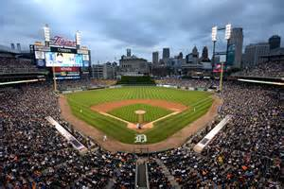
Michigan Poverty Level
Population living in poverty:
1,685,000 or 17%
  Enough people to fill Comerica Park
  to capacity 40 times!
Children living in poverty:
554,000 or 25%
  Enough children to fill Comerica Park
  to capacity over 13 times!
  (Annie E. Casey Foundation, www.aecf.org 2013)
Notes:
Low Income
40% of households across Michigan struggle to afford the basic necessities of housing, child care, food, health care, and transportation (United Way Alice Report, Michigan, Sept. 2014)
Michigan ranks 44 of 50 states in highest unemployment rates in 2012 (Feedingamerica.org)
Nearly one in seven households in Michigan couldn't afford enough food at some point during the last year, a 45 % increase in food insecurity over the last decade. (http://michiganradio.org/post/food-insecurity-could-continue-increase-michigan)
32% of working families in Michigan are “low income” 200% of the FPL (Michigan League for Public Policy)
The percentage of low income working families increased by more than 5% since 2007 (Michigan League for Public Policy)
Between 2009-2011, the top 1% captured 91% of income growth in the state (Michigan League for Public Policy)
Average income of the bottom 99% is $35,988 as of 2011 compared to $707,446 of the top 1% (Michigan League for Public Policy)
Children
Michigan taxpayers save $47,000 for every child ready to succeed in school in kindergarden; $96,000 per child in Detroit (M&M Fisher Foundation, News Release, 2/18/14)
Estimates taxpayers would see a $48 million savings for every 1% gain in school readiness among Michigan’s estimated 122,000 kindegartners. A 1% gain in school readiness among Detroit’s estimated 5,200 kindergarteners would save $4.2 million (M&M Fisher Foundation, News Release, 2/18/14)
There are over a quarter million children living in extreme poverty (Annie E. Casey, Kid’s Count Data Center)
One in 3 Michigan kindergarteners are not fully prepared to learn (W.K. Kellogg Foundation, Making Michigan Kids)
69% of Michigan 4th graders lack reading proficiency (W.K. Kellogg Foundation, Making Michigan Kids)
70.3% of K-12 students are eligible for free/reduced lunch (Michigan Department of Education Fast Facts 2013-2014)
High school graduation rates was at 77% for 2012-2013, this ranks 40th in nation (Common Core of Data, nces.ed.gov, 4 year adjusted cohort graduation rates)
Homeless
In 2012, 93,619 people were homeless in Michigan, enough to fill Comerica to over 2 times (http://detroit.cbslocal.com/2013/09/21/report-homelessness-in-michigan-continues-to-decline/)
In the 2010-2011 school year, more than 31,000 homeless students attended school in Michigan- an increase of over 8,000 from the previous year. (Detroit Free Press, 2011)
About 53% of the homeless population in Michigan consists of families
65% of homeless families are headed by women- the average homeless child is 7 years old. (campaigntoendhomelessness, 2012)
Miscellaneous
Michigan has approximately 43,000 adults incarcerated in local jails or state or federal prisons costing $2 billion a year

Slide 5
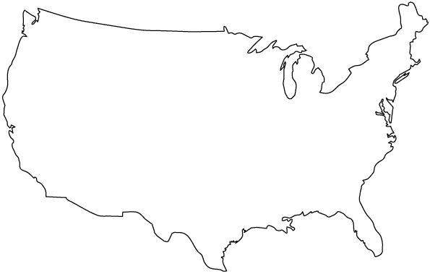
National Poverty Level
  In the U.S., 48.8 million (16%) are living in poverty in America
  (Annie E. Casey Foundation, Kid’s Count Report 2013)
Notes:
Poverty
Almost 60% of Americans will spend at least 1 year living in poverty between ages 25-75
In the US a child is born into poverty every 33 seconds, every 1 in 5 children (Familypromise.org)
The # of people living in poverty increased by 17% between 2008-2012 while the population grew by only 3% (Open Minds, 12/12/13)
50% of the world’s wealth will be held by the richest 1% across the globe by 2016 (TIME Magazine, Oxfam Report, antipoverty charity)
23% of children (16,397,000 children) are living in poverty (Annie E. Casey, 2014 Kids Count Profile)
Almost 60% of Americans will spend at least one year below the poverty line at some point between ages 25 and 75.
Between 1979-2007, the top 1% took home 53.9% of the total increase in US income. The income of the top 1% grew over 10x as much as the bottom 99%, by 200.5% (Economic Policy Institute)
There are 103 million people who have incomes below twice the poverty line ($36,000 a year for a family of 3) 1/3 of American people are in this low wage category, we have become a low wage country (Peter Edelman, taken from Pacific Rim, Hawaii.edu)
There is no city or county anywhere in the United States where a worker making the minimum wage can afford a fair market rate one-bedroom apartment. (http://www.familypromise.org/fast-facts)
Impoverished adults live to 7-8 year less than those who have incomes four or more times the FPL, ($11,770 for a one-person household) (University of Southern California, San Francisco, “Poor Health: When Poverty Becomes Disease” 1/6/16).
Without access to benefits and tax credits, a single parents with two children would need to earn $9.39 per hour- $2.14 more than the current federal minimum wage- working 40 hours per week for 50 weeks per year to just reach the poverty line (2015 Kids Count Data Book by Annie E. Casey Foundation, 2015).
Education
54% of children (4,307,000) are not attending preschool (Annie E. Casey, 2014 Kids Count Profile)
Health
The U.S. has the most expensive health care system, yet we have the 8th lowest life expectancy: worse than Chile, Singapore, or Kuwait (Taken from USA Today, 7/7/14, Organization for Economic Co-operation and Development)
Losing a job increased the odds of developing stress related health condition by 83% such as stroke, heart disease, diabetes and mental health issues (NPR, Patti Neighmond 3/2/15, University at Albany Kate Strully study)
American babies die within their first year of life 2X as often as infants do in Norway, South Korea, Czech Republic (Businessweek, 10-1-14)
Poverty is the #1 factor affecting health (“Newsflash: Poverty is Bad for Your Health.” 2010)
Takes away 8 years of healthy life (“Newsflash: Poverty is Bad for Your Health.” 2010)
Living on incomes less than 200% of the federal poverty level claimed more than 400 million quality adjusted life years between 1997 and 2002, meaning that poverty had a larger effect than tobacco use and obesity combined. (P. Muenennig, K. Fisella, American Journal of Public Health, 2003)
Human Services
There is one nonprofit for every 175 Americans
62.8 million Americans volunteer for nonprofits
86,000 charitable foundations and total giving was about $52 billion mark
Homeless
Extreme poverty is the strongest predictor of homelessness for families, forced to choose between housing and other necessities for their survival. http://www.apa.org/pi/families/poverty.aspx?item=6
In the United States, an estimated 1.7 million youth experience homelessness each year- that is more than the population of Philadelphia
In the U.S., more than 3.5 million people experience homelessness each year.
63% of the runaway/homeless youth are never reported missing by their guardians (http://www.studentsagainsthunger.org/page/hhp/overview-homelessness-america)
The homeless population includes people from all walks of life:
35% of the homeless population are families with children, the fastest growing segment of the homeless population.
23% are U.S. military veterans.
25% are children under the age of 18 years.
30% have experienced domestic violence.
20-25% suffer from mental illness.
In urban communities, people experience homelessness for an average of 8 months.
About 18% of the homeless population (109,132) are considered “chronically homeless http://www.studentsagainsthunger.org/page/hhp/overview-homelessness-america
Estimated 57,000 homeless vets
In 2012 approx. 21% of school aged children lived in poverty– nearly ½ of all US public school students (Southern Education Foundation, 2013)
At least 11% of American children living in poverty are homeless, an estimated 1.7 million
Homeless children are 2 X as likely to experience hunger as their non-homeless peers, having negative effects on:
Physical growth
Social functionality
Emotional state
Cognitive development
Homelessness is linked to poor physical health for children including low birth weight, malnutrition, ear infections, exposure to environmental toxins, and chronic illness (e.g. asthma). http://www.apa.org/pi/families/poverty.aspx?item=6
Miscellaneous
68% of all males in federal and state prisons do not have a high school diploma (Are Our Children Being Pushed into Prison? NASW, Michigan)
50% of young people leaving foster care will be unemployed within a few years after turning 18 (Are Our Children Being Pushed into Prison? NASW, Michigan)
70% of inmates in California state prison are former foster care youth (Are Our Children Being Pushed into Prison? NASW, Michigan)
415,129 children in the foster care system in September 2014 up from 401,000 in 2013. (Annual Report from Department of Health and Human Services, 2014.)

Slide 6


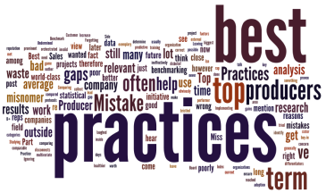
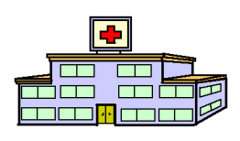


The Medical Model
Understanding and Treating Disease
A uniform system of industrywide standards and analytics with continuous quality improvement (CQI)
Industrywide
Training
Implementation
Research Evaluation, Meta-analysis CQI *
(e.g., diabetes, asthma, cancer)
Evidence- based
Condition- specific Standards
of Care
(National
Quality Forum establishes
measures and analytics)
Identify
Define
Applied
* Condition-Specific: Continuous Quality Improvement (CQI) ensures ongoing industrywide measurement, reporting, compliance, and outcomes. CQI identifies and responds to opportunities, waste, harm, and challenges.
Data Collection
© 2016 Transition To Success®
Notes:
National Quality Forum is an existing group in the Medical industry. I don’t like using Wikipedia but within our email string… this says it well… https://en.wikipedia.org/wiki/National_Quality_Forum

Slide 7

Treating Poverty in America
Poverty- related
Research, Evaluation, and Meta-analysis
Evidence- based
Client self-navigation
Practitioner directed care
Organizational directed care
Defines
Applied
No comprehensive, cross-industry, uniform analytics
to support CQI *
* Condition-specific: Continuous quality improvement (CQI) ensures ongoing industrywide measurement, reporting, compliance, and outcomes. CQI identifies and responds to opportunities, waste, harm, and challenges.
© 2016 Transition To Success®
Notes:
Is it really accurate to say “No” CQI or analytics?? Seems overly sweeping to me …
MW: “No Comprehensive Cross-Industry Analytics” is accurate to say

Slide 8

Treating Poverty in America
‘Siloed’ Spending – ‘Siloed’ Service
The current disconnected service delivery system in the United States
$1,660,451,000,000
Human Services
Education
Healthcare
Government
1.4 million not for profits
650,000 social workers
99,000 public schools
3.7 million elementary and secondary teachers
262,300 school counselors
5,723 hospitals
209,000 PCPs
Medicaid health plans
Medicare health plans
DHS
Community mental health
Housing
Medicaid/Medicare
Veterans
Juvenile justice
Prisoner reentry
Taken from: http://www.whitehouse.gov/sites/default/files/omb/budget/fy2013/assets/hist.pdf
© 2016 Transition To Success®

Slide 9
Alarming Poverty Statistics
For all the developed countries, for which there is data, the U.S. has the:
Highest infant mortality rate
Highest homicide rate
Highest teenage birth rate
Highest incarceration rate (we house ¼ of the world’s prisoners)
  (UNICEF, Max Fisher/Washington Post)
The number of people living in poverty increased by 17% between 2008 and 2012, while the population only grew by 3% (Openminds 12/12/13)
Notes:
Children growing up in poverty:
complete less schooling
work and earn less as adults
are more likely to receive public assistance
have poorer health
(Ed. Testing Service Poverty and Education, Finding the Way Forward, Coley & Baker, ets.org)

Slide 10
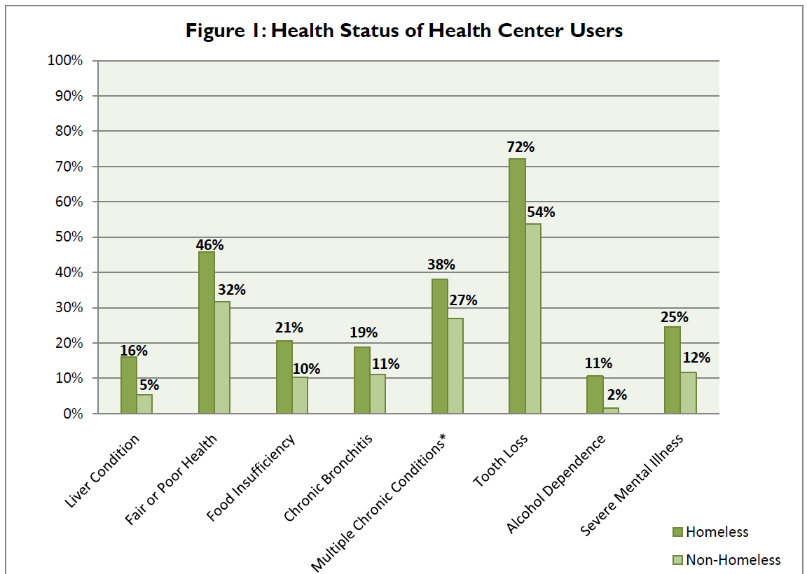
Homelessness and Health
Taken from The National Health Care for the Homeless Council, 2011)
Notes:
Those experiencing homelessness are 3-4 X more likely to die prematurely and experience an average life expectancy of 41 years (national health care for the homeless council)
Homeless also suffer from health problems at a higher rate from the gen. population with increased exposure to elements, disease, violence, unsanitary conditions, malnutrition, stress, and addictive substances. (nationalhomeless.org)
Of the 1 million bankruptcies in 2007, 62% were caused by medical debt (national health care for the homeless council)
Hospitals spent $41.3 billion in an 11 month period (January-November 2011) to treat patients readmitted within 30 days of discharge, according to the Agency for Healthcare Research and Quality (AHRQ) (Fierce Health Finance)

Slide 11

Treating Environmentally Based,
Industry-Accepted Medical Conditions *
Environmental Exposures | Symptoms | Diagnosis | Standard of Care | Billable
Lead ingestion | Irritability, high blood pressure, long-term neurological damage | Lead poisoning | Required | ✓
Asbestos | Trouble breathing, nausea, vomiting | Cancer/ Mesothelioma | Required | ✓
Mosquito bites | Fever, rash, joint pain, conjunctivitis, muscle pain, headache | Zika, West Nile, yellow fever, and malaria viruses | Required | ✓
Limited access to fresh fruits, vegetables, and exercise | Increased thirst, blurred vision | Type II diabetes Obesity | Required | ✓
Cigarette smoking and second-hand exposure | Wheezing, increased risk of cancer, asthma, COPD | Nicotine addiction | Required | ✓
Accidents | Broken bones, closed head injuries | Trauma | Required | ✓
Pollution | Difficulty breathing, decrease in lung function, wheezing | Asthma/COPD | Required | ✓
Social Determinates of Health Food insecurity, high crime rates, inadequate/unaffordable housing, lack of access to basic needs/resources, limited access to quality healthcare, poorly performing schools, racism, and unemployment, transportation | Increased rates of diabetes and blood pressure, infant and maternal mortality, increased depression and mental health disorders, asthma, compromised immune system and brain development, higher death rates | Extreme Poverty (ICD 10 VZ59.5) | Transition To Success® | Some state Medicaid plans and Medicare for chronic conditions. Care Management (CPT 99490)
* Note: Recognized disease without genetic predisposition
© 2016 Transition To Success®
Notes:
FIRST COLUMN ABOVE: How can there be limited access to exercise?
MW: When living in high crime and/or highly polluted areas – access to outdoors is extremely limited and dangerous. Example: When we moved a family from Detroit to Troy (suburbs) – the 12 year old boy had never ridden a bicycle. (Should this be explained to the readers??)
DWS: OK, good point.

Slide 12


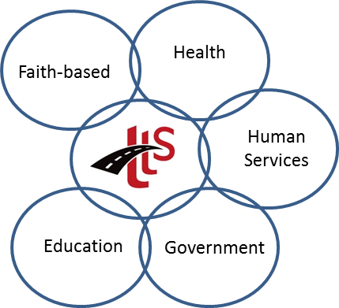
Understanding and Treating the
Condition of Poverty
Transition To Success:
A uniform system of care with continuous quality improvement (CQI)
Cross
Industry
Training
Implementation
Poverty- specific Research
Evaluation, Meta-analysis CQI *
Evidence- based
Transition To Success
Standards
of Care
to Treat
Poverty
Identify
Define
Applied
* Condition-specific: Continuous quality improvement (CQI) ensures ongoing industrywide measurement, reporting, compliance, and outcomes. CQI identifies and responds to opportunities, waste, harm, and challenges.
Multi-site
Data Collection
3/17/2016 12
© 2016 Transition To Success®
Notes:
JH: Resolved Faith-Based and Human Services… Arrow Placement ? I made some adjustments… please advise if needs more work

Slide 13
Transition To Success®
Treating the Condition of Poverty
With A Community Based Continuum of Care
Clients/
Customers
At Risk Youth
Employee Wellness
Foster Care
Homeless
Medicaid
Medicare
Older Adults
Returning Citizens
Unemployed
Veterans
Working Poor
TTS Trained
Organizations/
Practitioners
Education
Faith Based
Government
Healthcare
Human Services
Map of My Dreams ®
CARE* Management
Financial Literacy
Mentoring
Volunteerism
CARE* Network
2-1-1 Information & Referral to Funded…
Community
Education
Faith Based
Government
Healthcare
Human Services
* CARE
Coordinating
All
Resources Effectively
Living Wage
Employment
Skilled
Employment
Training
Literacy
GED
Training
Unskilled
Employment
Basic Needs
© 2016 Transition To Success®
Notes:
National Quality Forum is an existing group in the Medical industry. I don’t like using Wikipedia but within our email string… this says it well… https://en.wikipedia.org/wiki/National_Quality_Forum

Slide 14


Pre-Paid - Funded
Transition To Success
CARE* Network
*Coordinating All Resources Effectively
Education
Faith-based
Human Service
TTS
Adopting
Organizations
Healthcare
Government
Foundations
$1,660,451,000,000
1 trillion, 660 billion dollars annually in U.S. for services available to individuals and/or families living in poverty
(Federal Office of Management and Budget, http://febp.newamerica.net/background-analysis/education-federal-budget).
© 2016 Transition To Success®

Slide 15

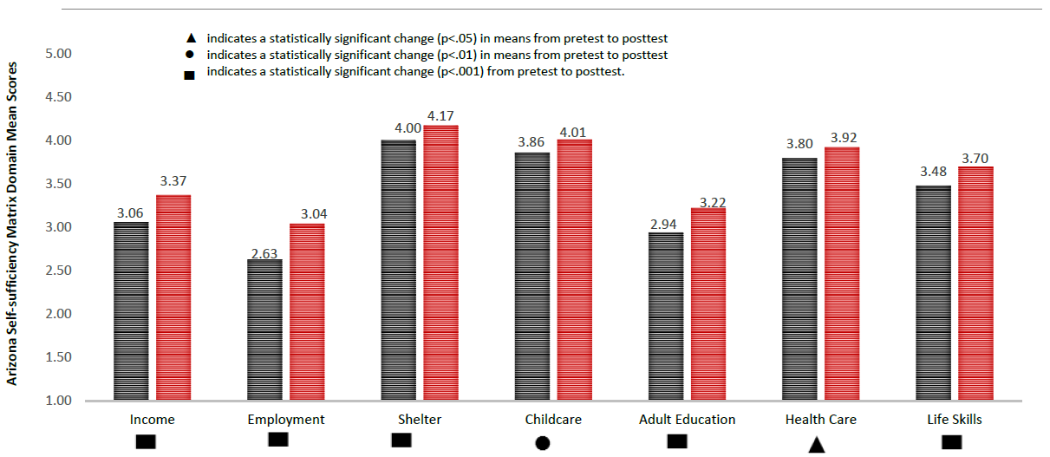
TTS Independent Evaluation Results
Matrix Head Start: SSM* Domains with a Significant Change in Mean Scores, Winter 2014 to Spring 2015
Transition To Success® Final Evaluation Report – 8/29/2015 W. K. Kellogg Foundation
Grant: P3018954
* Self-sufficiency Matrix
Notes:
In second-last chart it should be Healthcare, same as Childcare in center. Also, the Shelter rectangle needs to be centered below Shelter.
JH: The base of these charts are cut n paste from the Kellogg Foundation Report and cannot be edited. I was able to add the * to explain SSM and FSDWC on Slide 11 but the way they break Health care into 2 words is not editable nor the “.” at the end of “Indicates a statisically…”
DWS: Especially sorry to hear about Health Care, which needs to be Healthcare, same as Childcare. Maybe Paula (our designer) can fix it. Also, other shapes need to be better centered as well, plus the numbers are placed very inconsistently atop the columns. Finally, in addition to the deletion of the period after posttest, shouldn’t the third one also have “in means” like the preceding two?

Slide 16
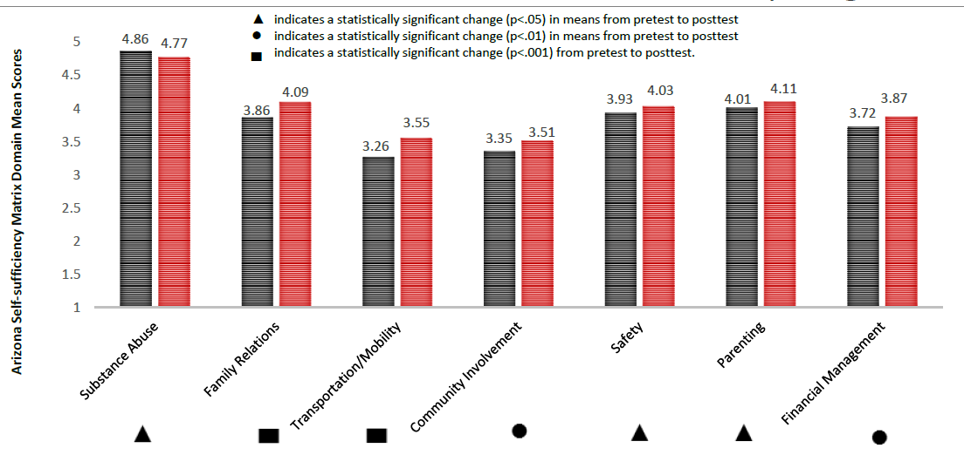
TTS Independent Evaluation Results
Matrix Head Start: SSM Domains with a Significant Change in Mean Scores Winter 2014 to Spring 2015
Transition To Success® Final Evaluation Report – 8/29/2015 W.K. Kellogg Foundation
Grant: P3018954
Notes:
JH see note in 9

Slide 17
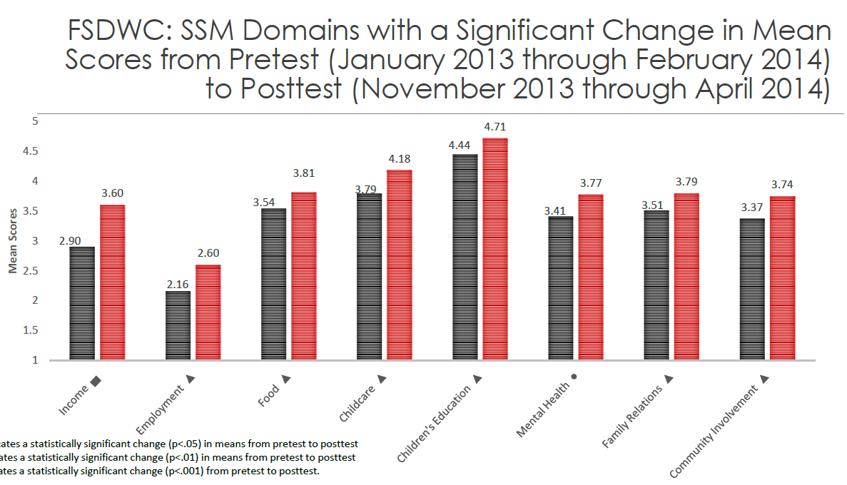
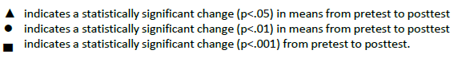
TTS Independent Evaluation Results
Transition To Success® Final Evaluation Report – 8/29/2015 W.K. Kellogg Foundation
Grant: P3018954
* FSDWC: Family Service of Detroit and Wayne County
Notes:
Employment (second from left) is essentially missing the first letter. Plus, there’s a lot of “alphabet soup” at the top of this chart. I know what TTS means, but I’m stumped re FSDWC and SSM.
JH see note in 9
DWS: I was able to delete the asterisk in FRONT of FSDWC, but I can’t seem to put it AFTER. It goes between the C and the :

Slide 18


Detroit NBC Affiliate News Story
Dreams Coming True
Summer 2013
https://www.youtube.com/watch?v=eM_zGnZ0-tM&list=PLJ59yBEYo1wrxLCGL0QsE2uGZxcPbbH1p
Notes:
The Real Story

Slide 19
Transition to Success®
A Standard of Care that is:
Scalable
Across human services, government, healthcare, education, faith based
Sustainable
Integrates and maximizes existing funding streams
Measurable
Easily Integrated with Health, Education, Human Service and Government Systems & Outcomes
Multigenerational and Population Specific
Seniors, Adult, Teens & Youth
Foster Care, Veterans, Tribal
Community Based Social Enterprise Business Model
Train the trainer to train workers to work with clients and advance communities
© 2016 Transition To Success®
Notes:
This is not about Matrix
This is about training trainers who then lead the development across their community and across the country

Slide 20
Transition To Success® (TTS):
A National Standard of Care
To Treat the Condition of Poverty
A Clinton Global Initiative
Over 80 Organizations Involved
Over 800 trained nationwide in the TTS Standard of Care
Community and State TTS Partners:
  Memphis TN
  Hawaii (Kauai & Oahu)
  Portland OR
  Detroit MI
  Michigan Department of Health Human Services
Organizational Partners
  Civic Health (Technology)
  MPHI (Research and Evaluation)
  Health Net (Mobile Technology)
  Diagnosis Poverty
© 2016 Transition To Success®

Slide 21
Marcella Wilson, Ph.D.
MWilson@TTS-LLC.org www.TransitionToSuccess.org
(313) 580-2672
Thank you!
Diagnosis: Poverty
A new approach for understanding and treating an epidemic
www.ahaProcess.com/diagnosis
21
© 2016 Transition To Success®

