Slide 1
What’s New in HMIS?
Presented By Kaity Hemgesberg
khemgesberg@mihomeless.org
Jill Shoemaker
jshoemaker@mihomeless.org
Shanna Cherubini
scherubini@mihomeless.org

Slide 2
What’s New in HMIS?
Overview
The HMIS world is ever evolving. We’ll take a look at the following topics to explore recent changes and what they mean to you, as well as the innovations to come:
2017 HUD Data Dictionary Updates
HMIS and Coordinated Entry
HMIS and HUD Reporting Requirements
Qlik Sense Overview

Slide 3
What’s New in HMIS?
2017 HUD Data Dictionary Update
Changes went into effect October 1st, 2017
Paper data collection forms have been updated on the MCAH website
MSHMIS statewide electronic assessments in ServicePoint have been updated
Data changes effect any new or existing clients as of 10/1/2017
All provider pages (including anything closed 2012 or later) need updating
Custom assessments need updating
Custom reports may need updating

Slide 4
What’s New in HMIS?
2017 HUD Data Dictionary Update
Project Descriptor Data Elements (AKA Provider Page Changes)
Operating Year Start and End Date (new)
Federal Partner Funding Sources (new and retired picklist options)
Bed and Unit inventory changes:
New: associate each inventory with CoC code
Removed: Youth bed age categories
Notes:
Operating Start Date: First day a project provided/will provide services and/or housing
Projects starting prior to 10/1/2012 the start date may be estimated if unknown
Projects that are fully funded but haven’t started operating may put in future date
Operating End Date: Last day project provided/will provide services
May be a future date or left blank if still operating
Federal Partner Funding Sources: Retired VA Community Contract Residential Treatment Program and Grant Per Diem
Added 6 new GPD types
Renamed Community Contract Emergency Housing to VA CRS Contract Residential Services
Bed and Unit inventory: Projects that operate in more than one CoC must have separate B&U inventory records for inventory located in each CoC. Pulls options from CoC code(s) indicated for the overall project/provider page settings.

Slide 5
What’s New in HMIS?
2017 HUD Data Dictionary Update
Data Collection Stages:
Record Creation
Project Start (Replaces Project Entry)
Occurrence Point/Update
Annual Assessment (HoH’s Anniversary date now applies to entire household)
Project Exit
Post Exit (New Data Collection Stage)

Slide 6
What’s New in HMIS?
2017 HUD Data Dictionary Update
Universal Data Elements
Gender: Dropdown value changes
Disabling condition: Collected at project start
Destination: Dropdown value changes
Living Situation: Dropdown value changes, same as destination changes
Housing Status: Still required for Michigan
Non-Cash: Retired options
Disability Types
Contact: location field retired; new field added
Notes:
Gender: Transgender options reworded and Gender Non-conforming replaces “Doesn’t identify as male, female, or transgender”
Destination: Now “Permanent Housing (other than RRH) for formerly homeless persons” and “Rental by client, with RRH or equivalent subsidy”
Housing Status: Note: You might hear or read that this is retired, but it is still required for Michigan due to its heavy use in statewide reports
Non-Cash: Retired “Section 8, public housing, or rental assistance” and “temporary rental assistance”
Disability Types: Retired “Documentation of disability and severity” and “currently receiving services”, as well as all PATH specific questions related to mental health and substance abuse
Contact: New field regarding whether client is on streets, ES or SH.

Slide 7
What’s New in HMIS?
2017 HUD Data Dictionary
Universal Data Elements (Cont’d)
Project Start – Replaces project entry, different depending on project type:
Street Outreach = Date of first contact
Emergency Shelter = Night of first shelter stay
Transitional Housing = Date of move in to residential project
All Perm. Housing (Including RRH) = date following admission into project
All other projects = date client 1st began working with project/rec’d service
Residential Move In Date (Retired – See below)
Housing Move in Date (New)
Replaces “Residential Move In Date” data element
Applies to all PH, including RRH
Collected for HoH at Occurrence Point/Update
Entered regardless of funding source or whether project is providing the rental assistance
Notes:
Housing Move-In date – need to answer for clients in PH, PSH, OPH, RRH
Should NEVER be the same date/time as entry

Slide 8
What’s New in HMIS?
2017 HUD Data Dictionary
Program Specific Data Elements
The following programs had significant updates to their data elements:
HOPWA
PATH
VA
RHY
Please refer to the Program Specific HMIS Data Manuals provided by HUD on their website. There is an additional RHY training covering changes on the MCAH training and certification site.

Slide 9
What’s New in HMIS?
2017 HUD Data Dictionary
What Should I Do With This Information?
Here are the steps you should have taken/be taking right now:
Update your paper forms with the new forms provided at mihomeless.org
Update your provider pages for Operating Year Start/End date and CoC Code per Bed and Unit inventory
If applicable, update federal partner funding source for new choices
If applicable, update custom assessments and/or reports (if affected by Residential Housing Move-In date)
Update any client records that were in project or starting as of 10/1/2017
Breathe easy knowing that the definition of chronic homelessness did NOT change this year
Notes:
This is also a great time to audit provider page information that is routinely updated; such as new Federal Partner Funding Source info (for new grant ID and/or dates), Bed and Unit inventory, visibility, etc.

Slide 10
What’s New in HMIS?
2017 HUD Data Dictionary
Fix Completed – SP.5.12.48
- Operating Start/End Date issue resolved
Fixes Scheduled Later this Month
- APR and ESG CAPER CSV files can’t be uploaded into SAGE
- Retired ‘Residential Move-In Date’ field not mapped over to new Housing Move-In Date question
Notes:
The CAPER and APR reports are back in alignment and some questions have been re-numbered/ re-arranged. The CAPER report reflects the new aligned data elements but the APR has yet to be programmed. Current CSV reports for both the CAPER and APR can’t be uploaded to SAGE at this time. Mediware is working on the programming now and expects to have an upgrade to release later this month. We will keep everyone posted.
In the Michigan implementation, the “Housing Move In Date” field mapping was unsuccessful in the upgrade. That means that if there was a move in date entered in the” Residential Move in Date” field prior to 10/1/17 that date was not mapped over into the new “Housing Move in Date” question. MCAH added the “Residential Move In Date” field into the ServicePoint assessments for your reference. Mediware is working to fix the programming and expects to release it later this month.

Slide 11
What’s New in HMIS?
HMIS and Coordinated Entry
Use HMIS as an electronic care plan (sharing data with community partners)
Available software elements include CallPoint, ClientPoint, VI and Full SPDAT assessments, standardized assessments, community customizable assessments, Goals and Case Plans, Services/Referrals and Reports.
Upload documents (ROI, housing history, eligibility documentation)
Notes:
HUD requiring all CoC establish or update its coordinated entry process in full compliance with HUD requirements by February 1, 2018
Complete Coordinated Entry – Self Assessment tool
HMIS offers solutions:
Use HMIS as an electronic care plan
Software elements includes CallPoint, ClientPoint, VI and Full SPDAT assessments, standardized assessments, community customizable assessments, Goals and Case Plans, Services and Referrals.
Complete the Vulnerability Index - Service Prioritization Decision Assistance Tool (VI-SPDAT) to help determine possible eligibility and recommend types of intervention (housing or referrals). NOT to force people into a certain type of housing.
HMIS Reports for VI and Full SPDAT (examples)
10 MINS = think of the HMIS as the Delorean that will get Marty where he needs to go. All the HMIS solutions are the bananas that fuel the flux capacitor that sets the deloreon on it’s path.

Slide 12
What’s New in HMIS?
HMIS and Coordinated Entry
Populate and track those eligible for services on a Housing Prioritization List
Complete the Vulnerability Index Service Prioritization Decision Assistance Tool (VI-SPDAT) to help determine possible eligibility and recommend types of intervention (housing or referrals)
Create a project entry and referral into a Coordinated Entry project page
Run a Housing Prioritization List Report
Notes:
HUD requiring all CoC establish or update its coordinated entry process in full compliance with HUD requirements by February 1, 2018
Complete Coordinated Entry – Self Assessment tool
HMIS offers solutions:
Use HMIS as an electronic care plan
Software elements includes CallPoint, ClientPoint, VI and Full SPDAT assessments, standardized assessments, community customizable assessments, Goals and Case Plans, Services and Referrals.
Complete the Vulnerability Index - Service Prioritization Decision Assistance Tool (VI-SPDAT) to help determine possible eligibility and recommend types of intervention (housing or referrals). NOT to force people into a certain type of housing.
HMIS Reports for VI and Full SPDAT (examples)
10 MINS = think of the HMIS as the Delorean that will get Marty where he needs to go. All the HMIS solutions are the bananas that fuel the flux capacitor that sets the deloreon on it’s path.

Slide 13
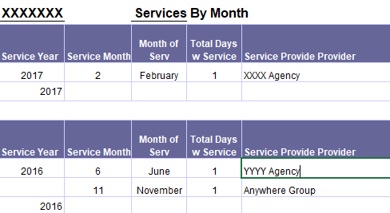
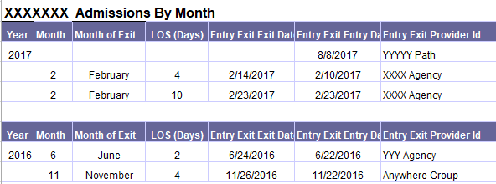
What’s New in HMIS?
HMIS and Coordinated Entry
HMIS Reports examples include:
Populate your Housing Prioritization List
Determine chronicity of client by requesting a chronic homeless history report from MCAH
Review a community report for clients receiving a VI
Notes:
HUD requiring all CoC establish or update its coordinated entry process in full compliance with HUD requirements by February 1, 2018
Complete Coordinated Entry – Self Assessment tool
HMIS offers solutions:
Use HMIS as an electronic care plan
Software elements includes CallPoint, ClientPoint, VI and Full SPDAT assessments, standardized assessments, community customizable assessments, Goals and Case Plans, Services and Referrals.
Complete the Vulnerability Index - Service Prioritization Decision Assistance Tool (VI-SPDAT) to help determine possible eligibility and recommend types of intervention (housing or referrals). NOT to force people into a certain type of housing.
HMIS Reports for VI and Full SPDAT (examples)
10 MINS = think of the HMIS as the Delorean that will get Marty where he needs to go. All the HMIS solutions are the bananas that fuel the flux capacitor that sets the deloreon on it’s path.

Slide 14
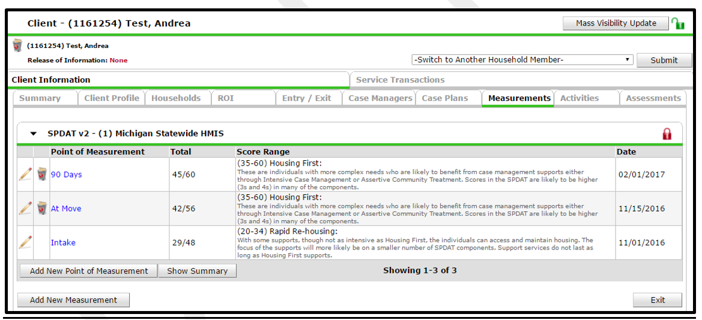
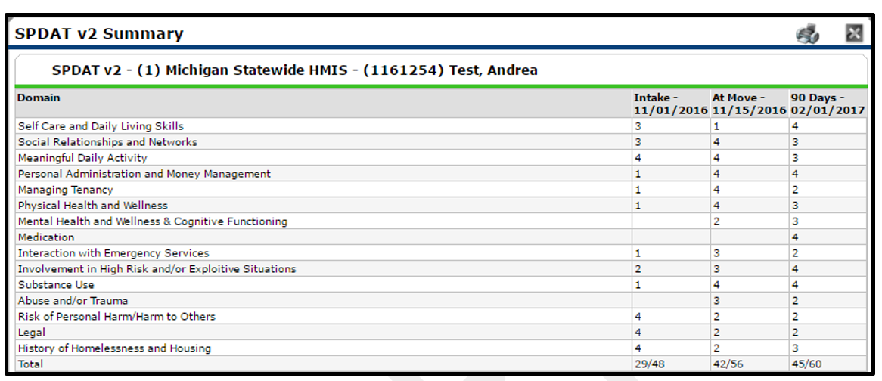
What’s New in HMIS?
HMIS and Coordinated Entry
HMIS Reports examples include:
Review SPDAT measurements over time
Notes:
HUD requiring all CoC establish or update its coordinated entry process in full compliance with HUD requirements by February 1, 2018
Complete Coordinated Entry – Self Assessment tool
HMIS offers solutions:
Use HMIS as an electronic care plan
Software elements includes CallPoint, ClientPoint, VI and Full SPDAT assessments, standardized assessments, community customizable assessments, Goals and Case Plans, Services and Referrals.
Complete the Vulnerability Index - Service Prioritization Decision Assistance Tool (VI-SPDAT) to help determine possible eligibility and recommend types of intervention (housing or referrals). NOT to force people into a certain type of housing.
HMIS Reports for VI and Full SPDAT (examples)
10 MINS = think of the HMIS as the Delorean that will get Marty where he needs to go. All the HMIS solutions are the bananas that fuel the flux capacitor that sets the deloreon on it’s path.

Slide 15
What’s New in HMIS?
HUD Report Updates
CoC APR (CSV download – upload into SAGE)
ESG CAPER (CSV download – upload into SAGE)
0640 HUD Data Quality Framework v2
Notes:
Definition of Reports, Review ART and SP, screenshots
Data Quality – New reporting requirement from HUD to assist projects, agencies and CoCs with monitoring data quality. Report is available in SP. Review data quality elements and template and glossary and reports. Screenshots place here
10 MINS

Slide 16
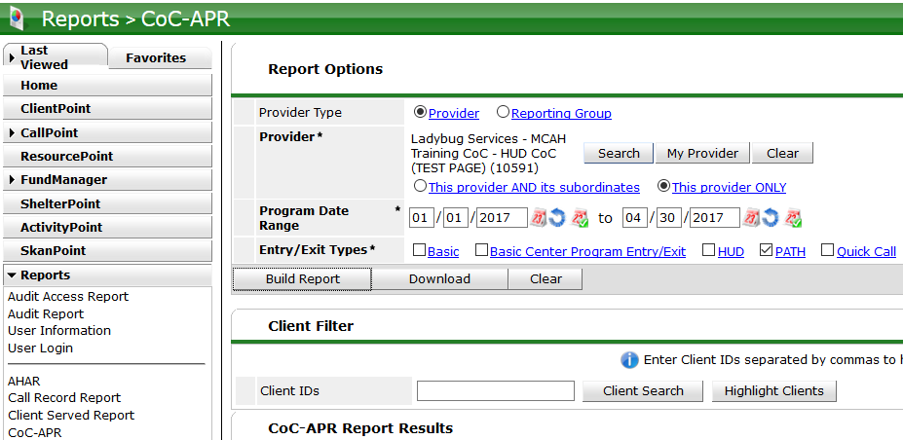
What’s New in HMIS?
CoC Annual Performance Report (APR)
Notes:
Definition of Reports, Review ART and SP, screenshots
HMIS export into CSV – means can’t edit data….before the data was manually entered into the ESNAPS and you could change data if necessary. NOW YOU CAN’T
Add screenshots
CoC APR is now a canned report in ServicePoint
Located in the Reports Tab
Example (screenshot of reporting filters)
Data is exported into a CSV file
CSV file contains only aggregate data (no client level data)
The CSV file cannot be edited

Slide 17
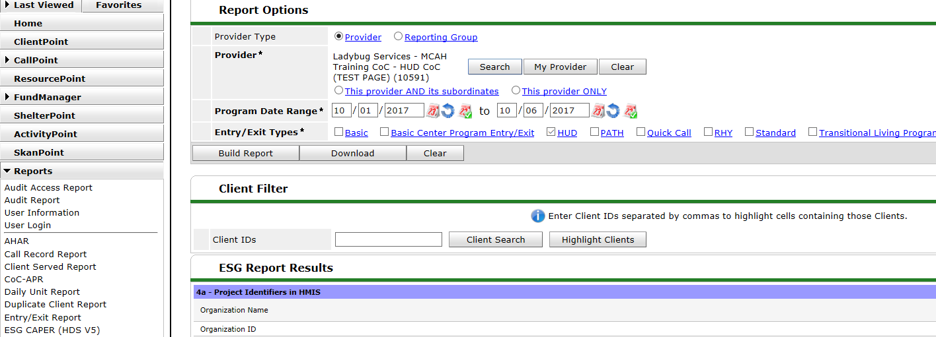
What’s New in HMIS?
ESG Annual Performance Report (CAPER)
Notes:
Beginning October 1, 2017, ESG CAPERs will be submitted in Sage. › The eCartis being retired and the new CSV-CAPER (effective 10/1) will not work in eCart.
CAPER/ APR specs are back in alignment though some questions have been re-numbered/ re-arranged.
CAPER report reflects the alignment
Mediware is in the process of programming the current APR to reflect this realignment and will have the updated report soon.
Known Issues

Slide 18
What’s New in HMIS?
0640 HUD Data Quality Framework
Report v2
Single report
Support data quality for the HUD COC APR, ESG CAPER and the HUD competition (grant application)
System Performance Measures Data Quality component (new in 2017)
Is intended to provide HUD with Data Quality metrics on a CoC.
Run frequently to maintain data quality throughout the year.
Notes:
Data Quality – New reporting requirement from HUD to assist projects, agencies and CoCs with monitoring data quality. Report is available in SP. Review data quality elements and template and glossary and reports. Screenshots place here
Built off clients last project stay
Add screenshots and give example of using both documents
Is a single report that can be run/used by project, across all projects in a project type, across the entire COC.
Can be used to support data quality for the HUD COC APR, ESG CAPER and the HUD competition (grant application)
Data is used in the System Performance Measures Data Quality component (new in 2017)
Is intended to provide HUD with Data Quality metrics on a CoC.
This report should be run frequently to maintain data quality throughout the year.

Slide 19
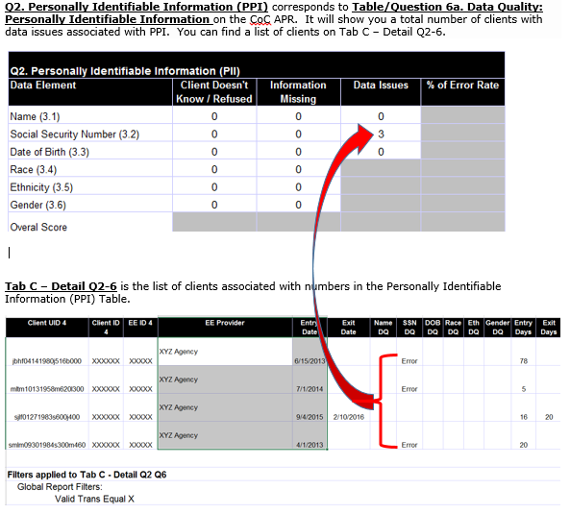
What’s New in HMIS?
Notes:
Data Quality – New reporting requirement from HUD to assist projects, agencies and CoCs with monitoring data quality. Report is available in SP. Review data quality elements and template and glossary and reports. Screenshots place here
Built off clients last project stay
Add screenshots and give example of using both documents

Slide 20
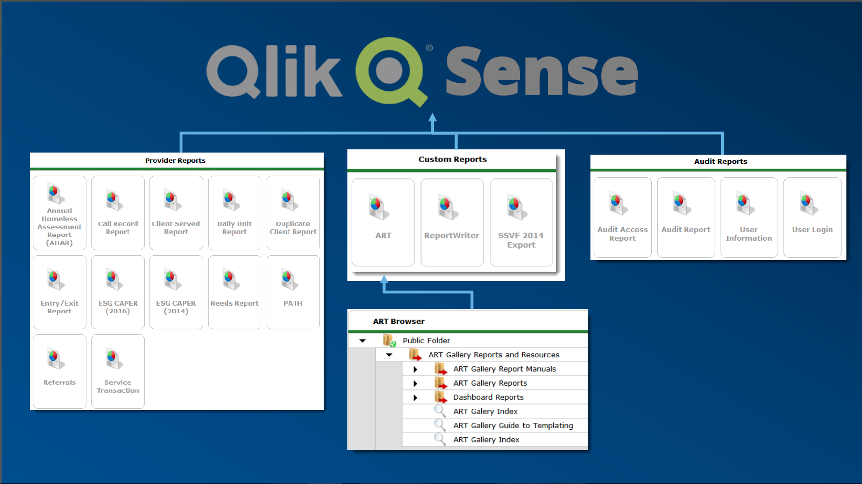
What’s New in HMIS?
Qlik Sense Unified Reporting
Notes:
Any reports created in ART or ReportWriter will need to be re-created in Qlik Sense. They will not be imported. Communities are responsible
ART will remain available in ServicePoint (along side Qlik Sense) as long as browsers continue to support either View Report or Edit Report mode.
Report Writer and Canned Reports will also remain available in SP5x until they are fully reproduced in Qlik Sense
Audit Reports may remain canned for propriety and security reasons.

Slide 21
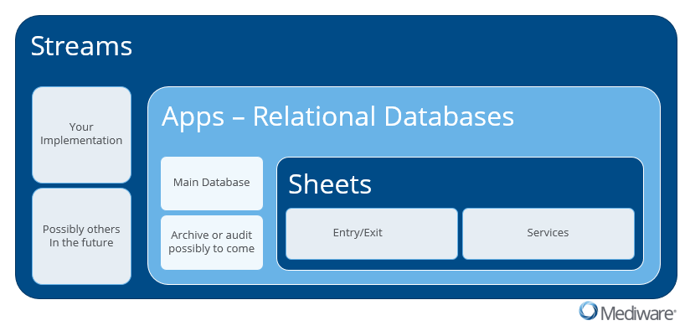
What’s New in HMIS?
Qlik Hierarchy
Notes:
Streams – Michigan’s implementation – access to North Carolina’s reports
Apps – reside in each stream (Apps are like ART’s Universe - - each app is its own relational database).
Within each App is where sheets are located – Sheets are like tabs in an ART report.

Slide 22
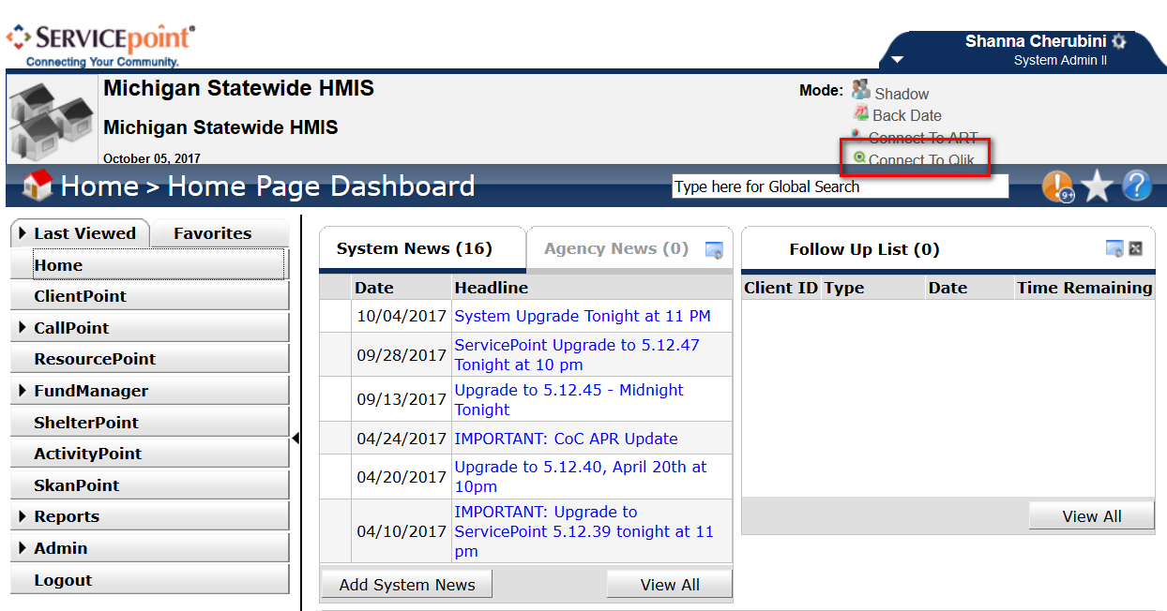
What’s New in HMIS?
Qlik Sense

Slide 23
What’s New in HMIS?
Qlik Sense Streams and Apps
Notes:
Refresh Rates and Data Loads
Qlik Sense has dramatically reduced load times, near instant reporting
Current version of Qlik (available to SAIIs) – Nightly full builds (like ART)
Delta Builds Next – Looking at multiple updates per day, if possible instead of once a day (like ART) frequency of build based on implementation size.
Real-time builds would cause issues with developing and testing new reports

Slide 24
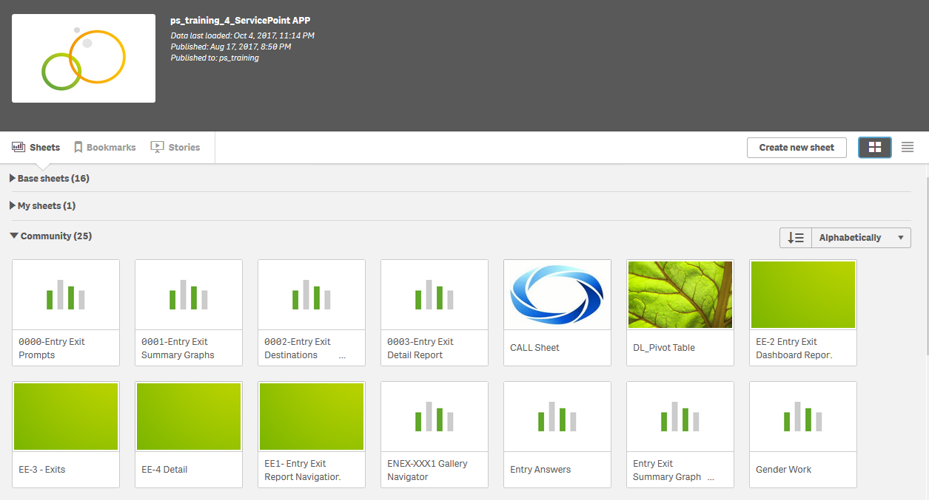
What’s New in HMIS?
Qlik Sense Sheets

Slide 25
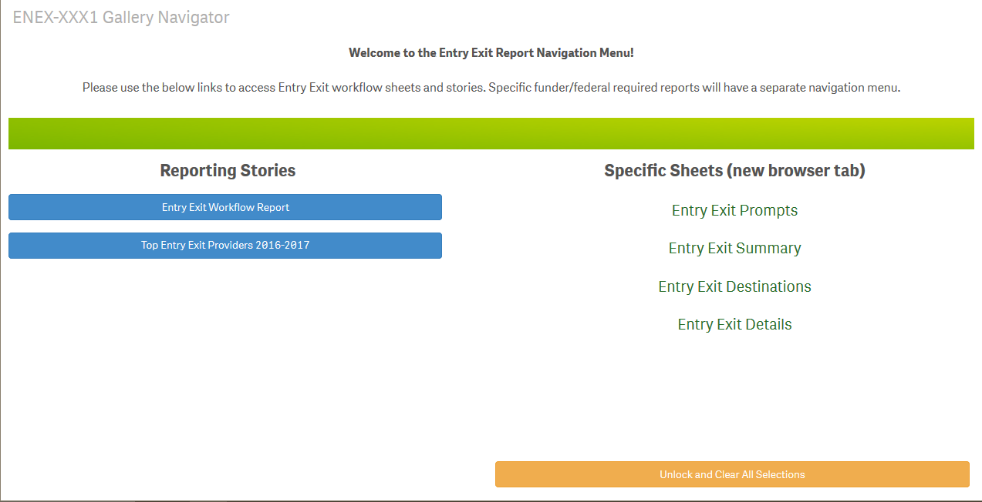
What’s New in HMIS?
Qlik Sense – Navigator Sheets

Slide 26
What’s New in HMIS?
Qlik Sense (Filters/Report Selection Sheet)

Slide 27
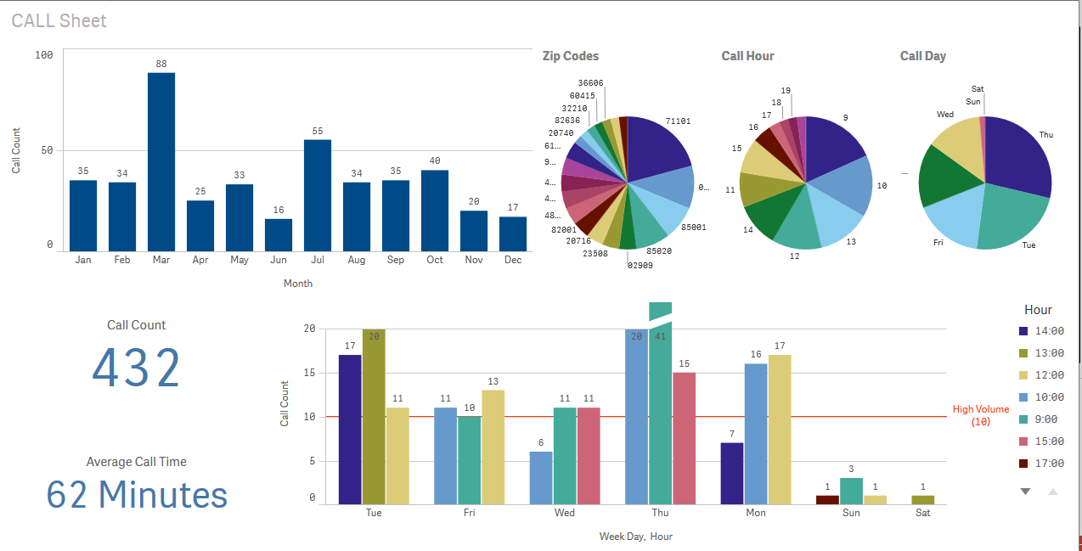
What’s New in HMIS?
Qlik Sense – Summary Sheet (1)

Slide 28
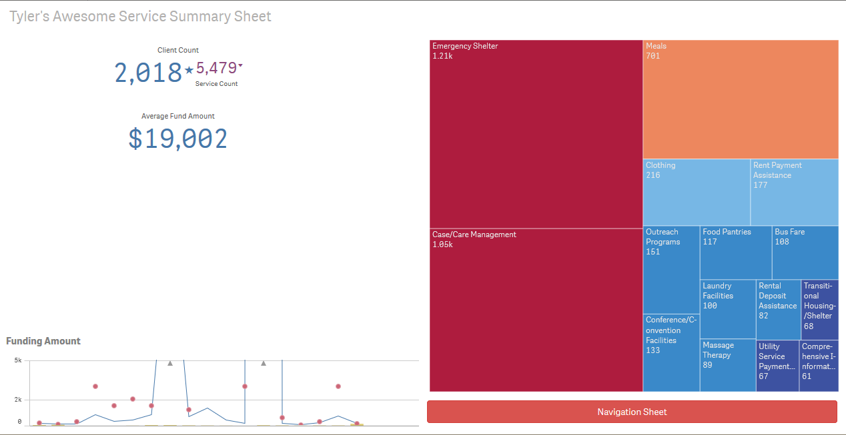
What’s New in HMIS?
Qlik Sense – Summary Sheet (2)

Slide 29
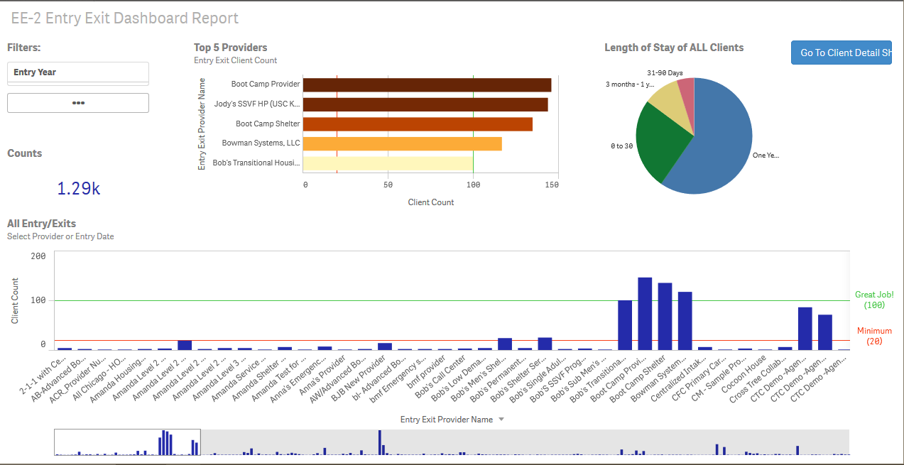
What’s New in HMIS?
Qlik Sense – Summary Sheet (3)

Slide 30
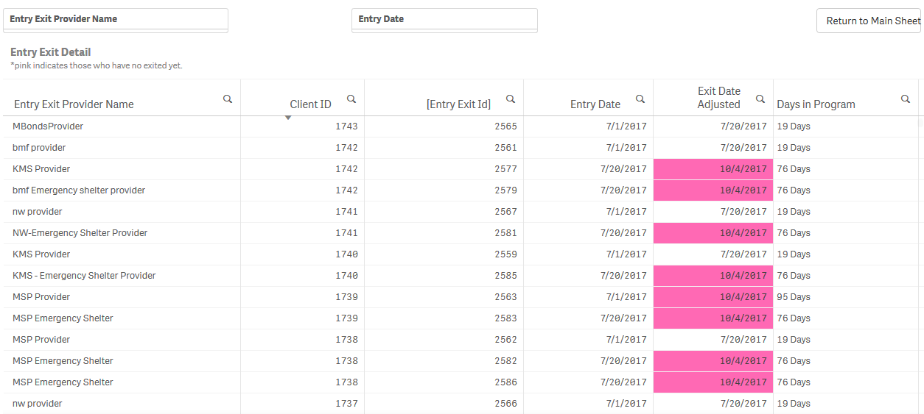
What’s New in HMIS?
Qlik Sense – Detail Sheet

Slide 31
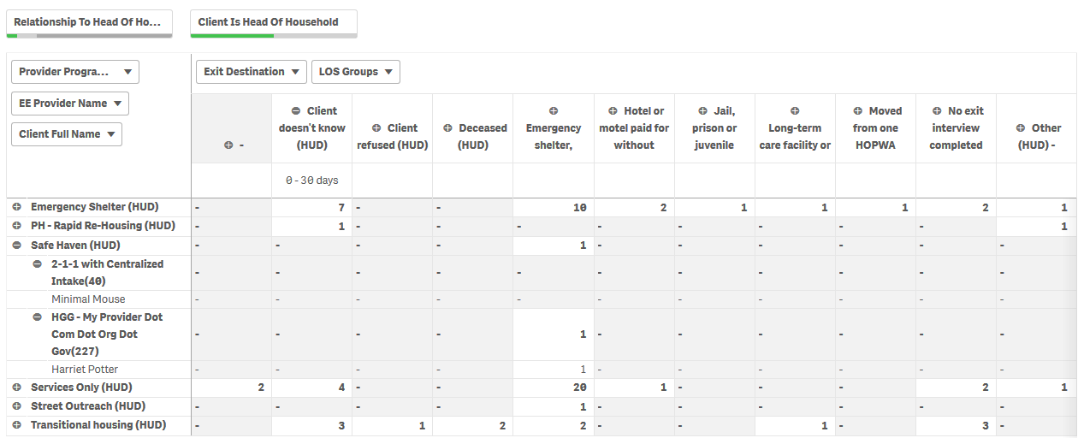
What’s New in HMIS?
Qlik Sense – Pivot Table

Slide 32
What’s New in HMIS?
Qlik Sense Resources
Qlik Guides and Training Materials available on Mediware Customer Portal
Request copies from Local System Administrator or MCAH Help Desk (mihelp@mihomeless.org)
Qlik Sense Desktop Free Download
Reduced functionality
Requires manual uploading of data
Reports created on desktop version will not map over to new version.
Internet Resources
Qlik Website (https://help.qlik.com)
YouTube

Slide 33
What’s New in HMIS?
Summary
We’ve covered changes in:
2017 HUD Data Dictionary Updates
HMIS and Coordinated Entry
HMIS and HUD Reporting Requirements
Qlik Sense Overview

Slide 34
For more information, please contact:
Kaity Hemgesberg
System Administrator II
khemgesberg@mihomeless.org
-Or-
Jill Shoemaker
System Administrator II
jshoemaker@mihomeless.org

