Slide 1

Improving Seatbelt Use at
Ypsilanti High School
University of Michigan (Student Project)
Notes:
Created 2012

Slide 2


Background:
Regional Alliance for Healthy Schools (RAHS)- clinic opened at Ypsilanti High School Jan 2011
Youth Advisory Council (YAC)- group started in October 2011

Slide 3


Introduction:
Identification of the Community-
  The median age in the city of Ypsilanti is 23.6 years; 47% are male and 53% are female. The majority of the population is White (61.4%) or African American (31%)
  Ypsilanti High School Students (YHS) range in age from 14-18 & majority of YHS students are racial minorities (81.9% non-Caucasian).

Slide 4



Introduction:
Unintentional deaths are among the largest causes of injuries and death among children ages 14 to 18 from 1999-2009 accounting for:
    State: 54%
    National : 55%
Healthy People 2020-
  Reduce motor vehicle crash-related deaths
  Increase the use of safety belts

Slide 5

Review of the Literature:
(Research has found) when seat belts are used they reduce the risk of fatal injury to the front seat passenger by 45% (percent) and the risk of moderate to critical injury by 50% (percent) (NHTSA, 2011).
Peer health education places focus on interactive learning which requires participation between the student educator and their peer
  Has been widely used in many schools and many different topics. Critics suggest that it can be an effective way to educate teens as long as the information if delivered in an accurate and sound method.
It may be more appropriate to influence the adolescent’s behavior and beliefs than try to directly motivate them to comply (Thuen & Rise, 1994)

Slide 6



Goals:
  1.) 100% of Ypsilanti High School students
  wear their seat belts 100% of the time
  2.) Improve the health of Ypsilanti high school students by developing a stronger YAC program

Slide 7
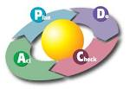
Planning Model
Plan, Do, Check, Act Model (PDCA)
  Model used for continuous quality improvement
Plan: Recognize an opportunity and plan a change
Do: Test the change. Carry out a small-scale intervention
Check: Review the test, analyze the results and identify what you’ve learned.
Act: Take action based on what you learned in the study step: If the change did not work, go through the cycle again with a different plan. If you were successful, incorporate what you learned from the test into wider changes. Use what you learned to plan new improvements, beginning the cycle again.

Slide 8

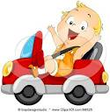
Plan:
  Needs assessment by RAHS- only 63% of the students in 10th and 12th grade reported wearing their seat belt 100% of the time compared to the national average of 85%
  Pre-test completed through observation- only 74% of students arrived to school with their seat belt on (completed 2/17/12, 68/91)

Slide 9

Do:
Planning the Interventions
  Social marketing
  Peer Health Education
  Adult leadership for YAC: Liz Loomis, NP; Janice Mitcham, MPH, LMSW; Amanda O’Reilly
  Social Marketing used by YAC members to educate their peers- buttons and wrist bands

Slide 10
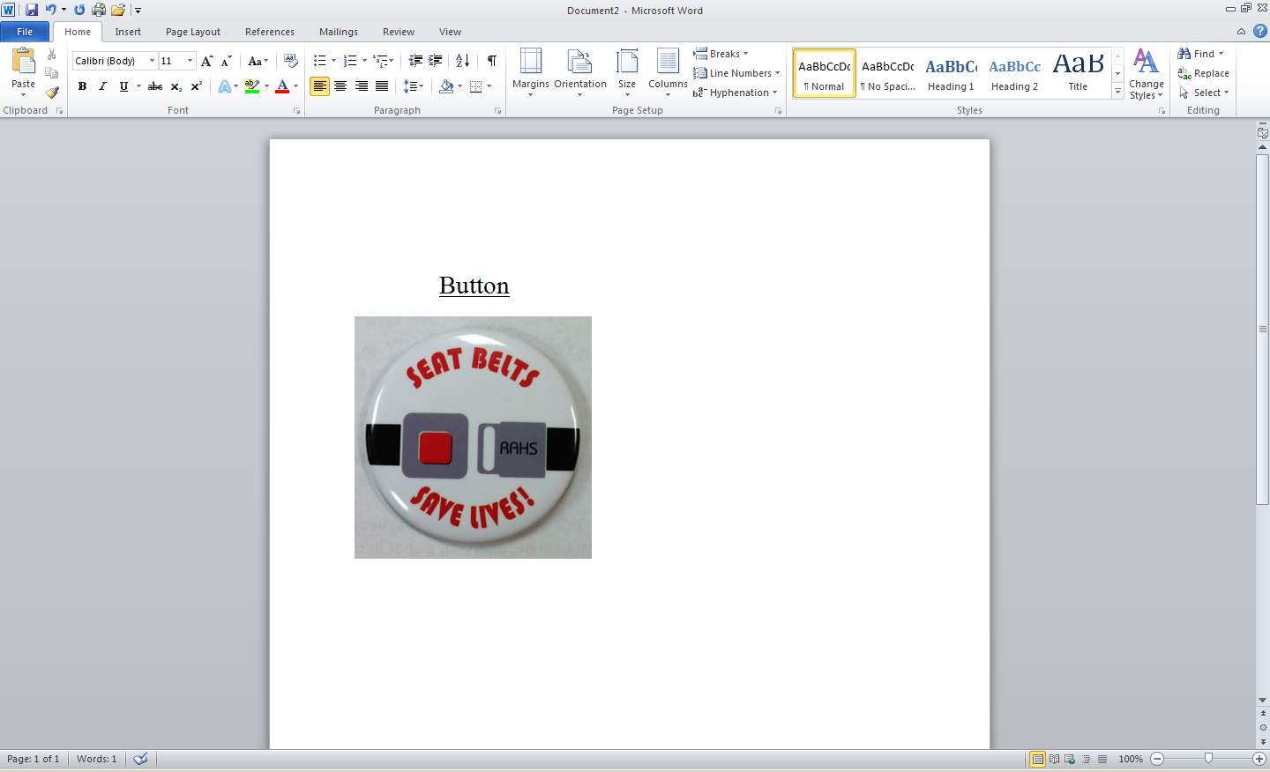
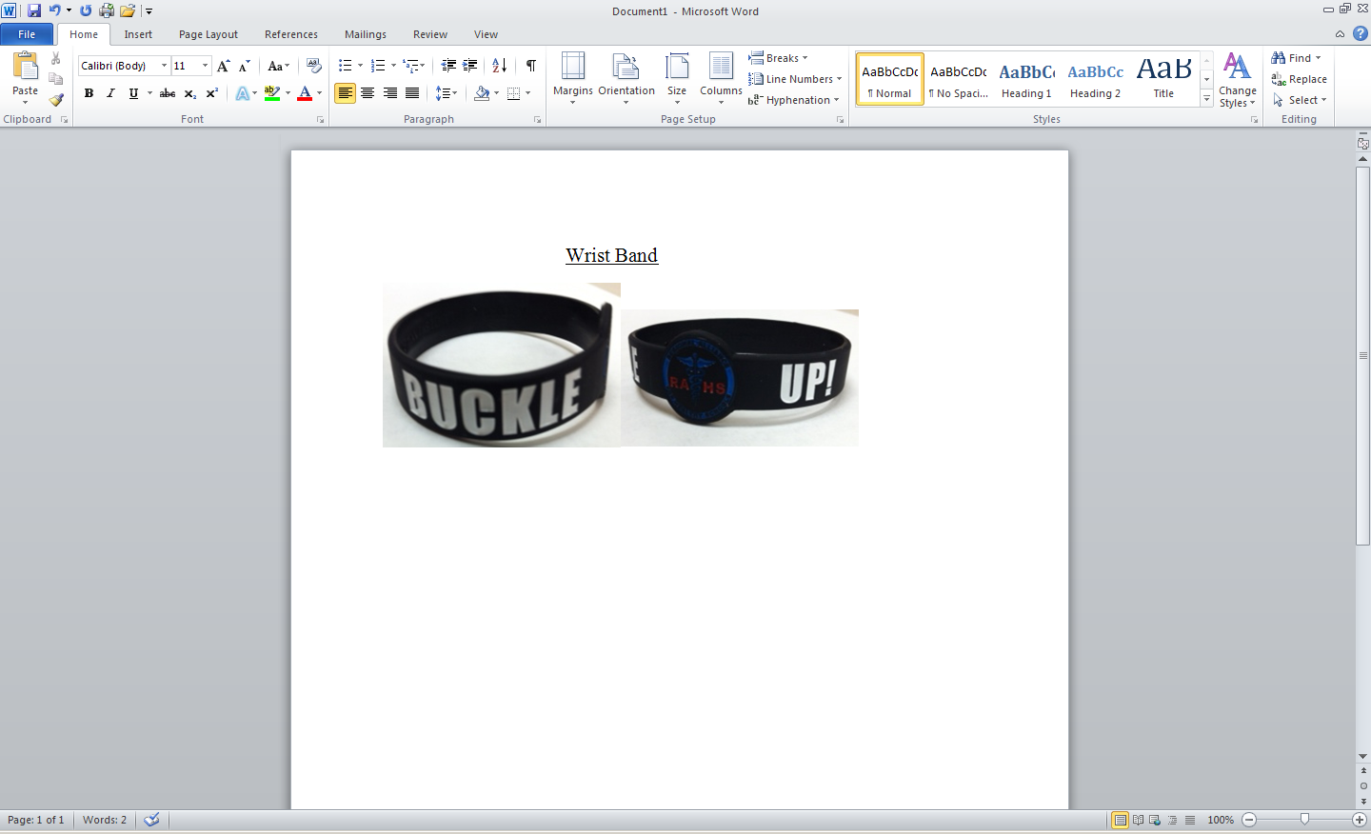
Social Marketing Examples:

Slide 11
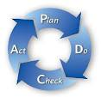
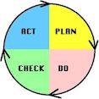
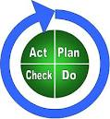
Evaluation Plan:
Check-
  Post-test- through observation, same as pre-test
    Completed 3/23/12, 82/93 adolescents were wearing their seatbelt = 88% (14% increase from pre-test)
  Survey- evaluating the YAC student members thoughts on how well the group worked together

Slide 12


Next steps: Act
Seat belt intervention
  YAC may implement the intervention again at the beginning of the next school year depending on their priorities
Group cohesiveness
  Based on the results- gain feedback from the group and re-evaluate goals and objectives to build a stronger YAC program for the next school year

Slide 13

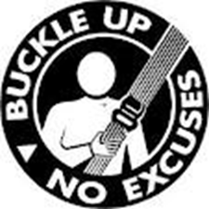
Conclusions:
A needs assessment of a public high school revealed low seat belt use and high risk for injury due to vehicle crashes among members of this population
A population-focused intervention focusing on increasing seat belt use was designed
A peer health education model combined with social marketing were novel features of the intervention
Effectiveness of the intervention will be evaluated using evaluation strategies designed for this intervention and population

Slide 14
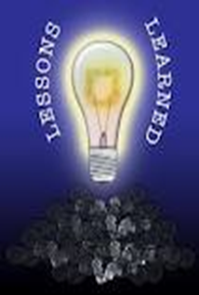
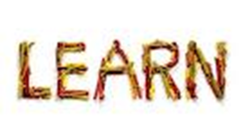

What I have learned:
Clear expectations and goals
Begin any project with a timeline and keep it updated
Stay realistic in estimating the amount of time it takes to accomplish each task
Keep open lines of communication with the agency you are working with to make sure each group is meeting their expectations and are working together towards the same goals
Remember that each project is a learning experience and continues to help you grow as a professional
Have fun!

Slide 15
References:
American Society for Quality (ASQ). Project Planning and Implementing Tools. Retrieved December 30, 2011 from http://asq.org/learn-about-quality/project-planning-tools/overview/pdca-cycle.html
Grier, S. & Bryant, C.A. (2005). Social marketing in public health. Annual Review of Public Health, 26, 319-339.
Mellanby, A. R., Rees, J. B. & Tripp, J. H. (2000). Peer-led and adult-led school health education: a critical review of available comparative research. Health Education Research, 15 (5), 533-545.
National Center for Chronic Disease Prevention and Health Promotion (CDC). Injury Prevention & Control. Retrieved January 16, 2012 from http://www.cdc.gov/motorvehiclesafety/teen_drivers/teendrivers_factsheet.html
National Center for Chronic Disease Prevention and Health Promotion (CDC). NCHS Data Brief. Retrieved January 16, 2012 from http://www.cdc.gov/nchs/data/databriefs/db37.htm
National Highway Traffic Safety Administration (NHTSA). Traffic Safety Facts. Retrieved January 13, 2012 from http://www-nrd.nhtsa.dot.gov/Pubs/810807.PDF
Regional Alliance for Healthy Schools (RAHS). Youth Advisory Councils. Retrieved February 18, 2012 from http://www.a2schools.org/rahs/youth_advisory_councils
Social Marketing Journal. Five Benefits of Social Marketing. Retrieved March 3, 2012 from http://socialmarketingjournal.com/2008/06/08/benefits-social-marketing/
Storey, J. D., Saffitz, G.B. & Rimon, J.G. (2008). Social Marketing. In K. Glanz, B.K. Rimer & K. Viswanath (Eds.), Health behavior and health education; theory, research, and practice (pp.435-464). San Francisco, CA: Jossey-Bass.
The Community Tool Box. Overview and Evidence Base- Implementing Effective Interventions. Retrieved January 26, 2012 from http://ctb.ku.edu/en/promisingapproach/tools_bp_sub_section_68.aspx
Thuen, F. & Rise, J. (1994). Young adolescents’ intention to use seat belts: the role of attitudinal and normative beliefs. Health Education Research, 9 (2), 215-223.

Slide 16

Questions???
Thank you.

