Slide 1
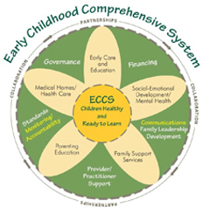
Early Childhood
Comprehensive System
Young Children, Trauma & Toxic Stress
Notes:
Welcome and Introductions
Introduce yourself and how/why you became interested in trauma & early childhood
Encourage audience participation, indicate when you want to have questions/discussion
Provide logistical information-sign in sheets, restrooms, etc.
If relevant discuss process for CEUs

Slide 2
Building Health Through Integration:
Great Start Trauma Informed System
Goal - Integrate a trauma informed approach into our Great Start system
  Education regarding trauma & toxic stress
  Expand screening
  Improve access to intervention services
Notes:
Early Childhood Comprehensive System (ECCS) – collaborative efforts to ensure that children are healthy and enter school ready to learn.
In Michigan the system is called Great Start
Federal ECCS grant to the Mi Dept of Community Health with the above goal
Primary activities are education, expand screening, and improve access to intervention

Slide 3
Today’s Objectives
Review key ideas about early brain development
Understand the effect of trauma & toxic stress on young children
Discuss ideas for preventing & lessening the effect of toxic stress & trauma
Notes:
Review objectives for the presentation
Discuss how the information is relevant to the particular audience, e.g. home visitors, child care providers, medical providers

Slide 4

Why Is This Important?
Trauma can change the course of a child’s life and their future
Notes:
Trauma & toxic stress in early childhood has significant impact across all domains of development - physical, cognitive, emotional & social
The long term impact can persist into adulthood and lead to physical and mental health problems which in turn impact economic and social well being

Slide 5
Important Terms
Trauma – an intense event that threatens safety or security of an individual
Toxic Stress – re-occurring negative experiences that threaten safety or security
Traumatic Stress- event, the experience and the effect
Notes:
Two terms we will talk about during the presentation
Differentiate between acute and chronic stress/trauma
Both types can be impactful
Traumatic stress = event, our experience of it, and the effect it has on us

Slide 6

Objective #1
Early Brain Development: Key Concepts
Notes:
Plan to discuss 5 key concepts of early brain development & then talk about how they connect to trauma & toxic stress
The first 3 months of life are sometimes referred to as the 4th trimester, a period of rapid growth of the body and the brain
The first 5 years are the most critical for development of skills necessary for adult competence and success; “everything I know I learned in early childhood”

Slide 7
Early Brain Development:
Key Concepts
Experience shapes brain architecture
Brains are built from the bottom up
Serve and return
Cognitive, emotional & social development are connected
Experience alters how are genes are expressed
Notes:
Neuroscientists and geneticists have learned a great deal about the ways human beings develop and the interactions between biology, genetics, environment and experience
The science reinforces the importance of early childhood as a critical point in development
It also emphasizes the complex and interconnected nature of development

Slide 8
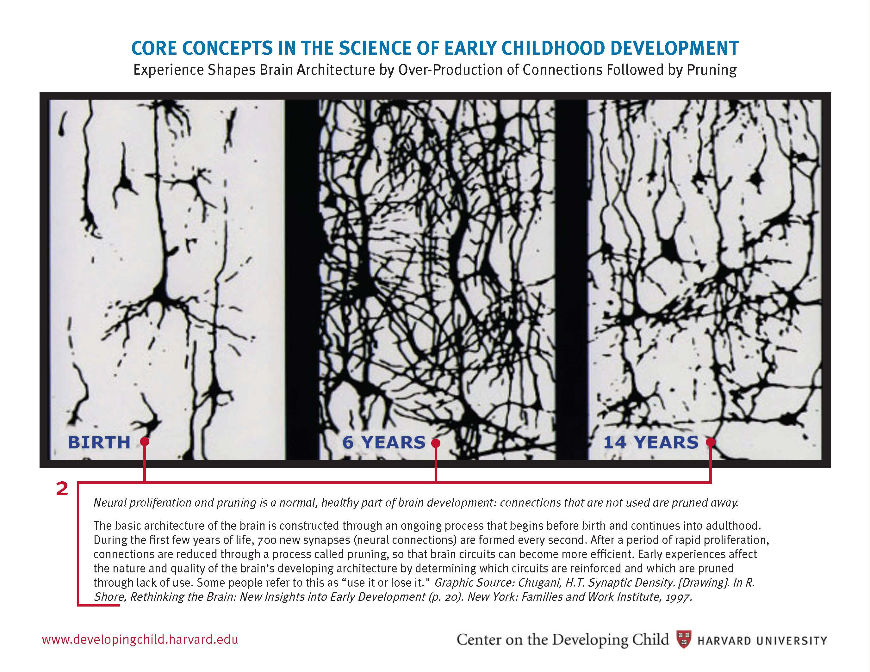
Experience Shapes Brain Architecture
Center on the Developing Child, Harvard University
Notes:
Brain architecture refers to the connections between neurons
The process of producing and then pruning neural connections begins before birth and continues into adulthood
During the first few years of life 700 new synapses (connections) are formed every second
The connections route information from experience & the environment to the cells (neurons) and then to the body for reaction/action.
The more a connection is used the stronger it becomes, less or unused connections are “pruned”
Pruning helps the brain to work more efficiently in the environment the child inhabits
Some people refer to this as “use it or lose it”

Slide 9
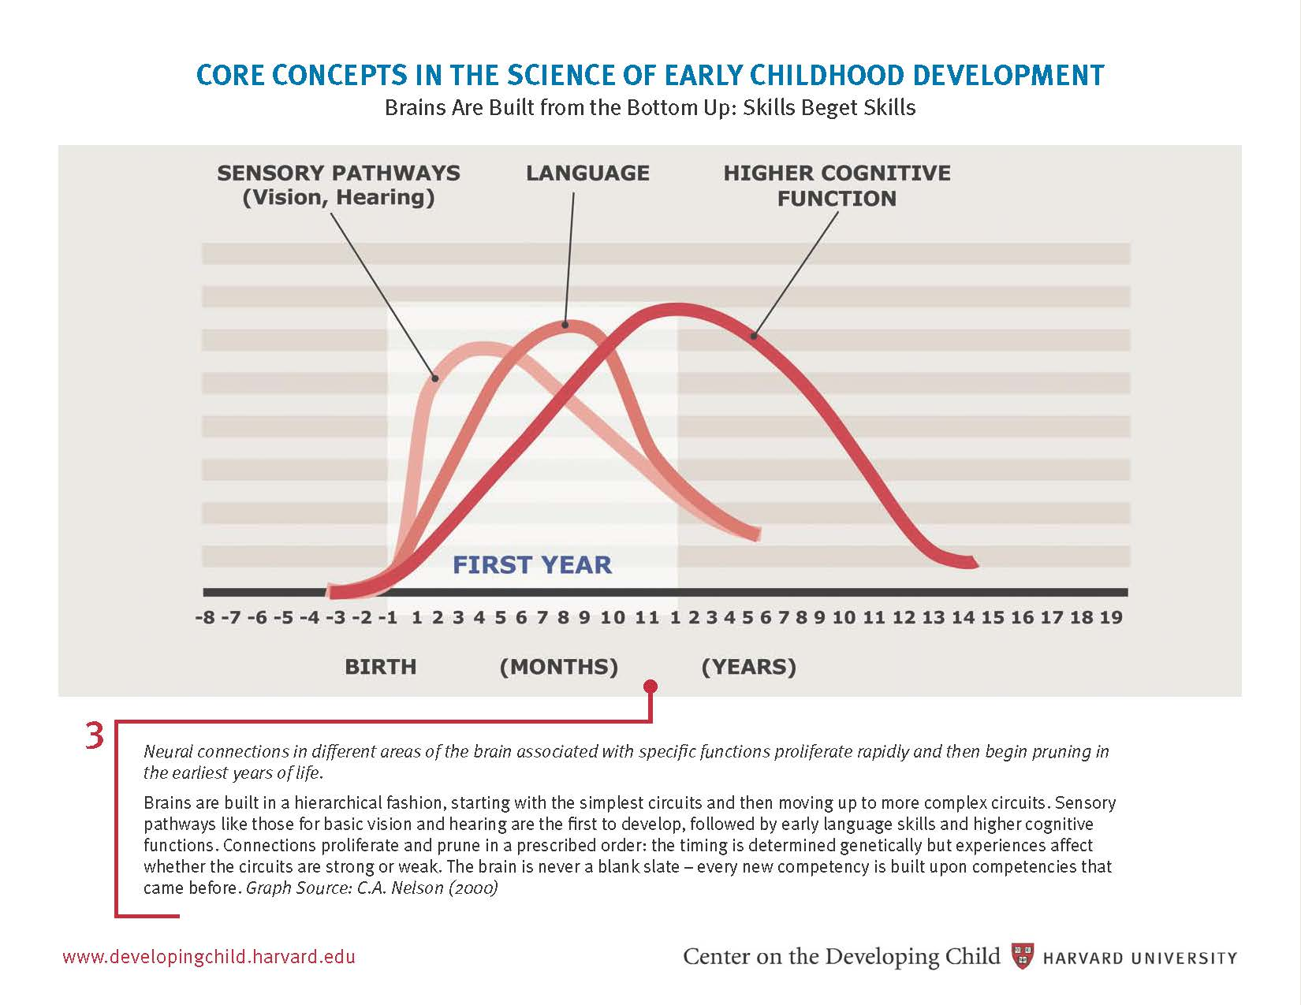
Brains Are Built From The Bottom Up
Center for Developing Child, Harvard University
Notes:
Brains are built in a hierarchical fashion-starting with simple circuits and proceeding to more complex
Each new skill is built on previous skills/competencies
The timing of proliferation and pruning is determined by our genes
Experience affects the strength/weakness of the circuits
Example-sensory pathways (vision, hearing) develop first, followed by pathways associated with language, followed by higher cognitive competencies

Slide 10
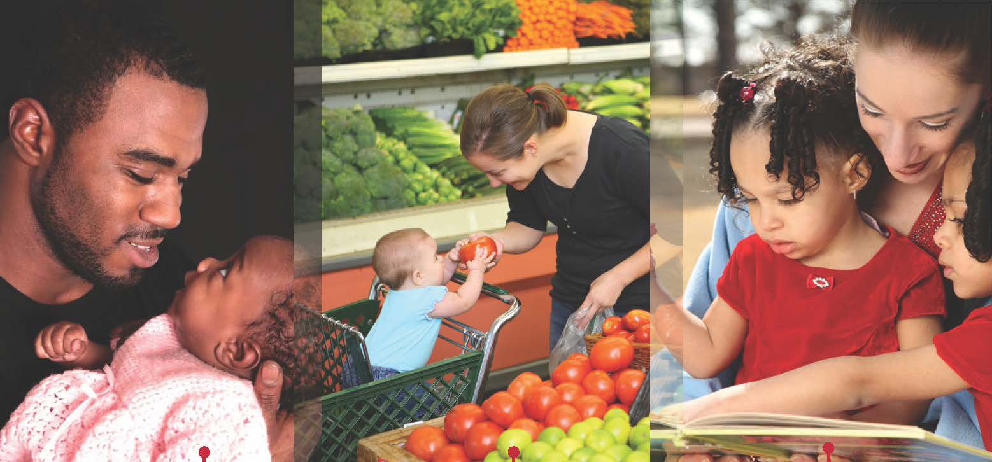
Serve & Return Interactions
Center for Developing Child, Harvard University
Notes:
This concept refers to the relationship between a child and his/her caregivers
Young children reach out for interaction and adults respond with similar gestures and vocalizations
The repetition of this “serve & return” activity strengthen neural connections
If responses don’t happen or are intermittent or inappropriate, the connections do not develop or are weaker

Slide 11
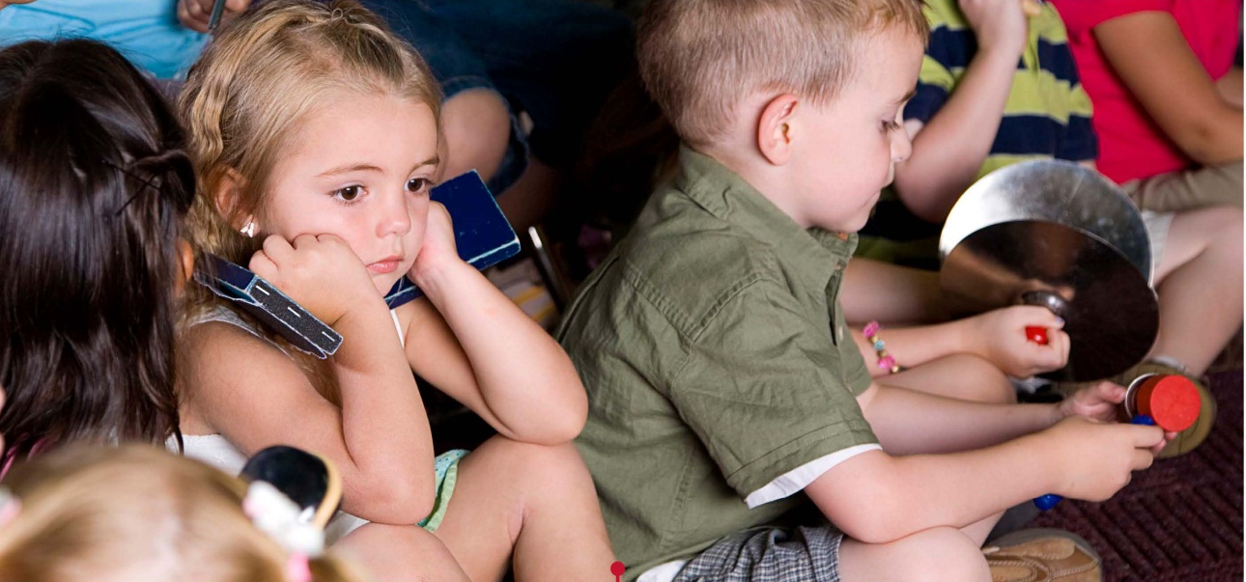
Cognitive, Emotional & Social Development are Connected
Center for Developing Child, Harvard University
Notes:
Cognitive, emotional & social skills are deeply intertwined in the brain
The brain operates in a richly coordinated fashion-emotional well-being, social competence & cognitive abilities all impact each other
Example-fear (emotion), diminishes interaction (social), diminishes opportunities for learning (cognitive) – learning to ride a bike
Example-happiness (emotion), increases interaction (social), increases opportunities for learning (cognitive) – playing music

Slide 12
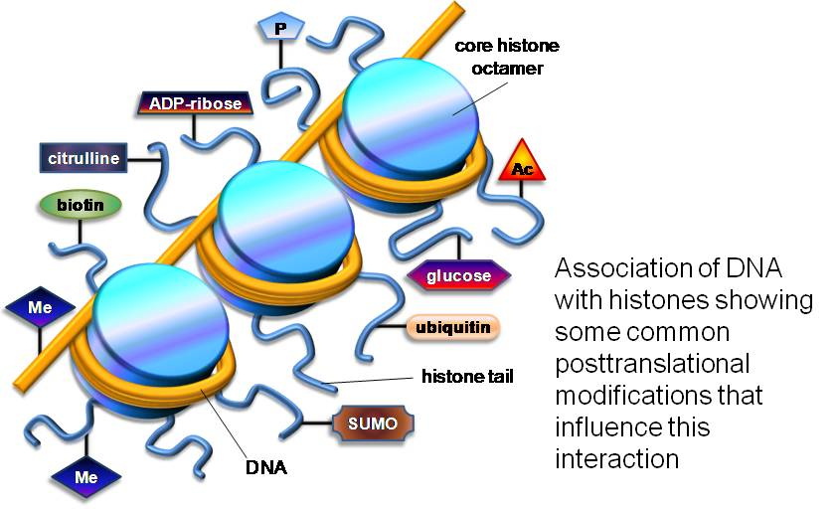
Experience Alters Genetic Expression
Notes:
DON’T WORRY ABOUT SPECIFIC LABELS IN THE PICTURE!
We used to think that we could not alter genetics but now we know that our experiences can alter the way the genetic program is read, the genes do not change but may or may not be activated
Chemical markers attach to structures in the cells (histones) that determine which genes are made available for use.
The markers are produced as a result of our environment and experiences
For example - research showed mice parents who were nurturing to young , the young had certain chemical markers and those young mice grew to tolerate stress as adults; when the chemical markers were blocked, they did not tolerate stress as adults even though they had nurturing parents

Slide 13
The Dance Between Nurture and Nature
Experience
Brain Development Epigenetic Changes
Behavior
AAP: Helping Foster and Adoptive Families Cope With Trauma ; 2013
Notes:
Development results from an ongoing and cumulative dance between nature and nurture
Experience (protective vs insecure) influences both genetic expression and brain architecture
Brain development leads to behavior (adaptive or healthy vs maladaptive or unhealthy) which influences the types of experiences we have
Repetitive, highly stressful experiences damage our brains and leads to an overactive adversity response system
Positive experiences, rich learning & supportive relationships activate genetic potential for countering adversity

Slide 14
Experience Build Brain Architecture
http://developingchild.harvard.edu/resources/multimedia/videos/three_core_concepts/brain_architecture/

Slide 15
Summary: Early Brain Development
Brain development is most intense before age 5
Brains develop in response to experience (environment)
Brain development impacts cognitive, social and emotional skills and lead to adult behaviors & competencies
Notes:
Summary of Key Concepts
Questions/Comments

Slide 16
Objective #2
Stress, Trauma & Toxic Stress
Notes:
Shifting focus to talk about stress, trauma and toxic stress
Connect that to young children and their development

Slide 17
How Does Stress Work?
Stress is a normal & necessary part of life
Stress disrupts our sense of well being
Stress causes physiological reactions
Stress causes behavioral reactions
Notes:
Stress happens to everyone
One of the experiences that helps us learn
Physiologic responses include increased heart and respiratory rates, increased blood pressure, increase levels of stress hormones (cortisol, norepinephrine)
Behavioral responses include fight, flight or freeze; focus is on the threat and dealing with it; reduces ability to plan and problem solve

Slide 18
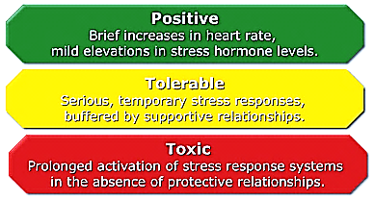
Three Types of Stress
Center on the Developing Child, Harvard University
Notes:
Not all stress is harmful or traumatic
Positive – e.g. waiting for a bottle, falling down; can lead to important learning, coping skills, problem solving
Tolerable – e.g. hospitalization, death; also teaches coping skills but the key is that support is available
Toxic – e.g physical or sexual abuse, neglect; can be a single event or ongoing; supports are not available

Slide 19
What Are Trauma & Toxic Stress?
Trauma – an intense event that threatens safety or security of an individual
Toxic Stress – re-occurring negative experiences that threaten safety or security
Traumatic Stress-event, the experience, and the effect
Notes:
Remind about previously discussed definitions
Traumatic stress = event, our experience of the event and the ongoing effect it has on us

Slide 20
How Does Trauma Affect Young Children?
Young children experience trauma differently than older children or adults
Primarily a sensory experience
Not as able to anticipate danger and protect self
Limited ability to express thoughts & feelings
Different understanding of causation - the power of thoughts, wishes, fears
Source: National Child Traumatic Stress Network
Notes:
A child’s experience of trauma or stress is different because of their different capacities
These differences make a child more vulnerable to the impact of toxic stress
Because the brain is still developing, trauma is more likely to change (damage) the brain’s architecture
This can lead to lifelong problems

Slide 21
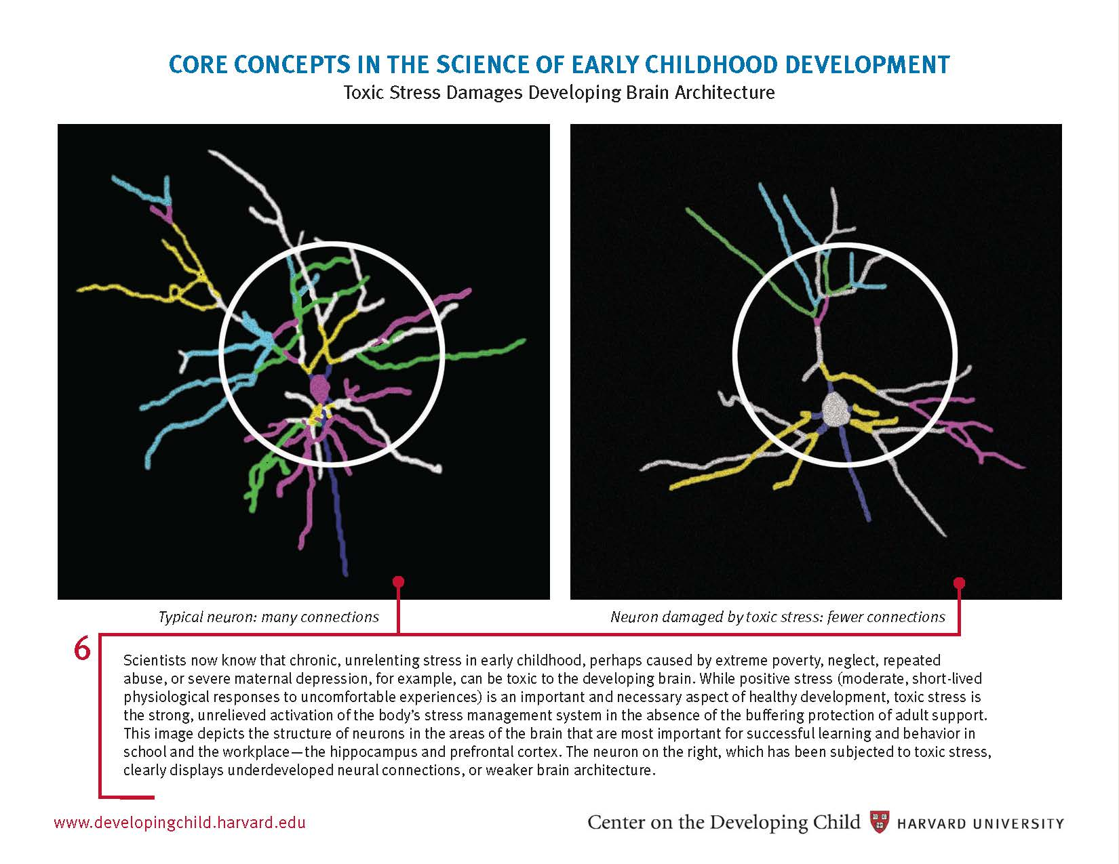
Impact of Toxic Stress on the Brain
Center for Developing Child, Harvard University
Notes:
Chronic, ongoing trauma/toxic stress leads to changes in the brain
Slide shows the structure of neurons in the hippocampus and prefrontal cortex (areas important for learning and behavior)
The neuron on the right, which has been subjected to chronic stress shows underdeveloped neural connections or weaker brain architecture

Slide 22
What Are the Long Term Consequences?
Adverse Childhood Experiences Study (ACES)
  When ACE score increases so does:
    High risk behaviors – smoking, substance abuse
    Behavioral health problems – depression, suicide attempts, intimate partner violence
    Physical health problems – STDs, COPD, liver disease, ischemic heart disease
    Early death
Notes:
Took place in 1998, joint study by Kaiser Permanente and CDC
Studied the effects of adverse childhood experiences on health and mental health in adulthood
17,000 participants, mostly white, average age 57, mostly middle class (not high risk population)
Asked about 10 adverse childhood events-physical & sexual abuse, neglect, separation form parent, living with a person with mental illness or addiction
ACE score = # of adverse events before 18 years
Here are some of the key findings

Slide 23
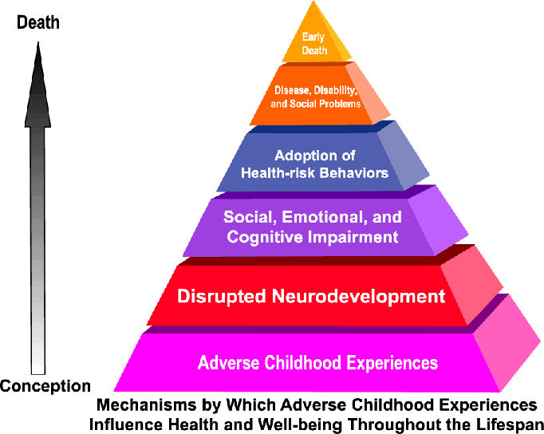
How Does This Happen: ACE Pyramid
Notes:
Developed a model for how the adverse experiences led to poor health outcomes
Experiences
change the brain’s architecture
leads to poor/maladaptive social, emotional and cognitive skills
leads to adoption of risky behaviors, e.g. smoking, substance abuse
leads to disease and disability
leads to early death

Slide 24
Summary: The Impact of Trauma & Toxic Stress
Changes in physiology
Changes in brain architecture
Changes in skills, abilities and behavior
Changes in health and mental health
Notes:
Summary of key concepts

Slide 25
The Impact of Early Adversity on Children’s Development
http://developingchild.harvard.edu/index.php/resources/multimedia/videos/inbrief_series/inbrief_impact_of_adversity/

Slide 26
Objective #3
What’s the Good News?
Notes:
Despite all of this, things are not hopeless
We have the ability to impact the progression along the way
The earlier we act the better the outcome

Slide 27
Supportive relationships buffer/protect young children from the effects of trauma/toxic stress
Notes:
Nurturing interactions build health brain architecture that is then the foundation of health and well being
Early childhood providers already know the importance for school success
This information also ties this concept to adult health and mental health

Slide 28
Components of Trauma Informed Care and Prevention
Understand impact of trauma for adults & children
Screen for trauma exposure/toxic stress
Teach strategies for preventing & mitigating stress/trauma
Refer for treatment/services as appropriate
Notes:
Parents/caregivers & early childhood providers (fill in specific audience-home visitors, child care providers, health care providers) are in a great position to influence outcomes for children
For providers a “trauma informed” approach helps them focus on practices that increase positive outcomes
It is a way of thinking & not always a new process
Components of trauma informed care include:

Slide 29
Trauma Screening
Ask what happened rather than what’s wrong
Unresolved trauma in parents may lead to toxic stress for children
An opportunity to support & educate parents/caregivers
Data base of trauma screening tools www.nctsn.org
Notes:
Changes the focus from what’s wrong to what happened
Depending on the setting it may be appropriate to utilize a formal screening tool
Trauma screening needs to take both parent & child into consideration
Trauma may affect parenting behaviors
Be careful not to re-traumatize an individual by
Screening everyone you work with
Be accepting & non-judgmental
Offer support, empathy & a listening ear
Use screening as a way to educate
Offer help/intervention but don’t insist
Examples of tools- Edinburgh (maternal depression); UNCOPE (substance use); RAT (relationship assessment tool-DV); ACEs tool

Slide 30
Strategies for Preventing/Mitigating Trauma/Toxic Stress
Emphasize What Young Children Need
Teach Coping Skills
Enhance Protective Factors
Notes:
Many early childhood providers are already doing these things, now have a better understanding about why it is so important
Early childhood providers are in an ideal place to help prevent trauma/toxic stress or reduce its impact
Our work is to support & educate parents/caregivers
The strategies can be incorporated into any early childhood setting and often are already part of our work with families

Slide 31
Strategies for Preventing/Mitigating Trauma/Toxic Stress
What Young Children Need
  Safety
  Security
  Nurturing
Notes:
Safe environments reduce the likelihood that trauma will happen
Security means stable, children develop best when there is consistency in their environment and their relationships
Nurturing consists of support, reassurance and encouragement; nurturing relationships are responsive to the needs of the child

Slide 32
Strategies for Preventing/Mitigating Trauma/Toxic Stress
Encourage development of social emotional skills
  Form relationships
  Communicate needs
  Regulate emotions
  Explore their world
Enable child’s own abilities
Notes:
Social emotional skills provide the foundation for coping with adversity
If a child can do these things they will create opportunities to get the support they need
Using the ASQ-SE is an opportunity to talk about social emotional skills with parents/caregivers
MI Assn for Infant Mental Health and Mi Dept of Community Health – Social Emotional Toolkit have more information for encouraging development of these skills.

Slide 33
Strategies for Preventing/Mitigating Trauma/Toxic Stress
Support Caregivers & Teach Coping Skills
  Self care
    Nutrition, sleep, exercise
  Stress management
    Support, stress relievers
  Problem solving
    Address stressors (safety, income, health access)
Notes:
Parents/caregivers may need support to cope with their own trauma histories
Educate parents about trauma and how it may have impacted them and/or could impact their child, remember to be non-judgmental
Support caregivers to increase healthy behaviors, learn ways to cope with stress and address issues that cause stress
When their needs are met, they are more able to their nurture and support their children

Slide 34
Strategies for Preventing/Mitigating Trauma/Toxic Stress
Enhance Protective Factors
  Family Functioning/ Resiliency
  Social Support
  Concrete Support
  Child Development/Knowledge of Parenting
  Nurturing and Attachment
Notes:
Research shows that when these factors are established for families:
the likelihood of abuse or neglect decreases
family strengths and family environment that promotes healthy child development increase
Early childhood providers have opportunities to help families build on their strengths and to increase the presence of protective factors in their lives
Actions can be simple and emphasize small but significant changes in everyday activities

Slide 35
Strategies for Preventing/Mitigating Trauma/Toxic Stress
Refer for Services
  School completion & job training
  Mental health treatment (adult or child)
  Substance abuse treatment
  Intimate partner violence services
Notes:
Develop of list of local agencies the provide these services to give to parents
Help parents/caregivers access community services that address issues that can lead to toxic stress for young children
Encourage parents to seek help but do not insist
Emphasize the importance of safety for parents and children, help parents plan for safety
Support parents, let them know they are not alone

Slide 36
In Summary
Trauma & toxic stress change a child’s experience of the world
Which leads to changes in biology & brain architecture
As a result, children act differently (defensively)
Which impacts how they learn, get along with others, and take care of themselves
Supportive relationships protect children from the impact of trauma & toxic stress

Slide 37
How Can I Learn More?
Website: www.michigan.gov/traumatoxicstress
Trauma Informed System Coordinator
Mary Mueller, LMSW
  (517) 373-4190
  MuellerM1@michigan.gov

Slide 38
QUESTIONS ?

