Slide 1

Michigan’s Letter Grade and Ranking System
2020-21 School year results

Slide 2
Public Act 601 of 2018 Requirements
Annual letter grades and ranking labels
For all public schools
No summative grade/ranking
Identification of:
Lowest achieving schools (State – Comprehensive Support and Improvement)
Highest achieving schools (Reward)
Schools with consistently underperforming subgroups
“Alternative Education Campuses” excluded from letter grades and rankings
Means Center Programs are excluded
Peer review panel
Review and submit findings to Michigan Department of Education (MDE) and state legislature

Slide 3
Peer Review Panel
5 Members:
Represent various locations and groups in Michigan
3 Members appointed by the Governor
1 Member appointed by the Senate Majority Leader
1 Member appointed by the Speaker of the House of Representatives
Autonomous
Submit findings to MDE and standing committees of the senate and house of representatives
Panel Actions
Met several times to review system materials
Final report submitted to MDE and Michigan Legislature October 31, 2019

Slide 4
Design and Development Approaches
Simple and understandable for parents and the general public
Combined subjects; very little disaggregation
Schools will earn up to five letter grades and three ranking labels
Reuse of existing policies, practices, and procedures for school and district familiarity
Schools, districts, and other consumers of these data will need to comprehend two different accountability systems and sets of results
Align as closely as possible to existing MDE priorities and systems

Slide 5
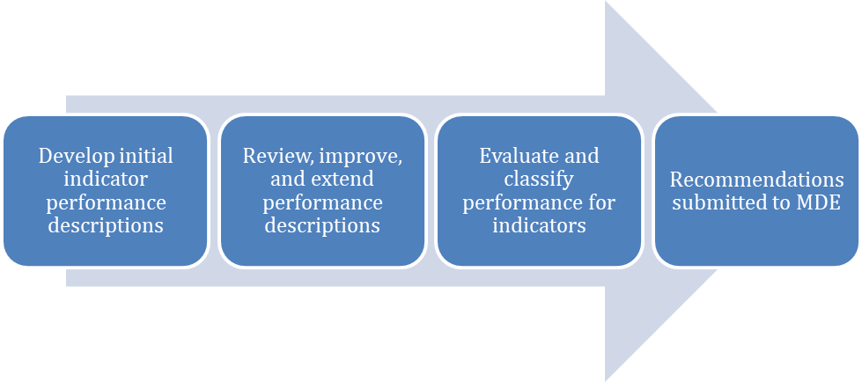
Standard Setting Process

Slide 6
State Board of Education Involvement
SBE considered options to initial MDE-designed system
Changes to cut scores
Participation
EL Progress
Graduation Rate
Proficiency
Growth
Methodology changes
Variables used in peer school comparison

Slide 7
Accountability for Traditional Schools

Slide 8
Letter Grade Indicators
Student proficiency
Single letter grade based on combined math and ELA performance
Students enrolled for a full academic year (FAY)
Students’ adequate growth
Single letter grade based on combined math and ELA performance
Students enrolled for a full academic year (FAY)
English Learner (EL) adequate growth
Based on the English language proficiency assessment (WIDA)
Based on School Index methodology – uses both proficiency and growth on WIDA
Graduation rate
Using best of the 4-, 5-, or 6-year cohort rate
Student proficiency compared to similar schools

Slide 9
Ranking Label Indicators
Rate of chronically absent students
Assessment participation rate
Single ranking based on combined math and ELA participation rates
Student subgroup proficiency compared with corresponding statewide student subgroup proficiency
Ranking labels
Significantly Above Average
Above Average
Average
Below Average
Significantly Below Average

Slide 10
Other System Features
No summative grade or ranking label
Schools receive up to five letter grades and three ranking labels
Indicators use aggregated “all students” population with the following exceptions
EL performance comprised only of EL students
Student subgroup comparison uses disaggregated student groups
Minimum n-size thresholds are aligned with existing accountability system rules
Student growth, proficiency, similar schools = 1
EL growth, assessment participation, subgroup comparison = 30
Graduation rate, chronic absenteeism = 10

Slide 11
Similar Schools
Original intent was to reuse methodology currently in place on the Parent Dashboard
Up to 30 similar schools used to calculate an average (using z-scores)
Would allow the same school comparisons across the accountability system and Parent Dashboard
Characteristics desired by State Board of Education
Percent of Free Lunch Students - 70%
Percent of Students with Disabilities FTE - 20%
Headcount (Student FTE) - 10%
Methodology
Z-scores created for each characteristic
Weights applied; aggregate created
Schools grouped by similar grade spans, then sorted based on aggregate closeness
Proficiency difference by subject between a school and its peers calculated then standardized

Slide 12
Identification of Low Performing Schools
P.A. 601 prescribes method for identifying lowest achieving public schools
Borrows federal term “Comprehensive Support and Improvement schools (CSI)” but defines differently
Results in two sets (one state and another federal) of schools identified as lowest achieving schools
State-CSI identification criteria:
High school graduating less than 2/3 of its students
Any school receiving the lowest grade on all of the following:
Student proficiency
Student growth
Similar school proficiency comparison
Total state-CSI schools cannot exceed 5% of all public schools
State-CSI schools will be identified on the same schedule as federal-CSI schools
Next identification will be Fall 2022 using 2021-22 data

Slide 13
Identification of Consistently Underperforming Subgroups
P.A. 601 requires the identification of schools with consistently underperforming subgroups as described in the Every Student Succeeds Act (ESSA)
MDE has developed standards and has been using them in the existing ESSA accountability system
MDE will continue to identify consistently underperforming subgroups using the ESSA accountability system to minimize confusion

Slide 14
Identification of High Achieving Schools
P.A. 601 prescribes criteria for identification of high achieving (Reward) schools
High school with a graduation rate of at least 99%
Any school receiving the highest grade on any of the following:
Student proficiency
Student growth
Similar school proficiency comparison
Meeting any other criteria as determined by MDE
MDE will not identify any school as a Reward school that is already identified as a lowest performing (CSI) school or any school with identified consistently underperforming subgroups

Slide 15
Public Reporting

Slide 16
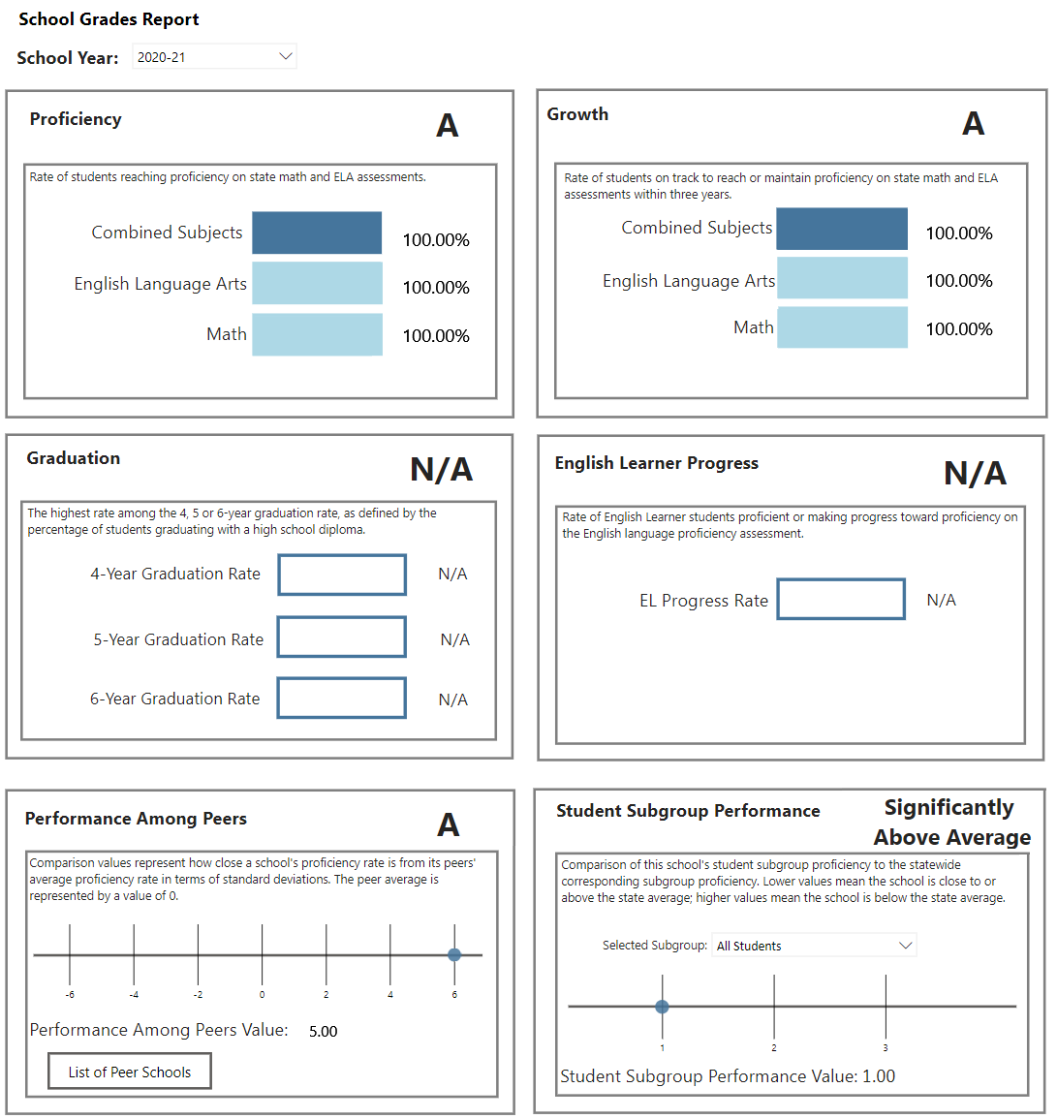
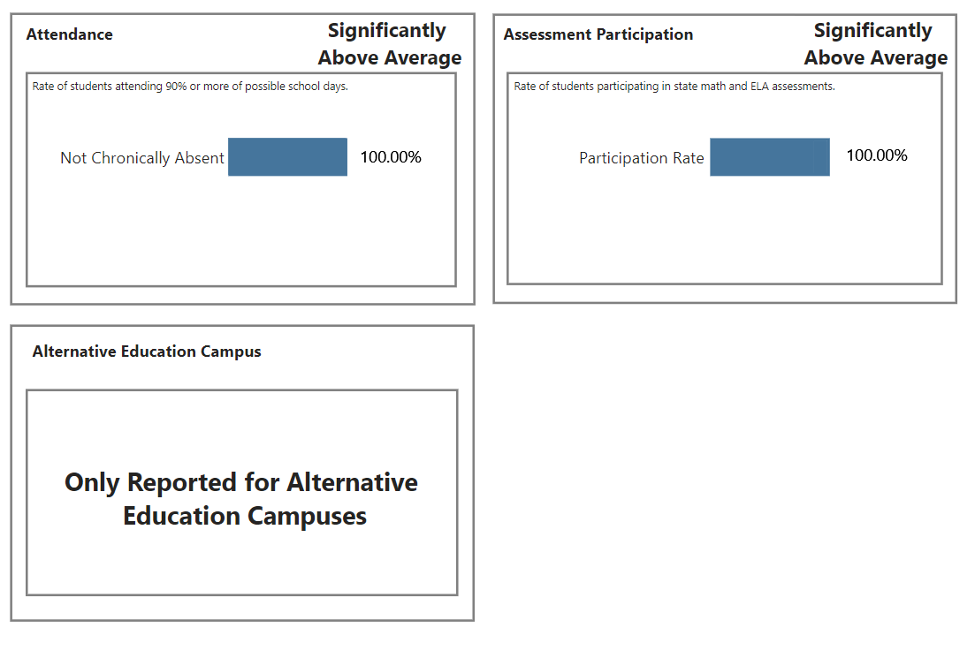
School Grades Report – Top Portion
Top of Report
Bottom of Report

Slide 17
Accountability for Alternative Education Campuses

Slide 18
Alternative Education Campuses
P.A. 601 excludes some schools from receiving letter grades and ranking labels. These schools are considered alternative education campuses:
Center programs
Strict discipline academies
Adjudicated youth programs
Any other school serving a specialized student population (alternative schools)
MDE defines alternative schools using three criteria:
School emphasis of Alternative Education reported in Educational Entity Master (EEM) data collection
Reporting at least 90% of enrolled students in an Alternative Education Program in the Michigan Student Data System (MSDS) data collection
Reporting as serving a grade or setting of Alternative Education in the Educational Entity Master (EEM) data collection

Slide 19
Alternative Education Campuses
In addition to our existing alternative accountability inclusion rules, the following criteria are added for alternative education campuses under P.A. 601:
Adjudicated Youth/Juvenile Detention Facilities
Schools that have EEM “Juvenile Detention Facility” entity type flag in Educational Settings
Schools that have EEM “Delinquent Institution” entity type flag in Educational Settings
Schools that have EEM “Neglected Institution” entity type flag in Educational Settings
Schools that have EEM “Locked-Down School” entity type flag in Educational Settings
Schools that have EEM “Residential Child Care Institution or Youth Home” (RCCI) entity type flag in Educational Settings
Schools that have EEM “Strict Discipline Academy” entity type flag in Educational Settings
Center Programs
Schools have EEM “Special Education Center Program” entity type flag in Educational Settings
AND report 90%+ of enrolled students as Students with Disabilities in MSDS

Slide 20
Alternative Education Campus Accountability
Alternative Education Campuses receive a summary status based on:
Whether the school is in compliance with applicable law
Whether enrolled students are making meaningful, measurable academic progress towards educational goals
There are two summary statuses
School meets expectations
Earned by schools in compliance with laws and making meaningful, measurable academic progress towards educational goals
School does not meet expectations
Earned by schools not in compliance with laws and/or not making meaningful measurable academic progress towards educational goals

Slide 21
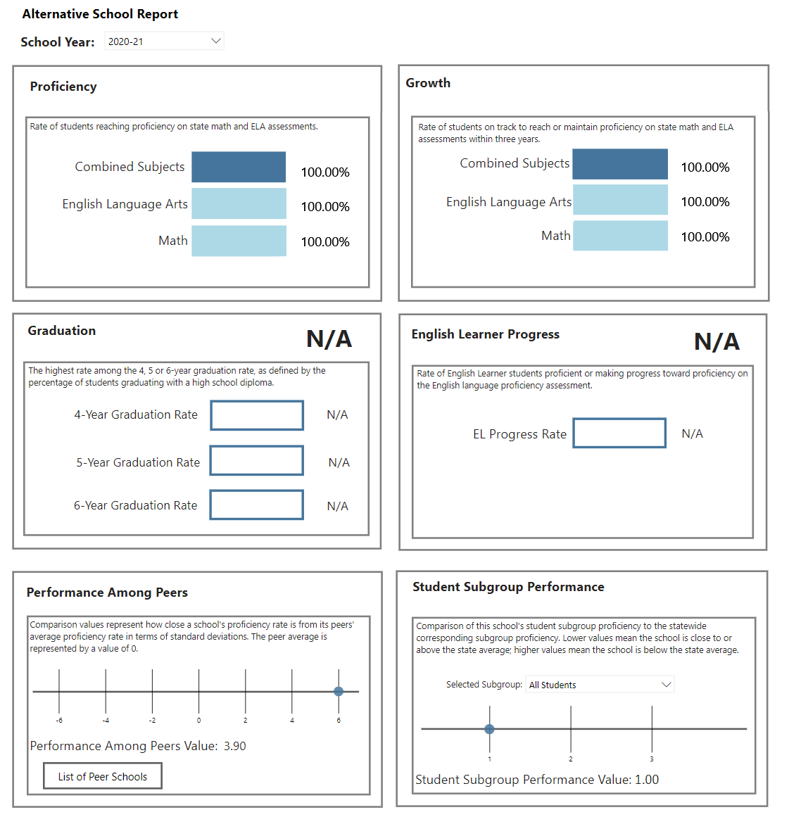
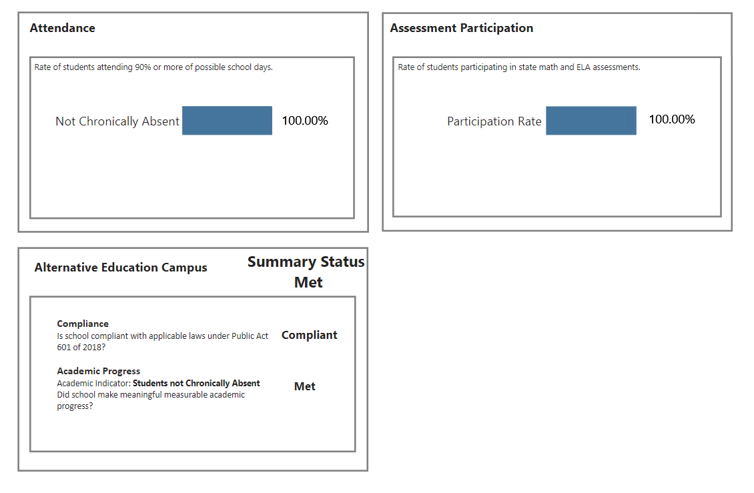
School Grades Report – Alt. Schools
Top of Report
Bottom of Report
Note: For 2020-21 AEC reports, all available indicator data are shown. AEC tile now shows indicator used for AEC Academic Progress objective.

Slide 22
Support
Information and resources on School Grades and Rankings:
www.michigan.gov/mde-schoolgrades
www.michigan.gov/mde-accountability
www.michigan.gov/mde-schoolindex
Help and support for School Grades and Rankings:
Call: 877-560-8378, Option 3
OR
Email: MDE-accountability@michigan.gov

