Slide 1
Michigan’s 2019-20 State Assessment System
Part of Michigan’s plan to become a Top 10 Education State

Slide 2
Inside this presentation
Overview of Michigan’s system of state summative assessments
Policies and practices related to early literacy and benchmark assessments
Information about how Michigan supports the use of formative assessment process

Slide 3
Why Assess Students?
Michigan taxpayers provide a free education to approximately 1.5 million Michigan students each year
State and federal laws require schools to assess student learning once per year in specific subjects and grade levels
Information and data from a high-quality assessment system helps us meet our goal to be a Top 10 education state
State assessments provide a once-a-year snapshot of student progress toward learning state content standards at state, district, and building levels

Slide 4
Why Assess Students? (cont’d)
M-STEP, MME, PSAT, and other state assessments provide valuable information on:
how students are performing by grade and subject
how well schools and districts are teaching students compared to those in other communities, states, and nations
This helps:
target state and federal supports and resources to students and schools that need them most
identify areas of success from which others can learn

Slide 5
Michigan’s Assessment System: 2019-20

Slide 6
System Features
Provides consistency and stability by maintaining M-STEP, MI-Access, and MME as state summative assessments for most students, and WIDA for students who are learning the English language
Continues use of PSAT college readiness assessment as the state summative assessment for English language arts (ELA) and mathematics in grade 8
Offers PSAT college readiness assessment in grades 9 and 10

Slide 7
System Features (cont’d)
Includes K-3 English language arts assessments to help prepare all students to read at grade level by end of grade 3
Michigan’s Early Literacy and Mathematics Benchmark Assessments: Now provided 3 times per year by MDE at no cost to districts; qualifies as an approved “Initial” assessment
Vendor-provided computer adaptive, benchmark, diagnostic, or screener assessments, paid for by districts (State reimbursement grants discontinued starting FY 2020)

Slide 8
System Features (cont’d)
Encourages use of district-selected benchmark assessments K-8 as an important practice to inform program improvement and measure within-year student progress. This option is at district’s choice and cost.
K-3 mathematics benchmark assessments (Michigan’s Early Literacy and Mathematics Benchmark Assessments available at no cost for grades K-2)
4-8 ELA and mathematics

Slide 9
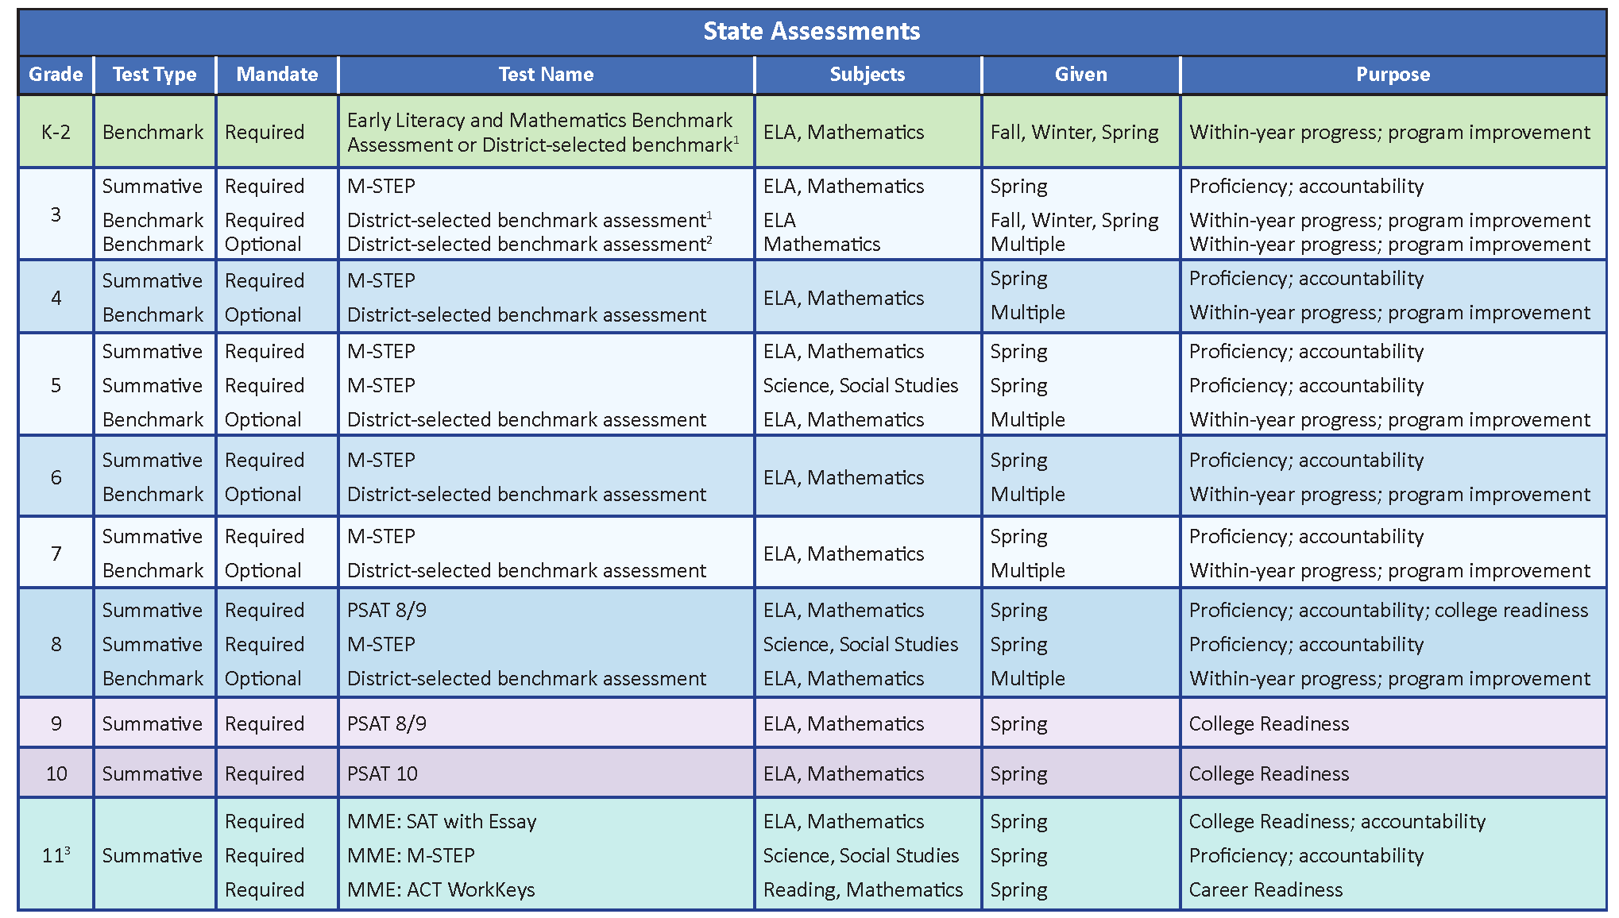
Michigan’s Assessment System
Notes:
Footnotes:
1. Michigan’s “Read by Grade Three” law (PA 306) requires districts to implement a system of assessments in grades K-3; districts choose from a list of approved “Initial” and “extensive” assessments. The Michigan Early Literacy and Mathematics Benchmark Assessment is the only K-2 state-provided “Initial Assessment” option (no cost to districts).
2. Benchmark assessments are still an important part of our assessment system. However, at this time they are at a district’s choice, and cost.
3. 12th graders who were not previously included in high school accountability in grade 11 or 12 are required to take the complete MME (all three components). Students in grade 12 who are missing one or more valid MME component score are eligible—but not required—to take the MME.

Slide 10
MI-Access Assessment
State assessment for Students with the most significant cognitive impairment

Slide 11
WIDA Program of Assessments
State assessments for English learners

Slide 12
State Summative Assessments

Slide 13
Annual Assessment in Michigan
Once each year, all students in Michigan take a high-quality state summative assessment. Summative assessments are given at the end of a learning cycle to measure what students know and are able to do
All Michigan students take one state summative assessment to measure student progress toward meeting Michigan’s content standards or other career- or college-readiness goals
Most students spend no more than 3-8 hours—less than 1 percent of instructional time—on state assessment. Other assessments are selected and given by districts and/or schools

Slide 14
State Summative Assessments
M-STEP (Michigan Student Test of Educational Progress)
given to students in grades 3-7 to measure student progress on academic standards in English language arts (ELA), mathematics
given to students in grades 5, 8, and 11 to measure student progress on science and social studies standards
PSAT (Pre-SAT by College Board)
PSAT 8/9 given to students in grades 8 to measures student progress on academic standards in ELA and mathematics and prepare for SAT taken in high school
PSAT 8/9 for students in grades 9 (no statewide reporting)
PSAT 10 for students in grade 10 (no statewide reporting)

Slide 15
State Summative Assessments (cont’d)
MME (Michigan Merit Exam)
given to students grade 11
consists of three required components:
SAT with Essay to measure student progress on ELA and mathematics standards and college readiness
M-STEP to measure student progress on science and social studies standards
ACT WorkKeys to measure career skills

Slide 16
M-STEP
State summative assessment taken by most Michigan students
First administered during the 2014-15 school year
Given to 99% of students online each spring
Measures how well students are mastering state standards
Developed for educators by educators
Broadly outlines what students should know and be able to do to be prepared for the workplace, career training, and college

Slide 17
M-STEP Features
Modern test design, with fewer multiple-choice questions and more problem solving and critical thinking
Computer adaptive testing (CAT) for ELA and mathematics assessments, which provides a more individualized test experience for students and more precise measurements of student learning
Efficiency: Testing time has been significantly reduced since 2015 and takes less than 1% of instructional time annually

Slide 18
M-STEP Features, cont’d
Actionable results
preliminary results available to schools within 48 hours of testing
final results, which include hand-scored items processed during summer, are provided to schools to distribute to parents near the start of the next school year
when combined with classroom work, report cards, local district assessments, and other tools, M-STEP results offer a comprehensive view of student progress and achievement

Slide 19
State Assessment for Students in Special Populations
WIDA Program of Assessments for English Learners
WIDA Screener and WIDA ACCESS Placement Test for newly enrolled English Learners
ACCESS for ELLs to measure listening, reading, writing, and speaking skills of English Learners
WIDA Alternate ACCESS for ELLs for English Learners with significant cognitive disabilities

Slide 20
State Assessment for Students in Special Populations, cont'd
MI-Access for students with the most significant cognitive impairments
alternative assessment program that measures student progress toward Michigan’s state alternate content standards
students are eligible to take MI-Access only when the Individualized Education Program (IEP) team has determined that general assessments, even with accommodations, are not appropriate for the student

Slide 21
MI-Access, cont’d
MI-Access alternate assessments are administered at three levels, for students who have, or function as if they have, a significant cognitive impairment, and whose instruction is most closely aligned to the Essential Elements within the:
MI-Access Functional Independence (FI) –High Range of Complexity
MI-Access Supported Independence (SI) –Medium Range of Complexity
MI-Access Participation (P) –Low Range of Complexity

Slide 22
Nonpublic and Home-School Students
All nonpublic schools can choose to administer state assessments during the assessment windows identified by the MDE (https://www.michigan.gov/mde/0,4615,7-140-22709---,00.html)
Home-schooled students can take state assessments
contact the school district in which the student resides to make arrangements
student’s scores will be reported individually and not included in district results

Slide 23
District-selected Interim/Benchmark Assessment Options

Slide 24
Interim/Benchmark Assessment
Benchmark assessments are given multiple times throughout the year and provide:
indicators of student progress
insight into whether students are on-track to perform well on state summative assessments
valuable data to inform program improvements
Benchmark assessment is a recommended component, selected and paid for by districts for:
K-3 mathematics
4-8 ELA and mathematics

Slide 25
Interim/Benchmark Assessment, cont’d
Michigan’s Read by Grade 3 law requires the use of an early literacy assessment system (K-3), which can include an ELA benchmark assessment
Must be an MDE-approved “initial assessment”
State-developed Michigan’s Early Literacy and Mathematics Benchmark Assessments (for grades K-2) is provided at no cost to districts
Vendor-provided ELA benchmark assessments (K-3) can be selected and paid for by districts

Slide 26
Michigan Early Literacy and Mathematics Benchmark Assessments
Developed by MDE with Michigan teachers to ensure our youngest learners (grades K, 1, and 2) are on track for success
Provided at NO-COST three times per year (early fall, winter, and spring)
Qualifies as an initial assessment under Michigan’s Read by Grade 3 law
Short assessments are fully aligned to State standards for early elementary grades
Student online practice opportunities are available, as with all state-developed assessments

Slide 27
State Support for Formative Assessment Practices

Slide 28
Formative Assessment Process
Formative assessment is a planned, ongoing process used by all students and teachers during learning and teaching to elicit and use evidence of student learning to improve student understanding of intended disciplinary learning outcomes and support students to become more self-directed learners.
(CCSSO FAST SCASS Austin, Texas June 2017)

Slide 29
Support for Formative Assessment
Learning about formative assessment processes and practices is best when it occurs in learning opportunities that are job embedded and collaborative.
MDE provides information, research, and resources for teachers and other educators.
Visit www.Michigan.gov/formativeassessment to learn more.

Slide 30
FAME (Formative Assessment for Michigan Educators)
FAME started in 2008 with 35 coaches.
Approx. 250 Coaches and Teams will participate during 2019-20.
Visit www.FAMEMichigan.org to learn more.
Blue shading indicates the influence FAME Coaches and Teams have made in Michigan.

Slide 31
State Assessment Resources

Slide 32
2020 Assessment Schedule

Slide 33
Resources to Help Students Prepare for State Summative Assessments
Students taking Michigan’s Early Literacy and Mathematics Benchmark Assessments, MI-Access and M-STEP can access sample test questions and practice testing online at https://wbte.drcedirect.com/MI/portals/mi
Students taking PSAT or SAT can take online practice tests and access Khan Academy tutorials at https://collegereadiness.collegeboard.org/sat/practice
Students taking WIDA assessments can benefit from the tools found at https://wida.wisc.edu/assess/access/preparing-students

Slide 34
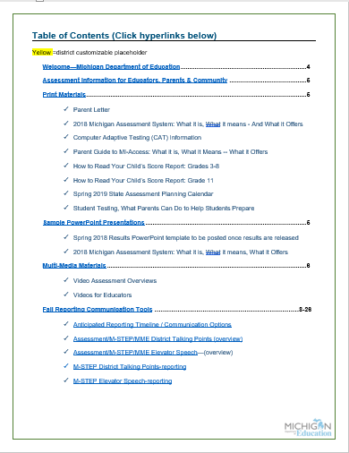
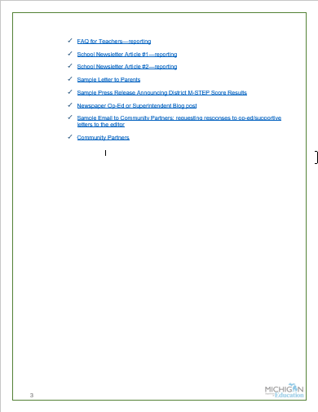
Helpful District Communication Tools twice per year prior to testing & data release

Slide 35
Helpful Resources: MDE
Spotlight newsletter: Michigan.gov/mde/0,4615,7-140-22709_70117-280911--,00.html
Early Literacy and Mathematics Benchmark: Michigan.gov/earlylitandmath
M-STEP: Michigan.gov/mstep
Michigan Merit Exam: Michigan.gov/mme (includes M-STEP, SAT with Essay, ACT WorkKeys)
PSAT Michigan: Michigan.gov/PSAT
College Board Michigan page: CollegeBoard.org/Michigan (includes SAT w/Essay, PSAT 8/9, and PSAT 10)
MI-Access: Michigan.gov/mi-access
WIDA: Michigan.gov/wida
Frequently Asked Questions about Michigan’s Read by Grade 3 law: Michigan.gov/documents/mde/3rd_ Grade_Reading_Law_FAQ-June_2017_573055_7.pdf
Fact Sheet on Benchmark and Early Literacy Assessment Reimbursement: Michigan.gov/documents/mde/Benchmark_Assessment_Reimbursement_FACT_SHEET-2018-19_629763_7.pdf
Formative Assessment Processes: Michigan.gov/formativeassessment

Slide 36
Questions?
Michigan Department of Education
Website: www.michigan.gov/oeaa
Email: mde-oeaa@michigan.gov
Phone: 877-560-8378

