Slide 1



What it IS, What it means,
What it Offers
2020
State Assessment in Michigan

Slide 2

Expecting More
Getting children ready to take their place in the world is challenging.
The knowledge and skills students need for a well-paying job continually evolve to meet current and future workplace demands.
Notes:
Parent Discussion Points
Most students will have 12-15 jobs or more in their lifetime. (Bureau of Labor Statistics).
Estimated number of careers in a lifetime – Seven.
Living in a new economy-powered by technology, fueled by information, and driven by knowledge.
Today’s students may be competing for jobs nearby or across the globe.
Need to routinely strengthen education standards to meet workplace and/or college demands.

Slide 3
Expecting More
To ensure students can meet these demands, the State Board of Education routinely strengthens Michigan learning standards.
State standards broadly outline what students need to know and be able to do in each subject and grade level to be career- and college-ready upon high school graduation.

Slide 4
Expecting More
Standards also serve as a foundation for teachers to develop classroom instruction and lesson plans.
Today's standards challenge students to:
  Understand subject matter more deeply.
  Learn how to think
  critically.
  Apply what they are learning to the real world.
  Make learning relevant in their lives.

Slide 5
What Business and Higher Ed are
Saying About High Standards
High education standards and aligned assessments are
critical to the success of all Michigan students
Business Leaders for Michigan and President’s Council, State Universities of Michigan

Slide 6
What are Michigan Standards?
They are learning goals for mathematics, English language arts (ELA), science and social studies.
They prepare students for college and careers.
They are educator-developed.
They will help students compete nationally and globally.
They are not a curriculum or federal program.

Slide 7
How does Michigan measure progress?
Once each spring, all students take a high-quality state assessment.
M-STEP is given each spring to students in grades 3-8.
PSAT™(PreSAT) is given each spring to students in grades 8, 9 (PSAT 8/9) and 10 (PSAT 10).
Michigan Merit Exam (MME) comprises a suite of tests for students in grade 11.

Slide 8
How does Michigan measure progress?
Certain populations of students take assessments uniquely designed for them.
MI-Access is given each spring to students whose Individualized Education Program (IEP) team has determined that general assessments, even with accommodations, are not appropriate for the student.
WIDA program of assessments is given each spring to English learners.

Slide 9
Why State Assessments?
State standardized assessments are required under both state and federal law, to ensure all children are learning and receiving a high-quality education.
State assessments are “summative,” meaning they measure what students are expected to know and be able to do at specific grade levels and in specific content areas.

Slide 10
Why State Assessments?...cont’d
State assessments provide:
  An important snapshot of student achievement at state, district, and building levels.
  Valuable information to parents on their child's academic achievement.
  Important data for teachers, schools, and districts to help guide instruction.

Slide 11
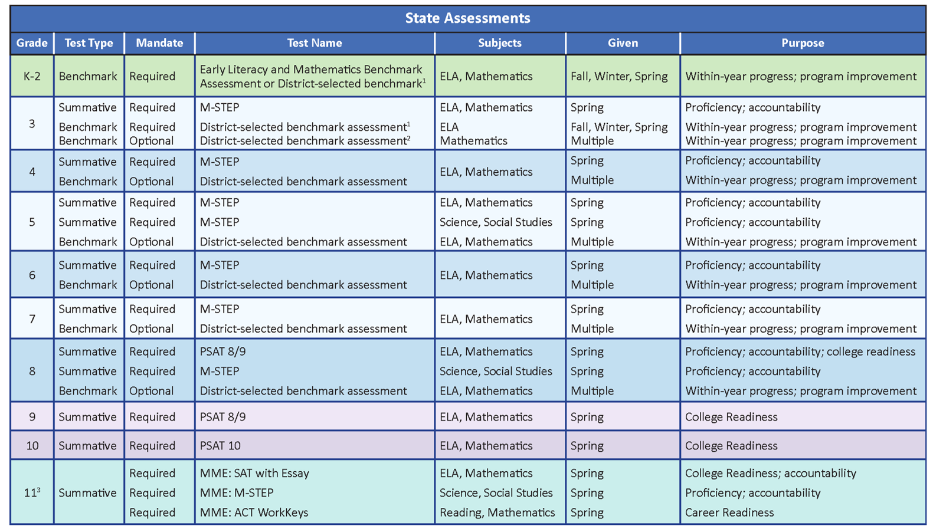
Michigan’s Assessment System at a Glance

Slide 12
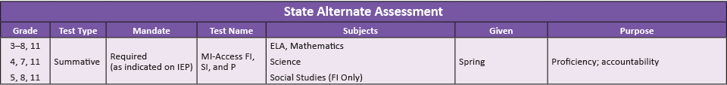
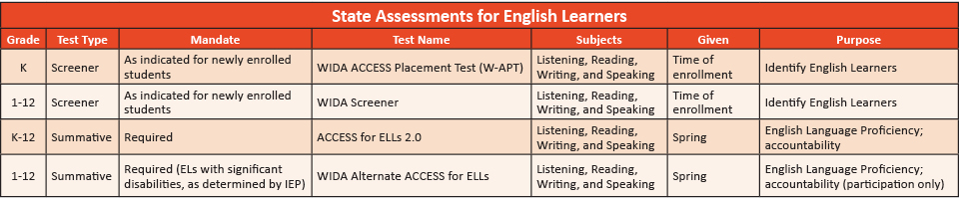
Michigan’s Assessment System at a Glance
State assessment for Students with Significant Cognitive Impairment
State assessments for English learners

Slide 13
M-STEP
The Michigan Student Test of Educational Progress (M-STEP) is the state assessment used to assess student progress on Michigan’s standards since 2015.
M-STEP has fewer multiple-choice questions than the previous MEAP assessment and more questions that require problem solving and critical thinking skills.

Slide 14
M-STEP…cont’d
M-STEP is aligned to Michigan’s challenging learning standards and is administered each spring to students in grades 3-8 and 11.
M-STEP measures skills in English language arts (ELA), mathematics, social studies, and science.
(NOTE: Students in grade 8 and 11 take M-STEP for
social studies and science only)

Slide 15
Computer Adaptive Testing
M-STEP assessments in English language arts (ELA) and mathematics use computer adaptive testing (CAT).
CAT tests are customized for each student for a more accurate measurement of what students know.

Slide 16
The PSAT
PSAT™ 8/9 for 8th and 9th graders
PSAT™ 10 for 10th graders
The Michigan Department of Education (MDE) provides the PSAT for students in grades 8, 9, and 10.
For students in grade 8, PSAT 8/9 replaces
M-STEP tests in ELA and mathematics.
(M-STEP science and social studies will continue to be administered in grade 8.)
For more information, please contact your local high school.
Notes:
Summative assessments measure what students are expected to know and be able to do at specific grade levels and in specific content areas to be on-track for career- and college-readiness by the time they graduate from high school.

Slide 17
High School Assessments
The Michigan Merit Exam (MME) for 11th grade students includes three components:
M-STEP assessments in science and social studies.
SAT® with Essay – the nation’s most widely-used college admission test, also measures student knowledge of state standards in English language arts and mathematics.
ACT® WorkKeys work skills measurement.

Slide 18
Support for Students
To prepare students to meet the standards measured by the College Board’s PSAT and the SAT with Essay, Michigan students have free access to the Khan Academy for online test practice.
To prepare for College Board testing, students in grades 8 and 11 can find sample test items at the College Board website at https://collegereadiness.collegeboard.org/sat.
Choose “Inside the Test” from drop down menu of the test your student will take.

Slide 19
State Testing Time Reduction
Since 2015, the MDE has been making changes that have reduced testing time:
  Students in grades 3-7 spend no more than three hours in state testing on average.
  SAT serves as both a college entrance exam and as the ELA and mathematics assessment for students in grade 11.
  State assessments take less than one percent of student instructional time during a school year.

Slide 20
When Does My Student
Take State Assessments?

Slide 21
State Testing Schedule
To provide districts and schools scheduling flexibility, online M-STEP testing sessions can be scheduled on any instructional day within a 4-week window.
Not all students need to be administered the same assessment at the same time, nor on the same day.
Test sessions are not timed (with the exception of the PSAT, College Entrance, and Work Skills tests). Students are allowed extra time if needed.

Slide 22
Spring 2020 Online Testing Schedule
Grade Level | Assessment Used and Content Area Assessed |  | Testing Window
Grades 3, 4, 6, 7 | M-STEP Mathematics and ELA |  | April 27 through May 22
Grades 5 | M-STEP Mathematics, ELA, Science, and Social Studies |  | April 13 through May 8
Grade 8 | M-STEP Science and Social Studies |  | April 13 through May 8
 | PreSAT™ (PSAT) 8/9 |  | April 14 (initial) April 15-21 and 28-29 (makeup)
Grades 9 and 10 | PSAT 8/9, PSAT 10 |  | April 14, 15, or 16 (initial) April 15-21 or 28-29 (makeup)
 | M-STEP Science Field Test and Social Studies |  | April 13 through May 8
Grade 11 MME | SAT® with Essay |  | April 14 (initial); April 28 (makeup)
 | ACT WorkKeys® |  | April 15 (initial); April 29 (makeup)
MI-Access Alternate Assessment — all grades, all content areas |  |  | April 13 through May 29
WIDA for students who are |  | learning the English language | February 3 through March 20

Slide 23

Paper and Pencil Option
99 percent of districts now administer the M-STEP online.
If a district has determined it has a school that is not yet technology-ready, it may request a waiver from administering the M-STEP online.
The paper and pencil test administration is held on designated dates within the online test window.

Slide 24
Student-level Test Results
Student performance is described as one of four levels: not proficient, partially proficient, proficient, and advanced.
  The M-STEP is a very different state test than those administered prior to the Spring of 2015; therefore results should not be compared to MEAP results through 2014.
  Similarly, the PSAT 8/9 differs significantly from M-STEP ELA and mathematics tests; therefore, year-to-year comparisons of grade 8 ELA and mathematics results should wait until 2020 and beyond.

Slide 25
Student-level Test Results…cont’d
Schools receive a printed report they give to parents and guardians that describes their student’s performance on the subjects tested by state assessments, which differ by grade.
MiLearn offers online access to student reports via the school’s student information system (SIS) (available in participating SISs only).
Your student’s teacher can explain each report in more detail.

Slide 26
Read by Grade 3 Law and M-STEP
(Note: Postponed due to state testing cancellation caused by COVID-19)
NEW for 2020: Any student in grade 3 whose M-STEP preliminary English language arts score falls below 1253 will be flagged as being eligible for retention.
Parents will receive letters from the Center for Educational Performance and Information (CEPI) to alert them about retention eligibility.
Families will have 30 days to contact the district superintendent to discuss options and next steps.

Slide 27
Questions?
Visit the following web pages:
  M-STEP: www.michigan.gov/mstep
  MME:www.michigan.gov/mme
  PSAT: www.michigan.gov/psat
  MI-Access: www.Michigan.gov/mi-access
  WIDA: www.Michigan.gov/wida
Contact the MDE Assessment and Accountability Office at mde-oeaa@michigan.gov or 877-560-8378 (toll-free)

