Slide 1

OBRA - 3878
User Role

Slide 2
LEVEL I SCREEN: CLAIMING EXEMPTIONS
INSTRUCTIONS FOR COMPLETING DCH-3878 – Mental Illness/Intellectual Disability/Related Condition Exemption Criteria Certification (For Use in Claiming Exemption only
The DCH-3878 is to be used ONLY WHEN A PERSON IDENTIFIED on a DCH-3877 as needing a Level II Evaluation MEETS ONE OF THE SPECIFIED EXEMPTIONS.
Indicate which exemption applies to the individual under consideration (check only one). If no Exemption is indicated or form is not properly signed and dated, this form may be considered invalid and could lead to the loss of Medicaid funding for the nursing facility.
Coma – Dementia – Hospital Exempted Discharge (HED)

Slide 3
Definitions of the three Exemptions:
COMA: Includes persistent vegetative state.
DEMENTIA: Review the five (5) criteria listed under the Dementia Exemption. DO NOT check this exemption UNLESS the individual has a Primary Psychiatric Diagnosis of Dementia and MEETS ALL FIVE (5) CRITERIA. Any individual who meets some, but not all five (5), criteria will be subject to a Level II Evaluation. If the person under consideration meets this exception category, please specify the type of Dementia on the line provided.
NOTE: The Dementia Exemption does not apply to those persons with a diagnosis of intellectual/developmental disabilities or related condition.

Slide 4
The individual must meet the following five (5) criteria for dementia:
1. Has demonstrable evidence of impairment in short or long-term memory.
2. Exhibits at least one of the following:
a. *Impairment of abstract thinking
b. *Impaired judgment
c. *Other disturbances of higher cortical function
d. *Personality change
3. Disturbances in items 1 or 2 above significantly interfere with work, usual activities or relationships with others.
4. The disturbance has NOT occurred exclusively during the course of delirium.
5. Either:
a. Medical history, physical exam or lab test show evidence of a specific organic factor judged to be etiologically related to the disturbance
OR
b. An etiologic organic factor is presumed in the absence of such evidence if the disturbance cannot be accounted for by any non- organic mental disorder.

Slide 5
HOSPITAL EXEMPTED DISCHARGE (HED): Review the three criteria listed under this exemption category. DO NOT CHECK this exemption UNLESS the individual MEETS ALL THREE CRITERIA.
1. The individual will be admitted to a nursing facility directly from a hospital after receiving acute inpatient care at the hospital. (Treatment in an emergency room or a hospital’s observation unit is not considered a hospital stay. An individual who received inpatient treatment in a psychiatric facility cannot be admitted to a nursing facility claiming this exemption, nor can an individual who comes directly from home
or any other community placement) and
2. The individual requires nursing facility services for the condition for which he/she received care in the hospital, and
3. The attending physician, NP or PA has certified before admission to the nursing facility that the individual is likely to require less than thirty (30) days of nursing services.

Slide 6
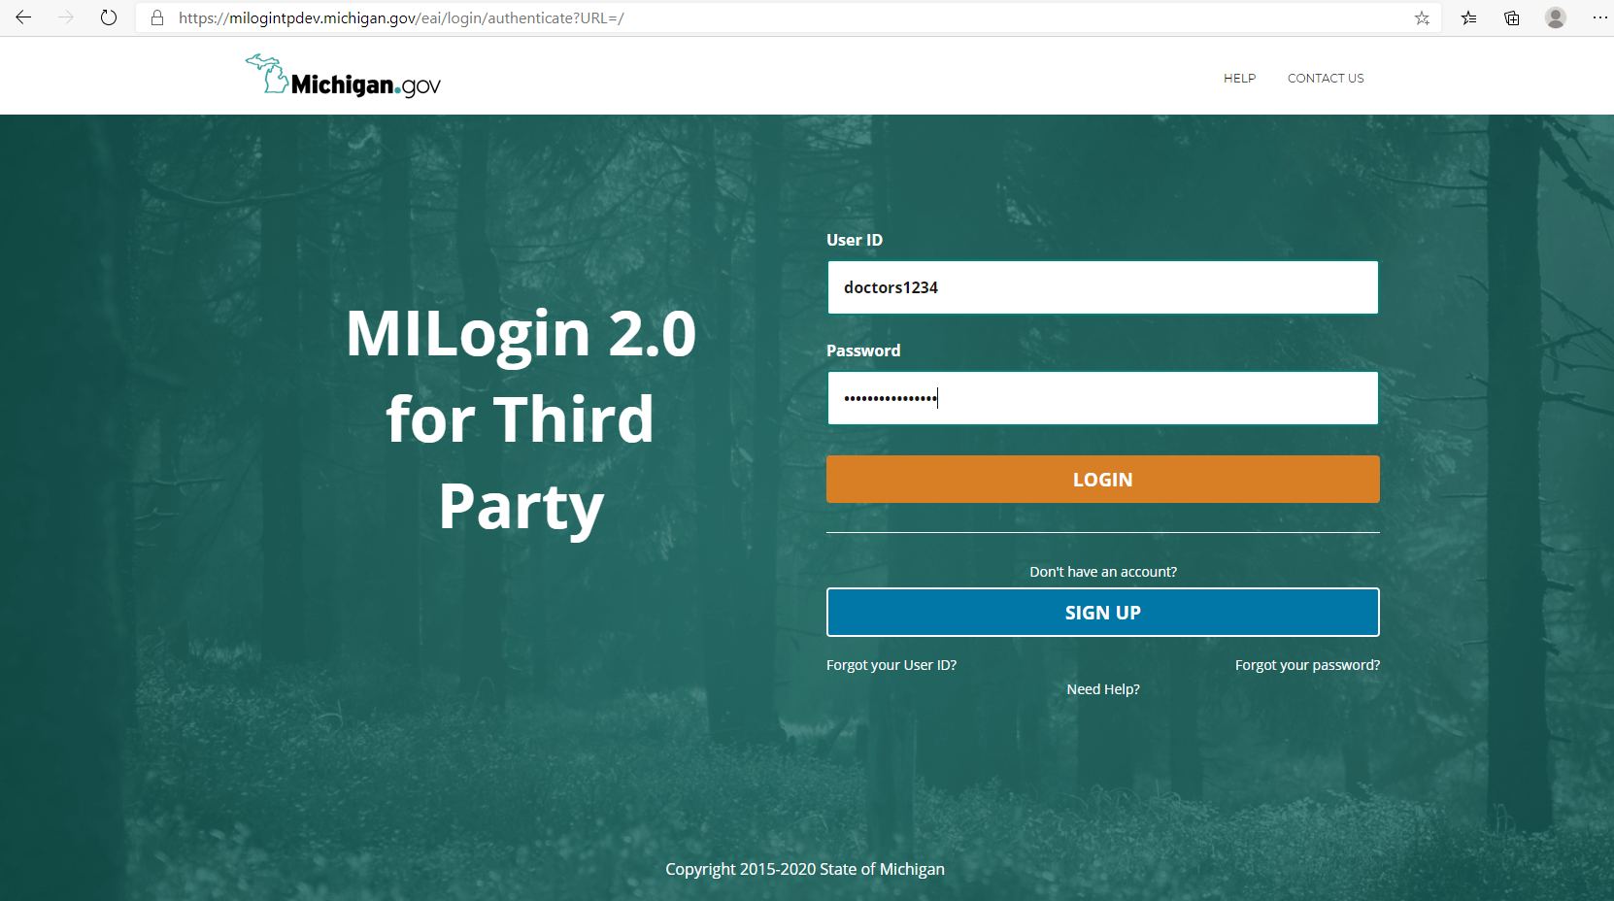

3878
User Role

Slide 7
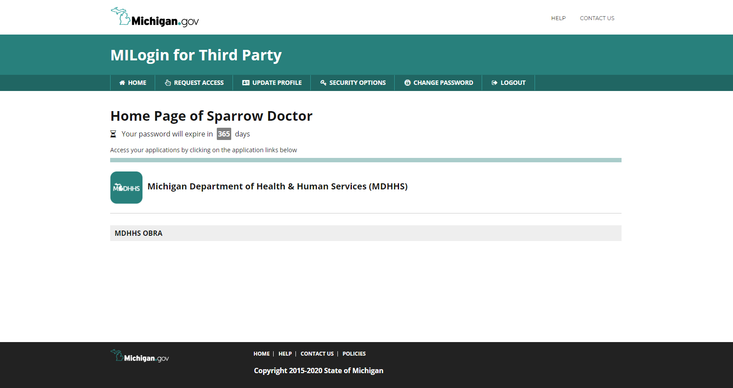

Click Here

Slide 8
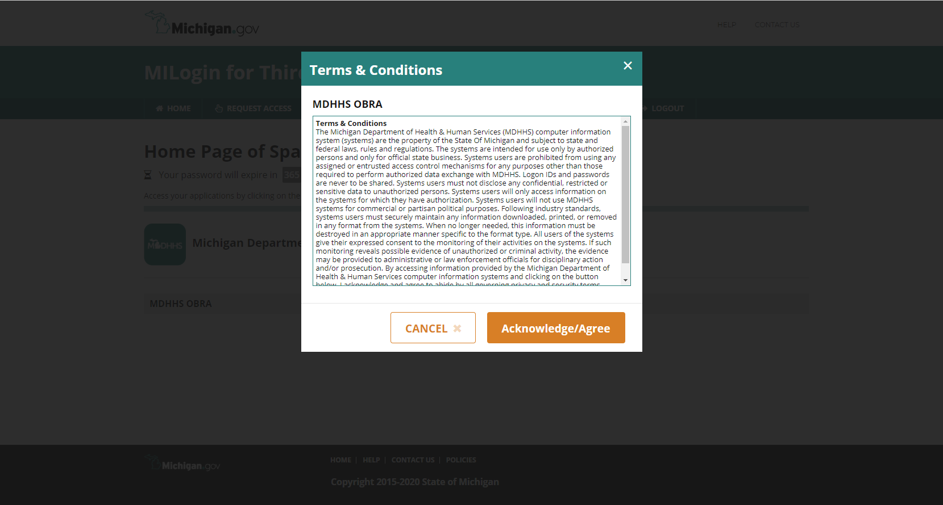


Slide 9
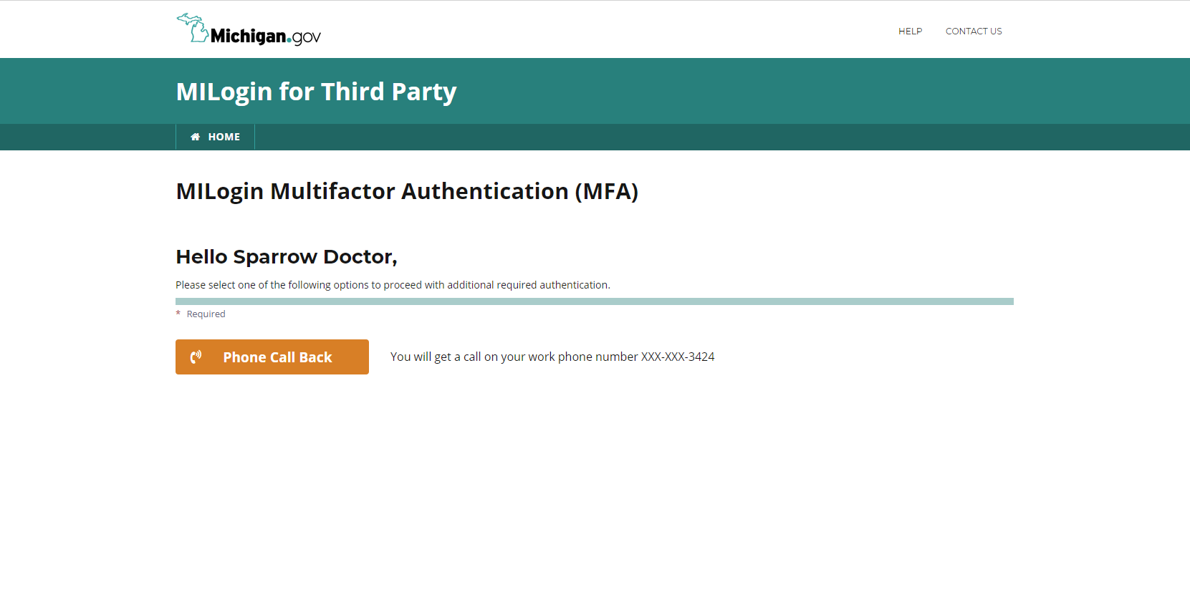


Slide 10
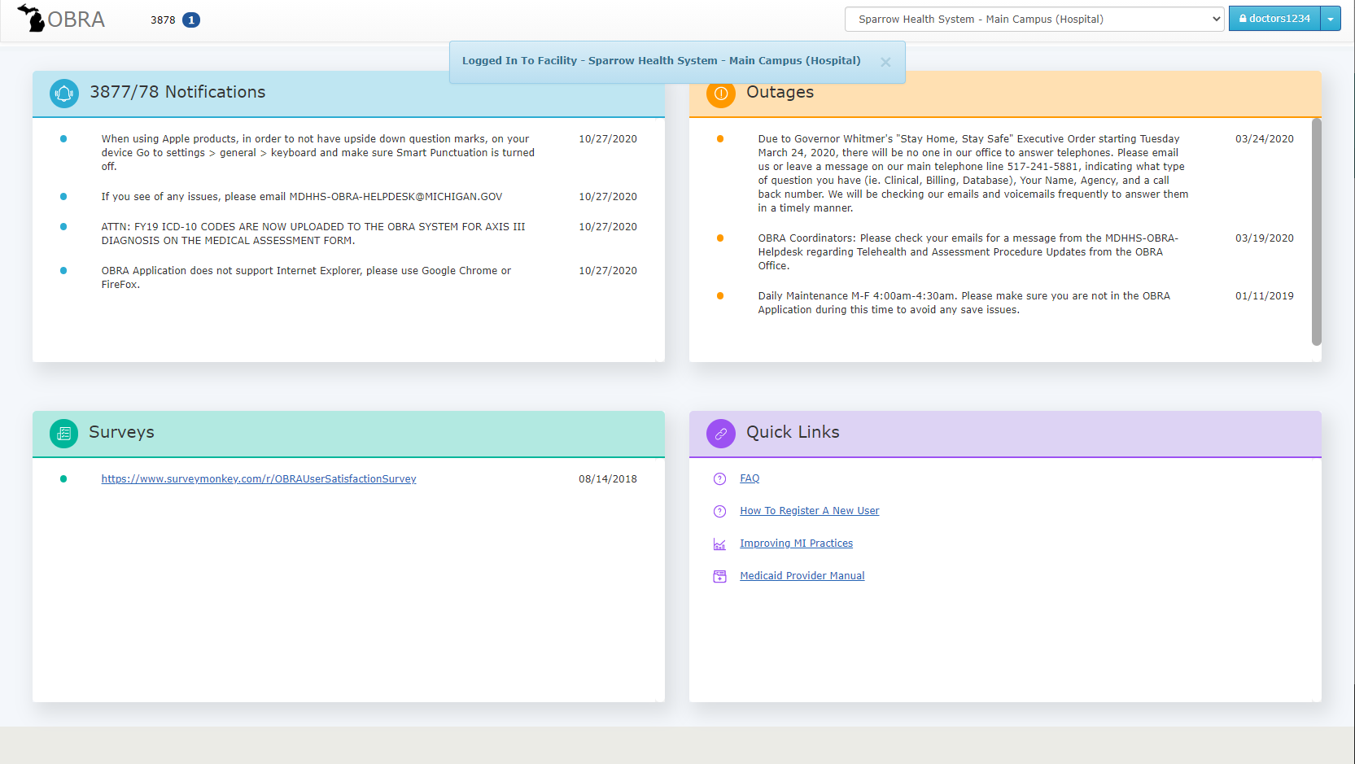
Click Here
Splash Page

Slide 11
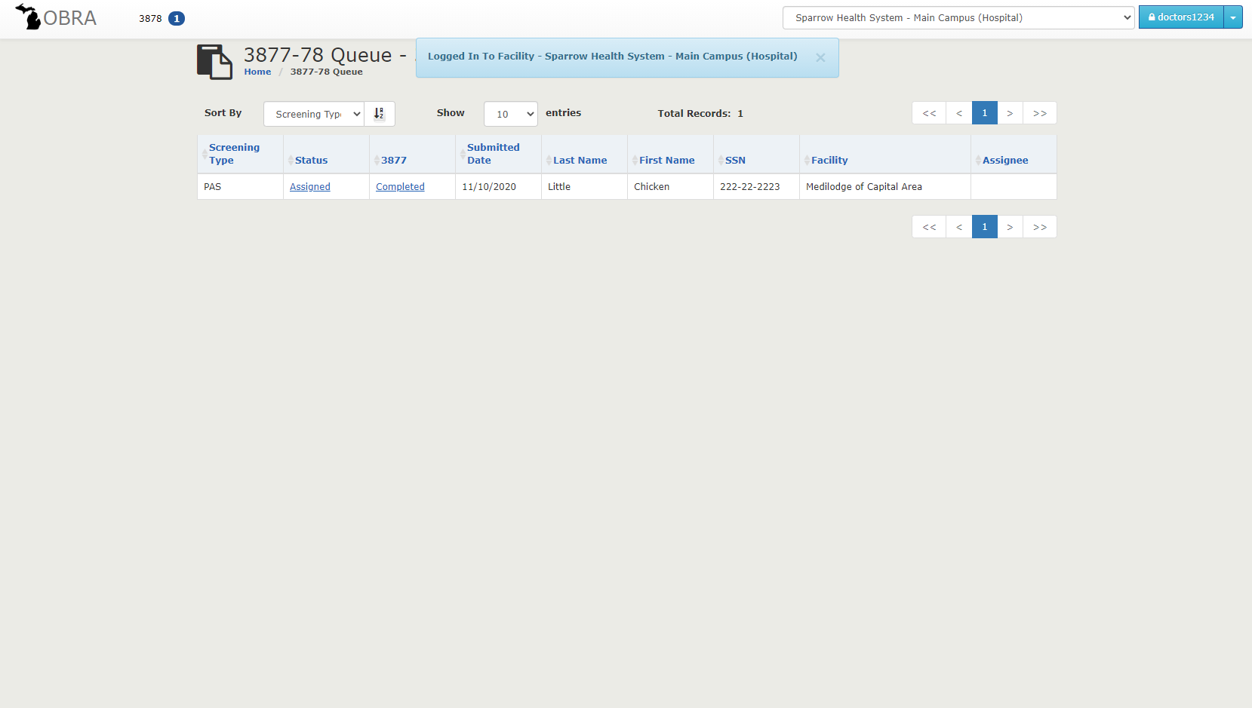

Your Queue
Facility Toggle
Click here to begin the completion of the 3878
Click here to view the 3877

Slide 12
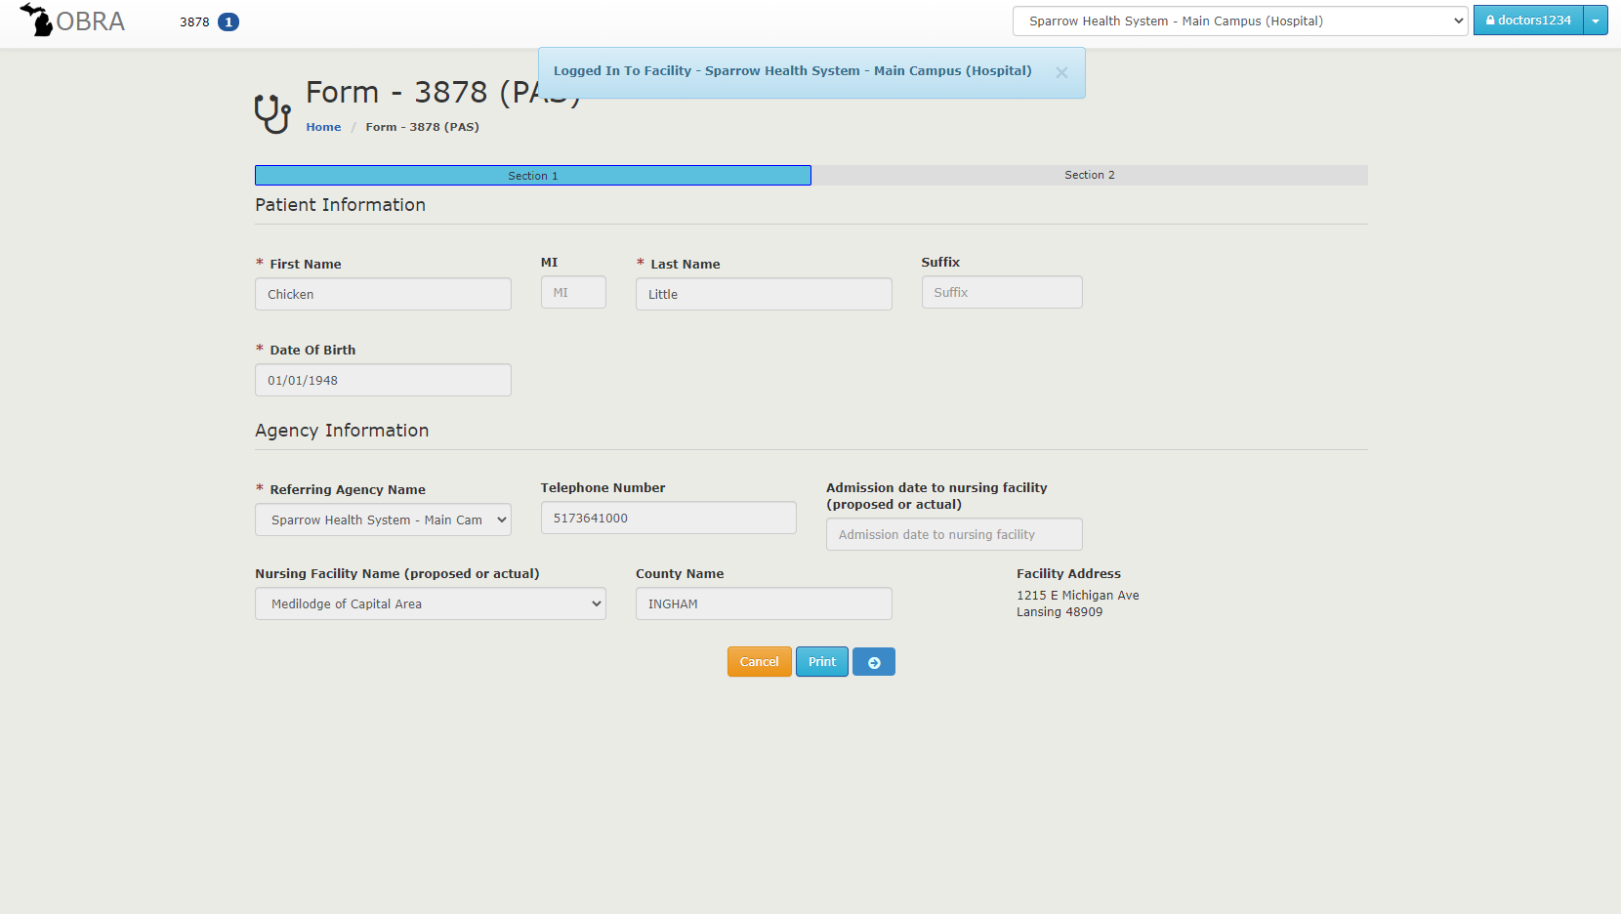
Patient Information auto populates
Click Here

Slide 13
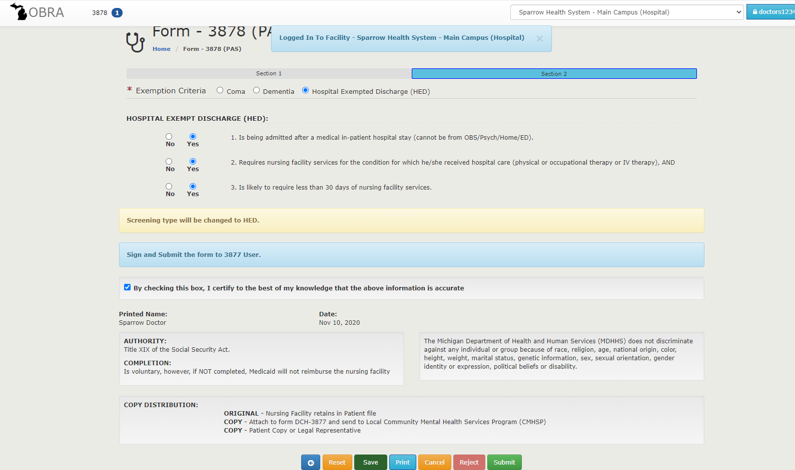


Pick your exemption type
Answer the required questions
By checking the box to certify, it will provide your electronic signature
Click on the Submit button to send
If the patient doesn't meet one of the exemptions, you can click on the Reject button
Thank you!

