Slide 1
WIC Direct training
Board the train…Have your tickets ready for the conductor!

Slide 2
Getting Started
User must subscribe to CDP Identy in MiLogin
A link will appear in the application on the MiLogin in homepage
User will click the link
User will be redirected to the CDP Identity login page
User will select “MiLogin Third Party” button
Notes:
Before we get started – Just wanted to let you know the information included in the slides is not from Michigan WIC Families. It is test data from CDP test system.
After the user has subscribed to CDP Identity in MiLogin,
a link to the application will be added to their MiLogin homepage.
If that is selected, it will be redirected to the CDP Identity login page. Click the MiLogin Third Party button.
As a NOTE: Workers can go directly to CDP Identity,
Do not have to start from MiLogin.
If the worker started with the CDP Identity and have not already logged into 3rd Party MiLogin, they will receive a prompt for MFA (Multi Factor Authentication) . IF they haven’t logged into MiLogin, they would have to login, at which point they would complete MFA. Upon completion of MFA, they are redirected back to their CDP Identity Profile page.

Slide 3
WIC Direct Log On Page To log in, select the appropriate login button under ‘Use another service to login’.
Notes:
All of you working at the Local Agencies will select MILogin Third Party.

Slide 4
Michigan Users Login Enter your User ID and Password
Notes:
If you have already logged into MILogin, you will not see this screen.

Slide 5
Notes:
Once successfully logged in, the user will be presented with the Home Screen.
Menu items are listed on the left side of the page.
Based on your security access it will determine which options are available specifically for you.
These menu items are on all WIC Direct pages.

Slide 6
Notes:
The person Icon, located on the right side of page, provides user-specific menu options.
This is the same format as most of the other applications out currently.

Slide 7
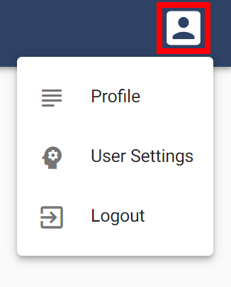
Managing Your Account
Notes:
Clicking this Icon will provide a drop-down to three options,
Profile – This is used to update user profile,
User Settings – Adjust the number of items see on a screen and a time zone
Logout – Used to Exit and Logout of WICDirect

Slide 8
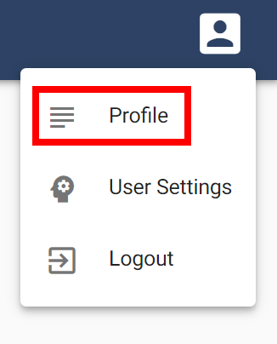
Profile
Notes:
Let's start with “Profile”

Slide 9
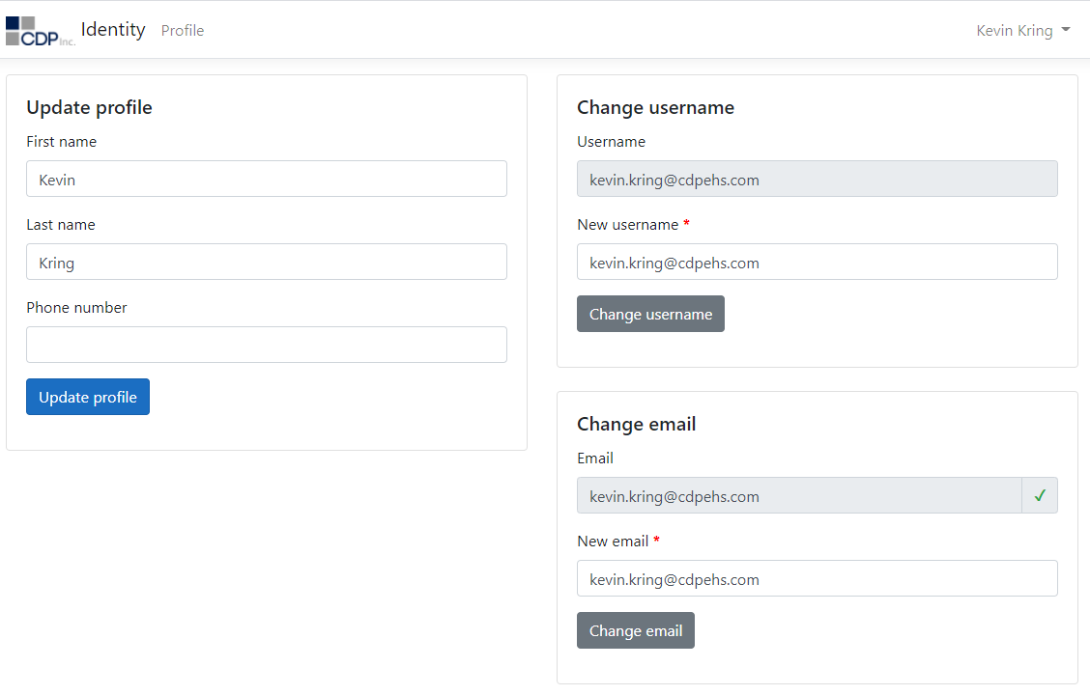
Profile
Notes:
This page allows the user to update their profile information.
NOTE: Changes on this page will not impact your external login service.
Verify the email address shown is correct.
We need the information from the LA Coordinator for the users you wish to have access to WIC Direct

Slide 10
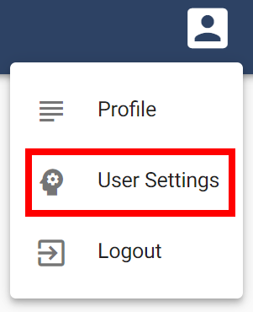
User Settings
Notes:
User settings - allows you to adjust settings specific to your user account.

Slide 11
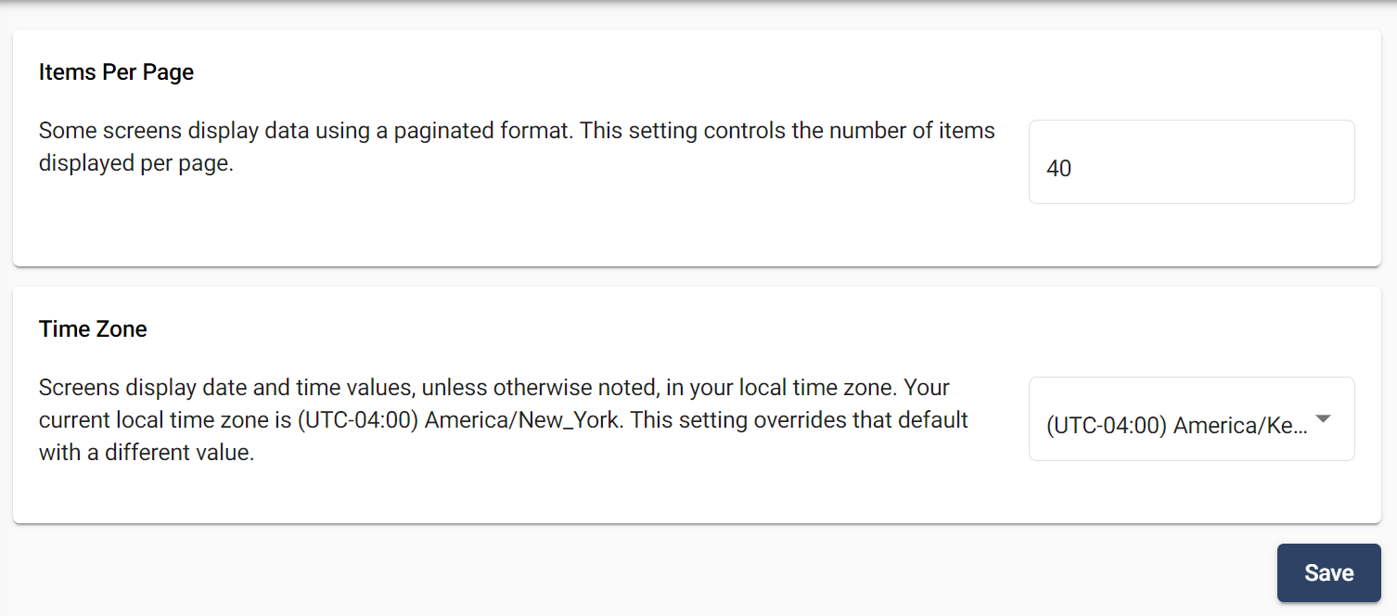
User Settings
Notes:
Settings that can be customized are:
The number of items you want displayed on a page,
And/or
Select your time zone. (We are in the Eastern Standard Time Zone)
Make sure to click on SAVE or your updates will be lost.

Slide 12
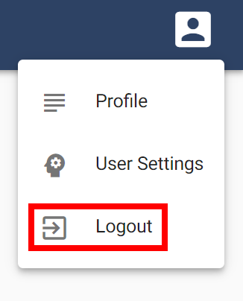
Logout
Notes:
To sign out of the application, click Logout.
After successfully logging off, users will be returned to the WIC Direct Login screen.

Slide 13
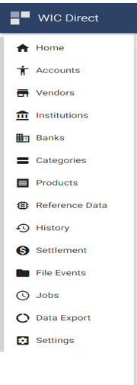
WIC Direct Functions
Notes:
The menu items on the left of the page are used to manage and monitor WIC Direct operations.
Menu items are managed by your security level, so you may not see all options.
Menu items outlined in RED, are the items that will be available to WIC Local Agency clinic staff.

Slide 14
Search for Existing Accounts

Slide 15
Notes:
When the user clicks on the Accounts menu item, the user will be directed to the Accounts search page.
All accounts will be shown
The list will be sorted by Household Number/Family ID number – If you click on the arrow (to the right of the word Number) will change from lowest to highest or highest to lowest.

Slide 16
Search Filter
Notes:
The top section of all pages provide search filters to narrow the list of items shown.
In the Account area, the search filters will narrow the list of accounts shown on the screen.
Users can enter search criteria and the list of matching accounts will update immediately.
Filters which can be entered are:
Family ID number/Number
Authorized person name
The only Select Types that will be in the system will be “NORMAL”. You will not have access to change this item.
NOTE: The default search will only show accounts (FAMILY ID) with an active status. If you need to see inactive accounts (FAMILY ID), click the toggle button to include inactive records.

Slide 17
Search Filter - View
Notes:
The “View” drop-down will allow you to toggle between
Households – Family Number
OR
Cardholders - WIC EBT Card Number.

Slide 18
Search – Other Options
Notes:
If you click the arrow at the end of each row, the account will be expanded to show the matching cardholder information.
Clicking the account will show the account detail information and clicking the EBT card number will show cardholder information.

Slide 19
Account Details
Notes:
Once your account (Family ID Number) has been located, click on the number to view the Account FAMILY ID Details page.

Slide 20
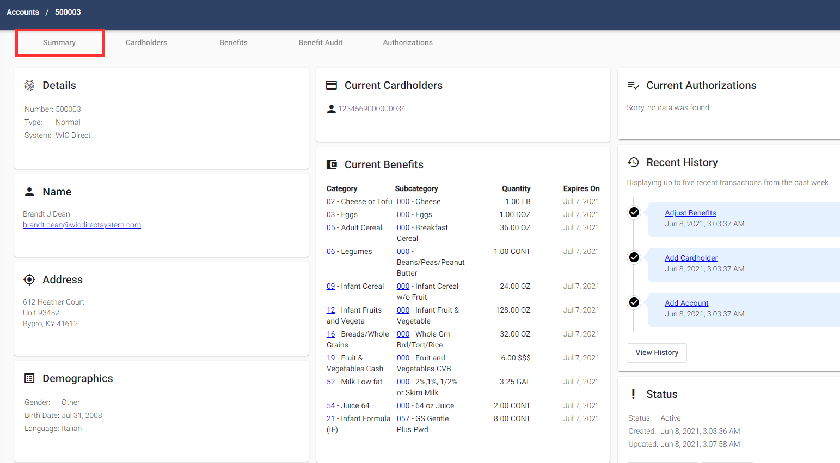
Account Details - Summary
Notes:
The Summary areas are set up like a dashboard to give you lots of information in one place.
Across the top of the screen there are different areas which dig a little deeper into the information for the selected Family number – see arrow.
Details
Name
Address
Demographics
Current Cardholders
Current Benefits – this is shown in the Category/Subcategory levels
Current Authorizations
Recent History – shows the last 5 recent transactions from the past week
Status

Slide 21
Account Details - Cardholder
Notes:
If “Cardholder” is selected, it displays the card number details page.
You will also see that “Cardholders” will now appear on the ribbon at the top.
If there were 2 active WIC EBT Cards for the family, they would show here.

Slide 22
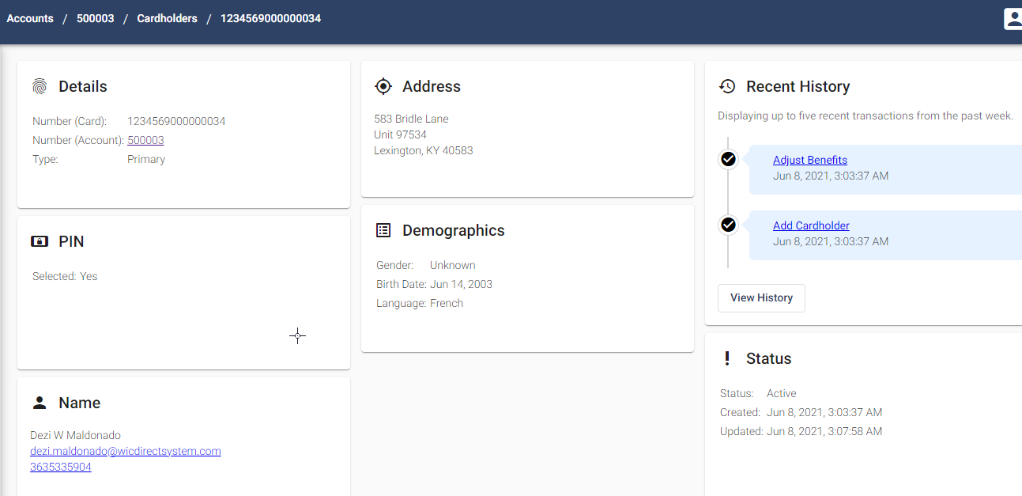
Account Details - Cardholder
Notes:
Again, the information on the screen is in a dashboard format.
On the ribbon at the top of the screen you can see the WIC EBT Card number now is added.
Information shown is:
Details
Pin
Name
Address
Demographics
Recent History – displays up to 5 recent transactions from the past week
Status

Slide 23
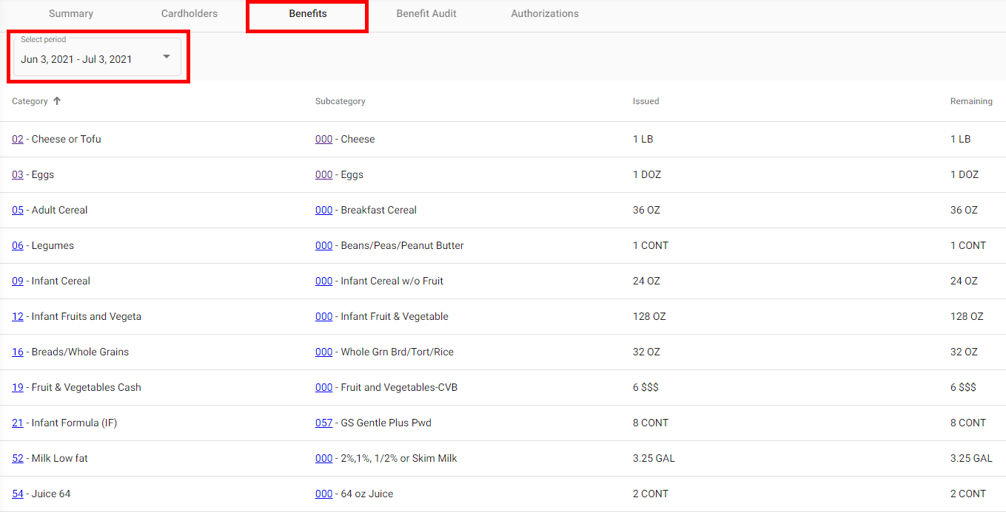
Account Details – Benefits
Notes:
If the Benefit tab is selected, it will display the account’s benefit balance and will be displayed by benefit period.
The current period will show by default. Like EPPIC, future benefits will be visible 7 days prior to the start date, in the Benefit Period drop down.

Slide 24
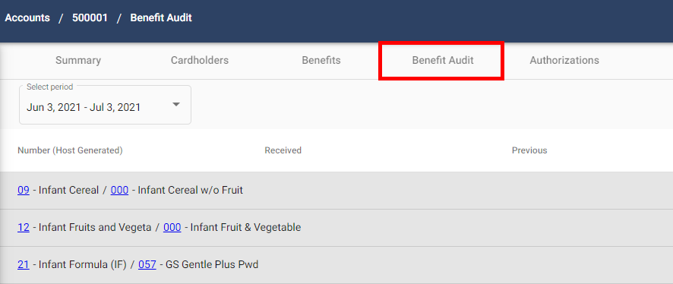
Account Details – Benefit Audit
Notes:
If Benefit Audit is selected, you can select the time period you wish to see the information for. It will display the items that were purchased by Category Subcatagory (Food type).
If you select the arrow at the right of the line it will give more detailed information about that Category/Sub Category purchase.

Slide 25
Notes:
The account’s benefit audit will display changes to benefit balance by Category/Subcategory within the benefit period.
The Select Period was changed to June 3, 2021 – July 3, 2021.
The arrow at the right side of the Food Item - Infant Cereal “Category 09” was selected. The details now appear.
Changes to the benefit balance would be caused by issuances, purchases or voids. The current period will show by default.
Like EPPIC, future benefits will be visible 7 days prior to the start date., in the Benefit Period drop down.

Slide 26
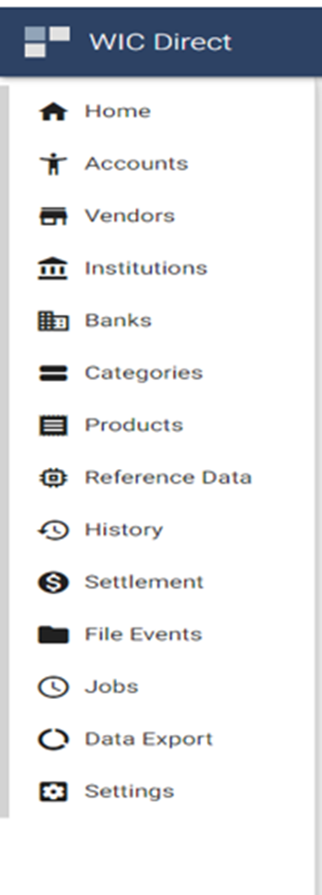
Search for Existing Vendors
Notes:
This function is used to review details for authorized WIC Vendors.
Like: Search for an existing vendor
View vendor details
Summary
Authorizations

Slide 27
Notes:
All active vendors will be shown, and the list will be sorted by Vendor number (MIS).
When the user clicks on the Vendor menu item, the user will be directed to the Vendor search page.
The list will be sorted by “Number” (MIS) WIC Vendor Number - If you click on the arrow (to the right of the word Number MIS) will change from lowest to highest or highest to lowest.
The top section of all pages in Vendor area also provide search filters to narrow the list of items shown.
Users can enter search criteria and the list of matching Vendors will update immediately.
Filters which can be entered are:
Number MIS/Vendor Number
Vendor name
The only Select Types that will be in the system will be “NORMAL”. You will not be able to change this.
NOTE: The default search will only show Vendor (MIS) Number with an active status. If you need to see inactive Vendors, click the toggle button to include inactive records.

Slide 28
Search Filter – List
Notes:
Some of the search filters will be in the form of a list of values.
You can click the down arrow and a drop-down list will appear.
You can select the values from the list by clicking the value.
Depending on your role permissions you may not be able to see this drop down.

Slide 29
Vendor Details
Notes:
To get detailed information, click on the vendor number to view the Vendor Details page.
Note: You probably will utilize the vendor name to search for a specific Vendor

Slide 30
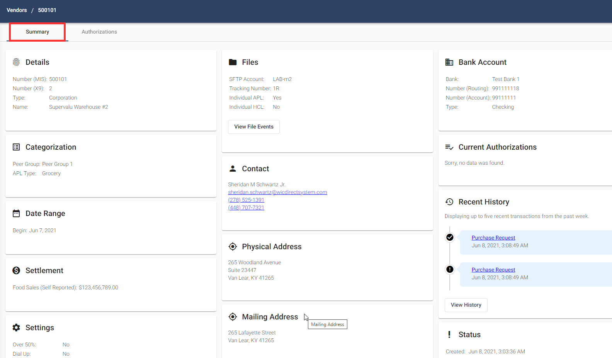
Vendor Details - Summary
Notes:
The Summary areas are set up like a dashboard to give you lots of information in one place.
Across the top of the screen there are different areas which dig a little deeper into the information for the selected Vendor – See the arrow at the top.
Details
Categorization
Data Range
Settings
Files
Contact
Physical Address
Mailing Address
Current Authorizations
Recent History – last 5 transactions this week
Status
Any information that displays in “Blue” can be selected to show more detailed information.

Slide 31
Categories
Search for an existing category
Notes:
This function is used to review the details for a Category and the related Subcategories.
The functions available are:
Search for an existing category
View an account’s details
Summary
Cardholder Information
Benefits
Benefit Audit
Authorizations

Slide 32
Notes:
When the user clicks on the Categories menu item, they will be directed to the Categories search page.
All active categories will be shown, and the list will be sorted by Category code (Clinics may be more familiar with Food Item or Type)
The list will be sorted by “Code”- If you click on the arrow (to the right of the word Code) will change from lowest to highest or highest to lowest.
The top section of all pages in Category area also provide search filters to narrow the list of items shown.
Users can enter search criteria and the list of matching Categories will update immediately.
Filters which can be entered are:
Code (Category number)
Category name or name of food item) Cheese, Cereal etc.
NOTE: The default search will only show Categories with an active status. If you need to see inactive Categories, click the toggle button to include inactive records.

Slide 33
Category Details
Notes:
Once the category has been located, click on the category code to view the Category Details page.

Slide 34
Category Details - Summary
Notes:
The information on the screen is in a dashboard format.
On the ribbon at the top of the screen you can see the Category number has been added.
Information shown is:
Details
Date Range
Status

Slide 35
Category Details – Subcategories
Notes:
If “Subcategory is selected the page displays the associated subcategories.
The items in blue can be selected to dig deeper into the information for that item.

Slide 36
Subcategory Details
Notes:
To review the subcategory details, click the subcategory code.

Slide 37
Subcategory Details
Notes:
Again, the information on the screen is in a dashboard format.
On the ribbon at the top of the screen you can see the Subcategory number has been added.
Information shown is:
Details
Categorization
Date Range
Settings – this is used only at the State Level
Status

Slide 38
History to search for eWIC Transactions
Notes:
This function is used to review the details for eWIC transactions.
The functions available on this tab are:
Search for an eWIC transaction
View transaction details

Slide 39
Notes:
When the user clicks on the History menu item, they will be directed to the History search page.
All eWIC transactions will be shown, and the list will be sorted by transaction received date/time.
The list will be sorted by “Received Date/Time”- If you click on the arrow (to the right of the word Received) will change from lowest to highest or highest to lowest.
The top section of all pages in History area also provide with search filters to narrow the list of items shown.
Users can enter search criteria and the list of matching transactions will update immediately.
Filters which can be entered are:
Account number (Family Number) or name
Card number or name (Full 16-digit WIC EBT Card number)
NOTE: The default search will only show transaction with a successful status. If you need to see failed transactions, click the toggle button to include failed records.
The History page provides a search filter to search by transaction date/time. If the user clicks on the “Today”filter, a drop-down of additional options will be provided

Slide 40
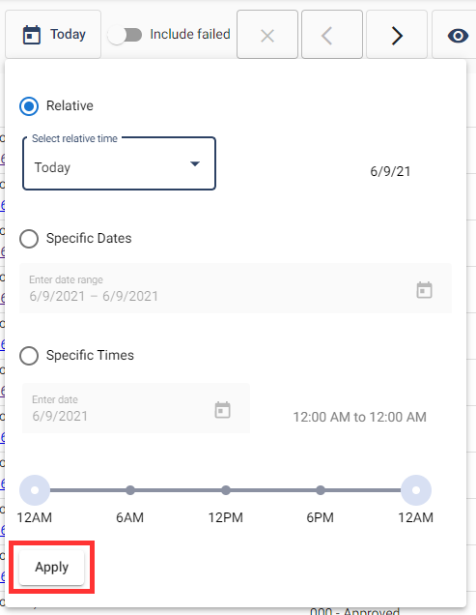
Search Filter - Date
Notes:
Options you can select are:
Relative – Options are:
Today
Yesterday
This Week
Last Week
This Month
Last Month
Specific Dates:
Specific Times:
Make sure you click on “Apply”

Slide 41
Search Filter - View
Notes:
The View drop-down will allow you to select different options for viewing transactions.
4 transaction views are available:
Account – used to review both clinic and retail transactions
Financial – used to review retail transactions, that have a financial settlement. This view will show the dollar amount of the transaction in the search view.
Retail – used to review retail transactions impacting a retailer.
Network – used to review transactions related to system performance.
NOTE: This will be based on your level of security. Your level of security may not allow you to see all of these.

Slide 42
Transaction Details
Notes:
Once the transaction has been located, click on the (HGTN – Host Generated Transaction Number) transaction number to view the details page.

Slide 43
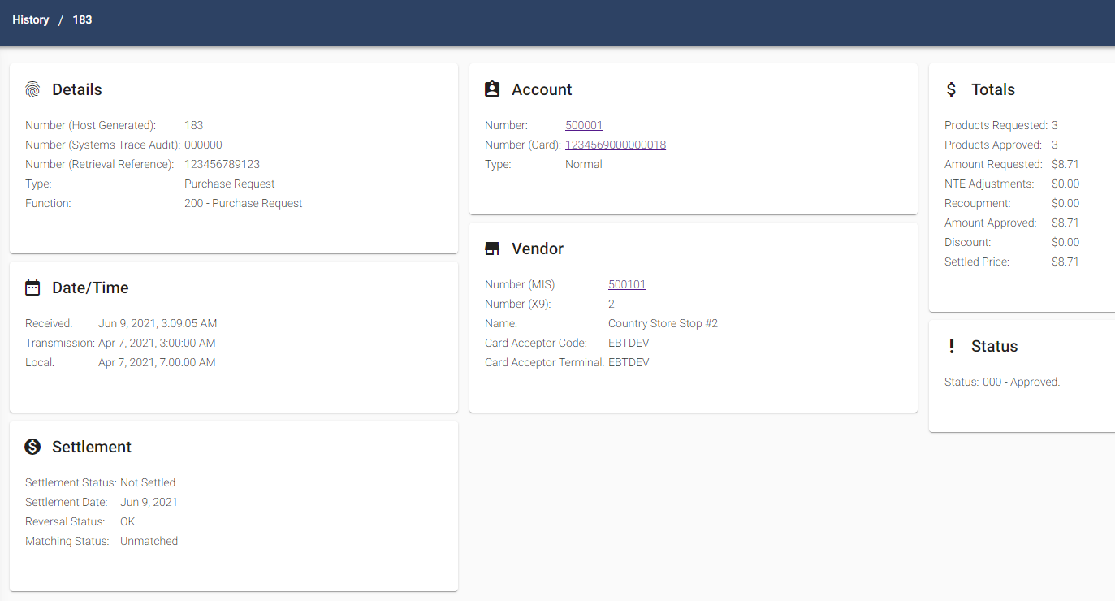
Transaction Details
Notes:
The information on the screen is in a dashboard format.
On the ribbon at the top of the screen you can see the transaction number has been added.
Information shown is:
Details
Date/Time
Settlement
Account
Vendor
Totals
Status
We know this is a LOT of information, but know that we are on board with you and available to help.

