Slide 1
Part 1 MEHA Body Art Enforcement Presentation of 3-16-2016

Slide 2
PA 375 Body Art Enforcement M.E.H.A. A.E.C. CONFERNECE Bay City, MI 03/16/2016
Michael Kucab, RS, REHS, MPH
Body Art Coordinator, MDHHS
Brandon Morrill, Sanitarian
Health Department of Northwest Michigan
Deborah Garcia, JD, MAHS
Office of Legal Affairs, MDHHS

Slide 3
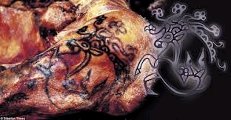
Tribal design found on a 2500 year old Siberian Princess mummy.

Slide 4
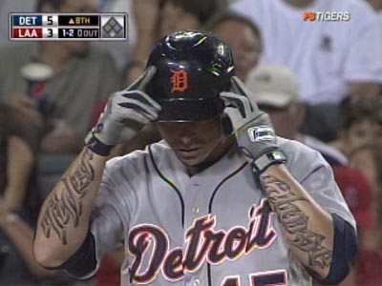
Tattoos in Sports: Detroit Tiger Brandon Inge

Slide 5
Annual amount of U.S. spending on tattoos | $1.65 Billion
Total percent of Americans (all ages) who have at least one tattoo | 14 %
Percentage of U.S. adults 18 – 25 who have at least one tattoo | 36 %
Percentage of U.S. adults 26 – 40 who have at least one tattoo | 40 %
Total number of Americans that have at least one tattoo | 45 million
Number of tattoo parlors in the U.S. | 21,000
Average cost of a small tattoo | $ 45
Average cost of a large tattoo | $150 / hour
Percentage of U.S. population who have covered up a tattoo with another tattoo | 5 %
Percentage of people with tattoos who claim they are addicted to ink | 32 %
Percentage of people who have some regret after getting their tattoo | 17 %
Percentage of people with a tattoo who are getting or have had one removed | 11 %
Factors Considered When Getting A Tattoo
Percentage of people with tattoos who think the reputation of tattoo artist or tattoo studio is the most important factor | 49 %
Percentage of people with tattoos who think price is the most important factor | 8 %
Percentage of people with tattoos who think a tattoo with a personal meaning is the most important factor | 43 %
How People Feel About Their Tattoo
Total percentage of people with tattoos who say their tattoo makes them feel rebellious | 29 %
Percentage of people with a tattoo that say it makes them feel more sexy | 31 %
Percentage of people with tattoos who say their tattoo makes them feel more intelligent | 5 %

Slide 6
History of the Public Acts to Regulate Body Art in Michigan
Public Act 149 of 2007 amended the Public Health Code to establish a statewide system for the licensure and regulation of facilities that perform tattooing, branding, and body piercing.
MDHHS in conjunction with MIOSHA, MDEQ and a Body Art Workgroup composed of both local public health and members of the body art industry created a set of minimum standards to regulate the body art industry statewide.
Resources used were local health department ordinances already in place plus “Body Art: A Comprehensive Guidance and Model Code” by the National Environmental Health Association.
PA 149 was later amended on 12/22/2010 as PA 375 in order to compensate LHDs for regulatory work performed for the state and allow a local variance. NEHA’s Model Code guidance was also removed from the law.

Slide 10
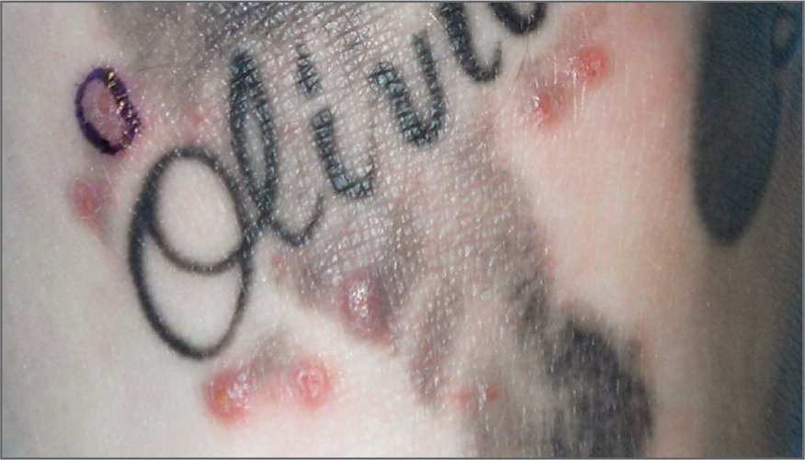
Papules Associated with Tattoo Ink–Related Nontuberculous Mycobacterial Infection.
LeBlanc PM et al. N Engl J Med 2012;367:985-987.

Slide 11
CDC-MMWR Weekly June 23, 2006/ 55(24):677-679
Methicillin-Resistant Staphylococcus aureus Skin Infections Among Tattoo Recipients---Ohio, Kentucky, and Vermont, 2004—2005
Community-associated methicillin-resistant Staphylococcus aureaus (CA-MRSA)…outbreaks have occurred among athletes, inmates at correctional facilities, and military recruits (2-4). This report summarizes investigations of six unlinked cluster of skin and soft tissue infections caused by CA-MRSA among 44 recipients of tattoos from 13 unlicensed tattooists in three states (Ohio, Kentucky, and Vermont); use of nonsterile equipment and suboptimal infection control practices were identified as potential causes of the infections………..

Slide 12
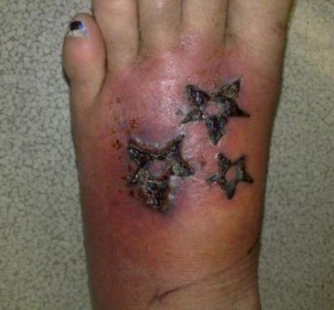

Slide 13
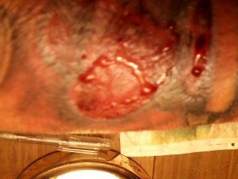

Slide 14
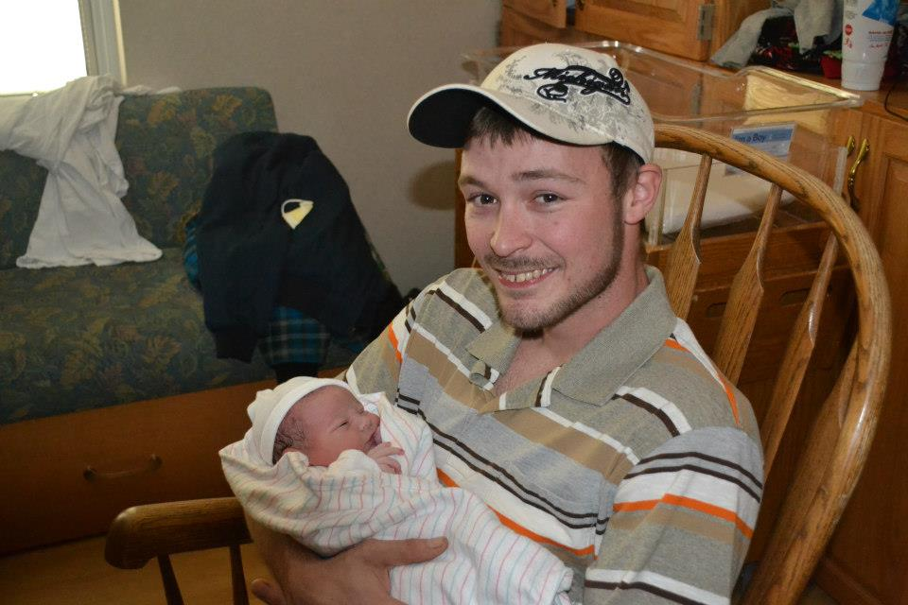
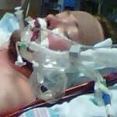

Slide 15
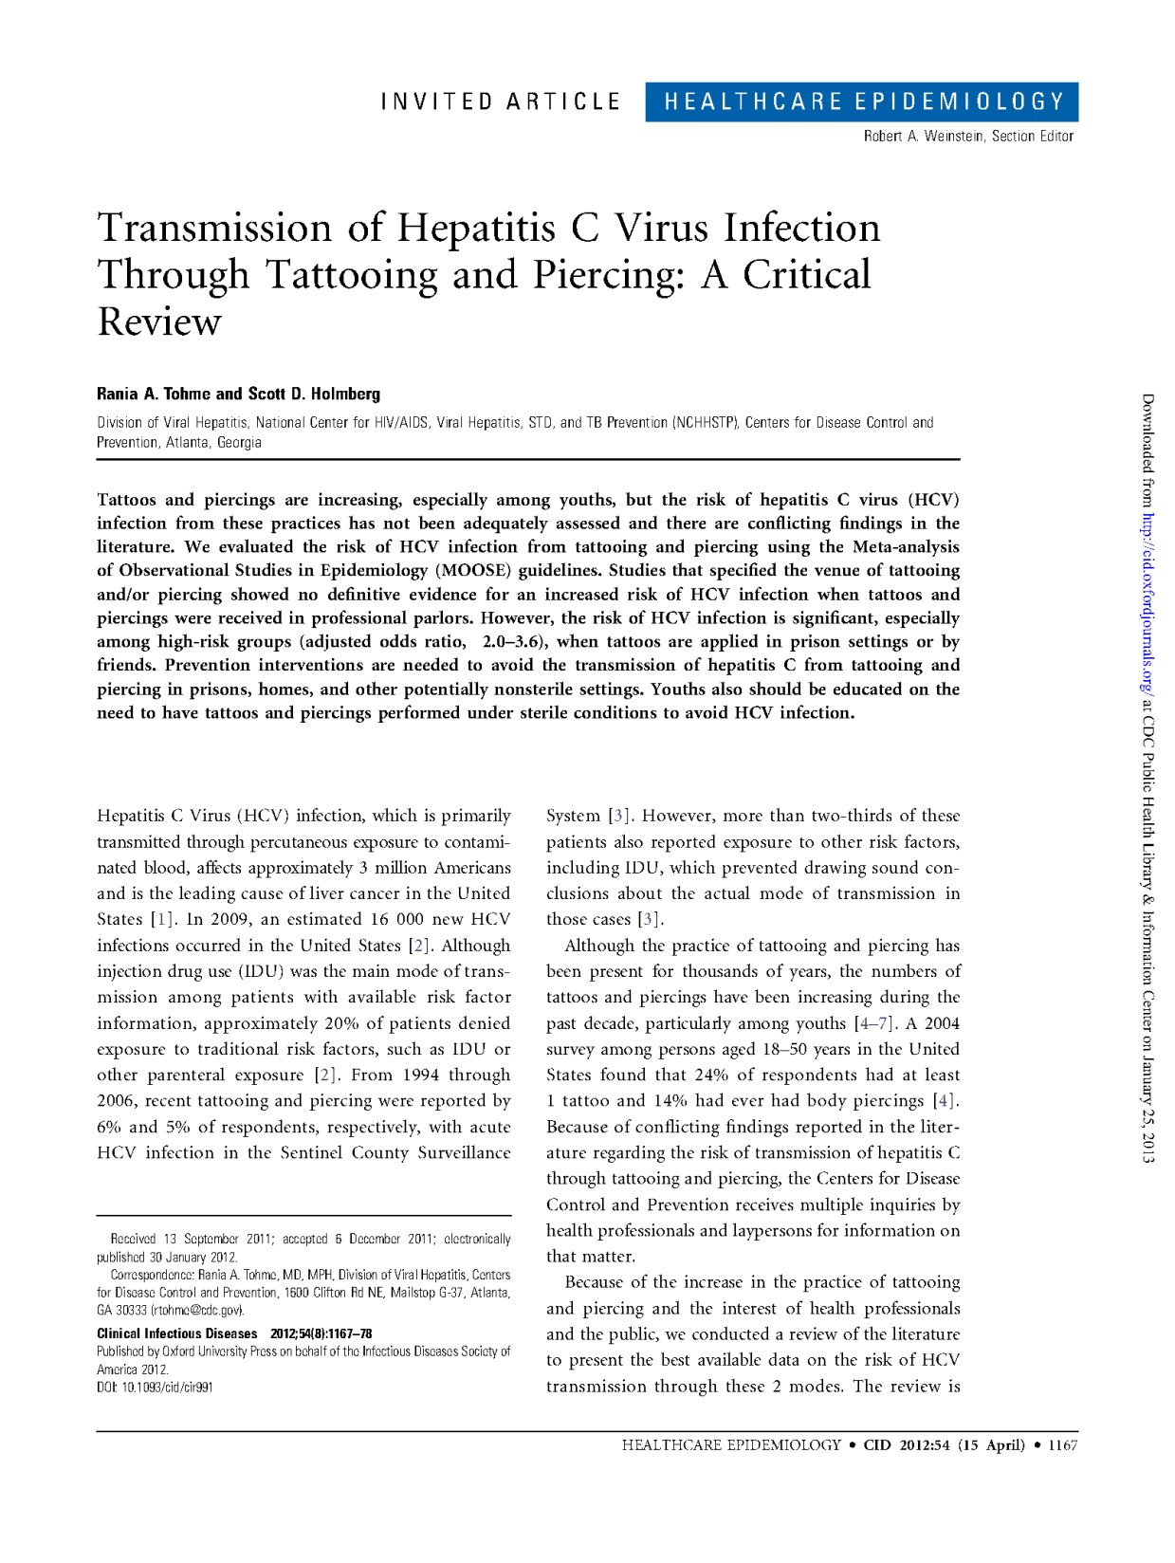

Slide 16
Body Art Complaints
Number of complaints forwarded to LHDs since year 2010 by MDHHS:
69 Social media parties, Facebook, Craigslist, etc.
18 Acquired infections.
85 Illegal facility operations.
50 Complaints on existing facilities.
13 Underage procedures.
4 Businesses selling tattoo machines not checking IDs for age.
Total =239

Slide 17
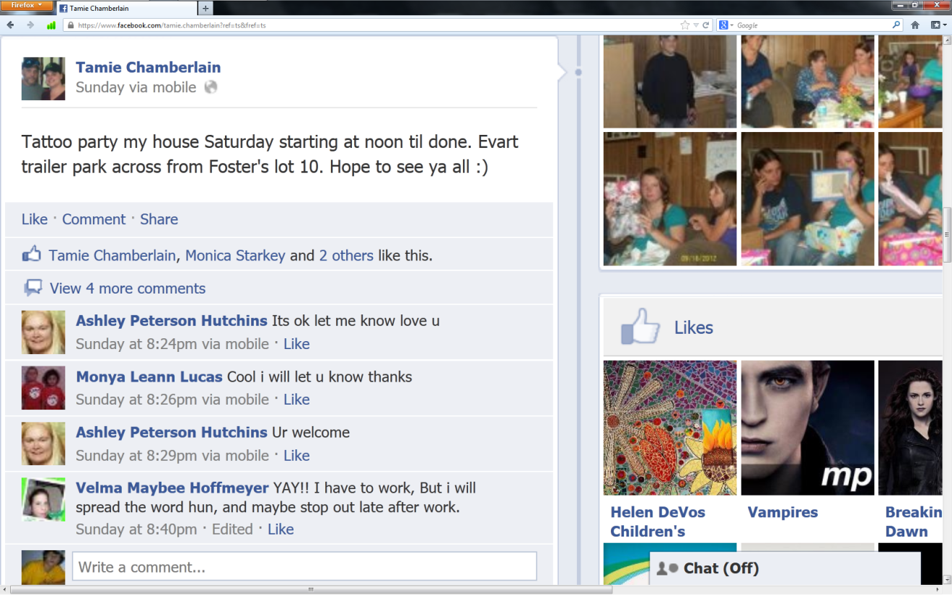

Slide 18
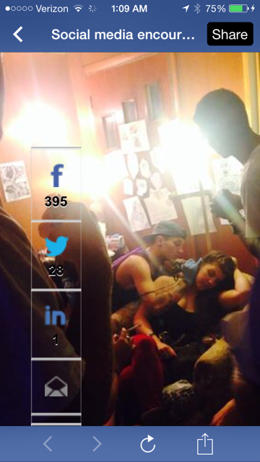

Slide 19
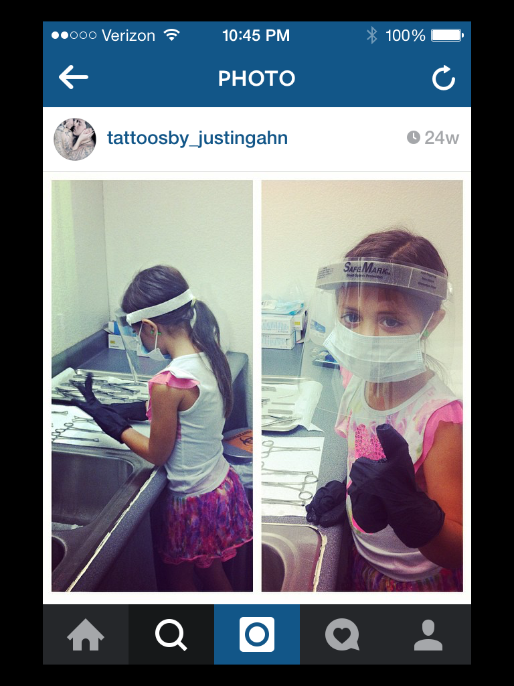

Slide 20
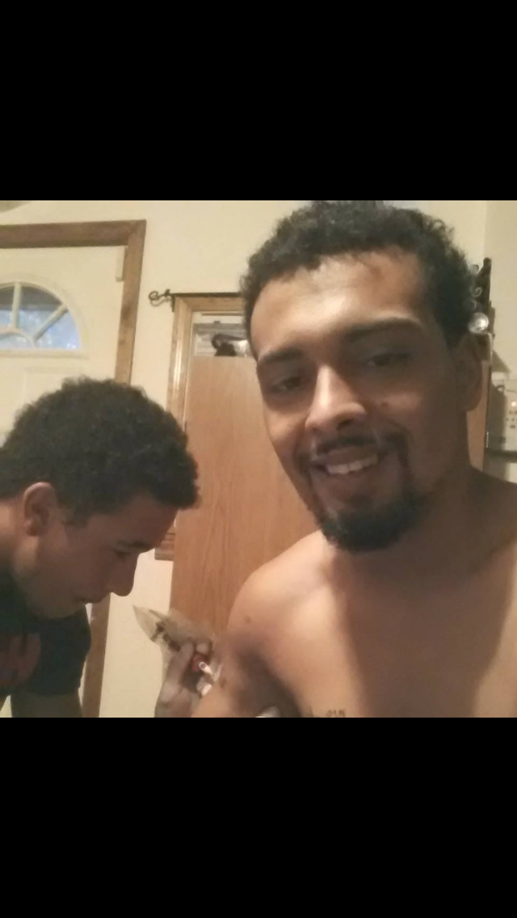

Slide 21
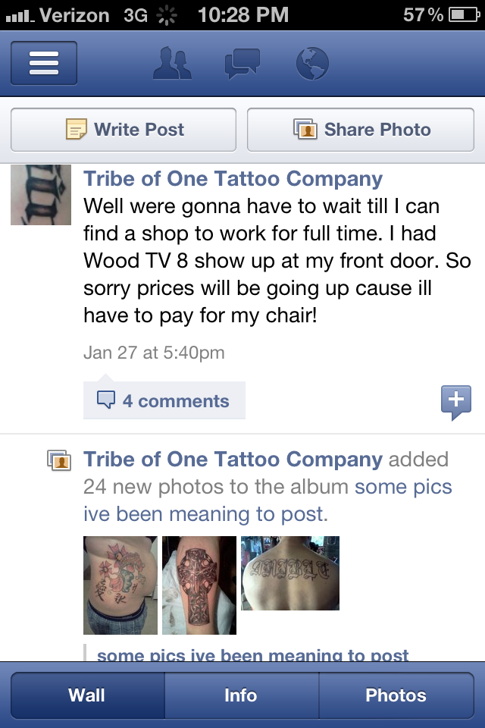

Slide 22
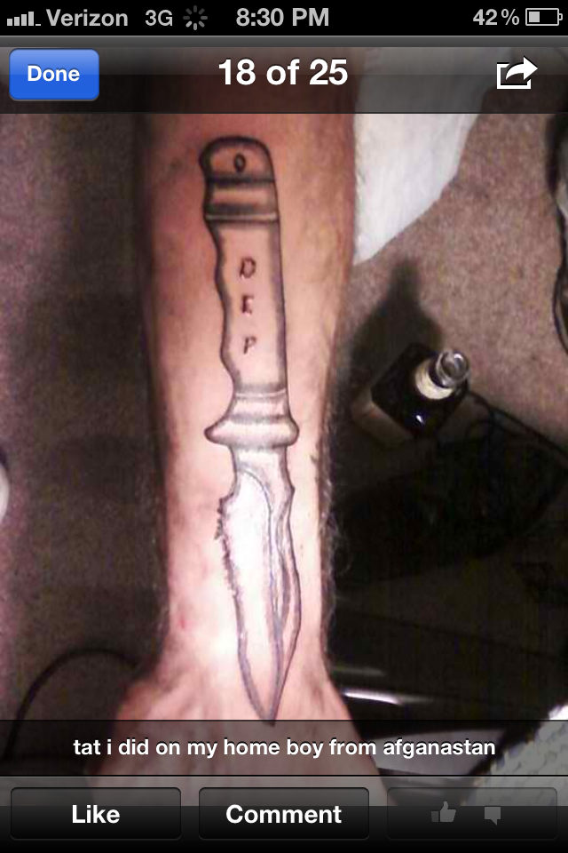

Slide 23
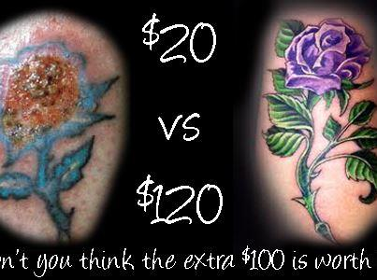

Slide 24
Where would be safer ?

