Slide 1

Mphi rapid response initiative
Racial disparities
task force
January 22, 2021

Slide 2



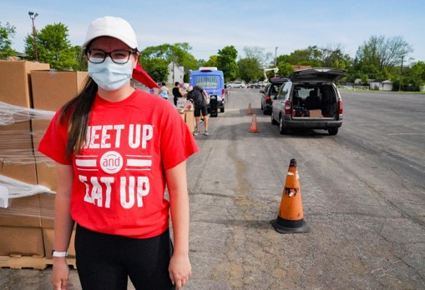
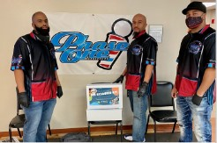
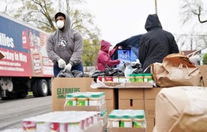

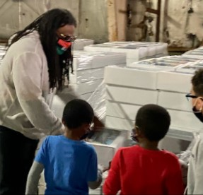
A Project of Partnership
Michigan Office of the Governor + Coronavirus Task Force on Racial Disparities
MDHHS Office of equity and minority health + MPHI + Accenture
33 Michigan organizations

Slide 3
































3 months…33 organizations…$17.6m
Vietnamese American Association of Grand Rapids
Notes:
Equity lens

Slide 4
Program expenditure summary
        $17,557,139.09 has been expensed to date.
        This represents 95.4% of awarded subrecipient funds.
        Total confirmed underspend is currently 2.1%.¹
        The balance (2.5%) will be reported on by 2/5. Pending two subrecipients’ final spenddown, the overall spenddown could range from 95.4% (if they spend no additional funds) to 97.9% (if they expend their full awards by 1/31/21).
Note: All data as of 1/21/21 at 6pm.
This excludes the balances of two subrecipients, whose contracts have been extended through 1/31/21. Total underspend could increase up to 4.6% if they spend no additional funds of their remaining balance by 1/31/21.
4

Slide 5
1 of 2
Reflections from subrecipients
Below are preliminary insights from subrecipient Final Program Reports. Additional detail will be provided, including actual outcomes achieved through the Rapid Response program, in the MPHI Program Evaluation.
CHALLENGES Delays: Supply chain, staffing, etc. Time: Short project duration Demand: Demand for services far exceeded capacity Capacity: Intermittent staffing and/or staff shortages Stay at home orders: Unpredictable business and school schedules; having to adjust service delivery Funding: Reimbursement-based payment Structural barriers: Internal (to execute activities) and external (to access social services) | CRITICAL NEEDS LEFT TO ADDRESS Housing and food security Employment Follow up medical care Mental health services and supports Operational and infrastructure support for partner community organizations (e.g., labor and food trucks) Specific populations, including undocumented residents, visually impaired/blind, individuals with “disabilities and special needs,” homeless and incarcerated
5
Notes:
-

Slide 6
2 of 2
Reflections from subrecipients
LESSONS LEARNED Collaboration: Bring the right people/partners to the table from strategy formation/proposal development through implementation Knowledge Sharing: Ensure everyone involved understands the full project scope; cross-train employees Feedback & Adaptability: Seek feedback early and often and be flexible to try new things Project Management: Build PMO capacity and have frequent check-ins with team and partners Support: Provide the people doing the work with support and resources for their own self-care Rapport: Allow ample time to educate and build trust with clients/beneficiaries Outreach: Early and strategic marketing and communication are essential; word of mouth key Risk Mitigation: Not everything can be implemented in a rapid response manner – create contingency plans!
6
Notes:
-

Slide 7
how subrecipient organizations experienced the grant
“The roll out, onboarding training, webinars, and technical assistance were so well thought out that onboarding to this grant was seamless. The reminder communications for upcoming report due dates were so essential to all partners’ success given the short time frame for this grant, as well as the year-end and close-out activities…Thank you for a flawless execution.”
“MPHI was a pleasure to work with. I am impressed by their professionalism, ability to move quickly, and their genuine concern for the needs of the grantee and the subsequent community. We could not have impacted our community without their help and assistance.”
“During the short period of time the MPHI funding was in place it provided very important assistance, it gave the agency that was closed from March until October new life and the ability to reopen.”
“This was a huge lift but the life-changing results it made happen in our community are incredible.”
“It was also helpful to connect with similar multi-partner grantees to hear their experiences and approaches to overcome challenges through sessions arranged by the RRI Team.”
“This support was far above and beyond what we typically see from grant funders.”
“We received an amazing amount of support from the team and all staff involved from MPHI and Accenture! They were extremely responsive, able to answer our multiple questions in a timely manner and guide us through the various budget and reporting iterations.”

Slide 8




We established a community of 4 peer organizations regranting RRI funds – “The POD”
Hold space for an exchange of ideas and lessons learned | Share program highlights and anecdotal feedback from communities supported | Provide customized technical assistance unique to organizations regranting funds
PURPOSE
4
80
$6,693,719.67
Subrecipients
Sub-grantees
Spend down

Slide 9



SUMMARY OF POD feedback
Joys of Mission-Driven Work and the RRI Grant | Why the POD Provided Value | What They’ll Take Away from the RRI Grant Experience
Opened their eyes to work on the ground | Making sure we are successful and having ongoing touchpoints | There was a unified effort: no worker or no task left behind; everyone is important
Encouraging to see the impact and not just numbers/financials; inspired by listening to the community impact with RRI funds | Helpful to connect with similar multi-partner grantees to hear their experiences and approaches to overcome challenges through sessions arranged by the Rapid Response Team | Joint vision and joint mission were critical
Working in the community (that some were raised in) | Connecting with people | Having common goals and doing the best we can for our communities
Very thankful for the funding provided, which truly impacted the community and will have long-term benefits; the need is there, and services are being used | The meetings among grantees were critical to the success of the project, our organization benefitted immensely from the touchpoints with MPHI and Accenture | Collaborative efforts across departments to bring initiative to fruition; takes more than one person to get the work done
“We only wish we had the opportunity to provide more, and longer term, support to agencies through this grant program managed by MPHI and we look forward to working with you in the future.”
9

Slide 10
THANK YOU!

