Slide 1
Handle With Care
______ County
Together we can make a difference

Slide 2
A recent national survey of the incidence and prevalence of children’s exposure to violence and trauma revealed that :.
60%
Of American children have been exposed to violence, crime and abuse.

Slide 3
40%
Of children in the United States were direct victims of two or more violent acts.

Slide 4
What is Trauma?
Why is it important?

Slide 5

Through our Eyes: Children, Violence and Trauma
Notes:
ATTRIBUTION
Joshua Sortino
joshuasortino.com

Slide 6
Handle
With
Care.
Notes:
ATTRIBUTION
http://www.wallpaperseries.com/textures/black-leather-texture-hd-free-wallpaper.html

Slide 7
The Concept
How can we identify more students that have had a traumatic experience and be sensitive to help schools keep children supported and safe?

Slide 8
MICHIGAN HANDLE WITH CARE Initiative
HWC was first piloted in an urban elementary school in West Virginia.
This elementary school has ranked 398 out of 400 elementary schools in WV for poor performance.
93% of students come from low-income families.
Jackson County Michigan sent a team to WV learn about it and how to implement when the time is right.
The Jackson HWC team met and determined next steps.

Slide 9
Who is Needed?
How can we identify more students that have had a traumatic experience and be sensitive to help schools keep children supported and safe?
_______ County Law Enforcement entities
School Districts in _______ County
Supporting community agencies as needed

Slide 10
Role of the Law Enforcement
"Handle with Care" provides the school with a “heads up” when a child has been identified at the scene of a traumatic event.
The “traumatic event” could be a drug overdose, domestic violence situation, a shooting, witness of a crime, a drug raid, a motor vehcile accident, etc.
Police are trained to identify children at the scene, find out where they go to school and send the school a confidential communication (email or fax or other way) that simply says . . . “Handle With Care” and the child’s name. That’s it. No other details.

Slide 11
Role of the School District
The specific school that the student attends will receive notice of a Handle With Care student.
If the student exhibits behavior or emotional problems in or outside of the classroom the teacher will implement trauma sensitive interventions and/or refer the student to the counselor.
Ideally, teachers and counselors will be trained on the impact of trauma on learning, and will incorporate interventions to mitigate the negative impact of trauma for identified students.
Interventions may include such things as: Re-teaching lessons; postponing testing; small group counseling by school counselors; and referrals to counseling, social service or advocacy programs.

Slide 12
Role of the community Agencies
Department of Health and Human Services: Initiator of Program, Success Coaches and Prevention Worker support in the schools
_____CMH: Support for mental health resources
__________: Trauma Training Resources and mental health resources
__________: School Based Health Centers and mental health resources

Slide 13
The
Handle with Care
Process

Slide 14
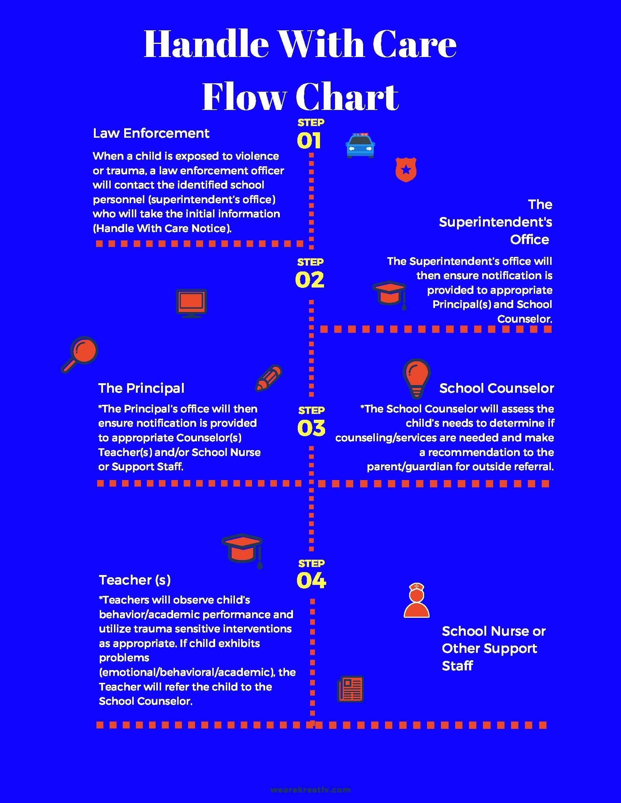
Notes:
ATTRIBUTION
<a href="http://www.freepik.com/free-photos-vectors/background">Background vector designed by Freepik</a>
http://www.freepik.com/free-vector/black-texture-background-vector_760552.htm

Slide 15
_______ County Handle With Care Planning
Present to all District Superintendents.
Engage with other major law enforcement agencies.
Determine what the most successful means of communication will be for officers.
Determine who the contact person will be in the schools.
Put a communication plan in place for teachers and parents in the school districts.
Provide Trauma Training to ALL who desire to receive it (police, school personnel, etc.)
Ensure process of Mental Health Resources for those who need it.

Slide 16
_______ County Handle With Care Assessment
Monthly check in with all schools that received a HWC.
Assess the communication points and their success.
Obtain information about how the school managed around the notice.
Determine how many of the HWC youth were assessed to need a mental health referral.
Determine whether additional training on Trauma or Resilience is desired.
Full HWC assessment of functioning during summer months.

Slide 17
Resources
Video:
Through Our Eyes: Children, Violence, and Trauma—Introduction
Website:
Helping Traumatized Children Learn
Following is a link to a great website for helping traumatized children learn.
http://traumasensitiveschools.org
Article:
Educational Leadership September 2016 | Volume 74 | Number 1
Relationships First Pages 28-32
The Trauma-Sensitive Teacher by Susan E. Craig

Slide 18


The Handle with Care Committee
DHHS
zoe Lyons
Northwest
Michelle McBean
JPS
William Patterson
JpD
Adam Williams
Blackman
Scott Grajewski
Northwest
Cari Bushinski
Lifeways
Elizabeth knoblauch
CFH
Sara Benedetto
JCISD
Janelle Buchler
Fsca
Bob Powell

Slide 19
Questions?
Notes:
ATTRIBUTION
<a href="http://www.freepik.com/free-photos-vectors/background">Background vector designed by Freepik</a>
http://www.freepik.com/free-vector/black-texture-background-vector_760552.htm

