Slide 1
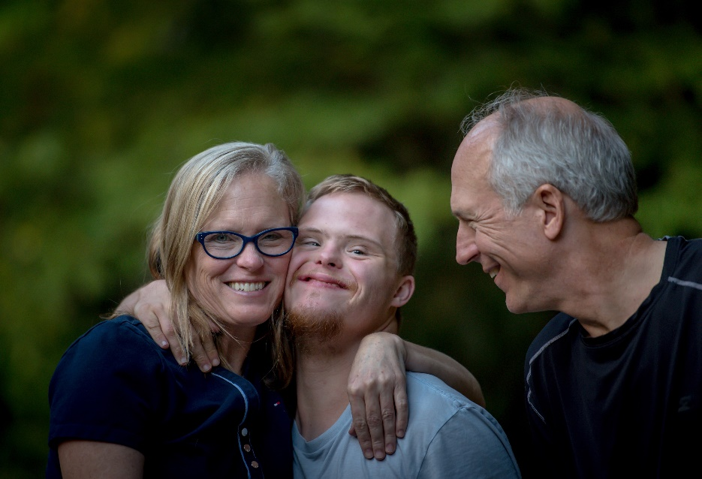

A Future that Includes Employment:
A Workshop for Families
Presenters: add information such as presenter’s names, location, date or event.

Slide 2
Today’s Agenda
Why are we talking employment?
Employment: Background and possibilities
Seeing things in a new way
Preparing for employment success
Address concerns: Social Security benefits
Action steps
Questions and connections
Remember to use your worksheet as we move along.

Slide 3
WORKSHEET QUESTION 1
What do you hope adult life will look like for your son or daughter?

Slide 4

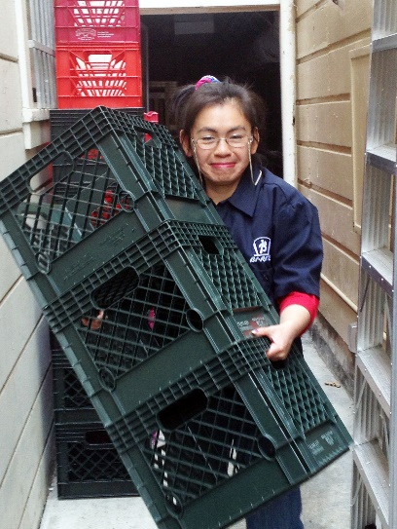




Today, People with Disabilities…..

Slide 5
But There is Still Work to Be Done….
There is still a long way to go before people with disability experience equality of opportunity in the US.
Employment rates
Poverty
Housing options
Social, recreational, relationships
A respected voice
Determine own futures

Slide 6
Employment = Equality of Opportunity
What we are trying to do:
Help families to see value in employment
Help families see that work is possible
Offer information and resources so families can make informed decisions
What we are NOT trying to do:
Take anything away from families and people with disabilities
Put people at risk
Push people into programs they don’t want

Slide 7
Employment:
So Much Is Possible

Slide 8
Understanding Current Efforts to Promote Employment Equality
Current thinking and practice reflects desire to offer all people choice in being able to work and where.
Legislation ensures competitive work is considered before sheltered work
Many Michigan employment providers focusing efforts on community-based employment
Increased focus on preparing students with disabilities for successful employment

Slide 9
Employment: Core Concepts
Everyone can work!
Work looks differently for everybody.
Employment should be rooted in what your son or daughter wants to do

Slide 10
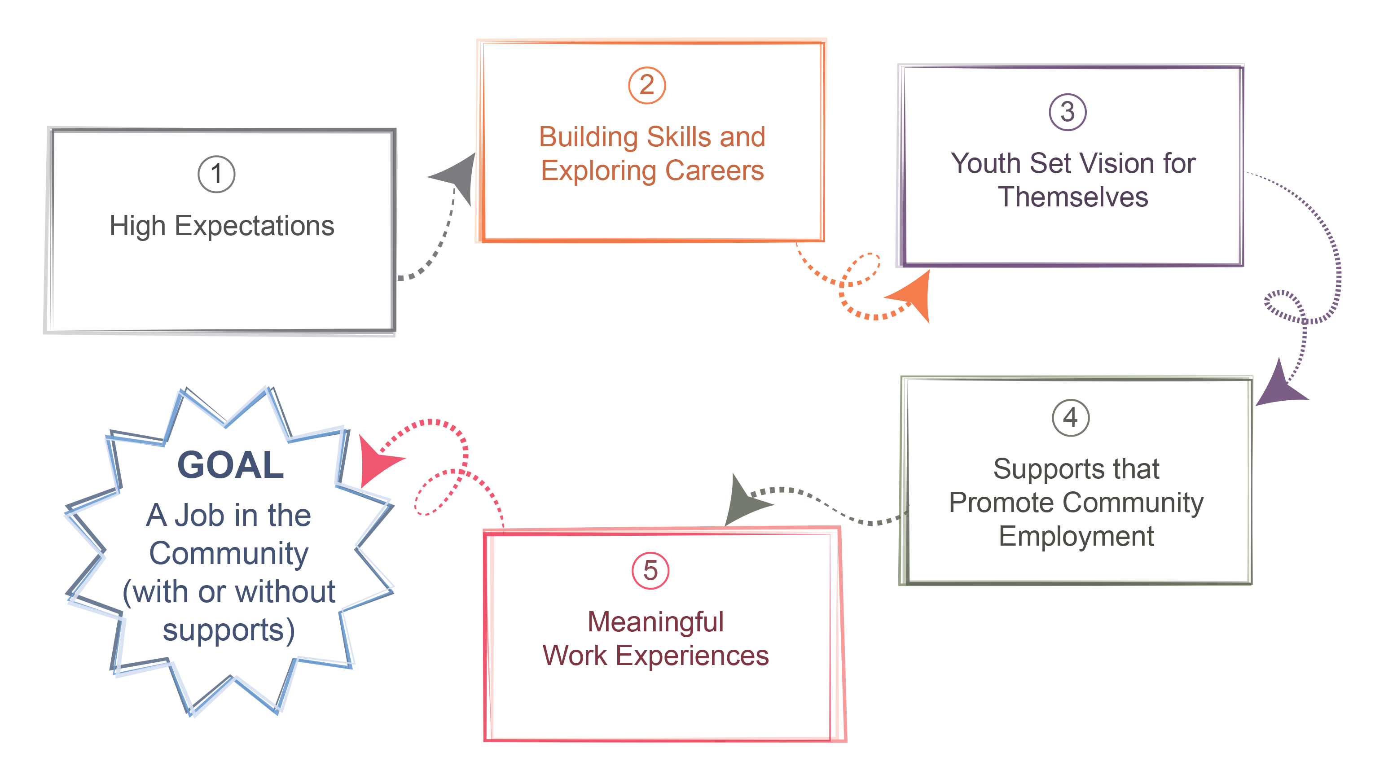
A New Path to Employment

Slide 11
“Employment First”
The State of Michigan recognizes that competitive employment within an integrated setting is the first priority and optimal outcome for persons with disabilities, regardless of level or type of disability.
Michigan Executive Order 2015-15
Individual – Not in a group or enclave
Integrated – Alongside those without disabilities, with opportunities to interact
Employment – In the general workforce, on the payroll of a business or self-employed
Minimum Wage – At or above minimum wage or at industry standard wage

Slide 12
Why Should Your Son or Daughter Work?
- Insert quote about employment from a MI parent-
It is what is expected of adults
Socialization
Self-worth (dignity)
Purpose
Money
Promotes mental health
Because they can!

Slide 13
Seeing Your Son or
Daughter in a New Way

Slide 14
What are “Expectations”?
Expectations are “quick predictions” about how much value someone’s contributions will add to the task at hand. If the value of someone’s contributions is predicted to be high, that person will receive more opportunities to contribute.
Esther Quintero - 2014

Slide 15
Where Do Low Expectations Come From?
Society’s perceptions about the impact of disability
Feelings about having a son or daughter with a disability
What we are told by others
The secret is seeing that people with disabilities can do great things, and not letting other people’s ideas impact your son or daughter’s ability to make lives for themselves.

Slide 16
The Importance of Having High Expectations
Families set the bar for how the rest of the world sees their son or daughter.
Avoiding restrictive programs or placements
Lives lived in the community
Lives based on the dreams your son or daughter have for themselves
Seeing that risk is good and failure can be constructive

Slide 17

The Balancing Act

Slide 18

Longer Runway

Slide 19

What is Success?
Think of a couple things that you would not be successful at on your first try.
Success in employment is an ongoing process and will look different for everyone.
Hours worked
Tasks
Tolerance
Recognize and celebrate progress!!

Slide 20
WORKSHEET QUESTION 2
What is your son or daughter’s greatest skill or attribute?

Slide 21
HELPFUL TOOL
Positive Personal Profile

Slide 22
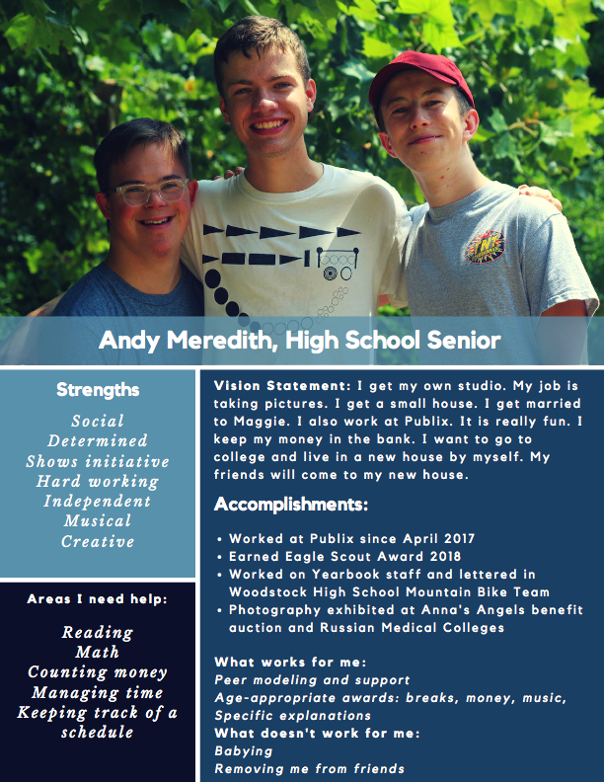
BUILDING A…
Vision Statement

Slide 23
Family Engagement Video

Slide 24
Preparing for Employment Success

Slide 25
The Power of Work Experiences
One of the best predictors of employment success for people with disabilities is having meaningful work experiences while in high school.
Informational interview
Job Shadowing
Volunteering
Internships
Paid entry-level job

Slide 26

Using Your Networks
Use the people you know to help find work experience opportunities.
Friends
Family
Places you do business
Neighbors
People you are in clubs with, worship with, or serve with

Slide 27
Building Responsibility
Finding ways for young people to have responsibilities helps them be good employees.
Chores
School work
Soft Skills
It’s OK for young people to take risks and to experience failure. The goal is to have them give a good effort.

Slide 28
School and Employment
The high school and transition years are the perfect time to focus school programs on preparing for employment.
Are skills needed for work included as goals in the IEP?
Career exploration
Functional skills and soft skills
Work experiences
Quick Tip: Parent advocates can help coach you on asking for employment-focused activities in the IEP.

Slide 29
Discussing Your Concerns

Slide 30
WORKSHEET QUESTION 3
What is your greatest concern when thinking about employment for your son or daughter?

Slide 31
Myths about Employment
Misinformation and misunderstanding can hold us back from considering employment.
People with disabilities don’t work fast enough (MYTH)
Employees with disabilities won’t be accepted by co-workers (MYTH)
Sheltered work is safer than community jobs (MYTH)
People who leave workshops lose their friends (MYTH)
People with significant disabilities don’t need to work (MYTH)
Don Lavin – Strengths at Work

Slide 32

Myths about Working & Social Security Benefits
Getting students on SSI will take care of everything
People who choose work will lose disability and healthcare benefits
People can live independently in the community on what SSI provides

Slide 33
Benefits Overview from an Expert
The Intersection of Employment and Public Benefits
(video)

Slide 34
WORKSHEET QUESTION 4
What do you need to feel hopeful and energized about your son or daughter’s employment future?

Slide 35
Action Steps: Getting Started

Slide 36
WORKSHEET QUESTION 5
Based on the information in this workshop, what are 3 action steps you will take to help start your son or daughter on the path to employment success?

Slide 37
Takeaways
Have high expectations and set a vision for employment
Celebrate and cultivate strengths and interests
Recognize challenges and address them
As a family member, find the information and support you need

Slide 38

Questions

Slide 39
Contact Information
Presenters, add your contact information here so attendees can reach you with any questions.

