Slide 1
Update of Racial Disparities in Michigan & COVID-19
April 9, 2020
Disparities Data Committee

Slide 2
Purpose
Provide relevant data to aid the Lt. Governor-appointed Racial Disparities Task Force in better understanding and addressing the needs of racial and ethnic minority communities.
  Outline existing upstream factors that result in disparities and put some people at greater risk of severe impact of COVID-19 epidemic and response
  Identify a set of actionable downstream indicators that can be used to measure change in disparity in short term

Slide 3
Disparity Indicators
Indicator: Rationale | Sample of Proposed Metrics
SARS-CoV-2 Testing: Are we testing enough in all communities? | Testing by Race and Ethnicity Testing Rate in Socially Vulnerable Communities Turn Around Time for Positive and Negative Tests
SARS-CoV-2 Spread: What is the spread of COVID-19 in Michigan populations? | Number & Percent of COVID-19 Cases by Race and Ethnicity Case Rate per Million People by Race and Ethnicity Missingness of Race/Ethnicity data for COVID-19 cases
COVID-19 Severity: Are some groups experiencing more severe outcomes? | COVID-like Illness (CLI) and COVID-19 diagnosis in EDs Number& Percent of COVID-19 deaths by Race and Ethnicity Death Rate per Million People by Race and Ethnicity
Access to Services for COVID-19: Is case investigation and contact tracing equitable? Are supportive services available for quarantine/isolation compliance? Is vaccine distributed equitably? | Percent of cases who were followed up with CI/CT Percent of cases who indicated need for services and services provided Total vaccines administered by race % population with first dose, completed vaccine series
Impact of Pandemic Response (rotating metrics): How are non-COVID outcomes impacted by COVID-19? And is the impact the same in all populations? Are preventive services and access to care equitable? | Excess deaths Maternal and Child Health Indicators (pre/antenatal, CLPPP) Substance use disorder services Health Screening (HIV, STD, Noncommunicable Diseases)

Slide 4
Key Messages
SARS-CoV-2 Testing
Among neighborhood testing sites, the number of tests conducted has increased for all races and ethnicities
Among NxGen testing data, Whites (58%) and Non-Hispanic (36%) continue to make up the majority of tests
In past 2 weeks at neighborhood testing sites, the highest positivity among minority races was among Blacks, while Hispanics and Non-Hispanics were similar
As state cases levels rise, individuals should be encouraged to seek testing when needed
SARS-CoV-2 Spread
Cases per million are increases for all races and ethnicities but is currently highest for Blacks and Hispanics
In the past 30 days, 30% of all cases have unknown race (↑ 4%), and 33% have an unknown ethnicity reported (↑ 3%)
The increases of unknown race and ethnicity can make findings less generalizable if there are systematic differences in the level of missingness
COVID-19 Severity
The proportion of ED Visits with coronavirus symptoms or a COVID-19 diagnosis is increasing for all races and is highest for Asian and Other Races
In the past 28 days, Blacks/African Americans and Other Race have been flagged as having more than their expected share of hospitalizations
Recent trends show that Whites and Blacks have the most reported deaths per capita, while Hispanic/Latinos and Non-Hispanic are about the same
Access to COVID-19 Services
Compared to the overall state, Blacks and Arabs report fewer cases per contact, whereas Hispanic have reported more
Compared to state totals, a fewer percentage of Blacks have reported quarantining at symptom onset and having a known source of infection
Vaccine Coverage for those 16 and older was highest among those of Whites (27%), followed by American Indian (24%), Asian/Native Hawaiian/Pacific Islanders (23%), Black/African American (16%), and Hispanics/Latinos (14%)
30% data remains missing or unknown (gradually improving)
Impact of Pandemic Response
No report this week
Notes:
Testing: Among those visiting neighborhood testing sites, the highest positivity was seen among Whites, Hispanics, and Arab

Slide 5
Testing by Race and Ethnicity (Sentinel Sites)
SARS-CoV-2 Testing
Cumulative Neighborhood Testing Demographics (22 sites)
Time Trends
Percent Tested |  | % Positive (3/18 – 3/31)
Race*
1% | Asian | 10% | Asian Positivity
< 1% | American Indian or Alaskan Native | 8%¶ | American Indian or Alaskan Native Positivity
39% | Black/African American | 15% | Black/African American Positivity
3% | Other Race | 10% | Other Race Positivity
37% | White | 18% | White Positivity
Ethnicity*
4% | Hispanic/Latino | 13% | Hispanic/Latino Positivity
76% | Non-Hispanic/Latino | 16% | Non-Hispanic/Latino Positivity
< 1% | Arab | 6% | Arab Positivity
* May not add to 100% due to those who responded unknown or preferred not to answer
¶ 2/25 – 3/24 due to low frequency of testing
Notes:
Race – Prefer not to answer 9.29% of samples; 10.11% positivity. The remaining percent of samples were blank (~45%).
Hispanic Ethnicity – Prefer not to answer 11.23% of samples; 8.57% positivity. The remaining percent of samples were blank.

Slide 6
NxGen Testing by Race and Ethnicity
78 testing sites, 96,800 samples
SARS-CoV-2 Testing
Percent Tested |  | Percent Positive (cumulative)
Race*
1% | Asian | 12% | Asian Positivity
< 1% | American Indian or Alaskan Native | 10% | American Indian or Alaskan Native Positivity
6% | Black/ African American | 6% | Black/African American Positivity
< 1% | Native Hawaiian/Pacific Islander | 14% | Native Hawaiian/Pacific Islander Positivity
2% | Other Race | 6% | Other Race Positivity
58% | White | 9% | White Positivity
Ethnicity*
3% | Hispanic/Latino | 17% | Hispanic/Latino Positivity
36% | Non-Hispanic/Latino | 6% | Non-Hispanic/Latino Positivity
< 1% | Jewish | 3% | Jewish Positivity
* May not add to 100% due to those who responded unknown or did not to answer
Notes:
Cumulative starts at 11/8/2020
Race – Unknown 21.94% of samples; 4.97% positivity. The remaining percent of samples were blank.
Ethnicity – 34.98% of samples; 5.78% positivity. The remaining percent of samples were blank.

Slide 7
Average daily new cases per million people by race and ethnicity
Draft
SARS-CoV-2 Spread
Daily new confirmed and probable cases per million (7 day rolling average) by race category
Daily new confirmed and probable cases per million (7 day rolling average) by ethnicity category
American Indian/Alaska Native
Black/African American
Hispanic or Latino
Not Hispanic or Latino
Asian/Pacific Islander
White
Updates since last week:
Cases per million are now increasing for all races and ethnicities
Most recent data show that Blacks and Hispanic/Latinos have the highest case rates
In the past 30 days, 35% of all cases represent unknown, multiple, or other races (30% of race is unknown, ↑ 4%)
In the past 30 days, 33% of all cases have an unknown ethnicity reported (↑ 3%)
Note: Case information sourced from MDHHS and reflects date of death of confirmed and probable cases.
Source: MDHHS – Michigan Disease Surveillance System

Slide 8
Average daily new cases per million people by race and ethnicity
Draft
SARS-CoV-2 Spread
Daily new confirmed and probable cases per million (7 day rolling average) by race category
Daily new confirmed and probable cases per million (7 day rolling average) by ethnicity category
American Indian/Alaska Native
Black/African American
Hispanic or Latino
Not Hispanic or Latino
Asian/Pacific Islander
White
Berrien
Genesee
Note: Case information sourced from MDHHS and reflects date of death of confirmed and probable cases.
Source: MDHHS – Michigan Disease Surveillance System

Slide 9
Average daily new cases per million people by race and ethnicity
Draft
SARS-CoV-2 Spread
Daily new confirmed and probable cases per million (7 day rolling average) by race category
Daily new confirmed and probable cases per million (7 day rolling average) by ethnicity category
American Indian/Alaska Native
Black/African American
Hispanic or Latino
Not Hispanic or Latino
Asian/Pacific Islander
White
Kent
Wayne
Note: Case information sourced from MDHHS and reflects date of death of confirmed and probable cases.
Source: MDHHS – Michigan Disease Surveillance System

Slide 10
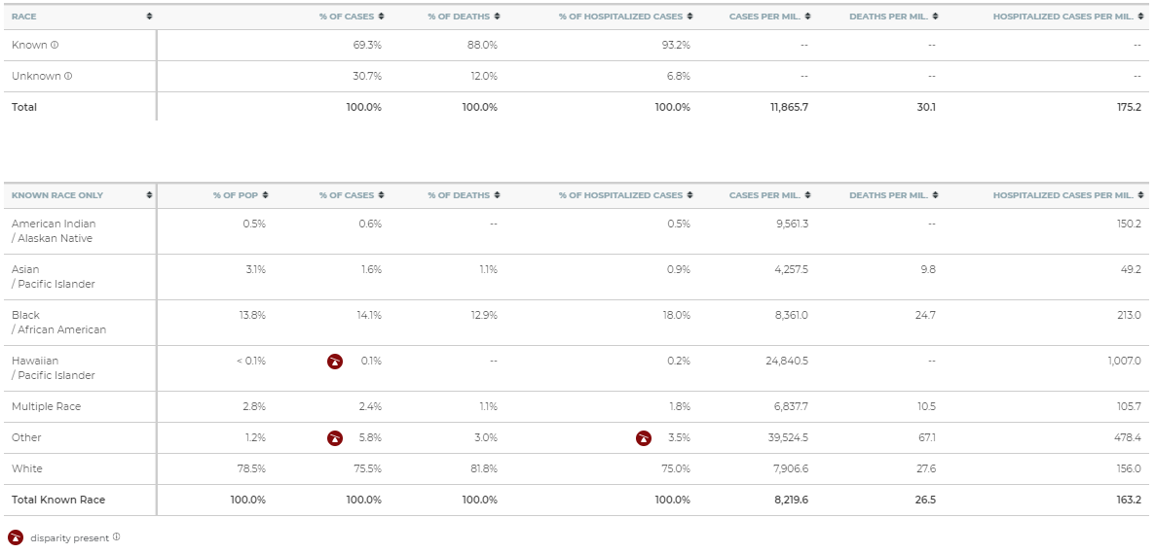
Prior 28 Days Metrics By Race (Mar 9, 2021 – Apr 6, 2021)
SARS-CoV-2 Severity
Source: MDHHS – UMich Collaborative – Michigan Disease Surveillance System, EM Resource, US Census
Notes:
Disparity flag: this demographic group has been flagged as having more than their expected share of cases, deaths, or hospitalizations, based on having at least 33% more cases, deaths, or hospitalizations per million than the general population

Slide 11
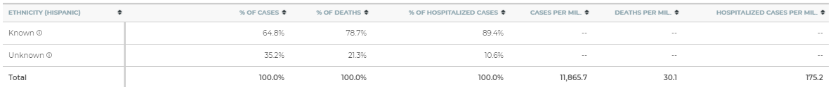
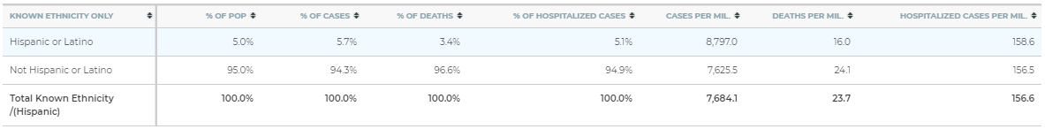
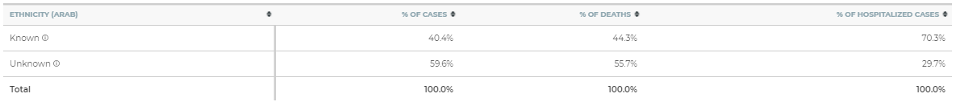
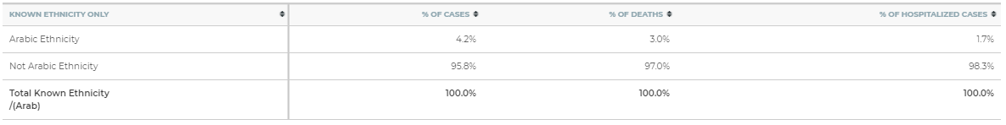
Prior 28 Days Metrics By Ethnicity (Mar 9, 2021 – Apr 6, 2021)
SARS-CoV-2 Severity
Source: MDHHS – UMich Collaborative – Michigan Disease Surveillance System, EM Resource, US Census
Notes:
Disparity flag: this demographic group has been flagged as having more than their expected share of cases, deaths, or hospitalizations, based on having at least 33% more cases, deaths, or hospitalizations per million than the general population

Slide 12
Proportion of ED Visits with Coronavirus Symptoms or a COVID-19 Diagnosis Code by Race - Michigan
SARS-CoV-2 Severity

Slide 13
30-day rolling average daily deaths per million people by race and ethnicity
Draft
SARS-CoV-2 Severity
Average daily deaths per million people by race
Average daily deaths per million people by ethnicity
American Indian/Alaska Native
Black/African American
Hispanic or Latino
Not Hispanic or Latino
Asian/Pacific Islander
White
Updates since last week:
Deaths are a lagging indicator of cases, and death rates are decreasing among racial and ethnic groups
Whites and Blacks have the most reported deaths per capita while Hispanic/Latinos and Non-Hispanic Latino are about the same
Deaths are not adjusted for confounders (e.g., age, sex, comorbidities)
Note: Death information sourced from MDHHS and reflects date of death of confirmed and probable cases.
Source: MDHHS – Michigan Disease Surveillance System

Slide 14
Average deaths per million people by race and ethnicity
Draft
SARS-CoV-2 Spread
Deaths per million (30 day rolling average) by race
Deaths per million (30 day rolling avg) by ethnicity
American Indian/Alaska Native
Black/African American
Hispanic or Latino
Not Hispanic or Latino
Asian/Pacific Islander
White
Berrien
Genesee
Note: Case information sourced from MDHHS and reflects date of death of confirmed and probable cases.
Source: MDHHS – Michigan Disease Surveillance System

Slide 15
Average daily new cases per million people by race and ethnicity
Draft
SARS-CoV-2 Spread
Deaths per million (30 day rolling average) by race
Deaths per million (30 day rolling avg) by ethnicity
American Indian/Alaska Native
Black/African American
Hispanic or Latino
Not Hispanic or Latino
Asian/Pacific Islander
White
Kent
Wayne
Note: Case information sourced from MDHHS and reflects date of death of confirmed and probable cases.
Source: MDHHS – Michigan Disease Surveillance System

Slide 16
Access to Services for COVID-19
Average Number of Contacts per Case by Race/Ethnicity
Race | White | 3.21
 | Black | 2.69
 | Other | 3.28
Ethnicity | Hispanic | 3.33
 | Non-Hispanic | 3.15
 | Arab | 2.47
 | Non-Arab | 3.17
Total Population |  | 3.18

Slide 17
Overall % of Cases Quarantining at Symptom Onset by Race/Ethnicity
Race | White | 33.2%
 | Black | 29.9%
 | Other | 34.8%
Ethnicity | Hispanic | 34.9%
 | Non-Hispanic | 33.0%
 | Arab | 39.9%
 | Non-Arab | 32.8%
Total Population |  | 33.0%
Access to Services for COVID-19

Slide 18
Access to Services for COVID-19
Overall % of Cases with Known Source of Exposure by Race/Ethnicity
Race | White | 56.4%
 | Black | 47.1%
 | Other | 55.4%
Ethnicity | Hispanic | 57.4%
 | Non-Hispanic | 55.5%
 | Arab | 50.8%
 | Non-Arab | 55.8%
Total Population |  | 55.5%

Slide 19
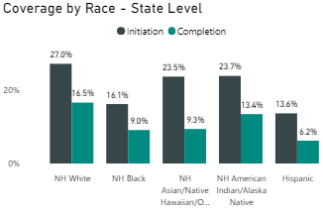
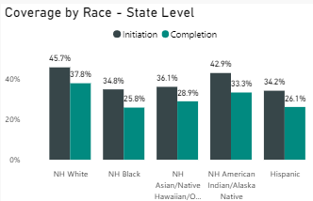
Coverage by Race: State Level
Access to Services for COVID-19
16 and older
65 and older
Coverage for those 16 and older was highest among those of Whites (27%), followed by American Indian (24%), Asian/Native Hawaiian/Pacific Islanders (23%), Black/African American (16%), and Hispanics/Latinos (14%)
Initial coverage disparities are also seen in those 65 and older, but slightly smaller disparities for Non-Hispanic Whites, Non-Hispanic Black, and Hispanic individuals
30% data remains missing or unknown (gradually improving)
Reporting correction: Asian/Native Hawaiian/Other Pacific Islander doses were previously double counted and have been corrected

Slide 20
Appendix

Slide 21
Access to Services for COVID-19

Slide 22
Access to Services for COVID-19

Slide 23
Access to Services for COVID-19

Slide 24
Access to Services for COVID-19

Slide 25
Access to Services for COVID-19

Slide 26
Access to Services for COVID-19

