Slide 1
Addressing the High Cost of Prescription Drugs in Michigan
Proposed Opportunities for the Prescription Drug Task Force

Slide 2
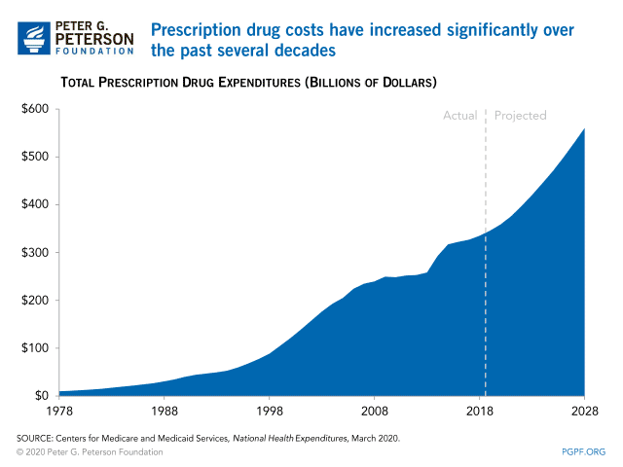
Background
Rising Cost of Prescription Drugs
Challenges to Addressing Costs
Opportunities Available
Notes:
Many of the problems we face in health care – plans that cost too much, deductibles that are too high – are a result of significant increases in the cost of prescription. Prices for the most commonly prescribed drugs for older patients have increased at more than 10 times the rate of inflation within five years, and the average cost of prescription drugs increased nearly 60% between 2012 and 2017, while income increased only 11%.
Among Michigan residents ages 19-64, 32% stopped taking their medication as prescribed due to cost in 2017.
The prices of prescription drugs are already monopolizing household budgets and are continuing to rise. No one knows how pharmaceutical companies set drug prices. A Congressional investigation found that prices are set as high as pharmaceutical companies believe the market can bear before significant access restrictions would be imposed on patients.
Total hospital and health system drug spending increased on average 18.5 percent from fiscal years 2015 to 2017. The spending growth was not driven by higher utilization, but higher prices. Overall drug spending for BCBS members in Michigan has been increasing 10% each year since 2010, driven largely by the cost of specialty drugs. Brand-name drugs represent just 10 percent of U.S. prescriptions but nearly 80 percent of spending.
Key Points
Nearly 60% of Americans take at least one prescription drug – 90% of seniors do – so expensive drug prices impact many Michiganders.
Specialty drugs are the number one driver of prescription drug costs.
Specialty drug spending is expected to quadruple by 2022; making up nearly 66% of all medication costs – and these new drugs cost between $450,000-$850,000.
Specialty drug prices climbed from 14 percent of total drug spending in Michigan in 2011 to 22 percent just three years later, a 42 percent increase
Studies show that marketing and advertising make up over 30% of drug costs, while R&D for new medicines makes up just 17%.
The federal government provides roadblocks to competition (patent “exclusivity”). There are over 100 brand name drugs that won’t have a money-saving generic available anytime soon – some even as late as 2029.

Slide 3
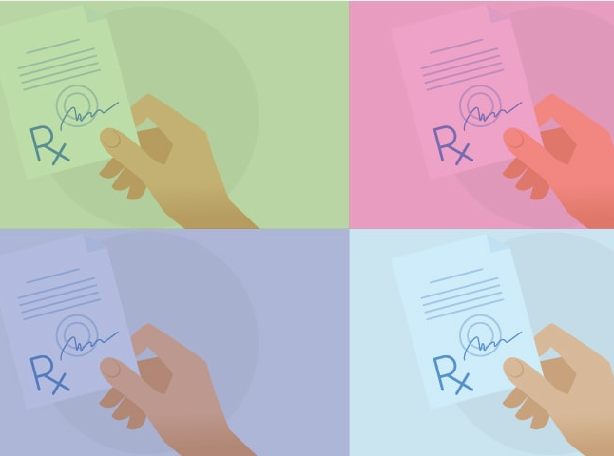
Transparency
Disclosure of Certain Cost Information
Require Notification of Price Increases
Require Prescriber Price Awareness
Notes:
The goal of drug transparency legislation is to understand the factors driving the continuous drug price increases and the high annual costs of certain drugs. Transparency laws create public pressure to demand explanations for price increases and may open the door for action to address unjustifiable price increases, such as anti-price-gouging laws and drug rate-setting commissions.
Transparency legislation will likely be the easiest legislative lift. Several prescription drug transparency bills have been introduced over the last few sessions. None of these proposals regulate or limit the price a pharmaceutical company can charge, require approval of a drug price, or limit the profits a drug company can earn.
States have created substantial fines and regulations to ensure compliance under transparency laws. Nevada recently fined 21 pharmaceutical companies $17.4 million for failing to submit a report explaining recent, significant price hikes to essential diabetes drugs.
Disclose certain cost information
Total cost of manufacturing
R&D costs
Clinical trial costs paid by the manufacturer
All marketing costs – including advertising and educational materials
Costs associated with coupons, discounts, and rebates
Require notification of price increases
Require drug companies to notify elected officials, insurers, employers, and the public of the price of new drug before it comes to market and about upcoming price increases – no overnight, surprise price hikes.
Require prescriber price awareness
Require anyone providing educational or marketing materials about a prescription drugs to a prescriber to also provide cost information about the drug, including the average cost of a 30-day supply.
Legislation Introduced: HB 4154 (Vaupel) is a limited transparency bill that targets specialty drugs over $10,000 and is supported in concept by stakeholders. BCBS is interested in it moving this session.
Stakeholder Positions (in concept):
Support Transparency: BCBS, MAHP, health plans, hospitals, AARP, pharmacists
Oppose Transparency: Drug companies

Slide 4

Accountability
Pharmacy Benefit Manager Licensing
License Pharmaceutical Sales Representative
Repeal Drug Industry Immunity Law
Notes:
Increased regulation will hold drug companies and pharmacy benefit managers accountable for the unfair practices that make consumers pay more.
Pharmacy Benefit Manager Licensing: In 2018, 21 states passed 32 bills to shed light on the opaque business practices of pharmacy benefit managers (PBMs) also known as the middlemen between insurers and pharmacies.
Establish a fiduciary relationship between the PBM and insurer. It’s helpful to think of this relationship like a relator selling a house – they get a larger commission if you pay more, but they are still legally required to get you a better deal.
Prohibit spread pricing. Spread pricing is when the PMB reimburses the pharmacy for less than they charge the insurer and pocket the rest.
Require pharmacies charge consumers the lowest cost.
Require rebates and coupons savings be passed on to the consumer.
If health insurers use PBMs to manage their prescription drug benefits, make the insurer responsible for monitoring all activities performed by its contracted PBM.
HB 4155 (Vaupel) to license and regulate PBMs.
License Pharmaceutical Sales Representatives : Pharmaceutical companies spend more money on medical education visits to doctor’s offices than direct-to-consumer advertisements or research and development. These interactions can be beneficial, yet a recent study shows that these relationships and incentives impact drug prescription practices.
License fee, continuing education, and disclosure requirements.
Provide the wholesale acquisition cost of the drug.
Require drug reps to provide educational materials and the name and acquisition cost of at least three generic drugs (if available).
Report health care professionals they contacted, how many free samples they provided, any expenses incurred educating medical offices, how many physicians were compensated, etc.
Repeal Drug Industry Immunity Law: Michigan is the only state in the country that gives pharmaceutical companies complete immunity from prosecution. Michigan citizens have virtually no legal recourse when a dangerous drug causes sickness or death and drug companies are not held accountable.
High payout settlement drug suits include: ^{iii}
GlaxoSmithKline, $3 billion (2012)
Pfizer, $2.3 billion (2009)
Johnson & Johnson, $2.2 billion (2013)
Abbot Labs, $1.5 billion (2012)
Eli Lilly & Company, $1.415 billion (2009)
TAP Pharmaceuticals, $875 million (2001)
Amgen, $762 million (2012)
GlaxoSmithKline, $750 million (2010)
Stakeholder Positions (in concept):
Support PBM Regulation: Meijer, Pharmacists, Health Plans that do not own PBMs,
Oppose PBM Regulation: Pharmacy Benefit Managers, UnitedHealth understands that PBM regulation is the direction the country is moving in and is willing to come to the table on this issue.
Caremark, owned by CVS Health / Aetna
Express Scripts, owned by Cigna
OptumRX, owned by UnitedHealth

Slide 5
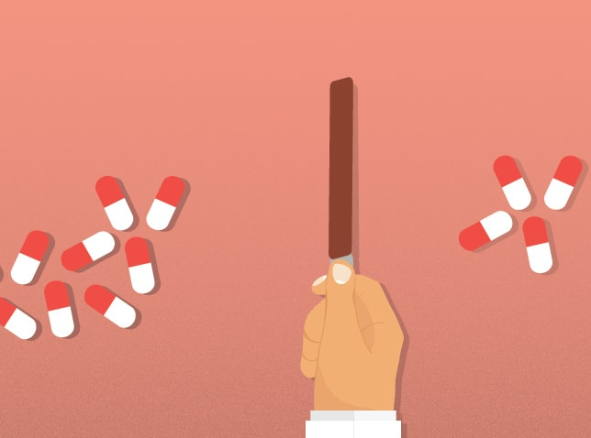
Accessibility
Importation from Canada
Public Production
Challenge Monopoly Power
Value-Based Contracting (Pay for Performance)
Notes:
Larger actions like wholesale importation and public production increase the supply and peoples assess to prescription medications.
Importation from Canada: Florida recently became the 4th state to pass a wholesale importation law (VT, CO, ME) and Governor DeSantis claims he has agreement with the Trump administration for federal approval. Michigan could follow and pass an importation law, but it would require final HHS approval.
Buying from a Canadian pharmacy could save Americans between 20 to 80 percent.
Senator Stabenow has been working on this issue for years and has federal legislation.
There are significant concerns about if Canada will allow these agreements and if the supply available in Canada could cover the demand in the US.
HB 5107 (Camilleri)
HB 4978/4979 (Brann)
SB 525 (Johnson)
Public Production: While the path to producing and selling insulin could take many years, openly developing and studying the idea could shift drug prices. If Michigan, or a public institution in Michigan, were to publicly produce drugs, they could be sold to Medicaid, other states, and on the private insurance market. Michigan would need to produce through a corporation, quasi-public corporation like the MEDC, or with a public university.
Challenge monopoly power (DHHS & MDOC recently partnered to do this for Hep C): One recent example of a state successfully challenging monopoly power is Louisiana. Louisiana’s Secretary of Health started publicly considering a request to the federal government to use patents on hepatitis C meds. Gilead, the manufacturer, came to the table and negotiated a pretty good deal for the public - the “Netflix” model, in which state pays a fixed amount for unlimited treatment.
The New York Times editorial team has endorsed the approach.
It can be done administratively and fairly quickly.
We could give it a try for insulin. The manufacturers are feeling immense pressure right now.
CMS encouraged other states to apply for approval to try subscription drug payment models for other expensive treatments. Such agreements can give states more certainty around their Medicaid budgets while ensuring drug makers a steady revenue stream.
It remains to be seen whether such a model can be extended to the expensive drugs that treat chronic illnesses and eat up much of states' Medicaid budgets, such as AIDS medications or anti-psychotics.
Value-Based Contracting – pay for performance: The executive budget recommendation included $5 M to transform how the state pays for health services to reward quality and positive outcomes as opposed to a procedure or pill. Medicaid could build off of this to 2.4 million Michiganders are Medicaid beneficiaries and the federal government recently approved a mechanism with the potential to improve the quality, value, and efficiency of drug-based treatments covered by the Michigan Medicaid program.
In November of 2018, Michigan became the second state – joining Oklahoma – to gain federal Centers for Medicare and Medicaid Services approval to move forward with negotiating contracts with drug manufacturers that are based on patient outcomes.
Under outcomes-based contract arrangements, drug manufacturers would be liable for increased supplemental rebate payments to the Medicaid program if the drug did not perform as claimed.
Outcome based contracts will make drug companies liable for higher payments to the state if a medication does not result in agree-upon patient outcomes.
Stakeholder Positions (in concept):
Support public production and importation: Consumer advocacy groups, people who can’t afford drugs
Oppose public production and importation: PhaRMa,
https://www.chrt.org/publication/rising-cost-of-specialty-drugs-in-michigan-and-the-united-states-a-case-example-for-multiple-sclerosis/

Slide 6
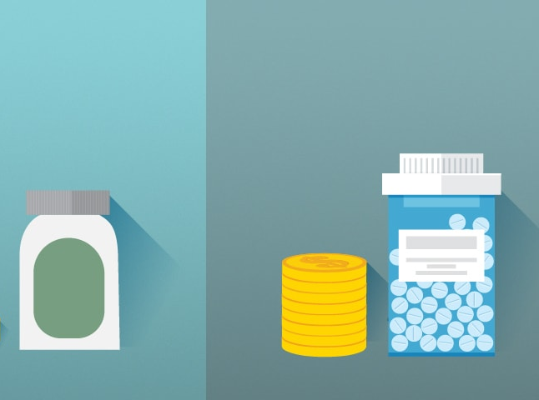
Affordability
Affordability Board
Cap Co-pay for Consumers
Rate Setting and Spending Targets
Prescription Drug Emergency Fund
Tax Drug Price Increases Greater Than The Rate of Inflation
Tax Credit for Insulin
Notes:
Affordability Board
An affordability board allows us to analyze the data and create price controls and price gouging prohibitions that will lower the cost of prescription drugs.
Co-Pay Caps
Legislation to limit the amount of out-of-pocket costs consumers are required to pay for prescription drugs DE, LA, MD, NJ, and Washington DC).
Legislation targets a $150 copay cap for ACA plans ($250 for higher deductible bronze plans).
Large coalitions are building for this approach. It often has health advocacy organizations serve as the public face and is pushed behind the scenes by Pfizer.
States have put limits on costs for specific drugs like insulin.
HB 4701 (Cambensy) caps cost-sharing for insulin at $100 per 30-day supply.
HB 4702 (Chirkun) requires an AG report on overpricing.
Rate Setting
Maryland and Maine recently established Prescription Drug Affordability Boards which regulate prescription drugs with targets and rate-setting like we regulate utilities. The boards identify drugs that pose an affordability challenge for the state and potentially impose an upper limit on payor reimbursements of a drug. The case for rate-setting, like utilities, is especially strong here: insulin is like water for people with type 1 diabetes, so it makes sense to regulate its price like water.
Maine’s board will set prescription drug spending targets for public entities including state, municipal, state university, and community college employees and teachers.
All entities are currently on their own plans with differing contracts and enrollment.
Can consider small businesses and individuals to buy into a public payer drug benefit.
The first report on drug spending targets is due in 2021.
Michigan could leverage additional purchasing power by pooling Michigan Medicaid pharmacy benefits with public employees, retirees, school and union plans to bulk purchase prescription drugs at a reduced cost.
Maryland’s board sets “allowable rates” for certain high-cost drugs with the legislature. In 2017, they prohibited price-gouging of generic drugs to take action against manufacturers whose price increases were “unjustified,” but the law was struck down.
Began as National Association of State Health Policy (NASHP) model legislation.
There is an alternative route of the stronger price-gouging statute that may stand up to legal challenge.
New York uses an aggregate upper payment limit for prescription drugs in Medicaid. Michigan Medicaid could set an aggregate ceiling for drug costs for FY21 that is the ten-year rolling average of the medical component of the consumer price index plus four percent, and minus a pharmacy savings target of $8 million gross.
This approach would give MSA additional authority and leverage to negotiate deeper discounts on certain high-cost drugs with the ultimate leverage of removing coverage.
This idea was proposed by DHHS for consideration in the FY’21 budget.
HB 5108 (Witwer) creates a ‘prescription drug consumer protection board’ to require drug manufacturers to justify increases for prescription drugs and impose penalties.
HB 5109 (Polehanki) strengthens the consumer protection law to protect citizens from being price gouged by drug manufacturers who charge consumers excessive prices for their medicine.
Prescription Drug Emergency Fund
To assist with out-of-pocket expenses related to purchasing prescription drugs not available by another funding source on a sliding scale, similar to the Children with Special Needs Fund. The fund could be financed through fines assessed for failing to file transparency reports, pharmacy benefit manager and pharmaceutical representative licenses, and other penalties.
Tax Drug Price Increases Greater than the Rate of Inflation: Private insurers and Medicaid require manufacturers to pay rebates on price increases greater than inflation. We could use this model to levy a similar tax on price increases.
The current sale price minus the inflation-adjusted initial price would be the taxable amount. The launch price of the drug could be the same baseline average manufacturer price included in the Medicaid inflation rebate calculation (updated monthly by Bureau of Labor Statistics).
The first sale of a drug within the state (manufacturer to a wholesaler or wholesaler to pharmacy) would be taxed and include a certificate of paid tax to pass down the supply chain.
Tax Credit for Insulin
The federal government allows all taxpayers to deduct the total qualified unreimbursed medical care expenses that exceed 7.5% of their adjusted gross income. Beginning in 2020, the amount increases to 10% of AGI.
We could develop a similar state tax credit to help people afford prescription drugs.
Stakeholder Positions (in concept):
Support Rate Setting: Meijer, Pharmacists, Health Plans that do not own PBMs,
Oppose Rate Setting: Hospitals, health systems and health plans believe that they get better deals now through their own bulk purchasing contracts. They also want control over the pharmacy benefit for care coordination. Most stakeholders are not opposed to additional bulk purchasing or rate setting for public plans. Unions, municipalities, and the state all have different contracts that would be difficult to align.

