Slide 1

Accessing BLRIS
User guide
(Bus and Limousine Regulatory Information System)
Step 1. Click MILOGIN website: https://milogintp.michigan.gov
Or cut and paste web address to your web browser

Slide 2
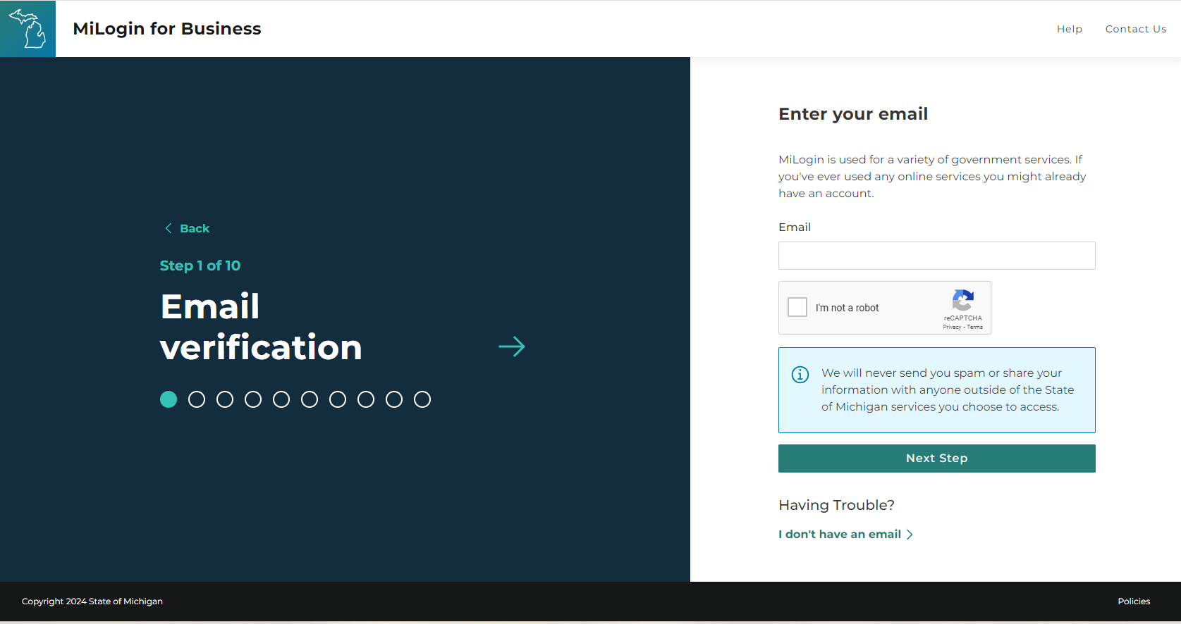
Accessing BLRIS - https://milogintp.michigan.gov
Step 1: Enter or cut and paste: https://milogintp.Michigan.gov to your web browser.
You will be directed to this screen.
Enter email
Check I am not a robot
Click Next Step

Slide 3
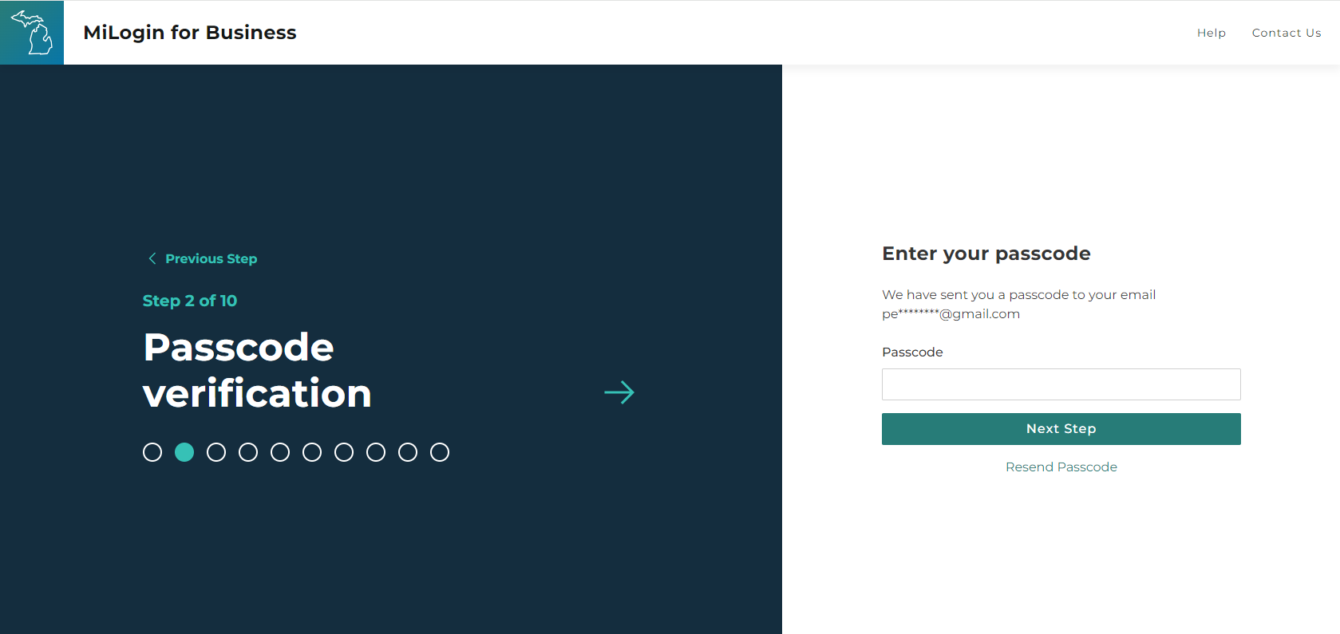
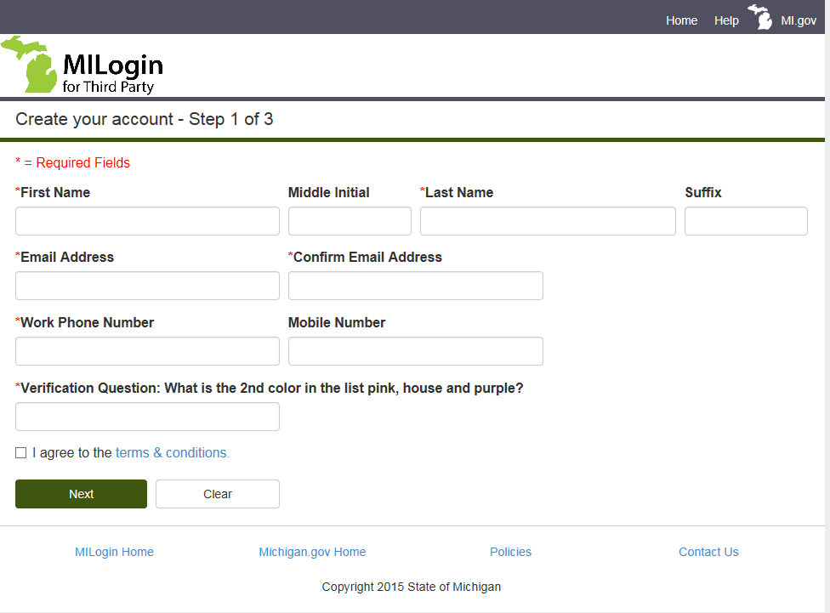
Accessing BLRIS
Enter passcode
Click Next Step

Slide 4
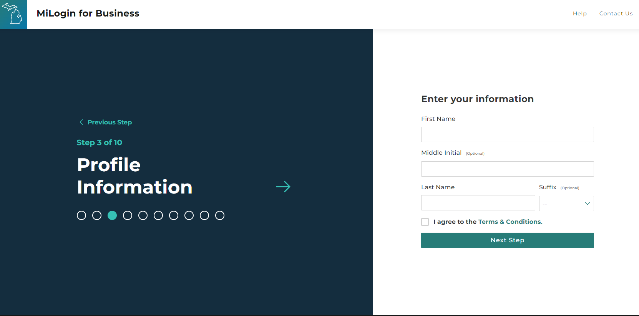
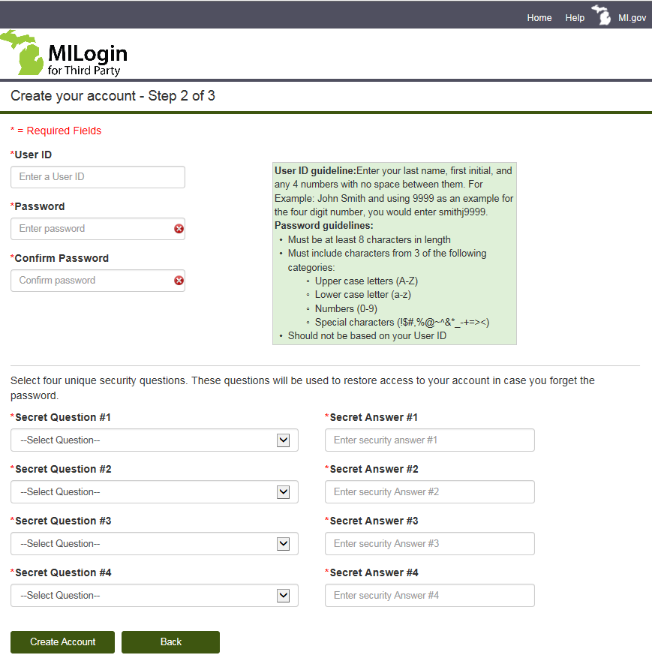
Accessing BLRIS
Enter First Name
Enter Last Name
Agree to the Terms and Conditions
Click Next Step

Slide 5
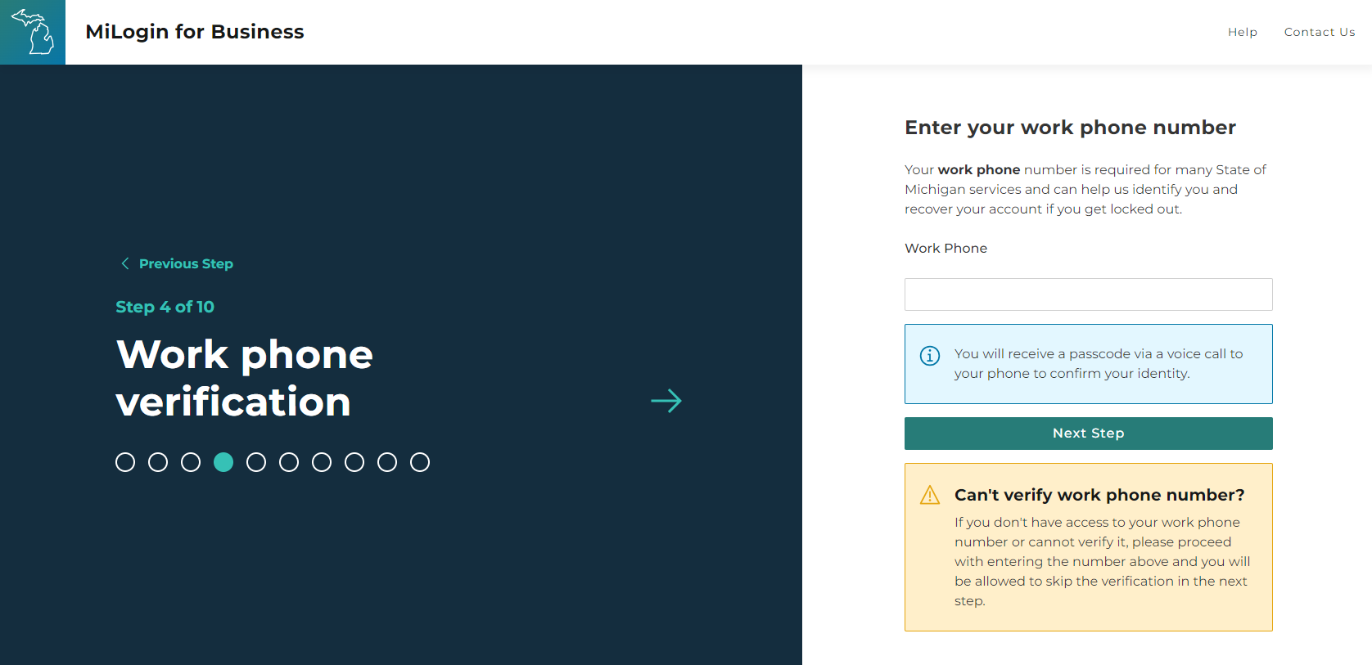
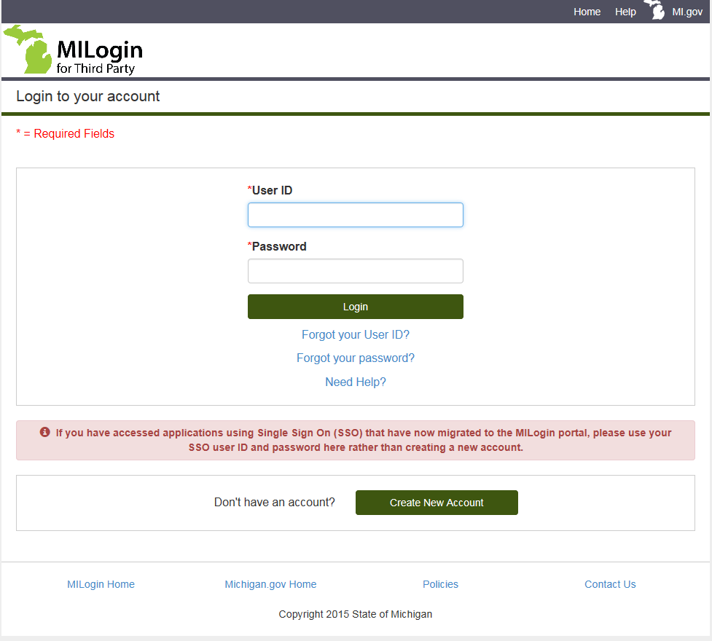
Accessing BLRIS
Enter your work phone
Click Next Step

Slide 6
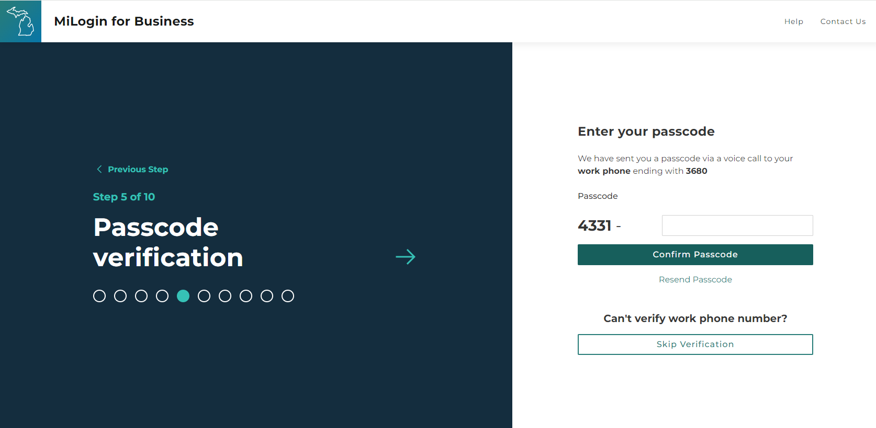
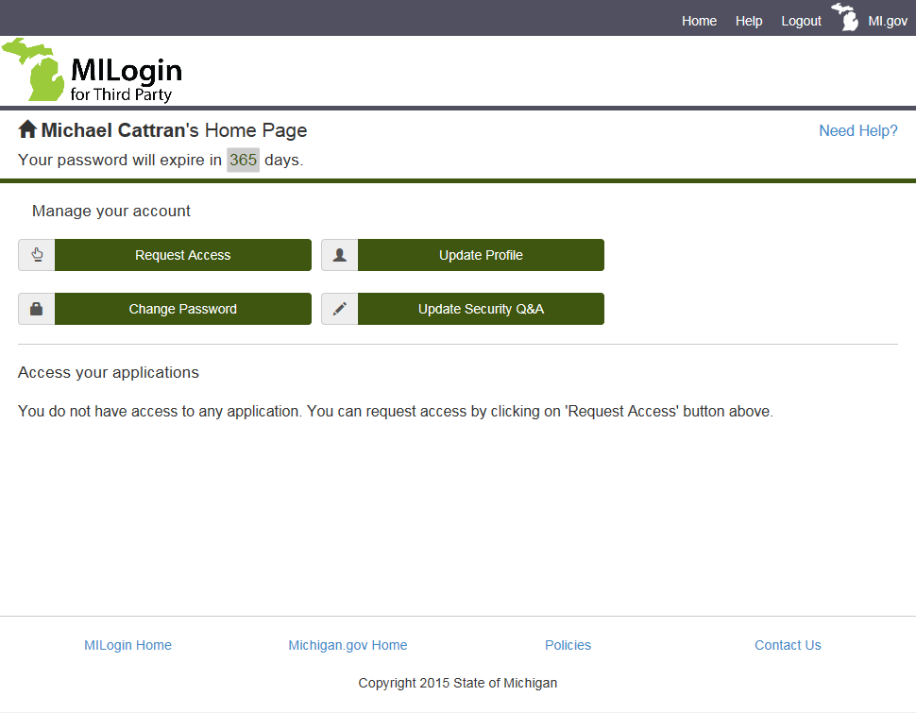
Accessing BLRIS
Enter Passcode
Confirm Passcode

Slide 7
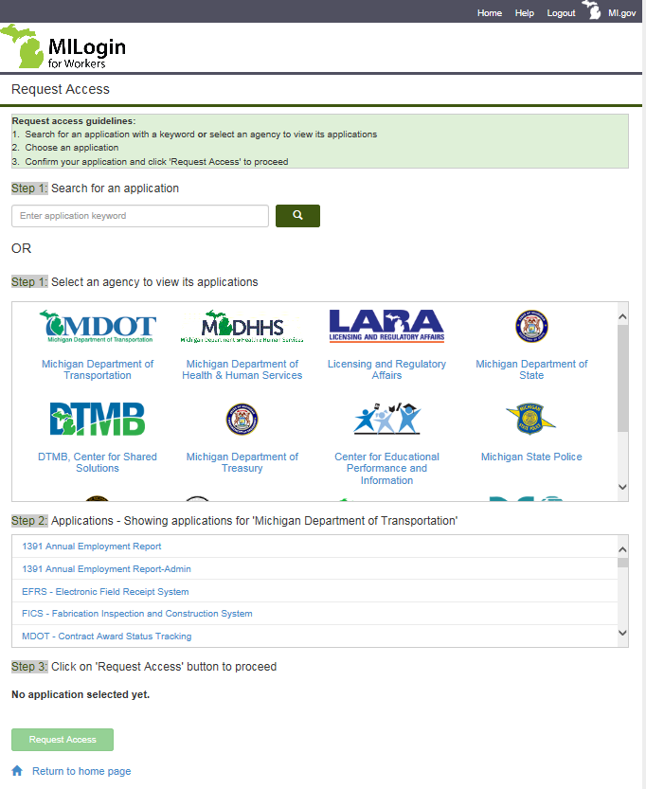
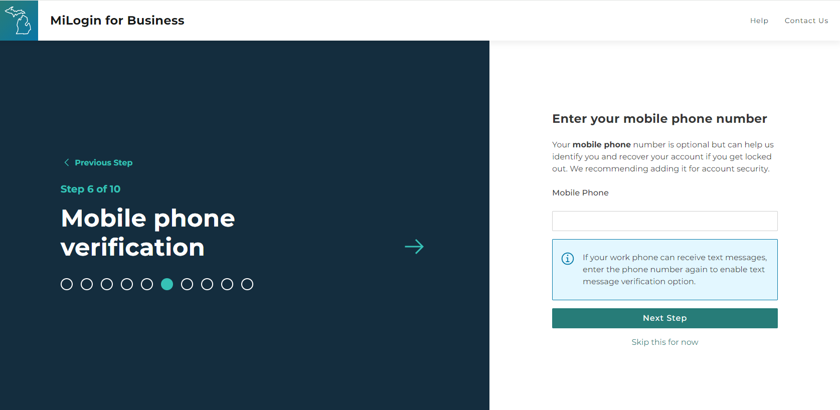
Accessing BLRIS
Enter Mobile Phone Number
Click Next Step

Slide 8
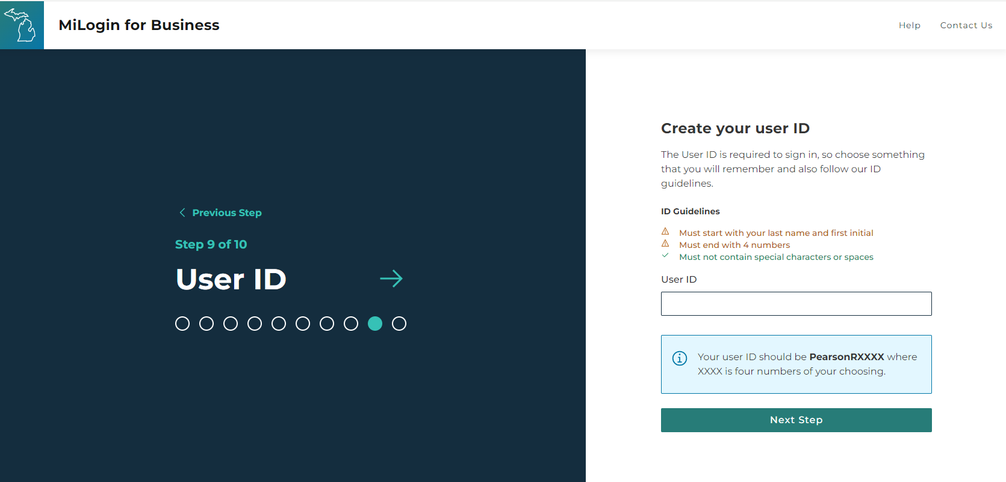
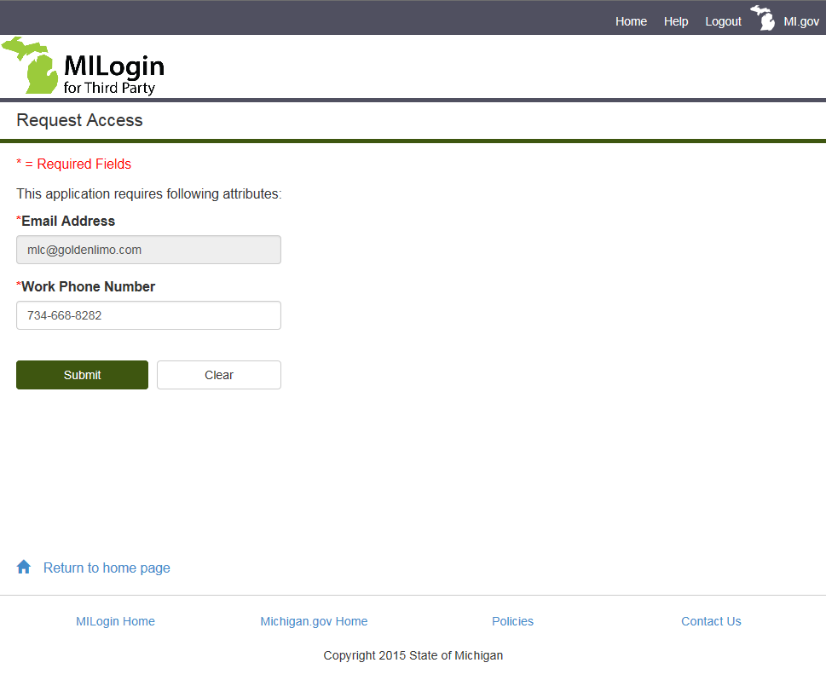
Accessing BLRIS
Create user ID
JohnDoe@yahoo.com
517-555-5555
Click Next Step

Slide 9
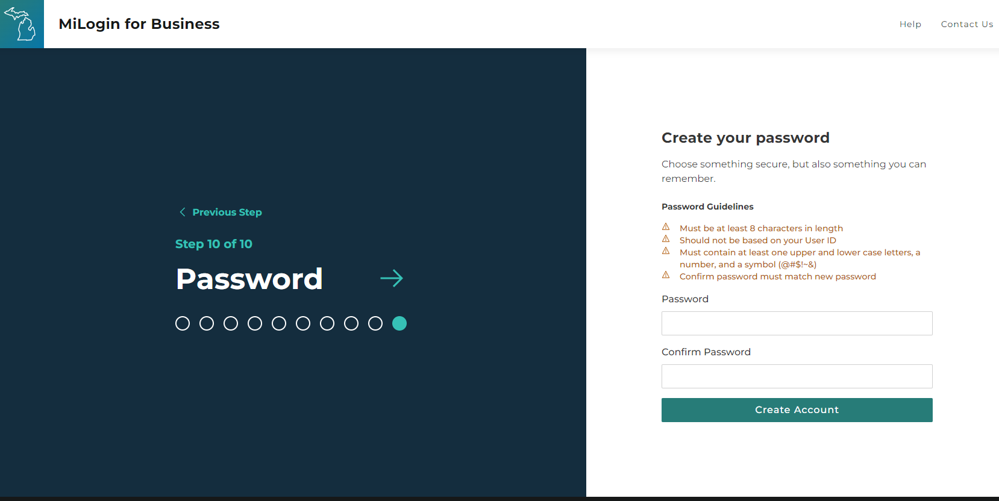
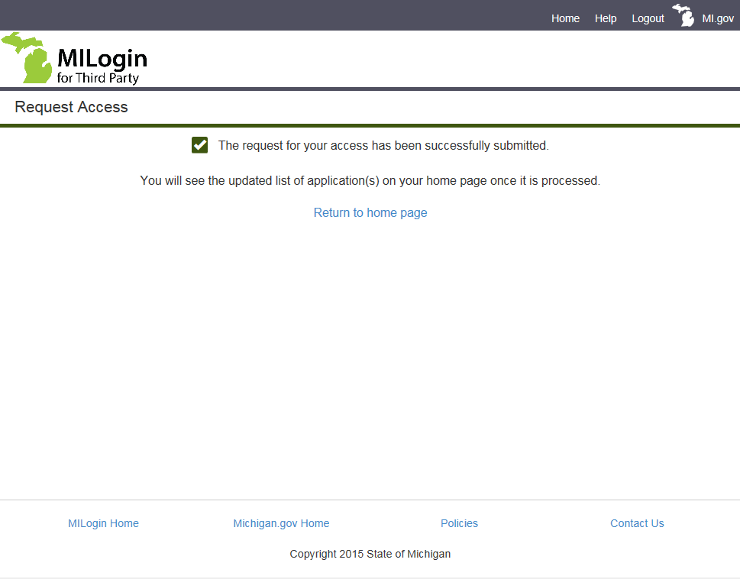
Accessing BLRIS
Create and Confirm password
Click Create Account

Slide 10
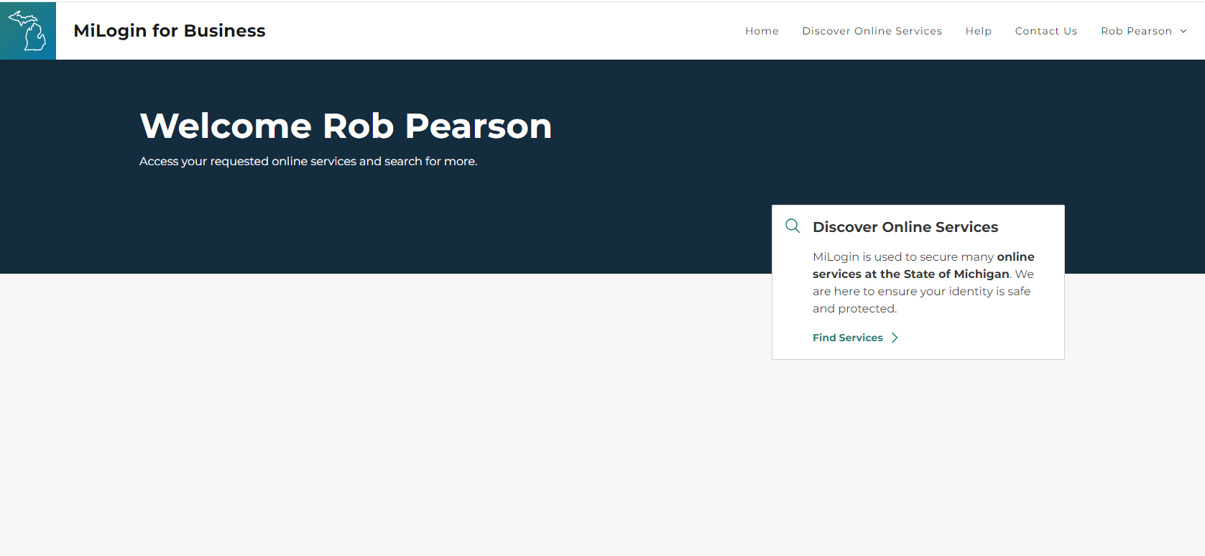
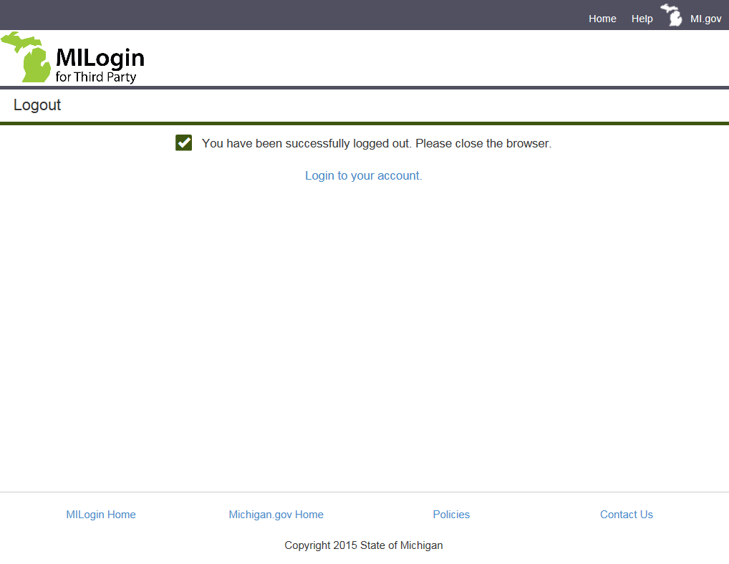
Accessing BLRIS
Select Find Services

Slide 11
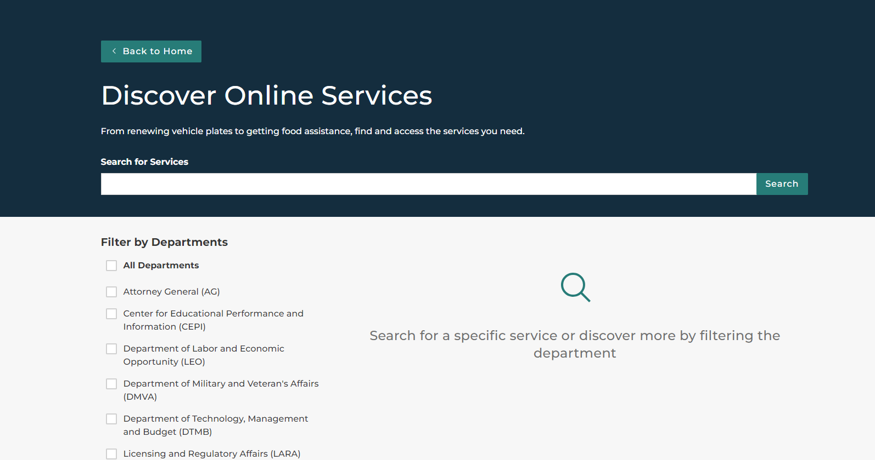
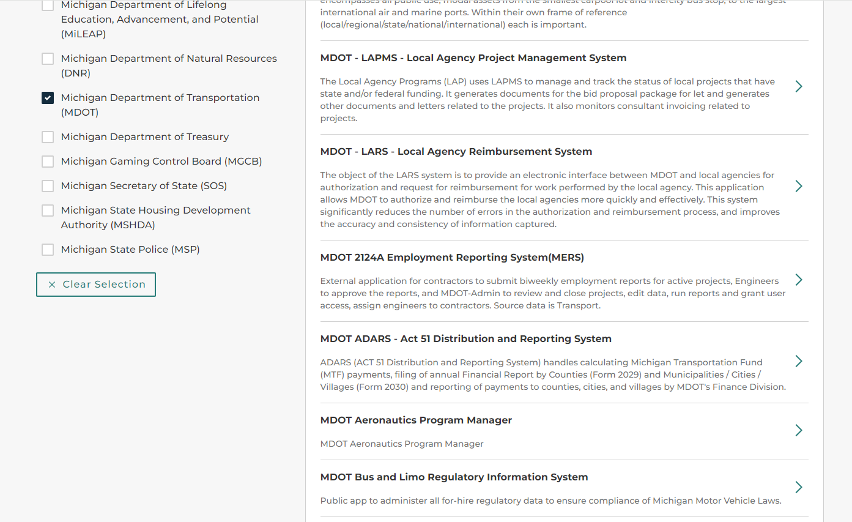
Accessing BLRIS
Check the MDOT box.
Click on MDOT Bus and Limo Regulatory Information System

Slide 12
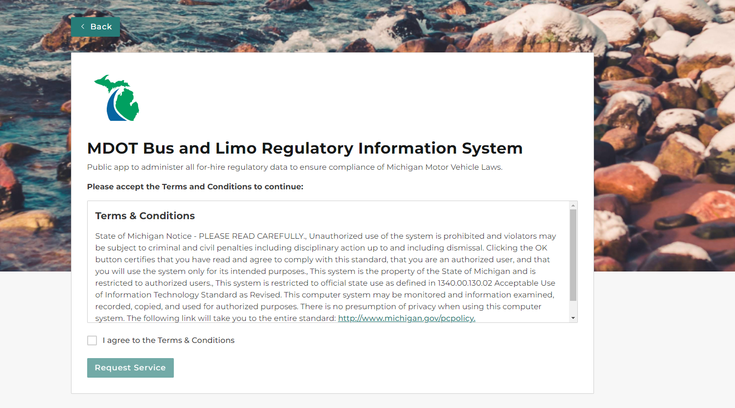
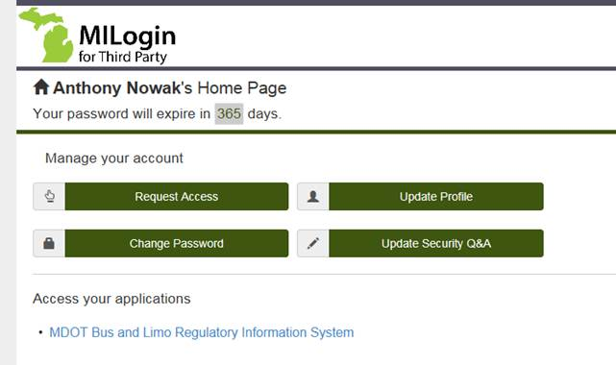
Accessing BLRIS
Check I agree to Terms & Conditions
Click Request Service

Slide 13
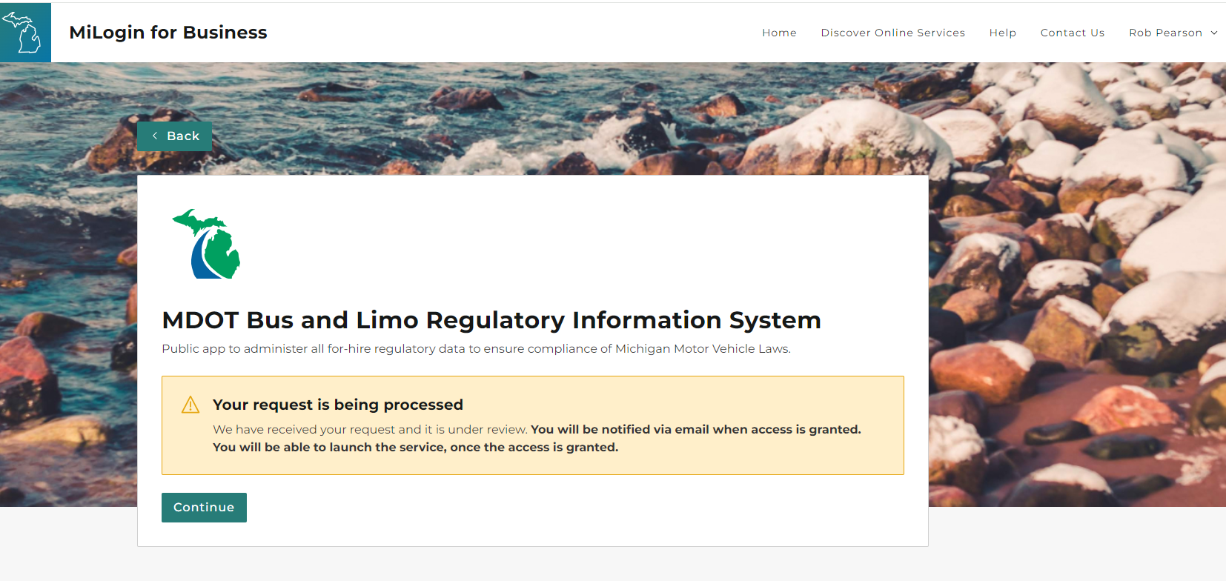
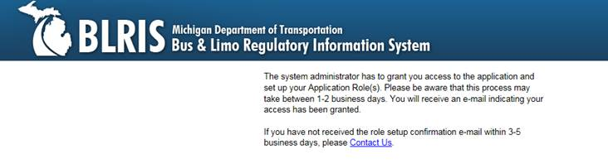
Accessing BLRIS
MDOT’s system administrator has been notified to grant your access to BLRIS.
Access should be granted or more information requested within 2 business days

Slide 14
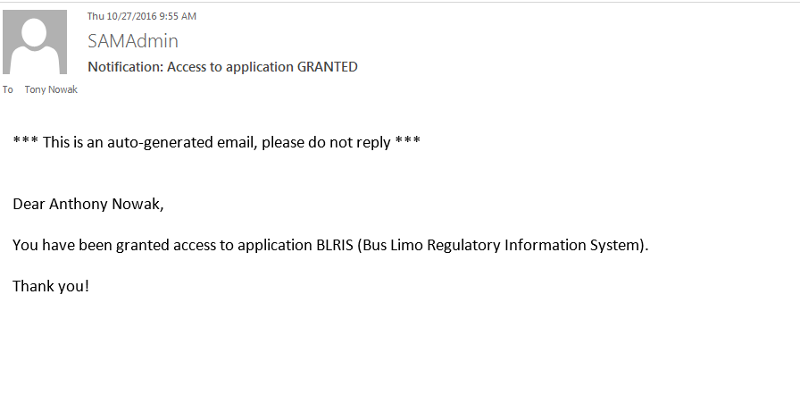
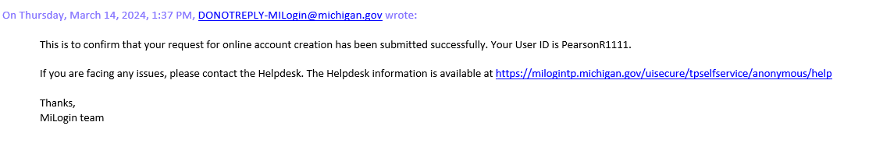

Accessing BLRIS – Access Request Email

