Slide 1
DETERMINING if A redistricting plan Complies with the Voting Rights Act
Dr. Lisa Handley

Slide 2
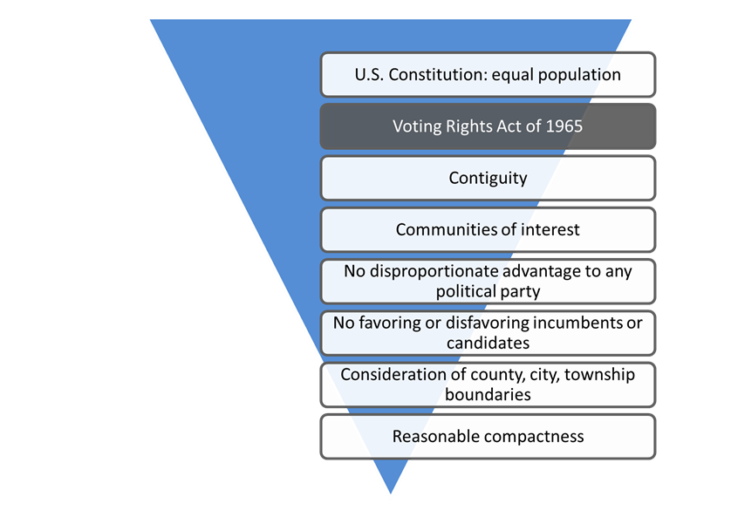
Redistricting Criteria Priority Pyramid: Voting Rights Act of 1965
Section 2 prohibits any voting standard, practice or procedure, including a redistricting plan, that results in the denial or dilution of minority voting strength.
All state and local jurisdictions are covered by Section 2 of the Voting Rights Act.

Slide 3
Redistricting Plans that Violate the Voting Rights Act
35%
35%
35%
35%
35%
Redistricting plans cannot:
crack, or
pack
a geographically concentrated minority community across districts or within a district in a manner that dilutes their voting strength.
Plan that cracks minority community across 5 districts
20%
15%
100%
20%
20%
Plan that packs minority community into single district

Slide 4
Thornburg v. Gingles: Three-Pronged Test
U.S. Supreme Court held that plaintiffs must satisfy three preconditions to qualify for relief under Section 2 of the Voting Rights Act:
  The minority group must be sufficiently large and geographically compact to form a majority in a single-member district
  The minority group must be politically cohesive
  Whites must vote as a bloc to usually defeat the minority-preferred candidates
A racial bloc voting analysis is used to ascertain whether minority voters are politically cohesive and if white voters bloc vote to usually defeat minority-preferred candidates.

Slide 5
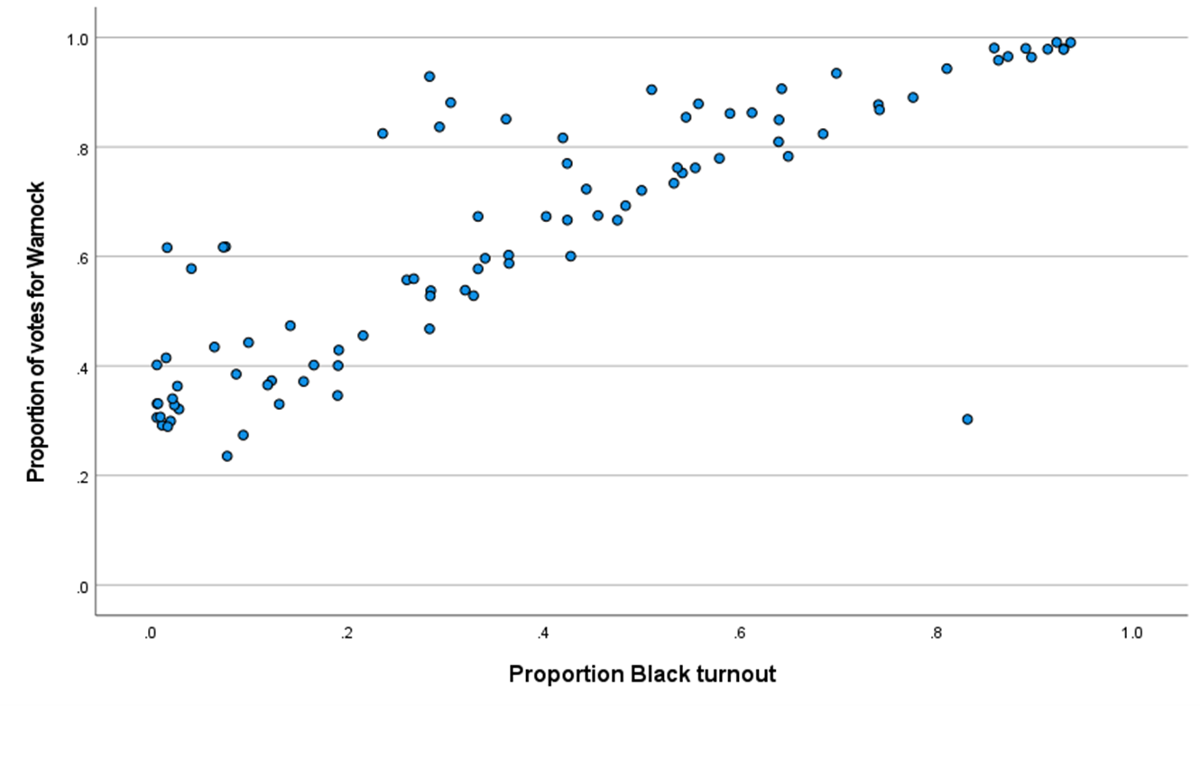
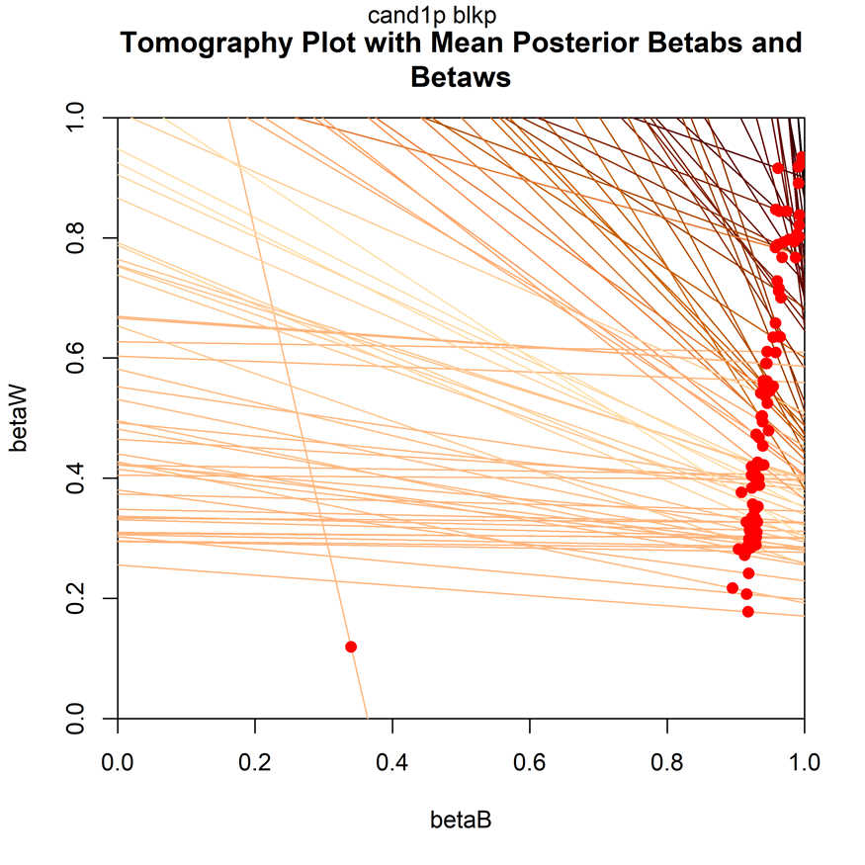
Analyzing Voting Behavior by Race
Two standard statistical techniques for estimating voting patterns of minority and white voters:
  Ecological regression analysis (ER)
  Ecological inference analysis (EI)

Slide 6
Area-Specific Analyses
Wayne
Oakland
Genesee
Saginaw

Slide 7
Elections Analyzed to Date
All federal and statewide general election contests, 2012-2020.
  Four election contests included minority candidates:
    2012 U.S. President (Barack Obama)
    2014 Secretary of State (Godfrey Dillard)
    2018 U.S. Senate (John James)
    2020 U.S. Senate (John James)
  Two contests included minority candidates as running mates
    2018 Governor (Gretchen Whitmer/Garlin Gilchrist)
    2020 U.S. President (Joseph Biden/Kamala Harris)
Only Democratic primary for statewide office this past decade: 2018 race for governor

Slide 8
Example of RBV Results: 2018 General and Democratic Primary for Governor
votes for office = percentage of voting age population who turned out and cast a vote for the office
HP = vote percentages from homogeneous precincts
ER = estimates derived from ecological regression analysis
EI 2x2 = estimates derived from standard EI (as developed by Prof. Gary King)
EI RxC = estimates derived from EI technique that takes into account differences in participation by race

Slide 9
Number of Racially Polarized Elections
 | General Elections with Minority Candidates | All Statewide General Election Contests | Statewide Democratic Primary
Statewide | 6/6 | 12/13 | 1/1
Genesee | 5/6 | 9/13 | 1/1
Saginaw | 6/6 | 11/13 | 1/1
Oakland | 6/6 | 13/13 | 0/1
Wayne | 3/6 | 7/13 | 1/1
Number of polarized contests / total number of contests

Slide 10
Complying with the Voting Rights Act
If, based on the racial bloc voting (RBV) analysis, it is determined voting is racially polarized, and candidates preferred by a politically cohesive minority group are usually defeated by white voters not supporting these candidates, a district(s) that offers minority voters an opportunity to elect their candidates of choice must be drawn.
If such districts already exist, and minority-preferred candidates are winning only because these districts exist, then these minority districts must be maintained in a manner that continues to provide minority voters with an opportunity to elect their preferred candidates.

Slide 11
Drawing Minority Opportunity Districts
Line drawers cannot simply set an arbitrary demographic target (e.g., 50% black voting age population) for all minority districts across the jurisdiction (Alabama Legislative Black Caucus v. Alabama, 2015).
A district-specific, functional analysis is required to determine if a proposed district will provide minority voters with the ability to elect minority-preferred candidates to office.

Slide 12
District-specific, Function Approaches
Estimates of participation rates, minority cohesion and white crossover voting for minority-preferred candidates derived from the RBV analysis can be used to calculate the percent minority population needed in a specific area for minority-preferred candidates to win a district in that area.
Election results from previous contests that included minority-preferred candidates (“bellwether elections” as identified by the RBV analysis) can be recompiled to reflect the boundaries of the proposed district to determine if minority-preferred candidates would consistently carry this proposed district.

Slide 13
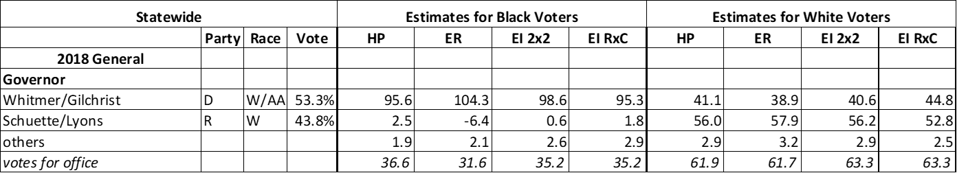

Slide 18
Threshold of Representation: State Senate
All districts over 48% Black elect minority candidates
67% of districts over 35% Black elect minority candidates
No state senate districts between 36 and 45% Black

Slide 19
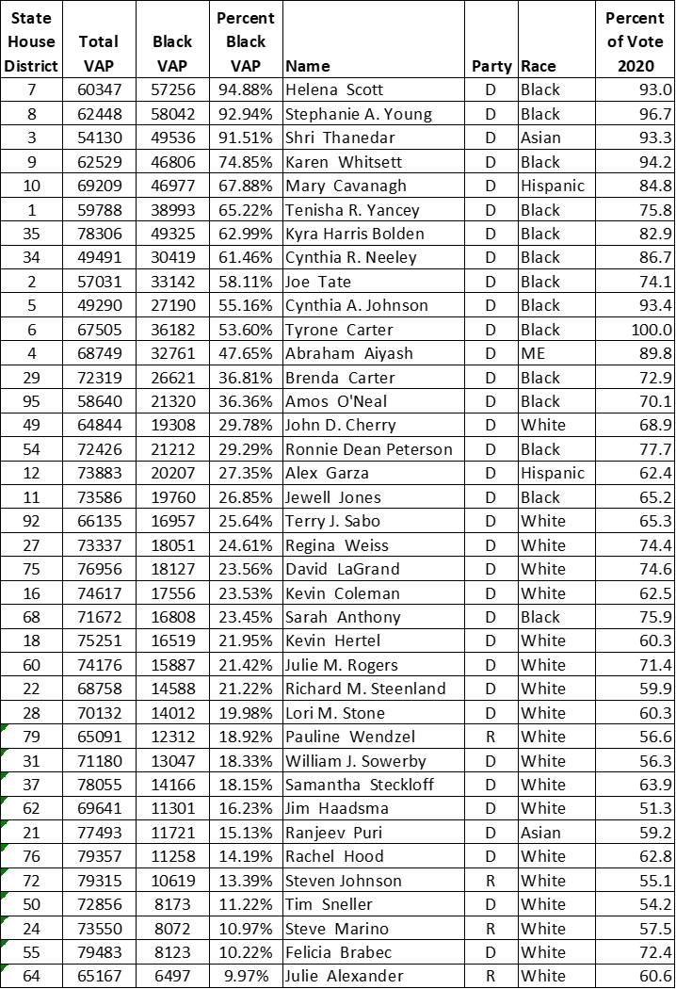
Threshold of Representation: State House
All districts over 36% Black elect minority candidates
89% of districts over 25% Black elect minority candidates
No state house districts between 37 and 47% Black

Slide 20
