Slide 1
Partisan Fairness Measures: Possible Unacceptable Scores
Dr. Lisa Handley

Slide 2
Ohio A. Philip Randolph Institute v. Householder
Ohio challenge to 2011 congressional plan
Year | Efficiency Gap
2012 | 22.4 R
2014 | 9.0 R
2016 | 8.7 R
2018 | 20.0 R
Year | Mean Median
2012 | 7.8 R
2014
2016
2018 | 5.0 R

Slide 3
League of Women Voters of Pennsylvania v. Commonwealth of Pennsylvania
Pennsylvania challenge to congressional plan
Year | Votes/Seats for Democrats
2012 | 50.8% / 27.8%
2014 | 44.5% / 27.8%
2016 | 45.9% / 27.8%
Year | Mean Median
2012-2016 | 5.9 R
Year | Efficiency Gap
2012 | 24 R
2014 | 15 R
2016 | 19 R

Slide 4
Whitford v. Gill
Wisconsin challenge to state assembly plan
Year | Votes/Seats for Democrats
2012 | 51.4% /39.4%
2014 | 48.0% /39.4%
Year | Efficiency Gap
2012 | 13.3 R
2014 | 10.0 R

Slide 5
League of Women Voters of Michigan v. Benson
Michigan challenge to all 3 redistricting plans
Efficiency Gap | Efficiency Gap
Year | Congress | State Senate | State House
2012 | 19.7 R |  | 12.3 R
2014 | 16 R | 20.0 R
2016 | 13 R
Year | Mean Median Difference
Congress | 7.7 R
State Senate | 6.1 R
State House | 6.9 R

Slide 6
Partisan Fairness Scores on Current Plans Using Composite Index
Measure | Congress | State Senate | State House
Votes / Seats | 52.3 / 35.7 | 52.3 / 44.7 | 52.3 / 45.5
Efficiency Gap | 21.2 | 10.9 | 11.6
Mean Median Difference | 5.5 | 5.1 | 6.1
Lopsided Margin | 13.1 | 8.6 | 10.1

Slide 7
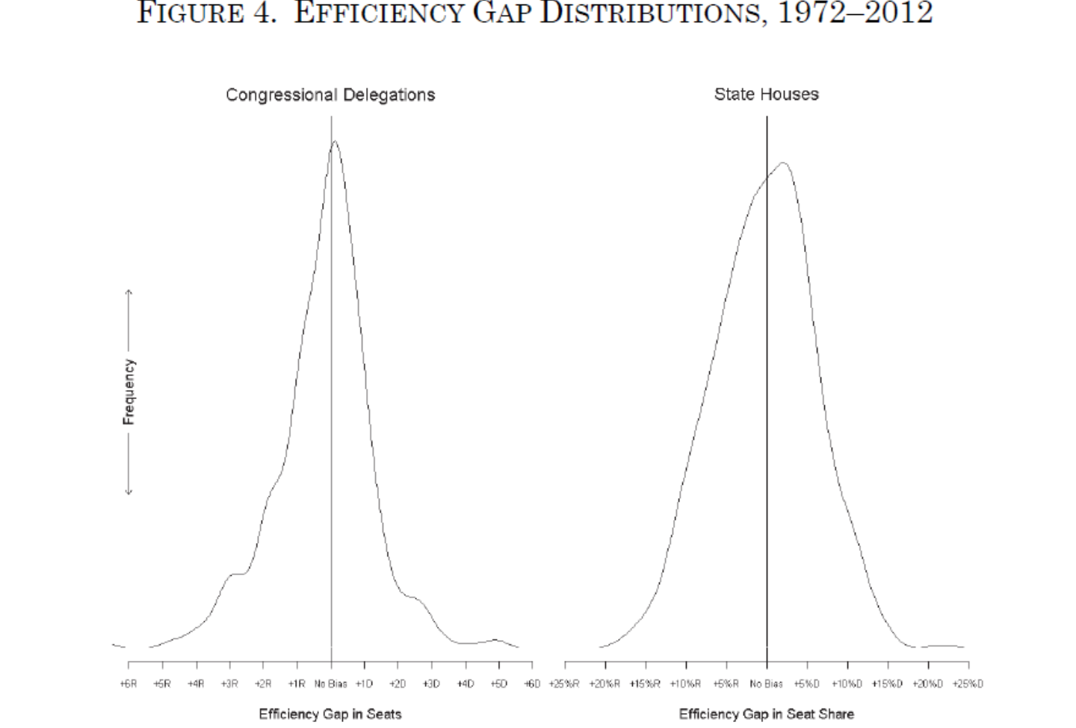
Efficiency Gap
Stephanopoulos and McGhee – argue for 8% threshold above which legislative plans should be considered presumptively unconstitutional
Simon Jackman – testified that 7% or higher should be considered legally significant (at least in part because over 95% of plans with an EG greater than 7% in the first year will favor the party benefiting from the EG for the remainder of the decade)

