Slide 1
Energy Waste Reduction (EWR)
Low Income
Jason Kupser
Manager – Residential / Education Awareness EWR
January 24, 2019

Slide 2
Executive Summary
EWR Low Income portfolio contains four programs delivering various energy savings measures:
  Energy Efficiency Assistance – high impact savings measures for single family homes
  Low Income Multifamily – simple and high impact savings measures for multifamily buildings and units
  Low Income Home Energy Consultation – simple savings measures for single family homes
  Low Income Home Energy Reports – behavioral treatment via neighbor comparison reports
DTE Energy’s Energy Waste Reduction (EWR) Low Income program has grown from $12 million per year to $18.7 million in 2018 and $22.4 million in 2019. A portion of the EWR performance incentive mechanism is tied to the spend of EWR Low Income budgets. Some of the budget increase is part of the EWR 2018-19 plan settlement.
American Council for an Energy-Efficient Economy (ACEEE) benchmarking placed DTE Energy’s EWR Electric Low Income program 9th largest nationally based on spend. No gas data available.
Low Income programs are expensive. For electric, it costs 4 to 5 times more than residential and commercial and industrial (C&I) programs. For gas, it costs 2 to 4 times more than residential and C&I programs. This is because the entire cost of the energy savings measure (often including installation) is funded through the program.

Slide 3
Agenda
Low Income EWR Portfolio and Benchmarking
Low Income Programs
  Energy Efficiency Assistance Program
  Low Income Multifamily Program
  Low Income Home Energy Consultation Program
  Low Income Home Energy Reports Program

Slide 4
EWR Low Income Portfolio
The program’s objective is to reduce the energy use of Low Income customers through improvements to their existing home at no cost to them.
Low Income program qualifications: Customers with a household income at or below 200% of the Federal Poverty Limit, or reside within a HUD census tract, or reside in a section 8 or other subsidized multifamily building
Low Income programs are expensive because the entire cost of the energy savings measure (often including installation) is funded through the program.
  Electric costs 4 to 5 times more than residential and C&I programs.
  Gas costs 2 to 4 times more than residential and C&I programs.
The revenue requirement for EWR Low Income programs is spread across all customers and customer classes. It is a portion of the distribution surcharge. For electric, it is applied volumetrically to residential customers and per meter for secondary and primary customers, and for gas applied volumetrically to all customer classes. Low Income portion of the surcharge is applied regardless of choice or EWR self-direct status.
The Energy Efficiency Assistance program is managed by Solutions for Energy Efficient Logistics L.L.C. (SEEL) and the Home Energy Consultation and Multifamily Low Income programs are managed by Walker-Miller Services.

Slide 5
Historical and Projected EWR Low Income Spend
Data Source: various DTE Energy historical EO and EWR filings, EWR plan filings and settlements (cases U-16289; U-16358; U-16290; U-16359; U-16737; U-16751; U-17282; U-17288; U-17602; U-17608; U-17832; U-17841; U-18023; U-18024; U-18332; U-18338; U-20029; U-20035; U-18262; U-18268)

Slide 6
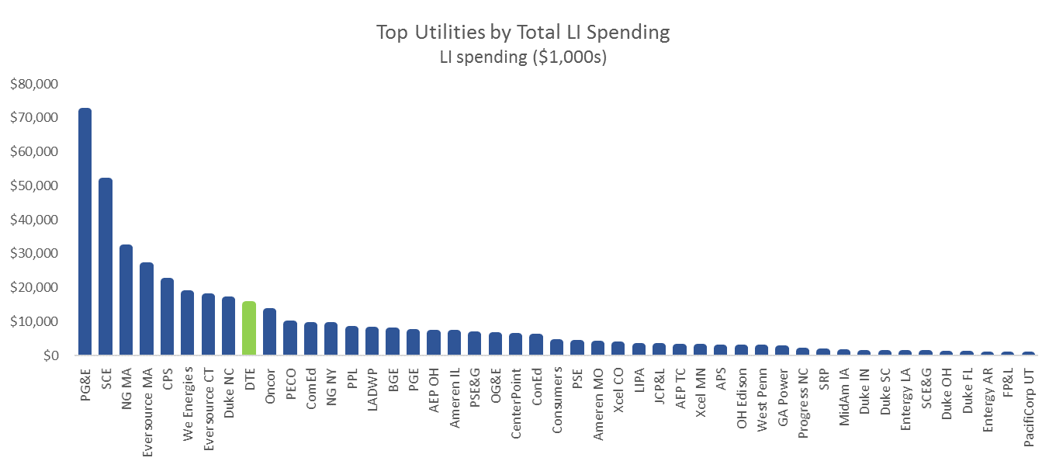
Benchmarking - ACEEE Top Utilities by Total Low Income Spending ($1,000s)
DTE Energy Electric was ranked 9th nationally and the increased spend moves DTE closer to the 6th position
Data Source: 2017 ACEEE Utility Scorecard
DTE Energy ranks 12th in total spend on energy efficiency programs and Consumers Energy ranks 15th

Slide 7
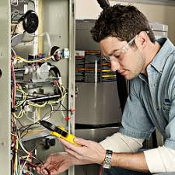
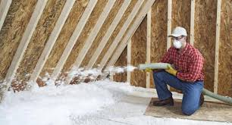
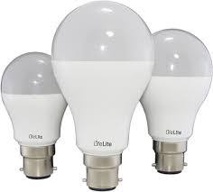
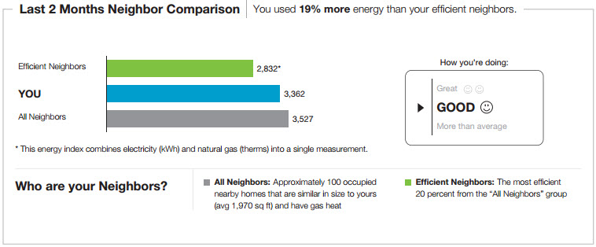
Energy Savings measures Provided in EWR Low Income Portfolio
  Energy Efficiency Assistance
  HVAC tune-ups and replacements
  Water heater replacement
  Air sealing and insulation
  Refrigerator
  Programable thermostats
  LED lights
  Pipe wrap
  Efficient showerheads
  Faucet aerators
  Low Income Multifamily
  HVAC tune-ups and replacements
  Water heater replacement
  Air sealing and Insulation
  Refrigerator
  Programable thermostats
  LED lights
  Pipe wrap
  Efficient showerheads
  Faucet aerators
  Low Income Home Energy Consultation
  LED light bulbs
  LED nightlights
  Pipe wrap
  Programable and smart thermostats
  Efficient showerheads
  Faucet aerators
  Low Income Home Energy Reports
  Paper Home Energy Reports
  Email Home Energy Reports

Slide 8
EWR Electric Residential and Low Income Portfolio
Data Source: DTE Energy EWR plan filings and settlements, case U-18262

Slide 9
EWR Gas Residential and Low Income Portfolio
Data Source: DTE Energy EWR plan filings and settlements, case U-18268

Slide 10
Agenda
Low Income EWR Portfolio and Benchmarking
Low Income Programs
  Energy Efficiency Assistance Program
  Low Income Multifamily Program
  Low Income Home Energy Consultation Program
  Low Income Home Energy Reports Program

Slide 11
Energy Efficiency Assistance (EEA) Program
  Energy Efficiency Assistance
  HVAC tune-ups and replacements
  Water heater replacement
  Air sealing and insulation
  Refrigerator
  Programable thermostats
  LED lights
  Pipe wrap
  Efficient showerheads
  Faucet aerators
Energy Efficiency Assistance – high impact energy savings measures for single family homes
EEA program serves 5000 – 6000 Low Income customers annually
As part of the EWR 2018-19 plan filing settlement, the EEA program is expanding its program offerings, resulting in an increase in spending by an additional $5 million over the original plan for the two years. Comprehensive energy efficiency home upgrades are targeted at customers in arrears and high energy use, partnering with THAW and Revenue Management & Protection to fully leverage all available customer assistance.
The EEA program is delivered through partnerships with Community Action Agencies and Non-Profit Agencies such as Wayne Metro, OLSA and Habitat For Humanity among many others.

Slide 12
Low Income Multifamily Program
Low Income Multifamily – simple and high impact energy savings measures for multifamily buildings and units
Low Income Multifamily serves over 6000 customers
As part of the EWR 2018-19 plan filing settlement, the Multifamily program is expanding its program offerings, resulting in an increase in spending by an additional $3.25 million over the original plan for the two years.
New program offerings will include:
  Much more expensive and impactful energy savings measures installed into the units
  Concierge full service for property owners:
    Audits and contractor estimates
    Finding financing
    Very attractive rebate incentives for energy efficiency upgrades in multifamily common areas
  Low Income Multifamily
  HVAC tune-ups and replacements
  Water heater replacement
  Air sealing and Insulation
  Refrigerator
  Programable thermostats
  LED lights
  Pipe wrap
  Efficient showerheads
  Faucet aerators

Slide 13
Low Income Home Energy Consultation (HEC) Program
Low Income Home Energy Consultation – simple energy savings measures for single family homes
Low Income HEC serves over 7000 customers
HEC program offerings are part of the outreach efforts at all Community Assistance Days (CADs), many foodbanks, community action agencies, multiple faith-based partnerships, community groups and neighborhood organizations.
  Low Income Home Energy Consultation
  LED light bulbs
  LED nightlights
  Pipe wrap
  Programable and smart thermostats
  Efficient showerheads
  Faucet aerators

Slide 14
Low Income Home Energy Reports (HERs) Program
  Low Income Home Energy Reports
  Paper Home Energy Reports
  Email Home Energy Reports
Low Income Home Energy Reports – behavioral treatment via neighbor comparison reports
The report provides a neighbor comparison along with energy efficiently behavior change recommendations and EWR program participation recommendations. The HER uses “social norming” via the neighbor comparison to cause the behavior modification.
HER has the most cost-effective energy savings measure in Low Income portfolio
Low Income HER serves about 182,000 customers

Slide 15
Questions?
Jason Kupser
DTE Energy
Manager – Residential / Education Awareness EWR
Office: 313-235-7062
Email: jason.kupser@dteenergy.com

