Slide 1




Thriving Cities

Slide 2
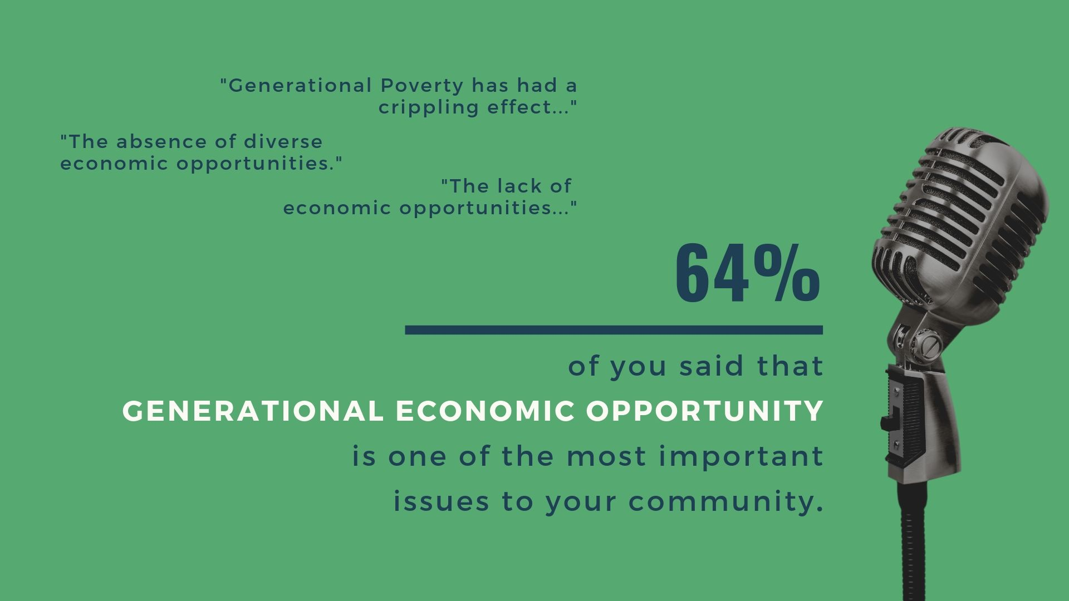
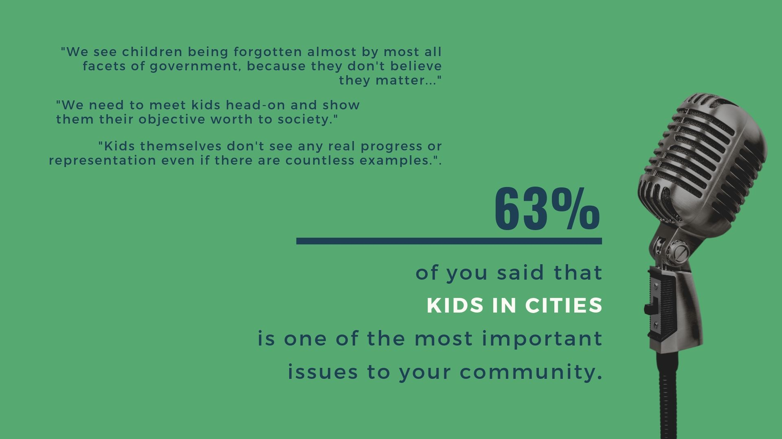
Cities SUrvey

Slide 3


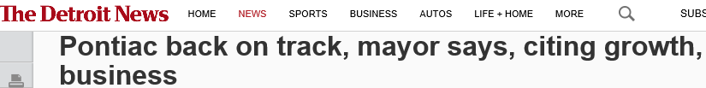
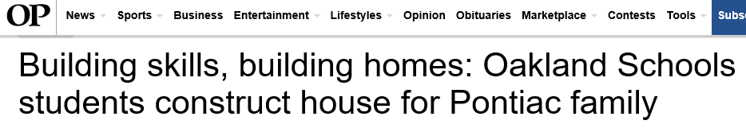

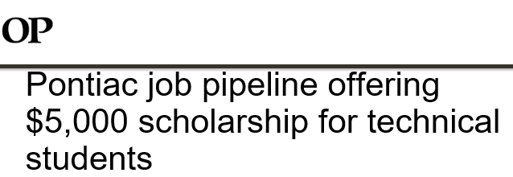
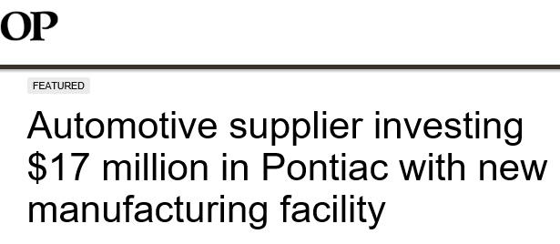
Opportunities in cities

Slide 4
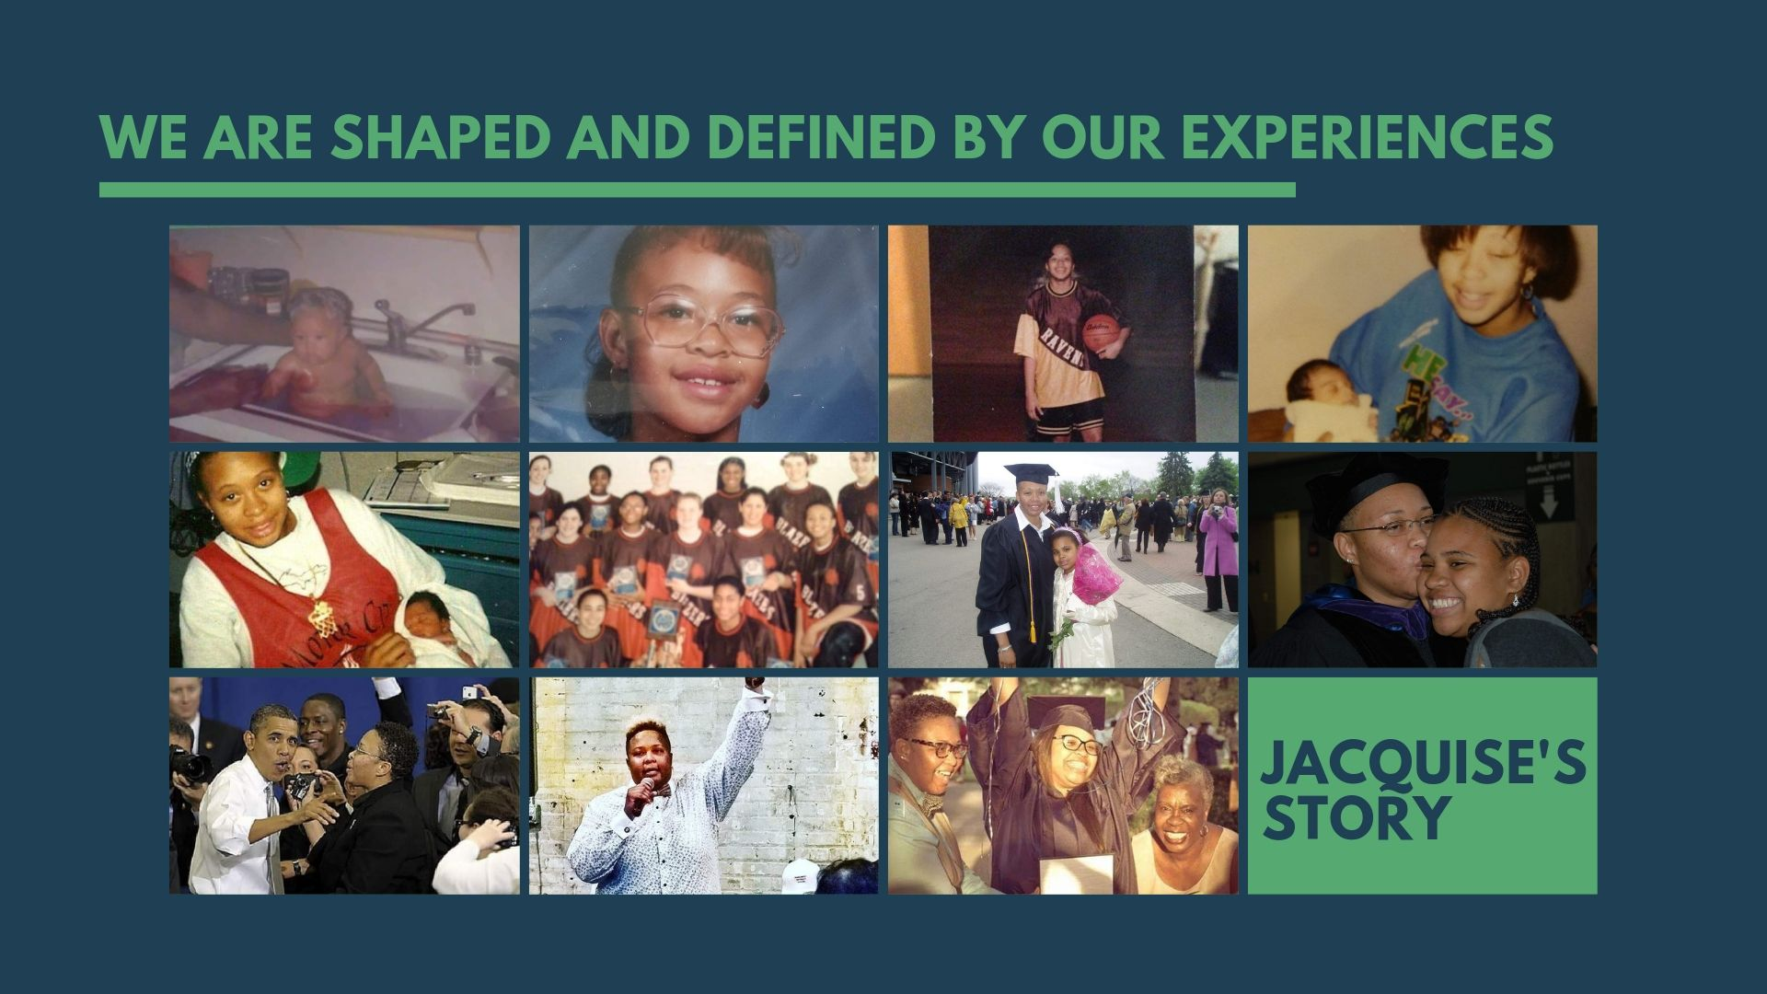

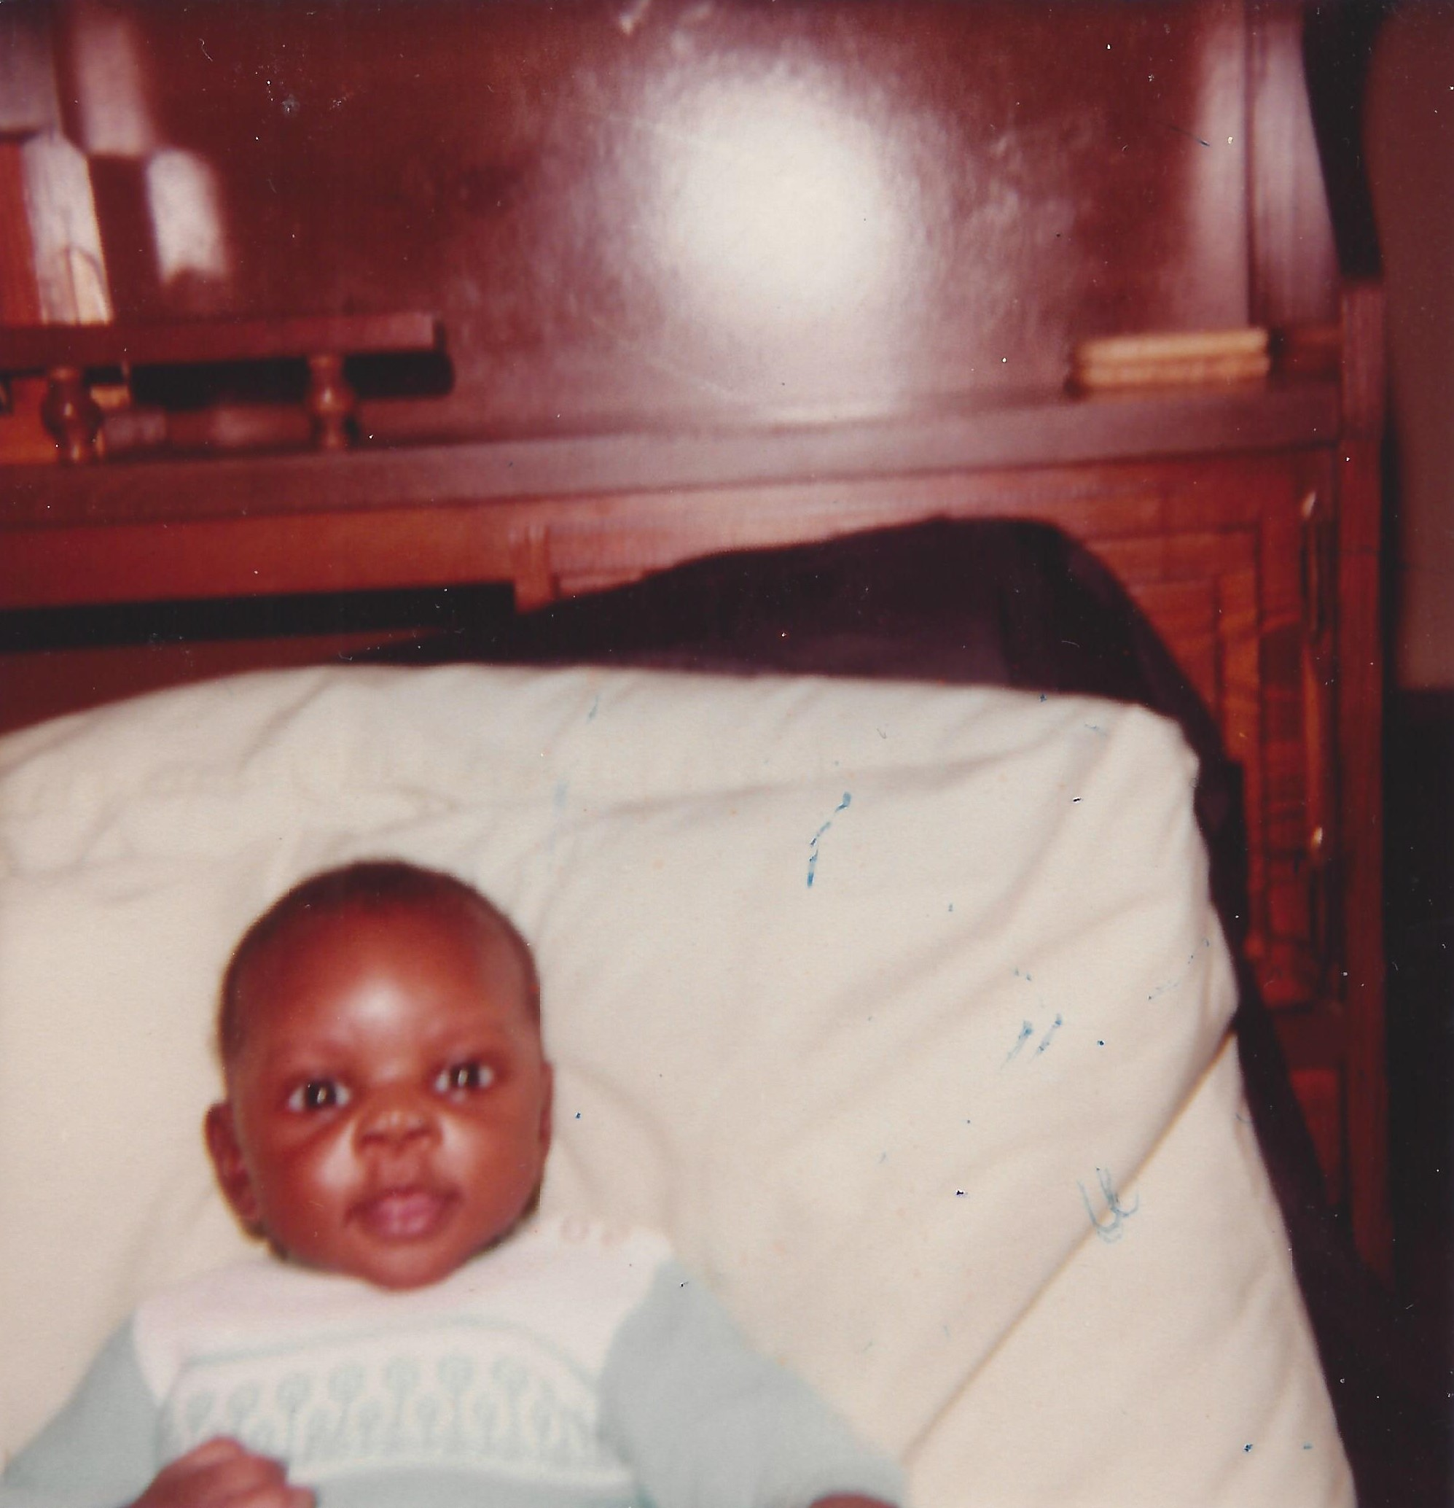
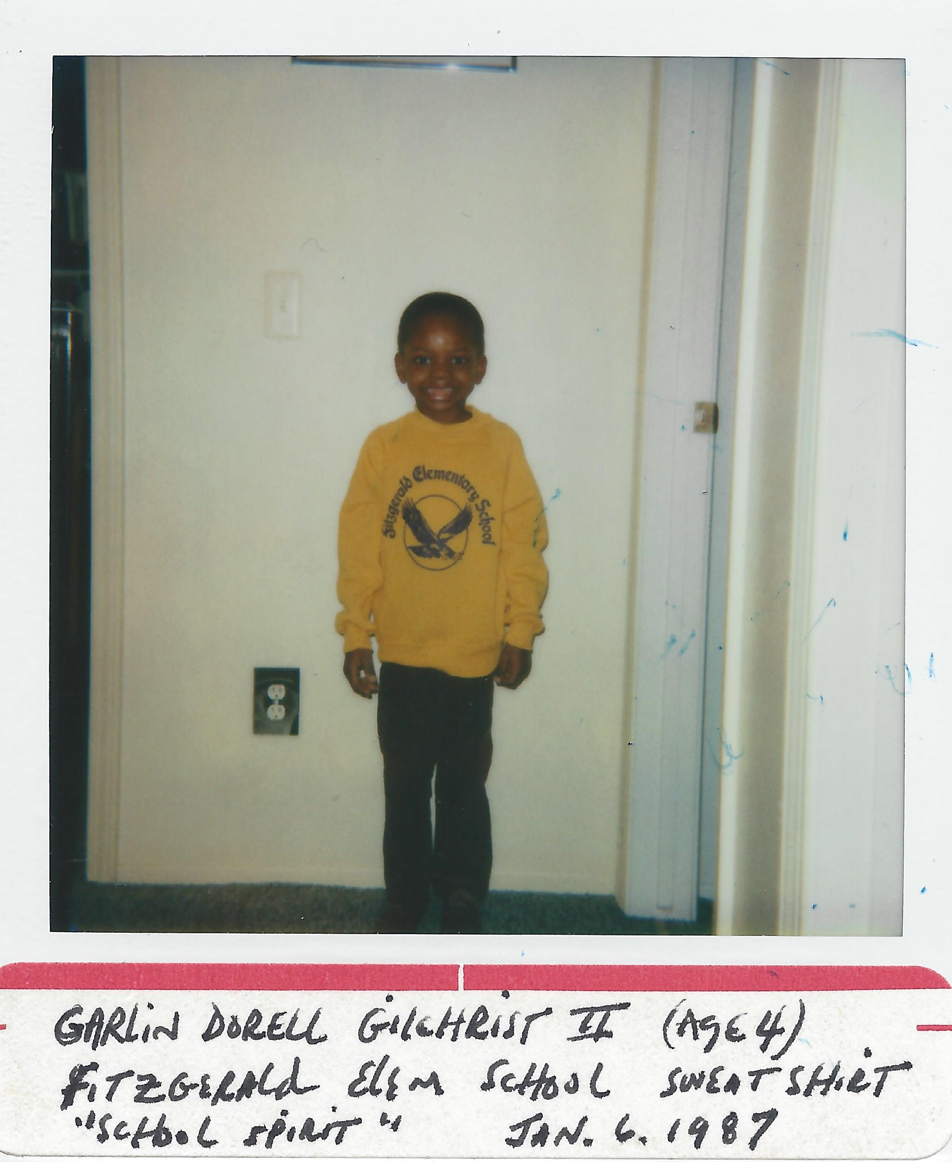
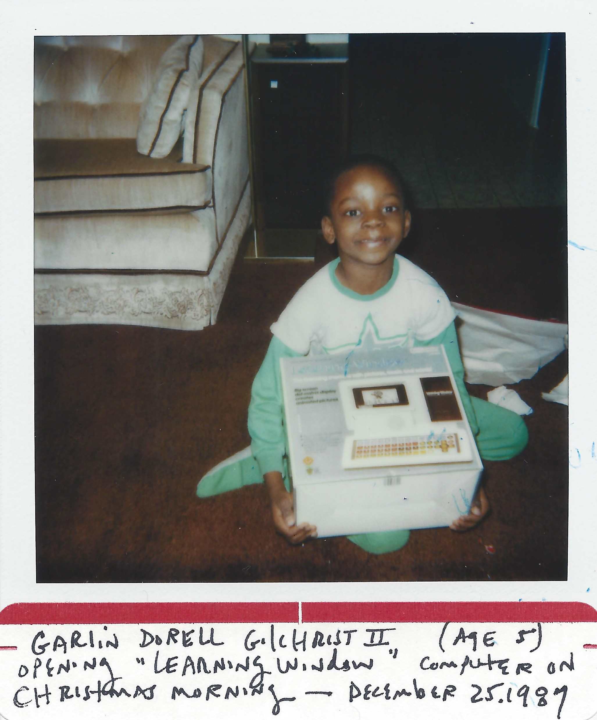


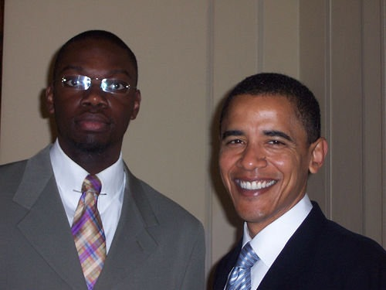
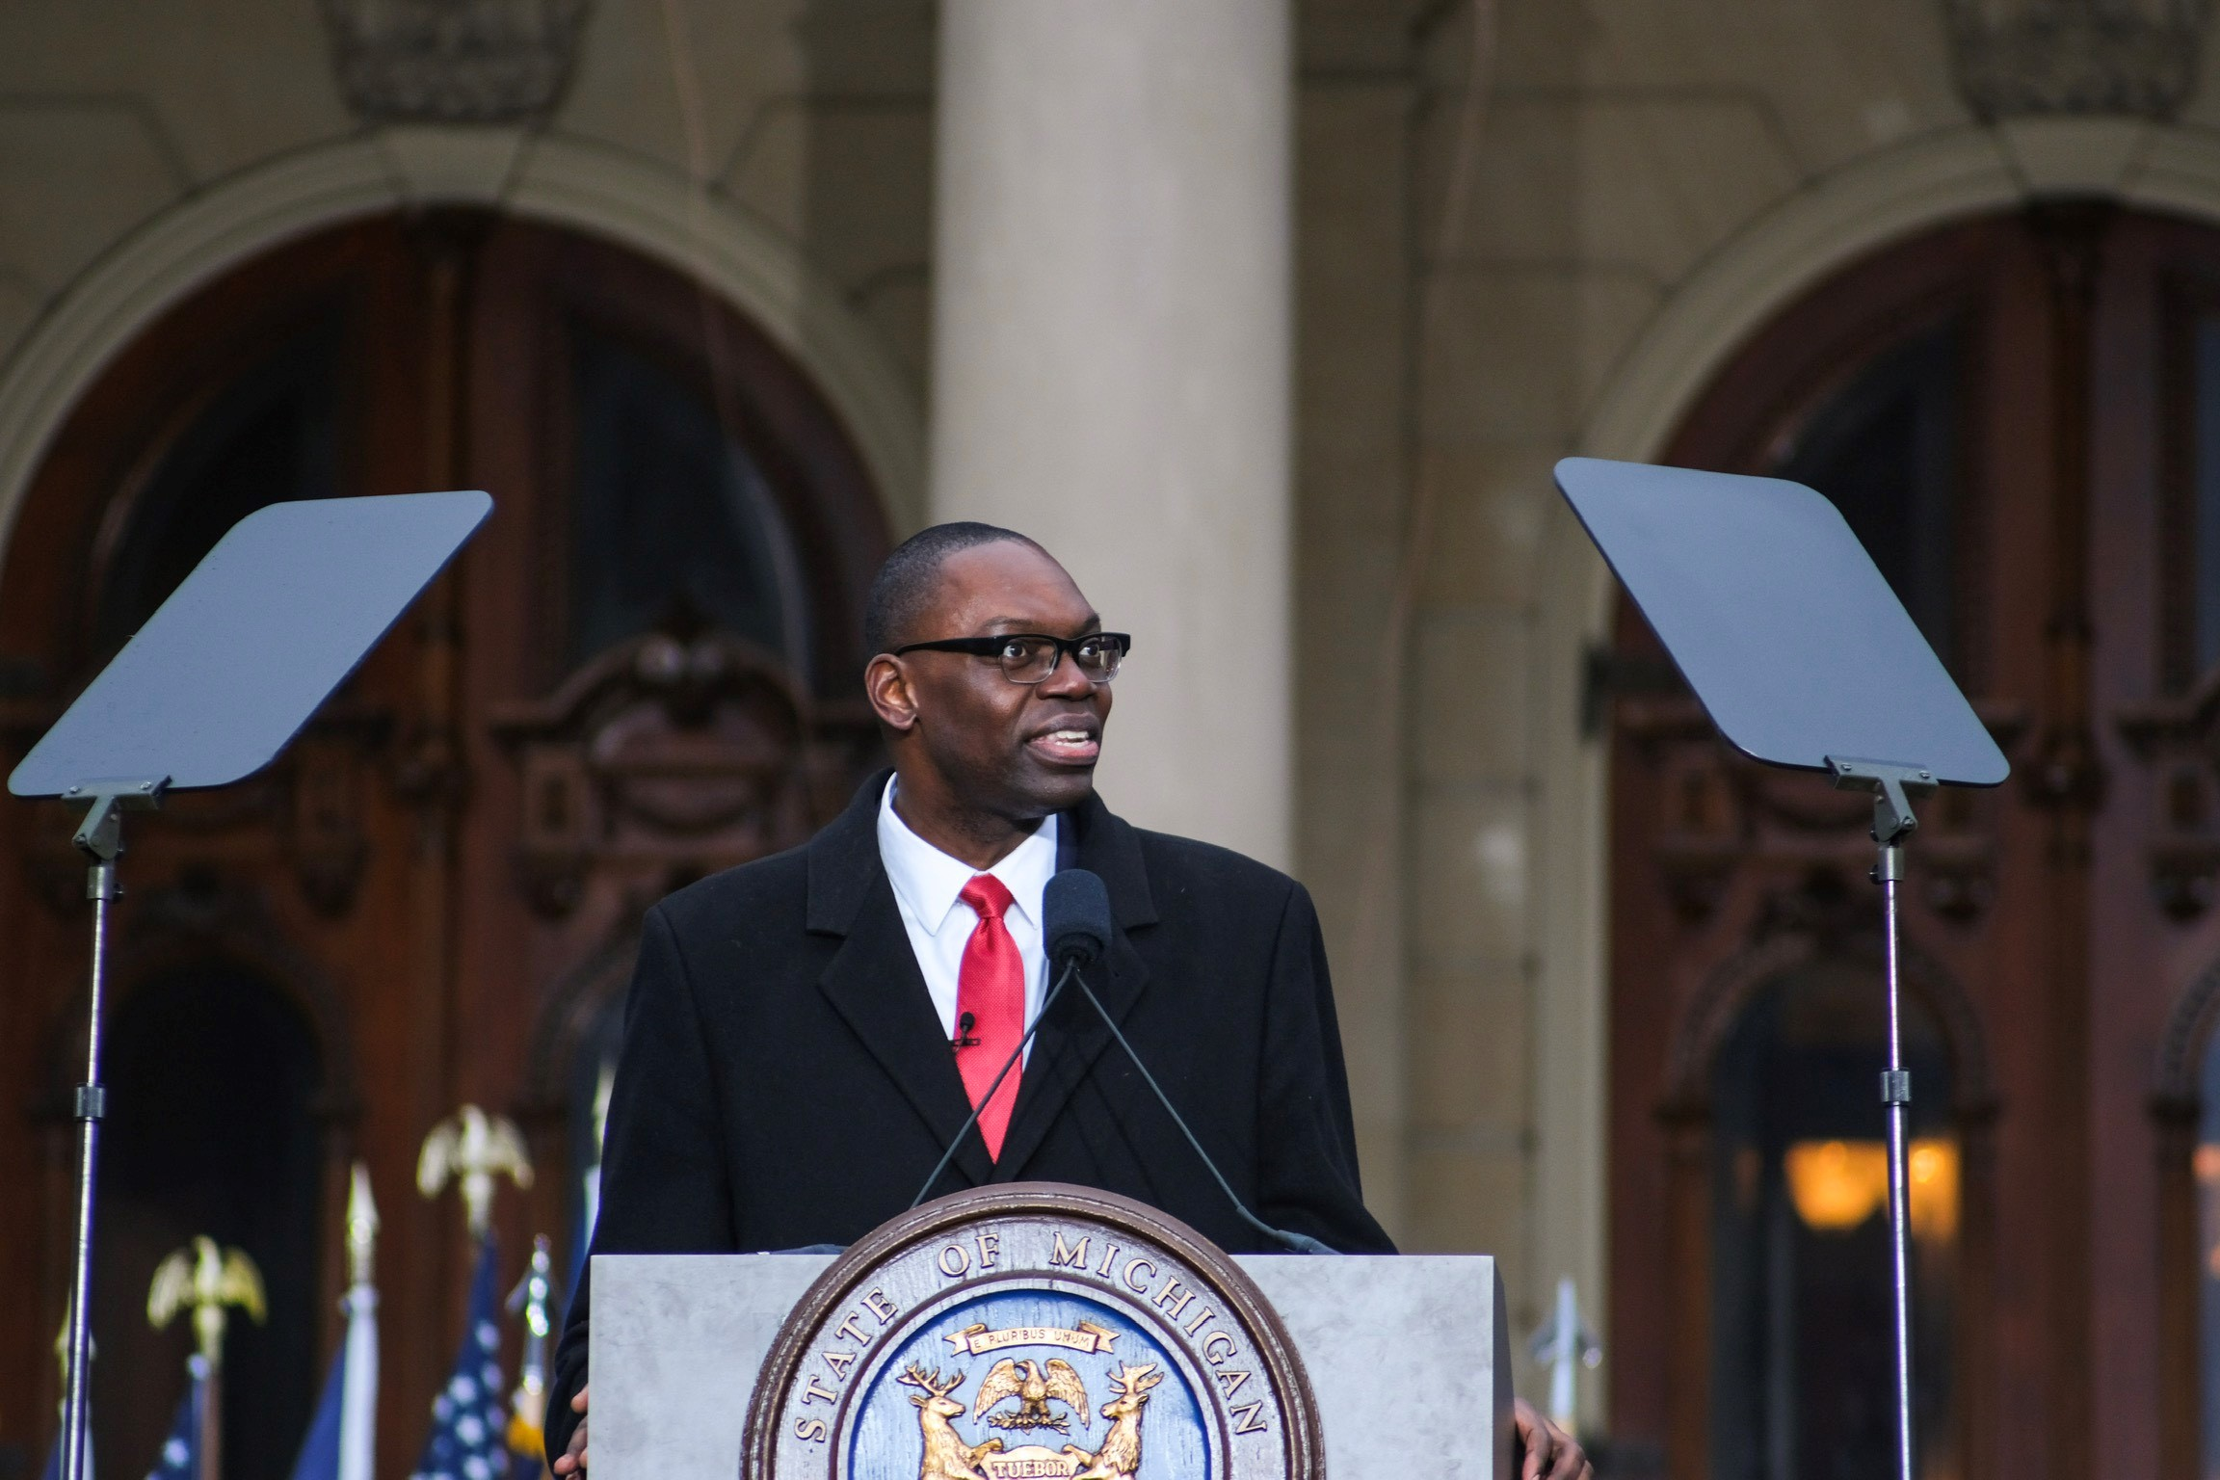
1982
1987
1987
1990s
2000s
2008
2019

Slide 5
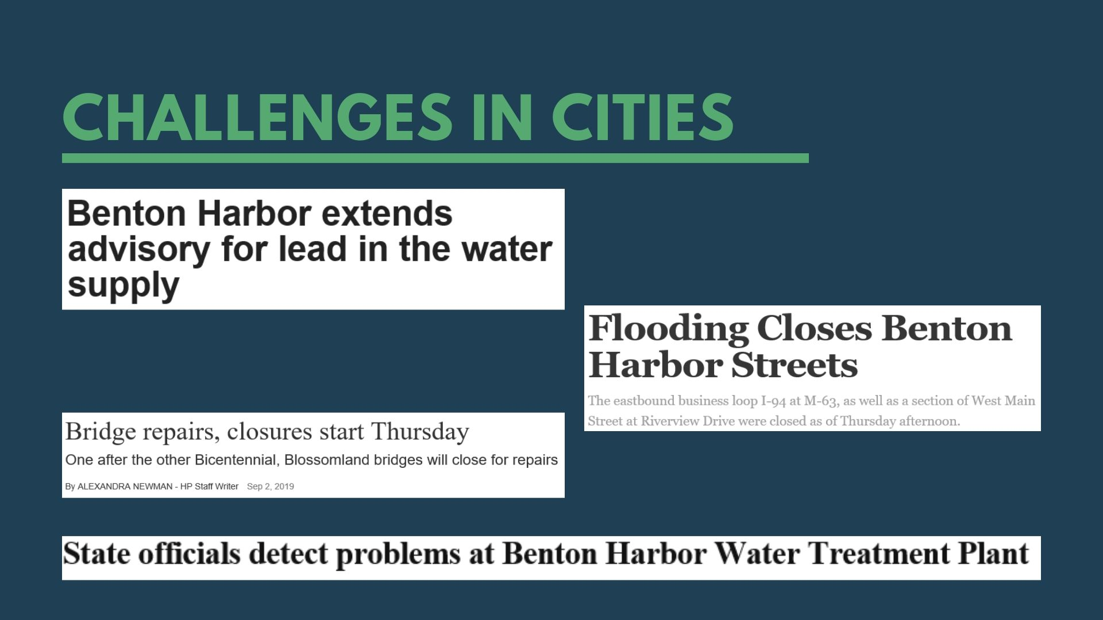

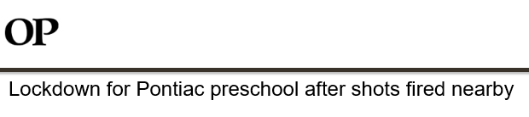
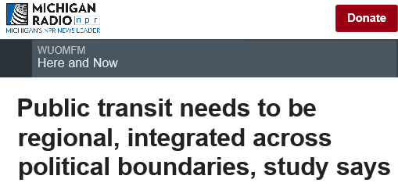
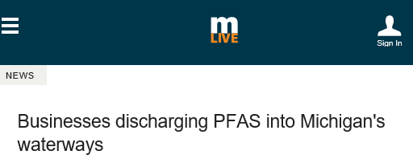
Challenges in cities

Slide 6
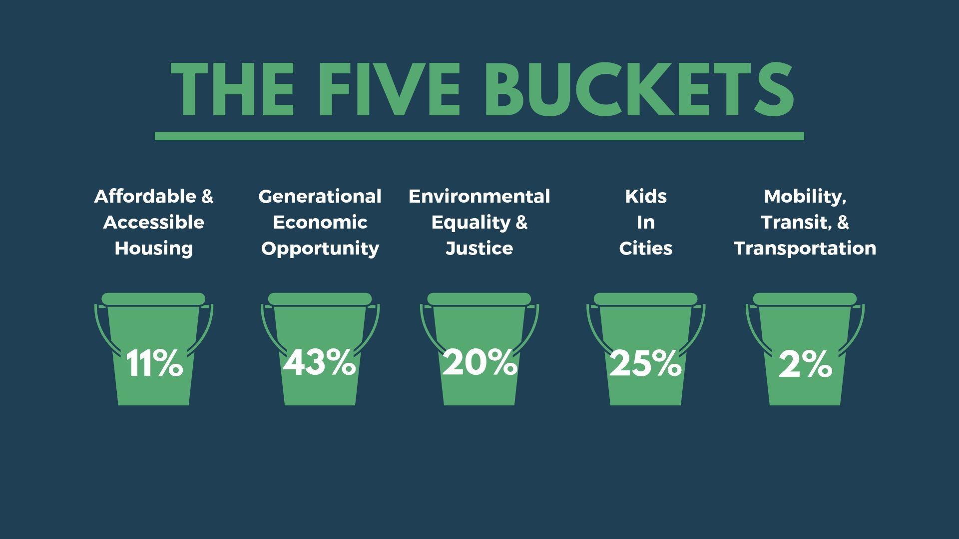
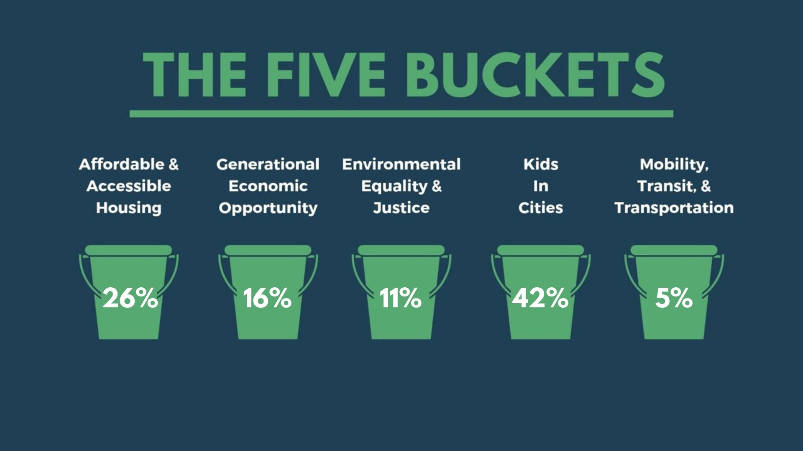
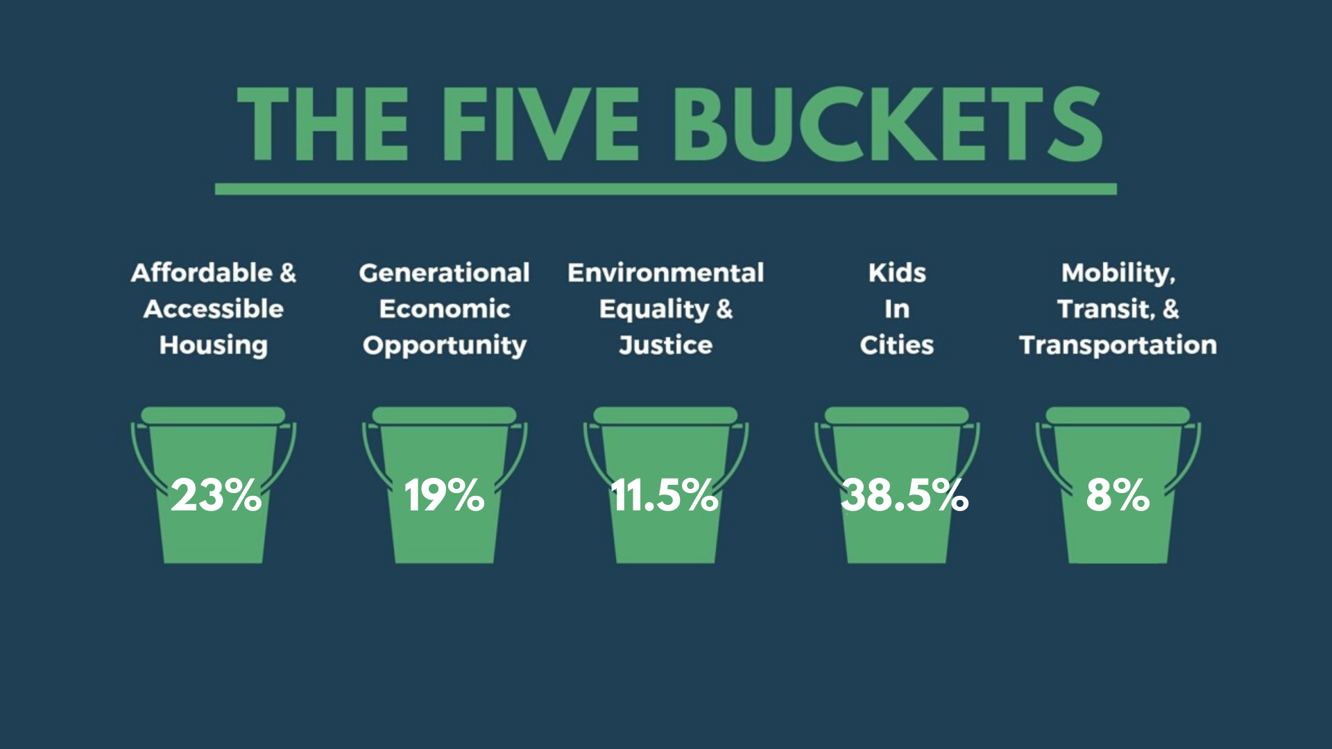

The five buckets
Affordable & Accessible Housing
Generational Economic Opportunity
Environmental Equality & Justice
Mobility, Transit, & Transportation
Kids in Cities

Slide 7
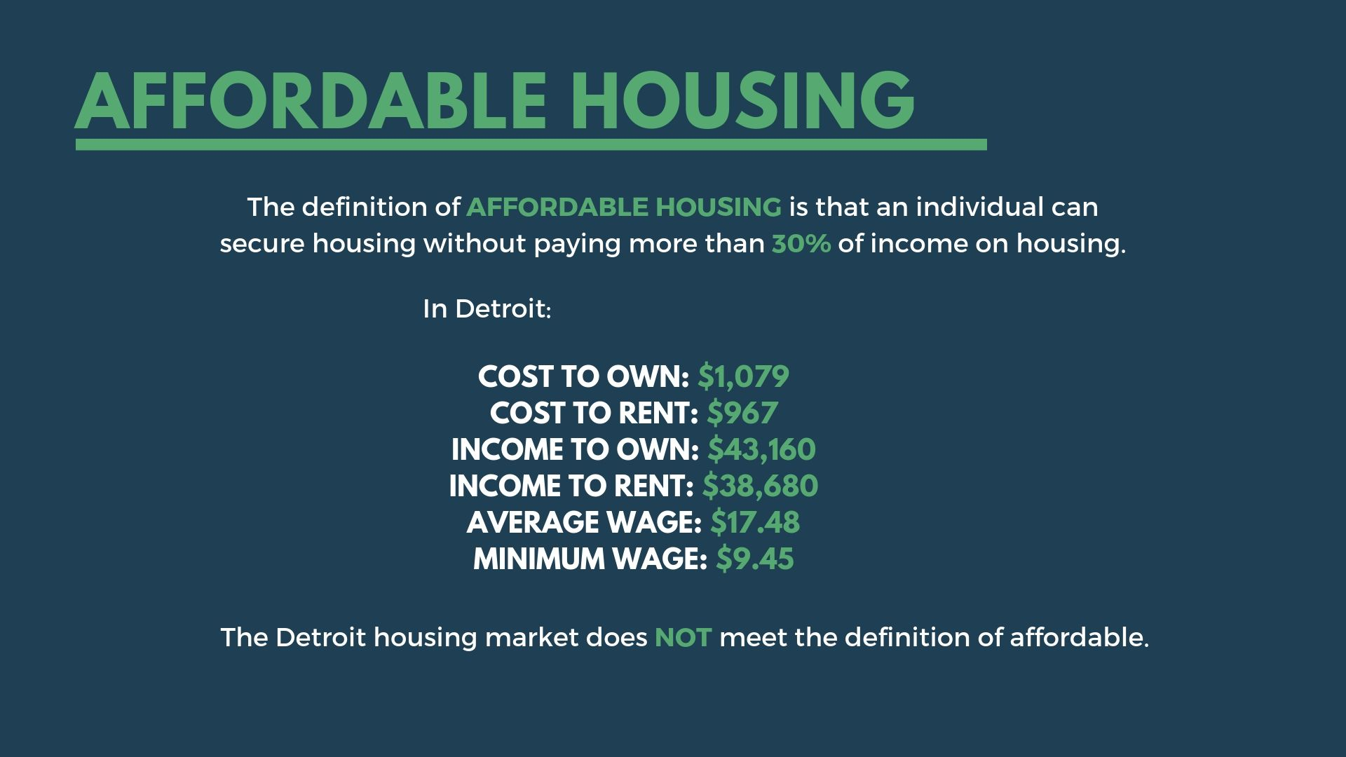
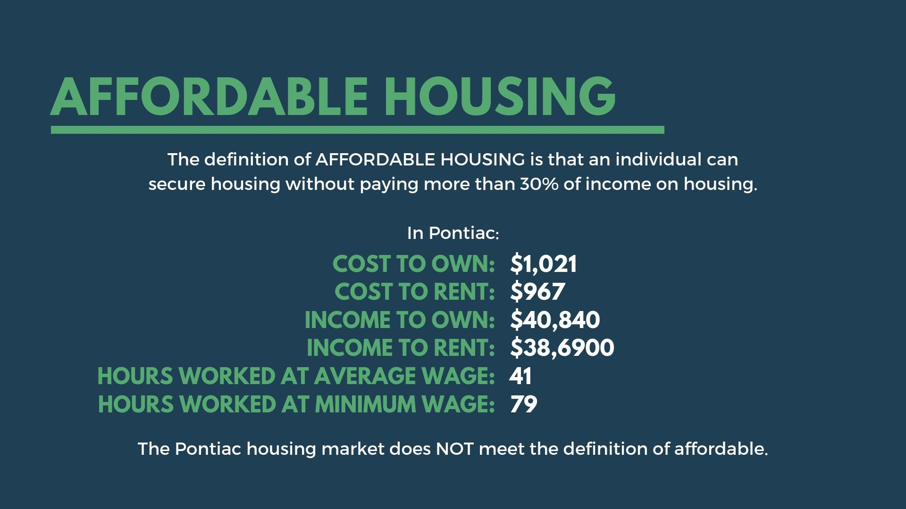
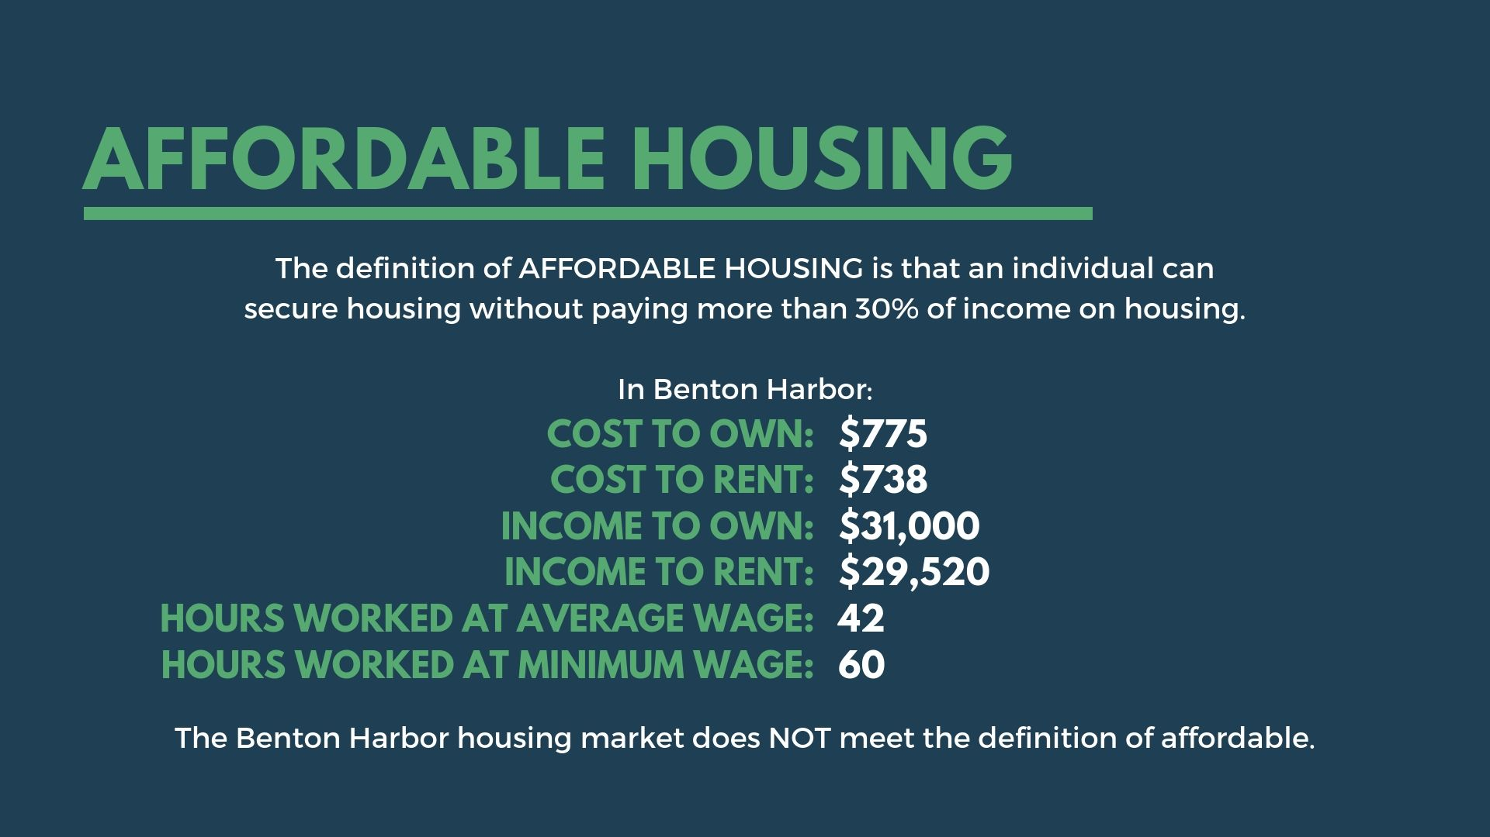
Affordable & Accessible
Housing
What is Affordable Housing?
Affordable & Accessible Housing
#1
#1
affordable housing
af·​ford·​able hous·​ing | \ ə-ˈfȯr-də-bəl ˈhau̇-ziŋ \
Affordable housing means that an individual can secure housing without paying more than 30% of income on housing.

Slide 8
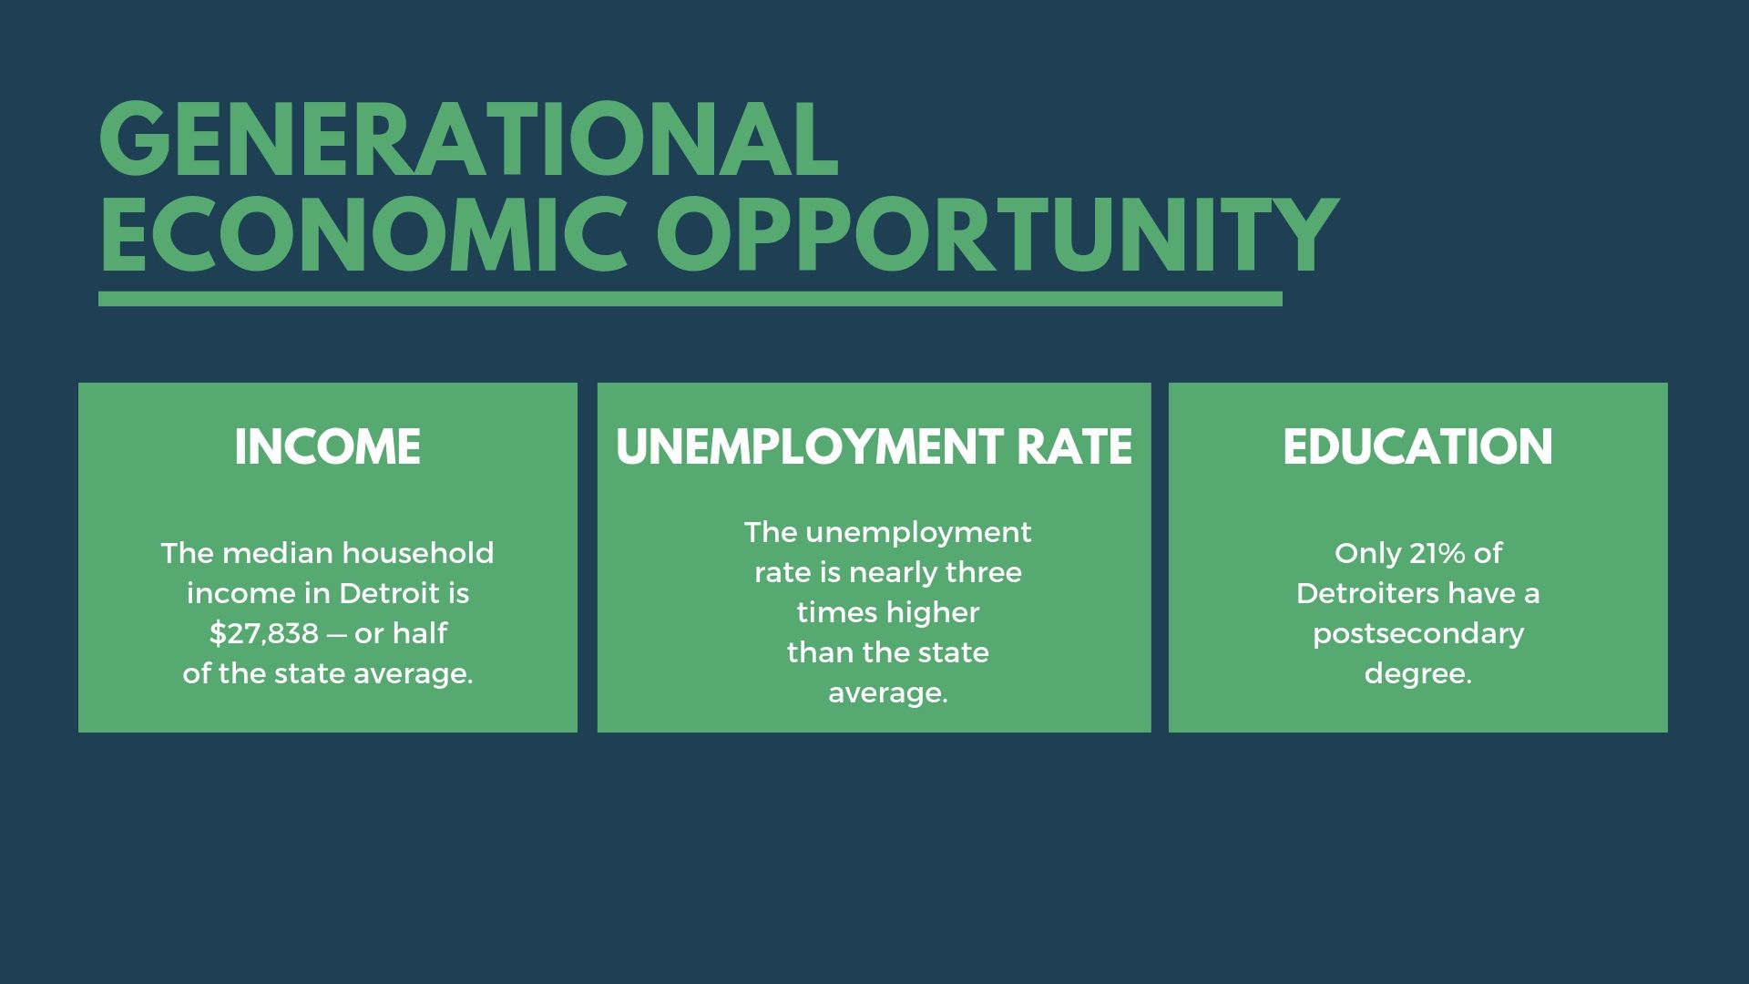
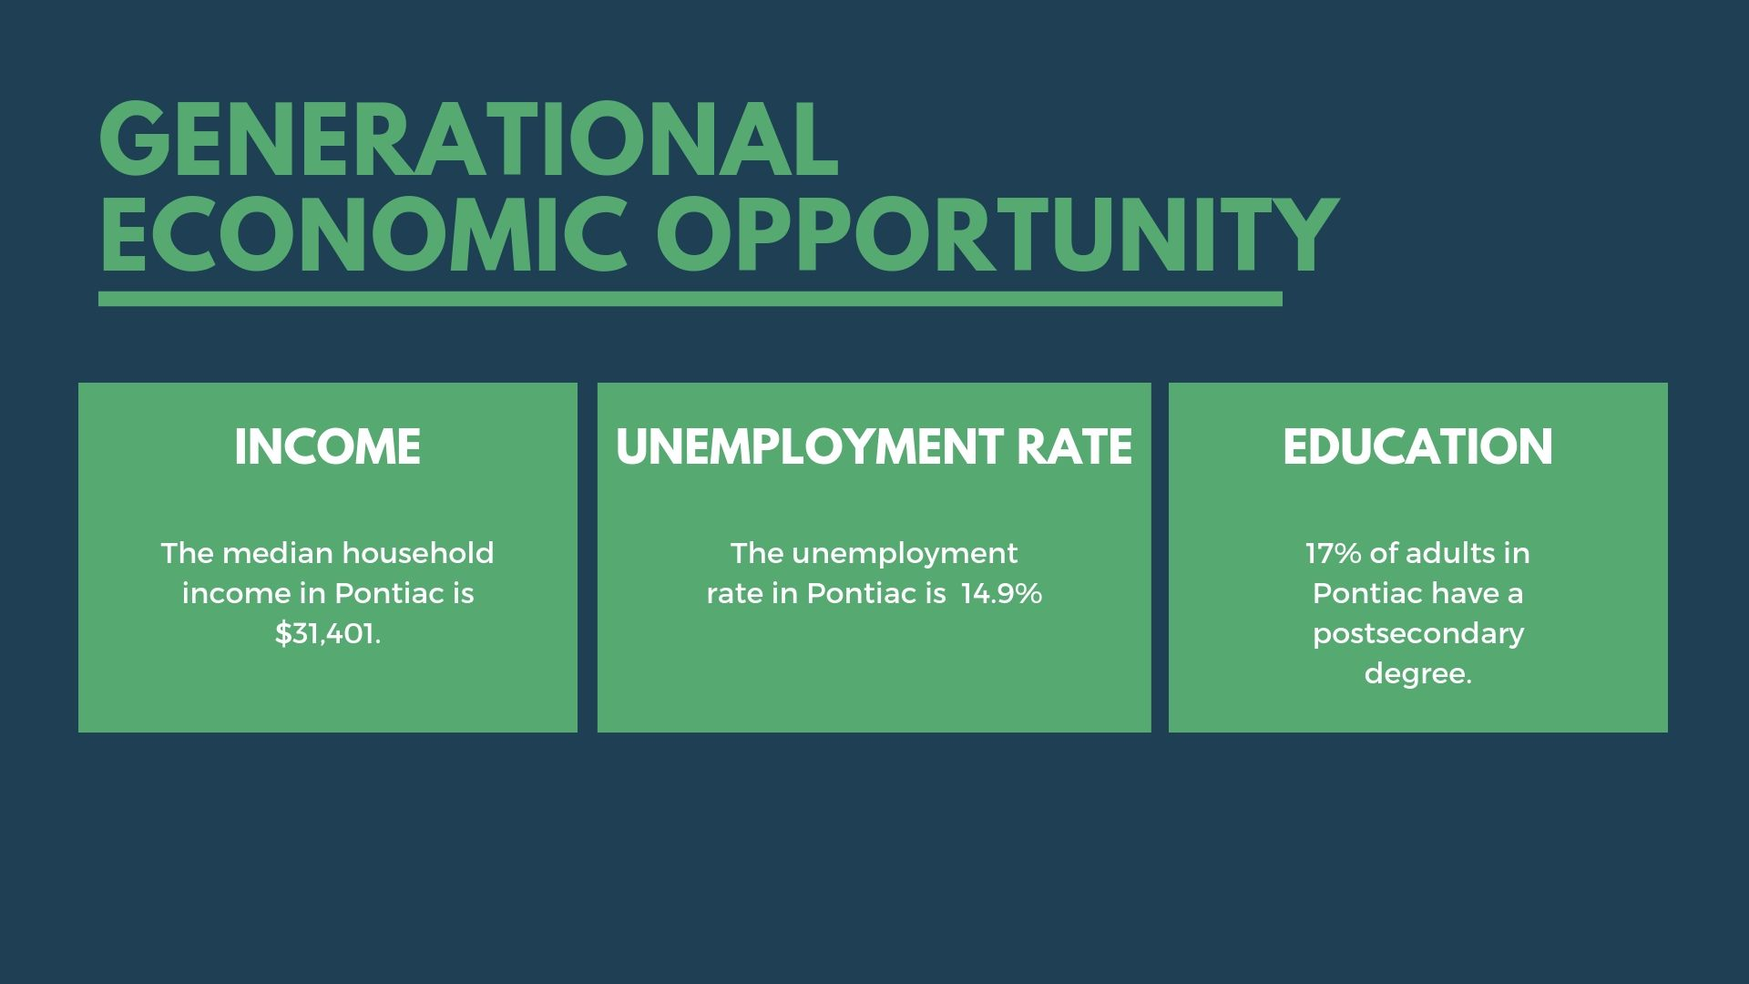
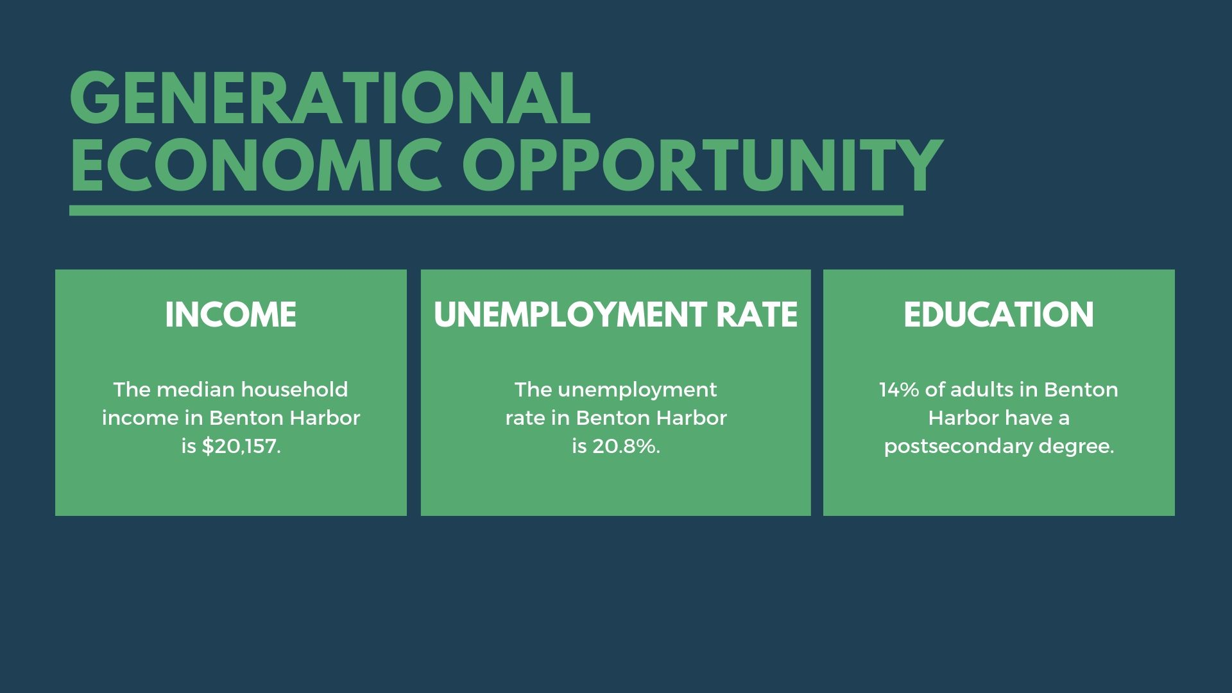
Generational Economic Opportunity
Median Household Income
Generational Economic Opportunity
#2
#2

Slide 9
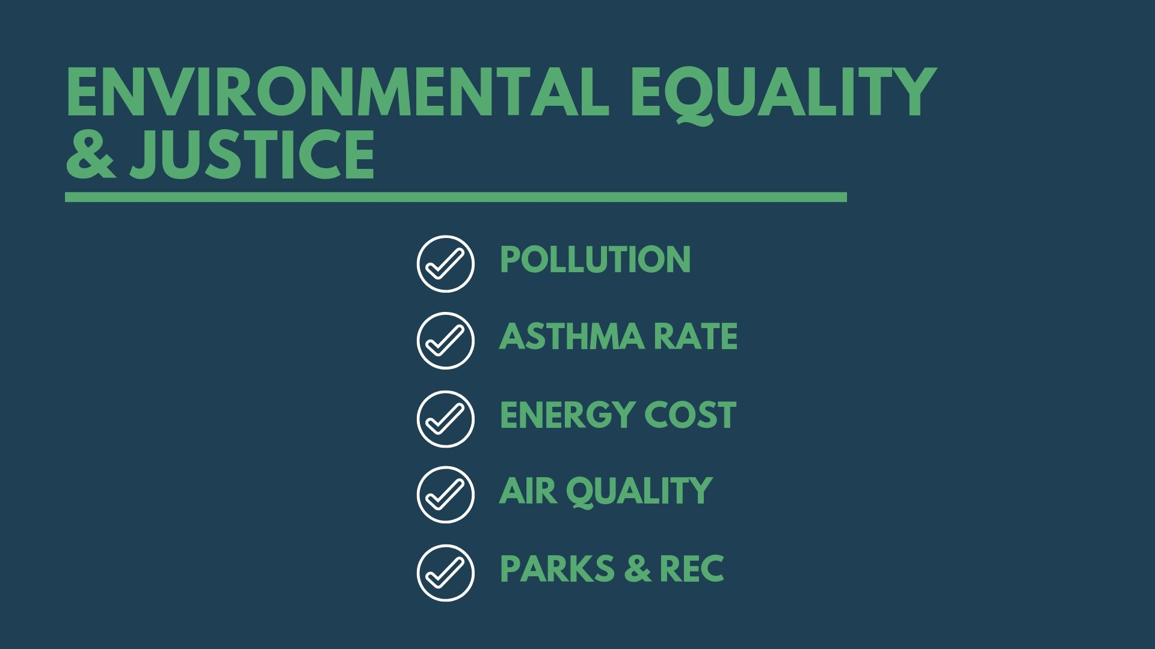
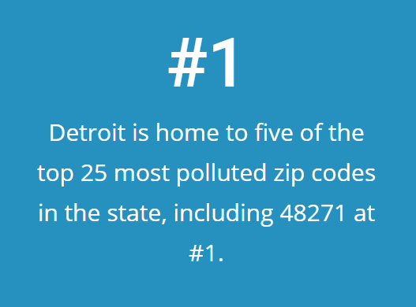
Environmental equality & justice
Pollution
Environmental Equality & Justice
#3

Slide 10
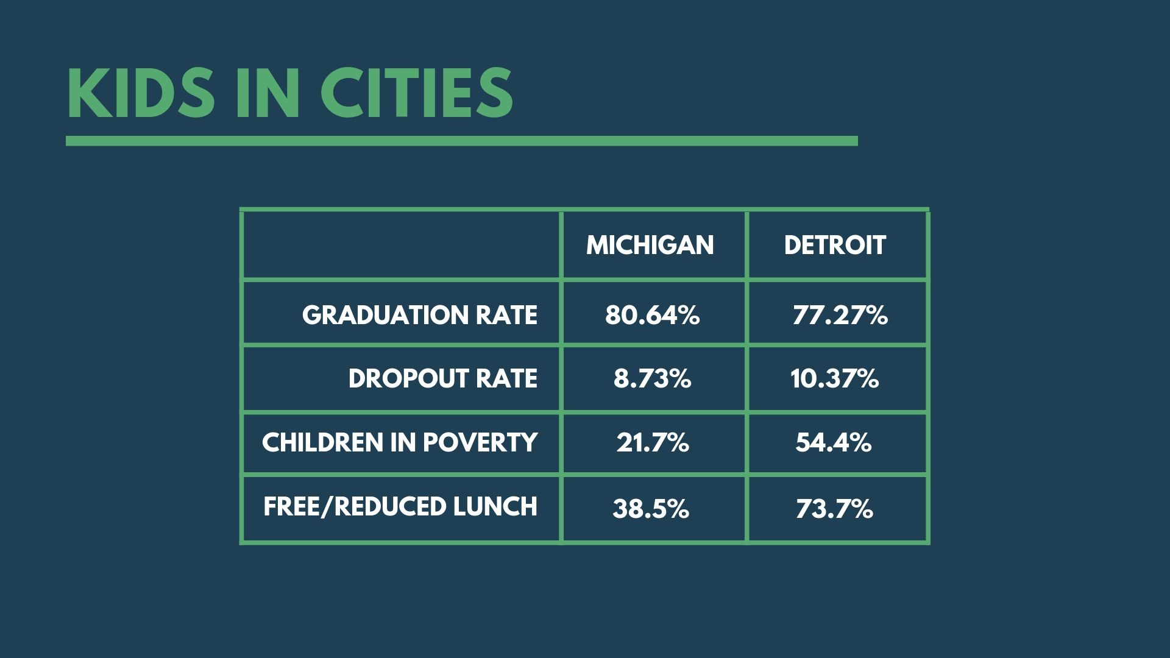
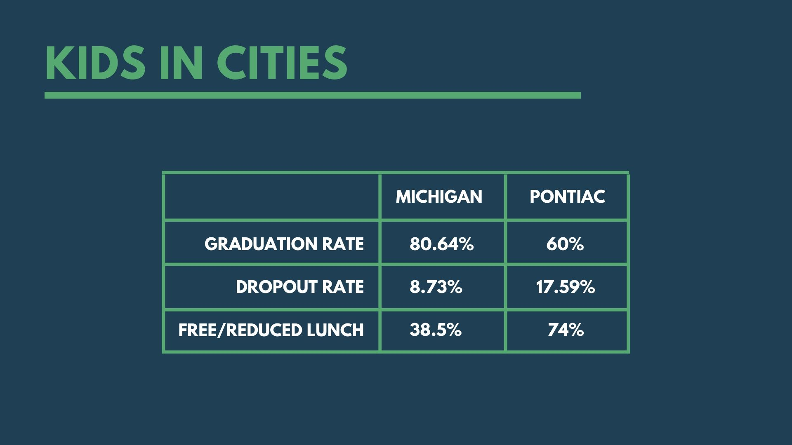
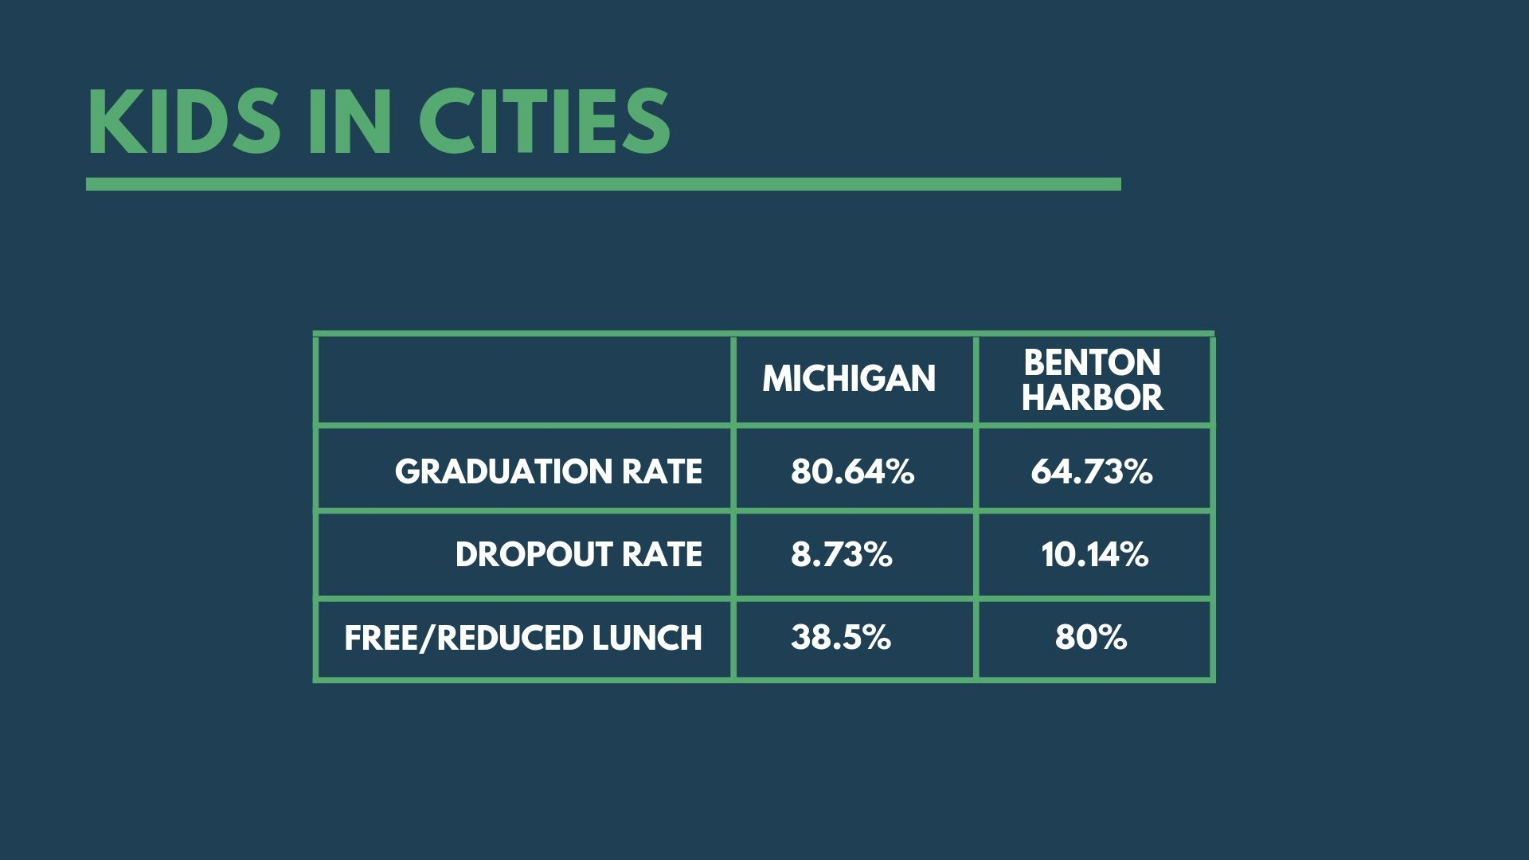
Kids in cities
Kids in cities
Kids in Cities
#4
 | Michigan | Detroit
Graduation Rate | 80.64% | 77.27%
Dropout Rate | 8.73% | 10.37%
Children in Poverty | 21.7% | 54.4%
Free/Reduced Lunch | 38.5% | 73.7%

Slide 11

Mobility, Transit, &
Transportation
ROAD Condition
Mobility, Transit, & transportation
#5

Slide 12
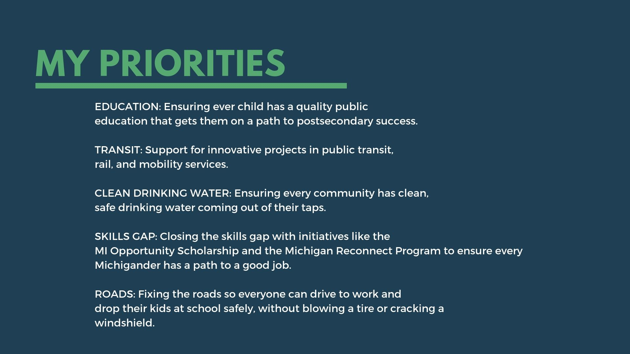
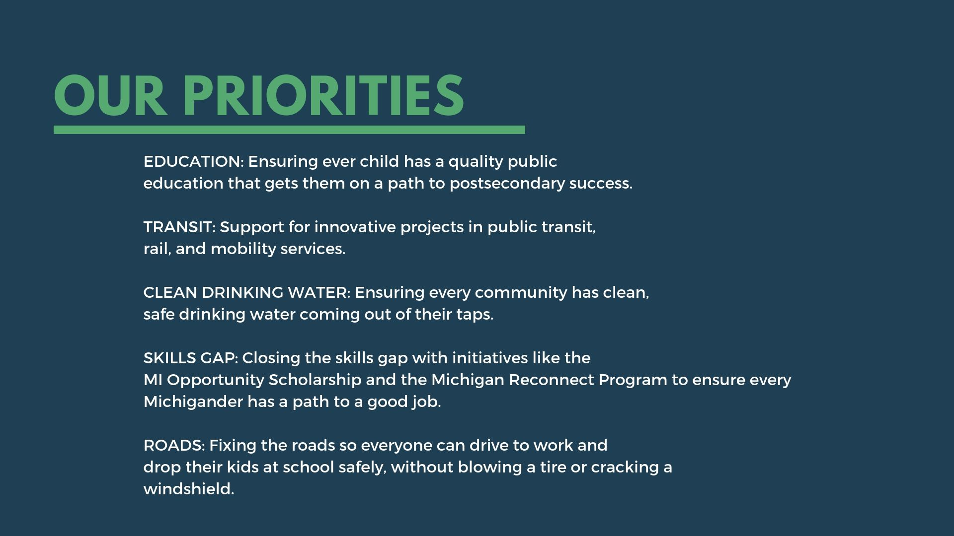

Slide 13

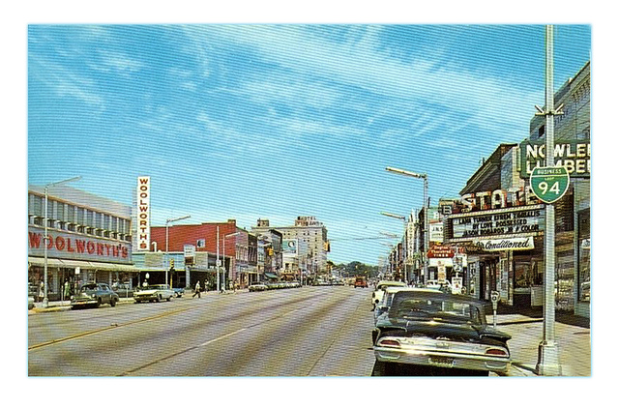

Slide 14


Thriving Cities
Email: mieog-thrivingcities@michigan.gov

