Slide 1


Slide 2
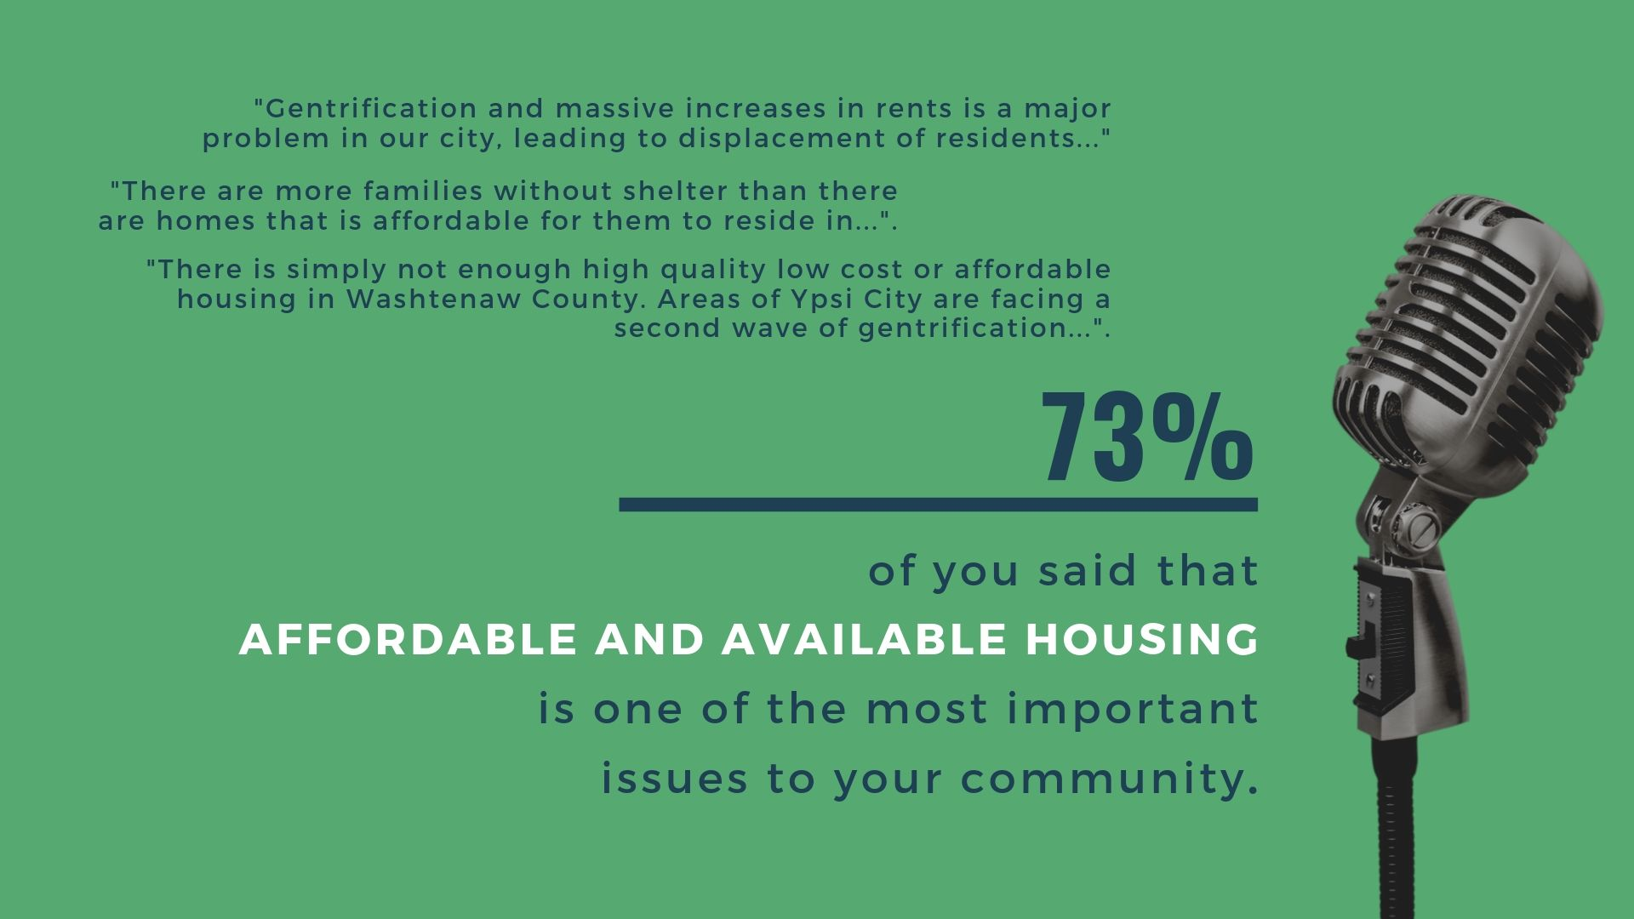
Cities SUrvey

Slide 3
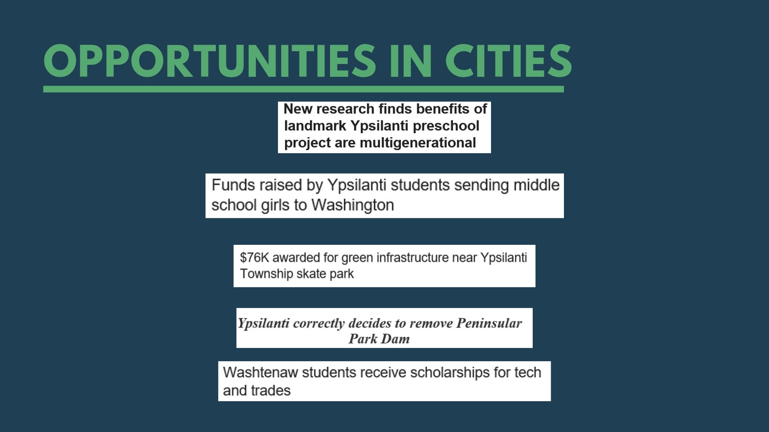

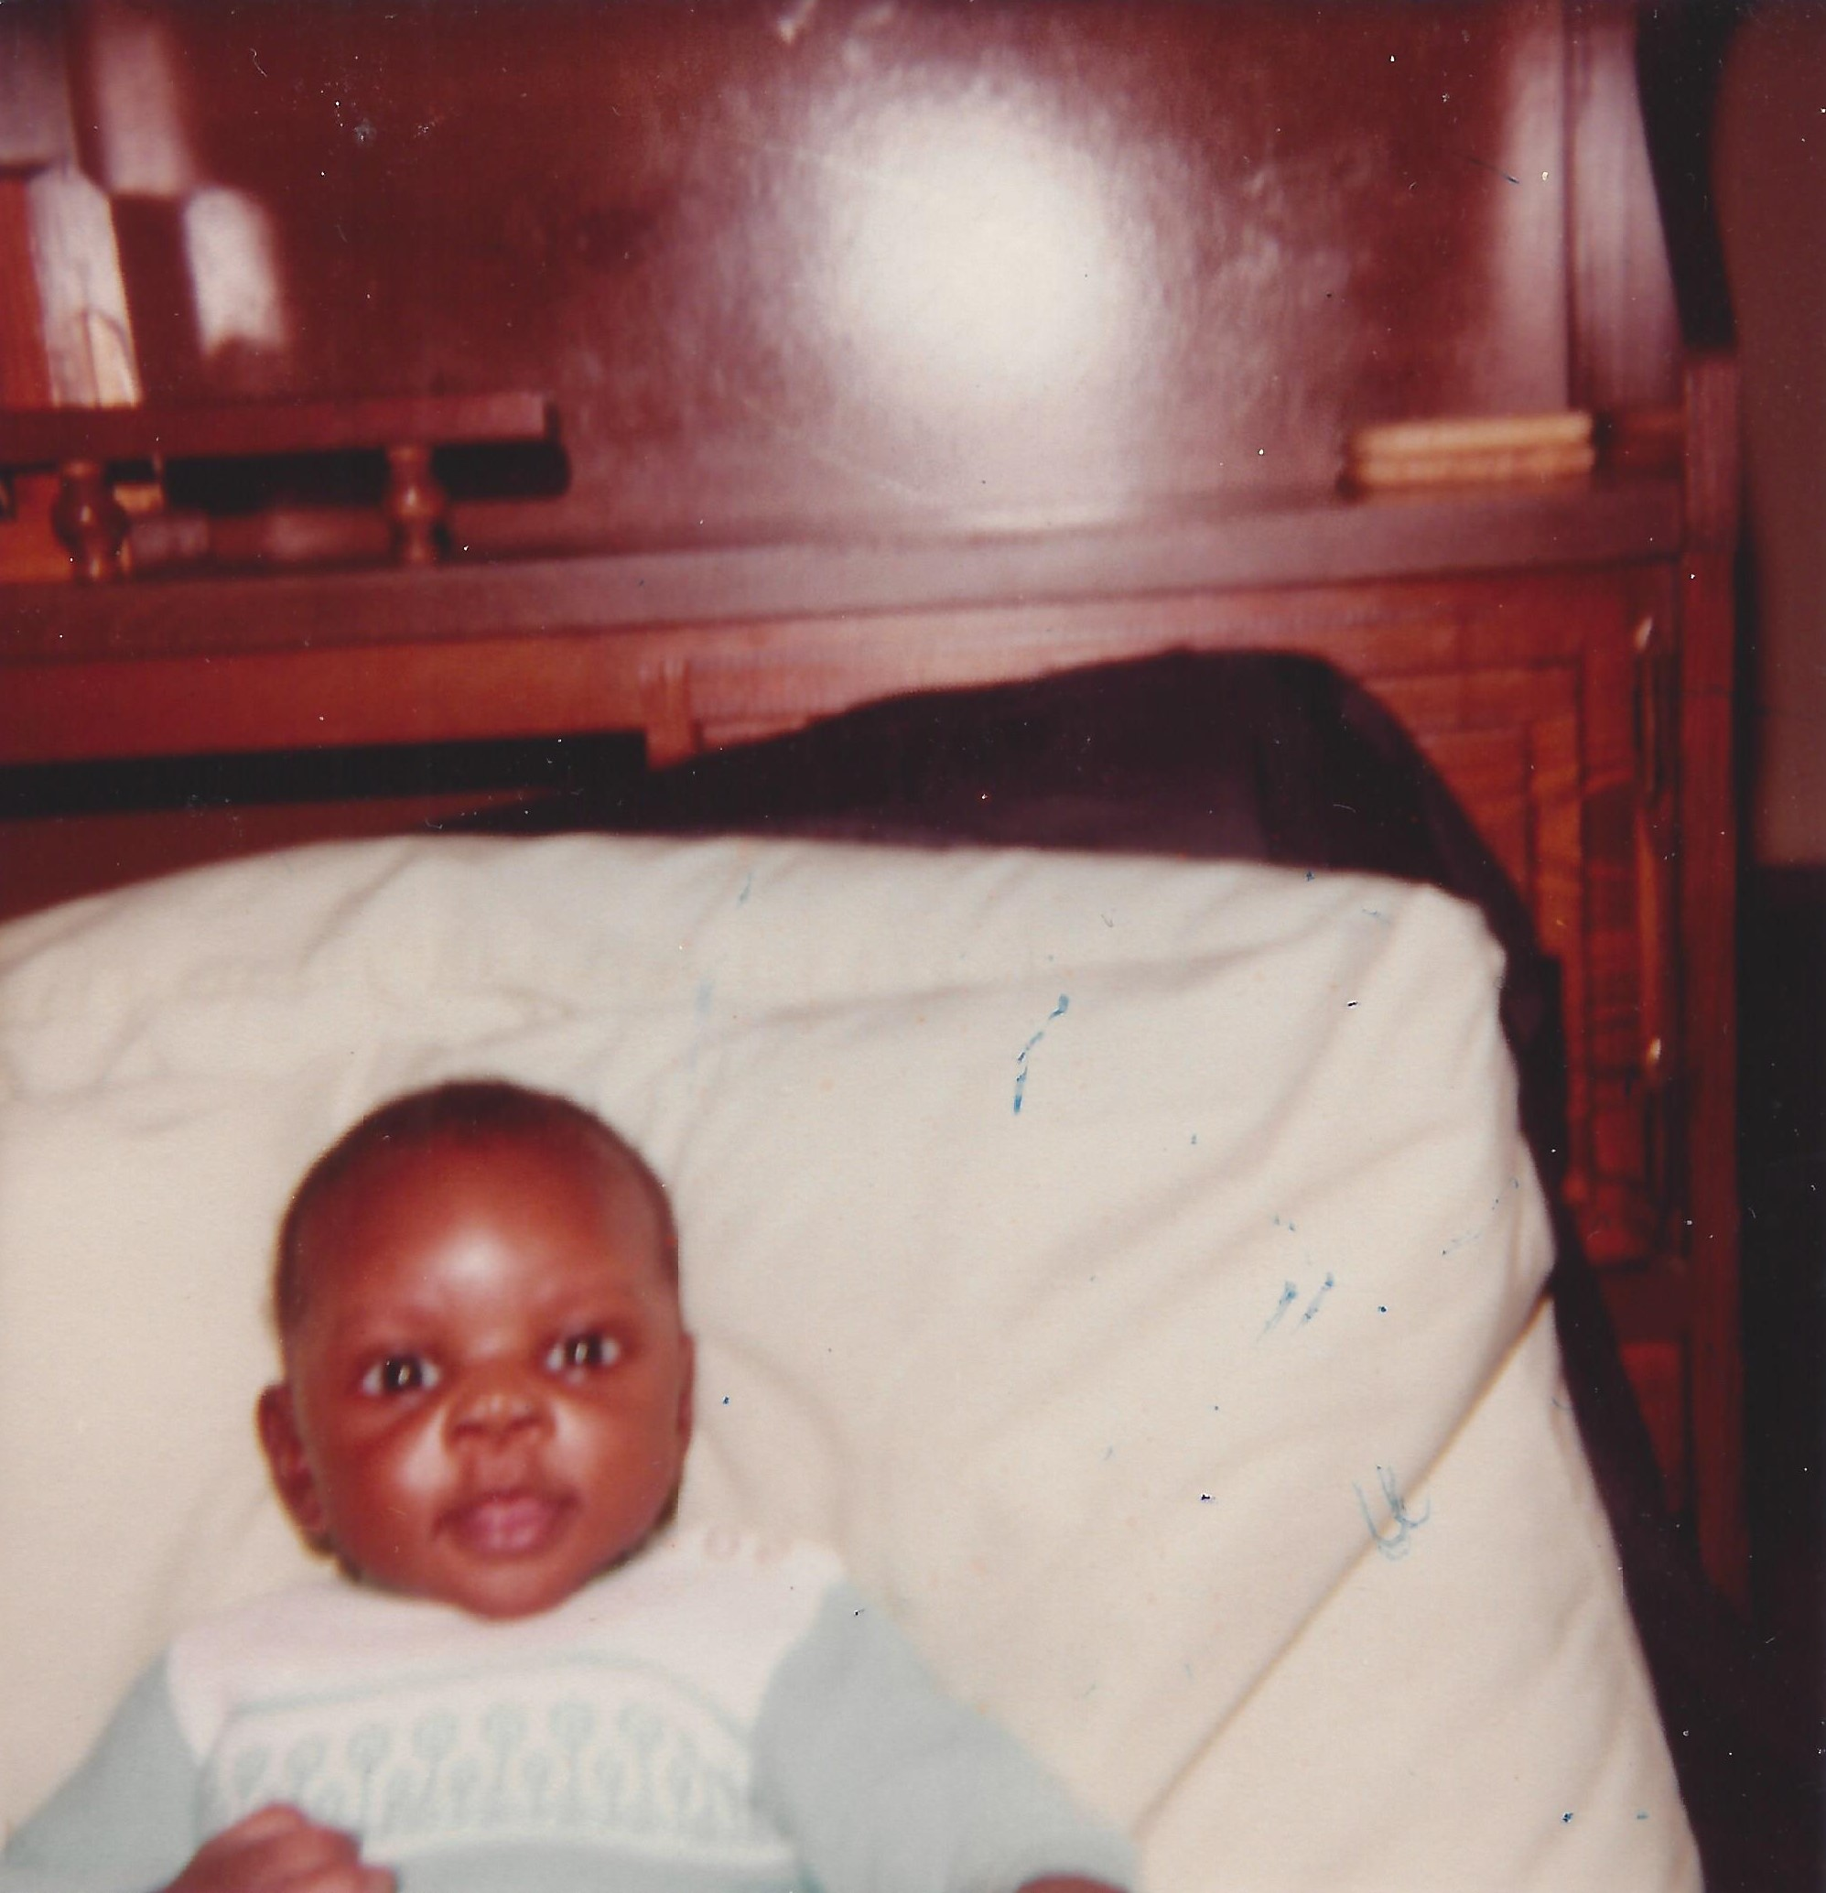
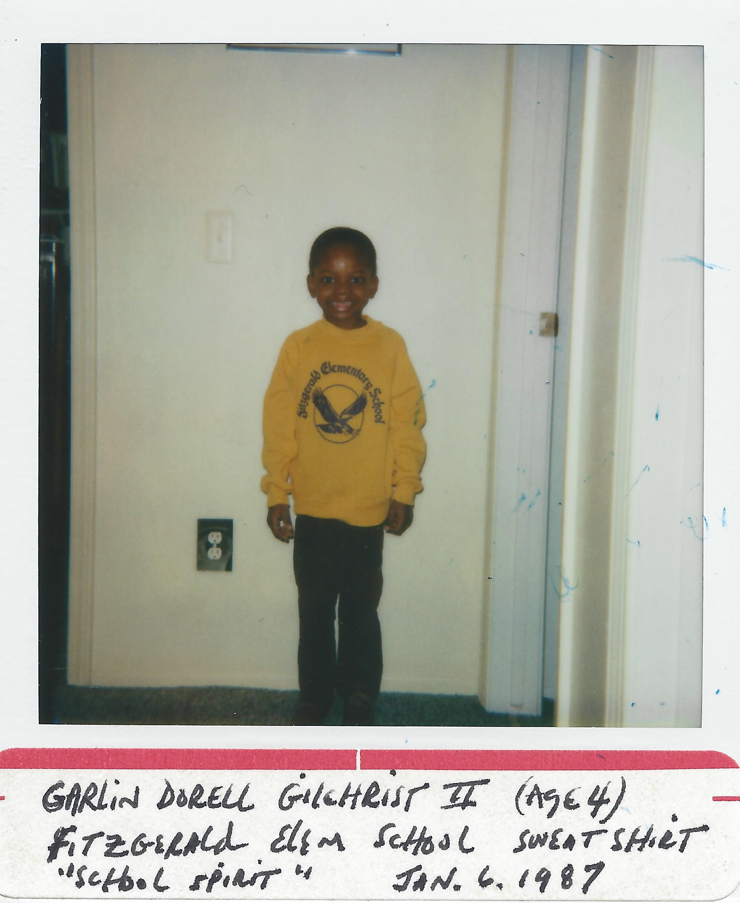
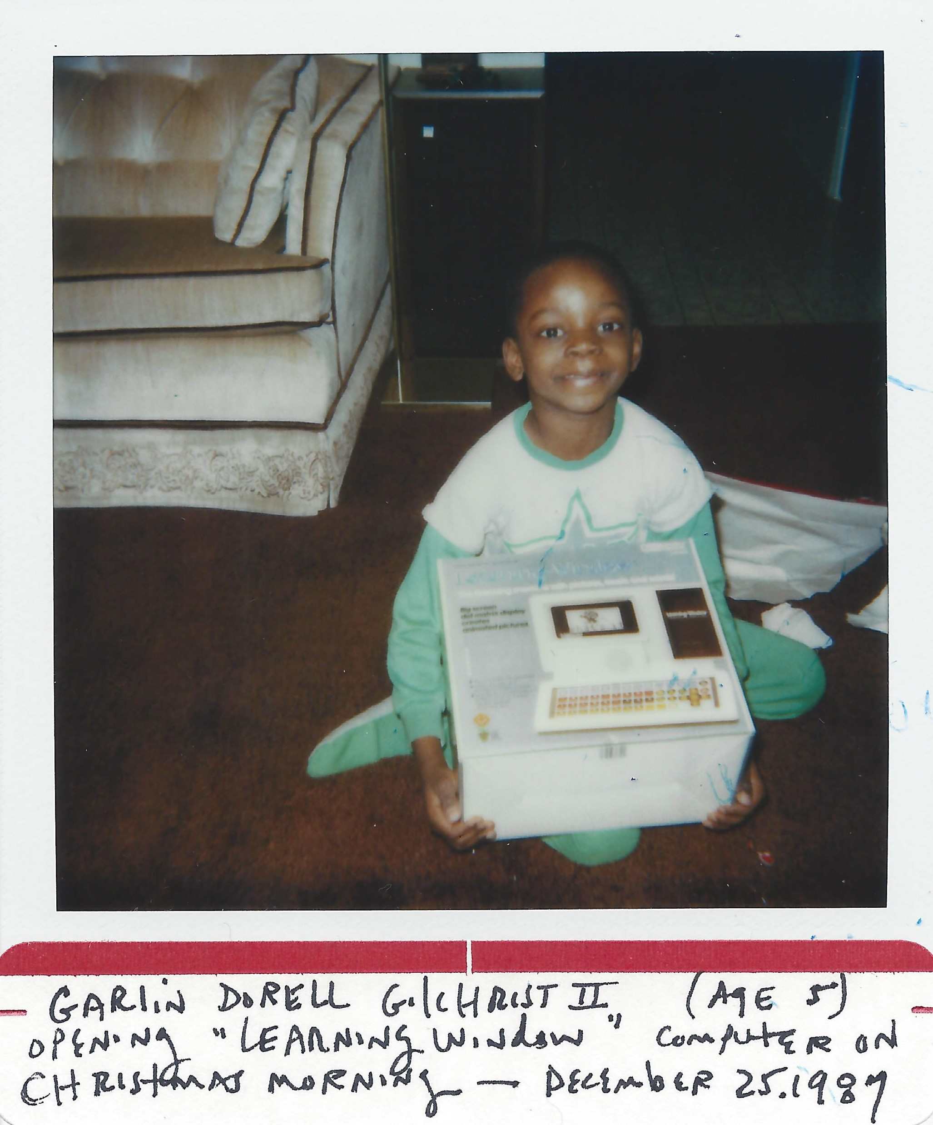


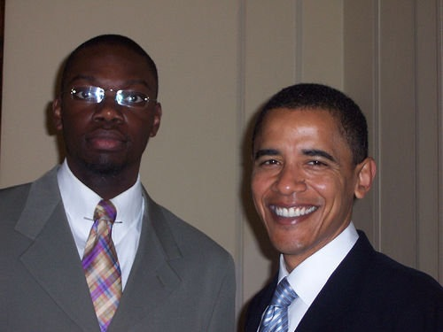
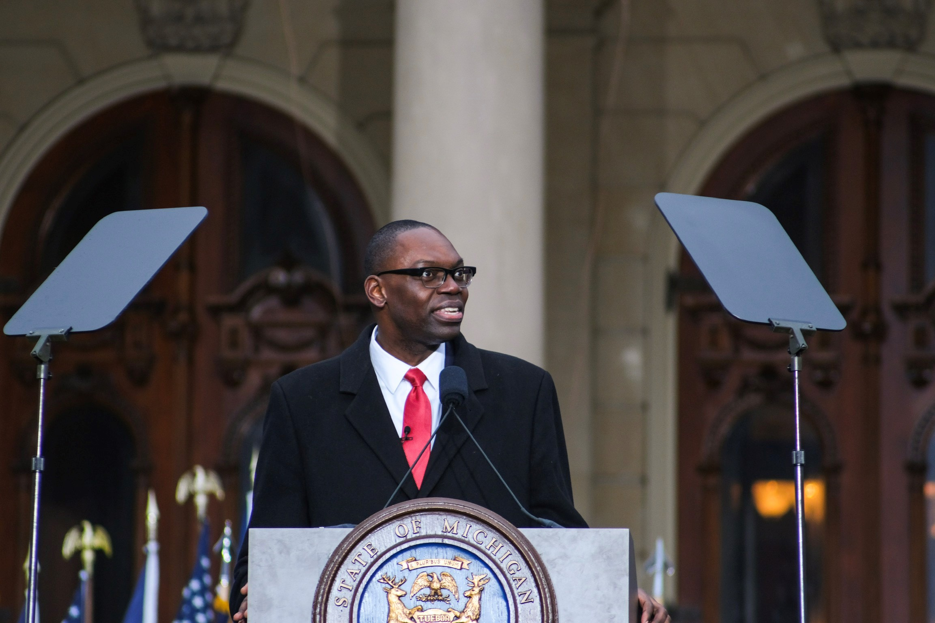
1982
1987
1987
1990s
2000s
2008
2019

Slide 4
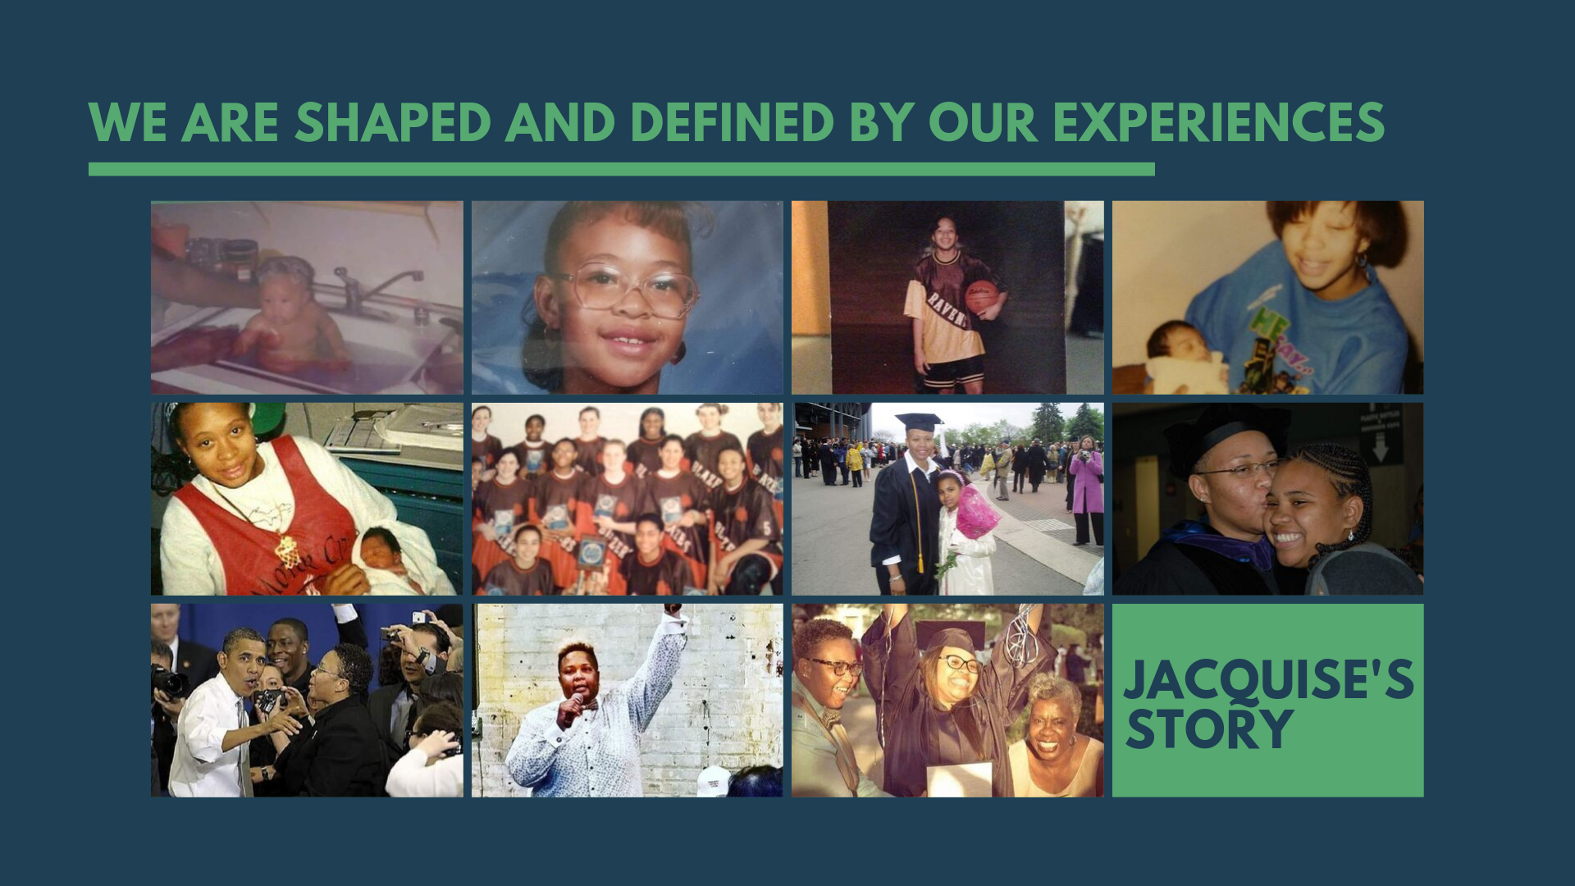

Opportunities in cities

Slide 5
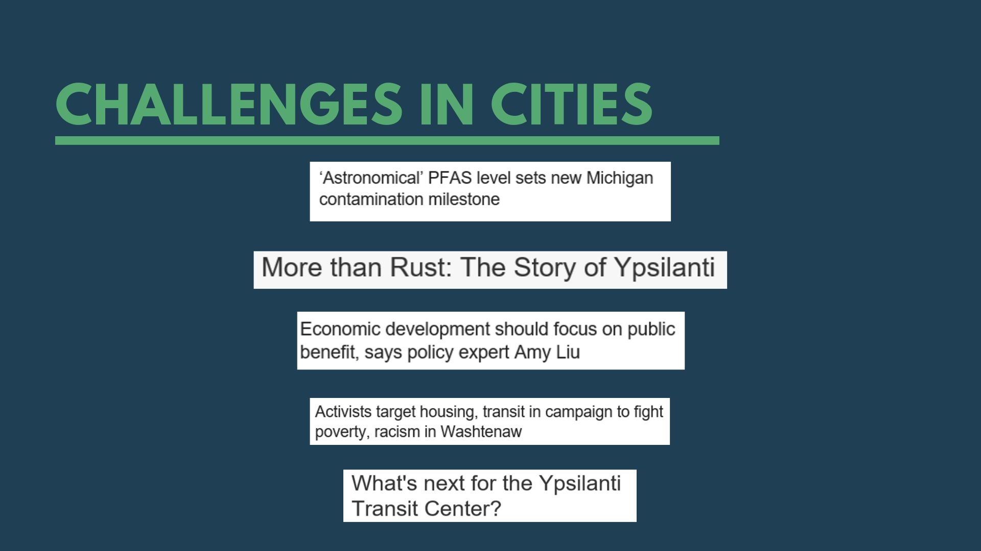

Challenges in cities

Slide 6
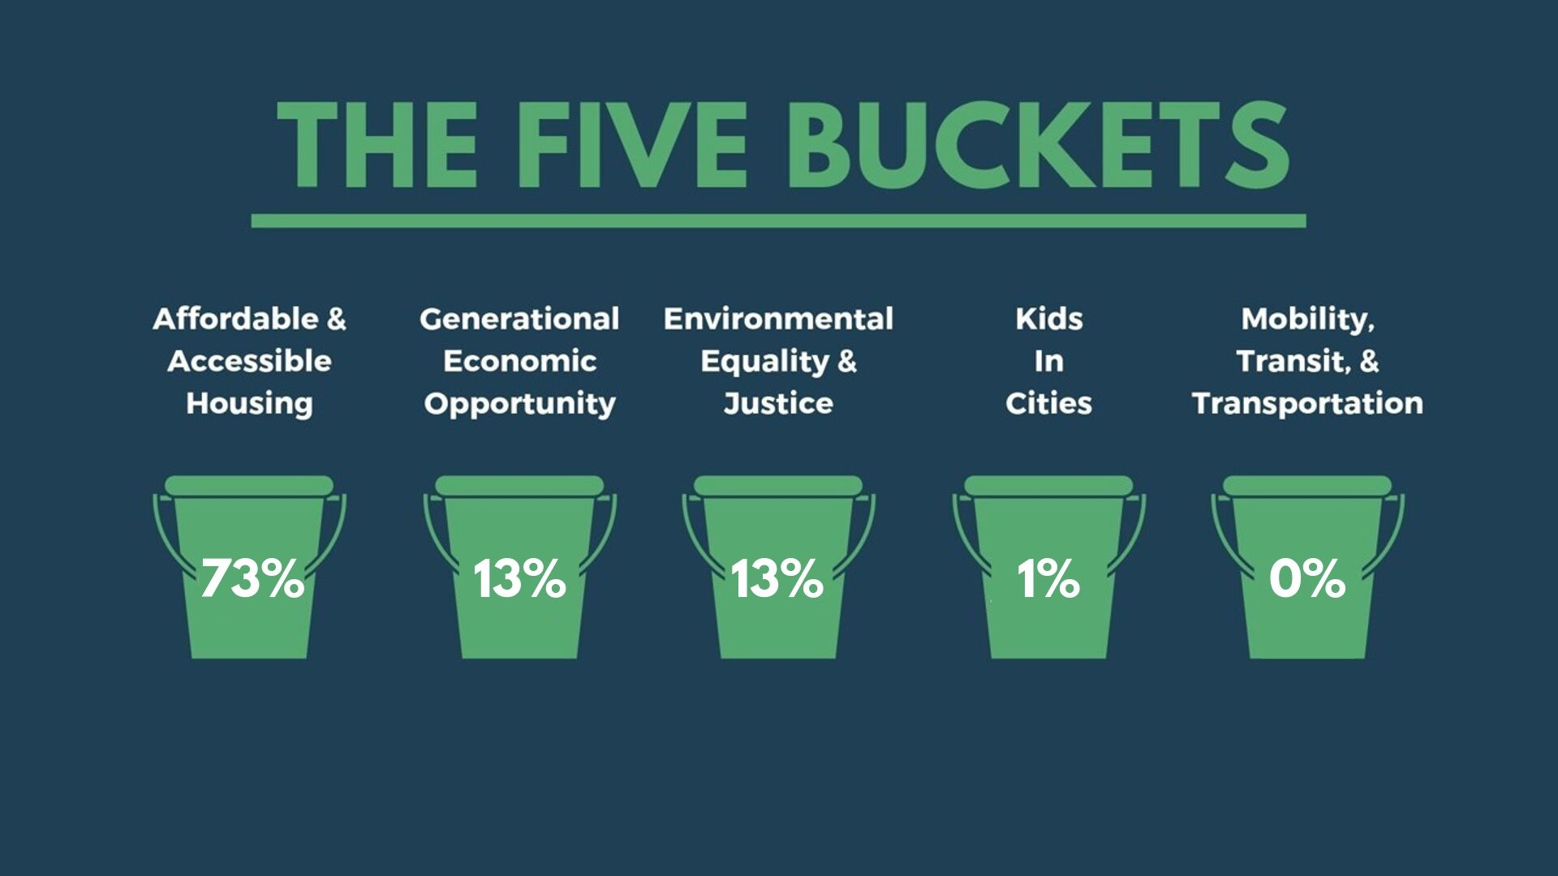

The five buckets
Affordable & Accessible Housing
Generational Economic Opportunity
Environmental Equality & Justice
Mobility, Transit, & Transportation
Kids in Cities

Slide 7
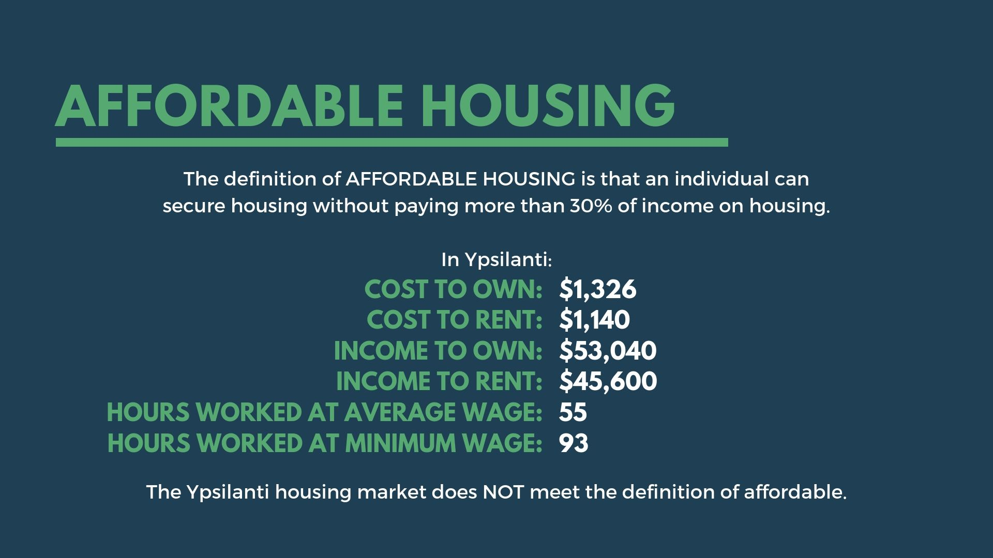
Affordable & Accessible
Housing
What is Affordable Housing?
Affordable & Accessible Housing
#1
#1
affordable housing
af·​ford·​able hous·​ing | \ ə-ˈfȯr-də-bəl ˈhau̇-ziŋ \
Affordable housing means that an individual can secure housing without paying more than 30% of income on housing.

Slide 8
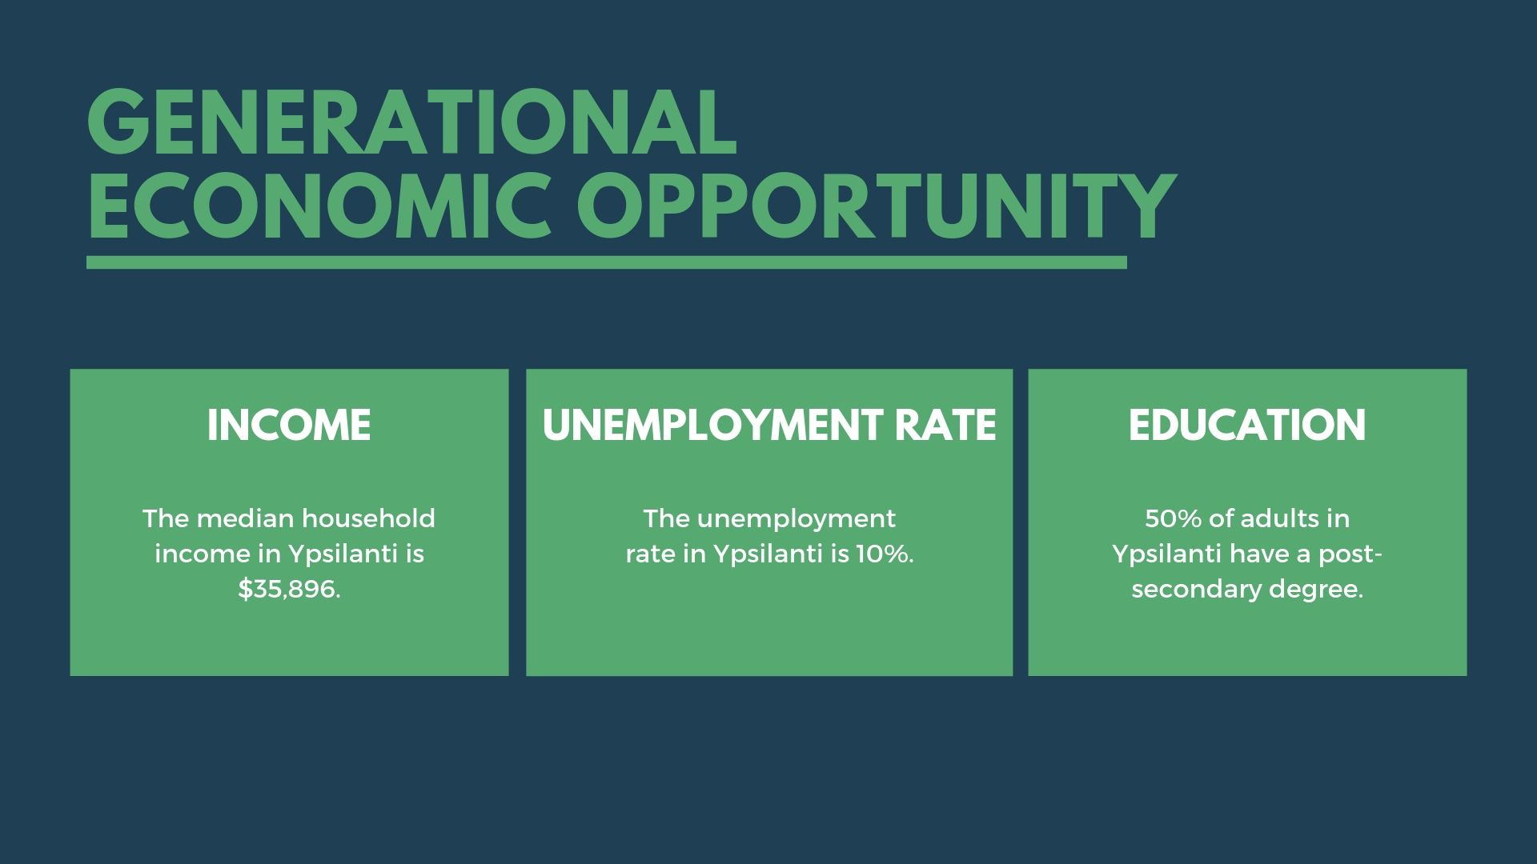
Generational Economic Opportunity
Generational Economic Opportunity
#2
#2

Slide 9
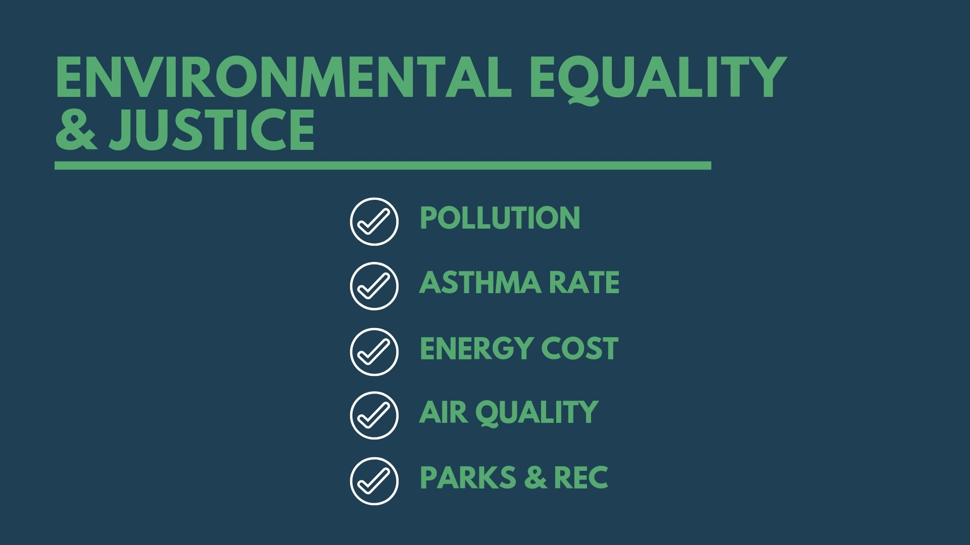
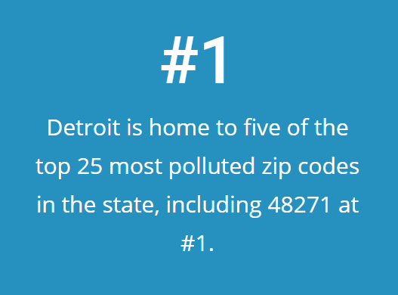
Environmental equality & justice
Pollution
Environmental Equality & Justice
#3

Slide 10
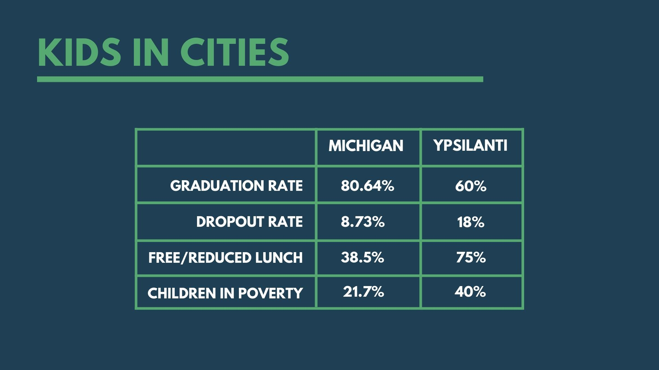
Kids in Cities
#4

Slide 11
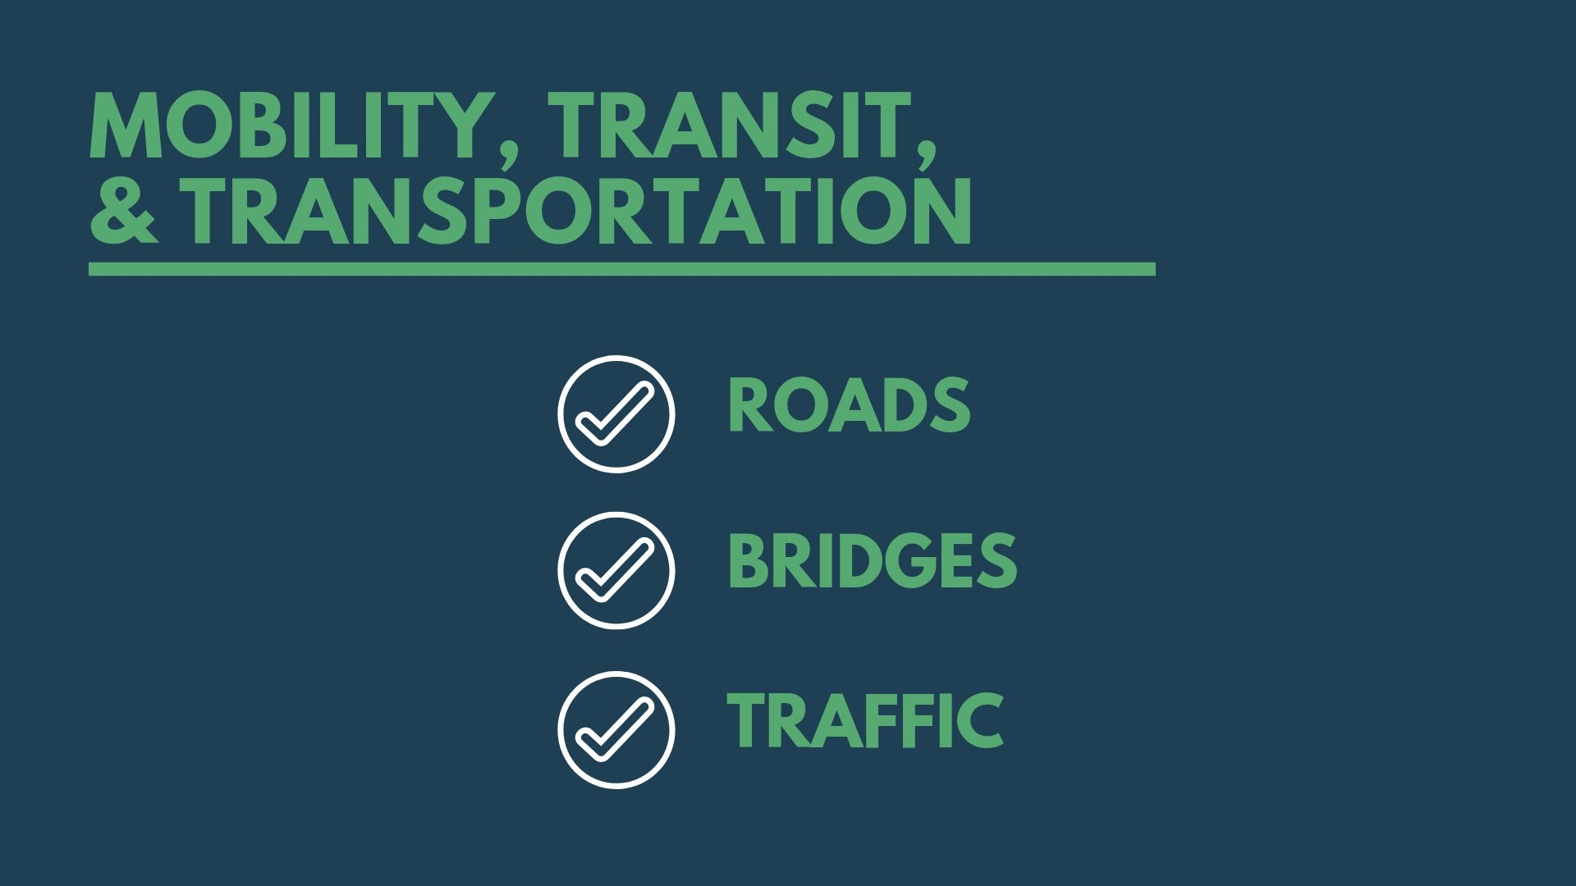
Mobility, Transit, &
Transportation
ROAD Condition
Mobility, Transit, & transportation
#5

Slide 12
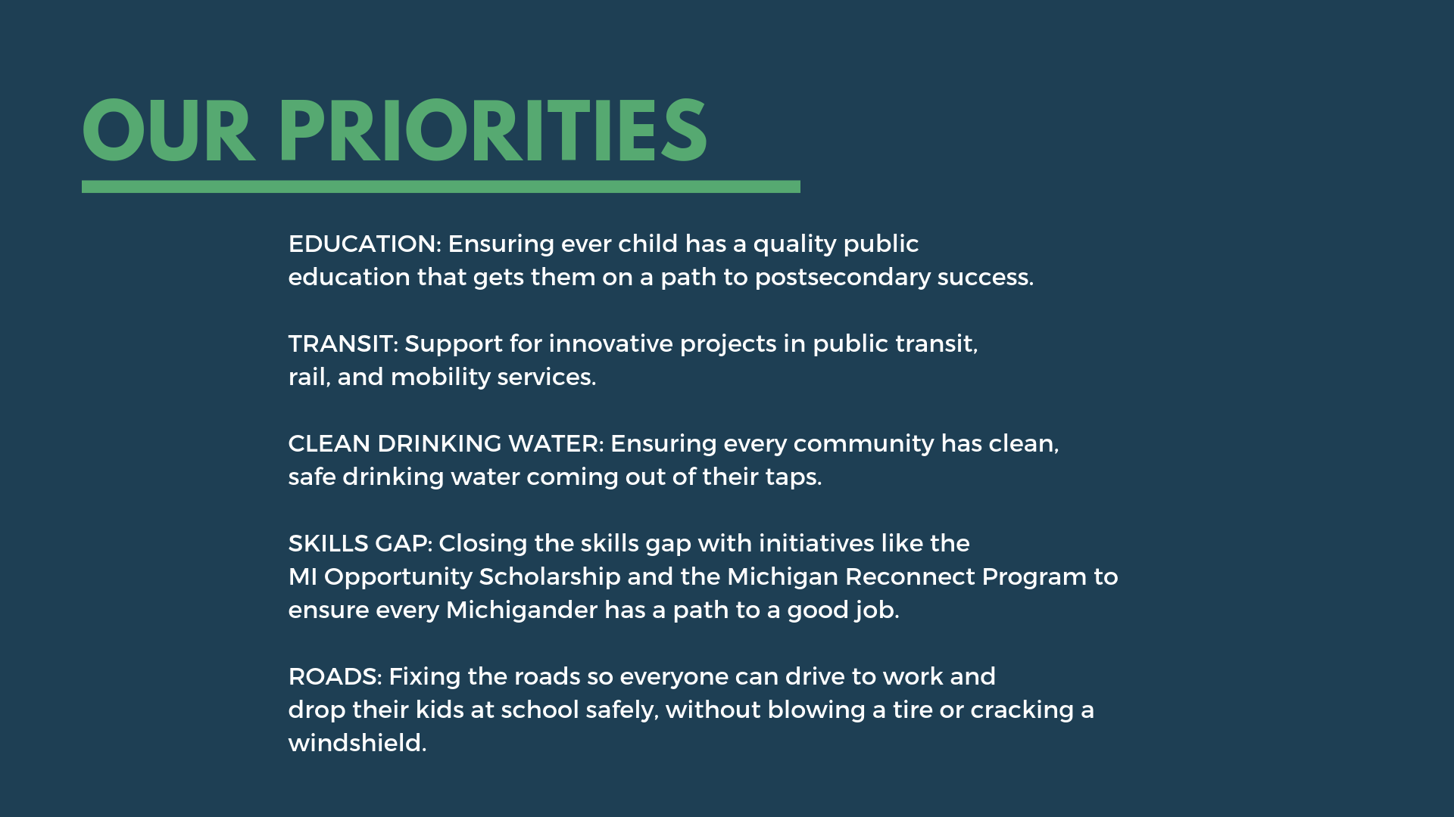

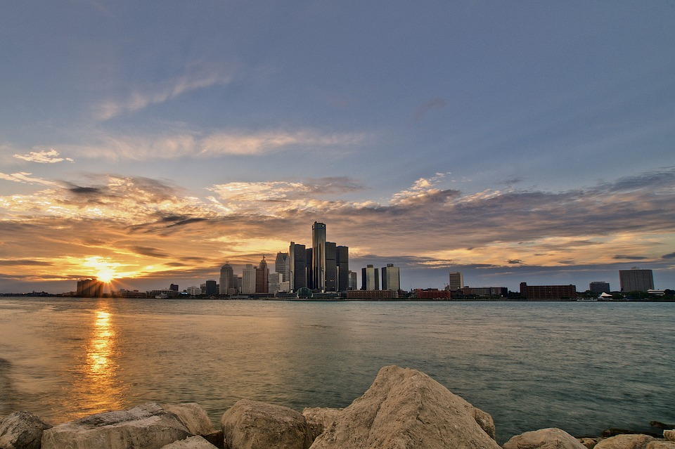

Slide 13
Email: mieog-thrivingcities@michigan.gov

