Slide 1

MDS Item Set Version 1.20.1
September 25, 2025
Haideh Najafi, BSN, RN, MSED, EDS
RAI/MDS and OASIS Educational Coordinator
E-mail: najafih@michigan.gov

Slide 2
Important Notice
This training is current as of the date of this presentation. Information in this training is not intended to be all inclusive and is not a substitute for current regulations, center for Medicare and Medicaid services (CMS) publications, and/or instructions outlined in the current RAI/MDS guidance manual, and update memorandum.

Slide 3
Learning Objectives
Identify revision item in MDS 1.20.1 item sets.
Identify changes in RAI manual.
Explain coding section O.
Explain changes in correction of the MDS Assessments
Identify resources available in RAI manual.

Slide 4
Section K
Swallowing/
Nutritional Status
4

Slide 5
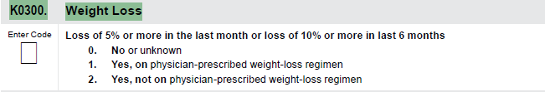
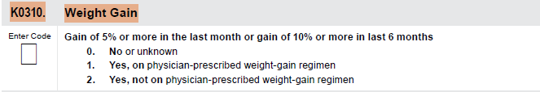
K0300: Weight Loss & K0310: Weight Gain
5

Slide 6
Definition-Weight loss in 30 days
6
5% Weight loss in 30 days:
Start with the resident’s weight closest to 30 days ago and
Multiply it by .95 (or 95%).
The resulting figure represents a 5% loss from the weight 30 days ago.
If the resident’s current weight is equal to or less than the resulting figure, the resident has lost more than 5% body weight.

Slide 7
Definition-Weight gain in 30 days
7
5% weight gain in 30 days:
Start with the resident’s weight closest to 30 days ago and
Multiply it by 1.05 (or 105%).
The resulting figure represents a 5% gain from the weight 30 days ago.
If the resident’s current weight is equal to or more than the resulting figure, the resident has gained more than 5% body weight.

Slide 8
Definition-Weight loss in 180 days
8
10% weight loss in 180 days:
Start with the resident’s weight closest to 180 days ago and
Multiply it by .90 (or 90%).
The resulting figure represents a 10% loss from the weight 180 days ago.
If the resident’s current weight is equal to or less than the resulting figure, the resident has lost 10% or more body weight.

Slide 9
Definition-Weight gain in 180 days
9
10% weight gain in 180 days:
Start with the resident’s weight closest to 180 days ago and
Multiply it by 1.10 (or 110%).
The resulting figure represents a 10% gain from the weight 180 days ago.
If the resident’s current weight is equal to or more than the resulting figure, the resident has gained more than 10% body weight.

Slide 10
K0300& K0310 (cont.)
10
At a point closest to 30 days preceding the current weight.
At a point closest to 180 days preceding the current weight.

Slide 11
K0300& K0310 (cont.)
11
The resident’s weight captured closest to these two time points are the only two weights considered for these items, but the resident’s weight should be monitored on a continual basis and weight loss and/or weight gain assessed and addressed on the care plan as necessary.

Slide 12
K0300& K0310- New Admission
12
  For a New Admission
  Ask the resident, family, or significant other about weight loss/weight gain over the past 30 and 180 days.
  Consult the resident’s physician, review transfer documentation, and compare with admission weight.

Slide 13
K0300 & K0310- New Admission (cont.)
13
  For a New Admission (cont.)
  If the admission weight is less than/more than the previous weight, calculate the percentage of weight loss/gain.
  Complete the same process to determine and calculate weight loss/gain comparing the admission weight to the weight 30 and 180 days ago.

Slide 14
K0300 & K0310- Subsequent Assessments
14
  For Subsequent Assessments
  From the medical record, compare the resident’s weight in the current observation period to their weight in the observation period 30 days ago.
  If the current weight is less/more than the weight in the observation period 30 days ago, calculate the percentage of weight loss/gain.

Slide 15
K0300 & K0310- Subsequent Assessments (cont.)
15
  For Subsequent Assessments (cont.)
  From the medical record, compare the resident’s weight in the current observation period to their weight in the observation period 180 days ago.
  If the current weight is less/more than the weight in the observation period 180 days ago, calculate the percentage of weight loss/gain.

Slide 16
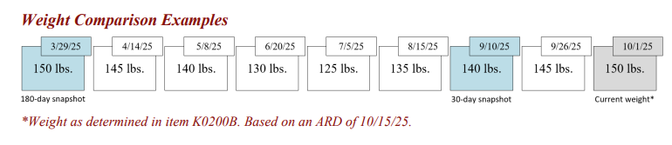
K0300: Weight Loss & K0310: Weight Gain (cont.)
16

Slide 17
K0300: Weight Loss & K0310: Weight Gain
17

Slide 18
K0300: Weight Loss & K0310: Weight Gain (cont.)
18
  Code 0, no or unknown, if :
  The resident has not experienced weight loss/gain of 5% or more in the past 30 days, or
  The resident has not experienced weight loss/gain of 10% or more in the last 180 days, or
  Information about prior weight is not available.

Slide 19
K0300: Weight Loss & K0310: Weight Gain (cont.)
19
  Code 1, yes on physician-prescribed weight-loss/gain regimen, if:
  The resident has experienced a weight loss/gain of 5% or more in the past 30 days, or
  The resident has experienced a weight loss/gain of 10% or more in the last 180 days, and
  The weight loss/gain was planned and pursuant to a physician’s order.

Slide 20
K0300: Weight Loss & K0310: Weight Gain (cont.)
20
  Code 2, yes, not on physician-prescribed weight-loss regimen, if:
  The resident has experienced a weight loss/gain of 5% or more in the past 30 days or
  The resident has experienced a weight loss/gain of 10% or more in the last 180 days, and
  The weight loss/gain was not planned and prescribed by a physician.

Slide 21
K0300: Weight Loss & K0310: Weight Gain (cont.)
21
  In cases in which multiple weights for the resident may exist during the time period being evaluated, select the weight on the date closest to the appropriate time point.

Slide 22
Section M
Skin Conditions
22

Slide 23
Determination of three steps
23
  Steps 1: Determination Deepest Anatomical stage.
  Step 2: Identify Unstageable Pressure Ulcer.
  Step 3: Determine “Present on Admission.”

Slide 24
Step 1: Determination Deepest Anatomical stage
24
  Steps 1: Determination Deepest Anatomical stage.
  For each pressure ulcer, determine the deepest anatomical stage.
  At admission, code based on findings from the first skin assessment that is conducted on or after and as close to the admission as possible.
  Do not reverse or back-stage.
  Consider current and historical levels of tissue involvement.

Slide 25
Step 2: Identify Unstageable Pressure Ulcer
25
  Step 2: The pressure ulcer is considered unstageable if:
  After careful cleansing of the pressure ulcer/injury, a pressure ulcer’s/injury’s anatomical tissues are obscured such that the extent of soft tissue damage cannot be observed or palpated.
  Known pressure ulcers/injuries covered by a non-removable dressing/device.

Slide 26
Step 2: Identify Unstageable Pressure Ulcer
26
  Pressure ulcers that have eschar or slough tissue present such that the anatomic depth of soft tissue damage cannot be visualized or palpated in the wound bed.
  A pressure injury with intact skin that is a deep tissue injury (DTI).

Slide 27
Step 3: Determine “Present on Admission”
27
  Step 3- “Present on Admission”:
  For each pressure ulcer/injury, determine if the pressure ulcer/injury was present at the time of admission/entry or reentry and not acquired while the resident was in the care of the nursing home.
  Consider current and historical levels of tissue involvement.

Slide 28
Step 3: Determine “Present on Admission” (cont.)
28
  Do not code “Present on Admission” :
  If the pressure ulcer/injury was present on admission/entry or reentry; and subsequently increased in numerical stage during the resident’s stay, the pressure ulcer is coded at that higher stage, and that higher stage should not be considered as “present on admission.”

Slide 29
Step 3: Determine “Present on Admission” (cont.)
29
  If a numerically stageable pressure ulcer/injury was present on admission/entry or reentry and becomes unstageable due to slough or eschar, during the resident’s stay.
  If a resident who has a pressure ulcer/injury that was originally acquired in the facility is hospitalized and returns with that pressure ulcer/injury at the same numerical stage.

Slide 30
Step 3: Determine “Present on Admission” (cont.)
30
  If a pressure ulcer was numerically staged, then became unstageable, and is subsequently debrided sufficiently to be numerically staged, compare its numerical stage before and after it was unstageable.
  If the numerical stage has increased, code this pressure ulcer as not “present on admission.”

Slide 31
Step 3: Determine “Present on Admission” (cont.)
31
  Code “Present on Admission” :
  If the pressure ulcer/injury was unstageable on admission/entry or reentry, then becomes numerically stageable later, it should be considered as “present on admission” at the stage at which it first becomes numerically stageable.
  If it subsequently increases in numerical stage, that higher stage should not be coded as “present on admission.”

Slide 32
Step 3: Determine “Present on Admission” (cont.)
32
  If a resident who has a pressure ulcer/injury that was “present on admission” is hospitalized and returns with that pressure ulcer/injury at the same numerical stage.
  If a resident who has a pressure ulcer/injury is hospitalized and the ulcer/injury increases in numerical stage or becomes unstageable due to slough or eschar during the hospitalization.

Slide 33
Step 3: Determine “Present on Admission” (cont.)
33
  If a resident has a pressure ulcer/injury that was documented on admission, then closed that reopens at the same stage.
  If two pressure ulcers merge, that were both “present on admission.”

Slide 34
Step 3: Determine “Present on Admission” (cont.)
34
  If a pressure ulcer/injury was unstageable on admission/ entry or reentry and then becomes unstageable for another reason, it should be considered “present on admission” at the new unstageable status.

Slide 35
Step 3: Determine “Present on Admission” (cont.)
35
  For example, if a resident is admitted with a deep tissue injury, but later the injury opens, the wound bed is covered with slough, and the wound is still unstageable, this wound would still be considered “present on admission.”

Slide 36
Section N
Medication
36

Slide 37

N0415
High-Risk Drug Classes:
Use and Indication
37

Slide 38
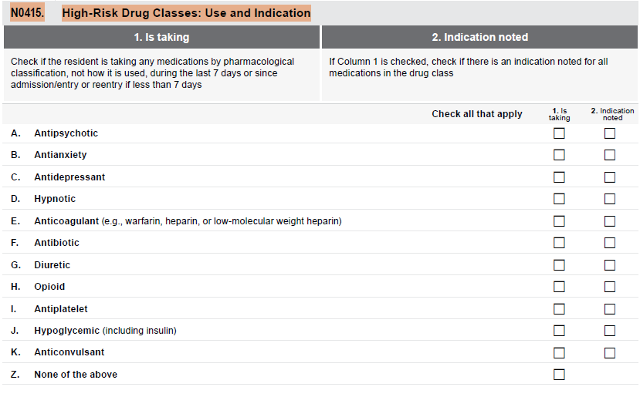
N0415-High Risk Drug Classes
38

Slide 39
Definitions
39
Adverse Consequence:
An unpleasant symptom or event that is caused by or associated with a medication, impairment or decline in an individual's physical condition, mental, functional or psychosocial status.
It may include various types of adverse drug reactions (ADR) and interactions (e.g., medication-medication, medication-food, and medication-disease).

Slide 40
Definitions (cont.)
40
Non-Pharmacological Intervention:
Approaches that do not involve the use of medication to address a medical condition.
Indication:
The identified, documented clinical rationale for administering a medication that is based upon a physician’s (or prescriber’s) assessment of the resident’s condition and therapeutic goals.

Slide 41
Definitions (cont.)
41
Dose:
The total amount/strength/ concentration of a medication given at one time or over a period of time.
The individual dose is the amount/strength/ concentration received at each administration.
The amount received over a 24- hour period may be referred to as the “daily dose.”

Slide 42
Definitions (cont.)
42
Monitoring:
The ongoing collection and analysis of information (such as observations and diagnostic test results) and comparison to baseline and current data in order to ascertain the individual's response to treatment and care, including progress or lack of progress toward a goal.
Monitoring can detect any improvements, complications, or adverse consequences of the condition or the treatments and support decisions about adding, modifying, continuing, or discontinuing any interventions.

Slide 43
Definitions (cont.)
43
Sleep Hygiene:
Practices, habits and environmental factors that promote and/or improve sleep patterns.
Medication Interaction:
The impact of medication or other substance upon another medication.

Slide 44
Definitions (cont.)
44
Medication Interaction (cont.):
The interactions may alter:
Absorption,
Distribution,
Metabolism, or
Elimination.
These interactions may decrease the effectiveness of the medication or increase the potential for adverse consequences.

Slide 45
N0415-High Risk Drug Classes: Use and Indication
45

Slide 46
N0415 (cont.)
46
Code all high-risk drug class medications according to their pharmacological classification.
Do not code these high-risk drug class medications according on how they are being used.

Slide 47
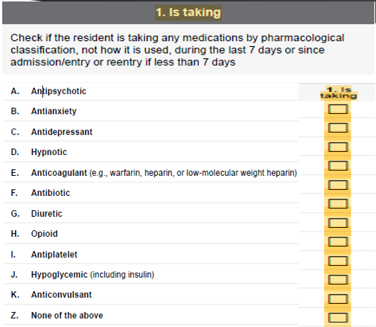
N0415- High-Risk Drug Classes: Use and Indication
47
Check column 1 if:
The resident is taking any medications by pharmacological classification during the 7-day observation period (or since admission/entry or reentry if less than 7 days).

Slide 48
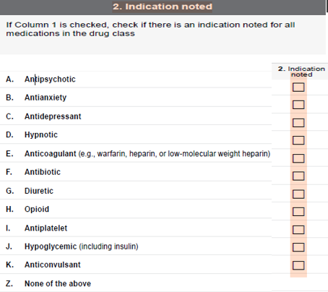
N0415- High-Risk Drug Classes: Use and Indication
48
Check column 2:
If Column 1 is checked,
Then checked column 2 if there is an indication noted for all medications in the drug class.

Slide 49
N0415A. Antipsychotic
49
N0415A1. Antipsychotic: Check if an antipsychotic medication was taken by the resident at any time during the 7-day look-back period .
N0415A2. Antipsychotic: Check if there is an indication noted for all antipsychotic medications taken by the resident any time during the observation period.

Slide 50
N0415B. Antianxiety
50
N0415B1. Antianxiety: Check if an anxiolytic medication was taken by the resident at any time during the 7-day look-back period.
N0415B2. Antianxiety: Check if there is an indication noted for all anxiolytic medications taken by the resident any time during the observation period.

Slide 51
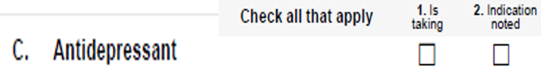
N0415C. Antidepressant
51
N0415C1. Antidepressant: Check if an antidepressant medication was taken by the resident at any time during the 7-day look-back period.
N0415C2. Antidepressant: Check if there is an indication noted for all antidepressant medications taken by the resident any time during the observation period.

Slide 52
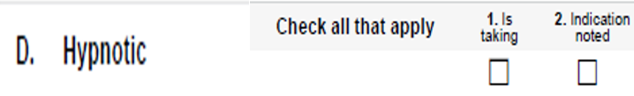
N0415D. Hypnotic
52
N0415D1. Hypnotic: Check if a hypnotic medication was taken by the resident at any time during the 7-day look-back period.
N0415D2. Hypnotic: Check if there is an indication noted for all hypnotic medications taken by the resident any time during the observation period.

Slide 53
N0415E. Anticoagulant
53
N0415E1. Anticoagulant : Check if an anticoagulant medication was taken by the resident at any time during the 7-day look-back period.
N0415E2. Anticoagulant: Check if there is an indication noted for all anticoagulant medications taken by the resident any time during the observation period.

Slide 54
N0415E. Anticoagulant (cont.)
54
Multiple medication interactions exist with use of anticoagulants which may:
Increase PT/INR results to levels associated with life-threatening bleeding, or
Decrease PT/INR results to ineffective levels, or
Increase or decrease the serum concentration of the interacting medication.

Slide 55
N0415E. Anticoagulant (cont.)
55
Information on common medication-medication interactions can be found in the:
State Operations Manual (SOM), Appendix PP, Guidance to Surveyors for Long Term Care Facilities [the State Operations Manual can be found at:
https://www.cms.gov/regulations-andguidance/guidance/manuals/internet-only-manualsioms-items/cms1201984

Slide 56
N0415E. Anticoagulant (cont.)
56
N0415E, should be coded for anticoagulants such as Target Specific Oral Anticoagulants (TSOACs), which may or may not require laboratory monitoring.
Do not code N0415E, Anticoagulant for following:
Antiplatelet medications such as aspirin/ extended release, dipyridamole, or clopidogrel.
Flushes to keep an IV access patent.

Slide 57
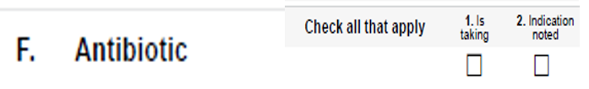
N0415F. Antibiotic
57
N0415F1. Antibiotic: Check if an antibiotic medication was taken by the resident at any time during the 7-day look-back period.
N0415F2. Antibiotic: Check if there is an indication noted for all antibiotic medications taken by the resident any time during the observation period.

Slide 58
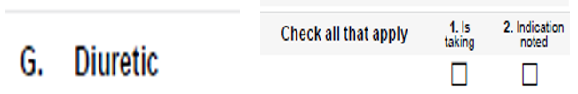
N0415G. Diuretic
58
N0415G1. Diuretic: Check if a diuretic medication was taken by the resident at any time during the 7-day look-back period.
N0415G2. Diuretic: Check if there is an indication noted for all diuretic medications received by the resident any time during the observation period.

Slide 59
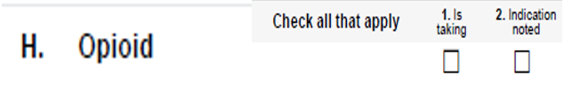
N0415H. Opioid
59
N0415H1. Opioid: Check if an opioid medication was taken by the resident at any time during the 7-day look-back period.
N0415H2. Opioid: Check if there is an indication noted for all opioid medications taken by the resident any time during the observation period.

Slide 60
N0415H. Opioid (cont.)
60
Transdermal patches are generally releasing medication over a period of several days.
To code N0415, only capture the medication if the transdermal patch was applied to the resident’s skin during the observation period.

Slide 61

N0415I. Antiplatelet
61
N0415I1. Antiplatelet: Check if an antiplatelet medication (e.g., aspirin/extended release, dipyridamole, clopidogrel) was taken by the resident at any time during the 7-day observation period.
N0415I2. Antiplatelet: Check if there is an indication noted for all antiplatelet medications taken by the resident any time during the observation period.

Slide 62

N0415J. Hypoglycemic
62
N0415J1. Hypoglycemic: Check if a hypoglycemic medication was taken by the resident at any time during the 7-day observation period.
N0415J2. Hypoglycemic: Check if there is an indication noted for all hypoglycemic medications taken by the resident any time during the observation period.

Slide 63

N0415K. Anticonvulsant
63
N0415K1. Anticonvulsant: Check if an anticonvulsant medication was taken by the resident at any time during the 7-day observation period.
N0415K2. Anticonvulsant: Check if there is an indication noted for all anticonvulsant medications taken by the resident any time during the observation period.

Slide 64
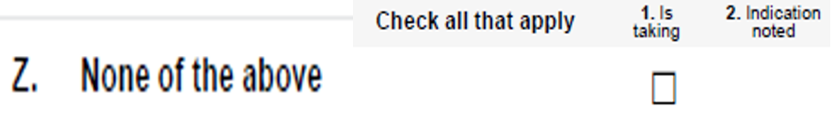
N0415Z. None of the above
64
N0415Z1. None of the above: Check if none of the medications above were taken by the resident at any time during the observation period (or since admission/entry or reentry if less than 7 days).

Slide 65
N0415- High-Risk Drug Classes
65
Facilities may wish to identify a resource that their staff consistently use to identify pharmacological classification as assessors should be able to identify the source(s) used to support coding the MDS 3.0.

Slide 66
N0415- High-Risk Drug Classes (cont.)
66
Assessors should consult the manufacturer’s package insert, which may contain the medication’s pharmacological classification.
They can also work with the resident’s pharmacist to confirm the medication classification(s) for a resident’s medication(s).

Slide 67
N0415- High-Risk Drug Classes (cont.)
67
Medications that have more than one therapeutic category and/or pharmacological classification should be coded in all categories/classifications regardless of how it is being used.

Slide 68
N0415- High-Risk Drug Classes (cont.)
68
Include any of the listed medications given to the resident by any route in any setting while a resident of the nursing home.
Code a medication even if it was given only once during the look-back period.

Slide 69
N0415- High-Risk Drug Classes (cont.)
69
Count long-acting medications that are given every few weeks or monthly only if they are given during the 7-day lookback period.

Slide 70
N0415- High-Risk Drug Classes (cont.)
70
Combination medications should be coded in all categories/pharmacologic classes that constitute the combination.
Do not code N0415 if the residents are using herbal and alternative medicine products.

Slide 71
N0415- High-Risk Drug Classes (cont.)
71
For more information use the FDA website at:
https://www.fda.gov/food/dietary-supplements/information-consumers-using-dietary-supplements.

Slide 72
N0415- High-Risk Drug Classes (cont.)
72
Diagnostic and Statistical Manual of Mental Disorders, Fifth Edition (DSM-5) (or subsequent editions) at: https://www.psychiatry.org/psychiatrists/practice/dsm
And
State Operations Manual, Appendix PP, Guidance to Surveyors for Long Term Care Facilities [the State Operations Manual can be found at :
(https://www.cms.gov/regulations-andguidance/guidance/manuals/internet-only-manuals-ioms-items/cms1201984)].

Slide 73
N0415- Medication resources
73
GlobalRPh Drug Reference,
https://globalrph.com/drugs/a/
USP Pharmacological Classification of Drugs,
http://www.usp.org/usp-healthcareprofessionals/usp-medicare-model-guidelines/medicare-model-guidelines-v50- v40#Guidelines6.
Medline Plus,
https://www.nlm.nih.gov/medlineplus/druginformation.html

Slide 74
N0415- Medication resources (cont.)
74
These resource are not all-inclusive, and use of these resources are not required for MDS completion.
The resources are being provided as a convenience, for informational purposes only, and CMS is not responsible for their accessibility, content, or accuracy.

Slide 75
N0415- Medication resources (cont.)
75
Note: References to non-CMS sources do not constitute or imply endorsement of these organizations or their programs by CMS or the U.S. Department of Health and Human Services and were current as of the date of this publication.

Slide 76
Section O
Special Treatments, Procedures, and Programs
76

Slide 77
O0110
Special Treatments, Procedures, and Programs
77

Slide 78
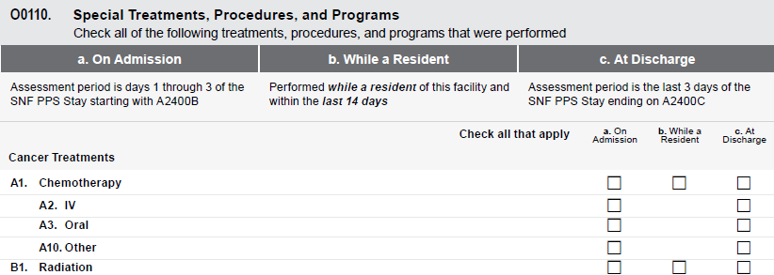
O0110- Special Treatments, Procedures, and Programs
78

Slide 79
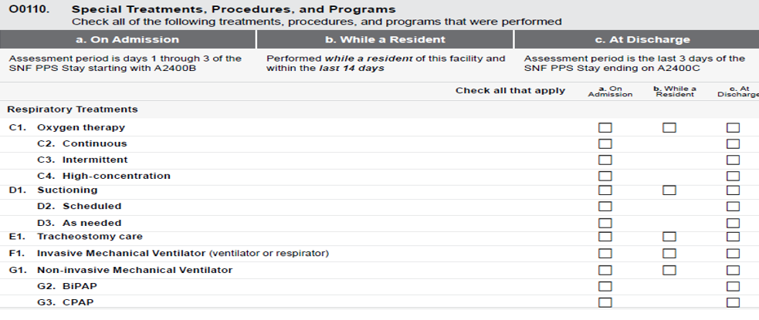
O0110- Special Treatments, Procedures, and Programs
79

Slide 80
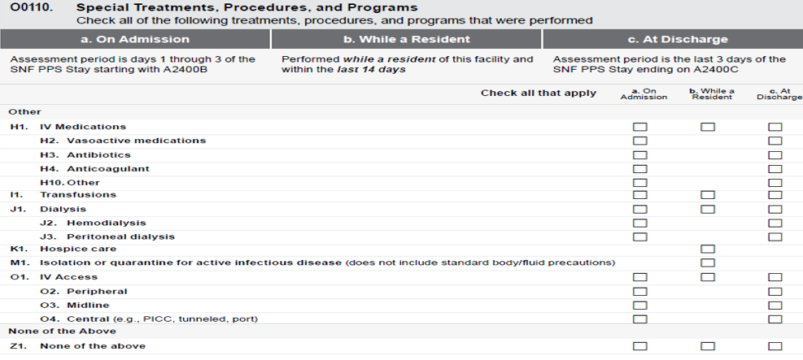
O0110- Special Treatments, Procedures, and Programs
80

Slide 81
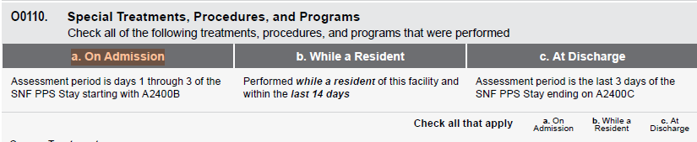
O0110:Column a-On admission
81

Slide 82
O0110:Column a-On admission (cont.)
82
Check all treatments, procedures, and programs received by, performed on, or participated in by the resident on days 1–3 of the SNF PPS Stay starting with A2400B.
If no treatments, procedures, or programs were received or performed in the 3-day assessment period, check Z, None of the above.

Slide 83
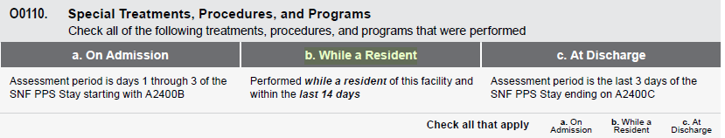
O0110- Column b-While a Resident
83

Slide 84
O0110- Column b-While a Resident (cont.)
84
Check all treatments, procedures, and programs that the resident received or performed after admission/entry or reentry to the facility and within the last 14 days.
If no treatments, procedures or programs were received by, performed on, or participated in by the resident within the last 14 days or since admission/entry or reentry, check Z, None of the above.

Slide 85
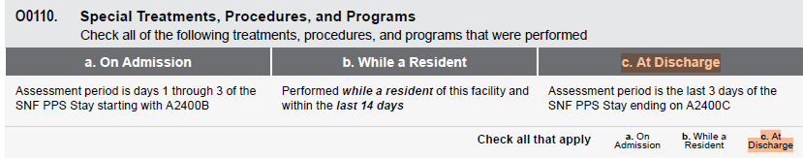
O0110:Column c-At Discharge
85

Slide 86
O0110- Column c-At Discharge (cont.)
86
Check all treatments, procedures, and programs received by, performed on, or participated in by the resident in the last 3 days of the SNF PPS Stay ending with A2400C.
If no treatments, procedures or programs were received by, performed on, or participated in by the resident in the 3-day assessment period, check Z, None of the above.

Slide 87
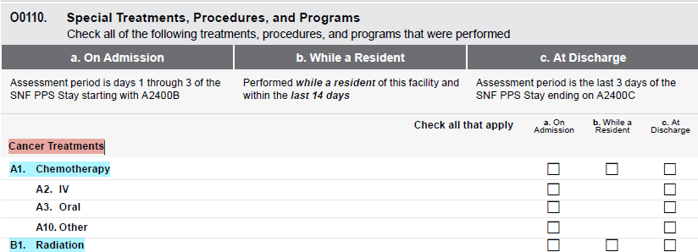
O0110A-B: Cancer Treatments
87

Slide 88
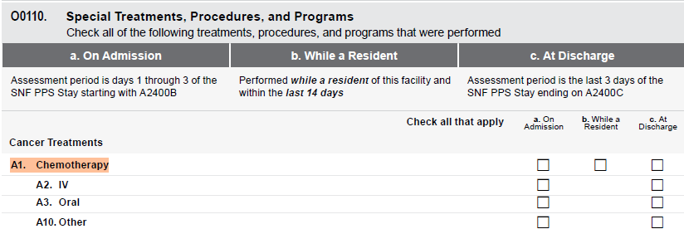
O0110A1-Chemotherapy
88

Slide 89
O0110A1-Chemotherapy (cont.)
89
Code any type of chemotherapy agent administered as an antineoplastic given by any route in this item.
Code only if the medications actually used for cancer treatment.

Slide 90
O0110A1-Chemotherapy (cont.)
90
Do not code O0100A1, hormonal and other agents administered to prevent the recurrence or slow the growth of cancer.
Do not code IVs, IV medication, and blood transfusions administered during chemotherapy on the following items:
K0520A (Parenteral/IV),
O0110H (IV Medications),
O0110I (Transfusions).

Slide 91
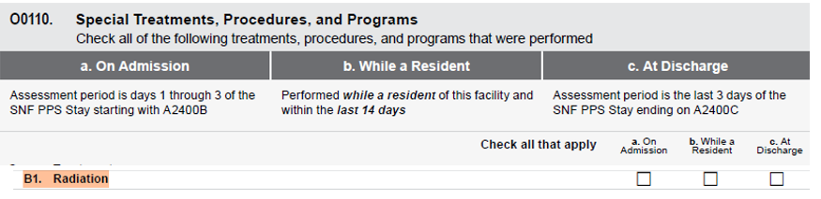
O0110B1- Radiation
91
Code O0110B1. Radiation:
Intermittent radiation therapy,
Radiation administered via radiation implant.

Slide 92
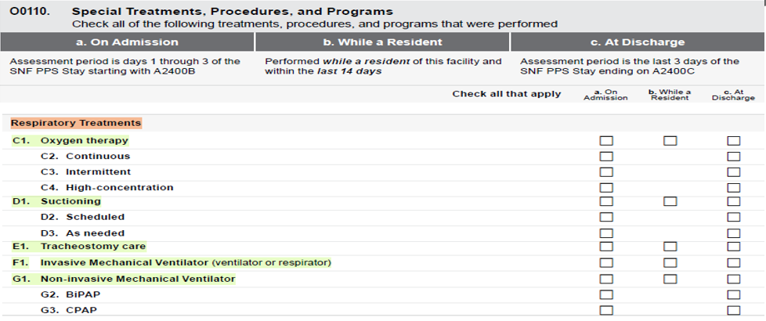
O0110C-G: Respiratory Treatment
92

Slide 93
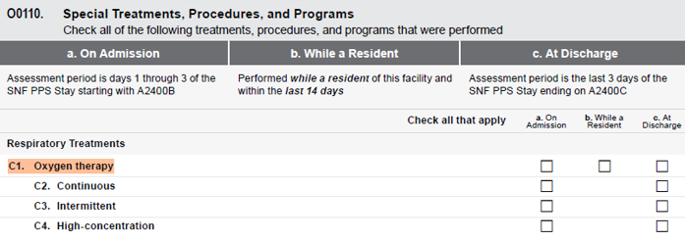
O0110C1- Oxygen Therapy
93

Slide 94
O0110C1- Oxygen Therapy
94
Code continuous or intermittent oxygen administered via mask, cannula, etc.,
Code oxygen used in Bi-level Positive Airway Pressure/Continuous Positive Airway Pressure (BiPAP/CPAP).
Code, if the resident places or removes their own oxygen mask, cannula.
Do not code hyperbaric oxygen for wound therapy.

Slide 95
O0110C- Oxygen Therapy (cont.)
95
The Oxygen may be delivered:
Continuous (O0110C2)
Intermittent (O0110C3)
High- concentration (O0110C4)

Slide 96
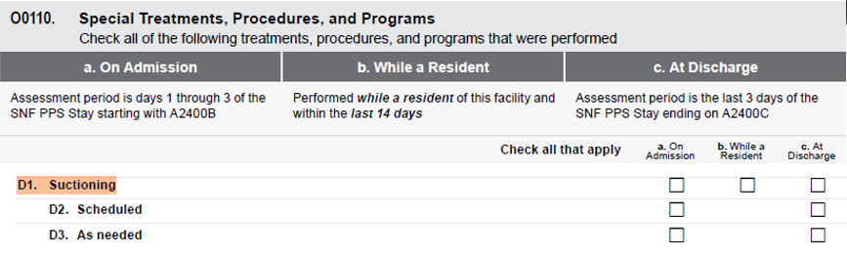
O0110D1- Suctioning
96

Slide 97
O0110D1- Suctioning (cont.)
97
Code only tracheal and/or nasopharyngeal suctioning in this item.
Code if the resident performs their own tracheal and/or nasopharyngeal suctioning.
Suctioning can be:
Scheduled (O0110D2).
As needed (O0110D3).
Do not code oral suctioning here.

Slide 98
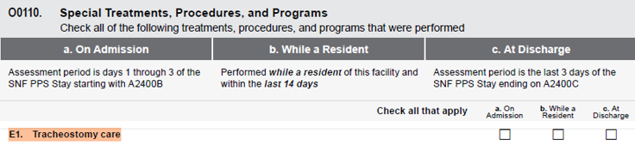
O0110E1- Tracheostomy Care
98
Code cleansing of the tracheostomy and/or cannula.
Code the laryngectomy tube care.
This item may be coded if the resident performs their own tracheostomy care.

Slide 99
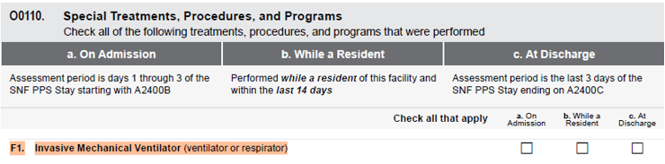
O0110F1- Invasive Mechanical Ventilator
99

Slide 100
O0110F1- Invasive Mechanical Ventilator (cont.)
100
Code any type of electrically or pneumatically powered closed-system mechanical ventilator support device
Code, for a resident who has been weaned off of a respirator or ventilator in the last 14 days or is currently being weaned off a respirator or ventilator.

Slide 101
O0110F1- Invasive Mechanical Ventilator(cont.)
101
Code if resident is receiving closed-system ventilation include those residents who are receiving ventilation via an endotracheal tube or tracheostomy.
Do not code this item when the ventilator or respirator is used only as a substitute for BiPAP or CPAP.

Slide 102
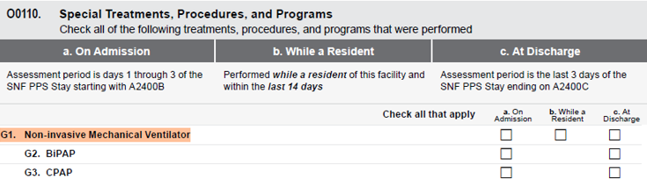
O0110G1- Non- Invasive Mechanical Ventilator
102

Slide 103
O0110G1- Non- Invasive Mechanical Ventilator (cont.)
103
Code any type of BiPAP (O0110G2) or CPAP (O0110G3) respiratory support devices that prevent airways from closing.
Code if a ventilator or respirator is being used as a substitute for BiPAP/CPAP.
Code if the resident places or removes their own BiPAP/CPAP mask/device.

Slide 104
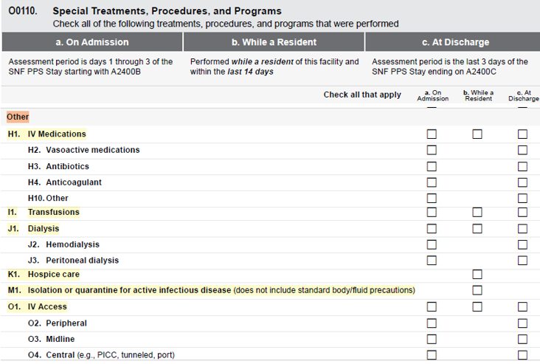
O0110H-O: Other Treatment, Procedure & Programs
104

Slide 105
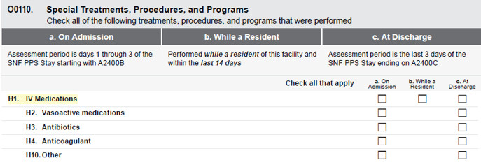
O0110H1- IV Medications
105

Slide 106
O0110H1- IV Medications (cont.)
106
Code any drug or biological given by;
  Intravenous push,
Epidural pump, or
Drip through a central or peripheral port.
Code epidural, intrathecal, and baclofen pumps.

Slide 107
O0110H1- IV Medications (cont.)
107
Code O0110H2, Vasoactive medications when:
At least one of the IV medications was an IV vasoactive medication.
Code O0110H3, Antibiotics when:
At least one of the IV medications was an IV antibiotic.

Slide 108
O0110H1- IV Medications (cont.)
108
Code O0110H4, Anticoagulation when:
At least one of the IV medications was an IV anticoagulant.
Do not include subcutaneous administration of anticoagulant medications.

Slide 109
O0110H1- IV Medications (cont.)
109
Code O0110H10, Other when at least one of the IV medications was not:
IV vasoactive medication.
IV antibiotic.
IV anticoagulant.
Examples include IV analgesics (e.g., morphine) and IV diuretics (e.g., furosemide).

Slide 110
O0110H1- IV Medications (cont.)
110
Do not code:
Flushes to keep an IV access port patent,
IV fluids without medication here.
Subcutaneous pumps.
IV medications of any kind that were administered during dialysis or chemotherapy.
Lactated Ringers given IV.

Slide 111
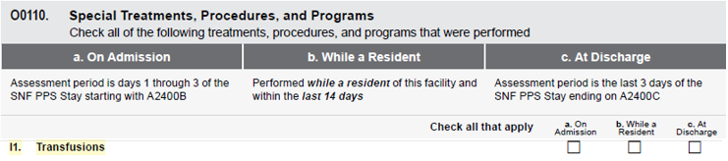
O0110I1- Transfusions
111
Code transfusions of blood or any blood products, that are administered directly into the bloodstream in this item.
Do not include transfusions that were administered during dialysis or chemotherapy.

Slide 112
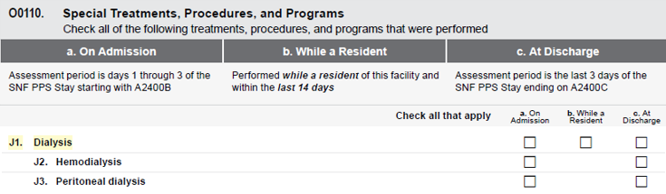
O0110J1- Dialysis
112

Slide 113
O0110J1- Dialysis (cont.)
113
Code peritoneal (O0110J3) or renal dialysis (O0110J2) which occurs at the nursing home or at another facility.
Code treatments of
hemofiltration,
Slow Continuous Ultrafiltration (SCUF),
Continuous Arteriovenous Hemofiltration (CAVH), and
Continuous Ambulatory Peritoneal Dialysis (CAPD).
Code if the resident performs their own dialysis.

Slide 114
O0110J1- Dialysis (cont.)
114
Code O0110J2, Hemodialysis when the dialysis was hemodialysis.
Code O0110J3, Peritoneal dialysis Check when the dialysis was peritoneal dialysis.
Do not code IVs, IV medication, and blood transfusions administered during dialysis.

Slide 115
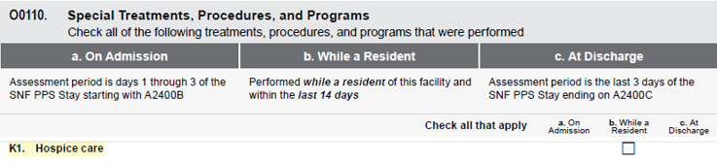
O0110K1- Hospice care
115

Slide 116
O0110K1- Hospice care (cont.)
116
Code residents identified as being in a hospice program for terminally ill persons where an array of services is provided for the palliation and management of terminal illness and related conditions.
The hospice must be licensed by the state as a hospice provider and/or certified under the Medicare program as a hospice provider.

Slide 117
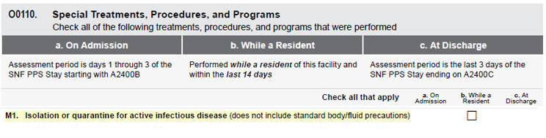
O0110M1- Isolation
117
Code only when the resident requires;
Transmission-based precautions, and
Single room isolation (alone in a separate room).

Slide 118
O0110M1- Isolation (cont.)
118
Code for “single room isolation” only when all of the following conditions are met:
The resident has active infection with highly transmissible or epidemiologically significant pathogens.
Precautions are over and above standard precautions.
The resident is in a room alone because of active infection and cannot have a roommate.
The resident must remain in their room.

Slide 119
O0110M1- Isolation (cont.)
119
If you are transporting a resident who meets the criteria for single room isolation to another healthcare setting to receive medically needed services when your facility does not or cannot provide, follow CDC guidelines for transport of patients with communicable disease, and you may still code O0110M for single room isolation since it is still being maintained while the resident is in the facility.

Slide 120
O0110M1- Isolation (cont.)
120
Do not code this item if:
The resident only has a history of infectious disease.
The precautions are standard precautions, because these types of precautions apply to everyone.

Slide 121
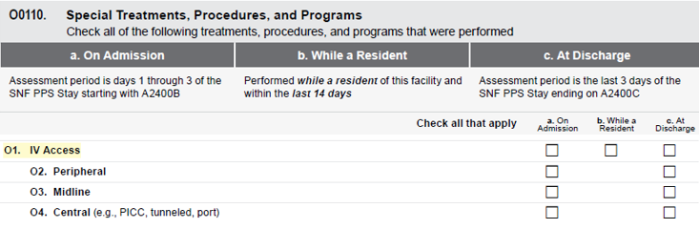
O0110O1- IV Access
121

Slide 122
O0110O1- IV Access (cont.)
122
Code IV access, which refers to a catheter inserted into a vein for a variety of clinical reasons.
Code O0110O2, Peripheral when IV access was peripheral access and remains peripheral.

Slide 123
O0110O1- IV Access (cont.)
123
Code O0110O3, Midline when IV access was midline access.
Code O0110O4, Central, when IV access was centrally located.
Do not code arteriovenous (AV) fistula in this item.

Slide 124
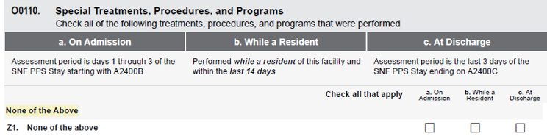
O0110Z1- None of above
124
Code O0110Z1, if:
None of the above treatments, procedures, or programs were received or performed by the resident.

Slide 125
O0250
Influenza Vaccine
125

Slide 126
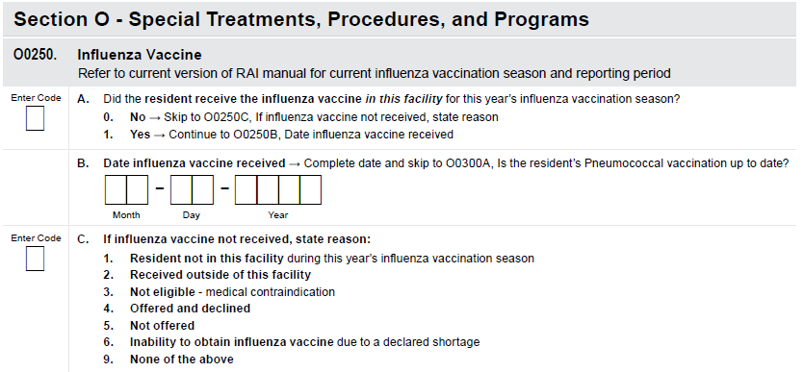
O0250- Influenza Vaccine
126

Slide 127
O0250- Influenza Vaccine (cont.)
127
For information regarding Influenza Vaccine Safety Monitoring and Vaccine Safety Activities of the CDC visit:
https://www.cdc.gov/vaccine-safety-systems/

Slide 128
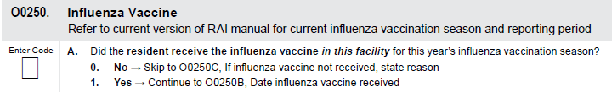
O0250A
128

Slide 129
O0250A (cont.)
129
O0250A, Did the resident receive the influenza vaccine in this facility for this year’s influenza vaccination season?
Code 0, no; if:
The resident did NOT receive the influenza vaccine in this facility during this year’s influenza vaccination season.
If influenza vaccine not received, state reason (O0250C).

Slide 130
O0250A (cont.)
130
Code 1, yes; if:
The resident did receive the influenza vaccine in this facility during this year’s influenza season.
Continue to Date influenza vaccine received (O0250B)

Slide 131
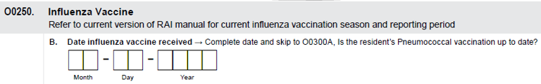
O0250B-Date Influenza Vaccine received
131

Slide 132

O0250B-Date Influenza Vaccine received (cont.)
132
O0250B, Date influenza vaccine received:
Enter the date that the influenza vaccine was received.
Do not leave any boxes blank.
If the month contains only a single digit, fill in the first box of the month with a “0”.
0
1
1
7
2
0
1
4

Slide 133
O0250B-Date Influenza Vaccine received (cont.)
133
If the day only contains a single digit, then fill the first box of the day with the “0”.
1
0
0
6
2
0
1
3
If the date is unknown or the information is not available, only a single dash needs to be entered in the first box.

Slide 134
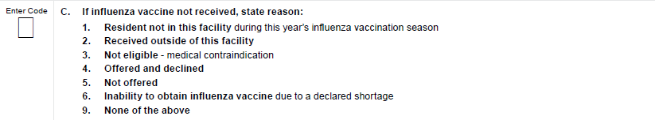
O0250C. If influenza vaccine not received, state reason
134

Slide 135
O0250C (cont.)
135
O0250C, If influenza vaccine not received, state reason
Code 1, if:
Resident was not in this facility during this year’s influenza vaccination season.

Slide 136
O0250C (cont.)
136
Code 2, Received outside of this facility:
Includes influenza vaccinations administered in any other setting during this year’s influenza vaccination season.

Slide 137
O0250C (cont.)
137
Code 3, Not eligible - medical contraindication: if
Influenza vaccine not received due to medical contraindications.
Influenza vaccine is contraindicated for a resident with severe reaction to a previous dose of influenza vaccine or to a vaccine component.

Slide 138
O0250C (cont.)
138
Code 4, Offered and declined, if:
Resident or responsible party/legal guardian has been informed of the risks and benefits of receiving the influenza vaccine and chooses not to accept vaccination.

Slide 139
O0250C (cont.)
139
Code 5, Not offered, if:
Resident or responsible party/legal guardian not offered the influenza vaccine.
Code 6, Inability to obtain influenza vaccine due to a declared shortage, if
Vaccine is unavailable at this facility due to a declared influenza vaccine shortage.

Slide 140
O0250C (cont.)
140
Code 9, None of the above, if
None of the listed reasons describe why the influenza vaccine was not administered.
The answer is unknown.

Slide 141
O0250-Influenza Vaccine (cont.)
141
Information about when facilities must offer residents the influenza vaccine is available in 42 CFR 483.80(d), Influenza and pneumococcal immunizations, which can be found in Appendix PP of the State Operations Manual (SOM):
https://www.cms.gov/Regulations-andGuidance/Guidance/Manuals/downloads/som107ap_pp_guidelines_ltcf.pdf#page=708

Slide 142
O0250-Influenza Vaccine (cont.)
142
Information about the current influenza season can located at the CDC Seasonal Influenza website at:
https://www.cdc.gov/flu/weekly/, http://www.cdc.gov/flu/weekly/usmap.htm

Slide 143
O0300
Pneumococcal Vaccine
143

Slide 144
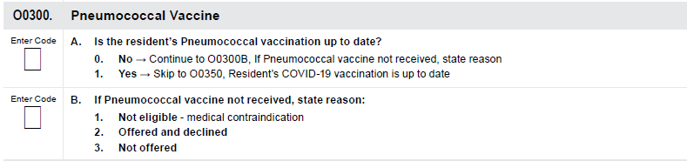
O0300- Pneumococcal Vaccine
144

Slide 145
O0300- Pneumococcal Vaccine (cont.)
145
Conditions that increase the risk of invasive pneumococcal disease include:
Decreased immune function.
Damaged or no spleen.
Sickle cell and other hemoglobinopathies.
Cerebrospinal fluid (CSF) leak.
Cochlear implants.

Slide 146
O0300- Pneumococcal Vaccine (cont.)
146
Chronic diseases of the heart, lungs, liver, and kidneys, including:
Dialysis,
Diabetes,
Alcoholism, and
Smoking.

Slide 147
O0300- Pneumococcal Vaccine (cont.)
147
CDC guidance about risk conditions can be found at:
https://www.cdc.gov/pneumococcal/hcp/vaccine-recommendations/risk-indications.html.

Slide 148
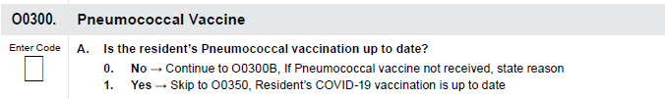
O0300A- Is the resident’s pneumococcal vaccination up to date?
148

Slide 149
O0300A (cont.)
149
“Up to date” means in accordance with current Advisory Committee on Immunization Practices (ACIP) recommendations.
For up-to-date information on timing and intervals between vaccines, refer to ACIP vaccine recommendations available at:
https://www.cdc.gov/vaccines/hcp/imz-schedules/
https://www.cdc.gov/acip-recs/hcp/vaccine-specific/
https://www.cdc.gov/pneumococcal/hcp/vaccine-recommendations/

Slide 150
O0300A (cont.)
150
O0300A:Is the Resident’s Pneumococcal Vaccination Up to Date?
Code 0, no; if:
The resident’s pneumococcal vaccination status is not up to date or cannot be determined.
Proceed to item O0300B, If Pneumococcal vaccine not received, state reason.

Slide 151
O0300A (cont.)
151
O0300A:Is the Resident’s Pneumococcal Vaccination Up to Date?
Code 1, yes; if:
The resident’s pneumococcal vaccination status is up to date.
Skip to O0350, Resident’s COVID-19 vaccination is up to date.

Slide 152
O0300A (cont.)
152
Code 1, yes (cont.); if:
A resident has received one or more pneumococcal vaccinations and is indicated to get an additional pneumococcal vaccination but is not yet eligible for the next vaccination because the recommended time interval between vaccines has not lapsed.

Slide 153
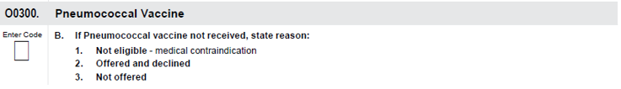
O0300B- If Pneumococcal Vaccine Not Received, State Reason
153

Slide 154
O0300B- If Pneumococcal Vaccine Not Received, State Reason
154
Code 1, Not eligible; if:
The resident is not eligible due to medical contraindications, including a life-threatening allergic reaction to:
The pneumococcal vaccine; or
Any vaccine component(s).
A physician order not to immunize.

Slide 155
O0300B- If Pneumococcal Vaccine Not Received, State Reason
155
Code 2, Offered and declined; if:
Resident or responsible party/legal guardian has been informed of what is being offered and chooses not to accept the pneumococcal vaccine.
Code 3, Not offered, if:
Resident or responsible party/legal guardian not offered the pneumococcal vaccine.

Slide 156
Coding Tips for O0300
156
Specific guidance about pneumococcal vaccine recommendations and timing for adults can be found at:
https://www.cdc.gov/pneumococcal/downloads/vaccine-timing-adultsjobaid.pdf

Slide 157
O0350
Resident’s COVID-19 vaccination is up to date
157

Slide 158

O0350- COVID-19 Vaccination is UP to Date
158
The intent of this item is to report if the resident is up to date with their COVID-19 vaccine status.

Slide 159
O0350- COVID-19 (cont.)
159
More information about potential side effects of the COVID-19 vaccine, precautions, and contraindications can be found on the CDC webpage “Interim Clinical Considerations for Use of COVID-19 Vaccines in the United States” at:
https://www.cdc.gov/vaccines/covid19/clinical-considerations/interim-considerations-us.html#contraindications.

Slide 160
O0350- COVID-19 vaccination is up to date (cont.)
160
Code 0, No, if:
The resident does not meet the CDC’s definition of up to date. This includes:
Residents who have not received one or more recommended COVID-19 vaccine doses for any reason including medical, religious, or other qualified exemptions.
Residents for whom vaccination status cannot be determined.

Slide 161
O0350- COVID-19 vaccination is up to date (cont.)
161
Code 1, Yes, if
The resident meets the CDC’s definition of up to date.
A dash is a valid response, indicating the item was not assessed.
CMS expects dash use to be a rare occurrence.

Slide 162
Definition of “Up to Date”
162
For the definition of “up to date,” refer to the CDC webpage “Staying Up to Date with COVID-19 Vaccines” at:
https://www.cdc.gov/covid/vaccines/stay-up-to-date.html

Slide 163
O0350 (cont.)
163
Current COVID-19 vaccine recommendations are available on the Centers for Disease Control and Prevention’s (CDC’s) webpage “Staying Up to Date with COVID-19 Vaccines” at
https://www.cdc.gov/covid/vaccines/stay-up-to-date.html .

Slide 164
New Item: O0390
Therapy Services
164

Slide 165
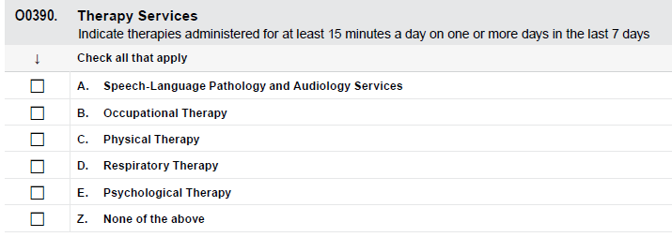
O0390- Therapy Services
165

Slide 166
O0390- Therapy Services (cont.)
166
Code only medically necessary therapies that occurred after admission/readmission to the nursing home that were:
Ordered by a physician (physician’s assistant, nurse practitioner, and/or clinical nurse specialist) based on a qualified therapist’s assessment (i.e., one who meets Medicare requirements or, in some instances, under such a person’s direct supervision) and treatment plan.

Slide 167
O0390- Therapy Services (cont.)
167
Documented in the resident’s medical record.
Care planned and periodically evaluated to ensure that the resident receives needed therapies and that current treatment plans are effective.
Therapy treatment may occur either inside or outside of the facility.

Slide 168
Definition
168
A day of therapy is defined as skilled treatment for 15 or more minutes during the day.

Slide 169
O0390- Therapy Services (cont.)
169

Slide 170
O0390- Therapy Services (cont.)
170
Psychological Therapy is provided by any licensed mental health professional, such as:
Psychiatrists.
Psychologists.
Clinical social workers.
Clinical nurse specialists in mental health as allowable under applicable state laws.

Slide 171
O0390- Therapy Services (cont.)
171
Psychiatric technicians are not considered to be licensed mental health professionals, and their services may not be counted in this item.

Slide 172
O0390- Therapy Minutes
172
Includes only therapies that were provided once the individual is actually living/ being cared for at the long-term care facility.
Only those therapies that occurred since admission / reentry to the facility and after the initial evaluation shall be counted, except in the case of an interrupted stay.

Slide 173
O0390- Therapy Minutes(cont.)
173
Do NOT include therapies that occurred while the person was:
An inpatient at a hospital, or
An inpatient at recuperative/rehabilitation center, or
An inpatient at other long-term care facility, or
A recipient of home care or community-based services.

Slide 174
O0390- Therapy Minutes (cont.)
174
Item O0390 therapy items do not require at least 15 minutes of a single mode of therapy to be checked on the MDS.
Minutes from the same therapy discipline (e.g., physical therapy) but different therapy modes (e.g., individual and concurrent) may be combined to meet the “at least 15 minutes” of skilled therapy in a day requirement.

Slide 175
O0390- Therapy Minutes (cont.)
175
Count the therapist’s time:
Spent on subsequent reevaluations, conducted as part of the treatment process.
Spent on family education when the resident is present and must be documented in the resident’s record.
Spent to adjust equipment or prepare the treatment area for skilled rehabilitation service.

Slide 176
O0390- Therapy Minutes (cont.)
176
Only skilled therapy time (i.e., requires the skills, knowledge, and judgment of a qualified therapist and all the requirements for skilled therapy are met) shall be recorded on the MDS.
In some instances, the time during which a resident received a treatment modality includes partly skilled and partly unskilled time; only time that is skilled may be recorded on the MDS.

Slide 177
O0390- Therapy Minutes (cont.)
177
Do not Count the therapist’s time:
Spent on documentation or on initial evaluation.
spent during a portion of a treatment that is:
Non-skilled;
During a non-therapeutic rest period; or
During a treatment that does not meet the therapy mode definitions.

Slide 178
O0390- Respiratory therapy minutes
178
Only minutes that the respiratory therapist or respiratory nurse spends with the resident shall count towards the 15 minutes per day on one or more days when coding the MDS.
This time includes;
Resident evaluation/assessment,
Treatment administration and monitoring, and
Setup and removal of treatment equipment.

Slide 179
O0390- Respiratory therapy minutes (cont.)
179
Do not include in respiratory minutes:
Time that a resident self-administers a nebulizer treatment without supervision of the respiratory therapist or respiratory nurse.
Administration of metered-dose and/or dry powder inhalers.

Slide 180
O0390- Therapy Minutes (cont.)
180
Include only skilled therapy services for:
Speech-Language Pathology Services (SLP),
Physical Therapy (PT),
Occupational Therapy (OT).

Slide 181
O0390- Therapy Minutes (cont.)
181
Skilled therapy services must meet all of the following conditions (Refer to Medicare Benefit Policy Manual, Chapters 8 and 15, for detailed requirements and policies):
For Part A, services must be ordered by a physician.
For Part B, the plan of care must be certified by a physician following the therapy evaluation.

Slide 182
O0390- Therapy Minutes (cont.)
182
The services must be related to an active written treatment plan that is approved by the physician.

Slide 183
O0390- Therapy Minutes (cont.)
183
The services must be of a level of complexity and sophistication, or
The condition of the resident must be of a nature that requires the therapist:
Judgment,
Knowledge, and
Skills.

Slide 184
O0390- Therapy Minutes (cont.)
184
The services must be provided with the expectation that the condition of the patient will improve materially in a reasonable and generally predictable period of time; or,
The services must be necessary for the establishment of a safe and effective maintenance program; or,
The services must require the skills of a qualified therapist for the performance of a safe and effective maintenance program.

Slide 185
O0390- Therapy Minutes (cont.)
185
The services must be considered under accepted standards of medical practice to be specific and effective treatment for the resident’s condition; and,
The services must be reasonable and necessary for the treatment of the resident’s condition; this includes:
The requirement that the amount, frequency, and duration of the services must be reasonable, and
They must be furnished by qualified personnel.

Slide 186
O0390- Therapy Minutes (cont.)
186
Include services provided by a qualified occupational/ physical therapy assistant who is employed by (or under contract with) the long-term care facility only if they are under the direction of a qualified occupational/physical therapist.
Medicare does not recognize speech-language pathology assistants; therefore, services provided by these individuals are not to be coded on the MDS.

Slide 187
O0390- Therapy Minutes (cont.)
187
Do not round therapy minutes (e.g., reporting) to the nearest 5th minute when counting therapy minutes.
Therapy logs are not an MDS requirement but reflect a standard clinical practice expected of all therapy professionals.

Slide 188
O0390- Therapy Minutes (cont.)
188
When therapy is provided, staff need to document:
The different modes of therapy and
Set up minutes that are being included on the MDS.

Slide 189
Respiratory and Psychological therapies Minutes
189
For purposes of the MDS, record services for respiratory and psychological therapies (items O0390D and O0390E) when the following criteria are met:
The physician orders the therapy;
The physician’s order includes a statement of:
Frequency,
Duration, and
Scope of treatment.

Slide 190
Respiratory and psychological therapies Minutes (cont.)
190
The services must be directly and specifically related to an active written treatment plan that is based on an initial evaluation performed by qualified personnel.
The services are required and provided by qualified personnel; and
The services must be reasonable and necessary for treatment of the resident’s condition.

Slide 191
Non-Skilled Services
191
Do not included therapy services in items O0390 (Therapy Services) or O0425 (Part A Therapies) if:
Services provided at the request of the resident or family that are not medically necessary, even when performed by a therapist or an assistant.

Slide 192
Non-Skilled Services(cont.)
192
Do not included therapy services:
When the performance of a maintenance program that does not require the skills of a therapist because it could be accomplished safely and effectively by the patient or with the assistance of non-therapists (including unskilled caregivers), such services are not considered therapy services in this context.

Slide 193
Non-Skilled Services(cont.)
193
Do not included therapy services (cont.):
If your facility elect to have licensed professionals perform repetitive exercises and other maintenance treatments or to supervise aides performing these maintenance services even when the involvement of a qualified therapist is not medically necessary.

Slide 194
Non-Skilled Services(cont.)
194
Do not code as therapy in items O0390 (Therapy Services) or O0425 (Part A Therapies) when:
Services provided by therapists, licensed or not, that are not specifically listed in RAI manual or on the MDS item set.
Document these services in the resident’s medical record.

Slide 195
Non-Skilled Services(cont.)
195
In situations where the ongoing performance of a safe and effective maintenance program does not require any skilled services, once the qualified therapist has designed the maintenance program and discharged the resident from a rehabilitation (i.e., skilled) therapy program, the services performed by the therapist and the assistant are not to be reported in O0390 Therapy Services or O0425 Part A Therapies.

Slide 196
Non-Skilled Services(cont.)
196
Services provided by therapy aides are not skilled services.
The time spent investigating the refusal or trying to persuade the resident to participate in treatment is not a skilled service and shall not be included in the therapy minutes.

Slide 197
Co-treatment- Medicare Part A
197
Co-treatment For Part A:
When two clinicians (therapists or therapy assistants), each from a different discipline, treat one resident at the same time with different treatments, both disciplines may code the treatment session in full.
All policies regarding mode, modalities, and student supervision must be followed as well as all other federal, state, practice, and facility policies.

Slide 198
Co-treatment- Medicare Part B
198
Co-treatment For Part B:
Therapists, or therapy assistants, working together as a “team” to treat one or more patients.
They cannot each bill separately for the same or different service provided at the same time to the same patient.

Slide 199
Therapy Aides
199
Therapy Aides cannot provide skilled services.
Therapy aide must be under direct supervision of the therapist or assistant.
Only the time a therapy aide spends on set-up preceding skilled therapy may be coded on the MDS.

Slide 200
Therapy Students- Medicare Part A
200
Therapy students are not required to be in the line of sight of the professional supervising therapist/assistant (Federal Register, August 8, 2011).
Supervising therapists/ assistants must make the determination as to whether or not a student is ready to treat patients without line-of-sight supervision.

Slide 201
Therapy Students- Medicare Part A (cont.)
201
Follow all state and professional practice guidelines for student supervision.
Time may be used to code the MDS when the therapist provides skilled services and direction to a student who is participating in the provision of therapy.
Document all time that the student spends with patients.

Slide 202
Therapy Students- Medicare Part B
202
The following criteria must be met in order for services provided by a student to be billed by the long-term care facility:
The qualified professional is present and in the room for the entire session.
The student participates in the delivery of services when the qualified practitioner is directing the service, making the skilled judgment, and is responsible for the assessment and treatment.

Slide 203
Therapy Students- Medicare Part B (cont.)
203
The practitioner is not engaged in treating another patient or doing other tasks at the same time.
The qualified professional is the person responsible for the services and, as such, signs all documentation.

Slide 204
Therapy Students- Medicare Part B (cont.)
204
Physical therapy assistants and occupational therapy assistants are not precluded from serving as clinical instructors for therapy assistant students while providing services within their scope of work and performed under the direction and supervision of a qualified physical or occupational therapist.

Slide 205
Modes of Therapy
205
A resident may receive therapy via different modes during the same day or even treatment session.

Slide 206
Modes of Therapy (cont.)
206
The therapist and assistant should document the reason a specific mode of therapy was chosen as well as anticipated goals for that mode of therapy.
For any therapy that does not meet one of the therapy mode definitions, those minutes may not be counted on the MDS.

Slide 207
Modes of Therapy- Individual therapy
207
The treatment of one resident at a time.
The resident is receiving the therapist’s or the assistant’s full attention.
Treatment of a resident individually at intermittent times during the day is individual treatment, and the minutes of individual treatment are added for the daily count.

Slide 208
Individual therapy-Example
208
Individual therapy:
Mode of Therapy | Individual therapy minutes
During breakfast time
8
At lunch time
13
Total
21

Slide 209
Individual Therapy- Therapy Student part A &B
209
Medicare Part A & B
Only one resident is being treated by therapy student & supervising therapist/assistant.
Medicare Part A
The supervising therapist/assistant shall not be treating or supervising other individuals, and they are able to immediately intervene/assist the student as needed.
Medicare Part B
The supervising therapist/assistant shall not be engaged in any other activity or treatment when the resident is receiving therapy.

Slide 210
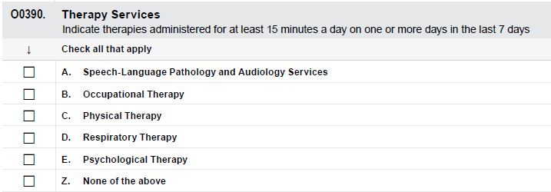
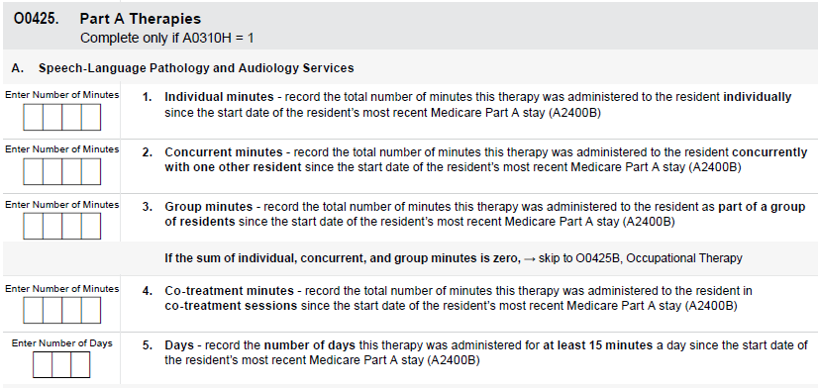
Example – Individual Therapy; Therapy Student
210
A speech therapy graduate student treats Resident A for 30 minutes.
Resident A’s therapy is covered under the Medicare Part A benefit.
The supervising speech-language pathologist is not treating any patients at this time but is not in the room with the student or Resident A.
3
0

Slide 211
Concurrent Therapy
211
The treatment of 2 residents who are not performing the same or similar activities at the same time, regardless of payer source,
Both residents must be in the line of sight of the treating therapist or assistant.
Medicare Part A

Slide 212
Individual Therapy- Therapy Student Part A
212
The therapy student is treating one resident, and
The supervising therapist/assistant is treating another resident, and
Both residents are within line of sight of the therapist/ assistant or student providing their therapy;
OR
Therapy Student Part A

Slide 213
Individual Therapy- Therapy Student Part A (cont.)
213
The therapy student is treating 2 residents, regardless of payer source, both of whom are within line of sight of the therapy student, and
The therapist is not treating any residents and not supervising other individuals;
OR
Therapy Student Part A(cont.)

Slide 214
Individual Therapy- Therapy Student Part A (cont.)
214
The therapy student is not treating any residents, and
The supervising therapist/assistant is treating 2 residents at the same time, regardless of payer source, both of whom are within line of sight.
Therapy Student Part A (cont.)

Slide 215
Example#1 – Concurrent Therapy
215
A physical therapist provides therapies that are not the same or similar to Resident Q and Resident R at the same time for 30 minutes. Resident Q’s stay is covered under the Medicare SNF PPS Part A benefit. Resident R is paying privately for therapy. Based on the information above, the therapist would code each individual’s MDS for this day of treatment as follows:

Slide 216
Example#2 – Concurrent Therapy
216
A physical therapist provides therapies that are not the same or similar to Resident S and Resident T at the same time for 30 minutes. Resident S’s stay is covered under the Medicare SNF PPS Part A benefit. Resident T’s therapy is covered under Medicare Part B. Based on the information above, the therapist would code each individual’s MDS for this day of treatment as follows:

Slide 217
Example#3 – Concurrent Therapy
217
An Occupational Therapist provides therapy to Resident K for 60 minutes. An occupational therapy graduate student, who is supervised by the occupational therapist, is treating Resident R at the same time for the same 60 minutes, but Resident K and Resident R are not doing the same or similar activities. Both Resident K’s and Resident R’s stays are covered under the Medicare Part A benefit. Based on the information above, the therapist would code each individual’s MDS for this day of treatment as follows:

Slide 218
Group Therapy- Therapy Student
218
The treatment of two to six residents, regardless of payer source, who are performing the same or similar activities, and
They are supervised by a therapist or assistant who is not supervising any other individuals.
Medicare Part A
The treatment of 2 or more individuals simultaneously, regardless of payer source, who may or may not be performing the same activity.
Medicare Part B

Slide 219
Group Therapy- Therapy Student for Part A
219
The therapy student is providing group treatment, and
The supervising therapist/assistant is not treating any residents and is not supervising other individuals (students or residents);
OR
The supervising therapist/assistant is providing group treatment, and
The therapy student is not providing treatment to any resident. In this case, the student is simply assisting the supervising therapist.
Therapy student Medicare Part A group therapy

Slide 220
Group Therapy- Therapy Student for Part B
220
The therapy student is providing group treatment, and
The supervising therapist/assistant is not engaged in any other activity or treatment;
OR
The supervising therapist/assistant is providing group treatment, and
The therapy student is not providing treatment to any resident.
Therapy student Medicare Part B group therapy

Slide 221
Example#1 – Group Therapy
221
A Physical Therapist provides similar therapies to Resident W, Resident X, Resident Y, and Resident Z at the same time, for 30 minutes.
Resident W’s and Resident X’s stays are covered under the Medicare SNF PPS Part A benefit.
Resident Y’s therapy is covered under Medicare Part B, and
Resident Z has private insurance paying for therapy.
Based on the information above, the therapist would code each individual’s MDS for this day of treatment as follows:

Slide 222
Example#2 – Group Therapy
222
Resident V, whose stay is covered by SNF PPS Part A benefit, begins therapy in an individual session.
After 13 minutes the therapist begins working with Resident S, whose therapy is covered by Medicare Part B, while Resident V continues with their skilled intervention and is in the line of sight of the treating therapist.
The therapist provides treatment during the same time period to Resident V and Resident S who are not performing the same or similar activities for 24 minutes, at which time Resident V’s therapy session ends.
The therapist continues to treat Resident S individually for 10 minutes. Based on the information above, the therapist would code each individual’s MDS for this day of treatment as follows:

Slide 223
Example#3 – Group Therapy
223
Resident A and Resident B, whose stays are covered by Medicare Part A, begin working with a physical therapist on two different therapy interventions.
After 30 minutes, Resident A and Resident B are joined by Resident T and Resident E, whose stays are also covered by Medicare Part A, and the therapist begins working with all of them on the same therapy goals as part of a group session.
After 15 minutes in this group session, Resident A becomes ill and is forced to leave the group, while the therapist continues working with the remaining group members for an additional 15 minutes.
Based on the information above, the therapist would code each individual’s MDS for this day of treatment as follows:

Slide 224
Therapy Modalities
224
Only skilled therapy time shall be recorded on the MDS.
In some instances, the time a resident receives certain modalities is partly skilled and partly unskilled time; only the time that is skilled may be recorded on the MDS.

Slide 225
Therapy Modalities (cont.)
225
Some modalities only meet the requirements of skilled therapy in certain situations.
For example, the application of a hot pack is often not a skilled intervention.
However, when the resident’s condition is complicated and the skills, knowledge, and judgment of the therapist are required for treatment, then those minutes associated with skilled therapy time may be recorded on the MDS.

Slide 226
Example#1 – Therapy Modalities
226
Resident Z’s assessment has an ARD of 09/05/24.
Review of the records show Resident Z received occupational therapy on 08/30/24 for 25 minutes, 09/01/24 for 15 minutes, and 09/03/24 for 30 minutes.

Slide 227
Example#2 – Therapy Modalities
227
On day two of the observation period Resident T received 10 minutes of physical therapy in the morning and 10 minutes of physical therapy in the afternoon.
Resident T did not receive physical therapy on any other days during the observation period.

Slide 228
Example#3 – Therapy Modalities
228
During the observation period Resident S received 10 minutes of respiratory therapy on day one, 7 minutes of respiratory therapy on day four and 13 minutes of respiratory therapy on day five of the observation period.

Slide 229
Example#4 – Therapy Modalities
229
Resident H did not receive any skilled therapy services during the observation period.

Slide 230
O0400:
Respiratory Therapy
230

Slide 231
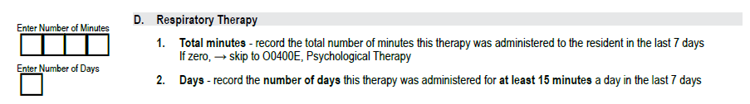
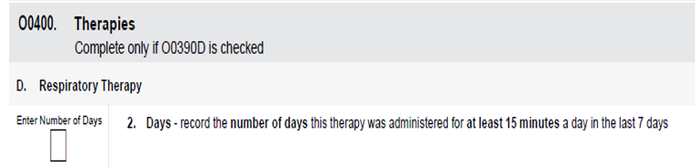
Respiratory Therapy
231
Old respiratory item
New respiratory item

Slide 232
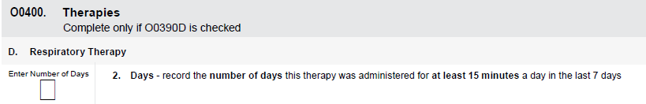
O0400: Respiratory Therapy (cont.)
232

Slide 233
O0400: Respiratory Therapy (cont.)
233
Days:
A day of therapy is treatment for 15 minutes or more in the day.
Enter the number of days therapy services were provided in the last 7 days.

Slide 234
O0400: Therapies (cont.)
234
0

Slide 235
New: O0425:
Part A Therapy
235

Slide 236
O0425: Therapies
236
This item Separate the S.T. , P.T. and O.T. therapy from respiratory therapy.
The Respiratory therapy coded on O0400 and ST, P.T., & O.T. would be coded on O0425.

Slide 237
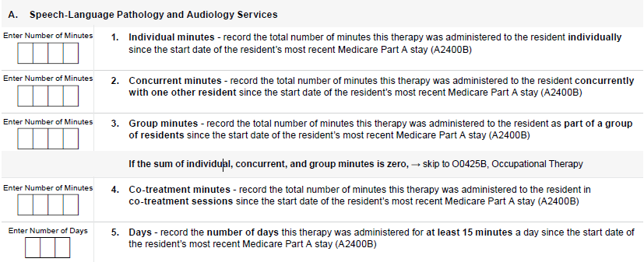
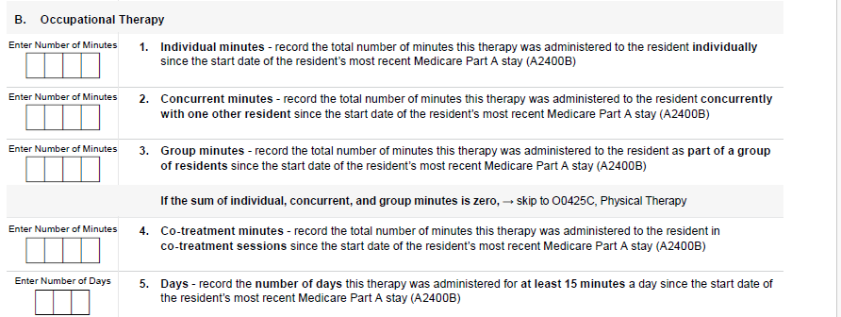

O0425: Part A Therapies
237

Slide 238
O0425: Part A Therapies (cont.)
238
Step 1: Total Therapy Minutes, by discipline:
(O0425X1 + O0425X2 + O0425X3).
Step 2: Total Concurrent and Group Therapy Minutes, by discipline:
(O0425X2+O0425X3).
Step 3: Concurrent/Group Ratio (Step 2 result/Step 1 result).
Step 4: If Step 3 result is greater than 0.25, then it is non-compliant.

Slide 239
O0425: Part A Therapies- Individual Minutes
239
Enter the total number of minutes of therapy that were provided on an individual basis during the entire Part A stay (i.e., from the date in A2400B through the date in A2400C).
Enter 0 if none were provided.

Slide 240
O0425: Part A Therapies- Concurrent Minutes
240
Enter the total number of minutes of therapy that were provided on a concurrent basis during the entire Part A stay (i.e., from the date in A2400B through the date in A2400C).
Enter 0 if none were provided.

Slide 241
O0425: Part A Therapies- Group Minutes
241
Enter the total number of minutes of therapy that were provided in a group during the entire Part A stay (i.e., from the date in A2400B through the date in A2400C).
Enter 0 if none were provided.

Slide 242
O0425: Part A Therapies- Co-treatment Minutes
242
Enter the total number of minutes of each discipline of therapy was administered to the resident in co-treatment session during the entire Part A stay (i.e., from the date in A2400B through the date in A2400C).
Skip the item if none were provided.

Slide 243
New: O0425A:
Speech Therapy
243

Slide 244


O0425A: Speech Therapy
244
Old Speech Therapy
New Speech Therapy

Slide 245

Added Area in New Seech Therapy
245
Added area -Speech Therapy

Slide 246
O0425A: Speech-Language Pathology Days
246
Enter the number of days speech-language pathology therapy services were provided over the entire Part A stay.
Use total minutes of therapy provided without any adjustment, to determine if the day is counted.

Slide 247

O0425A- Speech-Language Pathology Days (cont.)
247
Enter 0 if therapy was provided but for less than 15 minutes every day during the stay.
If the total number of minutes during the stay is 0, skip this item and leave it blank.

Slide 248
New: O0425B:
Occupational Therapy
248

Slide 249


O0425B: Occupational Therapy
249
Old O.T. Therapy
New O.T. Therapy

Slide 250
Added Area in New O.T. Therapy
250
Added area - Occupational Therapy

Slide 251
O0425B- Occupational Therapy Days
251
Enter the number of days occupational therapy services were provided over the entire Part A stay.
Use total minutes of therapy provided without any adjustment, to determine if the day is counted.

Slide 252

O0425B- Occupational Therapy Days
252
Enter 0 if therapy was provided but for less than 15 minutes every day during the stay.
If the total number of minutes during the stay is 0, skip this item and leave blank.

Slide 253
New: O0425C:
Physical Therapy
253

Slide 254


O0425: Physical Therapy
254
Old P.T. Therapy
New P.T. Therapy

Slide 255
Added Area in New P.T. Therapy
255
Added area -Physical Therapy

Slide 256
O0425B- Physical Therapy Days
256
Enter the number of days physical therapy services were provided over the entire Part A stay.
Use total minutes of therapy provided without any adjustment, to determine if the day is counted.

Slide 257

O0425B- Occupational Therapy Days
257
Enter 0 if therapy was provided but for less than 15 minutes every day during the stay.
If the total number of minutes during the stay is 0, skip this item and leave blank.

Slide 258
New: O0430:
Distinct Calendar
258

Slide 259


O0430: Distinct Calendar
259
Old O0420- Distinct Calendar
New O0430- Distinct Calendar

Slide 260

O0430: Distinct Calendar (cont.)
260
If a resident receives more than one therapy discipline on a given calendar day, this may only count for one calendar day for purposes of coding item O0430.

Slide 261
Section X
Correction Request
261

Slide 262
Section X: Correction Request
262
A modification request is used to correct an iQIES record containing incorrect MDS item values due to:
Transcription errors,
Data entry errors,
Software product errors,
Item coding errors, and/or
Other error requiring modification.

Slide 263
Section X: Correction Request (cont.)
263
An inactivation request is used to move an existing record in iQIES from the active file to an archive (history file) so that it will not be used for reporting purposes.
Inactivation should be used when the event did not occur.
The inactivation request only includes Item A0050 and the Section X items.
All other MDS sections are skipped.

Slide 264
Section X: Correction Request
264
The modification and inactivation processes do not remove the prior erroneous record from iQIES.
The erroneous record is archived in a history file.
In certain cases, it is necessary to delete or change a record and not retain any information about the record in iQIES.

Slide 265
Section X: Correction Request (cont.)
265
This requires the facility to complete an MDS 3.0 Individual Correction Request or MDS 3.0 Individual Deletion Request in iQIES.
Additionally, in situations in which the state-assigned facility submission ID (FAC_ID) or state code (STATE_CD) is incorrect, an MDS 3.0 Manual Assessment Move Facility Request is required.

Slide 266
Section X: Correction Request (cont.)
266
These special requests are required only in the following four cases:
Item A0410 Submission Requirement is incorrect.
Record was submitted with the incorrect state-assigned facility submission ID (FAC_ID) or state code (STATE_CD).
Record submitted was not for OBRA or Medicare Part A purposes.
Inappropriate submission of a test record as a production record.

Slide 267
Case 1: Correction Request
267
Item A0410 Submission Requirement is incorrect.
Submission of MDS assessment records to iQIES constitutes a release of private information and must conform to privacy laws.
Only records required by the State and/or the Federal governments may be stored in the iQIES.

Slide 268
Case 1: Correction Request (cont.)
268
If a record has been submitted with the incorrect Submission Requirement value in Item A0410, then the facility must request correction of A0410 via an MDS 3.0 Individual Deletion Request or MDS 3.0 Individual Correction Request in iQIES.
Item A0410 cannot be corrected by modification or inactivation.
See Chapter 5 of this Manual and the iQIES Assessment Management: Assessment Submitter Manual for details.

Slide 269
Case 2: Correction Request
269
Record was submitted with the incorrect state-assigned facility submission ID (FAC_ID) or state code (STATE_CD).
If a record was submitted to iQIES for an incorrect facility or with an incorrect state code, the record must be manually corrected by the State Agency. In these situations, the facility must complete an MDS 3.0 Manual Assessment Move Facility Request and send the request via certified mail to the State Agency.

Slide 270
Case 3: Correction Request
270
Record submitted was not for OBRA or Medicare Part A purposes.
When a facility erroneously submits a record that was not for OBRA or Medicare Part A purposes, CMS does not have the authority to collect the data included in the record, and deletion via an MDS 3.0 Individual Deletion Request in iQIES is required to remove it from the CMS database.

Slide 271
Case 3: Correction Request (cont.)
271
For erroneous PPS assessments combined with OBRA-required assessments, if the item set code changes, the assessment must be manually deleted, and a new, stand-alone OBRA assessment must be submitted.
If the item subset code (ISC) does not change, then a modification can be completed.

Slide 272
Case 4: Correction Request
272
Inappropriate submission of a test record as a production record.
Removal of a test record from iQIES requires record deletion via an MDS 3.0 Individual Deletion Request in iQIES.
Otherwise, information for a “bogus” resident will be retained in the database and this resident will appear on some reports to the facility.

Slide 273
X0310: Sex
273

Slide 274


X0310: Sex
274
Old X0300. Gender
New X0310. Gender

Slide 275

X0310: Sex
275

Slide 276
Section Z
Assessment Administration
276

Slide 277

Section Z- Legal Notice Regarding MDS
Old section Z legal notice
New section Z legal notice

Slide 278
Chapter 5
Submission and Correction of the MDS Assessments
278

Slide 279
Chapter 5: Submission
279
Omnibus Budget Reconciliation Act (OBRA) Minimum Data Set (MDS) must be submitted to the iQIES for all residents in Medicare- or Medicaid-certified beds regardless of the payer source.

Slide 280
Chapter 5: Submission
280
Skilled nursing facilities (SNFs) and non-critical access hospitals (non-CAH) with a swing bed agreement (swing beds), are required to transmit MDS assessments for all Medicare beneficiaries in a Part A stay reimbursable under the SNF Prospective Payment System (PPS).

Slide 281
MDS Correction Policy
281

Slide 282
Correction Policy
282
Once the assessment was completed, edited, and accepted into iQIES, you can not change a previously completed MDS assessment as the resident’s status changes during the course of the resident’s stay-the MDS must be accurate as of the ARD.

Slide 283
Correcting Errors in MDS Records That Have Been Accepted Into iQIES
283

Slide 284
Correcting Errors in MDS
284
Errors identified in iQIES records must be corrected within 14 days after identifying the errors.
A correction can be submitted for any accepted record within 2 years of the target date of the record for facilities that are still open.
If a facility is terminated, then corrections must be submitted within 2 years of the facility termination date.

Slide 285
Correcting Errors in MDS (cont.)
285
Inaccuracies can occur for a variety of reasons, such as:
Transcription errors,
Data entry errors,
Software product errors,
Item coding errors or other errors.

Slide 286
Correcting Errors in MDS (cont.)
286
Modification Request.
Inactivation Request.
MDS 3.0 Individual Correction/Deletion or Move Request.

Slide 287
Correcting Errors in MDS (cont.)
287
Modification Request moves the inaccurate record into history in iQIES and replaces it with the corrected record as the active record.
An Inactivation Request also moves the inaccurate record into history in iQIES but does not replace it with a new record.

Slide 288
Correcting Errors in MDS (cont.)
288
Both the Modification and Inactivation processes require the MDS Correction Request items to be completed in Section X of the MDS 3.0.
The MDS 3.0 Individual Correction/Deletion or Move Request are distinct processes to address a few types of errors in a record in iQIES that cannot be corrected with a Modification or Inactivation Request.

Slide 289
Correcting Errors in MDS (cont.)
289
A Modification Request should be used when an MDS record (assessment, Entry tracking record or Death in Facility tracking record) is in iQIES, but the information in the record contains clinical or demographic errors.
The Modification Request is used to modify MDS items not specifically listed under inactivation.

Slide 290
Correcting Errors in MDS (cont.)
290
The modification process is not permitted for certain items.
These items require the following correction measures if an error is identified:
An Inactivation of the existing record followed by submission of a new corrected record is required to correct an error of the Type of Provider (Item A0200).

Slide 291
Correcting Errors in MDS (cont.)
291
An MDS 3.0 Individual Correction/Deletion or Move Request is required to address the following situations:
Unit Certification or Licensure Designation (Item A0410)
State-assigned facility submission ID (FAC_ID) or state code (STATE_CD)
Record submitted was not for OBRA or Medicare Part A purposes
Test record submitted as a production record.

Slide 292
Inactivation
292
An Inactivation should be used when a record has been accepted into iQIES but the corresponding event did not occur.
For example, a Discharge assessment was submitted for a resident but there was no actual discharge.

Slide 293
Inactivation (cont.)
293
An Inactivation (Item A0050 = 3) must be completed when any of the following items are inaccurate:
Type of Provider (Item A0200).
Type of Assessment (A0310) when the Item Subset would change had the MDS been modified.

Slide 294
Inactivation (cont.)
294
Discharge Date (Item A2000) on a Discharge assessment record (Item A0310F = 10, 11) when the look-back period and/or clinical assessment would change had the MDS been modified.
ARD (Item A2300) on an OBRA or PPS assessment when the look-back period and/or clinical assessment would change had the MDS been modified.

Slide 295
MDS 3.0 Correction, Deletion, and Move Requests
295
A few types of errors in a record in iQIES cannot be corrected with a Modification or Inactivation request. These errors are:
The record has the wrong unit certification or licensure designation in Item A0410.
The record has the wrong state code or facility ID in the control Items STATE_CD or FAC_ID.
The record submitted was not for OBRA or Medicare Part A purposes.
The record is a test record inadvertently submitted as production.

Slide 296
MDS 3.0 Correction, Deletion, and Move Requests (cont.)
296
If a record was submitted either with an error in Item A0410, not for OBRA or Medicare Part A purposes, or as a test record, the facility must complete the proper request within iQIES.

Slide 297
MDS 3.0 Correction, Deletion, and Move Requests (cont.)
297
The State Agency will either:
Approve the request,
Reject the request or
In some cases—return the request and ask for additional information before approving or rejecting.

Slide 298
MDS 3.0 Correction, Deletion, and Move Requests (cont.)
298
If the State Agency approves the request, the assessment is deleted from or corrected in the iQIES database.
Deleted records cannot be recovered.

Slide 299
MDS 3.0 Correction, Deletion, and Move Requests (cont.)
299
If the State Agency rejects the request, the provider should address any concerns noted and, if appropriate, submit a new request.
Please refer to the iQIES Assessment Management: Assessment Submitter Manual for details.

Slide 300
MDS 3.0 Correction, Deletion, and Move Requests (cont.)
300
In situations in which the state-assigned facility submission ID (FAC_ID) or state code (STATE_CD) is incorrect, an MDS 3.0 Manual Assessment Move Facility Request is required.
The facility is responsible for completing the form.
The facility must submit the completed form to the State Agency.

Slide 301
MDS 3.0 Correction, Deletion, and Move Requests (cont.)
301
Completed forms with Protected Health Information (PHI) must be sent via certified mail through the United States Postal Service.
The State Agency will review the request for completion and accuracy and contact the facility if required.
After approving the provider’s request, the State Agency must sign the form and send it to the iQIES Help Desk.

Slide 302
MDS 3.0 Correction, Deletion, and Move Requests (cont.)
302
This process will transition to an iQIES-based process in the future, and the most up-to-date guidance regarding it will be available in the iQIES Assessment Management: Assessment Submitter Manual.)

Slide 303
MDS 3.0 Correction, Deletion, and Move Requests (cont.)
303
CMS does not have the authority to collect the data contained in the record that is not for OBRA or Medicare Part A purposes.
In this case an inactivation request will not fix the problem, since it will leave the erroneously submitted record in the history file/the CMS database.
An MDS 3.0 Individual Deletion Request is necessary to completely remove the erroneously submitted record and associated information from the CMS database.

Slide 304
MDS 3.0 Correction, Deletion, and Move Requests (cont.)
304
In situation in which an erroneous PPS assessment is combined with an OBRA-required assessment;
If the item set code does not change, then a modification can be completed.
If the item set code does change as a result of a modification, an MDS 3.0 Individual Deletion Request must be completed.

Slide 305
Resources
305

Slide 306
Resources
306
CMS 3.0 Web site:
https://www.cms.gov/medicare/quality/nursing-home-improvement/residentassessment-instrument-manual
All items for which a dash is not an acceptable value can be found on the CMS MDS 3.0 Technical Information web page at the following link:
https://www.cms.gov/medicare/quality/nursing-home-improvement/minimum-data-set-technical-information

Slide 307
Resources
307
The Privacy Act can be found at:
https://www.cms.gov/aboutcms/information-systems/privacy/privacy-act-1974-and-privacy-act-requests.
Medicare Benefit Policy Manual, located at:
https://www.cms.gov/medicare/regulations-guidance/manuals/internet-only-manuals-ioms

Slide 308
Resources (cont.)
308
Impact Act and Quality Measures (QM) can be found at:
https://www.cms.gov/medicare/quality/initiatives/pac-quality-initiatives/impact-act-2014-data-standardization-cross-setting-measures.
Emergency preparedness can be found at:
https://www.cms.gov/medicare/health-safety-standards/quality-safety-oversight-emergency-preparedness

Slide 309
Resources (cont.)
309
CMS information on PASRR can be found at:
https://www.medicaid.gov/medicaid/long-term-services-supports/institutional-long-term-care/preadmission-screening-and-resident-review
ICD-10-CM coding guidance with links to appendices can be found at:
https://www.cms.gov/medicare/coding-billing/icd-10-codes

Slide 310
Resources (cont.)
310
Surveillance Definitions of Infections in LTC (updated McGeer criteria):
https://pmc.ncbi.nlm.nih.gov/articles/PMC3538836/
CDC’s Healthcare Infection Control including UTI
https://www.cdc.gov/healthcare-associated-infections/

Slide 311
Resources (cont.)
311
All error and warning messages are detailed and explained in the iQIES MDS Error Message Reference Guide available at:
https://qtso.cms.gov/providers/nursing-home-mdsswing-bed-providers/reference-manuals
ICD-10 Diagnosis Codes mapping available at:
https://www.cms.gov/medicare/payment/prospective-payment-systems/skilled-nursing-facility-snf/patient-driven-model

Slide 312
Resources (cont.)
312
Skilled Nursing Facility Quality Reporting Program:
https://www.cms.gov/Quality-Initiatives-Patient-Assessment-Instruments/NursingHomeQualityInits/Skilled-Nursing-Facility-Quality-Reporting-Program/SNF-Quality-Reporting-Program-Overview
State Operations Manual:
https://www.cms.gov/Regulations-and-Guidance/Guidance/Manuals/Internet-OnlyManuals-IOMs-Items/CMS1201984

Slide 313
Resources (cont.)
313
MDS 3.0 Data Submission Specifications available on the CMS MDS 3.0 website at:
https://www.cms.gov/medicare/quality/nursing-home-improvement/minimum-data-set-technical-information
The RAI User Manual and MDS-3.0 item sets:
https://www.cms.gov/medicare/quality-initiatives-Patient-Assessment/NursingHomeQualityInits/MDS30RAIManual

Slide 314
Resources (cont.)
314
Michigan Department of Health and Human Services (MDHHS) Medicaid section for LTC:
Laurie Ehrhardt Manager of Long -Term Care,
EhrhardtL@michigan.gov
State Automation Coordinators
Christian Clemmons
ClemmonsC1@michigan.gov
State RAI/MDS Coordinator
Haideh Najafi
NajafiH@michigan.gov

Slide 315
Glossary
315
Activities of Daily Living (ADL)
Adverse Drug Reaction (ADR)
Advisory Committee on Immunization Practices (ACIP)
American Medical Association (AMA)
American Sign Language (ASL)
Arteriovenous (AV)
As needed/As necessary (PRN)
Assessment Reference Date (ARD)
Bilevel Positive Airway Pressure (BIPAP)
Care Area Assessment (CAA)
Care Area Triggers (CATs).
Centers for Disease Control and prevention (CDC)
Center for Medicare and Medicaid Services (CMS)
Cerebrospinal Fluid (CSF)
Cerebrovascular Accident (CVA)
Clinical nurse specialist (CNS)
Clostridioides difficile (C-diff)
Code of Federal Regulations (CFR)
Continuous Arteriovenous Hemofiltration (CAVH)
Continuous Ambulatory Peritoneal Dialysis (CAPD)
Continuous Positive Airway Pressure (CPAP)
Corona Virus Disease of 2019 (COVID-19)
Critical Access Hospital (CAH)
Current Procedural Terminology (CPT)

Slide 316
Glossary (cont.)
316
Deep Tissue Injury (DTI)
Department of Health and Human Services (DHHS)
Diabetes Mellitus (DM)
Diagnostic and Statistical Manual of Mental Disorders, Fifth Edition (DSM-5)
Discharge (D/C)
Discharge Return Anticipated (D/C RA)
Discharge Return Not Anticipated (D/C RNA)
Every Day/Daily (QD)
Every Morning (Q AM)
Every Night/ At Bed-Time (Q.H.S.)
Fiscal Year (FY)
Follow-up (FU)
Food and Drug Administration (FDA)
For example (e.g.)
(Fraction of Inspired Oxygen (FiO2)
Gastrostomy tub (G-tub)
Gradual Dose Reduction (GDR)
Guillain-Barré Syndrome (GBS)
Headache (HA)
Health and Human Services (HHS)
  Home Health Agency (HHA).
  Influenza (Flu)
  International Classification of Diseases, Tenth Revision, Clinical Modification (ICD-10-CM)
  International Normalized Ratio (INR)

Slide 317
Glossary (cont.)
317
  Internet Quality Improvement and Evaluation System (iQIES)
  Intramuscular Injection (IM)
  Intravenous therapy (IV)
  Invasive Mechanical Ventilator (IMV)
  Item Subset Code (ISC)
  Keep Vein Open(KVO)
  Master of Social Work (MSW)
  Methicillin-resistant Staphylococcus aureus (MRSA)
  Michigan Department of Health and Human Services (MDHHS)
  Minimum Data Set (MDS)
  Non-Critical Access Hospitals (non-CAH)
Not Applicable (NA)
Nursing Facility (NF)
Nurse practitioner (NP)
Nursing Home (NH)
Occupation Therapy (O.T.)
Occupation Therapy Assistant (OTA)
Omnibus Budget Reconciliation Act (OBRA)
Outcome and Assessment Information Set (OASIS)
Over-the-counter (OTC)
Oxygen (O2)

Slide 318
Glossary (cont.)
318
Percutaneous endoscopic gastrostomy (PEG) tube
Per oral/orally/By mouth (PO)
Peripherally Inserted Central Catheter (PICC)
Personal Health Information (PHI)
Physical Therapy (P.T.)
Physical Therapy Assistant (PTA)
Physician Assistants (PAs)
Pneumococcal Conjugate Vaccine (PCV13)
15-valent pneumococcal conjugate vaccine (PCV15)
20-valent pneumococcal conjugate vaccine (PCV20)
21-valent pneumococcal conjugate vaccine (PCV21)
Pneumococcal Polysaccharide Vaccine (PPSV23)
Pound (Lb)
Pre-Admission Screening and Resident Review (PASRR)
Pressure Ulcer (PU)
Prospective Payment System (PPS)
Prothrombin Time/International Normalized Ratio (PT/ INR)
Quality Measure (QM)
Registered nurse (RN)
Resident Assessment Instrument (RAI)
Respiratory therapist (RT)
Severe Acute Respiratory Syndrome Coronavirus 2 (SARS-CoV-2)
Significant Change in Status Assessment (SCSA)

Slide 319
Glossary (cont.)
319
Skilled Nursing Facility (SNF)
Skilled Nursing Facility Prospective Payment System (SNF PPS)
Slow Continuous Ultrafiltration (SCUF)
Social worker (SW)
Speech Language Pathology (SLP)
Speech Language Pathology Assistant (SLPA)
Speech Therapy (ST)
Speech Therapy Assistant (STA)
State Medicaid Agencies (SMA)
State Operations Manual (SOM)
Target Specific Oral Anticoagulants (TSOACs)
Total Parenteral Nutrition (TPN)
Twice a day (BID)
United State (U.S.)
Unknown (UK)
Urinary Tract Infection (UTI).
Ventilator (VENT)
Version (V)
Weight (WT)

Slide 320
320
Thank you

Slide 321
321
Questions?

