Slide 1
Using the Same Email Address as other MiPLUS/Accela Accounts
July 2019
Michigan Professional Licensure User System (MiPLUS)

Slide 2
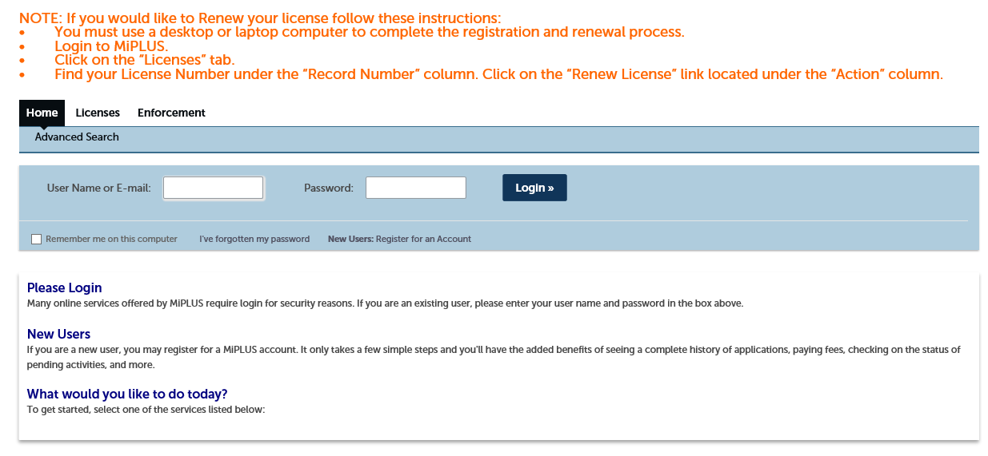
How to register for an account in MiPLUS
Begin the process to register a new account. In the blue box, click on “New Users: Register for an Account

Slide 3
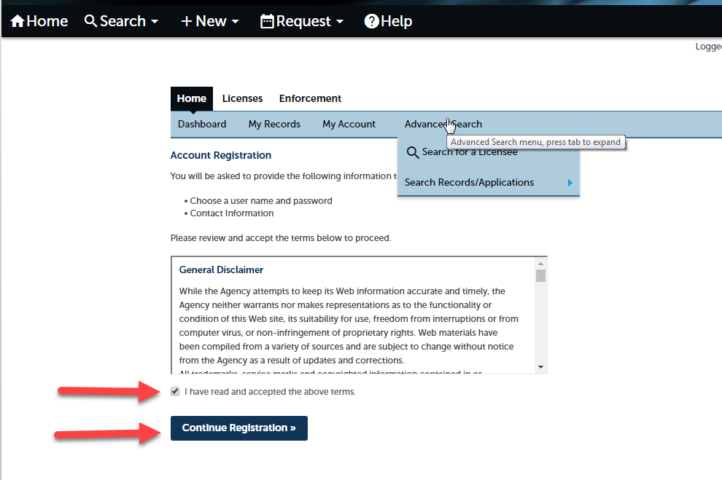
Register for an account in MiPLUS
Read the General Disclaimer first, then check the box next to “I have read and accepted the above terms.” Select Continue Registration.

Slide 4
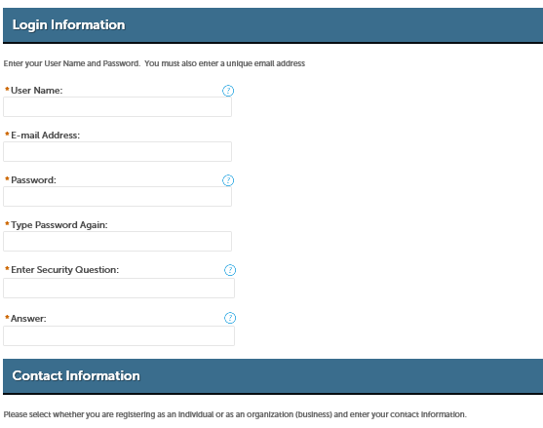
Register for an account in MiPLUS
Next you will see this screen. If you enter a “User Name” or “E-Mail Address” that already exists you will see the error shown in the next slide.

Slide 5
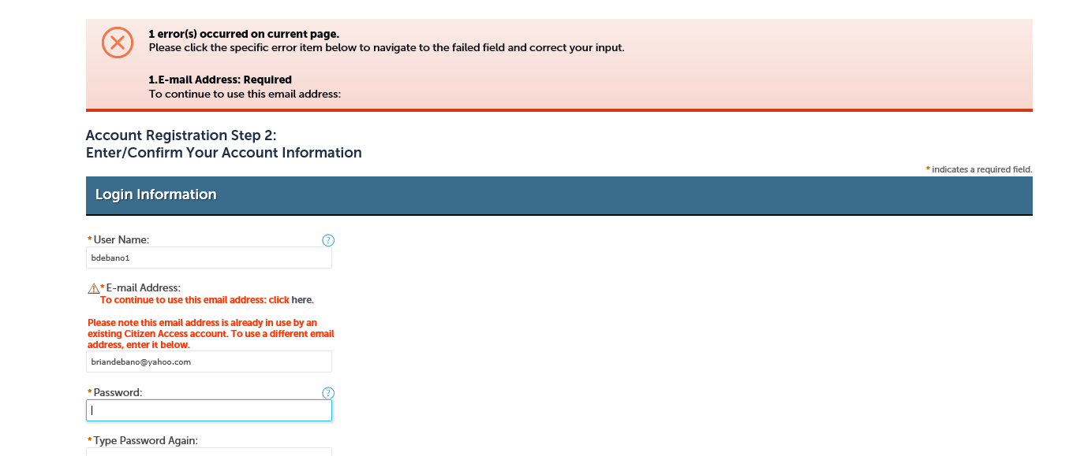
Register for an account in MiPLUS
If you enter a “User Name” or “E-Mail Address that already exists you will see the following error. To continue to use the email address make sure to click on the work “here”. Do not enter a password on this screen.

Slide 6
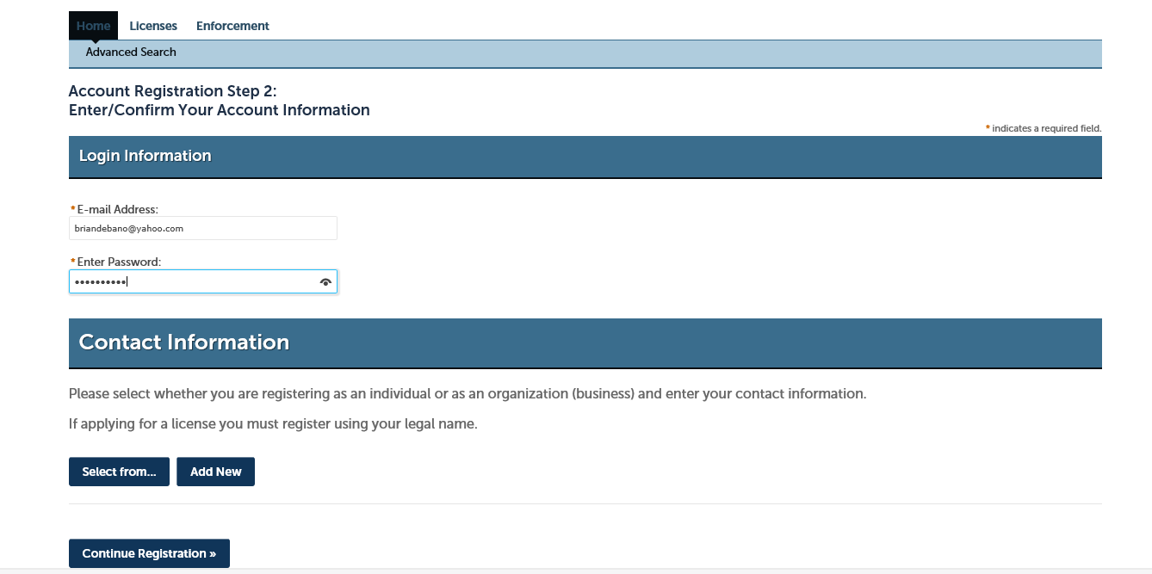
Register for an account in MiPLUS
On the next screen enter the password for your MiOSHA Radiation Safety or other Accela account associated with that email address. If you don’t remember your password you must go to that site first and follow the instructions to reset your password. For MiOSHA that www.michigan.gov/rss.

Slide 7
Register for an account in MiPLUS
Once your password is entered correctly click on “Select from” under “Contact Information”

Slide 8
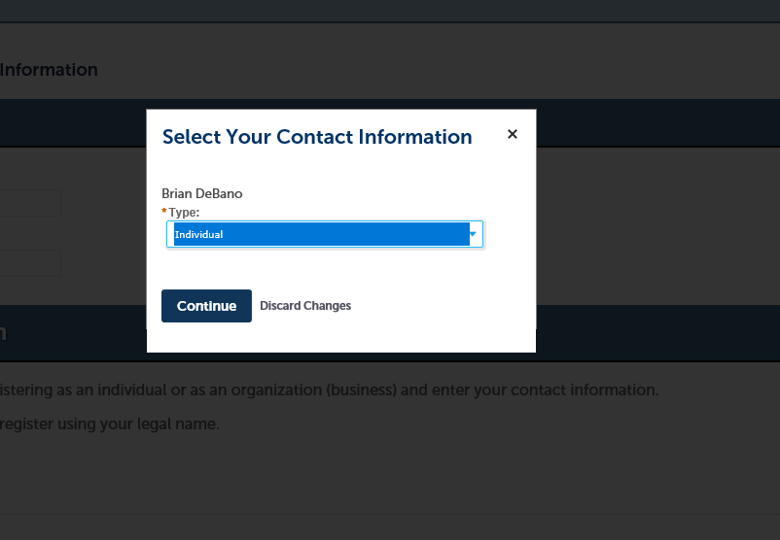
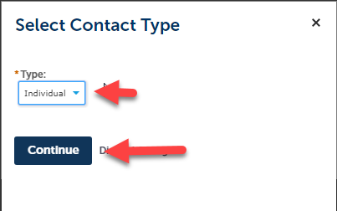
Contact Information
A box will appear that should show your name. Under Type, select Individual. Then select Continue.

Slide 9
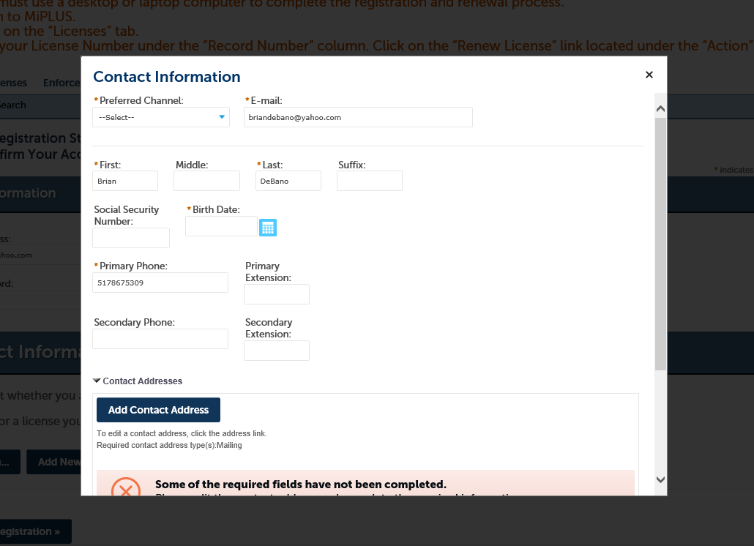
Contact Information
Next you will have to edit your contact information. While some of this information may already be part of your previous account, make sure all the required fields are filled out including your Birth Date.
Then scroll further down on the screen to edit your Contact Address.

Slide 10
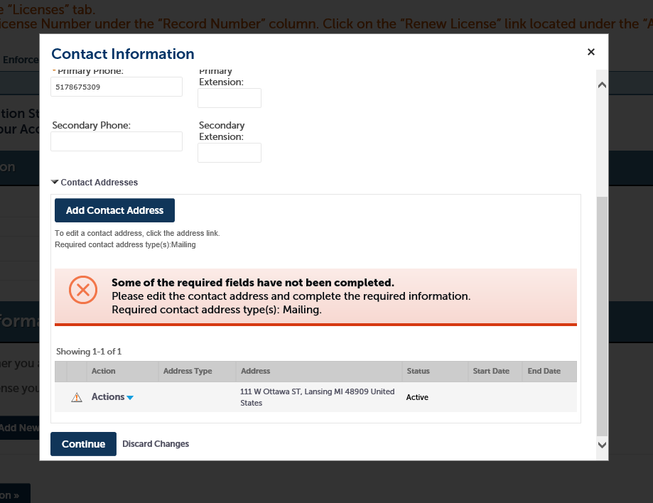
Contact Information
If there is missing information from your contact address you will see a yield sign in front of the word “Actions”. Click on the blue arrow next to “Actions” and select “Edit” to edit your contact information

Slide 11
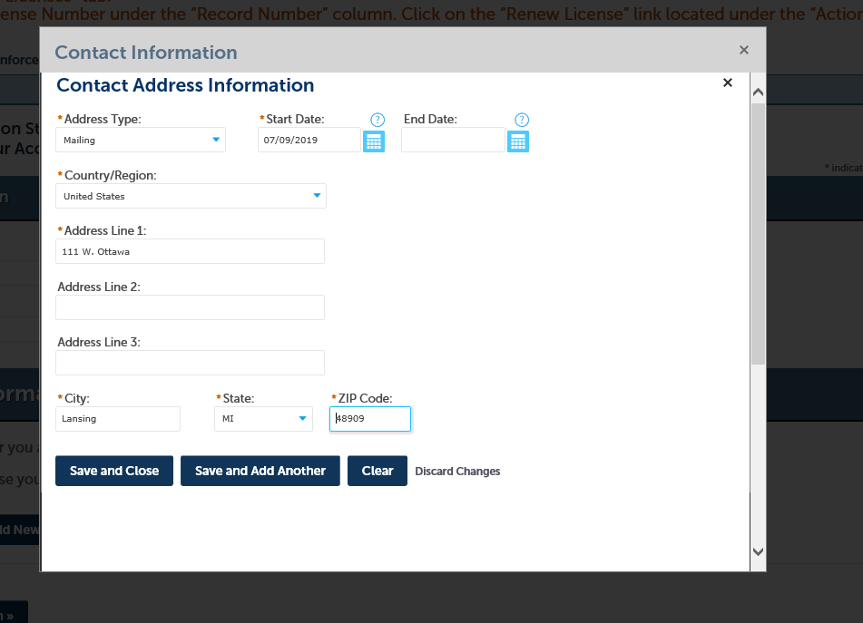
Contact Information
A new window will appear. Again, make sure all of the required fields are filled out. This includes Start Date-today’s date (mm/dd/yy), skip End Date, and type in the complete Contact Address (city, state, zip, country). Then, select Save and Close.

Slide 12
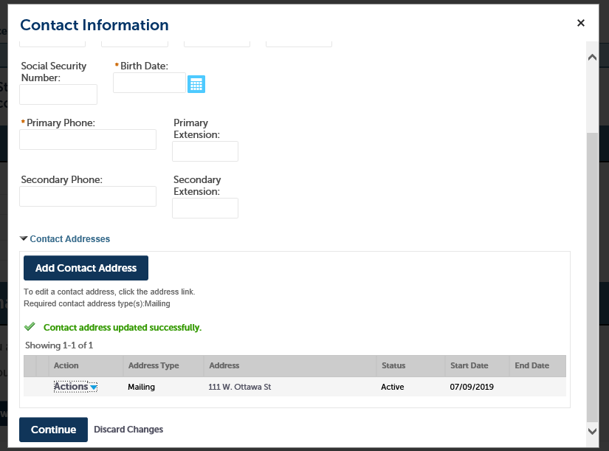
Contact Information
You should now see that the contact address was successfully updated. Click “Continue” at the bottom of the page.

Slide 13
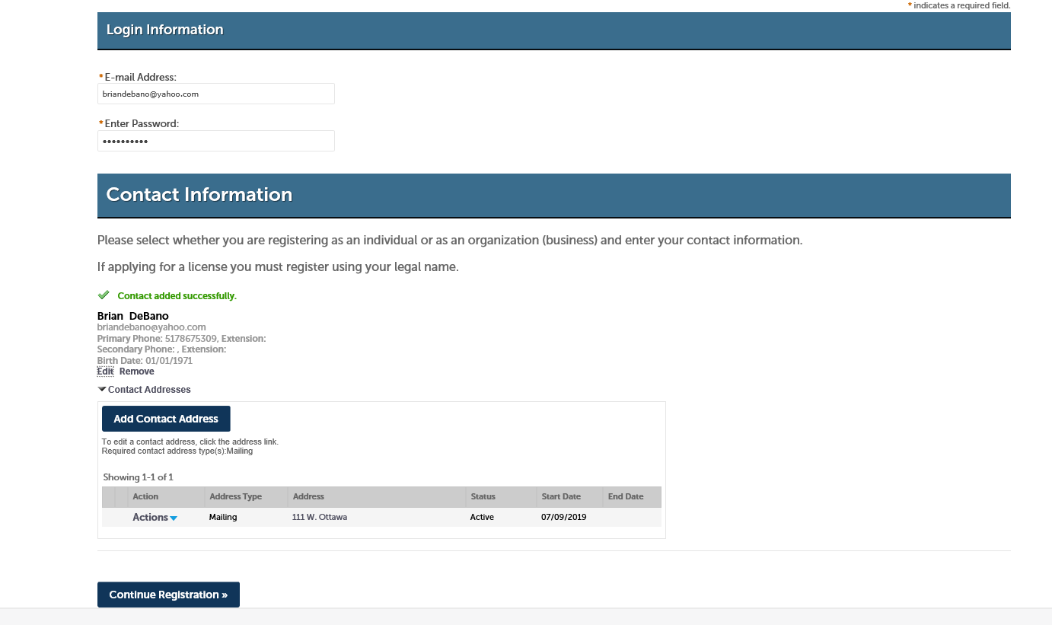
Contact Information
Now you should see that your contact information was successfully added. Click “Continue Registration” at the bottom of this screen.

Slide 14
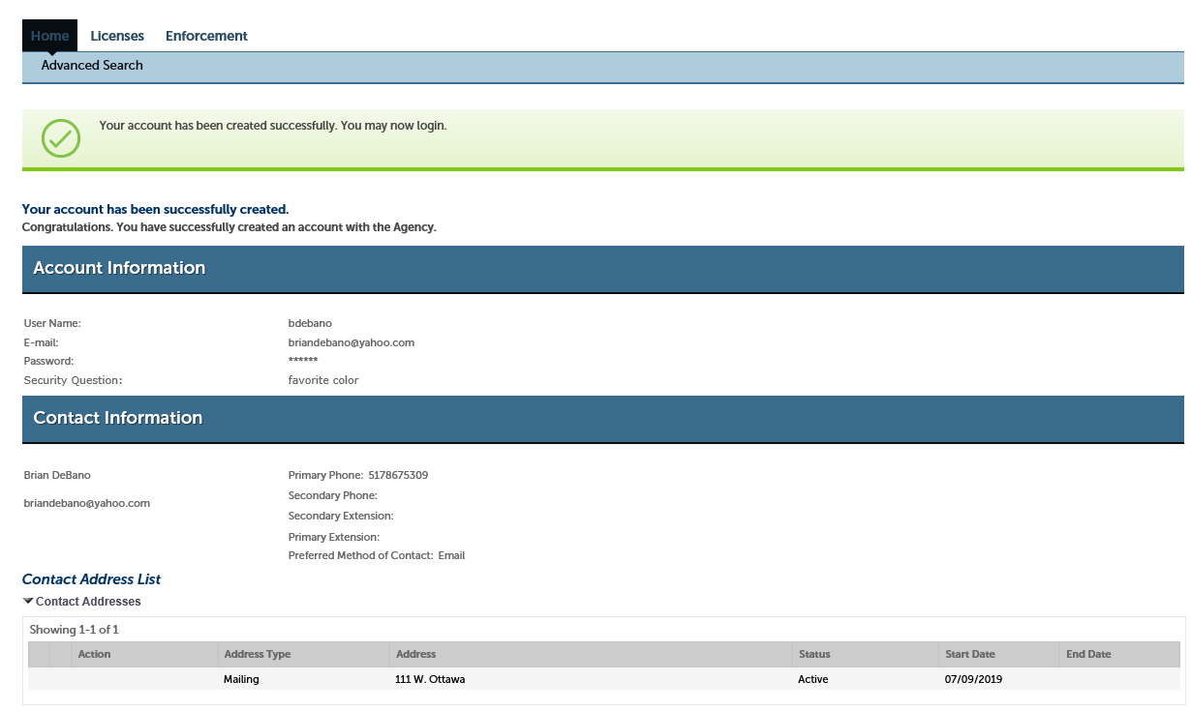
Contact Information
Afterward, you should see a green banner confirming, “Your account has been created successfully. You may now login.”. Please select Home , in the top left corner, then log in with the username/email, and password you created.

