Slide 1

Alliance for Housing
Oakland County Continuum of Care
Community Collaboration: Using New Approaches to Leverage Supports and Resources in Your Community
Presenter #1 Leah McCall, MA, Executive Director, Alliance for Housing, Oakland County Continuum of Care
Presenter #2 Angela Gougherty, Oakland County HMIS Administrator
Presenter #3 Patricia Wolschon, LMSW, ACSW, Director of Homeless Programming, John D. Dingell VA Medical Center
Presenter #4 Jamie Le Claire, MBA, Housing Resource Center Manager, Community Housing Network
www.oaklandhomeless.org

Slide 2
Alliance for Housing
Oakland County
History
The Alliance for Housing was established as a new entity through membership approval by the Oakland County Taskforce on Homelessness and Affordable Housing (OCTHAH) in 2012. The Alliance for Housing is the County’s Continuum of Care, serving as a collaborative of organizations and advocates dedicated to ending homelessness, and increasing the supply of sustainable and affordable housing. The OCTHAH was founded in 1987 to collect and analyze statistical data related to homelessness in order to better coordinate and restructure existing efforts.
The Alliance for Housing consists of stakeholders from the private and public sector that work collectively to assist residents in “achieving personal empowerment, economic independence, and self-sufficiency”.

Slide 3
Alliance for Housing
Oakland County
  Mission- To support housing solutions by promoting community partnerships.
  Purpose- The purposes of the Alliance for Housing, Oakland County Continuum of Care are as follows:
  To establish a collective response that addresses homelessness and affordable housing in our community.
  To develop a local system that identifies gaps in homeless services and creates solutions to overcome those barriers.
  To end homelessness in our community by linking people in need with the services they require.

Slide 4
Community Transformation in Oakland County
Centralized Inter-Agency Service Team (CIST)
Permanent Supportive Housing Registry (PSH)
Veteran By Name List (BNL)
Housing Choice Voucher Workgroup (HCV)
Notes:
I think this would be a good time to present how the Alliance works collaboratively in coordinating resources under these arenas. How the processes have shifted from individual to collective and focusing in on the barriers of the system.
We as a community have transformed how we provide the match for the right housing resources to the individual. It doesn't matter what door they walk into. Instead the community strategically makes decisions based on the array of resources with policy and administration so that each program participant receives the best match for their needs.

Slide 5
Coordinated Interagency Service Team (CIST)
"Linking Together Affordable Housing"
An active committee of the Alliance for Housing of Oakland County that discusses case studies and creates interagency support to determine the best outcomes for clients who are homeless.

Slide 6
Coordinated Interagency Service Team (CIST)
Address barriers to services for the implementation in homeless outreach
Address barriers to adequately service homeless clients
Interact and support each other
Create needed policy changes to end homelessness
Integrate cross county communication

Slide 7
Coordinated Interagency Service Team (CIST)
Initiated in Oct. 2008
  identify goals and objectives,
  outline potential project ideas
Brainstorm "system" solutions collaboratively
  PSH
  HMIS
  Community-wide
Resources/Services developed
  PSH Registry
Community Map
Contact List

Slide 8
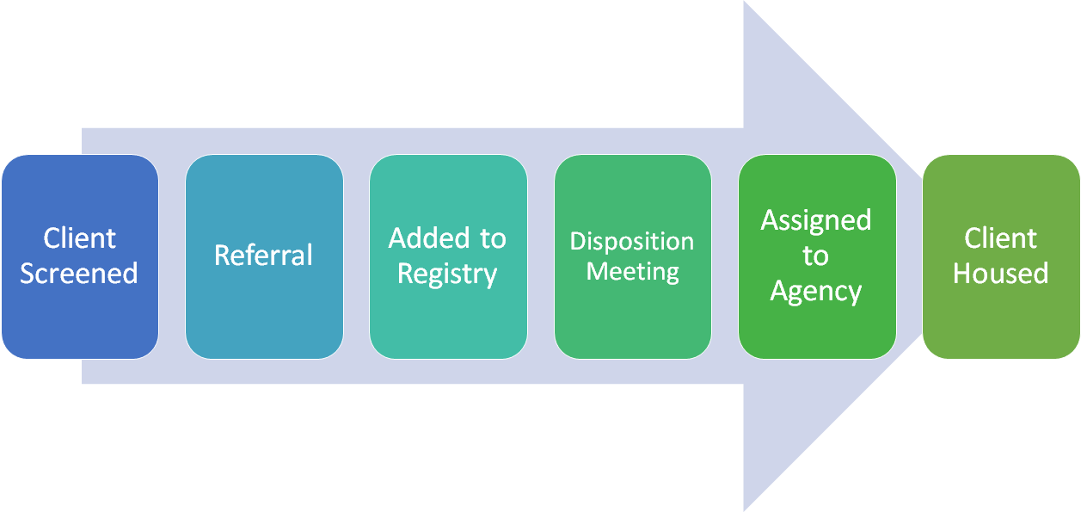


Permanent Supportive Housing Registry
Notes:
Background
Collaboration between CoC partners to prioritize clients most in need
Began in 2014? and has evolved to keep up with changing environment and funder standards
Participation- includes PSH providers, Shelters, HARA, Youth provider, Veteran providers,
QSOBBA share between HMIS partners
Community MOU to share

Slide 9
Permanent Supportive Housing Registry
Client Screened- Threshold Chronically homeless, VI-Single:8, VI-Family:9
Referral- Partners use HMIS to make referrals to the registry.
Added to Registry- Custom HMIS Assessment pulls in elements
Notes:
Screening
Threshold
All referrals are reviewed
Referrals
Unique provider page on HMIS- managed by SA1
Referral report run weekly
Added to Registry- Custom assessment to extract imp. elements
Keeps the information consistent for each client-easy to use

Slide 10
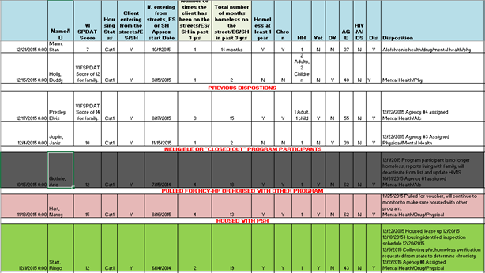
Permanent Supportive Housing Registry
Disposition Meeting
Assigned to Agency
Client House
Notes:
Disposition Meeting
Assigned to Agency
Housed

Slide 11
Permanent Supportive Housing Registry
Approximate referrals per week: 10
Number housed through registry: 150
Median Days to House: 97 days
Total referrals made to registry for last 2 years: 1,053
Notes:
Total referrals made to registry (10/1/2014-9/30/2016)
- may include duplicates and HH members

Slide 12

Veteran By Name List
Federal Plan to End Veteran Homelessness by 2016
National PIT Count Results from 2010 to 2016
47% Decrease in Veterans Experiencing Homelessness
56% Decrease in Unsheltered Veterans Experiencing Homelessness

Slide 13
Veteran By Name List
Tactics to End Veteran Homelessness
Increasing funding by VA for Permanent Supportive Housing, Outreach, SSVF, Community Collaboration
Targeting the correct housing resources to each Veteran
Collaborating with Community Stakeholders to best utilize VA and community resources

Slide 14
Veteran By Name List
All Stakeholder involvement in Oakland County
Bi-weekly meetings to update the names, offers of permanent housing, barriers, plans, and housing status
Primary case manager assignment and accountability
Ongoing communication
Face to face meetings allow for far greater coordination
VA resources used first, but Veterans also access general community resources, when needed.

Slide 15
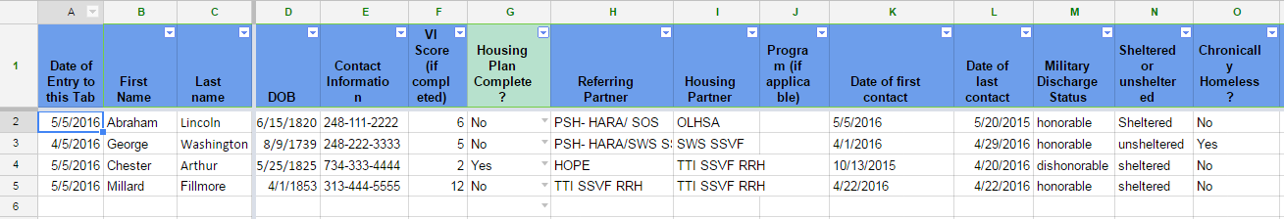
Veteran By Name List

Slide 16
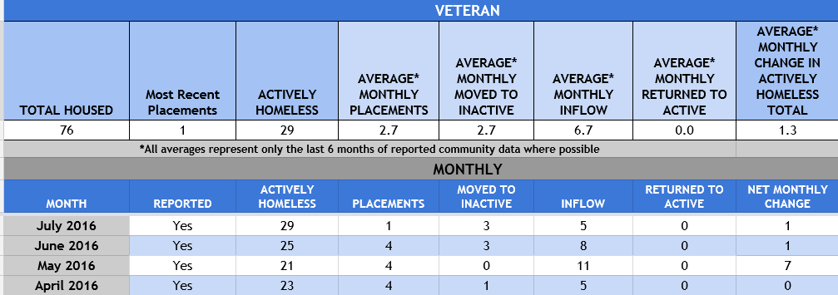
Oakland County Veteran Performance Management Tracker

Slide 17
Housing Choice Voucher Workgroup
A weekly workgroup meeting to provide status-updates on candidates that completed their applications for the Homeless Preference Housing Choice Voucher and were issued vouchers.
Briefing
Comprised of HARA; CMH providers; Community Action Agencies; ESG providers; Emergency shelters; Case managers; and MSHDA Housing Agent(s)
Workgroup runs off of HP-HCV tracking system

Slide 18
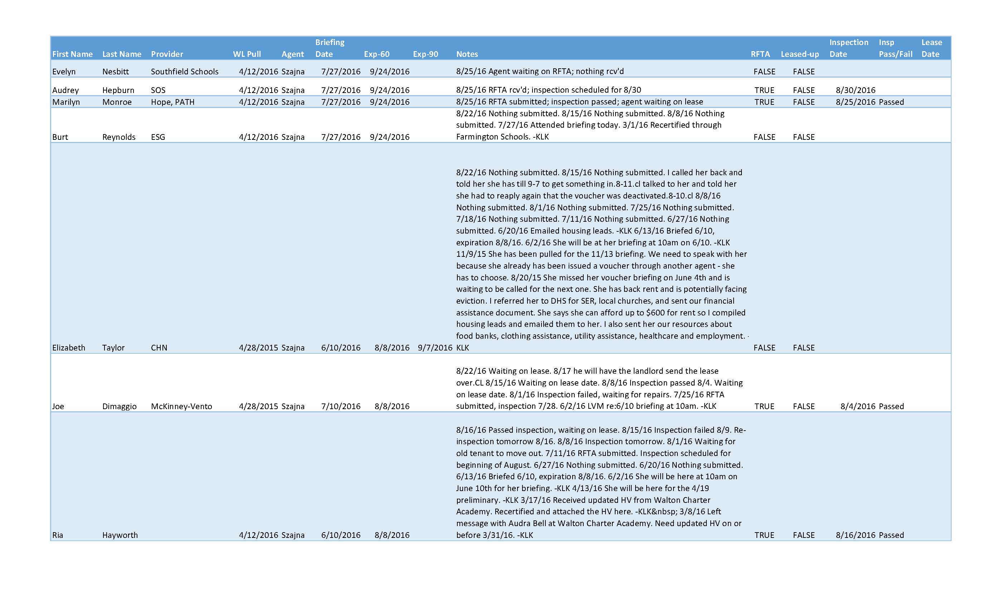
Housing Choice Voucher Workgroup

Slide 19
Housing Choice Voucher Workgroup
- Workgroup began Spring, 2014
- More than 250 program participants leased up with the voucher
- Oakland County has achieved 100% lease up with Housing Choice Vouchers
- By utilizing case management supports already found throughout the continuum, program participants are provided the supports they need to apply, be approved for, and lease up with the voucher

Slide 20





Questions

