Slide 1
Back to School Training
School Year 2025-2026

Slide 2
Meal Pattern Review
Notes:
We are going to review the meal pattern for National School Lunch Program, School Breakfast Program and Afterschool Snack Program.

Slide 3
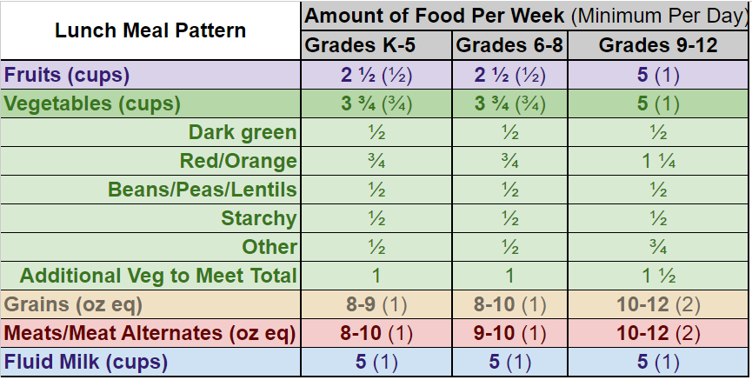
Lunch Meal Pattern
Notes:
Here is the National School Lunch meal pattern. This chart includes the meal pattern with portion sizes.
Last year we had a name change for Beans/Peas/Legumes vegetable sub-group. It is now Beans/Peas and Lentils.
The minimum serving sizes per week are listed for each component and the number in parenthesis is the minimum serving per day.
We are going to go over each component separately.

Slide 4



Fruit Component
Notes:
For K-8 the fruit component requirement is: ½ cup minimum per day with 2 ½ cups per week
For 9-12 the fruit component requirement is: 1 cup minimum per day with a total of 5 cups for week
Fresh, frozen, canned. Canned in water, juice or light syrup.
Dried fruit is also allowed.—1/4 cup dried fruit equals a ½ cup fruit portion
No more than half of the offered fruit servings can be juice per week—Juice must be 100%, full strength. Juice is credited as volume served
Use the Food Buying Guide to help determine crediting for whole fruit.
Best Practice: Offer a variety of fruit options

Slide 5
Lunch Meal Pattern - Vegetables
Notes:
Grades K-8: ¾ cup minimum vegetable per day and 3 ¾ cup per week
Grades 9-12: 1 cup minimum vegetable per day and 5 cups for the week
The NSLP meal pattern requires vegetable subgroups to be served each week. This requirement is in line with the Dietary Guidelines for Americans (also why the Beans/Peas/Lentils were renamed)
Notice that there are “Additional vegetables” that can come from any subgroup to meet the weekly total. If you served the minimum serving size of the 5 vegetable sub-groups, you would be short on vegetables for the week. That is where the “Additional vegetables” comes from.
Fresh, frozen, canned vegetables are allowed. Juice must be 100%
1/8 cup of vegetable smallest portion that can be credited
Best Practice: Offer a variety of vegetable options and use the Food Buying Guide to determine the correct amounts to serve

Slide 6

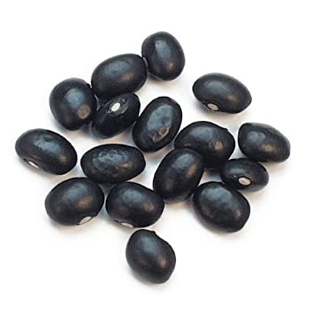



Vegetable Subgroups
Notes:
Vegetable subgroups that must be offered weekly include: dark green, red/orange, beans/peas (lentils), starch, and other.
Dark Green (e.g., broccoli, romaine, spinach, collard greens) Dark Leafy Green: 1 cup serving equals ½ cup dark green
Red/Orange (e.g., carrots, sweet potatoes, tomatoes, red peppers)
Beans/Peas/Lentils - (e.g., kidney beans, lentils, chickpeas, baked beans, black beans, refried beans) Beans/Peas/Lentils can count for meat/meat alt serving because they are high in protein. Then you would need to serve an additional vegetable because it can’t count for the meat and vegetable in the same meal. However, a new flexibility allows you to count the beans/peas/lentils serving towards the weekly vegetable subgroup, even if for the day it is being counted as a meat/meat alternate.
Starchy (e.g., corn, green peas, white potatoes)
Other (e.g., onions, green beans, cucumbers, iceberg lettuce, avocado, cauliflower, celery, zucchini)
Additional vegetables to meet the weekly total
The “other” vegetable subgroup is a distinct grouping of food items.
Schools can serve vegetables from the dark green, red/orange, or beans/peas in place of “other” vegetables if they desire, but they may NOT substitute starchy vegetables for “other” vegetables.
Mixed Vegetables – combinations containing 1/8 cup or more count toward their subgroup

Slide 7
Lunch Meal Pattern - Grains
Notes:
The Grains Component is next:
Grades K-8: 1 oz equivalent grain serving per day
Grades 9-12: 2 oz equivalent grain serving per day
Grains include: Burger buns, bread slices, tortillas, crackers, rice, pasta, pancakes, muffins
Cake, cookies, brownies are grain-based desserts
Grain based desserts are limited to 2 oz equivalent per week for lunch.
Grain based desserts are not allowed for preschool students.
We are continuing to follow the 80/20 rule. 80% of the weekly grain servings need to be whole grain-rich and the remaining 20% must be made with enriched flour.

Slide 8
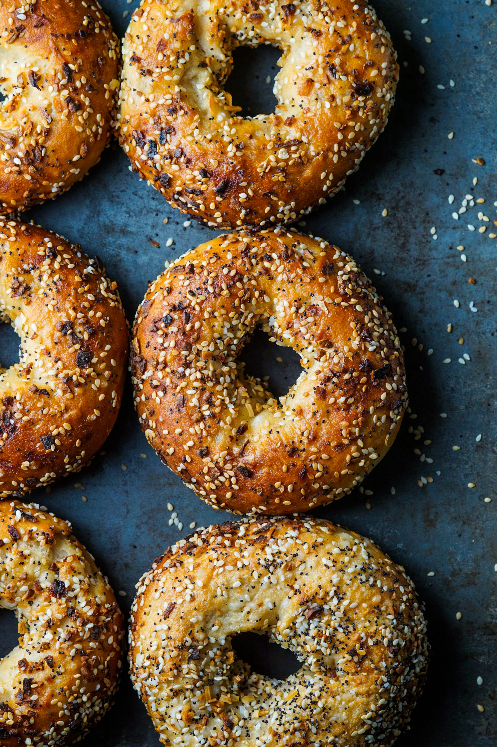
How do I know if a product is Whole Grain Rich?
Ingredient declaration
Food label
Recipe
Product Formulation Statement (PFS)
Notes:
How do you know if a product meets whole grain rich requirements?
There are 4 places to look and see if a product meets whole grain-rich requirements.
1. Ingredient declaration or statement from a product carton that shows a whole grain as the primary ingredient by weight. (A whole grain ingredient needs to be listed first.)
2. Copy of a food label showing amount of whole grain in grams for NSLP/SBP serving size.
3. Recipe that includes the ingredients & ingredient amounts by weight & volume.
4. Product Formulation Statement (PFS) from the manufacturer.

Slide 9
Whole Grain Rich Criteria
Contains 100% whole grain
Or
Contains a blend of:
  Whole-grain meal and/or flour (50% or more) AND
  Enriched meal and/or flour (remaining grain)
80% of weekly grain servings are whole grain rich
Notes:
How we can determine if a grain product is whole grain-rich.
What Foods Meet Whole Grain-Rich Criteria?
Contain 100% whole grain
OR
Contain a blend of:
Whole-grain meal and/or flour (50% or more) and
Enriched meal and/or flour (remaining grain)
If there is a blend of whole grain and other enriched flour, you must know the amounts of each in order to determine if product is whole grain-rich.

Slide 10
Meal Planning Options for Whole Grain-Rich Requirement
Option: Plan menu so enriched grains are served only on one day
Monday | Tuesday | Wednesday | Thursday | Friday
WGR 2 oz. eq. | WGR 2 oz. eq. | WGR 2 oz. eq. | WGR 2 oz. eq. | Enriched 2 oz. eq.
8 oz. eq. WGR
10 oz. eq. Total Grains
= 80%
Notes:
How to calculate 80% whole grain rich for the week? There are 2 options.
1.Serve all whole grain rich grain items 4 days of the week and then the 5th day is all enriched grains.

Slide 11
Menu Planning Options for Whole Grain-Rich Requirement
Option: Incorporate small amounts of enriched grains throughout the week
Monday | Tuesday | Wednesday | Thursday | Friday
WGR 1 oz. eq. + Enriched 0.5 oz. eq. | WGR 1 oz. eq. + Enriched 0.5 oz. eq. | WGR 2 oz. eq. | WGR 1 oz. eq. + Enriched 0.5 oz. eq. | WGR 2 oz. eq.
7 oz. eq. WGR
8.5 oz. eq. Total Grains
= 82%
Notes:
2nd option - Serve small amounts of enriched grains throughout the week, with the whole grain rich items totaling 80%

Slide 12
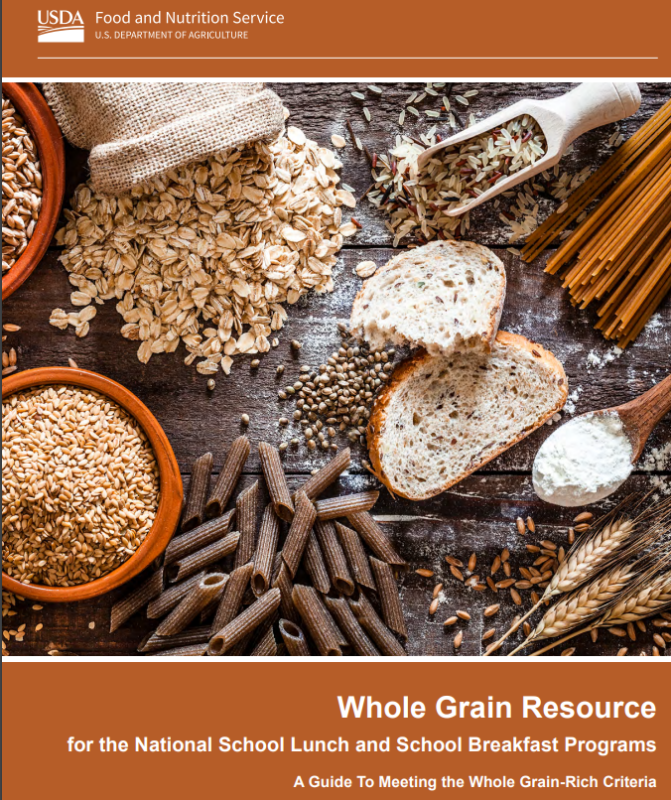

Whole Grain Resource
https://www.fns.usda.gov/tn/whole-grain-resource-national-school-lunch-and-breakfast-programs
Notes:
This is a helpful resource from USDA that can answer all your questions about serving whole-grain rich products.

Slide 13
Lunch Meal Pattern – Meat/Meat Alternate
Notes:
Meat/Meat Alternate or protein component is next
A 1-ounce equivalent serving is the minimum per day for grades K-8, with 8-10 servings for the week. So you will need to serve 2 oz equivalents most days in order to reach the total for the week.
Grades 9-12 do require a 2 oz equivalent portion each day.
Some examples are:
Meat – chicken, turkey, beef, pork, fish
Meat Alternates – cheese, yogurt, nut butters, seed butters, tofu, nuts & seeds
CN Labels are used for these items and tell us the meal pattern contribution of a serving.

Slide 14
Lunch Meal Pattern - Milk
Notes:
Milk component
1 cup of milk per day at all grade levels
Allowable milk: flavored or unflavored, fat free (skim) or 1%
Final rule makes permanent for 1% flavored milk—as part of meals, sold a la carte, snacks and CACFP participants age 6 and up.
More than 1 kind of milk needs to be offered—if flavored milk is offered, an unflavored option must be available as well (lunch and breakfast).
Lactose free and lactose reduced milk are allowed and only need a parent request to serve.
Remember that flavored milk cannot be served to preschool students.

Slide 15
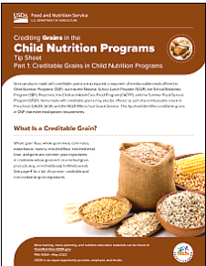
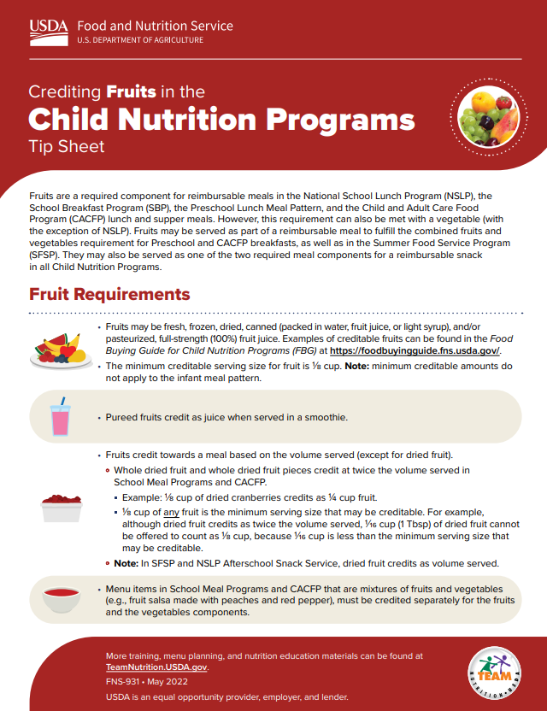
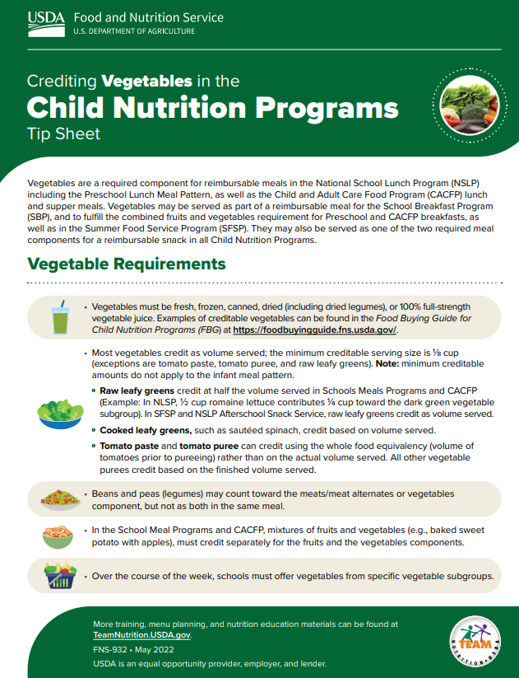
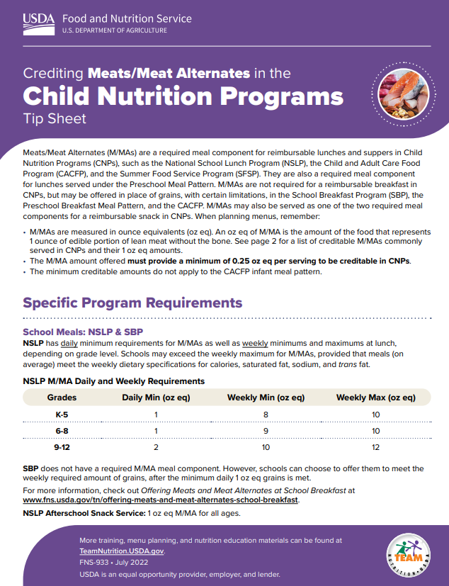
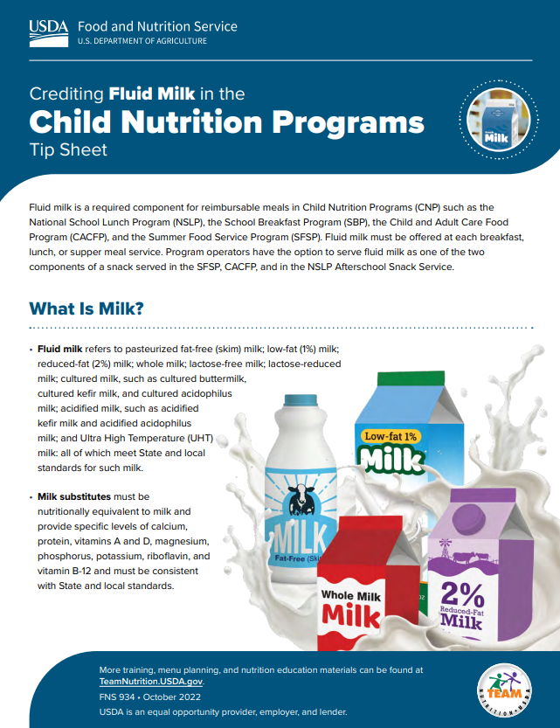

Crediting Tip Sheets
https://www.fns.usda.gov/tn/crediting-tip-sheets-child-nutrition-programs
Notes:
USDA has these helpful tip sheets-Multiple pages that go in depth on each component. They can be very helpful for staff.
There is one for each component: fruit, veg, meat/meat alternate and milk. Grains has 3 separate tip sheets (covering crediting, identifying whole-grain rich and program requirements)

Slide 16
Lunch Dietary Specifications
Age/Grade Group | K-5 | 6-8 | 9-12
Min-Max Calories | 550-650 | 600-700 | 750-850
Saturated Fat | <10% | <10% | <10%
Sodium | ≤1,110 mg | ≤1,225 mg | ≤1,280 mg
Notes:
In addition to complying with the meal pattern components, lunches and breakfasts must also meet a few dietary specifications.
There are currently three specifications for calories, sodium, and saturated fat. Meals must meet these specifications in order to comply with the Dietary Guidelines.
The standards for calories, sodium, and saturated fat are to be met on average over the school week. This means that the levels of any of these in any ONE MEAL COULD EXCEED THE STANDARD AS LONG AS THE AVERAGE NUMBER FOR THE WEEK MEETS THE STANDARD.
The first dietary specification is calorie ranges. These calorie ranges are to be met ON AVERAGE over the school week.
The next dietary specification is saturated fat.
It is for less than 10% of calories from saturated fat, just like the Dietary Guidelines.
Sodium is the next dietary specification – we are continuing at current levels until 2027-2028
By July 1, 2027 (SY27-28) There will be an additional 15% reduction in sodium at lunch.

Slide 17
Added Sugar Limits
Product Based Limits started July 1, 2025
Breakfast cereals: no more than 6 grams of added sugars per dry ounce
Yogurt: no more than 12 grams of added sugars per 6 ounces
Flavored milk: no more than 10 grams of added sugars per 8 fluid ounces
Notes:
New this school year - schools must follow product-based added sugars limits in the school lunch and breakfast programs:
Breakfast cereals must contain no more than 6 grams of added sugars per dry ounce.
Yogurt must contain no more than 12 grams of added sugars per 6 ounces
Flavored milk must contain no more than 10 grams of added sugars per 8 fluid ounces. The flavored milk limit also applies to flavored milk sold as a beverage in Smart Snacks in School.
Resources:
Added Sugars FAQs: https://www.fns.usda.gov/cn/school-nutrition-standards-updates/added-sugars
Added Sugars Section of Final Rule: https://www.federalregister.gov/d/2024-08098/p-179
Reducing Added Sugars at School Breakfast – Team Nutrition Webpage: https://www.fns.usda.gov/tn/sbp/reducing-added-sugars

Slide 18
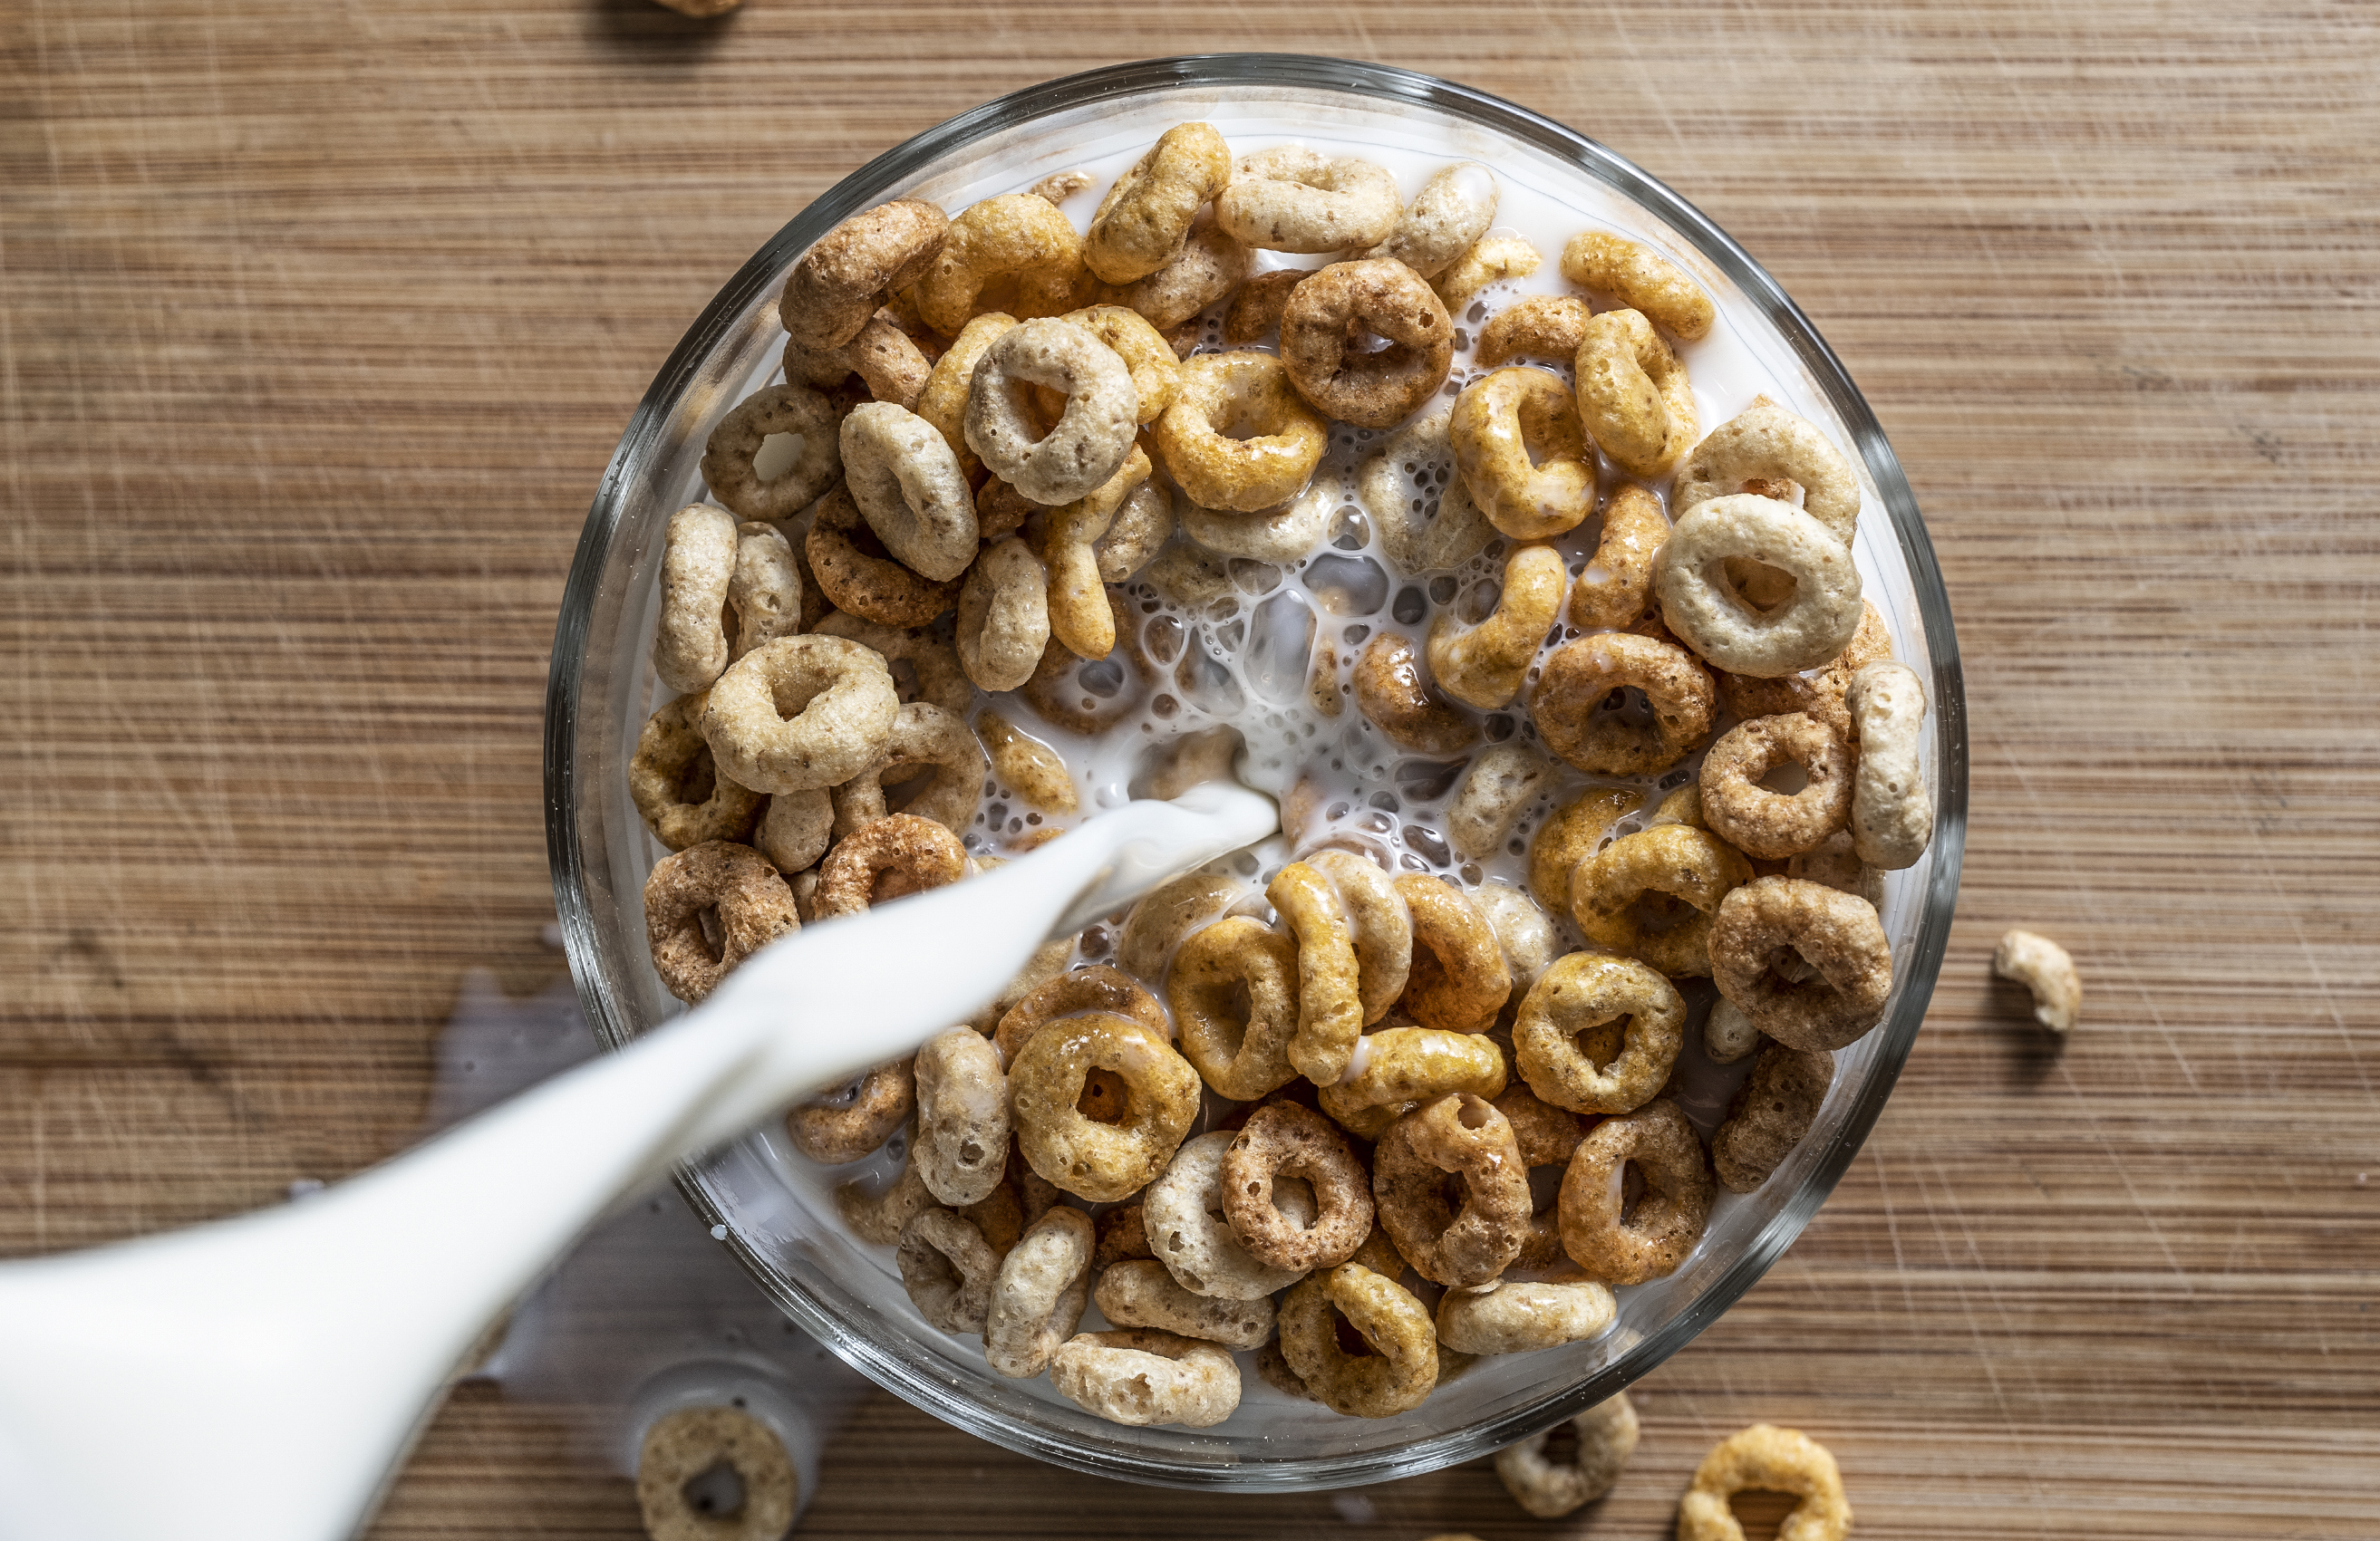
New Dietary Specification – Added Sugar
Weekly Limits starting by July 1, 2027 (SY 27-28)
Calories from added sugar must be less than 10% of total weekly calories
Weekly limits will be in addition to product-based limits
Notes:
There will be another added sugar change in 2 years.
By July 1, 2027, the rule requires schools to limit calories from added sugars to less than 10 percent of total weekly calories.
The limits apply on average to lunches and breakfasts offered during a school week, and apply to each program (school lunch and school breakfast) separately.
The weekly limits will be in addition to the product-based limits.
So then the dietary specifications will be for calories, saturated fat, sodium and added sugar.

Slide 19
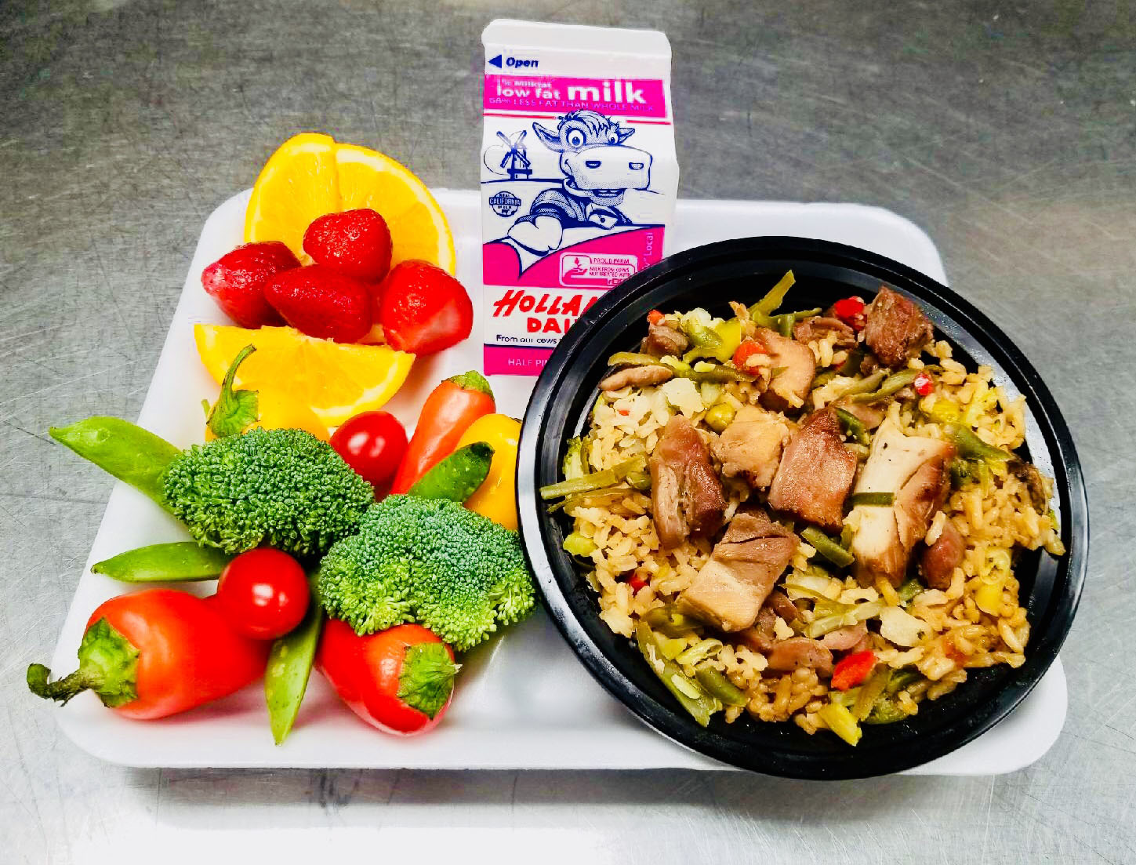
Is it a Reimbursable Lunch?
Meat/Meat Alternate: 2 oz
Vegetables: 1 cup
Fruit: 1 cup
Grain: 2 oz eq
Milk: 8 oz
Notes:
Menu Planning Practice – Is it a reimbursable meal? Have all components been planned for this meals?
Teriyaki Chicken with Fried Rice
(USDA Foods Used: Brown Rice, Mixed Vegetables, Peas, and Carrots from Rialto Unified School District, CA)
Yes!

Slide 20
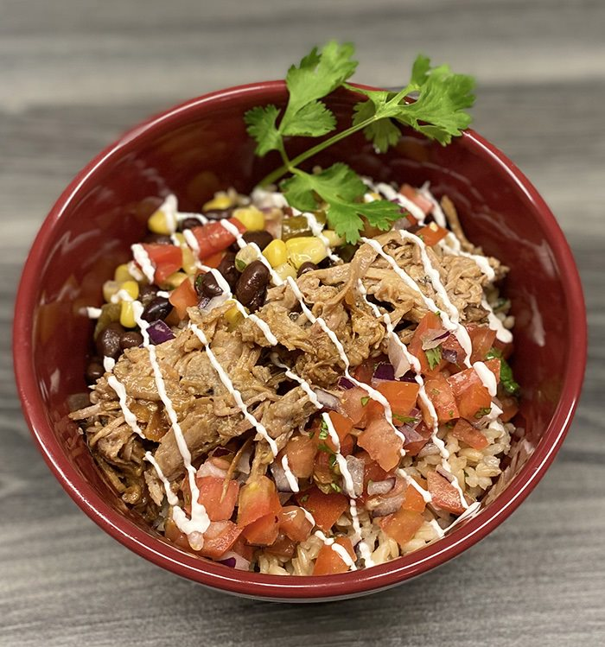
Is this a Reimbursable Lunch?
Meat/Meat Alternate: 2 oz
Vegetables: ½ cup
Grain: 1.5 oz eq
Fruit: 0
Milk:0
Notes:
Is this a reimbursable lunch?
Not as shown because there is no fruit or milk. (but could be added easily to make it reimbursable)

Slide 21
Breakfast Meal Pattern
Meal Components​ | Grades K-5​ | Grades 6-8​ | Grades 9-12​
Fruit (cups)​​ | 5 (1)​ | 5 (1)​ | 5 (1)​
Vegetables (cups) ​​ | 0​ | 0​ | 0​
Grains or meats/meat alternates (oz. eq.)​​ | 7-10 (1)​ | 8-10 (1)​ | 9-10 (1)​
Fluid milk (cups)​​ | 5 (1)​ | 5 (1)​ | 5 (1)​
Notes:
Breakfast has the same components as lunch but with flexibility built in. The April 2024 Final Rule has given us additional flexibilities also.
The five meal components are listed with their quantities.​ There are really only 3 required components at breakfast. This gives us more flexibility than at lunch.
Fruit is required, but you can substitute a vegetable for a fruit. (more on that on the next slide)
The grains and meat/meat alternate are now a combined component at breakfast. You can have a serving of either grain, or a meat/meat alternate, or a combination of both.
Milk is the final required component.
As you can see, the requirements are the same for grades K-12, the only difference being that more grains are required for the higher grades. Please note that 1 full cup of fruit must be offered at each grade level. Only 50% of the fruit or vegetable servings can be in the form of juice.
Just like at lunch -
80% of weekly grains must be WGR and remaining grains enriched. A school will be in compliance with grain component requirements if the menu is compliant with the daily and weekly minimums, regardless of whether maximums for this component have been exceeded.
At least 1 cup of milk must be offered each day for breakfast, regardless of grade group. This is a minimum requirement.
Schools must offer at least two choices of milk.

Slide 22
Substituting Vegetables for Fruit at Breakfast
If a vegetable is served instead of a fruit one day per week, it can be from any vegetable sub-group.
If a vegetable is served instead of a fruit on two or more days per week, then it must be from at least two different vegetable sub-groups.
Notes:
This is optional. Schools can choose to substitute a vegetable for a fruit at breakfast one day per week. If they do, it can be from any vegetable sub-group, including starchy.
If a school chooses to substitute a vegetable for a fruit at breakfast on two or more days per week, then they are required to offer vegetables from at least two different vegetable sub-groups.

Slide 23

Reimbursable Breakfast?
Grain: Muffin
Meat/Meat Alternate: Egg muffin
Fruit: ½ cup grapes and 4 oz juice
Milk: 8 oz
Notes:
Is this a reimbursable breakfast? Yes!

Slide 24
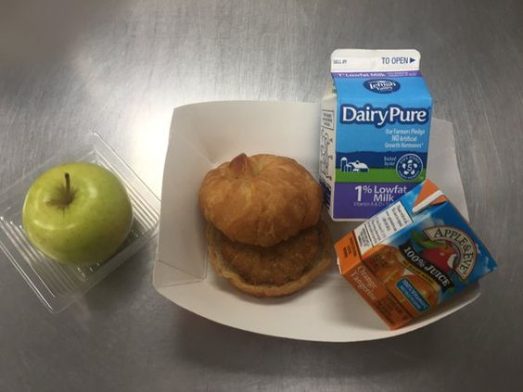
Is it Reimbursable?
Grain: 1 oz eq Croissant
Meat/Meat Alternate: 1 oz eq Sausage patty
Fruit: Apple and 4 oz Juice box
Milk: 8 fl oz
Notes:
Yes, it is reimbursable

Slide 25
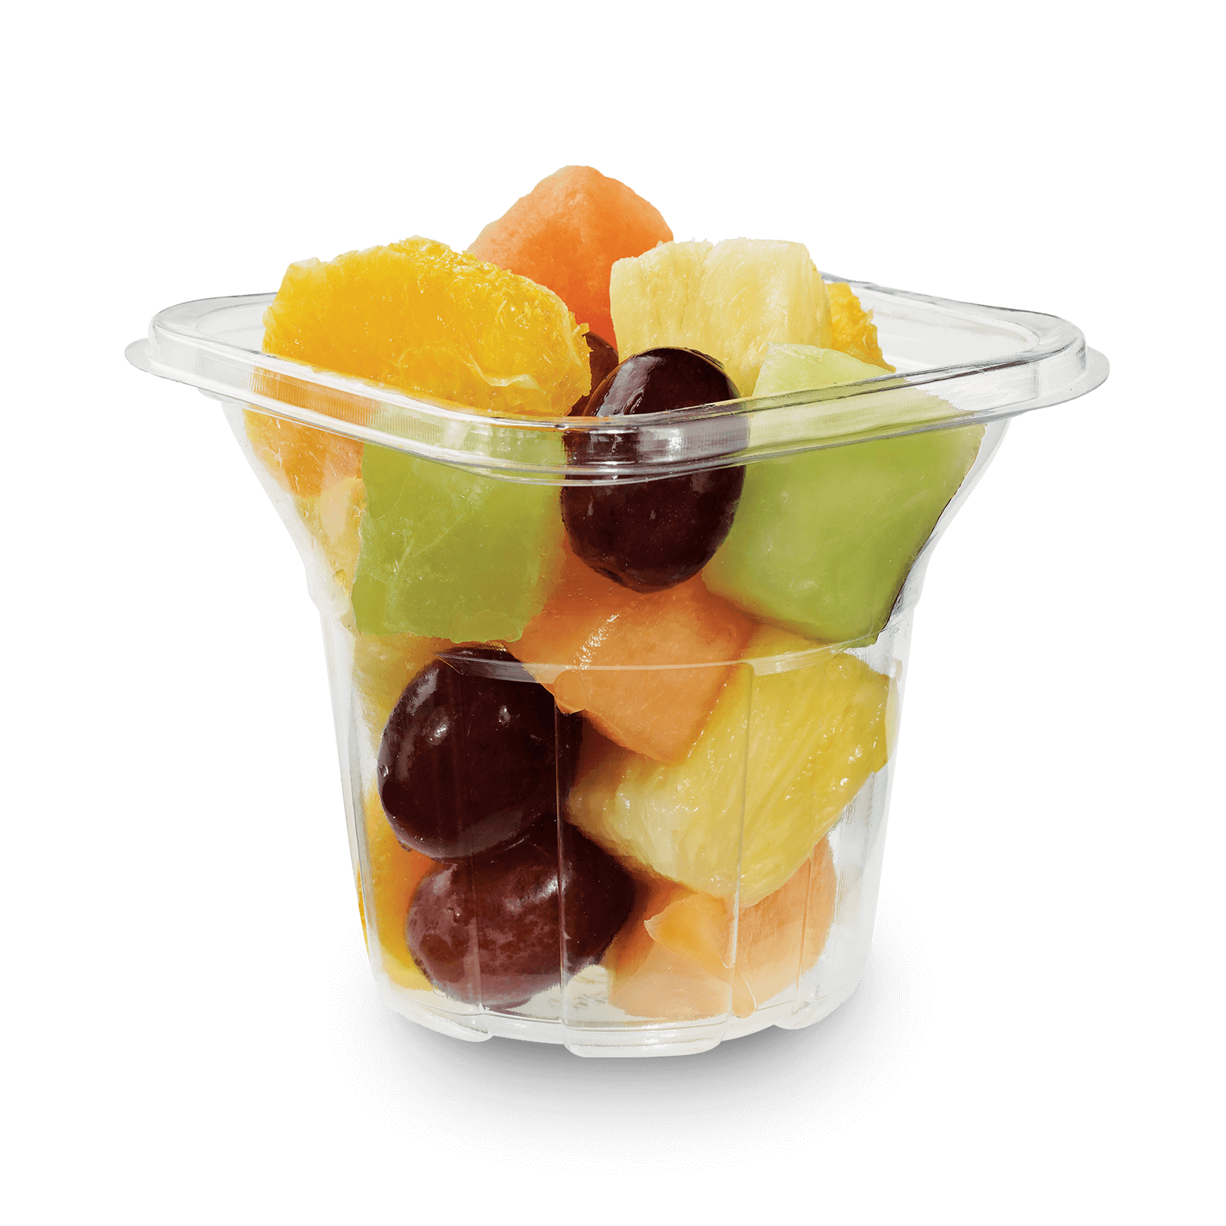

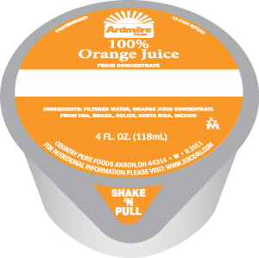
Is it a Reimbursable Breakfast?
Scrambled eggs: ¼ cup (No. 16 scoop) provides 2 oz equivalent meat alternate
1 slice whole wheat toast: 1 oz grain equivalent
4 oz cup fruit juice
½ cup mixed fruit
Notes:
Scrambled eggs
¼ cup (No. 16 scoop) provides 2 oz equivalent meat alternate
1 slice whole wheat toast
1 oz grain equivalent
4 oz cup fruit juice
1 fruit equivalent
½ cup mixed fruit
1 fruit equivalent
As is, this is not reimbursable, but all that is needed is to add an 8 oz milk.

Slide 26
Afterschool Snack Program Meal Pattern – Serve 2 components
Components | Ages 1 & 2 | Ages 3 to 5 | Ages 6 to 18
Milk | ½ cup | ½ cup | 1 cup
Fruits | ½ cup | ½ cup | ¾ cup
Vegetables | ½ cup | ½ cup | ¾ cup
Grains | ½ oz eq | ½ oz eq | 1 oz eq
Meat & Meat Alternate | ½ oz | ½ oz | 1 oz
Notes:
[Remove if you do not serve Afterschool Snack Program]
There are changes to the Afterschool Snack Program meal pattern starting School Year 2025-2026.
The meal pattern is show on the screen.
Now fruit and vegetables are separate components. You still need to serve 2 components to make a snack, but now it is 5 to choose from, instead of 4.
For ages 6-18, no more than half of the weekly servings of fruit or vegetable can be in the form of juice (just like National School Lunch Program and School Breakfast Program)
Ages 1 to 5 may only have juice 1 serving per day. (just like in the Child and Adult Care Food Program)
Grain servings must follow the 80/20 rule, with at least 80% of the grain servings being whole grain rich.
Very important – grain based desserts no longer count towards the grain requirement for all ages.
Sugar limits must be met for breakfast cereals, yogurt and flavored milk.
Remember, no flavored milk for kids under 6 years old.
These changes make the Afterschool Snack Program have the same meal pattern requirements as the National School Lunch Program. You may have already been following those standards, but now the regulations have been updated to require it.

Slide 27
Contact Us
Please contact MDE if you have further questions.
School Nutrition Programs Unit
  Phone: 517-241-5374
  Email: MDE-SchoolNutrition@Michigan.gov

