Slide 1

The Office of Partnership Districts
Introduction to the Partnership Agreement
Intensive Level of Support Webinar
December 12, 2022
Notes:
Bill - Welcome: Good morning everyone. The Office of Partnership Districts is looking forward to working with each partnership district. OPD will have three levels of support. Each level will correspond to the reason the district has been identified for support. Today’s webinar focuses on districts that have a school(s) re-identified for CSI support, which is our intensive level.

Slide 2
Welcome
Please rename your Zoom name as follows:
District/PSA/Organization Name, First Name, Last Name
Example –
Apple Public Schools, Pat Jones
Orange ISD, Tyler Smith
SWFT, Morgan Williams
Notes:
Lisa –
Before we begin it is important for to us to know who is attending and which districts and support organizations are represented.
Read the slide.
This webinar is being recorded and will be posted on the OPD webpage under resources. Please check to see that you are muted to prevent unintended background noise. Thank you.
Please place questions in the chat. Our office analyst, Sheri Riggle, will be capturing these and we will address them at the end of this presentation.

Slide 3
Welcome –
The Office of Partnership Districts (OPD) Team
Dr. William Pearson, Director
Gloria Chapman, Assistant Director
Shellee Carroll, Executive Secretary
Jill Baynes, Manager
Dan LaDue, Supervisor
Lisa Francisco, PAL Manager/Liaison
Sheri Riggle, Analyst
Tara Williamson, Data Technician
Partnership Agreement Liaisons
Kimberly Davis
Lisa Francisco
Dr. Liesel Carlson
Cassandra Guidry-Benion
Althanie Gardner
Dr. Eleanor Harris
Lynn Hogan
Paul Schummer
Dr. Traci Teasley
Notes:
Bill -
This slide shares the Office of Partnership Districts staff working together to support you and your districts.
For intensive level – Bill will introduce the three new PALs

Slide 4
Partnership District Model
Notes:
Gloria –
Cue up “partnership district model” prior to playing video
The following video explains the meaning of the Partnership District Model, and the speakers have been involved in a partnership agreement.

Slide 5
What we will cover today…
Identification
Assigned Level of Support
Role of Partnership Agreement Liaison
Partnership Agreement Template
& Timeline
MICIP Alignment
Areas of Inquiry
Goal Areas
18-Month Interim Target Benchmarks
36-Month End Target Outcomes
Benchmark Review
Proficiency Standard
Re-Identification
Section 21(h)
Funding
Completing Partnership Agreement
Summary Meeting/Report
Academic Outcome Evaluation
Resources
EPIC Survey
Accountability Measures
Notes:
Bill -
What we will cover today: This slide displays the topics we will cover in today’s webinar.
If not reading each box, pause briefly to allow attendees to read the boxes.

Slide 6
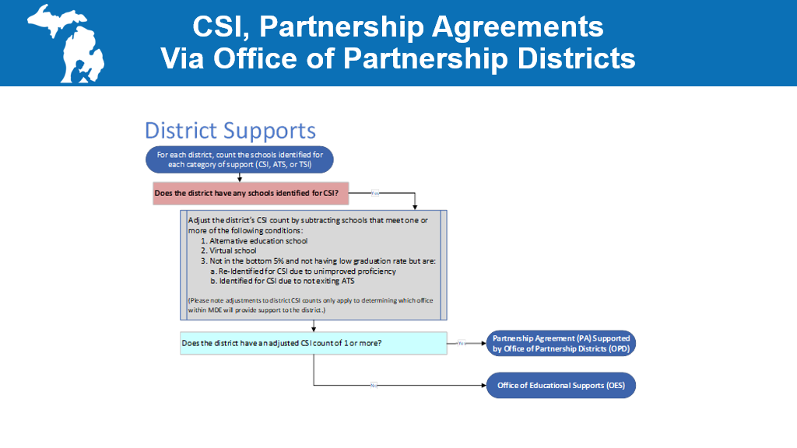
CSI, Partnership Agreement Via Office of Partnership Districts
Notes:
Bill -
Round four districts have been assigned to a partnership agreement if they have schools identified for CSI because of:
Being in the bottom 5% of schools in the MI/ Michigan’s School Index
A high school four-year graduation rate of 67% or less – EMPHASIZE, being assigned to partnership for low graduation rate is a change from previous identification cycles.
This flowchart explains the pathway to partnership agreement assignment for districts.
We start with the question, does the district have any schools identified for CSI?
If yes, we continue to the gray box and subtract schools that meet the following conditions:
Alternative education high schools identified as CSI,
Emphasize - AND FOR THIS IDENTIFICATION CYCLE ONLY, DUE TO PANDEMIC: Schools identified for CSI due to unimproved proficiency and schools identified for CSI due to not exiting ATS status.
All districts with an adjusted count of one or more schools identified for CSI are assigned to a partnership agreement.

Slide 7

Partnership Agreement
Level of Support Assignment
Expectations
Partnership Agreement Liaison
Notes:
Bill-

Slide 8
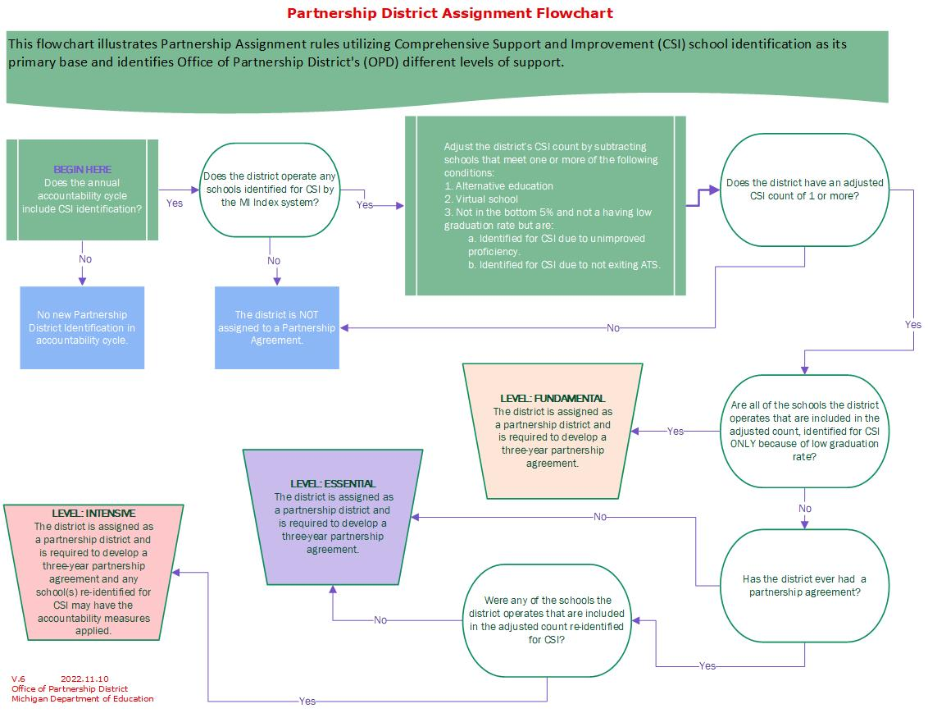
Partnership District Assignment Flowchart
Notes:
Bill - Go through the flowchart slowly
Emphasize –OPD has evolved our support to three customized levels based upon the reason the school was identified for CSI; ESSA requires us to provide more rigorous support to districts re-identified for partnership.

Slide 9

Intensive Level of Support
Notes:
Bill - The following slide outlines intensive level of support expectations.

Slide 10
Intensive Level of Support and Expectations
Twice monthly PAL support meetings to review partnership agreement progress; one meeting includes district leadership, ISD/RESA representative and OPD director or assistant director.​
Monthly OPD director or assistant director school visits.​
OPD director or assistant director participates in writing the partnership agreement.​
Twice a year presentation at local school board meeting by district superintendent/school leader regarding partnership agreement progress.​
With ISD/RESA and District, PAL co-facilitates the completion of a needs assessment utilizing MICIP and assists district in developing the partnership agreement.
PAL assists with Benchmark Review (BR) and AOE preparation.
PAL supports district with Section 21(h) requests to ensure alignment with partnership agreement.
Required to consider local school board training​
Notes:
Bill -
Read slide

Slide 11
Role of Partnership Agreement Liaison
Navigator
Communications Broker
Neutral Facilitator
Primary Point-of-Contact
Other Responsibilities
Notes:
Gloria
The OPD is committed to providing meaningful and ongoing support to districts and schools via an assigned liaison from the PAL Unit.
The PAL is responsible for supporting assigned districts in:
being the primary point-of-contact at MDE
the development and implementation of its partnership agreement;
helping resolve problems and break down barriers;
facilitating discussions and meetings; and
ensuring that the partnership district receives maximum support for success from the MDE, identified partners, and other state agencies
The PAL also provides support to schools identified for Additional Targeted Support (ATS) and Targeted Support and Improvement (TSI) within the assigned partnership district.

Slide 12
Partnership Agreement
Development Timeline
Components
MICIP Alignment
Notes:
Gloria –
Now we will touch on the partnership agreement timeline, components, and alignment with Michigan Integrated Continuous Improvement Process (MICIP).

Slide 13
Partnership Agreement Development Timeline
15 Dec. 2022 – 13 Jan. 2023
Introduction Meeting w/Assigned PAL, OPD Director or Asst. Director (if applicable), and District Superintendent/PSA School Leader
16 Dec. 2022 – 3 Feb. 2023
Initial Partnership Agreement (PA) Development Meeting with Partners
19 Dec. 2022 – 14 Apr. 2023
Intermediate PA Development Meetings to Complete MICIP Needs Assessment, Develop, and Complete PA
17 Apr. 2023
Obtain Signatures for PA and Submit to the OPD
18 Apr. 2023 - PA Implementation
Notes:
Gloria –
This timeline walks us through the stages from the initial meeting to develop the partnership agreement, through finalizing and obtaining all signatures on the agreement. The partnership agreement in implemented no later than April 17, 2023.

Slide 14
Partnership Agreement
Alignment with MICIP
Needs Assessment and Root Cause Analysis for each Area of Inquiry
Goal Areas
Strategies
Activities
18-Month Interim Target Benchmarks
36-Month End Target Outcomes
Notes:
Dan -
Collaboratively, your district, your assigned partnership agreement liaison, and ISD/RESA will conduct a needs assessment and root cause analysis on the five state and federal required areas of inquiry.
This part of the process will lead you to identify goal areas, strategies and activities to improve student achievement and address whole child needs.
PA Template Section II B (3-9 goal areas)
Through the monitoring and evaluation features in MICIP, you will also identify 18-month interim target benchmarks and aligned 36-month end target outcomes as measures of progress toward goal achievement.
The MICIP platform will be utilized during partnership agreement meetings to document progress on goals, strategies, activities, benchmarks and outcomes.

Slide 15
Needs Assessment > Areas of Inquiry
Implementation of MTSS
District and School Building Leadership and Educator Capacity
Curriculum, Instructional and Operational Practices Alignment to Best Practices
MI School Index
Resource Inequities
Notes:
Dan – Completing a needs assessment is not new to districts, but what may be new for you is conducting a needs assessment around these required areas of inquiry.
The five required areas of inquiry are:
A review of the district’s implementation and utilization of a multi-tiered system of supports to ensure that it is used to appropriately inform instruction [MCL Section 388.1621h]
A review of the district and school building leadership and educator capacity to substantially improve student outcomes [MCL Section 388.1621h]
A review of classroom curriculum, instructional and operational practices to ensure alignment with research-based instructional practices and state curriculum standards [MCL Section 388.1621h]
An assessment of school-level needs that includes student performance components of the MI School Index system [Every Student Succeeds Act Sec. 1111.c.4.D]
A review of resource inequities, which may include a review of district and school level budgeting [Every Student Succeeds Act Sec. 1111.c.4.D]
Above words are exact legislative language
As you do this, we think you will find they are aligned, integrated and coordinated. The five areas of inquiry are not required goal areas, but goals likely will be the product of the needs assessment you engage in.

Slide 16
Goals > Strategies > Activities
Implemented with Fidelity
Result in Success
Help District Reach Its Goals
Address Literacy, Mathematics, and Whole Child Needs
Aligned 18-Month Interim Target Benchmarks &
36-Month End Target Outcomes
Notes:
Lisa –
The needs assessment around the five areas of inquiry will lead districts to prioritize a minimum of three goal areas that include strategies, and activities, measured by aligned 18-month interim target benchmarks and 36-month end target outcomes.
These goals, strategies and activities must address literacy, mathematics, and whole child needs and implementation with fidelity will help ensure success.
The next two slides provide an example of a mathematics goal area with strategies and activities designated for two different buildings within one district’s partnership agreement.

Slide 17
Example District Goal Area
Student Math Achievement for
Elementary Building
Strategy – Elementary Building
Using the MDE MTSS Practice Profile, implement MTSS with fidelity building-wide in the area of reading and mathematics, and to address attendance.
Activities –
Establish a building level team with team-based decision-making authority
Establish a comprehensive assessment calendar that includes data analysis.
Select, provide, and adjust intervention /instruction at Tier 1, 2 and 3.
Conduct monitor and evaluation meetings on a regular basis to inform and adjust tiered intervention/instruction.
18-Month Interim Target Benchmark -
Student mathematics proficiency based on MSTEP will increase at least 2 percentage points from 2022 to 2024
36-Month End Target Outcome -
Student mathematics proficiency based on MSTEP will increase at least 3 percentage points from 2022 to 2025
Notes:
Lisa
The identified goal area is student math achievement.
The strategy being implemented at the elementary building within the partnership agreement is to implement MTSS.
The activities necessary to accomplish this strategy, are shown.
The student benchmark and outcome from this strategy and activities are also shown.
Implementation with fidelity will be key to meeting the 18-month and 36-month targets. Identifying the evidence to monitor that implementation is key. For example, with activity #2, a comprehensive assessment calendar document is one piece, but also the actual data reports from each assessment period, meeting notes and actions from each data-based decision-making cycle throughout the school year are included.
It is important to note, for the partnership agreement the 18-month and 36-month targets will not change for the duration of the agreement. However, as the district regularly monitors and evaluates this goal through this continuous improvement process, it may be necessary to adjust the strategies and activities in order to attain the targets.

Slide 18
Example District Goal Area
Student Math Achievement for Secondary Building
Strategy – Secondary Building
Implement the seven-step Michigan Early Warning Intervention Monitoring System (EWIMS) with fidelity building-wide to address reading, mathematics, and attendance.
Activities –
Establish a building level team with team-based decision-making authority
Establish a comprehensive calendar whereby attendance, behavior, and course performance data is analyzed as described in EWIMS.
Select, provide, and adjust intervention /instruction at Tier 1, 2 and 3.
Conduct monitor and evaluation meetings on a regular basis to inform and adjust tiered intervention/instruction.
18-Month Interim Target Benchmark -
Student mathematics proficiency based on SAT will increase at least 2 percentage points from 2022 to 2024.
36-Month End Target Outcome -
Student mathematics proficiency based on SAT will increase at least 3 percentage points from 2022 to 2025.
Notes:
Lisa
Likewise at the secondary building, the identified goal area is student math achievement.
The strategy being implemented at this building within the partnership agreement is to implement EWIMS.
The activities necessary to accomplish this strategy are shown; and the student benchmark and outcome from this strategy and activities are also shown.
Again, implementation with fidelity will be key to meeting the 18-month and 36-month targets. Identifying the evidence to monitor that implementation is key. For example, with activity #3, assigning a math coach to each math teacher is one piece evidence, but also include the logs indicating regular coaching sessions and instructional adjustments based upon this support.

Slide 19

18-Month Interim Benchmark Targets
& 36-Month End Outcome Targets Must Include
State assessments for at least one 18-month interim target benchmark and aligned 36-month end target outcome measuring proficiency or growth [MCL 388.1622p]
Local student data for at least one 18-month interim target benchmark and aligned 36-month end target outcome
Process data for at least one 18-month interim target benchmark and aligned 36-month end target outcome
Notes:
Dan
Interim benchmark targets and end outcome targets have requirements associated with them. First, at least one pair of interim and end targets must include state assessment results. This could be using growth or proficiency as the aggregation method. At least one pair of interim and end targets must utilize local data such as behavior, attendance, educator, or non-state assessment data. And last, at least one pair of interim and end targets must utilize process data such as staff implementation, educator performance, or other 'adult centric' results.

Slide 20
18-Month Interim Benchmark Targets
& 36-Month End Outcome Targets Must Include (cond.)
The minimum percentage point increase for proficiency on state assessments is three (3), but the desired increase shall be based upon the current proficiency rate and an increase that would likely result in the school’s index score at the end of the partnership agreement to be above the bottom 5%
At least one 18-month interim target benchmark and aligned 36-month end target outcome goal that addresses literacy
At least one 18-month interim target benchmark and aligned 36-month end target outcome goal that addresses mathematics
Notes:
Dan
The OPD has a established a minimum percent proficient increase across the 3-year agreement of three percent. Districts certainly may select to include a greater increase based upon a analysis of data, but the minimum is based upon the CSI school exit criteria that requires an increase in proficiency.
The identified strategies for the goals should address whole child.
Note, (paraphrase bullets two and three)
While goals, 18-month interim target benchmarks, and 36-month end target outcomes do not change, a partnership district will monitor and may need to adjust strategies, activities, funding, and communication to attain the final goal.

Slide 21
Sample Outcomes and Benchmark Table
# | Goal Area | Building Name | Building Code | Type | Data Source & Evidence | 36-month End Target Outcomes | 18-month Interim Target Outcomes
1 | Student Reading Achievement | Happy Elementary School | 01234 | Local | NWEA Report | During the 2024-25 school year at least 67% of full academic year students will meet their growth target on NWEA Reading MAP growth. | During the 2023-24 school year at least 50% of full academic year students will meet their growth target on NWEA Reading MAP growth.
2 | Student Mathematics Achievement | Happy Elementary School | 01234 | State | MSTEP Report | Student mathematics proficiency based on MSTEP will increase at least 3 percentage points from 2022 to 2025 | Student mathematics proficiency based on MSTEP will increase at least 2 percentage points from 2022 to 2024
2 | Student Mathematics Achievement | Sweetness High School | 04321 | State | MSTEP Report | Student mathematics proficiency based on SAT will increase at least 3 percentage points from 2022 to 2025 | Student mathematics proficiency based on SAT will increase at least 2 percentage points from 2022 to 2024
3 | Talent Management | Happy Elementary | 01234 | Process | Staff Roster | At least 85% of certified teachers will be retained from the 2023-24 school year to the 2024-25 school year. | At least 80% of certified teachers will be retained from the 2022-23 school year to the 2023-24 school year.
3 | Talent Management | Sweetness High School | 04321 | Process | Staff Roster | At least 85% of certified teachers will be retained from the 2023-24 school year to the 2024-25 school year. | At least 80% of certified teachers will be retained from the 2022-23 school year to the 2023-24 school year.
Notes:
Dan
This table provides example end and interim targets. PAUSE
It is meant to illustrate some of the terminology that has been introduced – such as the type – as in state, local, or process. All end and interim targets are expected to be written in a such a manner that they can be accurately evaluated at the end of the designated timeframe - commonly designated as SMART.

Slide 22
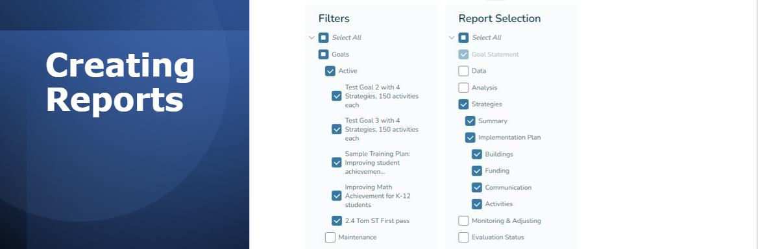
Partnership Agreement Report (MICIP Generated Report) Possibility
Notes:
Lisa
At this point in the partnership agreement development process districts, districts will generate a Partnership Agreement Report using the MICIP platform.
This report becomes part of the partnership agreement and is also uploaded into the GEMS/MARS platform for approval by the OPD Accountability, Research and Evaluation Unit – meeting ESSA requirements.
This slide shows a screenshot from the MICIP platform where reports are generated. The slide highlights the MICIP report keys needed to create the report.

Slide 23
Accountability Measures
Partnership districts operating schools in the partnership agreement re-identified for CSI in the 2025 identification cycle and who do not achieve more than one-third (33.33%) of the 36-month academic end target outcomes must impose accountability measures.
Notes:
Dan –
Districts must impose accountability measures for the schools in the partnership agreement that re-identified for CSI in the 2025 identification cycle and who do not achieve more than one-third (33.33%) of the 36-month academic end target outcomes

Slide 24
Accountability Measures –
Reconstitution
Traditional Districts MUST
Public School Academies MAY
Notes:
Dan –
For a traditional district assigned as a partnership district, accountability measures must include the reconstitution of the school [MCL Section 388.1622p]
For a PSA assigned as a partnership district, accountability measures may include the reconstitution of the school [MCL Section 388.1622p]

Slide 25
Accountability Measures –
Reconstitution Defined
The district shall make significant changes to the instructional and noninstructional programming of the school based on the needs identified through a comprehensive review of data.
The district shall review whether the current principal of the school should remain as principal or be replaced.
The reconstitution plan for the school must require the adoption of goals similar to the goals included in the partnership agreement, with a limit of 3 years to achieve the goals.
Notes:
Dan –
For traditional districts reconstitution of the school is defined by MCL Section 388.1622p:
The district shall make significant changes to the instructional and noninstructional programming of the school based on the needs identified through a comprehensive review of data.
The district shall review whether the current principal of the school should remain as principal or be replaced.
The reconstitution plan for the school must require the adoption of goals similar to the goals included in the partnership agreement, with a limit of 3 years to achieve the goals.
For a public school academy reconstitution is defined in MCL 380.507, 380.528, and 380.561.

Slide 26
Accountability Measure Examples
Example Accountability Measures
Restart the school
  Replace building principal
  Adopt new instructional and curricular programming
  Enroll students only at the lowest grade offered
Institute operational flexibility for the school distinct from the district's current systems
  Talent management system where the building principal has sole authority to select building staff
  Budgeting and use for all funds
Notes:
Dan -

Slide 27
Partnership Assignment Timeline
Notes:
Bill

Slide 28
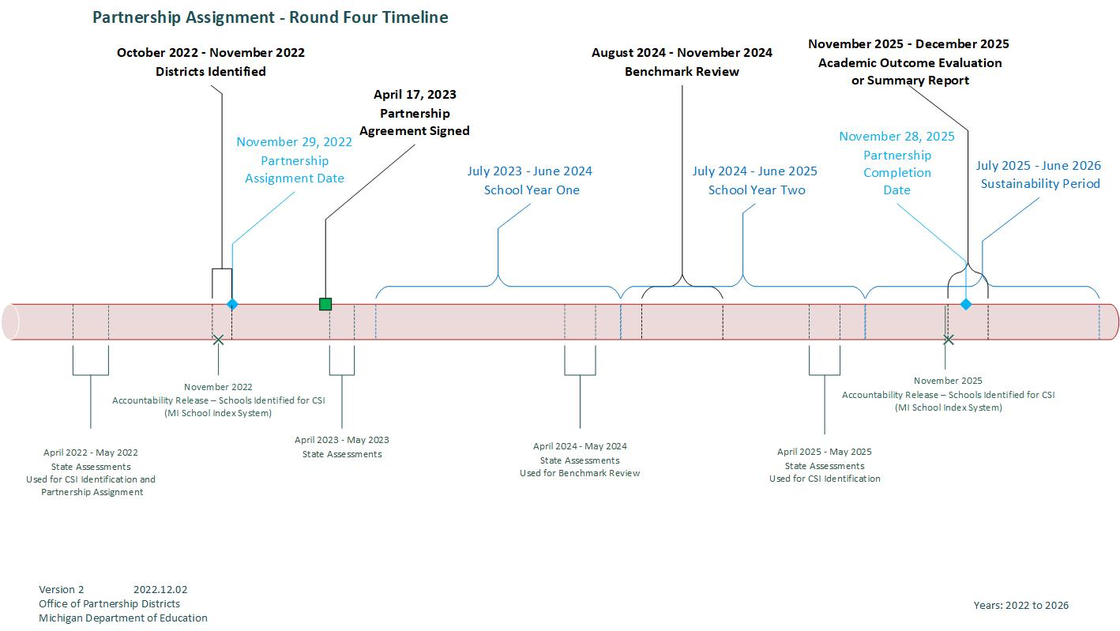
Partnership Assignment Round Four Timeline
Notes:
Bill
This is the Partnership Agreement Round Four timeline and will take 3 or 4 minutes to talk through.
Read and comment on each identified date.

Slide 29
Partnership Agreement Progress and Completion
Notes:
Dan

Slide 30
Benchmark Review
Collection of Evidence
District Presentation
Collaborative Conversation
Review Summary – Status Determination
The Benchmark Review (BR) is a collaborative review of the partnership agreement which takes place approximately halfway through the three-year agreement after the first full year of implementation.
Notes:
Dan
Read the slide
Specifically, the BR is a process designed to collect, review, and discuss evidence for the purpose of determining the status of the agreement. The PAL provides technical assistance to support the partnership district in preparing for the BR.
On-Track: A district that is On-Track is meeting all or most of its interim target benchmarks and is making adequate progress in meeting its identified partnership agreement 18-month interim target benchmarks to improve student achievement.
Off-Track with Progress: A district that is Off-Track with Progress is meeting some of its interim target benchmarks and is making some progress in meeting their identified partnership agreement 18-month interim target benchmarks to improve student achievement.
Off-Track: A district that is Off-Track is meeting few to none of its interim target benchmarks and is making insufficient progress in meeting their identified partnership agreement 18-month interim target benchmarks to improve student achievement.

Slide 31
Completing the Partnership Agreement
Partnership Agreement Summary Meeting & Report
Academic Outcomes Evaluation
Notes:
Lisa
The completion of partnership agreements is dependent upon whether the partnership district continues to operate school(s) identified for CSI in the next identification cycle in the Fall of 2025. Please note these identifications will be based upon the Spring 2025 testing cycle.
The 36-Month Partnership Agreement Summary Meeting takes place at the end of the three-year agreement and will be completed only by districts who operate one or more schools NOT re-identified for CSI.
The Academic Outcomes Evaluation process is only completed for districts who operate one or more schools re-identified for CSI supports

Slide 32
Partnership Agreement Summary Meeting & Report
Takes place at the end of the three-year agreement and will be completed only by districts who operate one or more schools NOT re-identified for CSI.
A collaborative meeting between the district, ISD/RESA, and MDE explaining progress of end target outcomes, opportunities for growth, and identifying next steps to sustain progress toward increased student achievement.
Notes:
Lisa –
The Partnership Agreement Summary Meeting is a collaborative meeting, of approximately two hours, between the district, ISD/RESA, and MDE explaining:
Progress of end target outcomes,
Opportunities for growth, and
Next steps to sustain progress toward increased student achievement.
A summary of this meeting will be incorporated into a final partnership agreement summary report written by the PAL and shared with the district, ISD/RESA and MDE Office of Educational Supports (OES) who will coordinate supports moving forward if applicable.
The OPD Comprehensive Guide for Partnership Districts includes guidance and the report template.

Slide 33
Academic Outcomes Evaluation (AOE)
An AOE is only completed for districts who operate one or more schools re-identified for CSI supports.
To exit CSI status a school must:
Not be in the bottom 5%
Have a graduation higher than 67%
Improve proficiency in BOTH math and ELA MSTEP/SAT in the Spring of 2024 and 2025
Notes:
Dan -
EMPHASIZE Proficiency Standard
The completion of partnership agreements commencing November 2022/expiring November 2025 is dependent upon whether the partnership district continues to operate school(s) identified for CSI in the next identification cycle.

Slide 34
Academic Outcomes Evaluation (AOE)
An evaluation of school level outcomes.
A multi-phased process designed to collect, discuss, and evaluate academic outcome evidence for the purpose of determining the need for the application of school level accountability measures
Notes:
Dan
The 36-month Academic Outcome Evaluation (AOE) is an evaluation of school level outcomes. Similar to the Benchmark Review, the AOE is a multi-phased process designed to collect, discuss, and evaluate evidence for the purpose of determining the need for the application of school level accountability measures defined in the Section XV of the partnership agreement.

Slide 35
Section 21(h)
Notes:
Tara

Slide 36
Section 21(h)
MCL 388.1621(h)
The Michigan Legislature has allocated funds for partnership districts.
Partnership districts apply for funds on an annual basis.
Funding is dedicated to improving instruction and learning in districts and their respective schools.
Notes:
Tara:
Since the 2017-18 school year, the OPD has approved $31,273,800 of funding that has been dedicated to improving instruction and learning in Partnership Districts and schools for the students that they serve.
This fiscal year, the Michigan Legislature has allocated $6,137,400 for partnership districts.
$137,400 of this allocation is specifically for the purchase of data analytic tools. It is divided equally among the number of partnership districts. So, for this fiscal year, each of the 54 partnership districts will receive $2,544 towards the purchase of an analytical tool.
Section 21(h) applications are developed in collaboration with the PAL assigned to the district and submitted and reviewed within NexSys.
In the coming months, as you complete your resource allocation review during the assess needs process and develop your partnership agreement consider how Section 21(h) funding can support the needs of your students.
Round four partnership districts will be able to apply for Fiscal Year 2023 Section 21(h) funds following completion of their partnership agreement. The application for Fiscal Year 2024 will be available if and after legislature approves Section 21(h) funds.

Slide 37
Section 21(h)
Requirements to Receive Funds and How Funds May be Used
Requirements for districts to receive funds:
Complete a needs assessment utilizing MICIP
Develop an intervention plan which is incorporated into the agreement
Utilize funds to support the attainment of:
18-month interim target benchmarks
36-month end target outcomes
Demonstrate effectiveness and meet a minimum utilization rate
Funds may be used for:
Professional development for teachers, district, or school leadership,
Increased instructional time,
Teacher mentors, or
Other expenditures that directly impact student achievement and cannot be paid from existing district financial resources
Notes:
Tara:
Part of demonstrating effectiveness is the completion of an Implementation and Effectiveness Worksheet also known as the I & E Worksheet.
The I & E Worksheet is a tool that is used by the district to record progress on implementation of each line item. This record includes district identified levels of implementation, impact, timeline, barriers to implementation, modifications to line items and utilization of funds. It is submitted to OPD on a triannual basis.
In addition, a Budget-to-Actual report is submitted annually. Once funds are expended, these two documents comprise the Final Expenditure Report.
And I highlight Section 21(h) funds may be used for - read the slide.
Examples of "Other” expenditures that have been funded are:
Behavior and Achievement Interventionists
Attendance & MTSS Support
Diverse Literacy Classroom Libraries

Slide 38
Partnership Agreement Requirements
EPIC Survey
MI Data Hub
Notes:
Bill

Slide 39
Education Policy Innovation Collaborative (EPIC), Michigan State University
Provide permission for the appropriate benchmark assessment vendor (i.e., NWEA, Curriculum Associates, Renaissance Learning, or Data Recognition Corporation) to transfer student-level benchmark assessment data from the fall and spring of each year to the Michigan Data Hub for EPIC’s research of the partnership district model. FERPA shall be followed as required by law.
Complete annual EPIC survey:
Partnership teachers and principals with a minimum participation rate of 50%
Non-partnership teachers and principals with a minimum participation rate of 30%
Participate in EPIC’s qualitative data collection efforts if asked to do so by the EPIC research team.
Notes:
Bill –
The MDE contracts with the Education Policy Innovation Collaborative (EPIC) to conduct annual research on the partnership district model through school leader interviews and teacher surveys (qualitative data) to determine the overall effectiveness of the partnership district model.
FOCUS on DATA HUB.

Slide 40
Resources
Notes:
Lisa

Slide 41
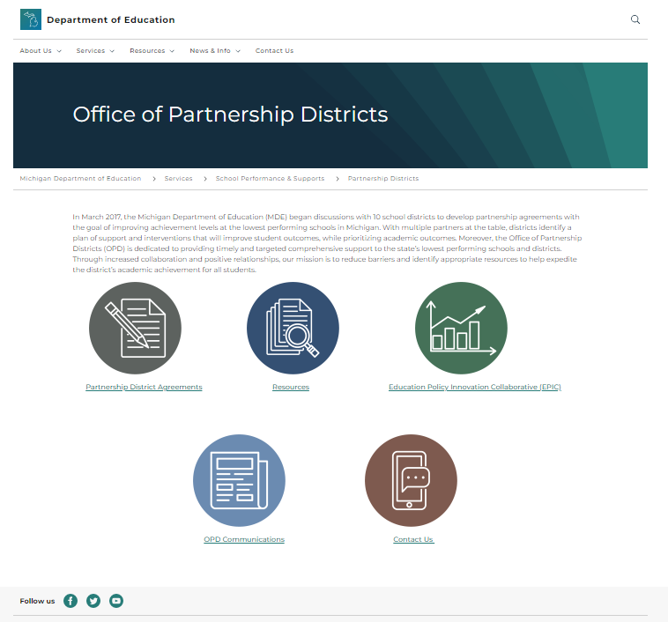
Office of Partnership Districts (michigan.gov)
Notes:
Lisa –
The OPD page on the MDE website is a key resource we want you to access. On this page you will find:
A listing of partnership districts; their agreements will be linked once they are completed and signed
Resources which include links to:
OPD Comprehensive Guide for Partnership Districts (December 15)
Partnership Agreement Template
Partnership Assignment Timeline
Level of Support and District Requirements
Role of Partnership Agreement Liaison
A link back to the MDE webpage, “Resources for Schools Identified for Supports”
Networking Event Materials (Spring 2023)
EPIC requirements and annual reports
Key OPD communications
Our office contact information
As you communicate with your board and community, direct them to the OPD webpage for the most updated information.

Slide 42
Resources for Partnership Districts
MDE Webpage
Resources for Schools Identified for CSI, ATS, or TSI (michigan.gov)
OPD Webpage
Partnership Districts (michigan.gov)
Michigan Integrated Contiuous Improvement Process (MICIP)
Michigan Integrated Continuous Improvement Process (MICIP)
MiStratgey Bank (MSB) MiStrategyBank (MSB) - Projects - MAISA (gomaisa.org)
Regional Assistance Grant
Targeted Assistance Grant
Mental Health
Mental Health (michigan.gov)
African American Student Initiative (AASI)
African American Student Initiative (AASI) (michigan.gov)
Curriculum
Academic Standards (michigan.gov)
Literacy Webpage
Literacy (michigan.gov)
Literacy Grant – LETRS
LETRS Training Grant (michigan.gov)
Literacy Essential Practices Literacy in Michigan and Essential Practices
Multi-Tiered Systems of Support (MTSS)
Multi-Tiered System of Supports (MTSS) (michigan.gov)
MiMTSS TA Center
Our Center | Michigan's MTSS Technical Assistance Center (mimtsstac.org)
Early Warning Intevention and Monitoring System (EWIMS) Early Warning Intervention and Monitoring System (EWIMS) (michigan.gov)
MI Systems Support
MI Systems Support (misystemsupport.com)
Michigan DataHub
Home (midatahub.org)
Section 21(h) Funding
Notes:
Lisa –
Here are additional resources w/links if applicable readily available to you. This is not an exhaustive list. As we begin our work together, additional resources specific to your district’s goals will be sought and discovered.

Slide 43

OPD Networking Event
Save the Date:
May 17, 2023
Notes:
Lisa
The OPD hosts networking style event(s) each school year to inform partnership districts of updates, provide technical assistance, and offer districts an opportunity to exchange practices impacting student achievement.
This spring we encourage to hold May 17, 2023, on your calendars for our first networking event for round four partnership districts.

Slide 44
Communications Recap
Partnership District Notification Letter – November 29, 2022
PAL Assignment Notification – December 5, 2022
Partnership Agreement Template – December 7, 2022
Next Up: OPD Comprehensive Guide for Partnership Districts – December 15, 2022
Notes:
Lisa –
Before we head into the final slides of this presentation, we recap the OPD communications you have received thus far.

Slide 45
Next Steps
Notes:
Gloria
Let’s look at next steps for the initial planning meeting to write the partnership agreement.

Slide 46
Introduction Meeting:
District Superintendent/PSA School Leader
PAL
OPD Director/Assistant Director
Introductions
Answer Questions
Explain Necessary Actions to Complete PA Template by April 17, 2023
Identify Signatory and other (union rep, family, community…) Partners
Set Initial PA Development Meeting Date to Begin the Work: Conduct MICIP Needs Assessment and Complete PA Template
Identify District/School Leadership Designee
Attend Meetings
Develop and Implement PA, Work with PAL and Partners,
Notes:
Gloria
You are in the process of setting up a virtual INTRODUCTION MEETING with your assigned PAL. Our ISD partners are also included in this meeting. This meeting should take no more than an hour of your time. If you are a returning district, this time may be even shorter.
At this meeting we will:
cover any questions you have following this webinar
talk about and identify partners the district will want on the team that will complete the needs assessment and develop the partnership agreement
and set the date for that first partnership agreement development meeting

Slide 47

Questions
Notes:
Lisa and Sheri –

Slide 48
What We Covered
Identification
Understand Assigned Level of Support
Role of Partnership Agreement Liaison
Partnership Agreement Template
& Timeline
MICIP Alignment
Areas of Inquiry
Goal Areas
18-Month Interim Target Benchmarks
36-Month End Target Outcomes
Benchmark Review
Proficiency Standard
Re-Identification
Section 21(h)
Funding
Completing Partnership Agreement
Summary Meeting/Report
Academic Outcome Evaluation
Resources
EPIC Survey
Accountability Measures
Notes:
Lisa
We thank you for committing time and hope we came close to meeting our intended objectives.
We understand this is a vast amount of information to take in, and hope you are leaving with a greater understanding of the expectations and supports available to you as a partnership district.
Your PALs will be able to answer any additional questions you have during your introduction meeting.

