Slide 1
2023A Wet Mount Challenge

Slide 2
Instructions
Wet Mount PT: 2023A
Micrographs 1 - 10
Evaluate items 1 – 10 as if each is from a representative field (indicated as either low or high power) from an individual patient
Identify the cellular image indicated with an arrow in each photomicrograph
Enter results for items 1 – 10 on result sheet

Slide 3
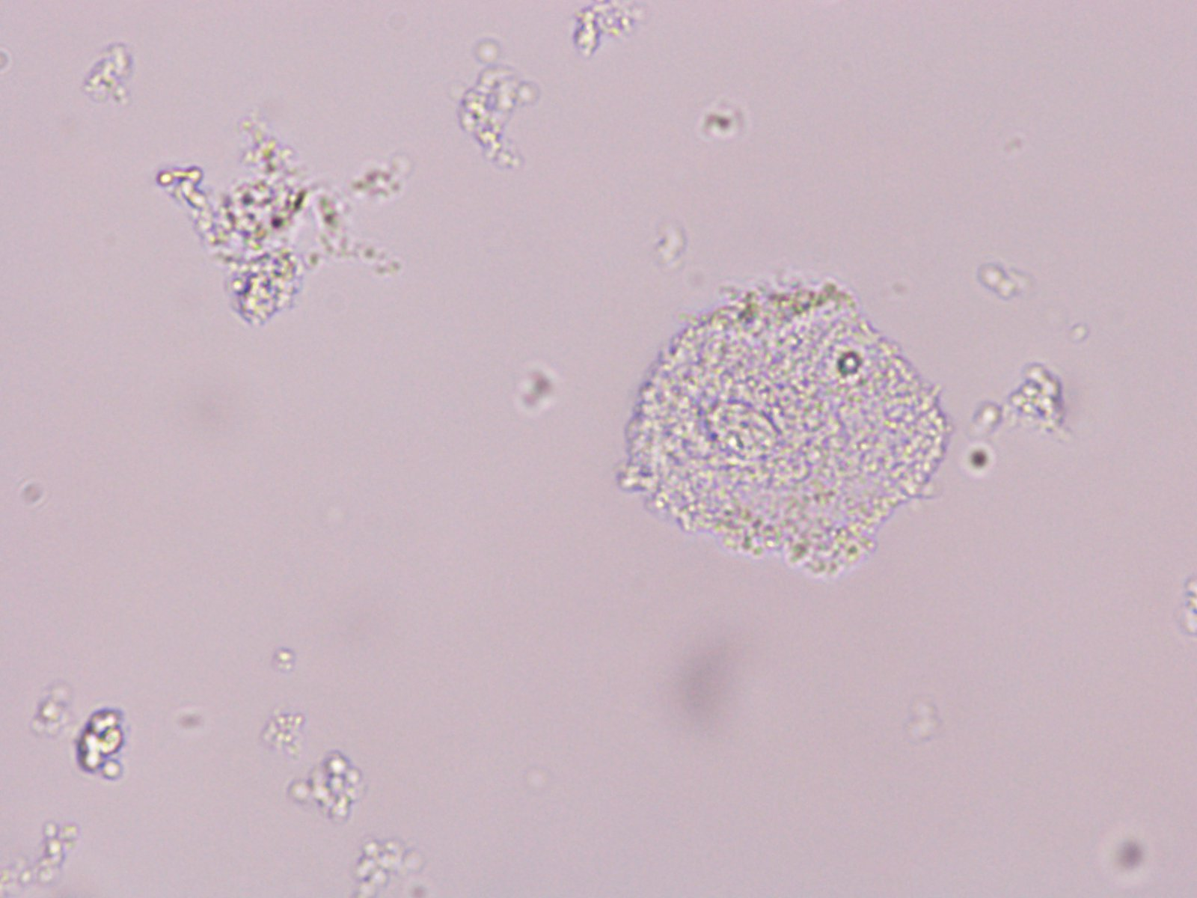
Slide 1
40X

Slide 4
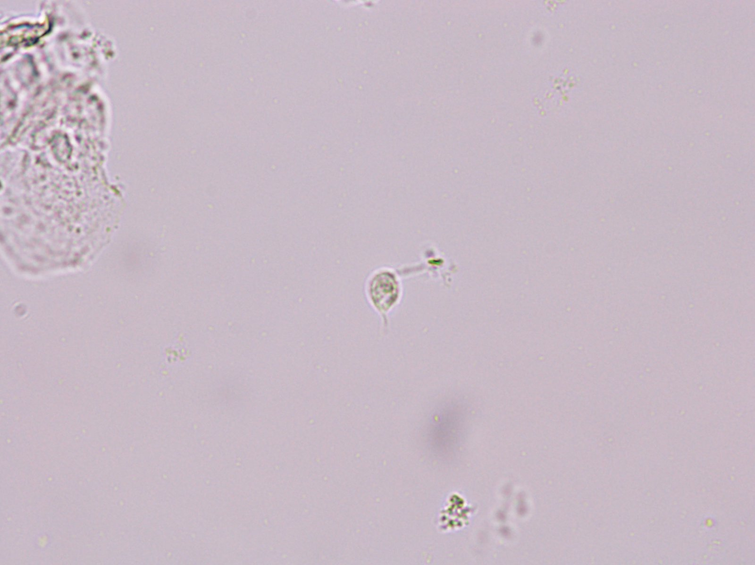
Slide 2
40X

Slide 5
Slide 3
40X

Slide 6
Slide 4
40X

Slide 7
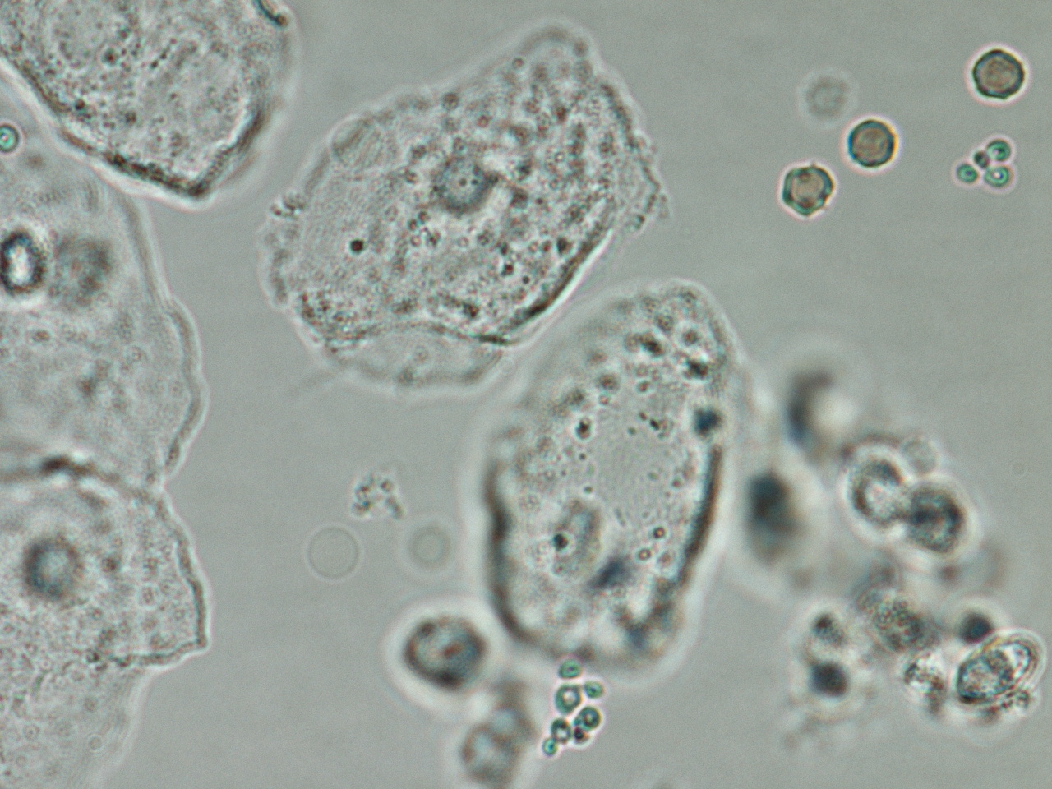
Slide 5
100X

Slide 8
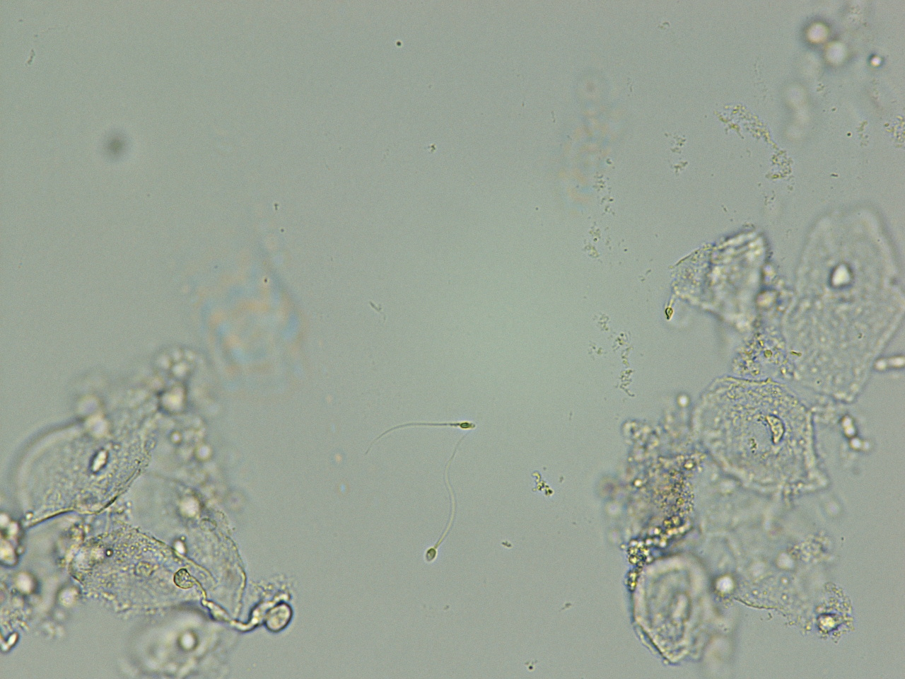
Slide 6
40X

Slide 9
Slide 7
40X

Slide 10
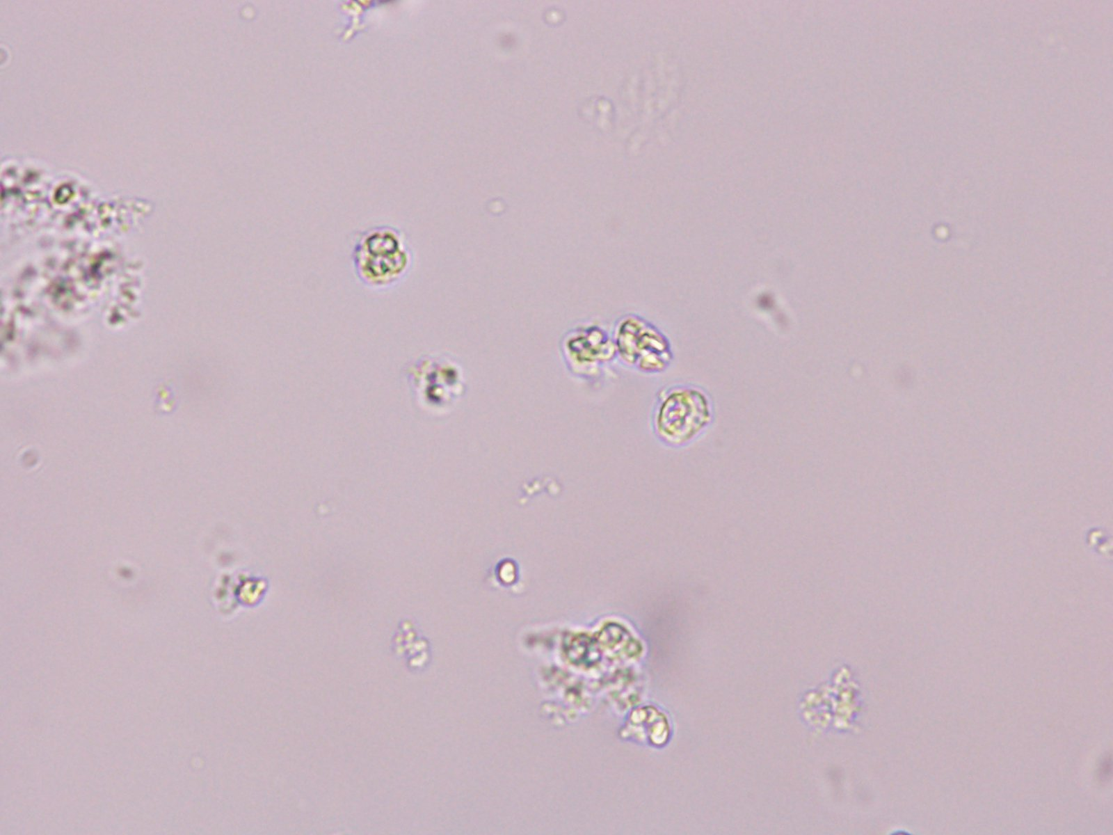
Slide 8
40X

Slide 11
Slide 9
40X

Slide 12
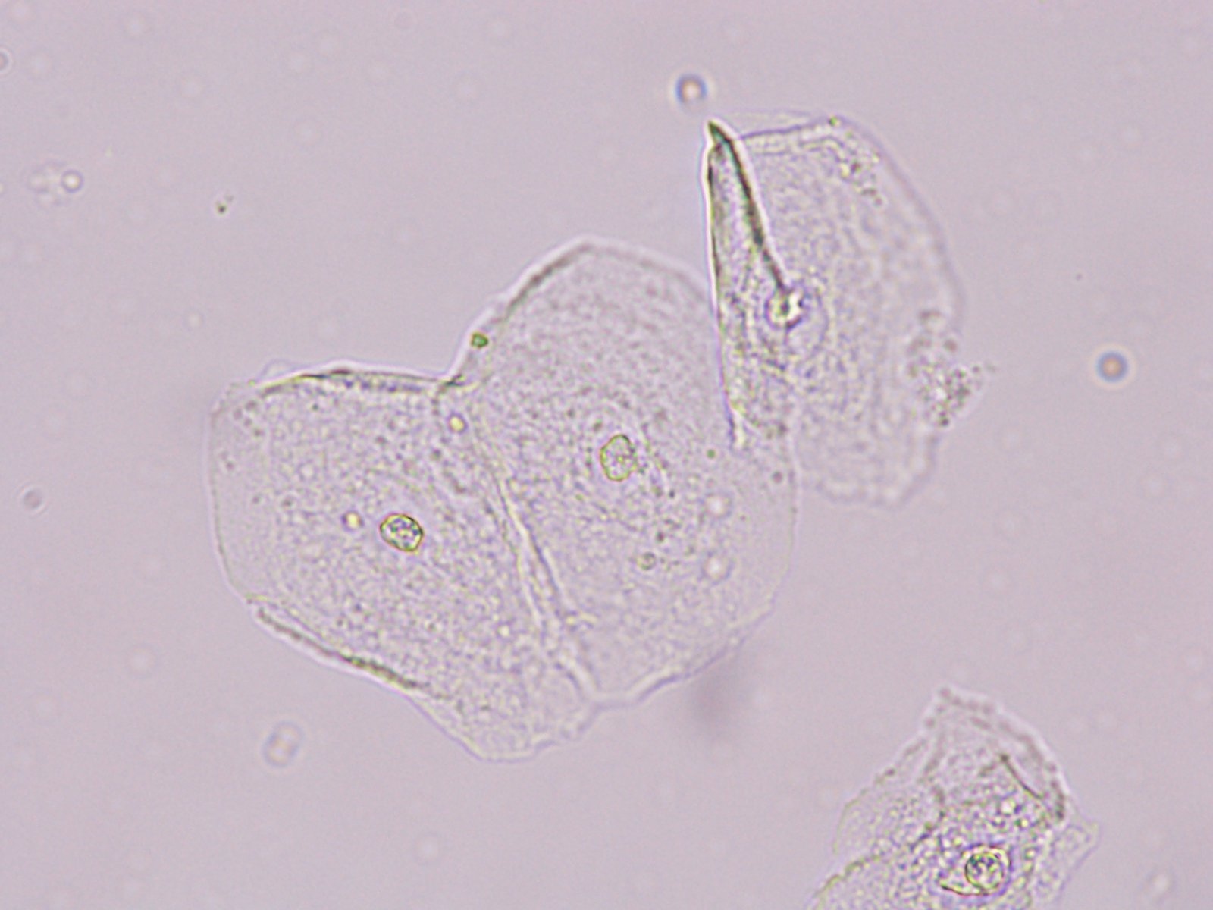
Slide 10
40X

