Slide 1



How to read the Michigan State Map

Slide 2
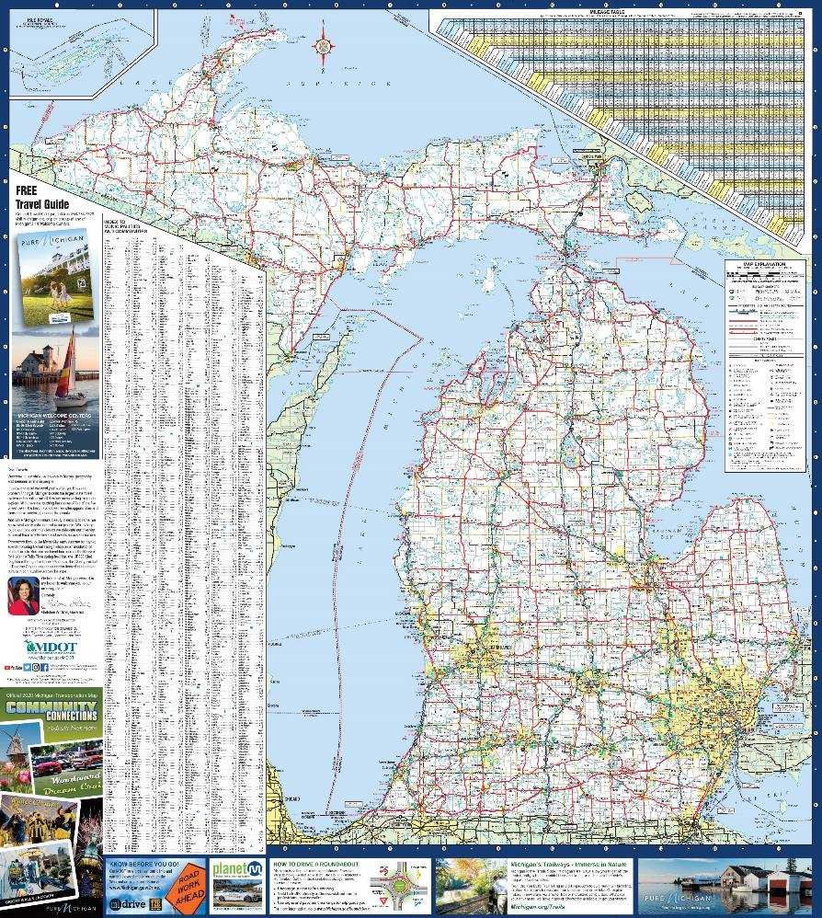
ROAD MAPS
Road maps can help you get from one place to the other in Michigan on state, county and city roads.
Sometimes your GPS or phone won’t work. It’s important to be able to read a map so you can get to where you need to go safely.

Slide 3

Which way’s up?
When you open the map, hold it so the Upper Peninsula is above the Lower Peninsula.
Most maps have a compass that shows which way is north. Can you find the compass on your map?

Slide 4

Map Orientation
When you look at a map, the top will always face north. That means the right side of your map is east and the left side of your map is west.
Can you find north, south, east and west on your map?

Slide 5
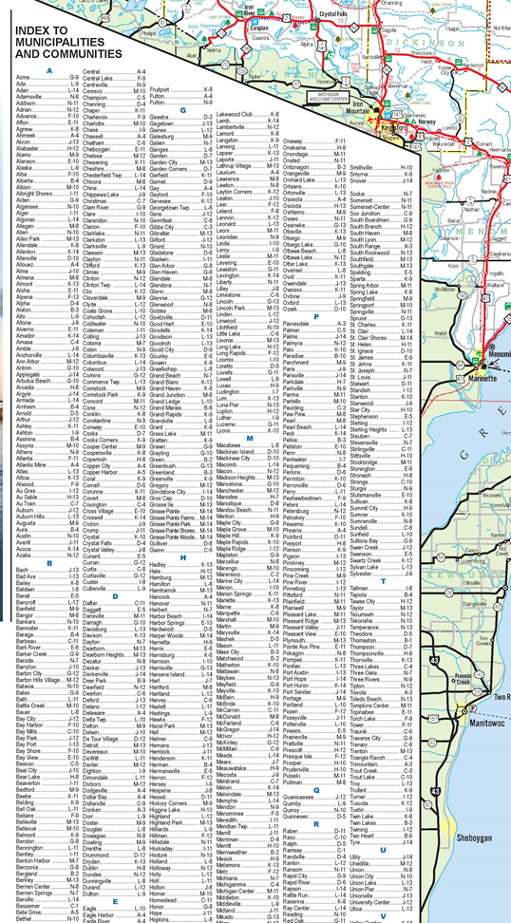
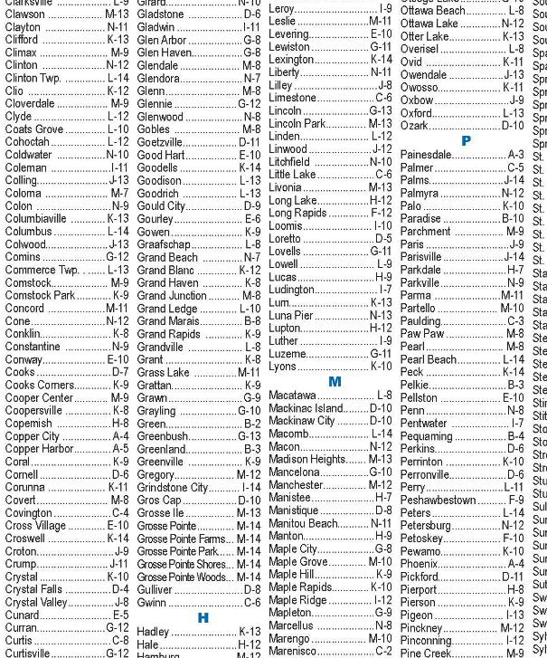

Finding your destination
The map has a list (also called an index) of the cities and towns that are on the map.
The map is made to help people who are traveling, so towns are only listed if they provide a place for people to stop and get gas or food.
Find your hometown or one close to you in the index. Next we will learn how to use the grid to easily find it on the map.

Slide 6
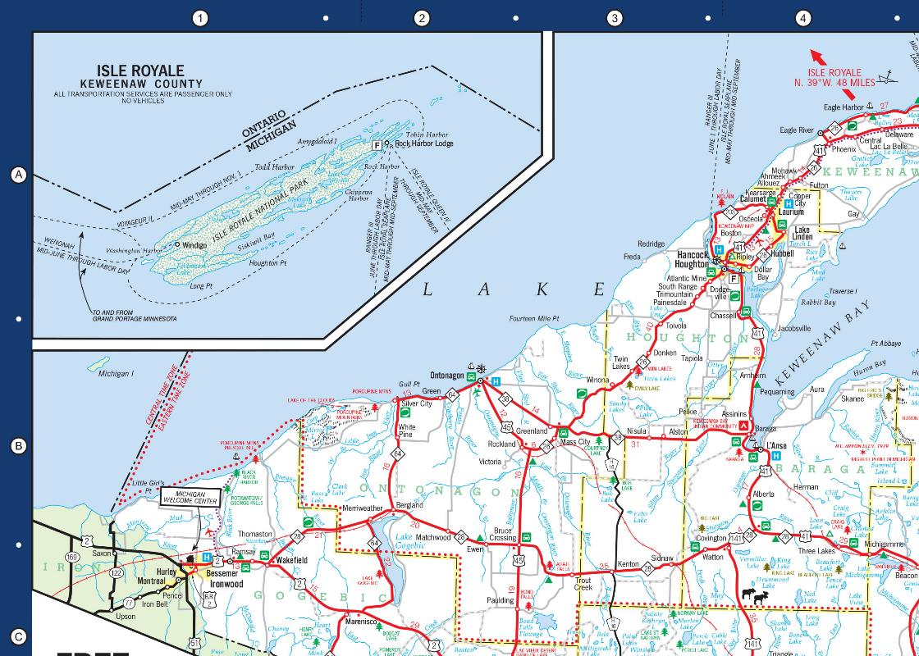
Using the grid
There are numbers along the top of the map and letters down the side.
These numbers and letters form a grid.
To find a location on the map, put one finger on the number and another finger on the letter. Go straight down and straight across until your two fingers meet.
What city do you find at J-9?
What state park is located at E-11?
Can you find your city or town using the index and the grid?

Slide 7
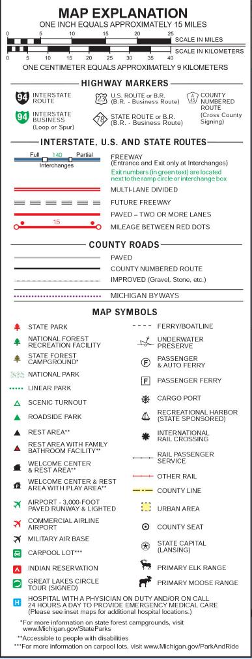
Map Key/Legend
Maps have a key or legend. This lets you know what the symbols on the map mean.
Can you find the legend on your map?

Slide 8
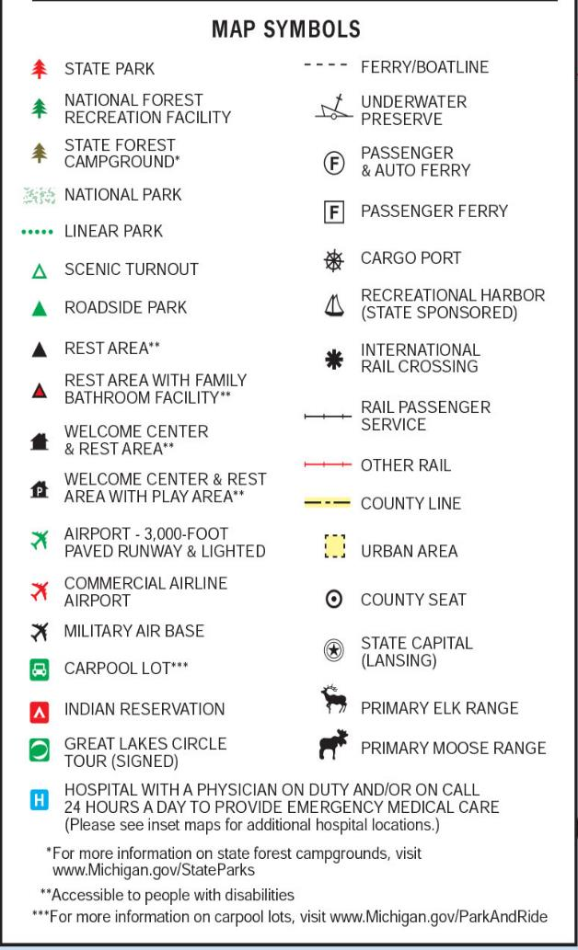
Map SYMBOLS
Symbols help you find places on the map, like parks, airports, hospitals and even wildlife ranges.
These symbols can help you when you travel. If you need to go to the bathroom or fill up a water bottle, then you can look for a rest area or Welcome Center.
Can you find a moose range on the state map? What about the rest area closest to where you live?

Slide 9
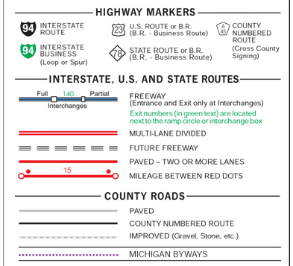
Types of roads - Freeways
Not all roads are the same. Our biggest roads are called freeways.
You have to enter or exit a freeway using a ramp.
Freeways are made to move a lot of traffic and to help that traffic move faster. That’s why freeways have higher speed limits than other roads.
The food and other things you buy in stores is delivered on trucks and those trucks use the freeways.
What color are freeways on the state map?

Slide 10
Other Types of roads
The Michigan Department of Transportation (MDOT) builds, maintains and repairs I, US and M roads.
Other roads are county and city roads. The local government owns and maintains them.
If you live in a neighborhood or on a dirt road, your road probably isn’t on the state map. To find your road, you might need to look at a city map.
How many different kinds of roads do you see listed on the state map?

Slide 11

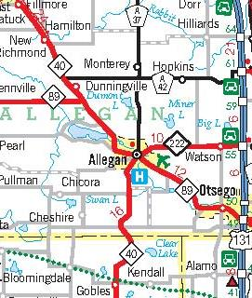
There is a lot of information besides just roads and cities on the state map.
If you don’t know what all the numbers and symbols mean it can look very confusing.
Using the legend can help.
Knowing what the numbers and shapes mean can help too.

Slide 12
Interchanges
Freeway ramps are shown as a square. These ramps are called an interchange.
An Interchange is where the freeway connects with another road.
Sometimes roads go over or under the freeway but there isn’t a ramp for you to get off or on. You have to go to the next interchange to get to the other road.
Can you look on the map and find the closest interchange to where you live?

Slide 13
Exit numbers
These little green numbers on the map are Exit numbers.
Exit numbers can be used instead of road names to know when to turn off one road onto another.
Exit numbers work with mile markers you see on the side of the road to know how far it is to your exit.
If you miss your exit, it also tells you how far you are to the next exit. So, if you miss exit 61, and you are going north, it will be three miles until the next interchange, at exit 64.
If you are traveling north and you are at Mile Marker 50 and you need to take Exit 64, how far are you from your exit?

Slide 14

Road shields
Road shields can tell you what kind of road you are on and the road’s number.
Some roads have road numbers instead of names, such as I-75 or US-131.
Different kinds of roads have different shaped shields. Using the legend, what kind of road is 131? What kind of road is 222? What kind of road is 37?
The shield and the color of the road can tell you if it’s a freeway, divided road or two-lane road.

Slide 15
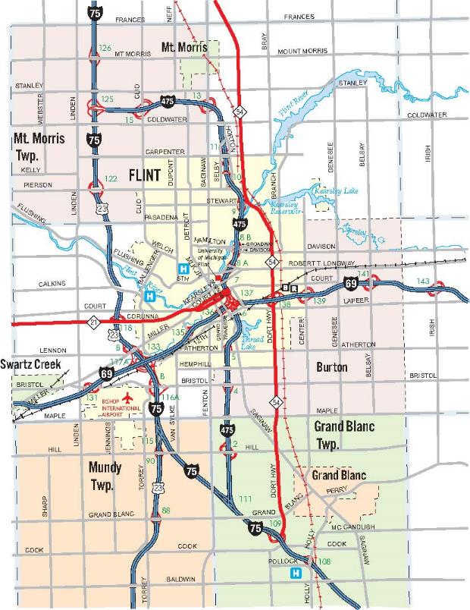
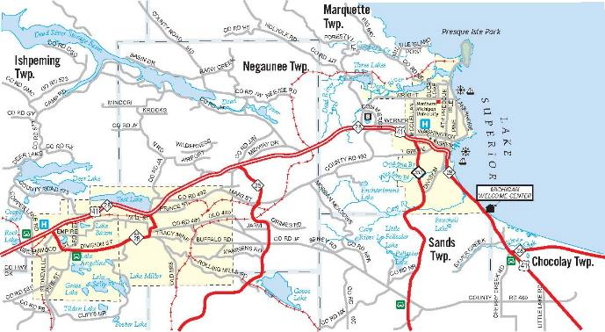
City maps
Because there is so much detail on the map, larger cities get their own smaller map.
Look on the back of your map to find these “breakout” maps.
Breakout maps let the map makers put in more details in places where there are a lot of roads, interchanges, airports, hospitals and parks.

Slide 16
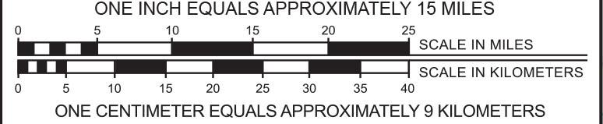
MAP scale
We don’t have life size maps, so to make sure everything is in the right proportion, maps need to include a scale.
A scale lets you know how far you need to travel to get to where you want to go. You can also count the exit numbers to get an idea of the distance you need to travel.
Map scales use what’s called a ratio. On the state map, one inch equals 15 miles.
This ratio simply means that 1 unit of distance on the map is equal to 100,000 units in real life.

Slide 17
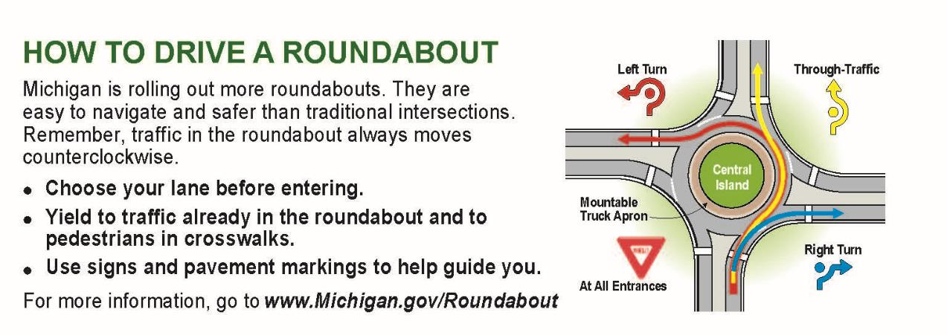
Other Information
There is a lot of other information on the state map to help drivers stay safe.
How to Drive a Roundabout is a diagram that shows drivers the right way to drive through a roundabout.

Slide 18
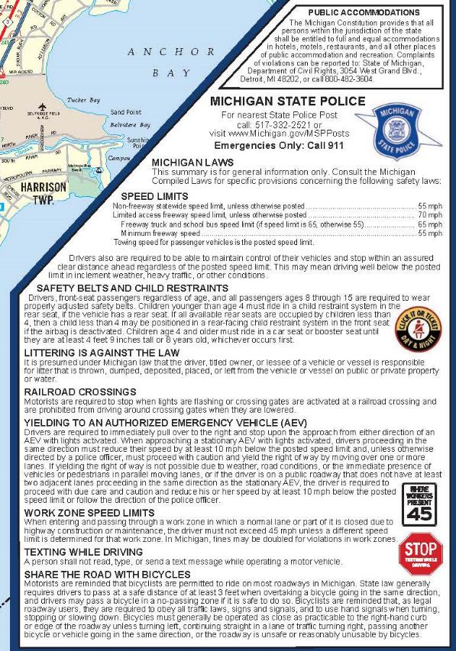
Michigan driving laws
Michigan driving laws are shown on the back side of the state map.
Different states have different laws so this is important information for someone visiting Michigan to understand.
The list is just a quick overview of laws, such as speed limits, safety belt usage, and texting while driving.
For a complete listing of Michigan driving laws ,go to https://www.michigan.gov/sos/0,4670,7-127-1642-103522--,00.html.

Slide 19
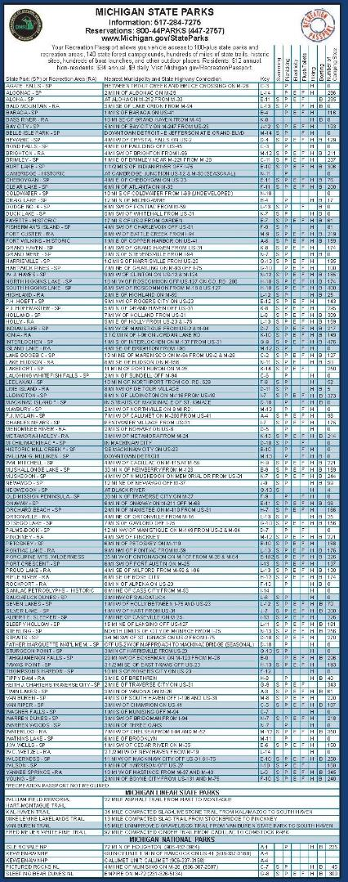
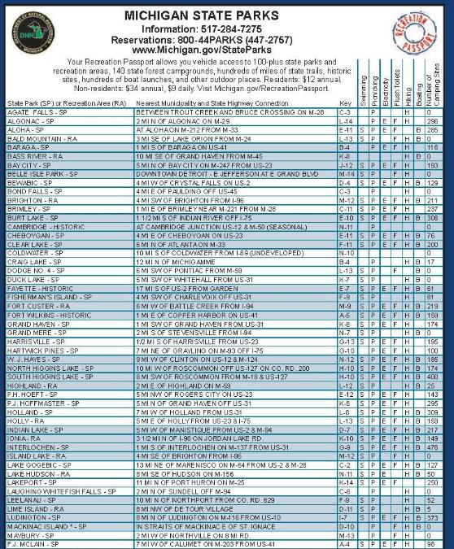
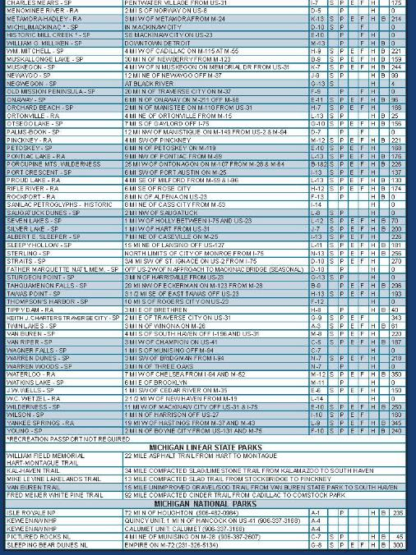
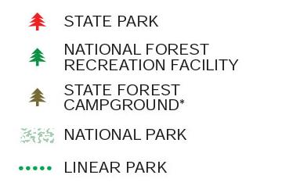
State parks
The back of the state map also provides a list of state and national parks in Michigan.
There are grid coordinates so you can find them on the map.

Slide 20
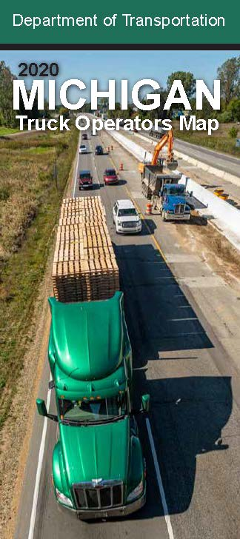

specialty maps
Most maps are made for a specific purpose. The state map is made to help people get from one place to another in Michigan.
Some maps are made especially for bicyclists. Other maps are made for truck drivers.
A bicyclist and a truck driver need different information to help them get to where they are going. One would have the location of truck stops and the other would show you where the bike paths are.
These are called specialty maps.

Slide 21

Draw A specialty map
If you were making a map for dog walkers in your neighborhood, what kinds of things might you put on that map? Fire hydrant locations? Parks? Houses where other dogs live?
What about a map for donut lovers? You could make a map of all the places that sell donuts in your town.
Draw a specialty map of something you like.

Slide 22
Draw a map of your neighborhood
Using the state map as your guide, draw a map of your building or neighborhood.
Use different colored lines to show main roads, side roads and driveways.
Make sure to include a legend to help people know what symbols mean. What kind of landmarks do you want to show on your map?
Create a grid on the top and side to help people find buildings or parks.
If you draw a map of your neighborhood or building, make a breakout map on the back of your house or apartment.
Don’t forget to put a compass on your map and make sure the top is facing north.

Slide 23

Plan a trip
Choose a park or town you would like to visit in Michigan using the index and grid.
Plan your route from your home using the map. Write down the directions, including what roads to take, what exits to take and what direction to go in once you turn onto a different road.
Is there more than one way to get to where you want to go?
What are some places you could stop and visit along the way?
What kind of roads will you be driving on?
About how many miles is it from your home?

