Slide 1
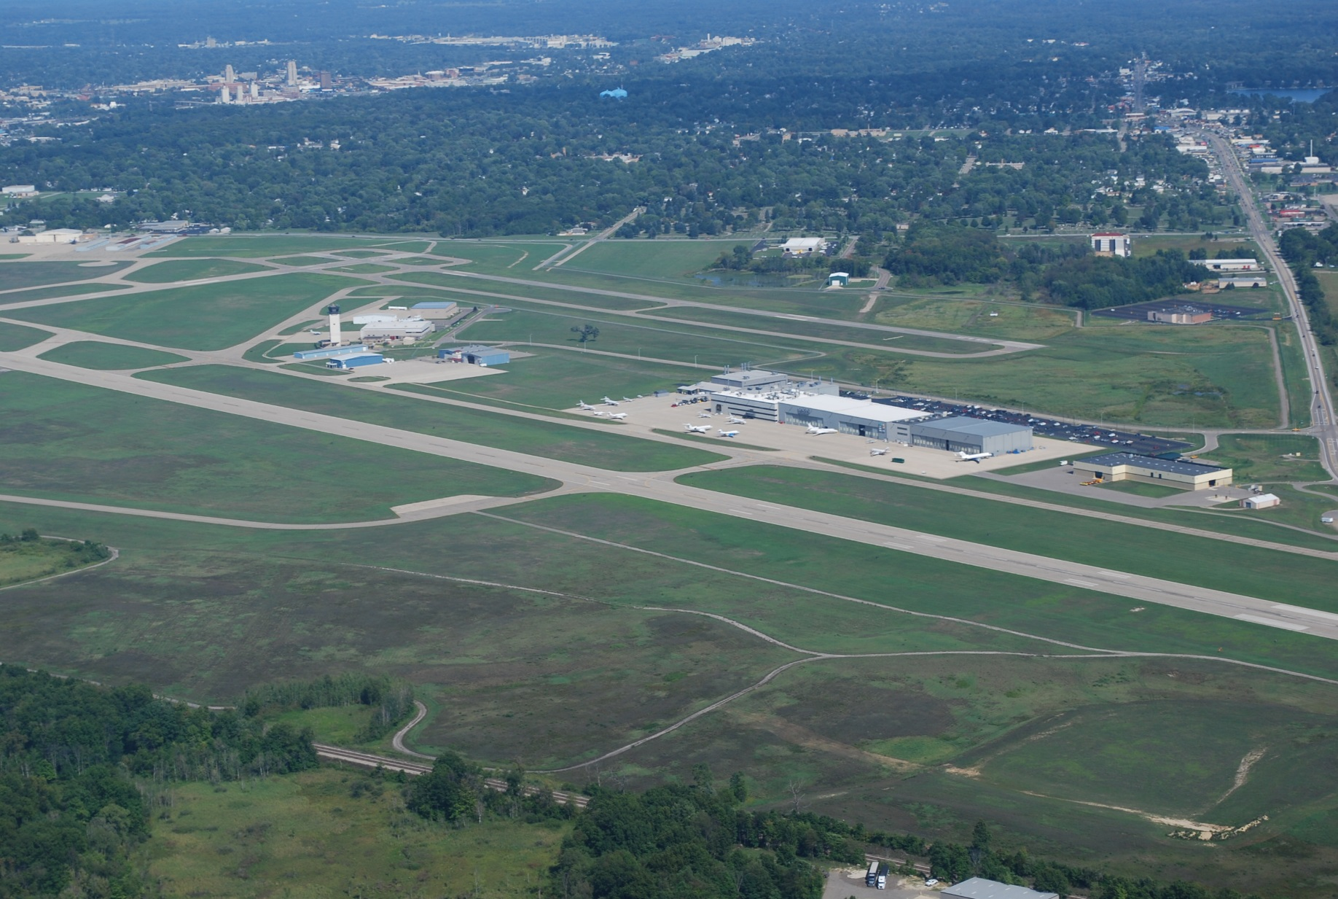
SPONSOR CONTRACT APPROVALS
March 2022

Slide 2
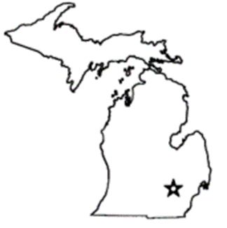
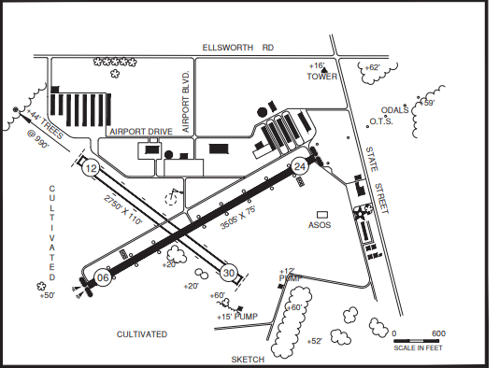
Ann Arbor Municipal Airport (ARB)
Project: Environmental Assessment (EA) - Phase 3
Additional Alternatives
State Block Grant Program
Federal funds State funds Local funds Total
$146,776 $4,995 $4,995 $156,766
Airport Facts:
Tier: 1 Airport (TC,RC)
ARC: BII
Based Aircraft: 151
Primary Runway: 06/24
Length: 3505
PCI: 75
Last Inspection: 2/9/2022
License Class: General Utility
Notes:
The EA was initiated in December 2018 and Phase 2 in December 2020
Phase 3 includes three new alternatives to be analyzed, additional FAA reviews and edits, and additional public comment.

Slide 3
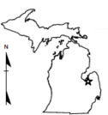
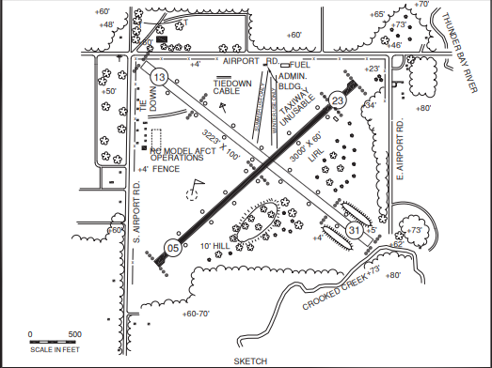
Atlanta Municipal Airport (Y93)
Project: Acquire Land for Approaches of Runway 5 (Parcel 16)
State Block Grant Program
Federal funds State funds Local funds Total
$101,547 $5,641 $5,642 $112,830
Airport Facts:
Tier 2 Airport
ARC: BII
Based Aircraft: 9
Primary Runway: 5/23
Length: 3000
PCI: 38
Last Inspection: 9/24/2019
License Class: Basic Utility
Notes:
Provisional License – once they acquire the parcel, they will be able to remove obstructions in the Runway Protection Zone of Runway 5
And that will help bring them into compliance.

Slide 4
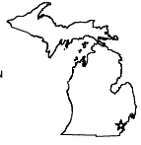

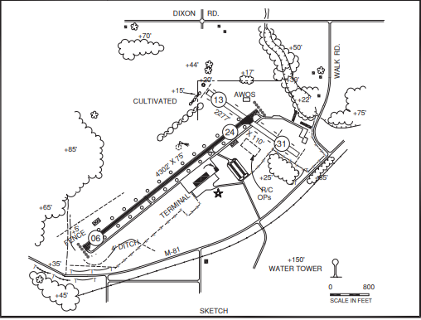
Tuscola Area Airport, Caro (CFS)
Project: Rehabilitation of Runway 6/24
Installation of PAPIs for 6/24
State Block Grant Program
Federal funds State funds Local funds Total
$ 1,117,993 $0 $0 $1,117,993
$ 232,508 $7,245 $7,246 $246,999
Airport Facts:
Tier: 2 (BC, TC, RC)
ARC: BII
Based Aircraft: 30
Primary Runway: 06/24
Length: 4302
PCI: 41
Last Inspection: 10/15/2019
License Class: General Utility
Notes:
Rehabilitation of runway 6/24 and taxiway connectors to holdlines. The rehabilitation will include pulverizing the existing pavement, fine grading and compacting the base material, and paving a new asphalt surface.
Also, Installation of new LED Precision Approach Path Indicators (PAPI) on both ends of Runway 6/24. The existing PAPI were installed in 1995 and 2002 and are 27 and 20 years old. The installation will also include cable in conduit system, and vault equipment.
The existing runway is 4,300' x 75'. The existing pavement was last rehabilitated in 1995/2002 and will be 27/20 years old at the time of this project. According to the PCI data taken in 2018, the existing pavement was listed at 64/68 and is experiencing medium severity alligator cracking, low to medium severity longitudinal and transverse cracking, low severity patching, and low to high severity weathering. The PCI for runway 9-27 is forecasted to be at 59/63 in 2022.

Slide 5

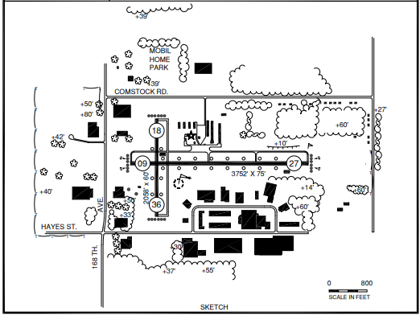
Grand Haven Memorial Airpark (3GM)
Project: Acquire Land for approach of Runway 27 (Parcels E62 and E63)
State Block Grant Program
Federal funds State funds Local funds Total
$60,507 $326 $327 $61,160
Airport Facts:
Tier: 1 (TC)
ARC: BII
Based Aircraft: 62
Primary Runway: 09/27
Length: 3752
PCI: 55
Last Inspection: 7/31/19
License Class: General Utility
Notes:
Two easements were needed to clear trees in the east approach of Runway 27. The easements have already been obtained and the trees have been cleared, this is a reimbursement. .

Slide 6
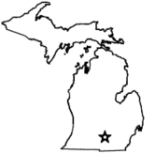
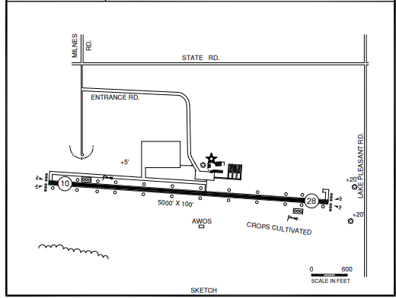
Hillsdale Municipal Airport (JYM)
Project: Planning Study for New Terminal Building
State Block Grant Program
Federal funds State funds Local funds Total
$ 30,273 $0 $0 $30,273
Airport Facts:
Tier: 1 (PC,BC,I)
ARC: CII
Based Aircraft: 13
Primary Runway: 10/28
Length: 5000
PCI: 84
Last Inspection: 10/4/2018
License Class: General Utility
Notes:
The existing terminal has reached it useful life and cannot remain in the current location because it is not compliant with FAA Part 77 Surfaces for the ultimate development configuration per the ALP. The terminal study will define the facility size based on airport needs and available funding.

Slide 7
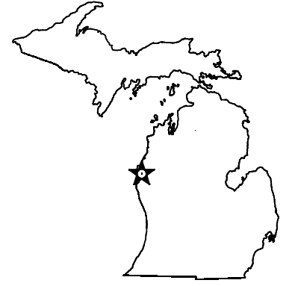
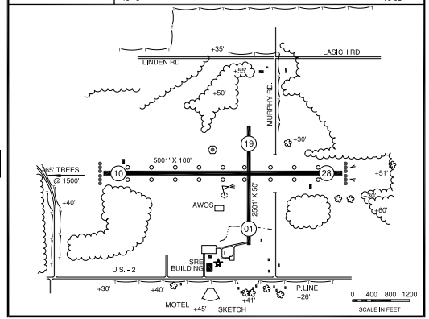
Schoolcraft County Airport, Manistique (ISQ)
Project: Design of Snow Removal Equipment
State Block Grant Program
Federal funds State funds Local funds Total
$14,085 $457 $458 $15,000
Airport Facts:
Tier 1 Airport (LA)
ARC: BII
Based Aircraft: 12
Primary Runway: 10/28
Length: 5001
PCI: 58
Last Inspection: 8/24/2018
License Class: General Utility
Notes:
This airport receives an average of 121 inches of snowfall each year and large snow banks accumulate frequently. This equipment will include a blower and bucket to remove snowbanks and broom to cleanup around lighting.
Their current truck with blower was acquired with in 2005 and has reached the end of it's useful life.
They did get a SRE with plow in 2019, but cannot accommodate other attachments needed to remove snow banks (blower, bucket) or cleanup around lighting (broom).
Equipment cost estimated $375,000

Slide 8
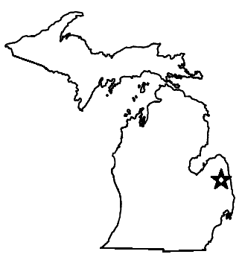
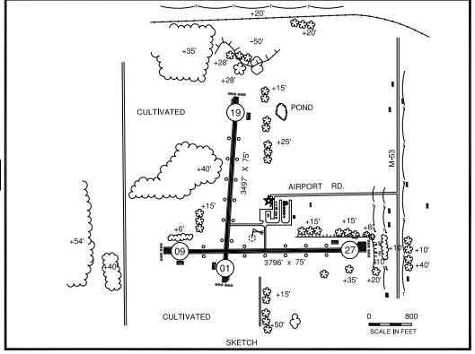
Marlette Township Airport (77G)
Project: Design of Rehabilitation for Taxiway A, B, and Taxilanes
State Block Grant Program
Federal funds State funds Local funds Total
$98,744 $0 $0 $98,744
Airport Facts:
Tier 1 Airport (LA)
ARC: BII
Based Aircraft: 39
Primary Runway: 09/27
Length: 3796
PCI: 37
Last Inspection: 1/19/2022
License Class: General Utility
Notes:
In 1993, Taxiway B was constructed, and Taxiway A was rehabilitated. Both had pavement repairs in 2002.
In 2020, the taxiway system had a Pavement Condition Index (PCI) of 24-36
They will be rehabilitated with bituminous asphalt pavement at 35' wide, Taxiway A will be 1100' in length and Taxiway B will be 430' in length. Two taxilanes were constructed in 1993 and one was constructed in 2002. They will be rehabilitated at 25' wide and 500' long with bituminous asphalt pavement. More research is needed to determine if subbase will be needed to provide pavement strength. This project design assumes geometric configurations will stay the same and no electrical work is required meeting the requirements per the FAA AIP

Slide 9
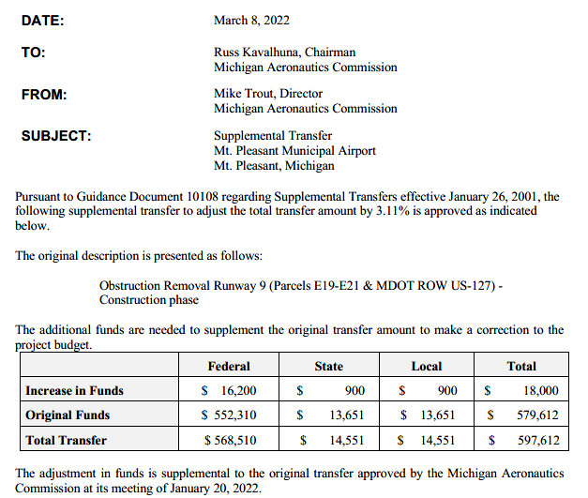
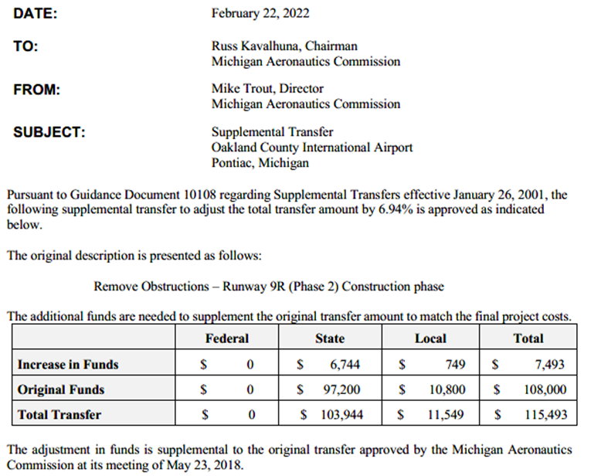
  Supplemental Transfer
  For Information Only (no action required)
Notes:
We also have three Supplemental Transfers; they are under 15% and for information only
Mt. Pleasant Municipal Airport, Obstruction Removal for Runway 9, Originally transferred in January 2022. Increase of $18,000 (3%), to make correction of project budget
Oakland County International Airport, Pontiac; Obstruction Removal for Runway 9R; Originally transferred in May 2018; Increase of $7,493 (7%), based on final project quantities

Slide 10
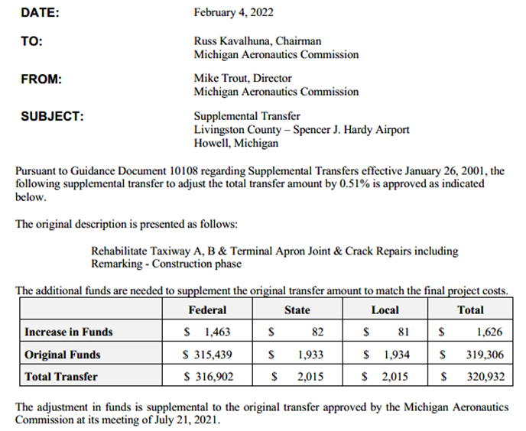
  Supplemental Transfer
  For Information Only (no action required)
Notes:
Livingston County – Spencer J. Hardy Airport, Howell; Rehabilitation of Taxiway A, B & Terminal Apron; Originally transferred in July 2021; Increase of $1,626 (0.5%) based on final project quantities

Slide 11
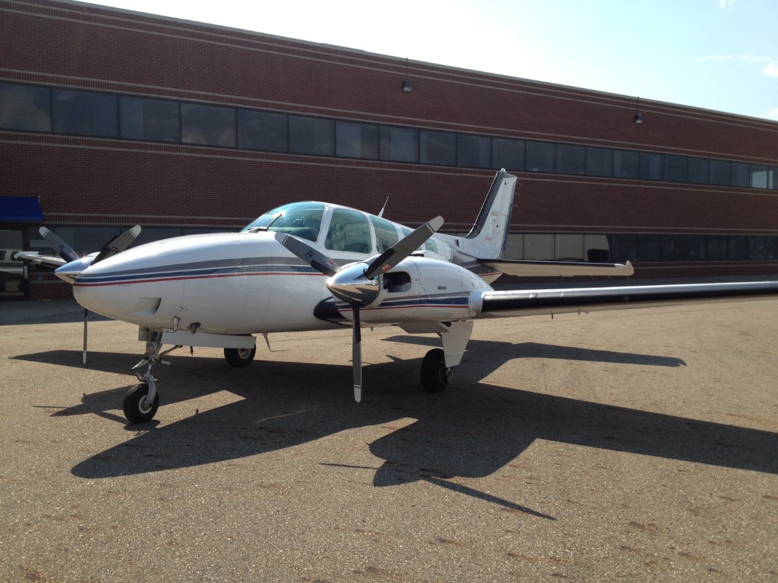
Questions?

Slide 12

MDOT’s role in the
FAA Airport Improvement Program (AIP)
for Direct Grants (Primary Airports)
Goal:
Streamline MDOT’s role in the FAA AIP process for direct grants, support Michigan’s Aviation System, meet the priorities of the Michigan Aeronautics Commission (MAC), and meet the requirements of the Aeronautics Code.
Notes:
All of the projects you saw in the pervious approval are part of the State Block Grant Program. For that Program, FAA has delegated much of the oversight authority to MDOT
Unlike that program for the Primary Airports, FAA retains that authority.
MDOT’s involvement is based on the Aero Code and the contribution and oversight of the state funds included in the project.

Slide 13
AERONAUTICS CODE OF THE STATE OF MICHIGAN (EXCERPT)
Act 327 of 1945
259.135 Federal or other assistance to political subdivisions; submittal of project application to administrator of federal aviation administration; commission as agent; terms and conditions of agency; disbursements.
Sec. 135.
(1) A political subdivision of this state is empowered to accept federal or other assistance in the acquisition, construction, enlargement, improvement, maintenance, equipment, or operation of airports, landing fields, and other aeronautical facilities.
(2) A political subdivision of this state, whether acting alone or jointly with another political subdivision or with the state, shall not submit directly to the administrator of the federal aviation administration or its successor agency any project application under the provisions of an act of Congress for airport and airway systems, unless the project and the project application have been first approved by the commission.
Notes:
You should have copies in your packet.
The Aero Code states the no project application shall be submitted to FAA without commission approval

Slide 14
AERONAUTICS CODE OF THE STATE OF MICHIGAN (EXCERPT)
Act 327 of 1945
Sec. 135.
(3) A political subdivision shall not directly accept, receive, receipt for, or disburse any funds granted by the United States for the purpose of acquisition, construction, enlargement, maintenance, equipment, or improvement of airports, landing fields, or other aeronautical facilities, but it shall designate the commission as its agent and in its behalf to accept, receive, receipt for, and disburse such funds. A political subdivision shall enter into an agreement with the commission which shall prescribe the terms and conditions of the agency in accordance with federal laws, rules, and regulations and the applicable laws of this state. Money paid over by the United States government for the acquisition, construction, improvement, enlargement, equipment, or maintenance of airports, landing fields, or other aeronautical facilities shall be channeled through the state treasury and disbursed for and in behalf of the political subdivision under the terms and conditions of the respective grants. The disbursements shall be made in accordance with the accounting laws and procedures of this state.
Notes:
It also states, that all funding shall be channeled though the state treasury

Slide 15
MDOT role in FAA Airport Improvement Program (AIP)
For Direct Grants
MDOT Role:
MDOT will participate in the planning process and annual Planning Meetings as an aviation stakeholder to support our mission and goals. MDOT will receive a copy of each airports’ 5-year Airport Capital Improvement Plan (ACIP).
  MDOT creates a Statewide ACIP (Primary and State Block Grant Airports) for the annual Capital Budget Request and 5 Year Aviation Plan for Legislative review due in late October.
MAC will review and consider approval of projects (at pre-application)
  Ensure the projects align with and support the Michigan Aviation System Plan
  Commit to a State match % (with max $)
  Provide letter of support to sponsors with match commitment
Sponsor to include letter with the final application submitted to FAA and copy MDOT
Notes:
With our goal and the Aero Code in mind, we have come with a new process
We want to be part of the Planning Process to ensure the projects align with and support the Michigan Aviation System Plan
and are also required to maintain a 5 Statewide Aviation Plan
We are requesting the Commission approve the projects at pre-application and commit the state match, prior to final submittal
A letter will then be provided to the airports sponsor to include with their final application to FAA

Slide 16
MDOT role in FAA Airport Improvement Program (AIP)
MDOT Role (continued):
FAA awards AIP Grants to Sponsor
Sponsor Contract with MDOT to ensure financial commitments and responsibilities.
Projects will be channeled through the State Financial System (SIGMA).
Sponsor will be responsible for all financial reporting.
  Projects will be programmed in AeroPM, one job number per grant
  Sponsors will submit monthly payment request to MDOT (in ProjectWise)
  MDOT will pay Airport Sponsors and MDOT will request reimbursement from FAA.
  FAA processes payment request up to 90% of the Federal share. Once 90% of the Federal share and 100% of the State share is paid, MDOT will hold remaining payment requests until closeout.
  Once FAA approves project Closeout, any remaining funds will be released
FAA retains all oversight authority of the AIP for Primary Airports. Oversight of the projects, including, but not limited to, procurement (consultant selection, construction lettings, etc.), plan development, environmental clearance, and construction will be done by the FAA. MDOT will confirm with the FAA project manager that the sponsor and the project are in conformance with Federal and Grant requirements prior to processing payments and at final payment and closeout.
Notes:
Project Funding will channel though the MDOT
Airport sponsor will submit payment request to MDOT, MDOT will pay the sponsor directly and request reimbursement from FAA
We have confirmed that this can be based on incurred cost, they will not have to show proof of payment, only invoice showing the costs have been incurred
We plan to process these on a monthly basis, unless that will cause an undo hardship on the airport
Airport Sponsors will do their own finical reporting

Slide 17
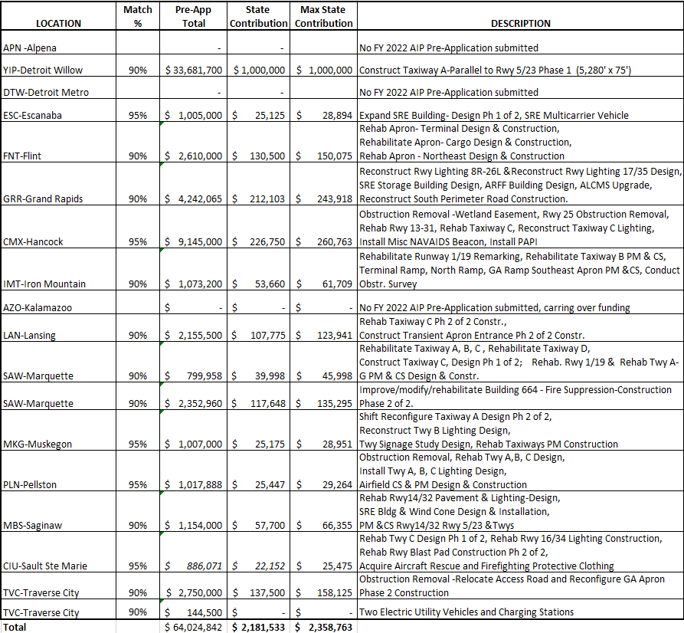
Notes:
Michigan has 15 Primary Airports (pre-COVID) and
Wayne County Airport Authority is the sponsor for Detroit Metro and Willow Run, so Willow Run opts out of the State Block Grant Program and also receive their grants directly.
So currently 16 airports receive their grants directly
Alpena County Regional Airport (APN)
Kalamazoo/Battle Creek International Airport (AZO)
Detroit Metropolitan Wayne County Airport (DTW)
Have not submitted pre-applications, we believe they are carrying over their funding for use in a future year
Willow Run Airport (YIP) project is over $33M,
Per Michigan Aeronautics Commission Guidance Document on Airport Funding (#10030, dated March 2004)
“A maximum of $1 million in state funds may be allotted to any one airport in any fiscal year. “, 5% of the project would be $1.28M, we are showing this at the max of $1M
Delta County Airport, Escanaba (ESC)
Houghton County Memorial Airport, Hancock (CMX)
Muskegon County Airport (MKG)
Pellston Regional Airport of Emmet County (PLN)
Chippewa County International Airport, Sault Ste Marie (CIU)
Are considered Economically Distressed Areas and they receive 95% Federal Funding (instead of the Traditional 90%), so the state match is only 2.5% (instead of 5%)
The remaining include a 5% State Match
Capital Region International Airport, Lansing (LAN)
Sawyer International Airport, Marquette (SAW)
Bishop International Airport, Flint (FNT)
Cherry Capital Airport, Traverse City (TVC)
MBS International Airport, Saginaw (MBS)
Gerald R Ford International Airport, Grand Rapids (GRR)
Ford Airport, Iron Mountain Kingsford (IMT)
Pre-application is an estimate, final application will be based on actual bids, so we are requesting approval to match up to 15% higher. So, the letter will sate a 5% state match up to a max $ amount.
The total match for these is about $2.2M
Expected state match for the State Block Grant Program is about $1.4M
Once you add in the cost of statewide programs like the PCI and state/local crack sealing and pavement marking programs; we are almost at $4M. The total appropriation for FY 22 is $3M,
Because cost are expected to change, usually a few project end up getting delayed, and with the timing of the awards are late in the FY and a portion of that funding can be obligated until October so it hits the FY 23 appropriation. We are comfortable with committing to providing a match for the FY 22 AIP projects.
That being said, if the supplemental appropriation does not come though and our FY 23 appropriation in not increased, we will not be able to provide a state match to all of the FY 23 AIP projects.
Requesting Commission Approval of the projects and commitment of state match.

Slide 18
Questions?

