Slide 1
Michigan Independent Citizens Redistricting Commission
Redistricting & Voting Rights Act Analysis
Mark Braden – May 16, 2024

Slide 2
Overview
Objectives for this presentation:
  Brief recap of the requirements of the Voting Rights Act (“VRA”).
  Review of the Senate plans provided by the Commission to Dr. Palmer and myself. Principally, addressing the opportunity of Black voters to elect representatives of their choice to the Michigan Senate.
  No opinion will be offered on plan compliance with Michigan Constitutional requirements. I will offer only an opinion on draft plans’ compliance with VRA.

Slide 3
Section 2 of the VRA, Gingles
To prove a § 2 violation under Gingles, plaintiffs must satisfy three preconditions.
The “minority group must be sufficiently large and [geographically] compact to constitute a majority in a reasonably configured district.”
The minority group must be able to show that it is politically cohesive.
The minority must be able to demonstrate that the white majority votes sufficiently as a bloc to enable it to defeat the minority’s preferred candidate.

Slide 4
A plaintiff who demonstrates the three Gingles preconditions must then show, under the “totality of circumstances,” that the challenged political process is not “equally open” to minority voters.
The totality of circumstances inquiry recognized that application of the Gingles factors is fact-dependent and requires courts to conduct “an intensely local appraisal: of the electoral mechanism at issue, as well as a “searching practical evaluation of the past and present reality.”
There is no genuine issue that Gingles requires a review of any Michigan Senate plan for compliance with the VRA.
The Commission, its experts, the Court and plaintiffs agree that legally significant polarization is present.

Slide 5
Review Process
Scope of Review
    Not reviewing plans for compliance with Michigan Constitutional requirements.
    Any opinions on VRA compliance are based on the assumption that the reviewed proposed Senate districts are (1) “reasonably configured” and (2) race was not impermissibly used in the creation of any plans.
How?
    The question is: Does a particular Senate plan provide a reasonably equal opportunity for Black voters to elect their candidates of choice?
    The answer is not based on how many majority/minority districts are in a plan or any set racial target. An answer is based on how many districts will likely “perform” with the election of Black voters’ candidates of choice.
Result?
  The State of Michigan, through this Commission, can decide whether to create majority/minority districts, crossover districts or some combination for compliance with the VRA.

Slide 6
Minority Voters’ Ability to Elect Candidates of Choice
Two types of elections are considered.
A. General Elections
  Analysis of plans based on recompiled elections results.
B. Primary Elections
  Analysis of plans relies on estimates of Black and White turnout in the Democratic primary election, with an eye to whether Black turnout is likely to exceed White turnout in a proposed district.
  The reasonably-equal-opportunity analysis does not guarantee any particular election results.

Slide 7
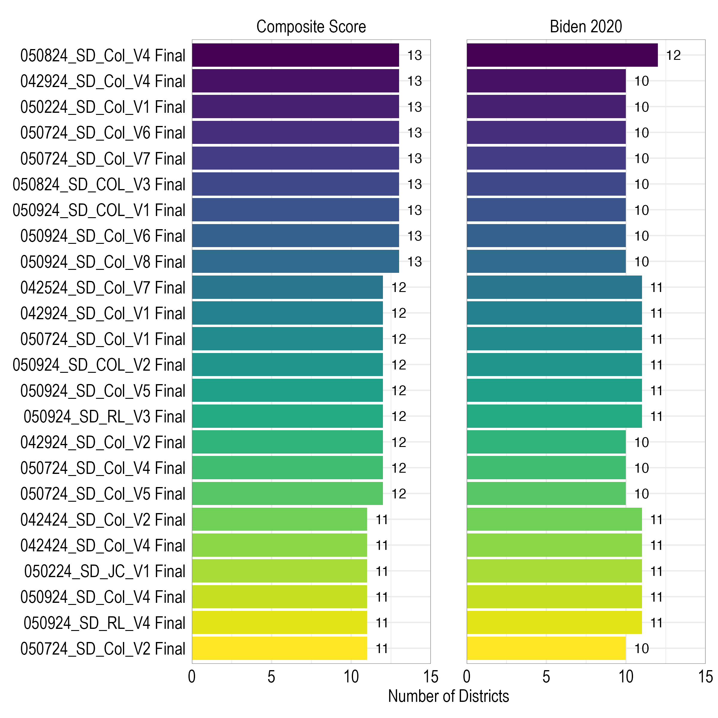
General Elections

Slide 8
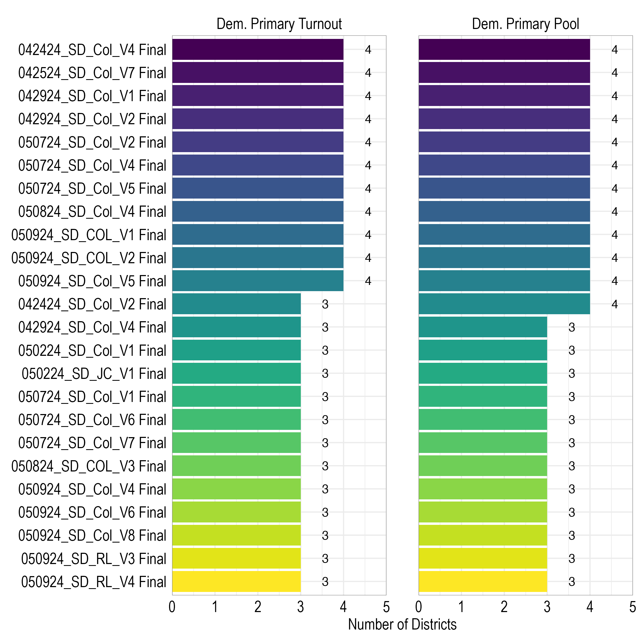
Primary Elections

Slide 9
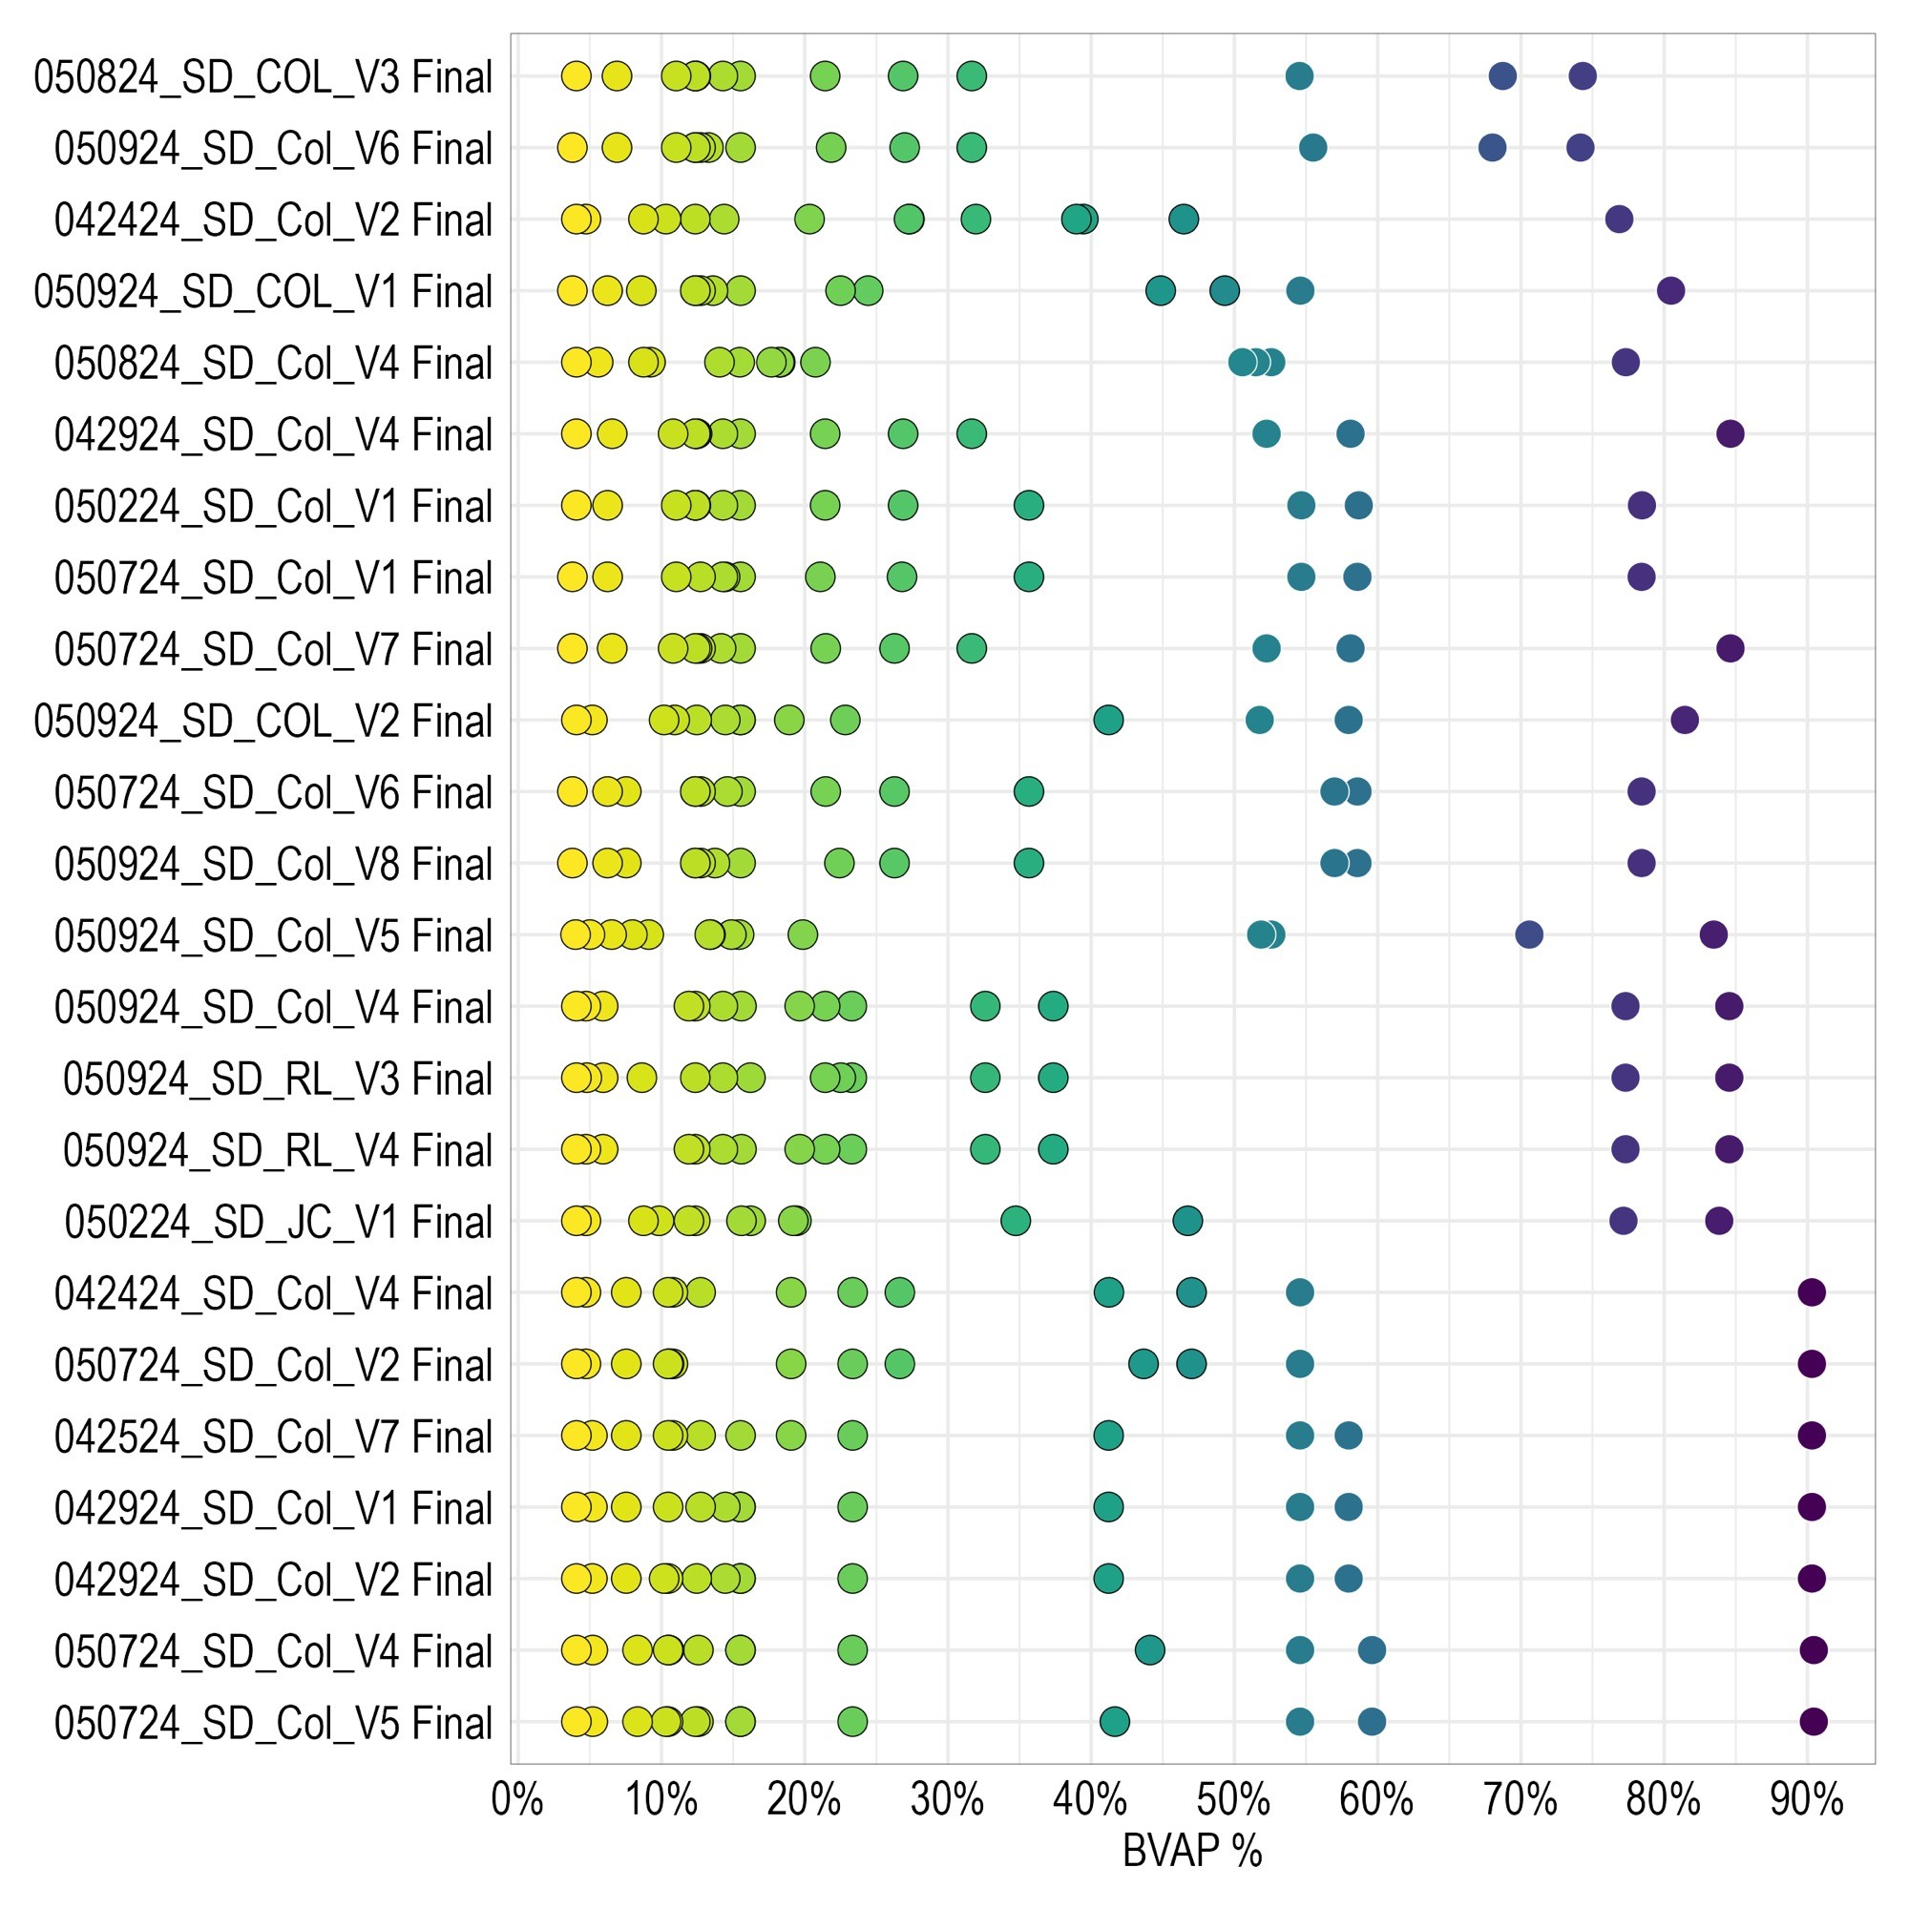
Distribution of BVAP by Plan

Slide 10
Questions?

