Slide 1
Michigan Independent Citizens Redistricting Commission
Redistricting & Voting Rights Act Analysis
Mark Braden – May 21, 2024

Slide 2
Overview – VRA Analysis
Topics for this presentation:
  General Elections & Potential Senate Districts
  Primary Elections & Potential Senate Districts
  Analysis of 5/20 Plans

Slide 3
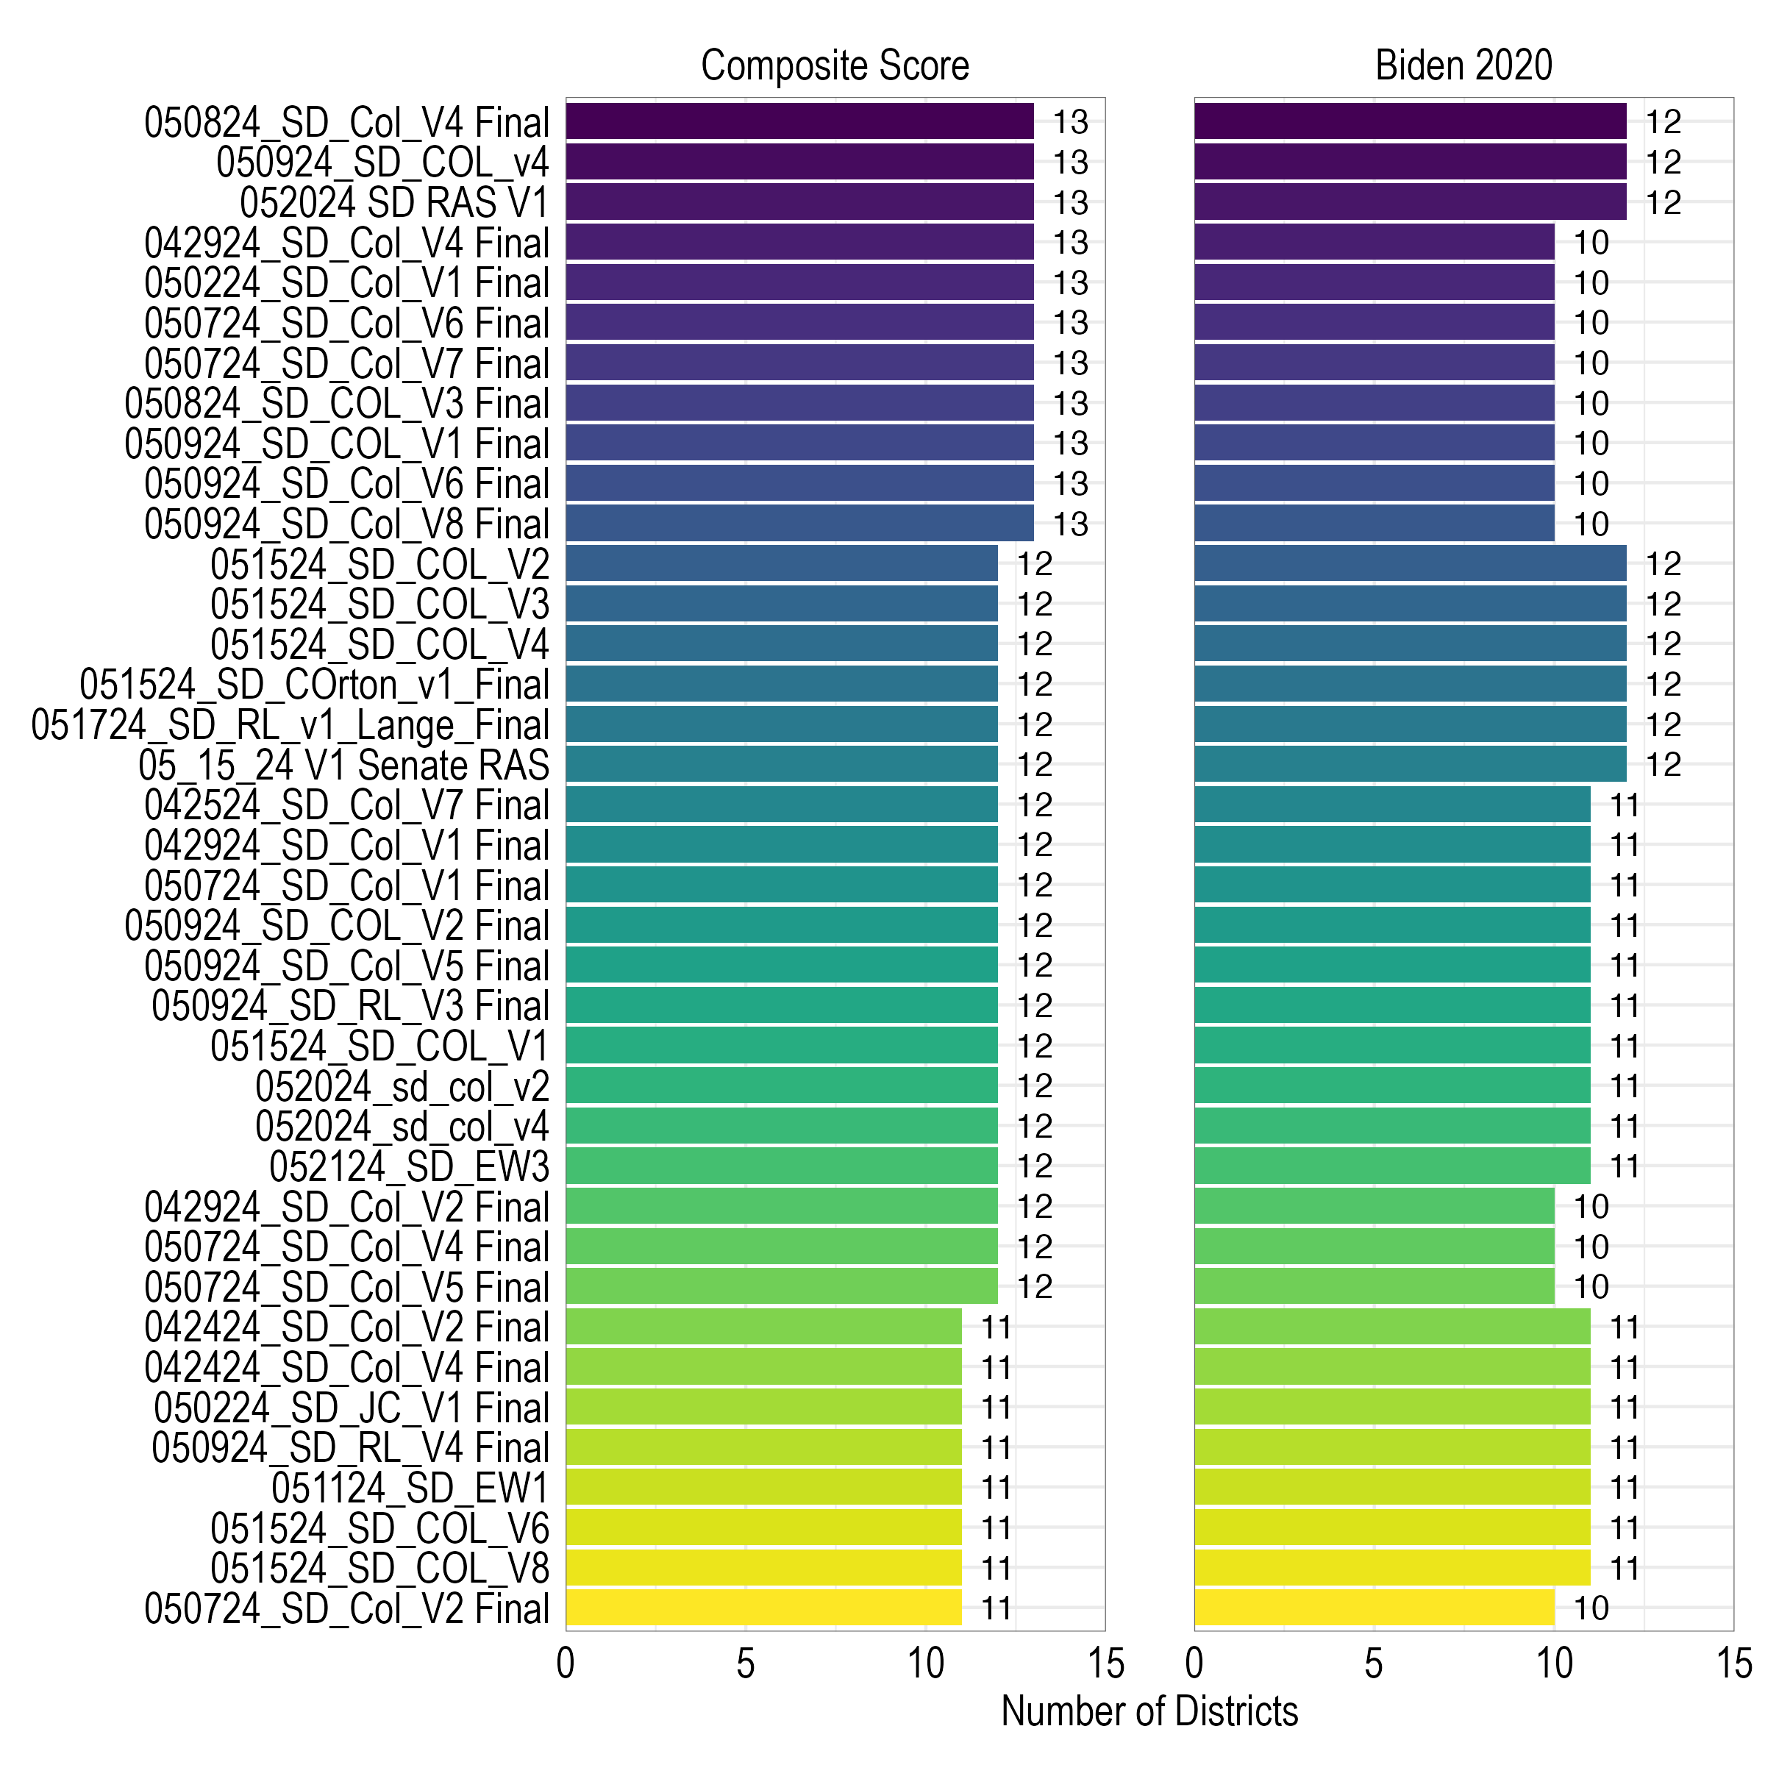
Senate District Performance –General Elections

Slide 4
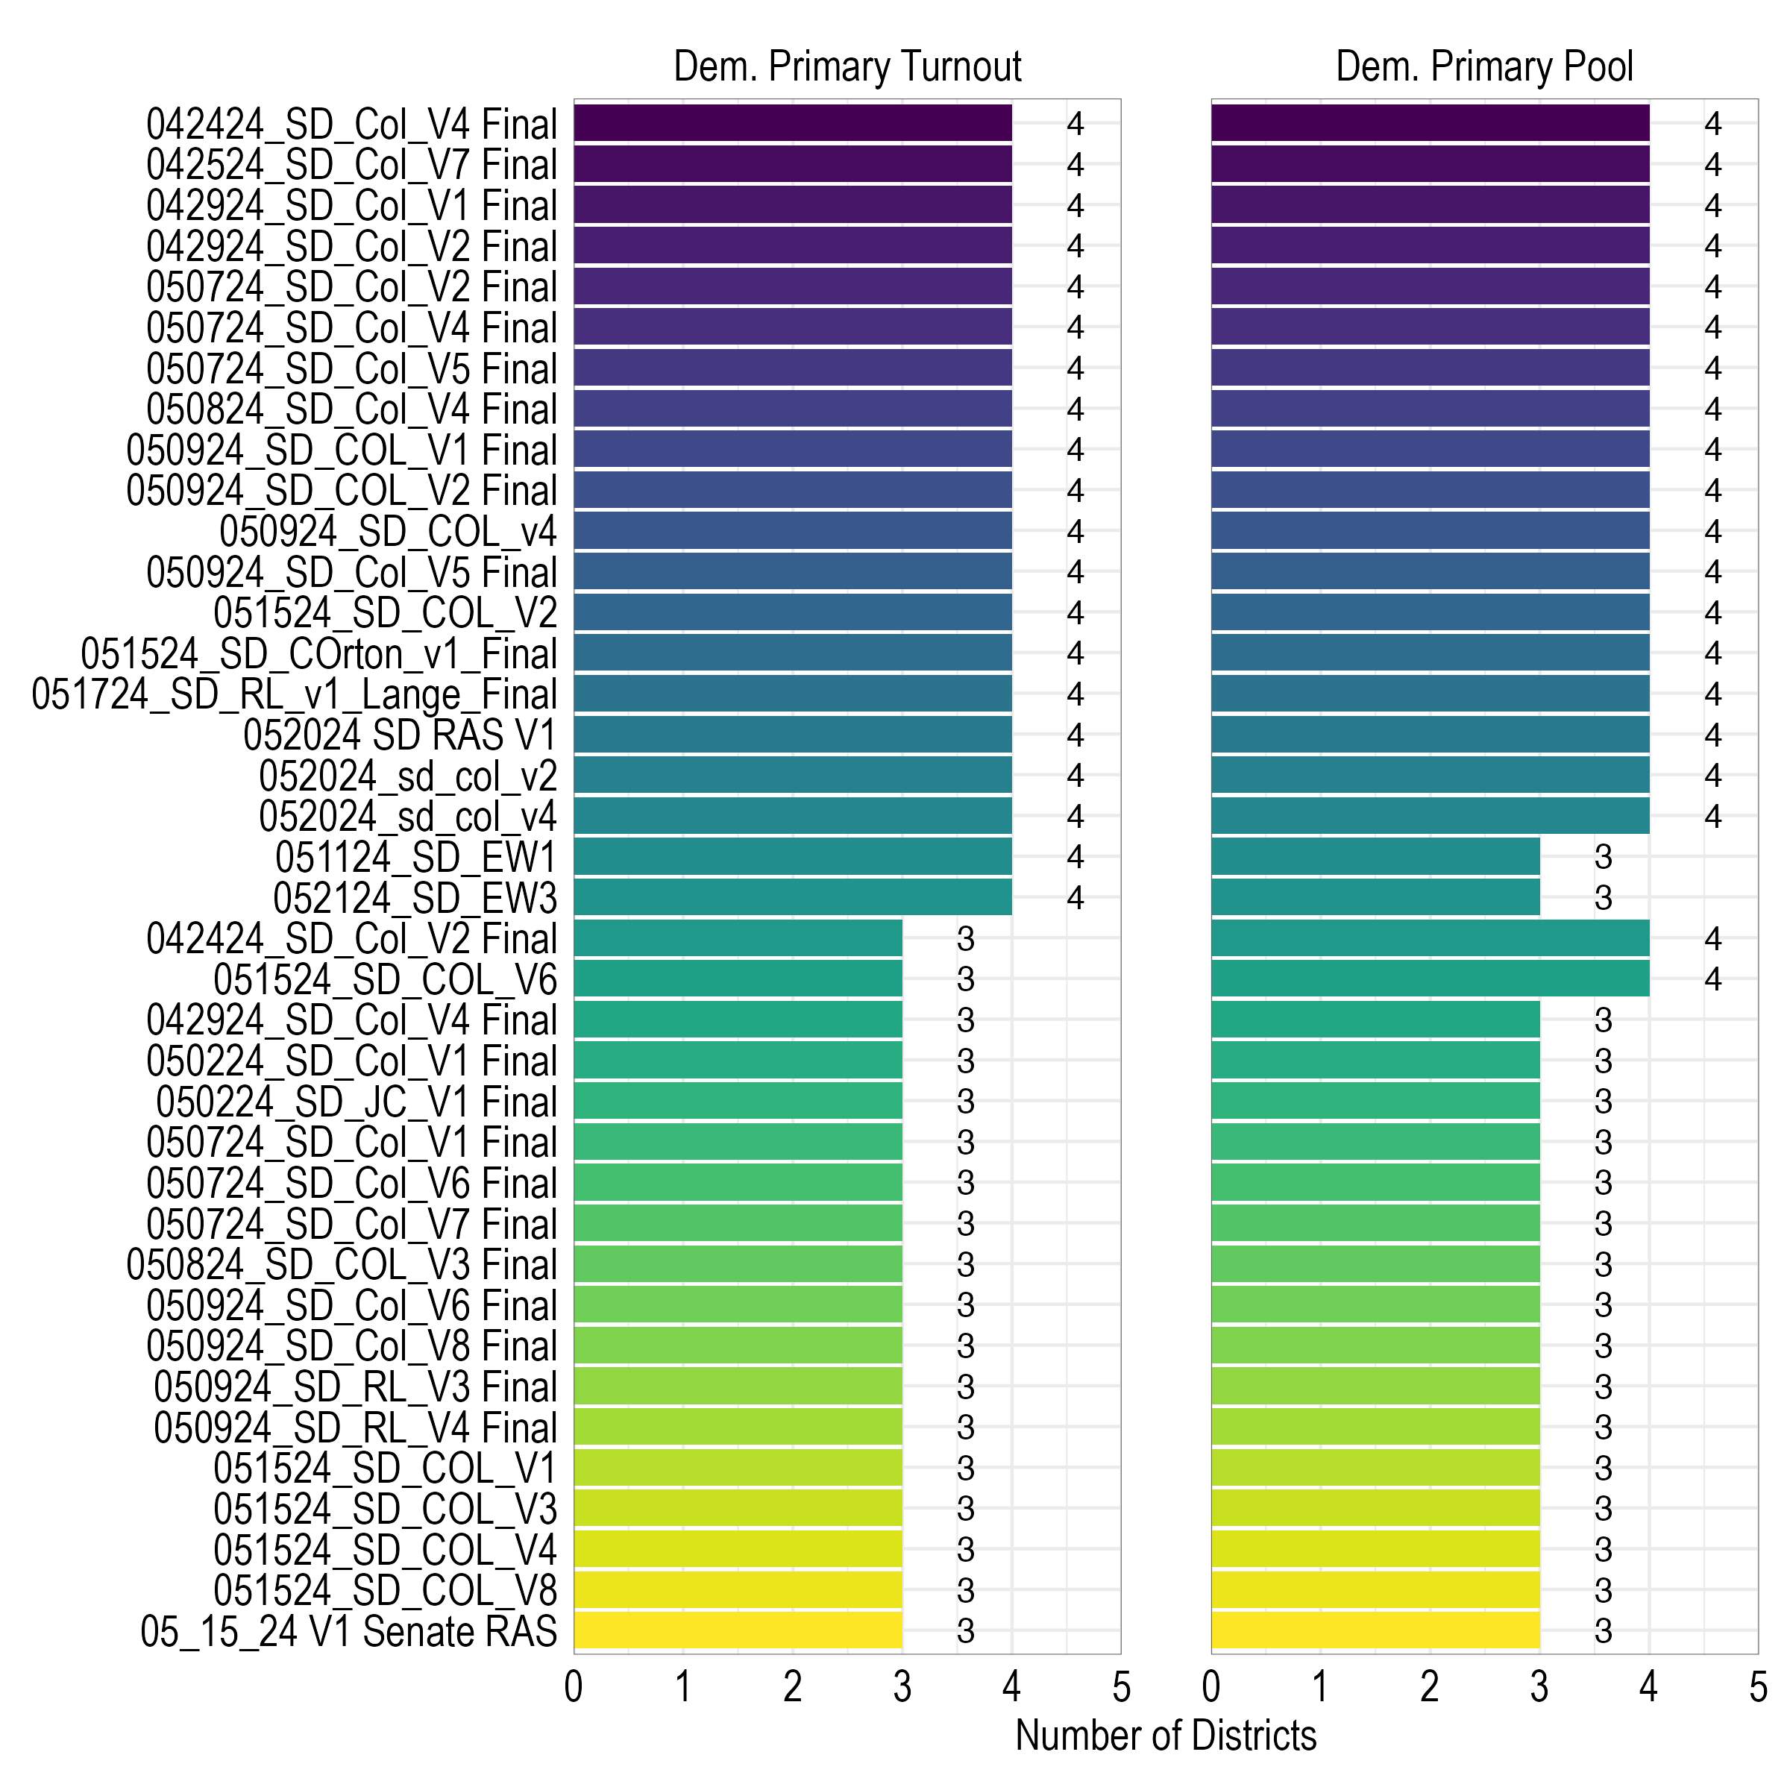
Senate District Performance –Primary Elections

Slide 5
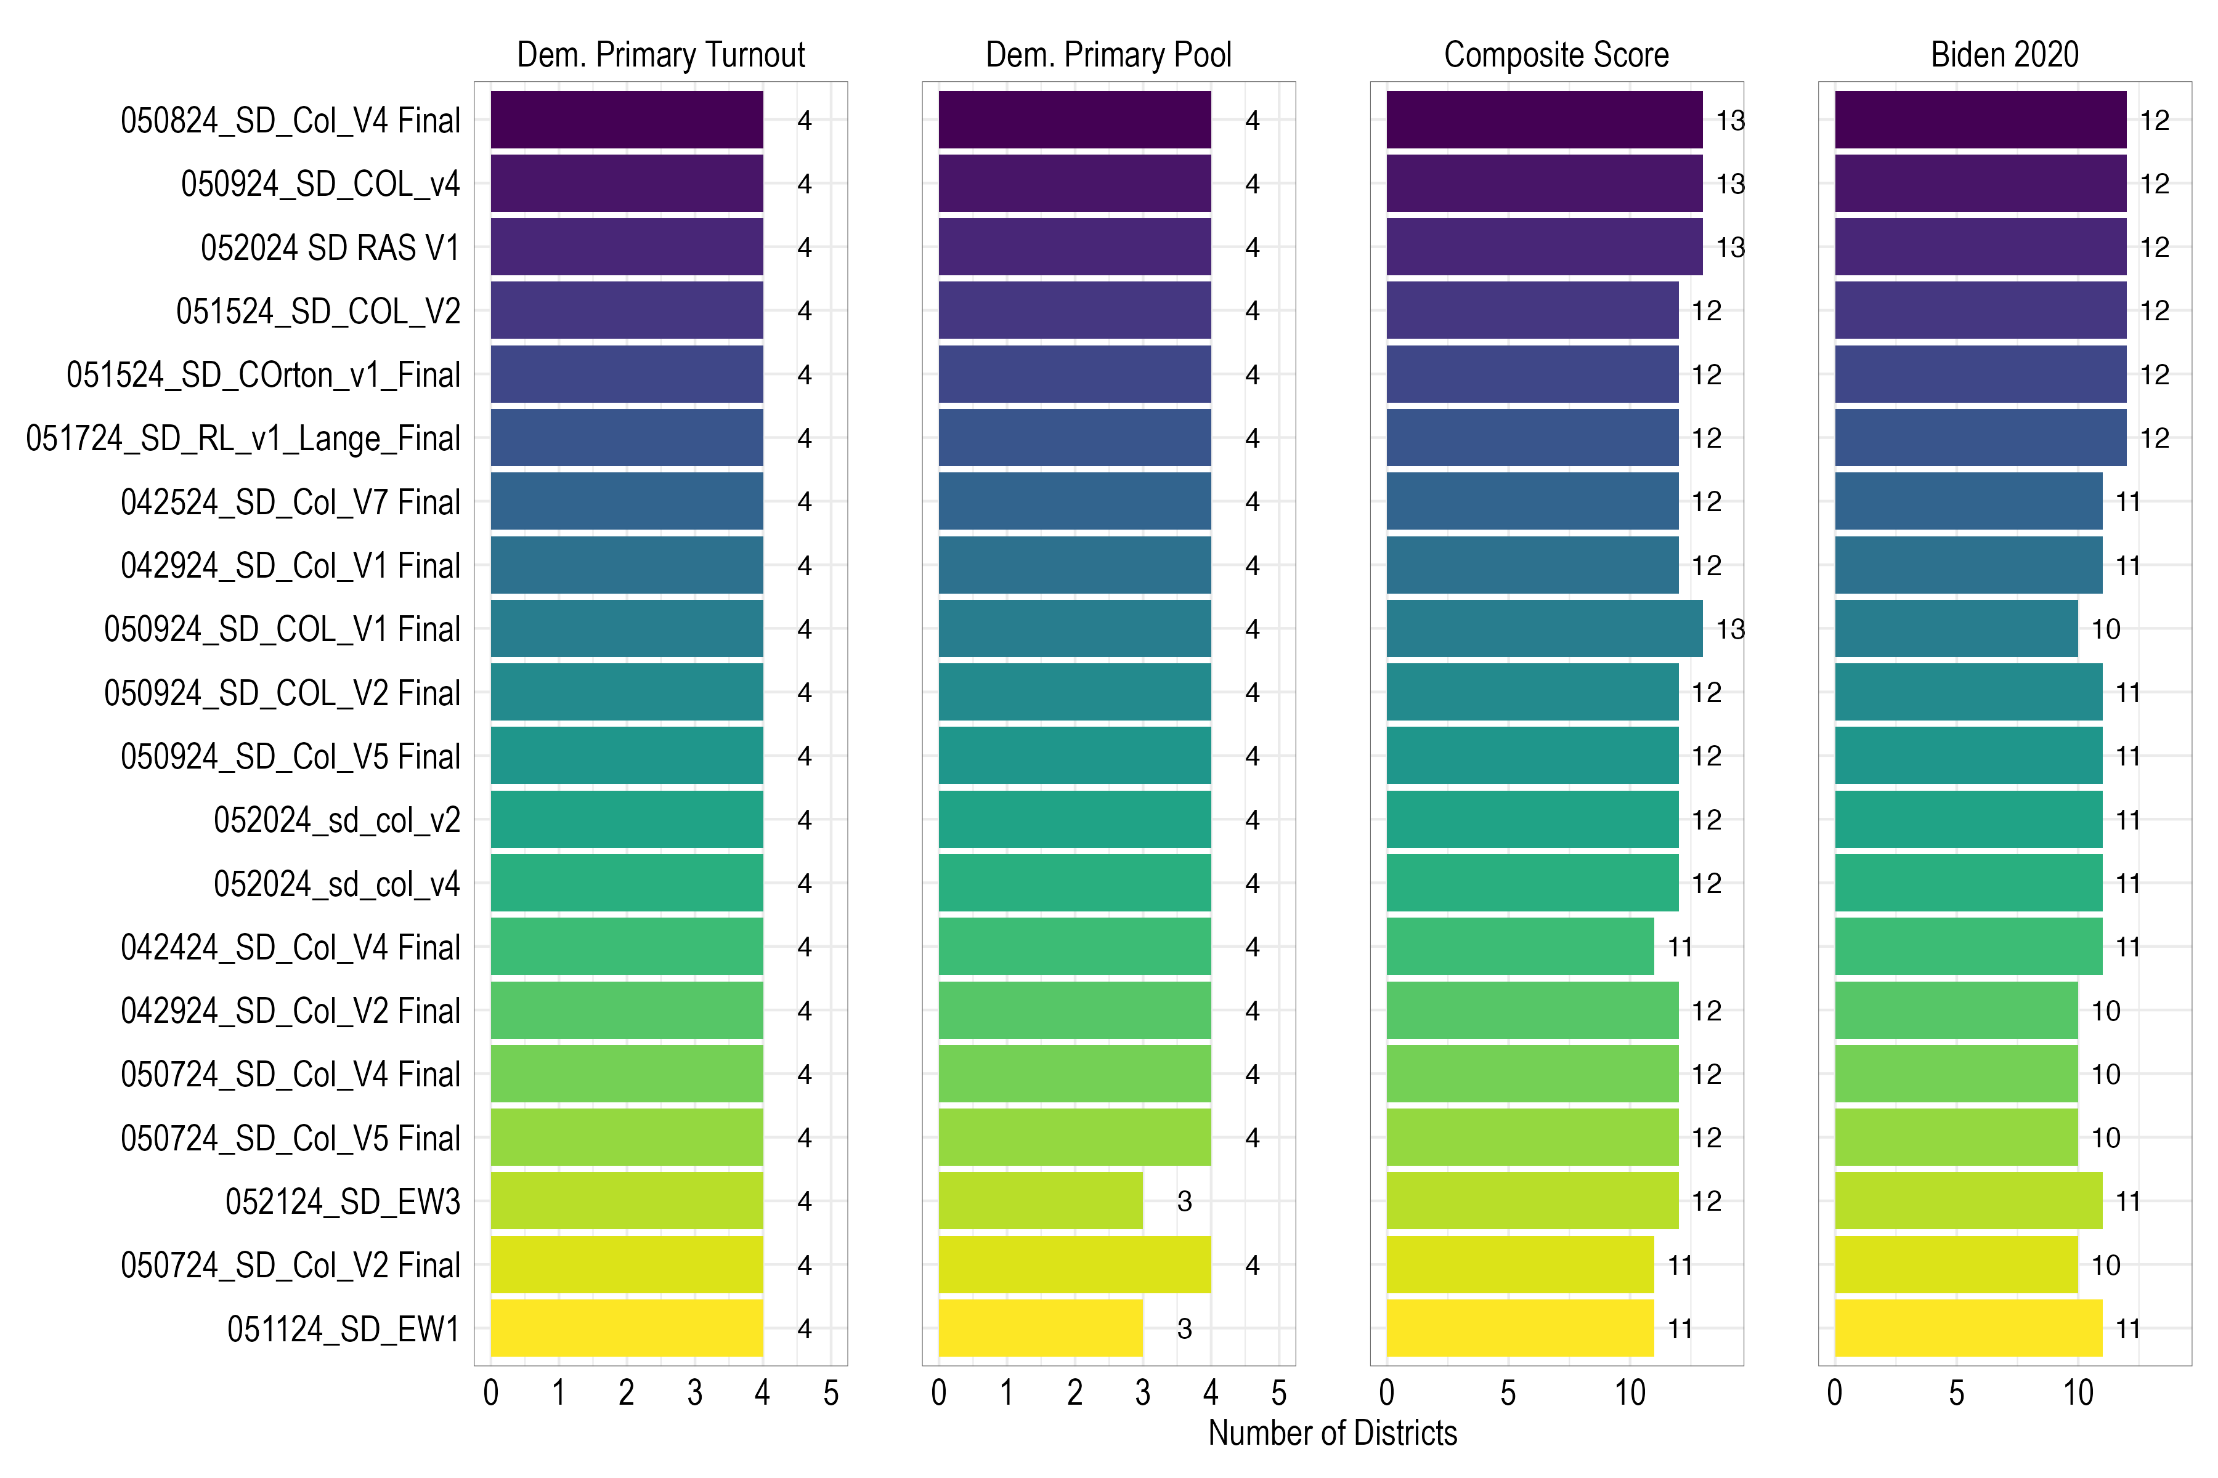
Combined Senate Performance (Primary and General)

Slide 6
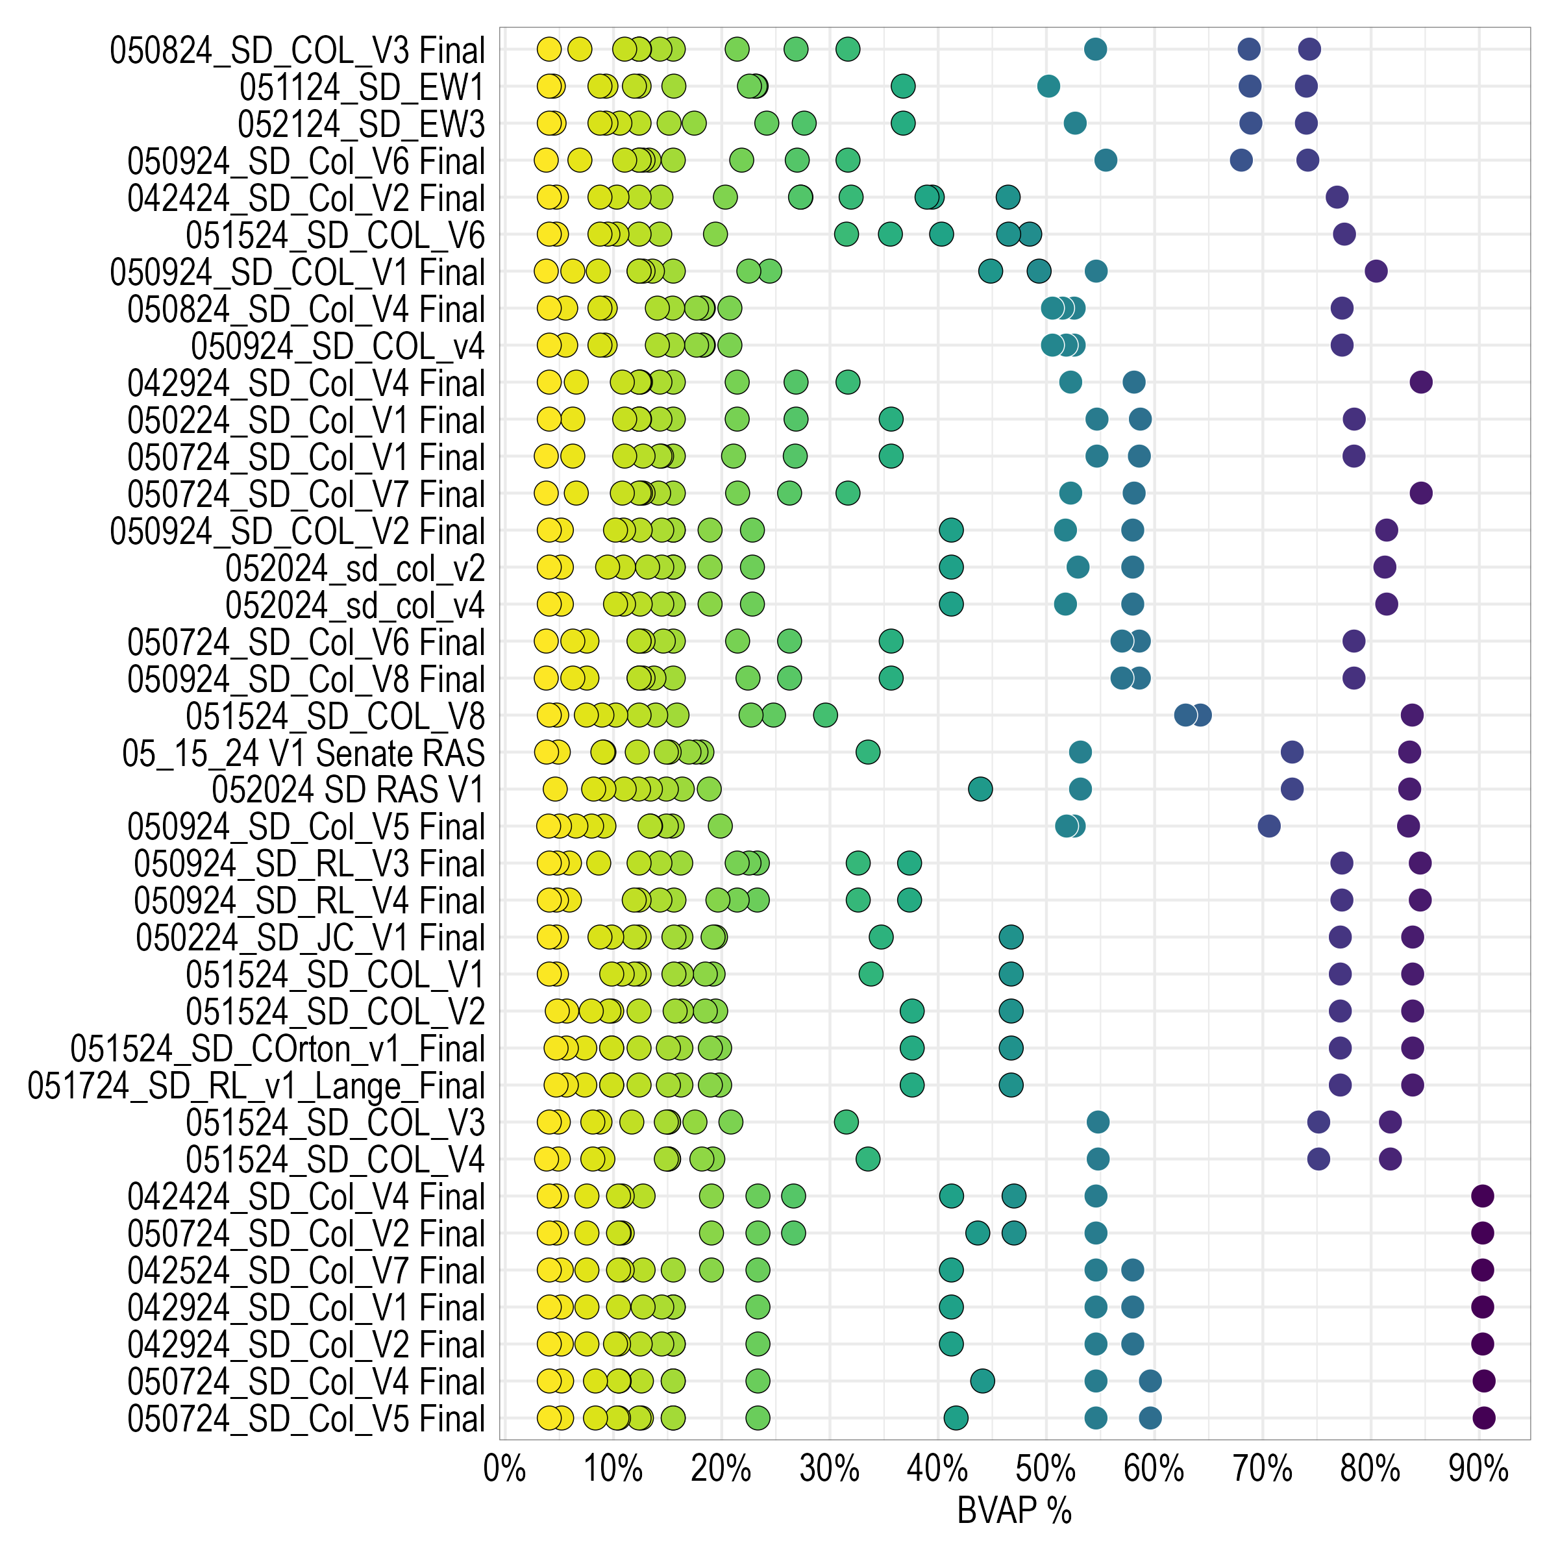
BVAP Distribution Across Plans

Slide 7
Analysis of 5/20 Plans

Slide 8
052024 SD RAS V1
 | Primary Turnout | Estimated Current Voters |  |  | Dem. Primary Pool
District | Black > White | Black | White | Other | Black > White
8 | Yes | 81.7% | 13.6% | 4.7% | Yes
3 | Yes | 74.0% | 18.4% | 7.6% | Yes
1 | Yes | 54.7% | 25.8% | 19.5% | Yes
6 | No | 15.9% | 75.2% | 8.9% | No
4 | No | 11.4% | 79.5% | 9.1% | No
12 | No | 9.5% | 85.0% | 5.5% | No
2 | No | 6.3% | 82.2% | 11.4% | No
5 | No | 5.0% | 77.0% | 17.9% | No

Slide 9
052024_sd_col_v2
 | Primary Turnout | Estimated Current Voters |  |  | Dem. Primary Pool
District | Black > White | Black | White | Other | Black > White
3 | Yes | 81.3% | 10.7% | 8.0% | Yes
7 | Yes | 52.9% | 40.8% | 6.3% | Yes
1 | Yes | 54.9% | 25.7% | 19.4% | Yes
10 | Yes | 40.6% | 50.2% | 9.2% | Yes
5 | No | 19.8% | 66.6% | 13.6% | No
2 | No | 17.1% | 71.8% | 11.1% | No
6 | No | 12.7% | 78.2% | 9.1% | No
12 | No | 10.4% | 84.4% | 5.2% | No
4 | No | 7.6% | 83.2% | 9.2% | No

Slide 10
052024_sd_col_v4
 | Primary Turnout | Estimated Current Voters |  |  | Dem. Primary Pool
District | Black > White | Black | White | Other | Black > White
3 | Yes | 81.4% | 10.5% | 8.1% | Yes
7 | Yes | 52.9% | 40.8% | 6.3% | Yes
1 | Yes | 53.6% | 26.6% | 19.8% | Yes
10 | Yes | 40.6% | 50.2% | 9.2% | Yes
5 | No | 19.8% | 66.6% | 13.6% | No
2 | No | 17.1% | 71.8% | 11.1% | No
6 | No | 12.7% | 78.2% | 9.1% | No
12 | No | 9.8% | 85.0% | 5.2% | No
4 | No | 7.6% | 83.2% | 9.2% | No

Slide 11
Questions?

