Slide 1
PROPOSED SCHEDULE PUBLIC HEARINGS

Slide 2
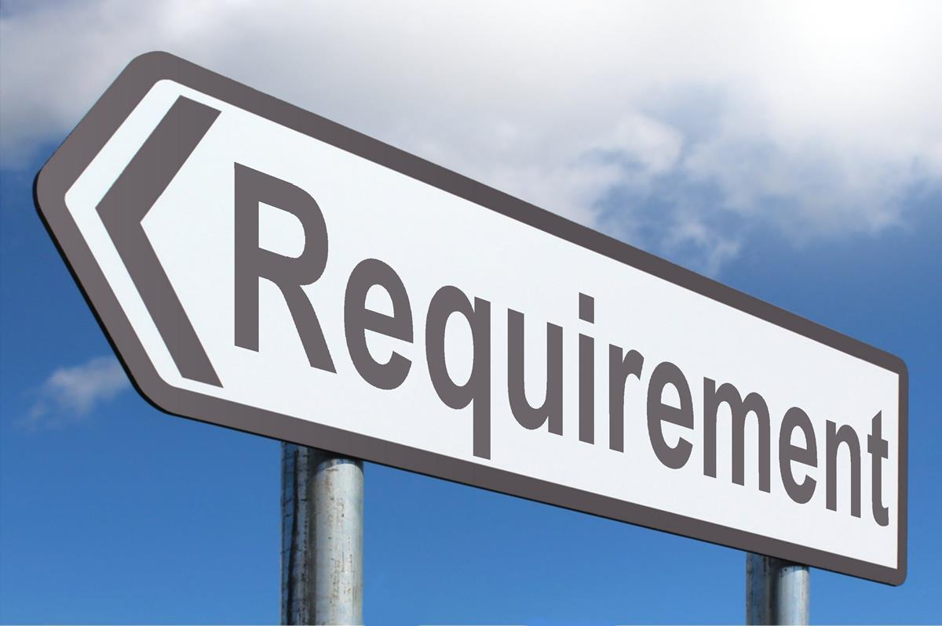
REQUIREMENT
Before commissioners draft any plan, the commission shall hold at least ten public hearings throughout the state of Michigan.

Slide 3
PURPOSE
Inform the public about the redistricting process.
1
Purpose and responsibilities of the commission.
2
Solicit information from the public about potential plans.
3

Slide 4
COMMUNICATION ASSETS
Photos/Videos/Branding
Statewide Market Research
Identify Key Messages
Communication Plan
Public Comment Tool

Slide 5
OUTREACH
MARCH
Local and county governments
APRIL
Statewide organizations and their affiliates
MAY
Community-based outreach

Slide 6
PUBLIC HEARING CRITERIA
The commission shall conduct its hearings in a manner that invites wide public participation in the state.
The commission shall use technology to provide contemporaneous public observation and meaningful public participation in the redistricting process during all meetings and hearings.

Slide 7
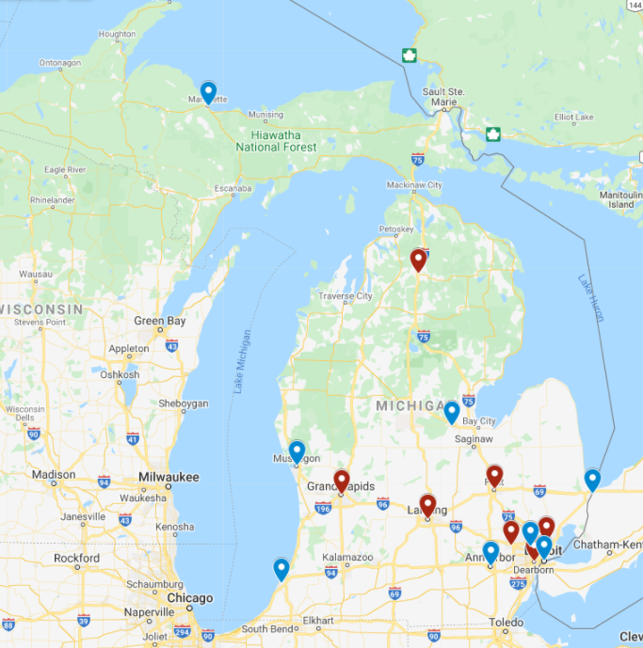
PROPOSED LOCATIONS AND DATES
GAYLORD—1st and 2nd
Treetop Resorts
May 4
Marquette
Northern Michigan University
May 6
Benton Harbor
Lake Michigan College
May 11

Slide 8
PROPOSED LOCATIONS AND DATES
Muskegon
Lakeshore Convention Center
May 12
GRAND RAPIDS—1st and 2nd
Devos Center
May 13
Ann Arbor
University of Michigan
May 17

Slide 9
PROPOSED LOCATIONS AND DATES
LANSING—1st and 2nd
Lansing Center
May 18
Midland
Great Hall Banquet & Convention Center
May 19
FLINT
Dort Financial Center
May 20

Slide 10
PROPOSED LOCATIONS AND DATES
Southfield
Southfield Pavilion
May 24
Dearborn
Ford Conference Center
May 25
NOVI—1st and 2nd
Suburban Collection Showplace
May 26

Slide 11
PROPOSED LOCATIONS AND DATES
DETROIT—1st and 2nd
TCF Center (Cobo Hall)
May 27
WARREN—1st and 2nd
MRCC Banquet Center
June 2
Port Huron
Blue Water Convention Center
June 3

Slide 12
Questions or Comments?

