Slide 1
MDHHS Doula Initiative
December 13, 2023
Notes:
Chelsea

Slide 2
Presentation Outline
What is A Doula?
Medicaid Doula Policy
MIHP Provider – Doula Collaboration
MDHHS Doula Initiative
Preliminary Claims Review
Year One Lessons Learned
Vision for the Future
Notes:
Chelsea
We are going to pause after each section to see if there are any questions or clarifications, we want this to be interactive
Please pick our brain and push us to explain or bring it back for further consideration
If we use confusing language or something seems out of place please let us know
This is our test run as we move the initiative toward more engagement and outreach

Slide 3

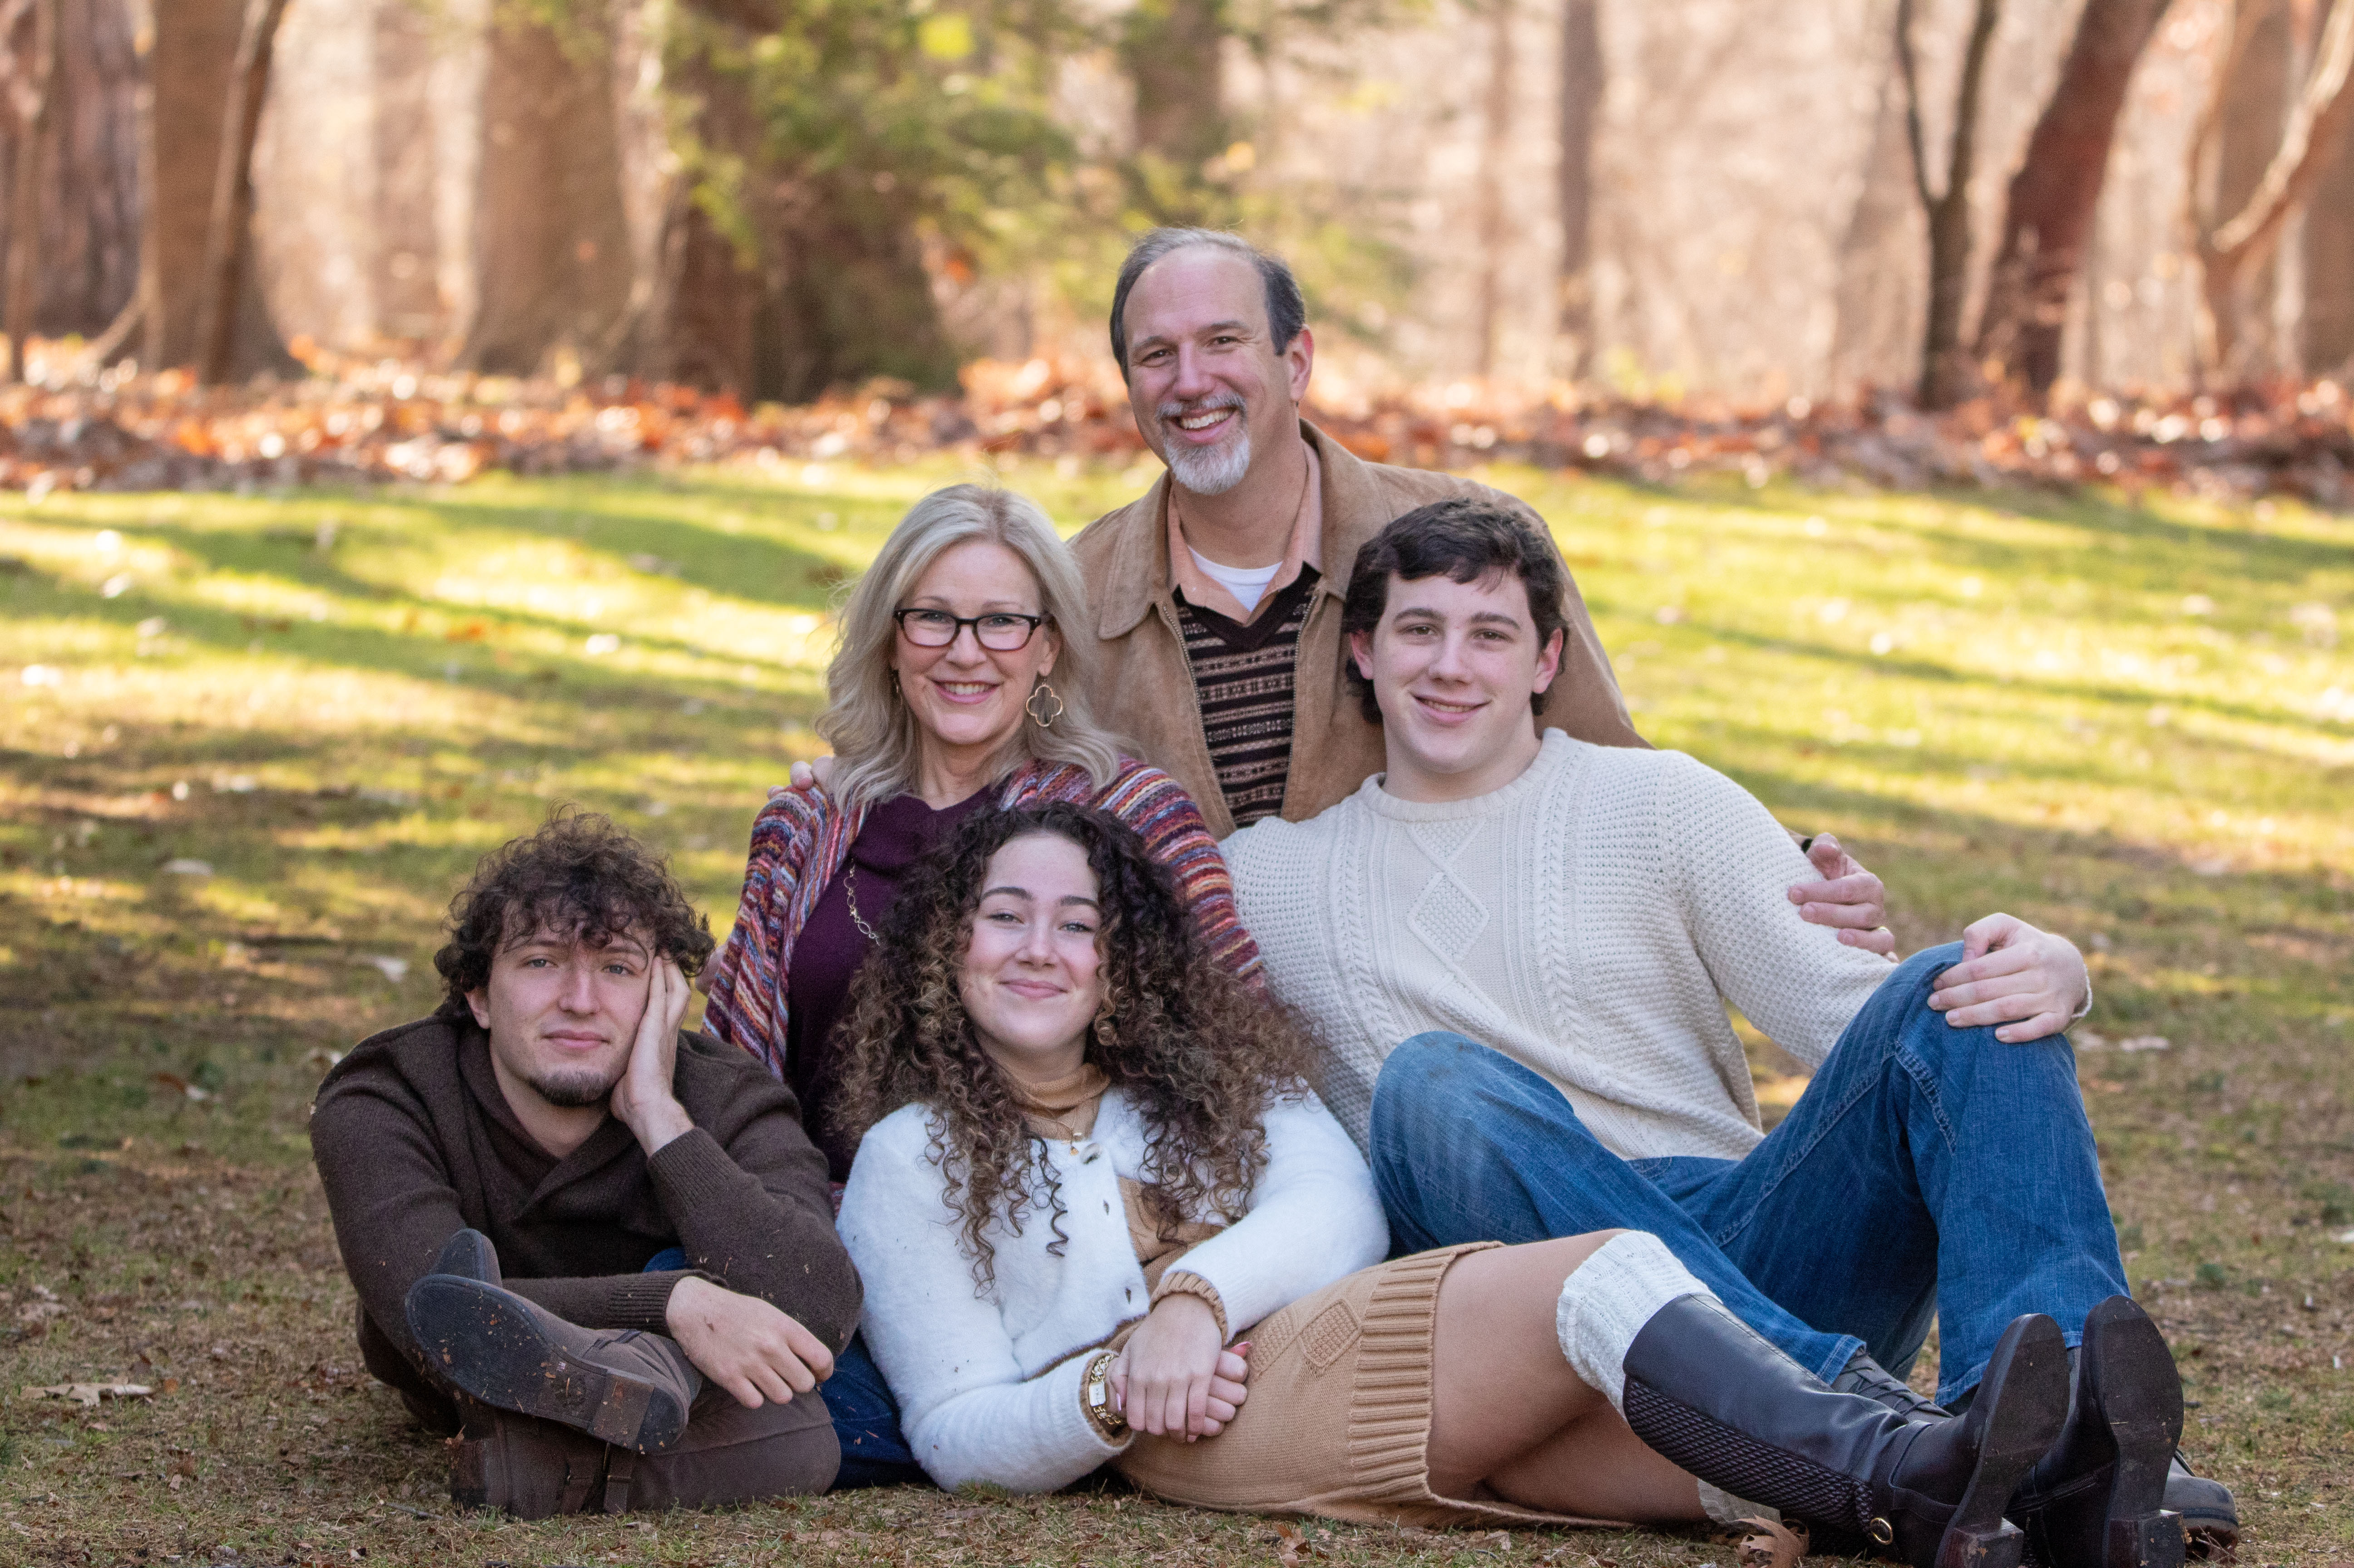
Introductions – Doula Specialists
Chelsea Low Darling, LMSW
Lisa Whitener, RN, IBCLC

Slide 4
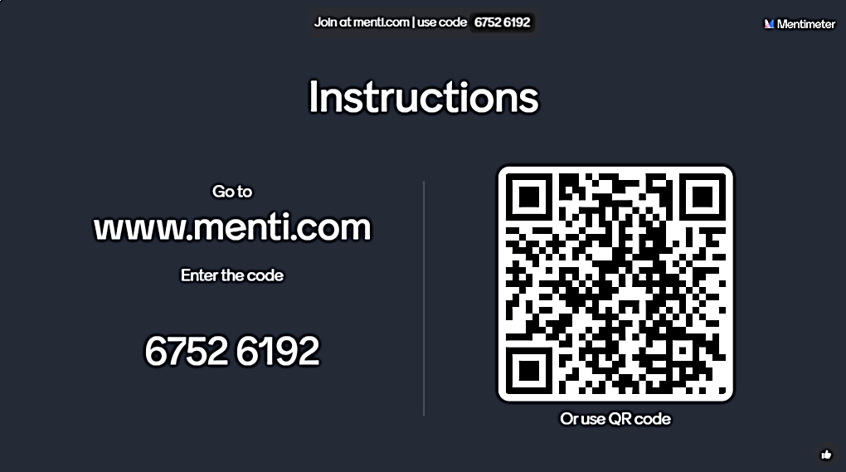
Notes:
Chelsea

Slide 5
What Is A Doula?
Doulas are trained professionals also known as birth workers
  Help families navigate pregnancy, birth and the postpartum period
  Advocate for safe, healthy and positive experiences
  Provide non-clinical 1:1 emotional, physical, and informational support
Doula services have been shown to positively impact social determinants of health, support birth equity and decrease existing health and racial disparities.
Notes:
Lisa
Provided resources at the end of the presentation describing the evidence base behind doula services.

Slide 6
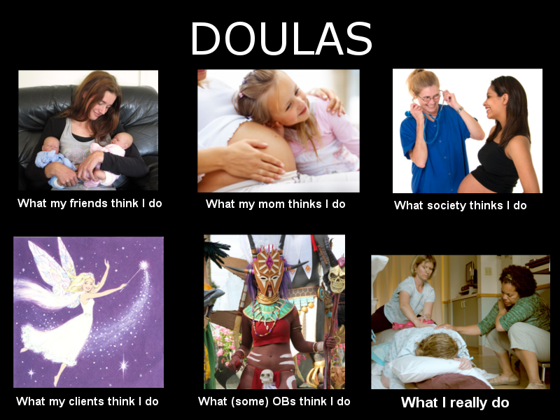
Source: quotesgram.com
Notes:
Lisa

Slide 7
Doula Connection
Notes:
Lisa

Slide 8
Doula Practice Models
Private Practice
Collaboratives
FQHCs
Hospital-based
Other
Notes:
Chelsea
Each practice model is going to define the way in which a doula operates.

Slide 9
Types of Doulas – Birth Doula
Prenatal visits
  Birthing person and birth support person expectations
  Birth preferences, planning, explaining options
  Childbirth education
  Attend prenatal visits with birthing person
Attend entire labor/birth and early postpartum
  On call two weeks prior and two weeks after estimated due date
  When on call, doulas must be prepared to meet with laboring client within one hour
  Partner support
Postpartum visits
  Breastfeeding assistance
  Newborn care – what to expect, bathing, calming techniques, understanding baby cues, etc.
  Referrals
Number of clients
  2 – 3 births per month
Length of Service
  Birth is unpredictable
Notes:
Chelsea
The following information is from the private practice or doula collaborative perspective – which is currently the most common doula practice model. These specifics will change if a doula is employed by a hospital or other institution

Slide 10
Types of Doulas – Postpartum Doula
Postpartum Visits
  Breastfeeding assistance
  Newborn care – what to expect, bathing, calming techniques, understanding baby cues, etc.
  Referrals
  Light housework
    Dishes, laundry
  Meal prep
  Daytime vs Overnight support
Services are family specific and scheduled
  Number of Clients
    Doula specific
  Length of Service
    Based on family need
Notes:
Do whatever will help the family into parenthood with ease

Slide 11
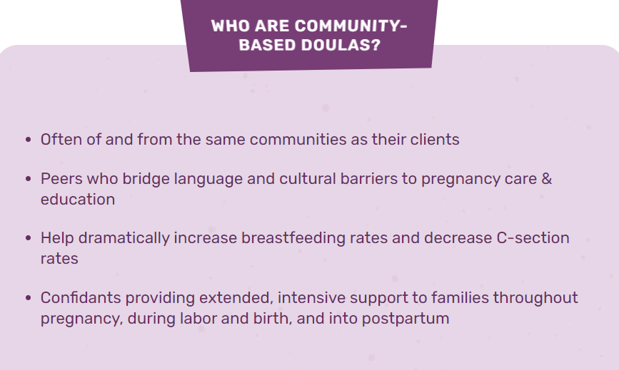
Types of Doulas – Community-Based Doula
Source: Community-Based Doulas - HealthConnect One
Notes:
Lisa

Slide 12
Types of Doulas – Specialty
Full Spectrum
Birth and Bereavement
Notes:
Lisa
End of Life Doulas

Slide 13
Doula Provider Considerations
Childcare
Illness
Transportation
Service Area
Unpredictability of birth
  Burnout and self-care
  One on one support
Reflection/Decompression
Backup Doula
Notes:
Lisa

Slide 14
Medicaid Doula Policy
Notes:
Chelsea

Slide 15
Setting the Stage
Medicaid Policy (MMP 22-47)
  Medicaid Coverage of Doula Services
    Effective January 1, 2023
Medicaid Provider Manual
Medicaid Doula Services Billing Guidance
Notes:
Chelsea

Slide 16
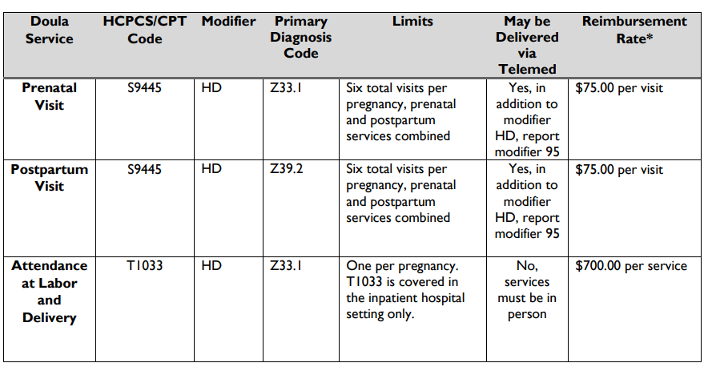
Reimbursement Structure
Notes:
Chelsea

Slide 17
MDHHS Doula Initiative
Notes:
Chelsea
Pause for questions, get a drink of water, review any comments in the chat, any reflection on the mentimeter from earlier.

Slide 18
Doula Initiative
The Michigan Department of Health and Human Services (MDHHS)
Doula Initiative supports a broader statewide goal of reducing infant and maternal mortality and addressing birth inequities by:
  Increasing and supporting the doula network in Michigan
  Providing technical assistance for Medicaid doula providers
  Engaging with doulas, families and partners to prioritize and expand doula service access.
Notes:
Chelsea

Slide 19
Doula Initiative Funding
Supports Core Activities
  Doula Registry
  Doula Advisory Council
  Sponsored Doula Trainings
  Continuing Education
  Maternal Infant Health Summit
Two Doula Specialist positions
Notes:
Chelsea
Next section will focus on the status and successes in each of the core metric categories, then we will describe the additional support activities our team is working on.

Slide 20
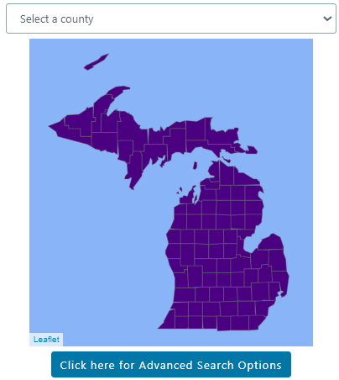
Doula Registry Publication
Doula Registry Application Approval
  Doula submits application, reviewed/approved by Doula Initiative Team
January 2024
  Available on Doula Initiative website
Future Enhancement
  Clickable map
Notes:
Public posting on hold based on feedback from doula network
Chelsea

Slide 21
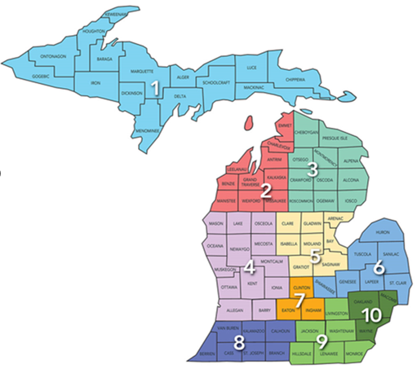
Doula Registry
Statewide:
  285 doulas / 168 Medicaid-enrolled doulas
By Prosperity Region:
Region | R1 | R2 | R3 | R4 | R5 | R6 | R7 | R8 | R9 | R10
Doulas | 9 | 26 | 21 | 58 | 17 | 30 | 21 | 38 | 83 | 139
Medicaid | 7 | 15 | 10 | 33 | 8 | 21 | 8 | 24 | 49 | 80
Doula Registry – December 6, 2023
Notes:
Chelsea

Slide 22
Michigan Doula Advisory Council (DAC)
Formed in early 2023
Currently 26 members – application process
Representation from across Michigan, including indigenous doulas and members of the LGBTQ+ community
Receive reimbursement for their time and expertise
Doula Training expansion
Initial Policy:
Current:
Formation of strategic workgroups
Community & Health Plan Relations
Doula Mentorship
Legislative Action & Advocacy
Structure & Bylaws
Input from doulas is highly-valued and continually integrated
Immediate feedback on doula provider experience
9 MDHHS-approved training organizations
26 MDHHS-approved training organizations
Network of experts supporting doulas in their communities
Community building: in-person meetings, MIHS reception, etc.
Notes:
Lisa

Slide 23
Sponsored Doula Trainings
Summer/Fall 2023
  9 doula trainings conducted by 5 different MDHHS-approved organizations
  161 doulas were trained and received stipends for their time and travel
Fiscal Year 2024
  Improved process
    "Call for Trainers”
  Applications currently under review
    Approved applicants will be notified in December 2023
Notes:
Lisa
Summer/Fall 2023
9 doula trainings conducted by 5 different MDHHS-approved organizations
161 doulas were trained and received stipends for their time and travel
Fiscal Year 2024
Improved process
"Call for Trainers”
Applications currently under review
Approved applicants will be notified in December 2023

Slide 24
Continuing Education
The following MDHHS-sponsored sessions are either scheduled or in development for fiscal year 2024:
  Breastfeeding
  Navigating Hospital Systems
  Pregnancy and Infant Loss
  Self-Care
  Trauma-Informed Care
  Urgent Maternal Warning Signs
All topics requested/suggested by doulas (DAC survey, May 2023)
Continuing Education Credits often available for attendance at live webinar
  Recordings housed on Doula Initiative website
Promoted through Doula Updates – please register!
Notes:
Lisa

Slide 25

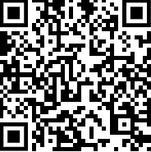
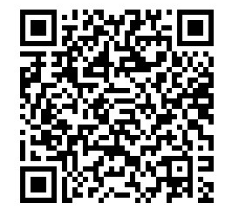
Engagement and Technical Assistance
Doula Initiative Updates
Doula Inbox Management
  MDHHS-MIDoula@michigan.gov
Doula Initiative Website - Refresh
Medicaid Health Plan Troubleshooting
Community Partner Consultation
  Health Endowment Fund Grant
Collaborations
  Presentations for internal and external partners
Subscribe to MDHHS Doula Initiative Updates
MDHHS Doula Initiative Website
Notes:
Chelsea
Put links in chat for website and Doula Updates

Slide 26
MDHHS Doula Initiative
Vision for the Future
Notes:
Chelsea
- In addition to all the things mentioned thus far
- Culture of Equity meeting – doulas expressed alignment with our team’s strategic planning and vision for the future
Continuing Education
Family voice and digital story telling
Partnerships

Slide 27
Partnerships
  Maternal Infant Health Partners
    WIC, Home Visiting Collaborative, Perinatal Quality Collaboratives, etc.
  Community Outreach
    Doulas
      Latinx, Hispanic community resource gaps
    Family Engagement
  Hospital and Medical Community
    Michigan Health and Hospital Association (MHA)
      Michigan Alliance for Innovation in Maternal Health (MI AIM) Webinar
    Birthing Hospital Information Sessions
Notes:
Chelsea

Slide 28
Doula Practice – Lived Experience
  The Doula Initiative seeks to broaden understanding, diminish misconceptions and uplift the doula profession.
  Digital Storytelling
  What does it mean to be a doula?
    "A Day in the Life“
  Birthing person/family experience and perspective
    Birth stories
      Partner and father experience
    Visual representation: photo essays
Notes:
Lisa

Slide 29
Doula Policy Implementation
Preliminary Claims Review
January 1, 2023 – September 1, 2023
Notes:
Lisa

Slide 30
Preliminary Claims Review
January 1, 2023 – September 1, 2023
Medicaid-covered services were provided to beneficiaries residing in each of the 10 Prosperity Regions of Michigan
MDHHS continues to see an increase in the number of Medicaid beneficiaries receiving doula services
  As of September 1, 2023, there have been more than 200 paid doula service claims
Early data suggests that the highest volume of services was provided to Black individuals residing in Southeastern Michigan
There have been paid claims for doula services from each of the nine Medicaid Health Plans.
Notes:
Lisa

Slide 31
Year One Lessons Learned
Notes:
Chelsea

Slide 32
Lessons Learned
Doula Provider Onboarding
  MDHHS Doula Initiative
  Medicaid Provider Enrollment
  Medicaid Health Plans
Doula Advisory Council Facilitation and Engagement
Outreach Capacity
Notes:
Chelsea

Slide 33
MIHP Provider – Doula Collaboration
Notes:
Chelsea

Slide 34
MIHP Provider Collaboration with Doulas
Get to know the doulas in your community
  Each doula offers their services uniquely
  Varies in ability to take clients
  Contracts with Medicaid Health Plans vary
  May specialize with certain populations
  Business structures vary
Doula Registry
  Listed by county
  Includes doulas who are not Medicaid Enrolled
Notes:
Lisa
These are people, not a program - no practice requirements beyond Medicaid policy – intentional to support the fidelity of doula services

Slide 35
Doula Connection
November 22, 2023
  Medicaid Doula Provider wrote to the Doula Initiative Team
  "I was up most of the night providing phone support to a Medicaid client who tested positive for COVID, but had to be induced. I know I can't bill for that support, but didn't want to leave her feeling alone (she didn't have a birth partner). Fortunately her sister was able to at least sit with her the whole time, but she still needed the emotional support from me, which I was happy to give."
Notes:
Lisa

Slide 36
Discussion with Families
Doula Service Discussion
  Birth doula
  Postpartum doula
Medicaid Covered Services
Connect family with doula provider resource
  Doula Initiative website
  MDHHS Doula Registry
    A doula for everybody
      Languages offered, special population served, etc.
Reach out to MDHHS Doula Initiative
Notes:
Chelsea

Slide 37
Questions? Recommendations?
Notes:
Chelsea

Slide 38
Sources
ACOG Committee Opinion No. 766
Asteir Bey et al., Advancing Birth Justice: Community-Based Doula Models as a Standard of Care for Ending Racial Disparities (March 25, 2019), https://everymothercounts.org/wp-content/uploads/2019/03/Advancing-Birth-Justice-CBD-Models-as-Std-of-Care-3-25-19.pdf
Doula Medicaid Project - National Health Law Program
Gruber, K.J., Cupito, S.H, Dobson, C.F. (2013) Impact of doulas on healthy birth outcomes. Journal of Perinat Education, Winter; 22(1):49-58.
Kozhimannil, K.B. (2016) et al., Modeling the Cost-Effectiveness of Doula Care Associated with Reductions in Preterm Birth and Cesarean Delivery, Birth 43(1): 20-7
Mother Infant Health & Equity Improvement Plan: Year Three Highlights – 2022
Notes:
Lisa

Slide 39
Thank you!
MDHHS Doula Initiative
MDHHS-MIDoula@michigan.gov
Questions, feedback, recommendations are welcome!

